Slide 1
Repo2Docker Binder Hub & S2I

Slide 2
It’s all about reproducibility

Slide 3
Docker - ‘containerize’ your application Kubernete - manager of ur containerized applications

Slide 4
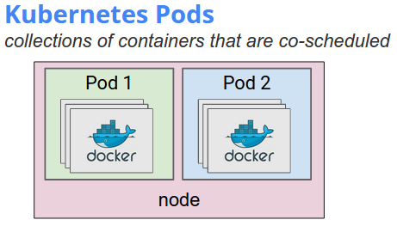

Slide 5
Repo2Docker ??

Slide 6
Repo2Docker
Takes as input a repository source, such as a GitHub repository.
It then builds, runs, and/or pushes Docker images built from that source.

Slide 7
What is it?
The core feature of repo2docker is to fetch a repository (from GitHub or locally), build a container image based on the specifications found in the repository & optionally launch a local Jupyter Notebook you can use to explore it.

Slide 8
ONLY ONE COMMAND
jupyter-repo2docker <URL-or-path to repository>
Terminal will return a URL with token id
Paste into your browser and ready to launch

Slide 9
Prerequisites
Docker
Python 3.4+
Pip installed

Slide 10
INstallation
pip install jupyter-repo2docker
OR
git clone https://github.com/jupyter/repo2docker.git
cd repo2docker
pip install -e .

Slide 11
S2I (Source to image)??
Source-to-Image (S2I) is a toolkit and workflow for building reproducible Docker images from source code.
S2I produces ready-to-run images by injecting source code into a Docker container and letting the container prepare that source code for execution.
By creating self-assembling builder images, you can version and control your build environments exactly like you use Docker images to version your runtime environments.

Slide 12
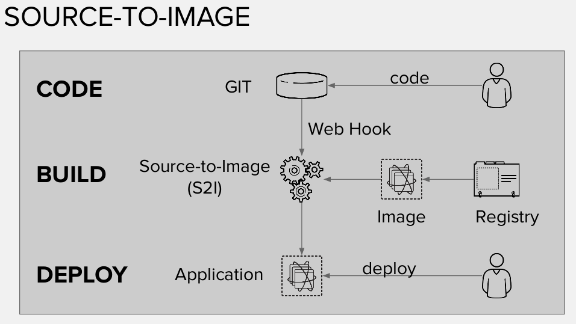

Slide 13
Goals
Reproducibility
Allow build environments to be tightly versioned by encapsulating them within a Docker image and defining a simple interface (injected source code) for callers. Reproducible builds are a key requirement to enabling security updates and continuous integration in containerized infrastructure, and builder images help ensure repeatability as well as the ability to swap runtimes.
Flexibility
Any existing build system that can run on Linux can be run inside of a container, and each individual builder can also be part of a larger pipeline. In addition, the scripts that process the application source code can be injected into the builder image, allowing authors to adapt existing images to enable source handling.
Speed
Instead of building multiple layers in a single Dockerfile, S2I encourages authors to represent an application in a single image layer. This saves time during creation and deployment, and allows for better control over the output of the final image.
Security
Dockerfiles are run without many of the normal operational controls of containers, usually running as root and having access to the container network. S2I can be used to control what permissions and privileges are available to the builder image since the build is launched in a single container. In concert with platforms like OpenShift, source-to-image can enable admins to tightly control what privileges developers have at build time.

Slide 14
docker >= 1.6 Go >= 1.7.1
Installation
Mac: $ brew install source-to-image
Windows:
$ go get github.com/openshift/source-to-image $ cd ${GOPATH}/src/github.com/openshift/source-to-image $ export PATH=$PATH:${GOPATH}/src/github.com/openshift/source-to-image/_output/local/bin/linux/amd64/ $ hack/build-go.sh
WILL SHARE THE LINKS & DOCS LATER ☺

Slide 15
Binder Hub??
The primary goal of BinderHub is creating custom computing environments that can be used by many remote users.
BinderHub enables an end user to easily specify a desired computing environment from a GitHub repo.
BinderHub then serves the custom computing environment at a URL which users can access remotely.

Slide 16
BinderHub allows you to BUILD and REGISTER a Docker image using a GitHub repository, then CONNECT with JupyterHub, allowing you to create a public IP address that allows users to interact with the code and environment within a live JupyterHub instance. You can select a specific branch name, commit, or tag to serve.
BinderHub ties together:
JupyterHub ---to provide a scalable system for authenticating users and spawning single user Jupyter Notebook servers, and
Repo2Docker ---- generates a Docker image using a Git repository hosted online.
BinderHub is created using Python, kubernetes, tornado, and traitlets. As such, it should be a familiar technical foundation for Jupyter developers.

Slide 17
Who need binderhub
Users who want to easily interact with computational environments that others have created.
Authors who want to create links that allow users to immediately interact with a computational enviroment that you specify.
Deployers who want to create their own BinderHub to run on whatever hardware they choose.

Slide 18
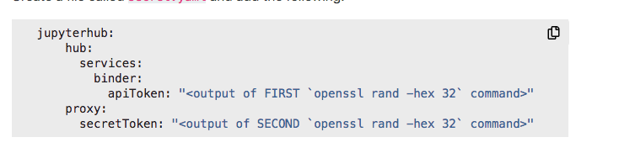
Set up binderhub
Set up Kubernete on Cloud.
Install Helm(Package manager for Kubernetes, a useful tool for installing and managing applications on Kubernete cluster).
Set up Container Registry(provide Binderhub with proper credentials so it can push image)
install binderhub
(helm repo add jupyterhub http://jupyterhub.github.io/helm/chart
helm repo update
Helm install jupyterhub/binderhub)

Slide 19
BinderHub is based on Python 3, it's currently only hosted on GitHub (pip release soon). However, it can be installed using pip:
pip install git+https://github.com/jupyterhub/binderhub

Slide 20
Binder
Binder allows you to create custom computing environments that can be shared and used by many remote users. It is powered by BinderHub
Turn terminal to UI Interface

Slide 21
mybinder.org
Binder turns a GitHub repository into a collection of interactive notebooks that can be shared and access by anyone, anywhere.
To make Binder work, you'll need a URL for a Git repository, which could be GitHub, that contains Jupyter notebooks and a configuration file that contains the dependencies for running your Jupyter notebooks.

Slide 22
What we have done
Use Repo2docker to dockerize
Use s2i to dockerize
Cloud deployment on AWS
Setting Up a Kubernetes Cluster on AWS
Create cluster and EC2 instances

