Slide 1
CS550 - Project Presentation
Group 5
Ji Tin Justin Li A20423037
Subowen Yan A20430537
Yuhan Li A20431466

Slide 2
Presentation Outline
Motivation
Proposed Work
Brief Introduction to Used Systems
Results and Evaluation
Conclusions
References

Slide 3



Proposed Work
Selected Systems:
Benchmark 3 selected systems
Compare and contrast the chosen systems to ZHT
Metrics and scale: Latency and Throughput

Slide 4
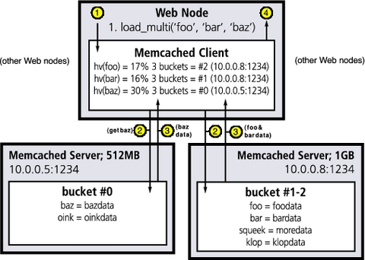
Memcached
“Free & open source, high-performance, distributed memory object caching system”
In-memory key-value store, does not support persistence out-of-the-box
Easily aggregate memory caches on multiple nodes
API used: spymemcached (java)
Source: https://www.linuxjournal.com/article/7451

Slide 5
Riak
Riak is detailed as "A distributed, decentralized data storage system". Riak is a distributed database designed to deliver maximum data availability by distributing data across multiple servers. As long as your client can reach one Riak server, it should be able to write data. Riak is designed for horizontal scale and lets user easily add capacity by joining additional nodes to cluster.Bitcask is the most commonly used backends. It uses an in-memory hash-table of all keys users write to Riak, which points directly to the on-disk location of the value. Therefore; Bitcask cannot handle an extremely large number of keys.

Slide 6

Redis
Redis is an open source (BSD licensed), in-memory data structure store, used as a database, cache and message broker.

Slide 7
Throughput vs. Scale (operations per second)
 | 1 | 2 | 4 | 8
ZHT | 4117 | 5524 | 9813 | 18680
Memcached (paper) | 7385 | 7961 | 14480 | 40995
Memcached | 32794 | 38938 | 51998 | 90099
Redis | 21006 | 33630 | 58733 | 91642
Riak | 309 | 507 | 683 | 723

Slide 8
Latency vs. Scale (milliseconds per operation)
 | 1 | 2 | 4 | 8
ZHT | 0.243 | 0.362 | 0.408 | 0.428
Memcached (paper) | 0.122 | 0.324 | 0.272 | 0.278
Memcached | 0.0301 | 0.0584 | 0.0698 | 0.0908
Redis | 0.0341 | 0.1242 | 0.1562 | 0.1821
Riak | 3.182 | 3.771 | 5.843 | 10.516

Slide 9
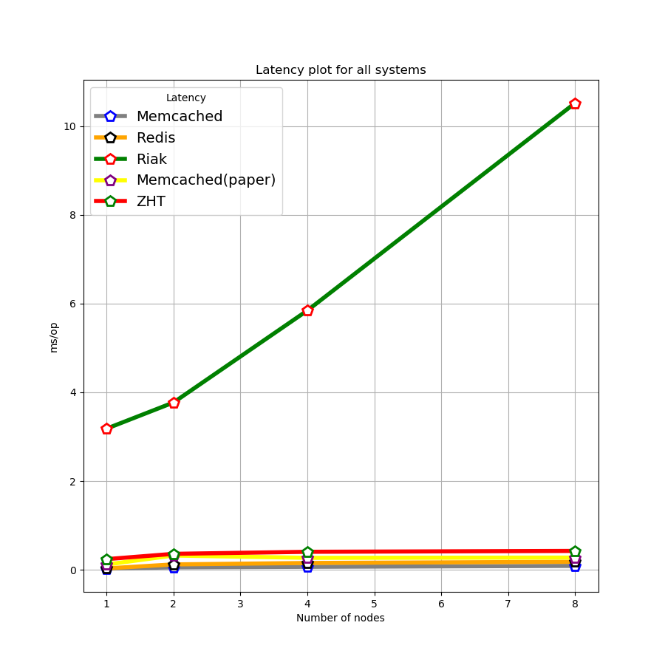
Latency vs. Scale plot
Riak - slow due to disk I/O
Notes:
Riak is way slower - Riak uses Bitcask as default storage engine, which stores keys in an in-memory hashtable, which points directly to on-disk location of the stored value.
(Bitcask - erlang application)

Slide 10
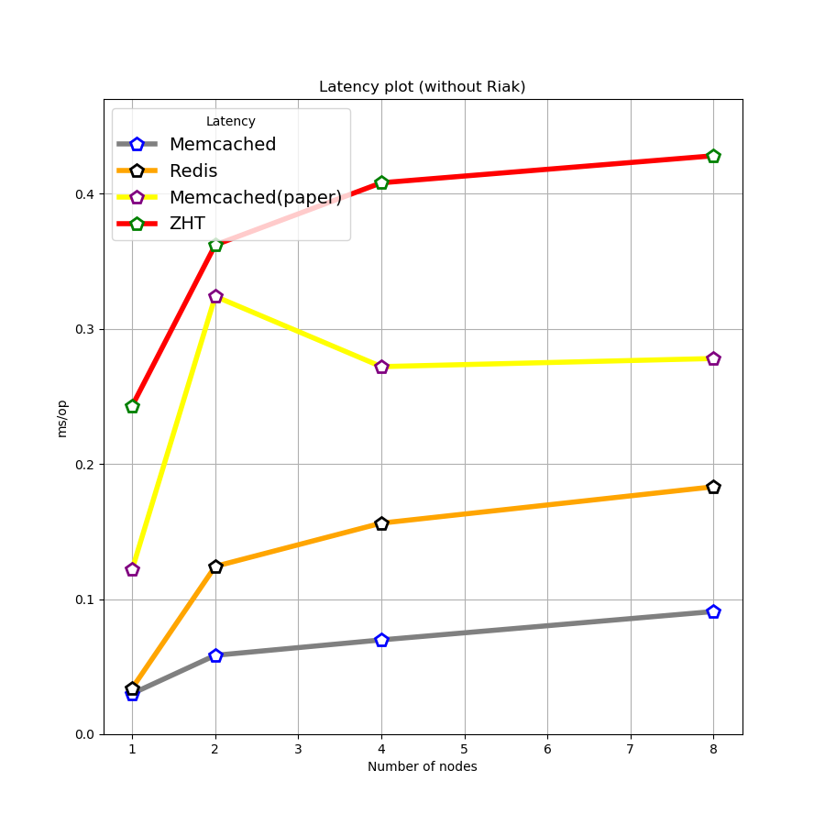
Latency vs. Scale plot (without Riak)
Significant jump from 1 to 2 nodes
Notes:
Note: Our memcached benchmark did not see the sudden jump (from 1 node to 2 nodes) as the ZHT paper data showed.

Slide 11
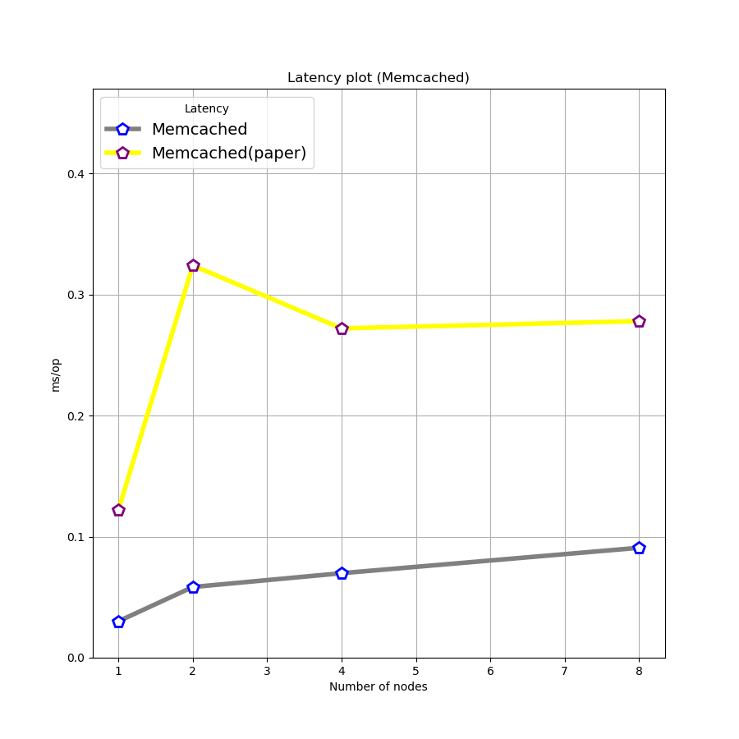
Latency vs. Scale plot
(Memcached)
Possible reasons behind the difference:
Hardware (HEC-Cluster, Chameleon)
Software
Memcached server configs
client libraries & APIs
Notes:
Hardware Diff:
HEC-Cluster nodes - dual processor quad-core, 8GB RAM
m1.medium instances - 2 vcpus, 4GB RAM
Software - ZHT paper did not specify these conditions.
Memcached servers - default configs,
-m, --memory-limit default 64MB,
-n, --slab-min-size=<size>, i.e. minimum size for key, value and flags, default 48bytes ~> memory efficiency
API is not specified, we used java with spymemcached (installed with maven)
Python-memcached
Note: Our memcached benchmark did not see the sudden jump (from 1 node to 2 nodes) as the ZHT paper data showed. We don’t really know why there is a peak with 2 nodes.

Slide 12
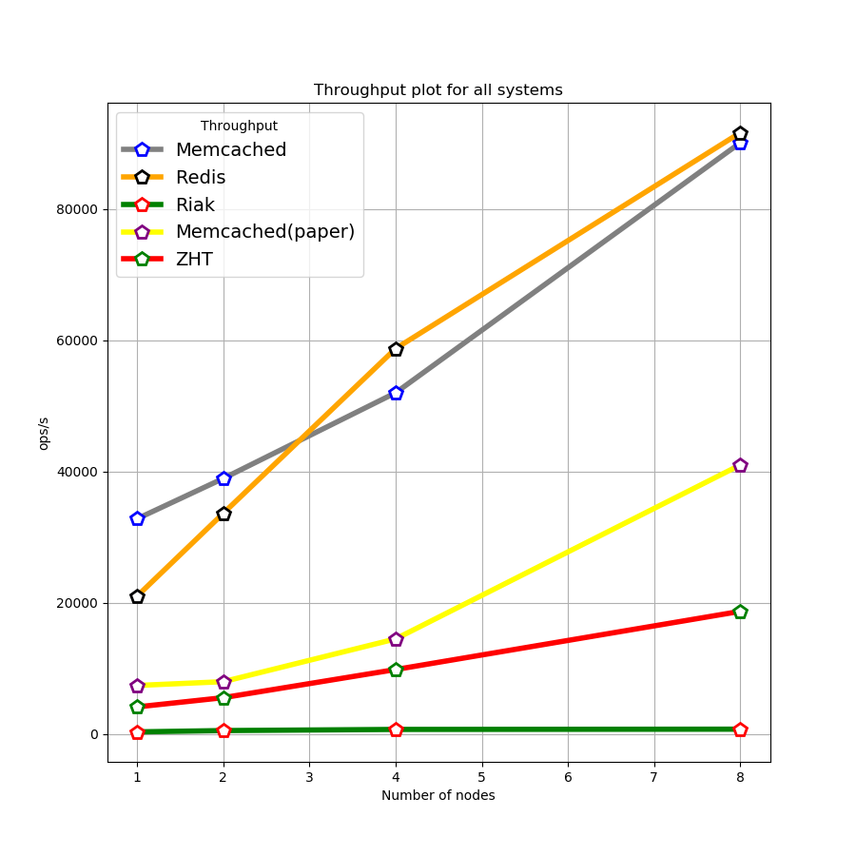
Throughput vs. Scale plot
Notes:
Note: Memcached benchmark data we obtained closely mimics as in the ZHT paper, only upscaled ~2x.

Slide 13
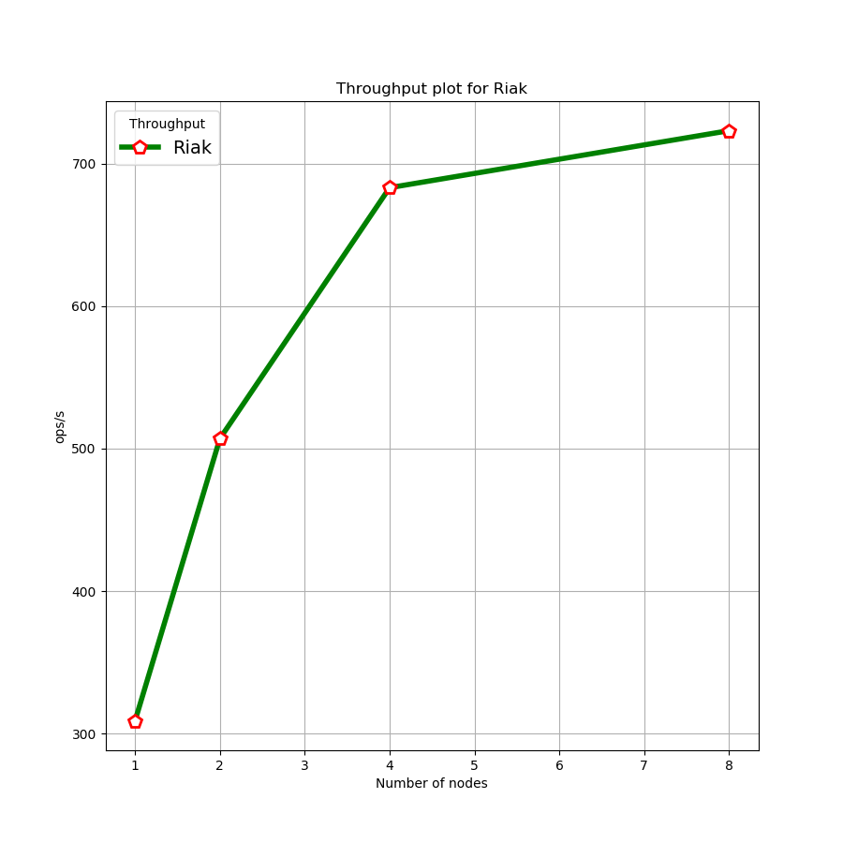
Throughput vs. Scale plot
(for Riak)
Notes:
Note: Memcached benchmark data we obtained closely resembles the ZHT paper, only upscaled ~2x.

Slide 14
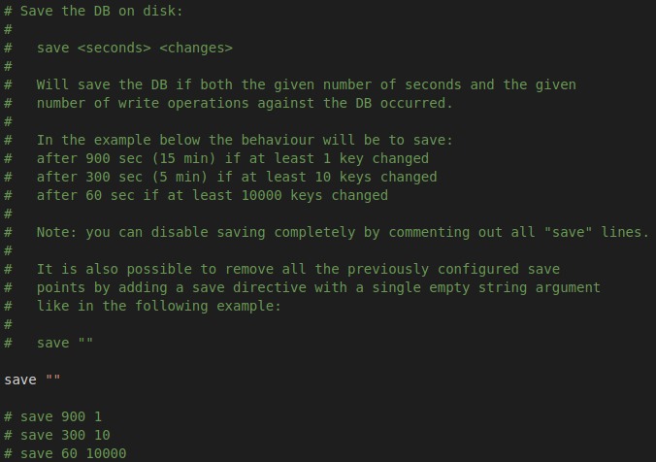
Improve ---redis.conf
Save option will save the DB if both the given number of seconds and the given number of write operations against the DB occurred.
Save <second> <changes>
We remove all the previously configured save points to get better performance.

Slide 15
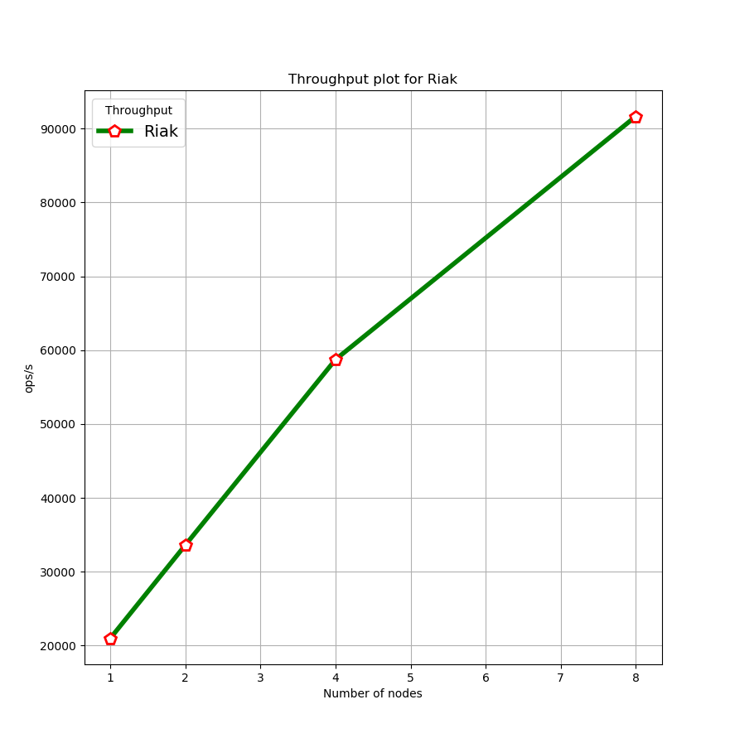
Redis-Throughput
 | 1 | 2 | 4 | 8
redis(op/s) | 21006 | 33630 | 58733 | 91642

Slide 16
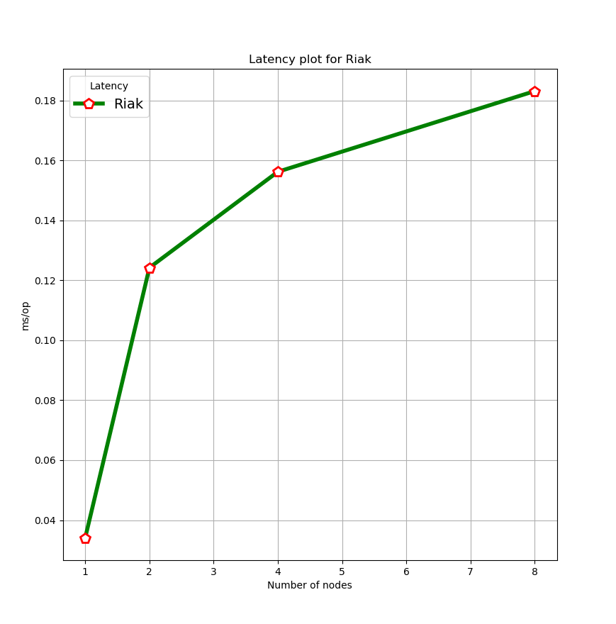
Redis-Latency
 | 1 | 2 | 4 | 8
redis(ms/op) | 0.0341 | 0.1242 | 0.1562 | 0.1831

Slide 17
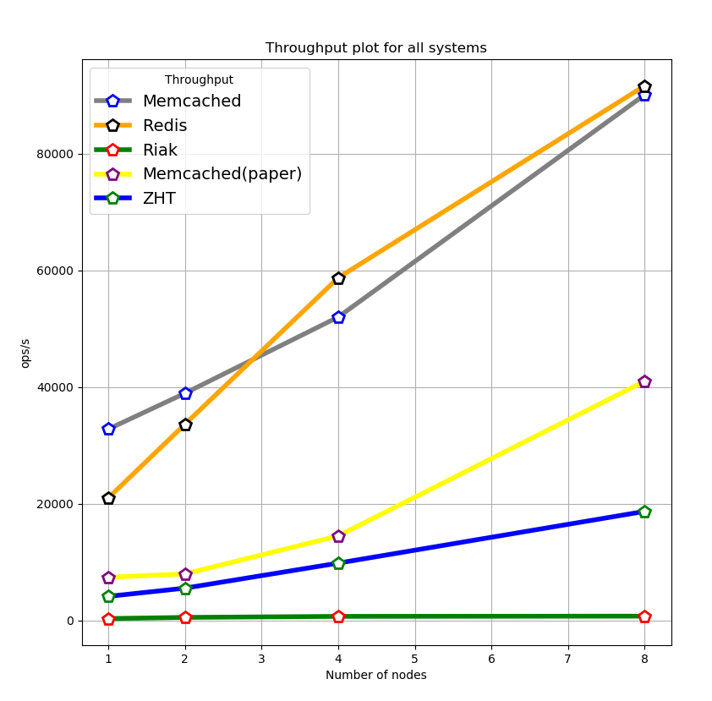
Compared with others
Pretty fast.

Slide 18
conclusion
Throughput
Latency

Slide 19
References
Javadocs for spymemcached 2.4.2 - http://dustin.sallings.org/java-memcached-client/apidocs/
Server-world (Memcached quickstart) - https://www.server-world.info/en/note?os=CentOS_7&p=memcached&f=1
Python for Riak - https://docs.riak.com/riak/kv/latest/developing/getting-started/python/index.html
Riak set-up - https://docs.riak.com/riak/kv/latest/using/running-a-cluster/index.html Redis-py-cluster - https://pypi.org/project/redis-py-cluster/

Slide 20
Thank you !!!
QUESTION?

