Slide 1
Robust Offline RL
via Disentangled Privileged Pretraining
Representation robustness under synthetic observation corruption Privileged Pretraining Framework (PPF) + disentanglement regularizers
Course Final Presentation · 2026

Slide 2
Motivation
Why does robustness matter in offline RL?
The Problem
Real-world sensors are noisy or unreliable
Offline datasets are collected under ideal conditions
At deployment, observations can be corrupted
Standard offline RL policies degrade sharply under noise
The Challenge
Cannot collect more data online to adapt
Encoder must separate task-relevant from noise features
Three corruption families studied: concat | project | nonlinear
Goal: learn a robust state encoder from offline data that transfers to corrupted observations at test time

Slide 3
Problem Setup
concat
project
nonlinear
Append nuisance noise directly to clean obs → dimension increases → easy to detect
Random orthogonal linear mixing after concatenation → features entangled → moderate difficulty
Two-layer nonlinear mixing after concatenation → highly entangled → hardest setting
Environments (D4RL medium-v2)
halfcheetah-medium-v2 | hopper-medium-v2 | walker2d-medium-v2 | ant-medium-v2
Policy: IQL (main) + TD3+BC / BC (ablation A)

Slide 4
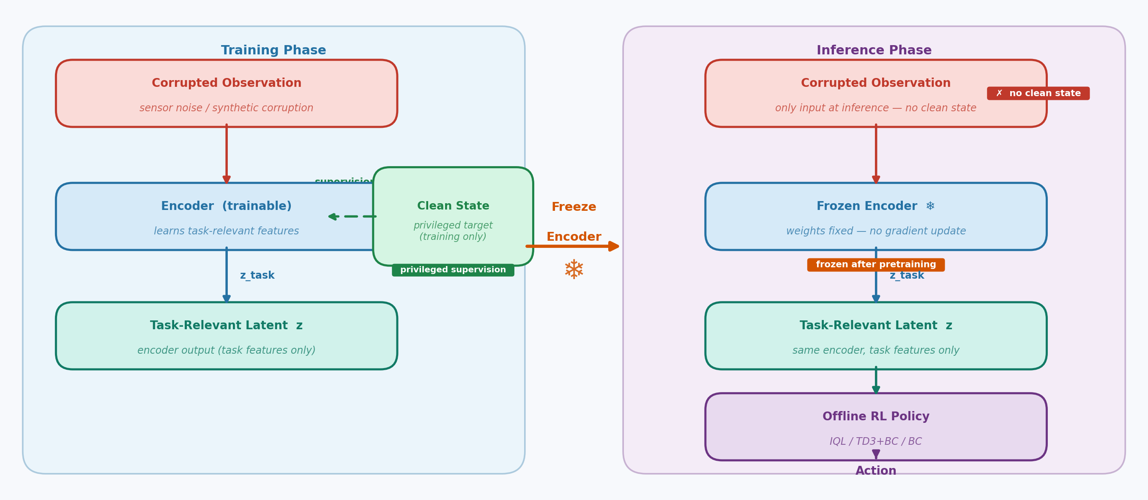
Privileged Pretraining Framework (PPF)
Encoder trained with clean-state supervision; frozen at inference on noisy observations only
Regularizers: Barlow Twins | Cov-Whitening | HSIC | Distance Corr | InfoNCE | L1

Slide 5
Methods & Baselines
Method
Type
Description
true_only
Upper bound
Policy trained directly on clean states
raw_noisy
Lower bound
Policy trained on raw corrupted observations
plain (PPF)
PPF no reg.
PPF encoder — dynamics + reward, no disentanglement
disentangled_barlow
PPF method
PPF + Barlow Twins cross-correlation penalty
disentangled_cov
PPF method
PPF + covariance whitening penalty
disentangled_hsic
PPF method
PPF + HSIC independence criterion
disentangled_dcor
PPF method
PPF + distance correlation penalty
disentangled_infonce
PPF method
PPF + InfoNCE contrastive penalty
disentangled_l1
PPF method
PPF + L1 cross-correlation penalty
PCA-IQL
External baseline
PCA projection (no neural encoder, no privileged info)

Slide 6
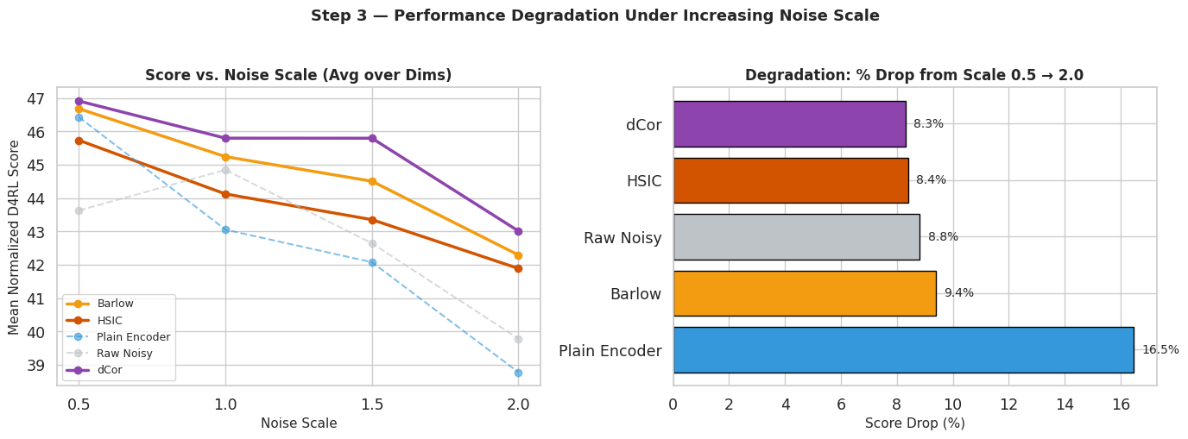
Results: Performance Degradation Curve
hopper-medium-v2 · nonlinear noise · score vs. noise scale · IQL
dCor and Barlow show the flattest curves → most graceful degradation under increasing noise
plain PPF already outperforms raw_noisy; disentanglement regularizers provide an additional margin at high scale
PCA-IQL degrades sharply beyond scale 1.0

Slide 7
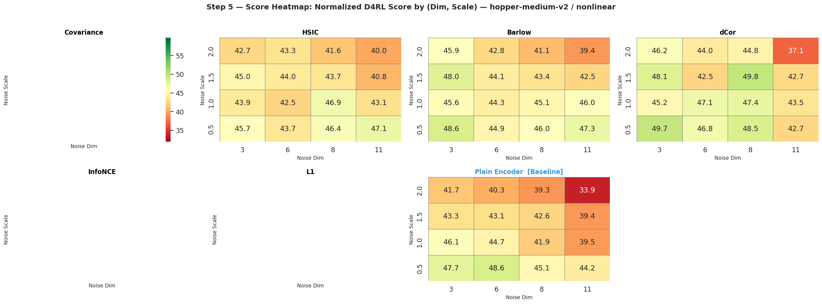
Results: Full Score Heatmap
hopper-medium-v2 · nonlinear · normalized score across all (dim, scale) configs
Top-left cells (small dim/scale) are easy — all methods score well
Bottom-right corner (large dim & scale) is the hardest regime — disentangled methods retain color while plain/raw_noisy fade
Heatmap reveals method-specific strengths: dCor / Barlow maintain brightness across the entire grid

Slide 8
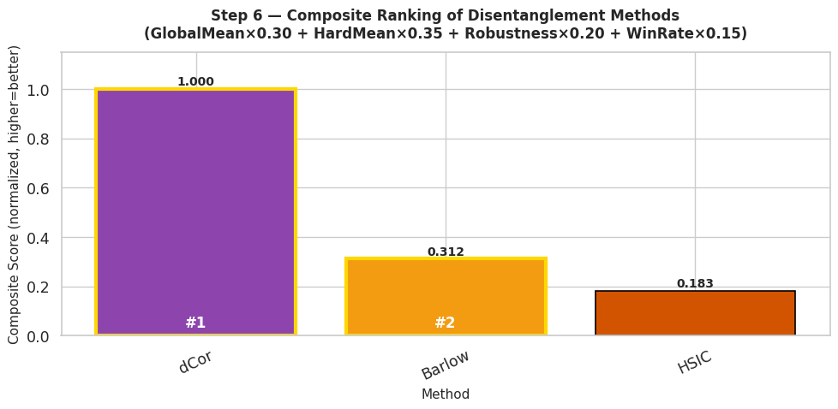
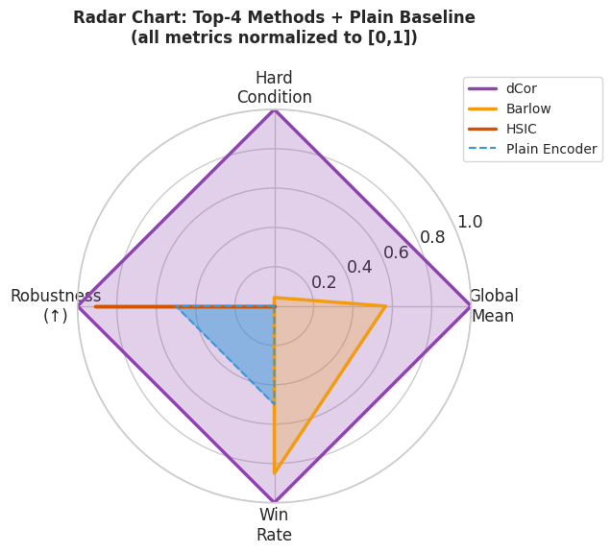
Method Selection: Composite Ranking
hopper-medium-v2 · four metrics weighted: global mean 30%, hard-condition 35%, drop% 20%, win-rate 15%
Composite score (higher = better overall)
Radar: top-4 methods vs plain — four evaluation axes
dCor ranks #1 overall: leads on both global mean and hard-condition robustness
Barlow Twins #2: comparable hard-condition performance, slightly lower global mean
plain PPF #3 — disentanglement consistently provides a meaningful uplift
Verdict: dCor and Barlow are the recommended methods for high-noise regimes

Slide 9
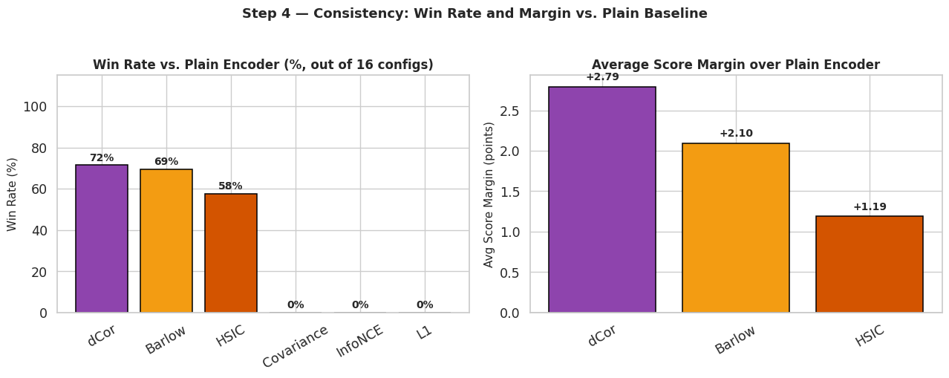
Results: Win Rate vs. Plain Baseline
hopper-medium-v2 · nonlinear · fraction of (dim, scale) configs where method beats plain
dCor wins in 71.5% of configurations with an average margin of +2.8 pts
Barlow wins in 69.4% — both methods reliably outperform the un-regularized PPF encoder
InfoNCE and L1 show lower win rates, suggesting sensitivity to specific noise regimes

Slide 10
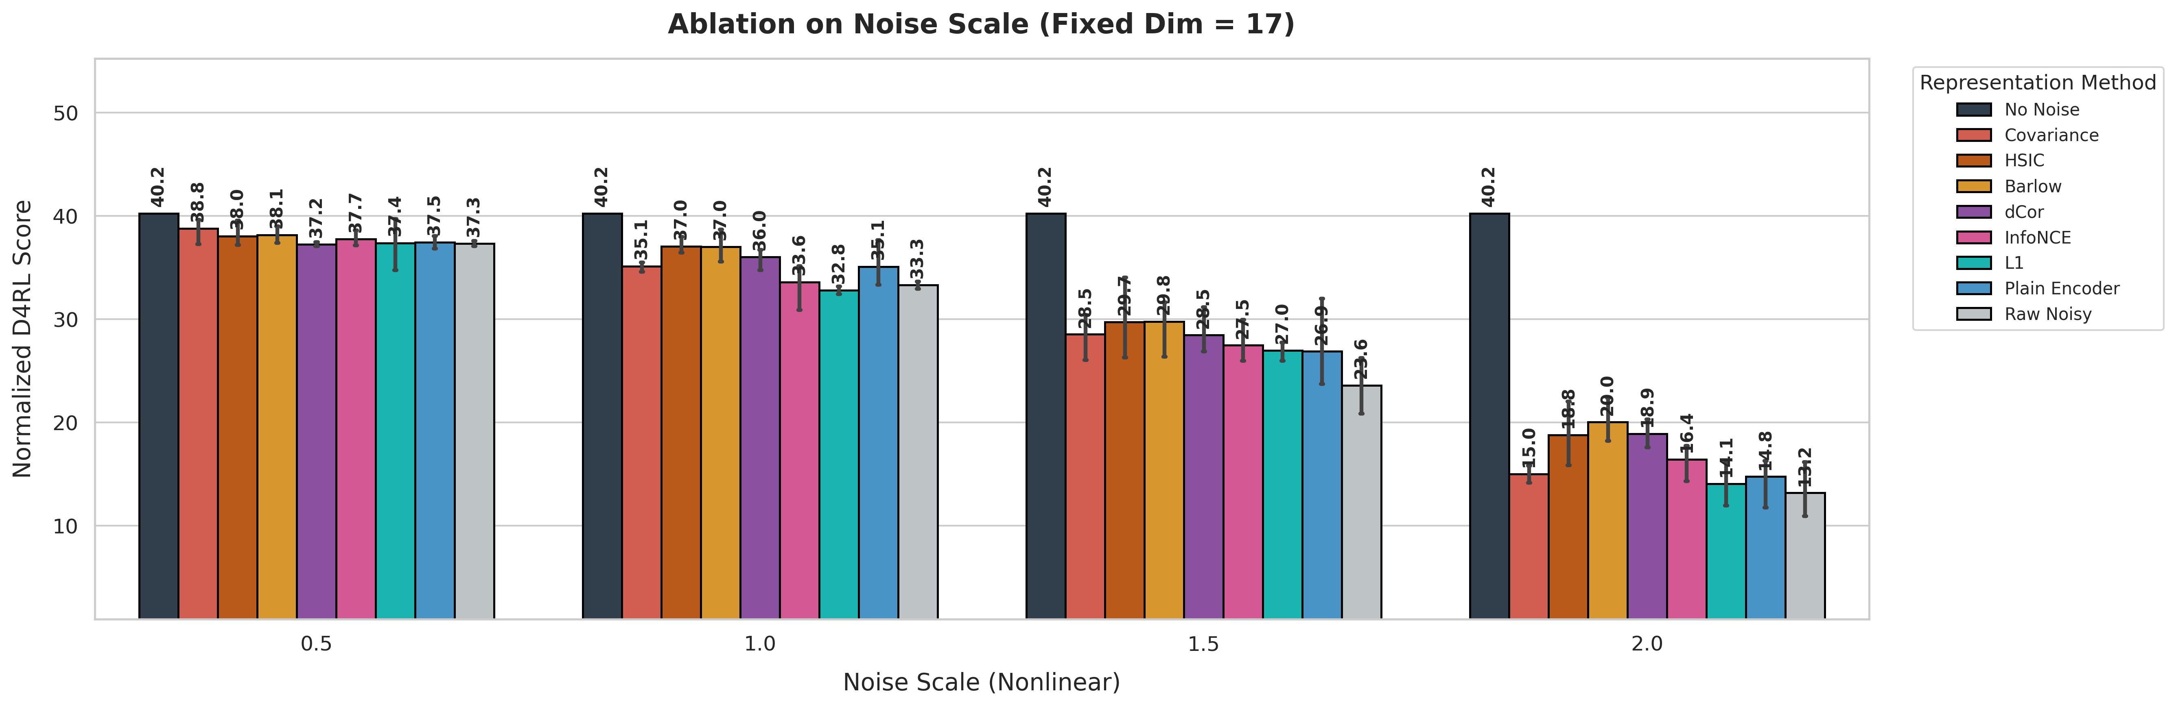
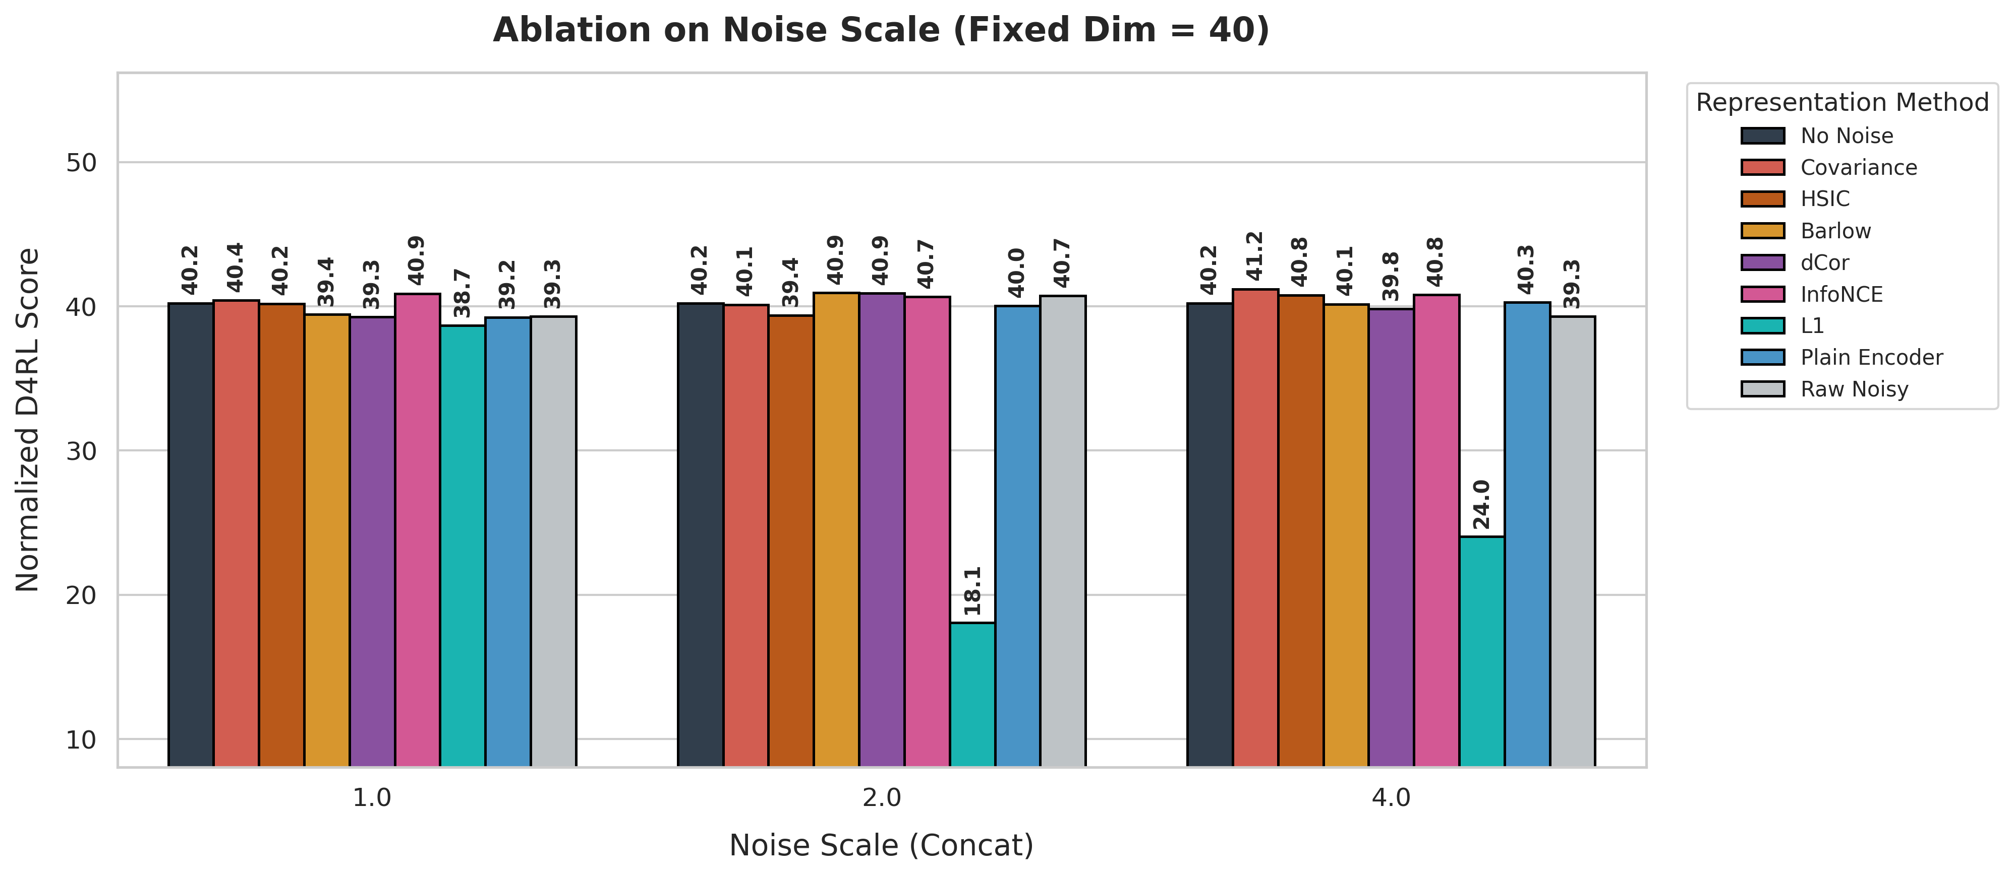
Ablation Study
B1: remove privileged target | B2: reward-only pretraining
Full PPF vs no-privilege (B1) — halfcheetah nonlinear
Full PPF vs reward-only (B2) — halfcheetah nonlinear
B1 (no privileged supervision): removing clean-state targets degrades all methods — confirms that privileged info is the key ingredient
B2 (reward only, halfcheetah nonlinear): Plain (reward_only) is competitive with or better than all disentanglement variants — Barlow/HSIC/dCor regularizers do not provide clear gains; dCor (reward_only) consistently underperforms; noise scale dominates over noise dimension as the key degradation factor; high seed variance (±5–10 pts) indicates results need more seeds to be conclusive

Slide 11

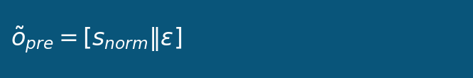
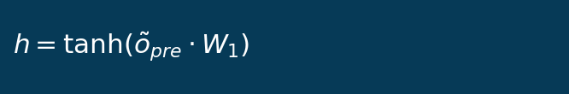
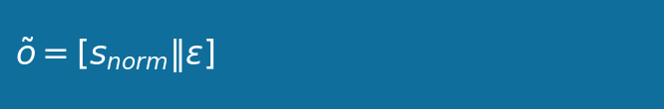
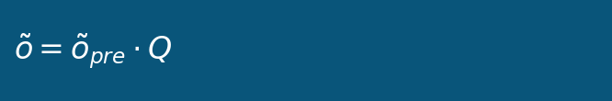
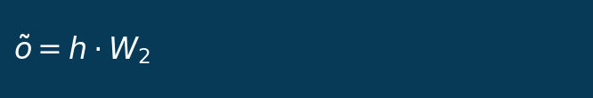
Noise Construction: Three Corruption Families
How synthetic observation noise is injected into clean states
concat
project
nonlinear
Clean state s is normalized; Gaussian noise appended directly. Total dim = obs_dim + noise_dim. Corrupted dims are linearly separable in principle.
Q is a fixed random orthogonal matrix (QR decomp of Gaussian). State and noise are linearly mixed — requires linear algebra to separate.
W₁, W₂ are fixed random orthogonal matrices. tanh introduces nonlinearity — features are deeply entangled. Hardest corruption to undo.
noise_dim d ∈ {4, 8, 13, 17} | noise_scale σ ∈ {0.5, 1.0, 1.5, 2.0} | pure_obs = s_norm (first obs_dim dims) — used as privileged supervision target

Slide 12










Disentanglement Regularizers: Mathematical Formulas
All methods minimize independence between z_task and z_irrel via different criteria
Barlow Twins
Cov-Whitening
HSIC
Drives entire cross-corr matrix -> 0 (L2 penalty, sensitive to large off-diag)
Same matrix form as Barlow; differs in normalization + context
Kernel-based independence test; K_c, L_c are double-centered kernels
Distance Corr (dCor)
InfoNCE Repulsion
L1 Cross-Corr
Captures nonlinear dependence; zero iff z_task is independent of z_irrel
Pushes representations apart via cosine-similarity repulsion
L1 penalty encourages sparse correlations (more robust to outliers)

Slide 13
Conclusion & Future Work
Takeaways
PPF (Privileged Pretraining Framework) effectively protects offline RL policies from observation corruption
Disentanglement regularizers show mixed results: beneficial in full-PPF setting (hopper), but do not clearly outperform Plain in the reward-only ablation (halfcheetah nonlinear) — dCor in particular underperforms in the reward-only regime
Privileged supervision (B1) is essential; reward-only pretraining (B2) does not further degrade relative to Plain — dynamics loss may matter less than previously assumed
Results hold across 4 environments and 3 noise families (concat, project, nonlinear)
Future Work
Relax the privileged-information assumption (e.g., self-supervised or contrastive pretraining only)
Extend to image-based / partial-observable environments
Combine with uncertainty-aware offline RL (EDAC, IQL-uncertainty) for distribution shift robustness
Thank you!

