Slide 1

FUTURESKILL AI / VISUAL FOR SLIDE 02
Students need a clear next step.
A team-defined problem hypothesis to validate through a student pilot.
Career direction
Connect interests with roles worth exploring.
Skill priorities
Identify areas that need further practice.
Practical action
Turn a chosen direction into weekly activities.
Illustrative classroom photograph
[S2] Pexels photo 7092344. Photo is illustrative; the three needs are not measured research findings.

Slide 2
FUTURESKILL AI / VISUAL FOR SLIDE 03
Connect a career direction to weekly action.
An integrated journey, with direct career browsing available alongside the assessment.
01
02
03
04
05
DISCOVER
EXPLORE
IDENTIFY
ACT
TRACK
42-question profile
or direct browsing
Choose a role
from the catalogue
Review starter skills
and self-ratings
Set availability
and generate tasks
Completed tasks,
practice hours, XP
923
42
3
catalogued occupations
assessment questions
interface languages
[S3] Source: project code and supplied catalogue. Skill targets, group starter profiles and time estimates include illustrative assumptions.

Slide 3
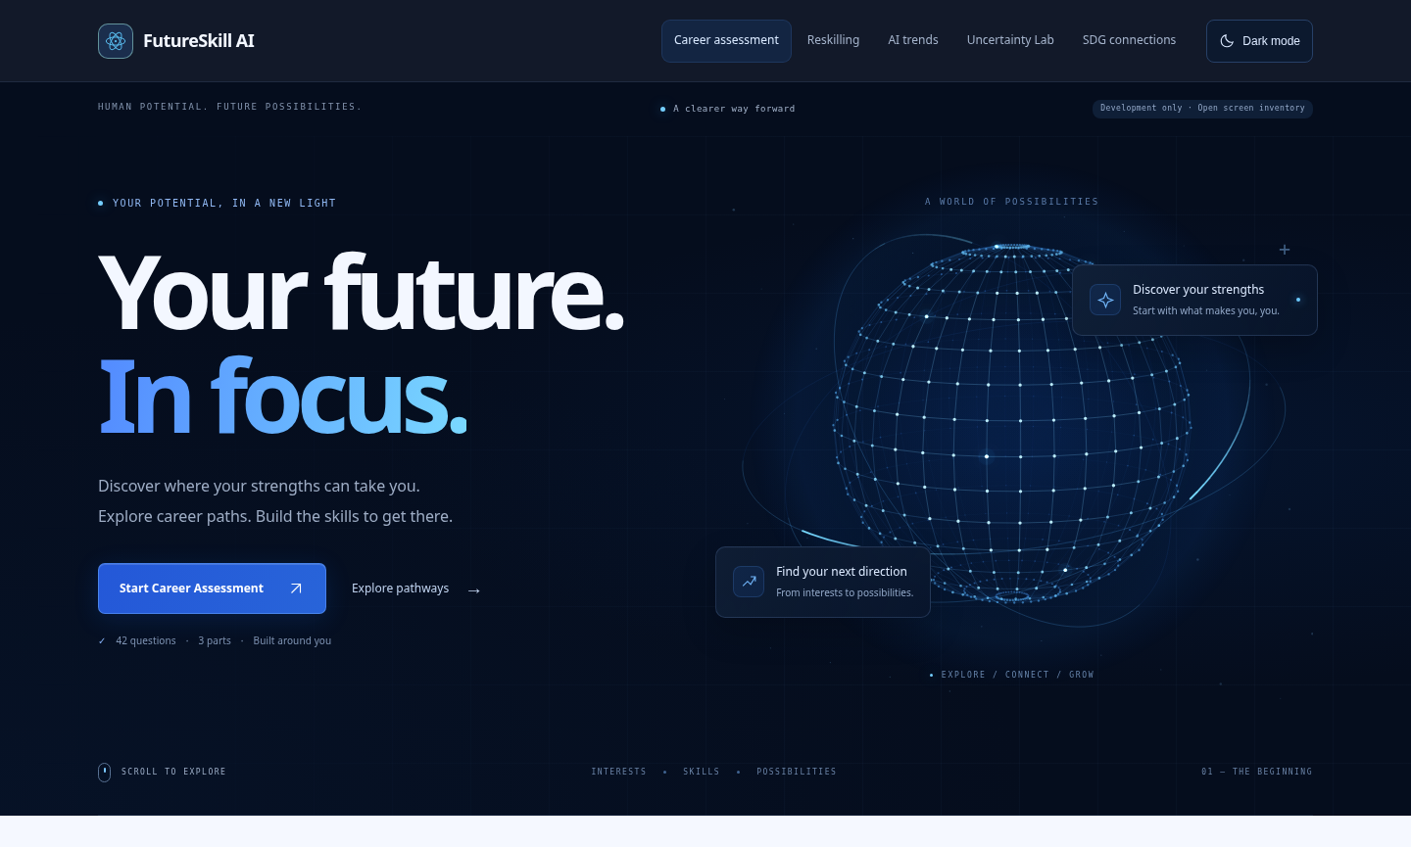
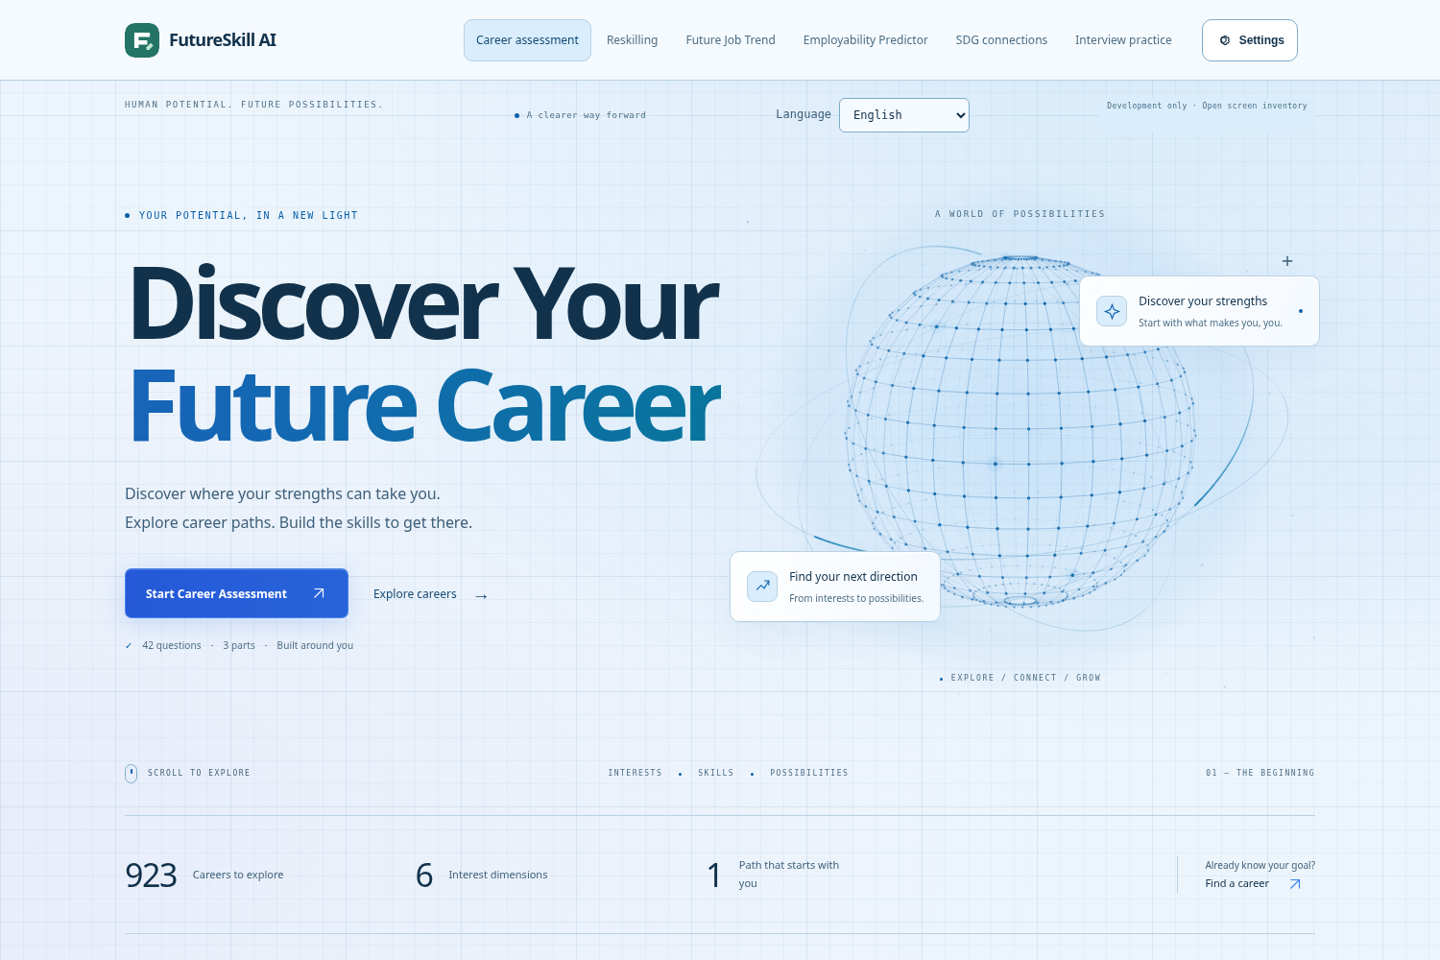
FUTURESKILL AI / VISUAL FOR SLIDE 04
Iteration made the experience more consistent.
Actual interface screenshots: an earlier light theme and the current light theme.
EARLIER LIGHT THEME
REFINED LIGHT THEME
Consistent surfaces / readable colours / preserved navigation
[S4] Project screenshots; before asset from commit 53cfea7, after capture from 48339bc. This is product iteration, not a user-study result.

Slide 4
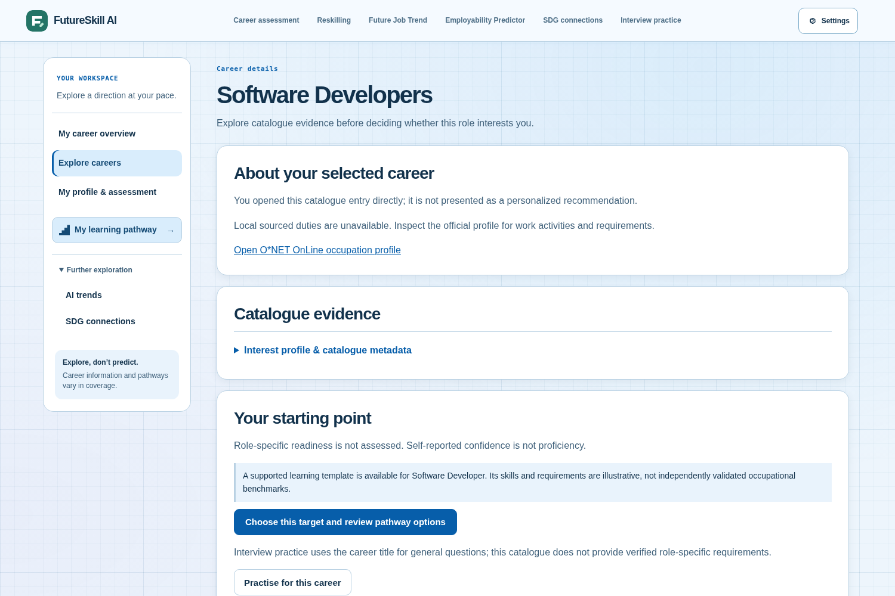
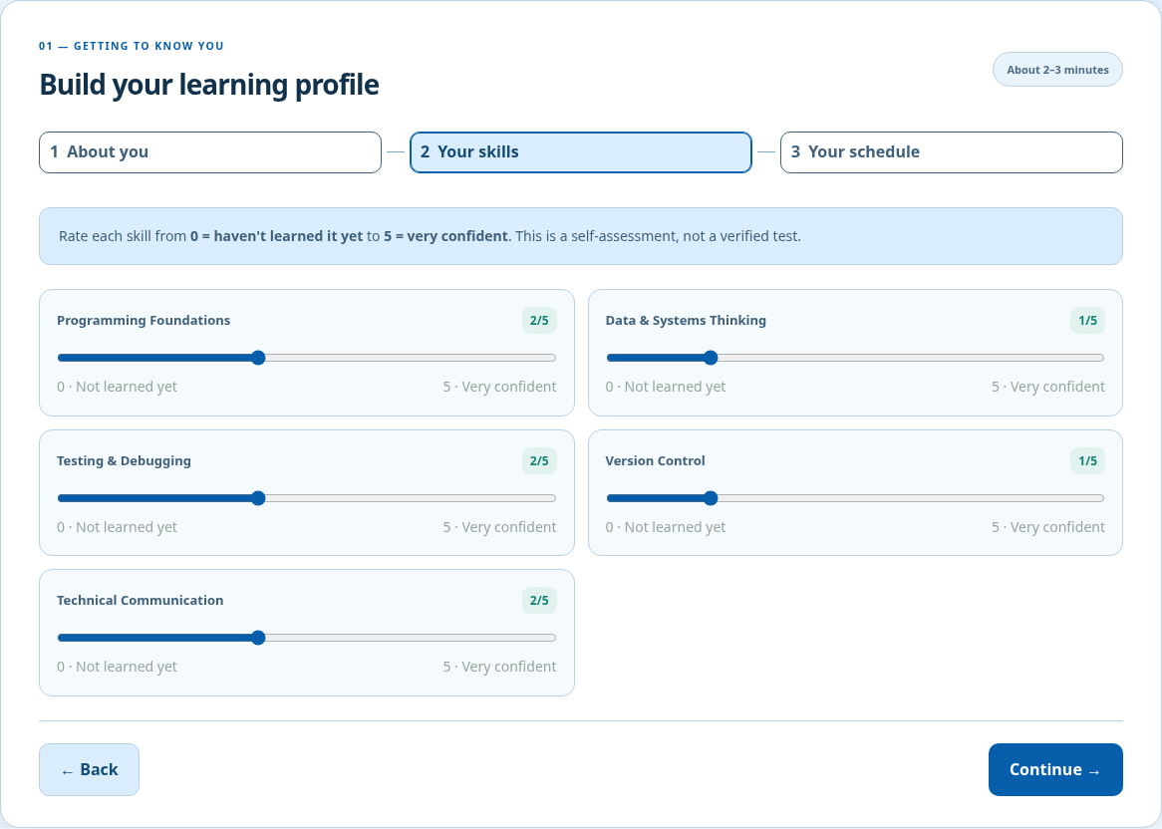
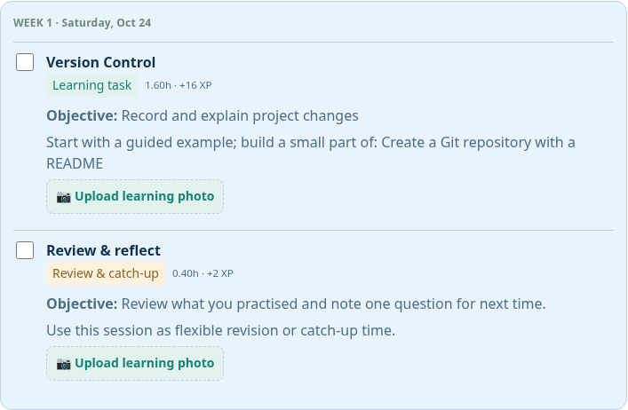
FUTURESKILL AI / VISUAL FOR SLIDE 05
Choose a role. Build a plan. Take action.
Illustrative learner: Software Developers • 6 hours/week • an 8-week planning horizon
1 CHOOSE A DIRECTION
2 REVIEW YOUR SKILLS
3 FOLLOW WEEKLY TASKS
[S5] Real local browser captures with isolated sample inputs. Full-resolution originals are included. No real learner record or measured outcome is shown.

Slide 5
FUTURESKILL AI / VISUAL FOR SLIDE 06
A connected architecture for the current prototype.
Core career and planning flows use deterministic rules; AI services are a separate integration.
CAREER + PLANNING RULES
Matching and starter learning plans
BROWSER
FASTAPI
HTML / CSS / JS
Routes, sessions and orchestration
CSV / O*NET TASK DATA
Occupation profiles and task evidence
Render: hosting
GitHub: version control
Replit / PyCharm: development
FLASK INTERVIEW MODULE
SQLITE RECORDS
Learning, sessions and task progress
Live provider verification pending
OPTIONAL OPENAI SERVICES
[S6] Source: src/main.py, reskilling/storage.py, explanation_provider.py and hr_interview/. Dashed link: AI service integration pending live verification.

Slide 6

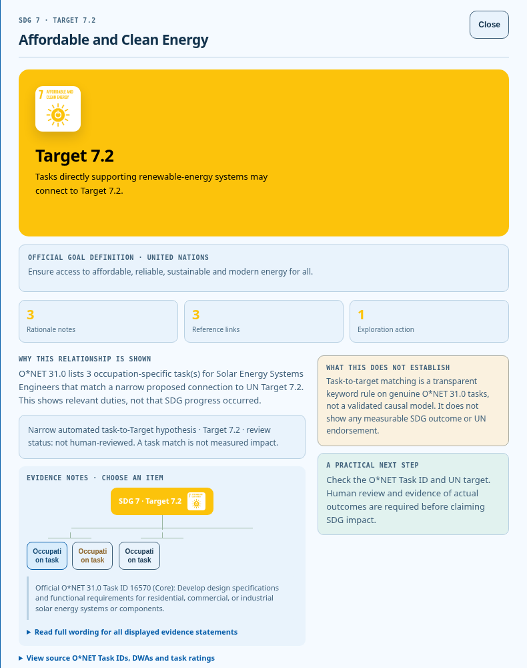
FUTURESKILL AI / VISUAL FOR SLIDE 07
Skills development through SDG 4.4.
Keep the platform contribution distinct from exploratory occupation-to-Goal context.
PLATFORM CONTRIBUTION
TASK IDs + SOURCES
Identify practice priorities
Follow learning activities
Track completed tasks
Solar Energy Systems Engineers
O*NET Task ID 16570
Exploratory Target 7.2 hypothesis
Potential support for skills development.
Impact is to be evaluated in the pilot.
[S7] UN Goal 4 / Target 4.4; O*NET 31.0 Task Statements. Source data does not validate the project’s SDG interpretation or imply UN endorsement.

Slide 7
FUTURESKILL AI / VISUAL FOR SLIDE 08
A measurable route to Phase 2.
Separate implemented capabilities, engineering checks and future user outcomes.
CURRENT PROTOTYPE
PHASE 2 PRIORITIES
Career exploration
Starter learning pathways
SQLite task tracking
Three-language interface
Structured student pilot
Validate role requirements
Verify live AI services
Security, durable storage and monitoring
PROPOSED PILOT: 20 STUDENTS / TARGET: AT LEAST 16 SUCCEED (80%)
Success: independently create a plan and explain the priority skill and next activity. Baseline: not yet measured.
[S8] 80% is the team’s Phase 2 target. A 20-person sample and 16 successes are a proposed test design, not observed results.

Slide 8
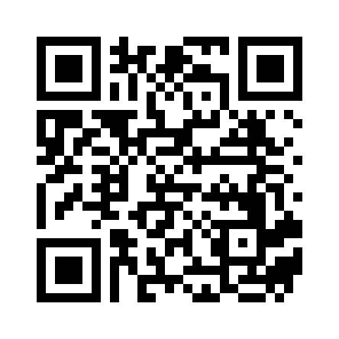
FUTURESKILL AI / VISUAL FOR SLIDE 09
From “What should I do?”
to “What can I learn next?”
Test a clearer plan.
Find a clearer next step.
Proposed ask: student pilot participants
and career-service feedback.
Francium fluoride
Xiamen University Malaysia
SCAN TO TRY THE PROTOTYPE
[S9] QR encodes https://future-skill-ai-model.onrender.com/ • URL supplied by the team; live deployment was not verified from this cloud environment.

