Slide 1
Project: The Secret Behind Popular Restaurants

Slide 2
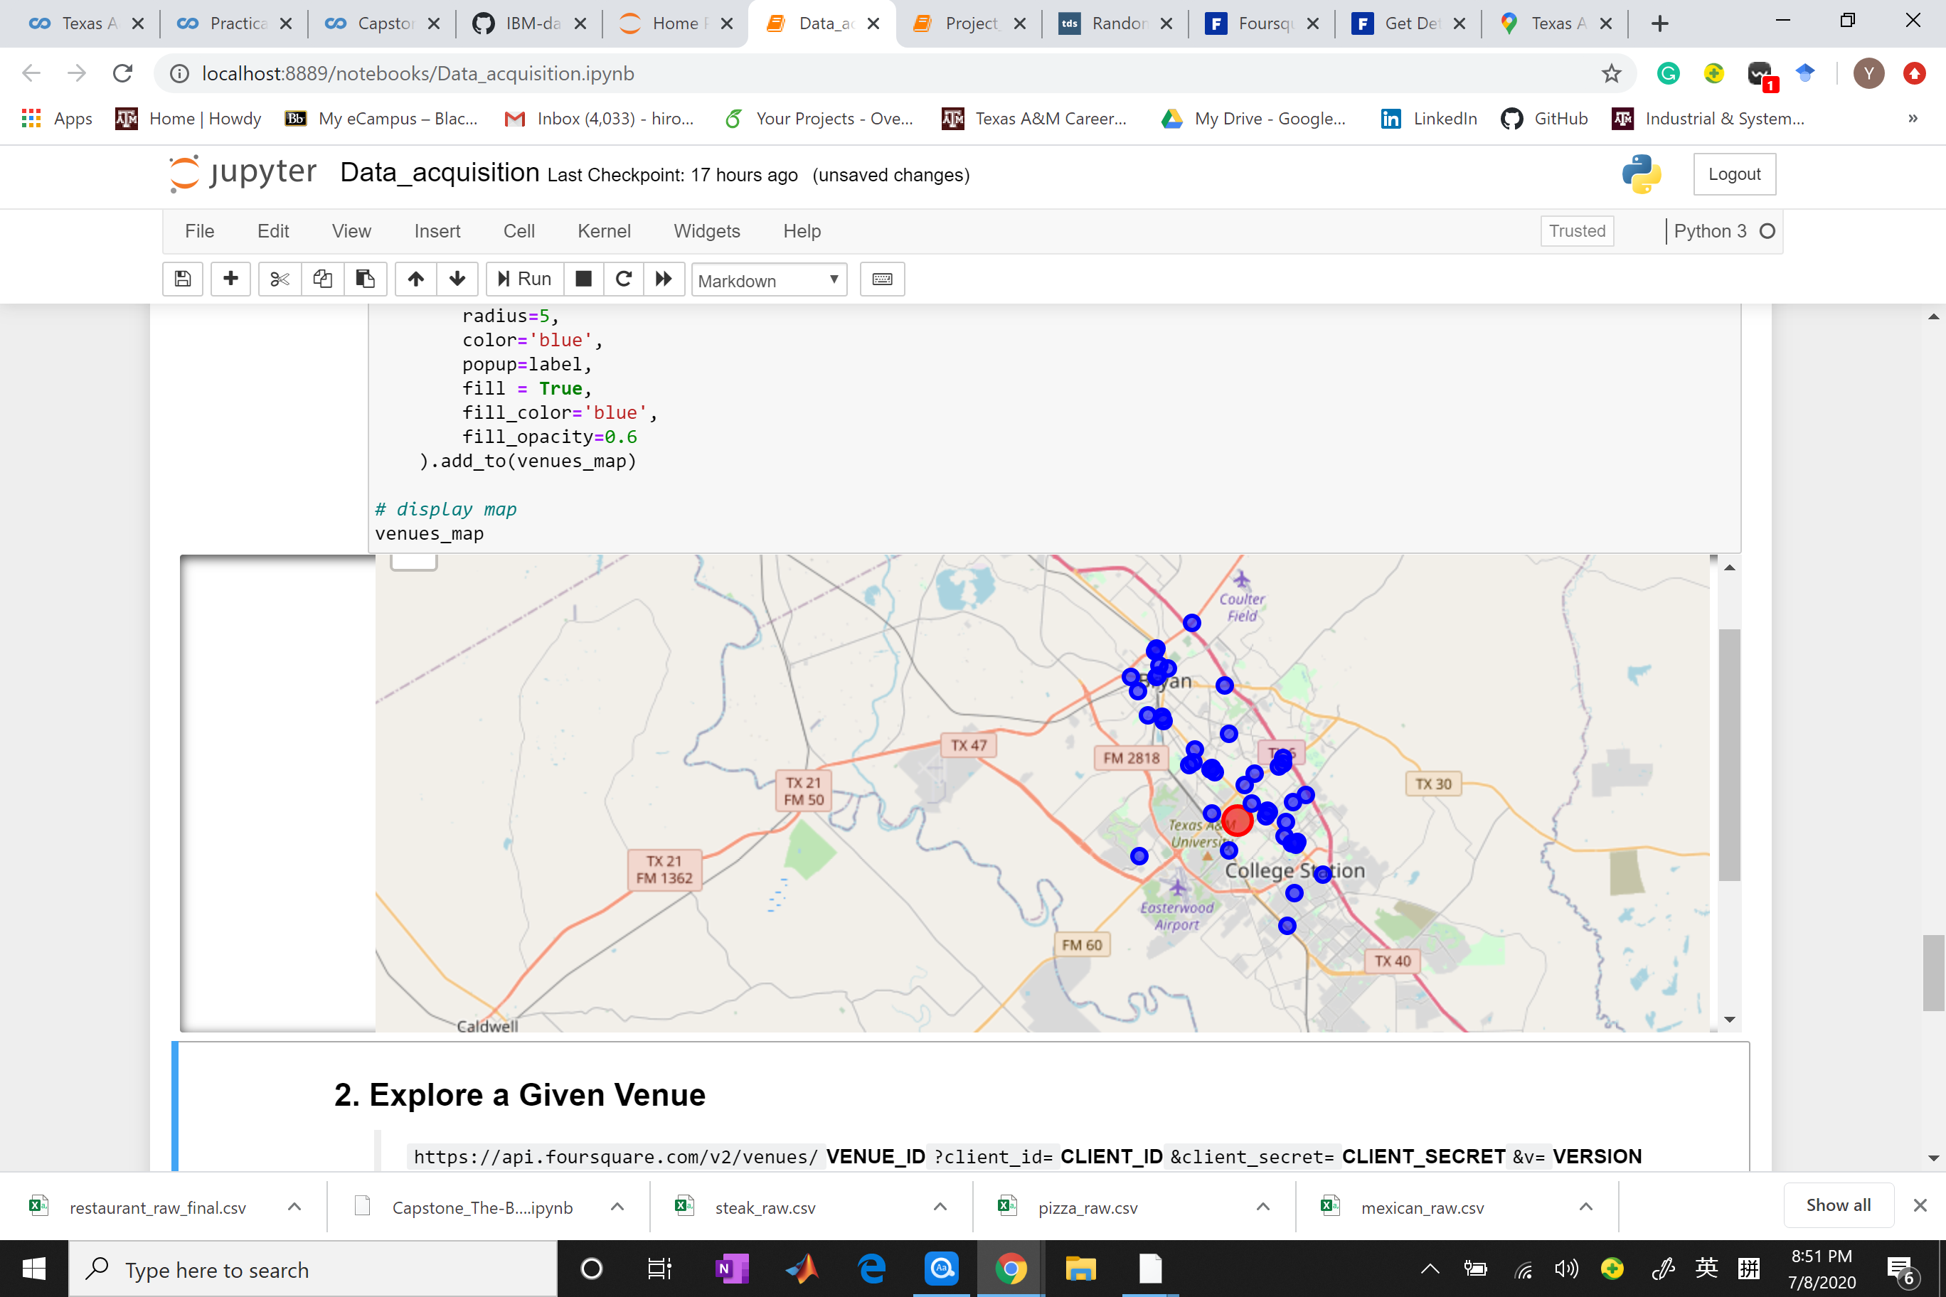
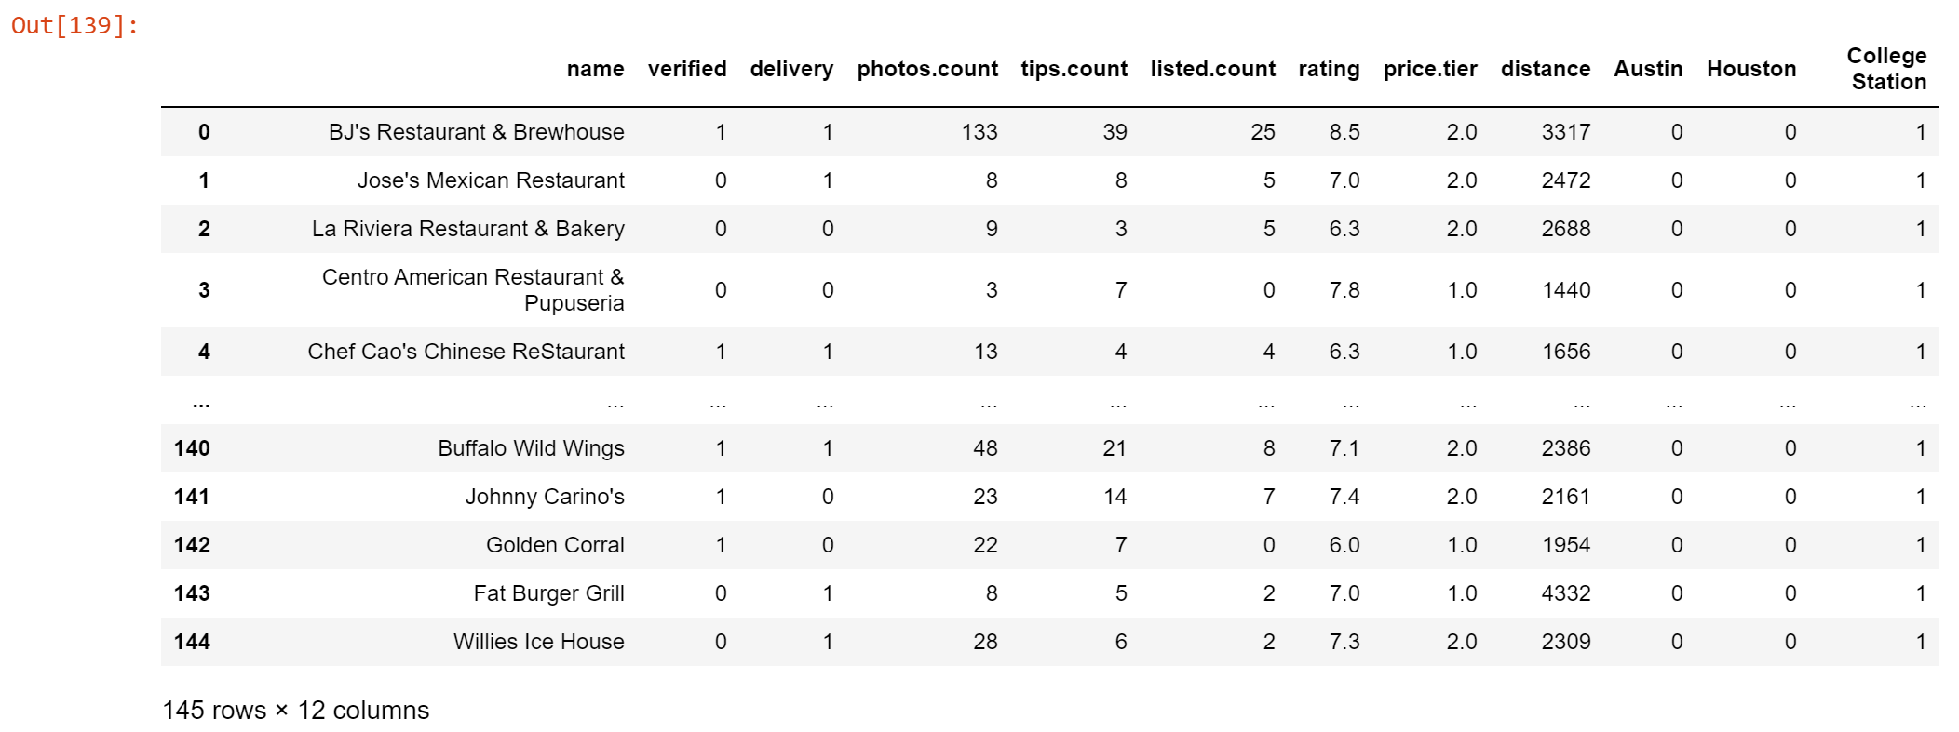
Data
Data Acquisition
Target variable:
rating
Predictors:
whether this restaurant is verified (binary variables);
distance from the university;
located county (binary variables for each county);
whether there is any delivery provider (binary variables);
Count of photos of this restaurant that are public;
price tier of the restaurant;
count of reviews;
how many people have added the restaurant to their lists.
Data Cleaning
Acquired from Foursquare
Information of restaurants near three universities in Texas

Slide 3
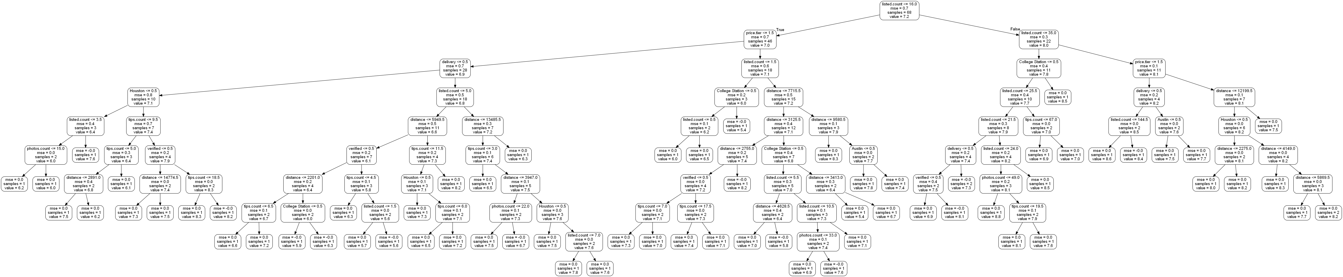
Random forest regression model
Reasons of using random forest:
It is a non-parametric method using decision trees to fit the data, which provides certain extent of nonlinearity.
Random forest algorithm reduces the correlation between each decision tree by using only part of the predictors for each tree.
It has less hyperparameters to tune.
We can visualize the trees and acquire the importance of each variable.
An example of a decision tree

Slide 4
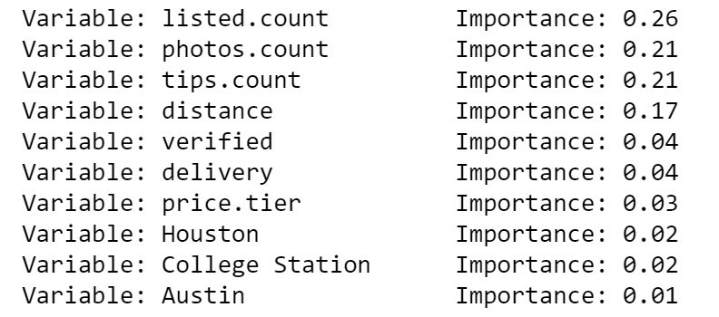
Result
Prediction accuracy
89.88%
Variable importance ranking

Slide 5
Conclusion
In this project, we studied the common features of some popular restaurants in Texas using a random forest regression model.
The result indicates that the important features are:
how many people have added the restaurant to their list;
number of photos that are public online;
number of tips online;
the distance from the chosen university.
Therefore, it indicates that the operators of restaurants should pay more attention to their online operation and location. However, to figure out what specific actions should be taken, we have to further study the interpretation of the machine learning model.

Slide 6
Thank you!

