Slide 1
PROCESS-RELATED IMPURITY · RESEARCH USE ONLY
HLA-DR immunogenicity of a dsRNA affinity ligand
dsRNA_7071_A08 · 132 aa · dsRNA-binding domain fused to a Protein A Z-domain variant
25-molecule HLA-DR panel · 97.3% weighted US/EU coverage · benchmarked against 14 comparators and controls
NetMHCIIpan EL + BA · human-self tolerance filter · population-weighted scoring · BepiPred-2.0 · exposure banding
Notes:
Test article is sponsor-supplied and proprietary - no public accession, and none is needed: the pipeline works from de-identified FASTA. Every comparator and control in the batch is public and was fetched live with its accession, so the scale the ligand is read against is reproducible even though the ligand is not.

Slide 2
VERDICT
Executive summary
1.8×
13
69%
5/25
VS PROTEIN A Z-DOMAIN
NON-SELF EPITOPES
US/EU POPULATION AT RISK
PEAK PROMISCUITY
the affinity ligand with the longest controlled clinical leachate history
of 14 total; 1 matched human self and were down-weighted
carry a DR molecule predicted to present ≥1 non-self epitope
DR molecules presenting the dominant epitope
The risk is concentrated, not diffuse. Residues 35–52, binding core FIVEAKIKE, peak 15-mer HKKKFIVEAKIKEYR — presented by 9 of 25 DR molecules, reaching 55% of the weighted US/EU population. That single peptide is what a confirmatory assay should be built around; the rest of the sequence is unremarkable for a non-human protein this size.
Intrinsic score 0.80 population-weighted non-self epitope units / 100 aa, against 0.45 for the Protein A Z-domain — same batch, same panel, same thresholds.
Batch controls all pass: the panel finds the tetanus universal epitopes, and the tolerance filter suppresses the human self controls without flattening the foreign ligands.
The headline understates where the risk sits. 70% of pIRS is in the novel dsRBD (residues 1–72); the Protein A scaffold half scores 0.45 per 100 aa against 0.45 for the benchmark itself, and 4/5 of its epitopes are ones the qualified leachate already carries.
Risk is intrinsic potential × dose. At ≤1 ng ligand / mg product and a 10 mg dose the exposure is ~0.01 µg — the regime in which qualified Protein A leachate has decades of clinical use.

Slide 3
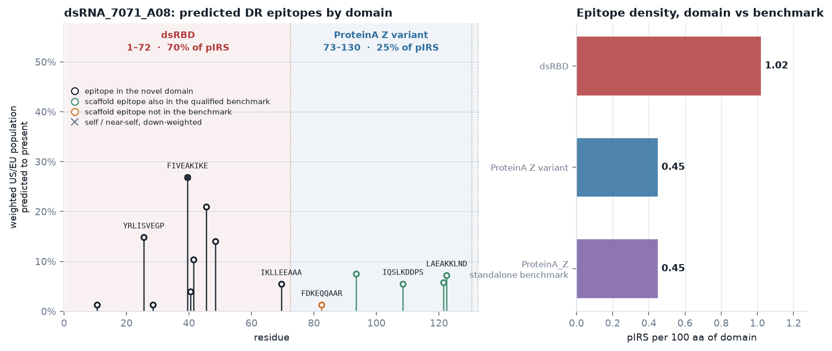
MODULE 14 · DOMAIN ATTRIBUTION
Which half of the molecule carries the risk?
This ligand is a fusion, and the two halves have entirely different regulatory standing. Scoring it as one object makes the headline fold-change partly a comparison of the molecule with a piece of itself — so the risk was attributed per domain, and the scaffold half compared epitope-by-epitope against the benchmark it derives from.
70% of pIRS is in the novel domain residues 1–72, 8 epitopes, peak breadth 5/25; closest human relatives STAU1_HUMAN 30.6% and DSRAD_HUMAN 41.8% — dsRBDs, but not human ones
The scaffold half is the benchmark 87.7% identical to ProteinA_Z over 50/57; 0.45 pIRS per 100 aa against 0.45 for ProteinA_Z scored standalone in this batch
4 of 5 scaffold epitopes are not new exposure they overlap epitopes the qualified Protein A leachate already carries
What this changes for the risk call. The whole-molecule number is 1.77× the Protein A benchmark, but that is the wrong unit here. Essentially all of the elevation is the novel dsRBD, at 1.02 pIRS per 100 aa against 0.45 for the benchmark — about 2.3×. The scaffold contributes essentially nothing new, so it is the RNA-binding domain that any confirmatory assay and any deimmunisation effort should target.
7 substitutions created 1 epitope, worth 0.00 pIRS and it is presented only by a DRB3/4/5 molecule, which carries no DRB1-locus frequency — so its zero population weight is an artefact of the coverage model, not an absence of risk
Domain boundaries were assigned in this run by local alignment, not taken from the supplied annotation; the human search is 5-mer seeded, so it bounds the nearest human hit rather than proving none is closer.
Notes:
The point of this slide: do not let a chimera's headline fold-change be read as a property of the whole molecule when one domain is already a qualified affinity ligand. Split it, and compare the shared half against the benchmark epitope by epitope rather than by score.

Slide 4
WORKFLOW REVIEW
What a single-tool DR scan cannot tell you
 | Added step | The failure mode it fixes
M2 | Panel designed against measured coverage | The DR subset of the IEDB class II reference set is widely used as "broadly representative". Measured, it reaches 84.2% weighted US/EU DRB1 coverage — it cannot meet a 95–98% requirement at any size. A greedy build to a stated target reaches 97.3% at 21 DRB1 molecules.
M3 | Two orthogonal prediction heads | Both eluted-ligand and binding-affinity scores are computed for every 15-mer. Whether affinity should gate a call was an open question until M11 settled it against ground truth — the gate removed four real epitopes for every false one, so it is off, and both scores are still reported.
M4 | Self / pre-existing-tolerance filter | Most DR hits in an antibody-derived ligand are framework cores near-identical to human germline V. Counting them inflates every VHH, scFv and Fab ligand identically and destroys the ranking. Validated here against a shuffled-sequence null.
M5–M6 | Population weighting + benchmark calibration with controls | "13 strong binders" is uninterpretable. Weighting each hit by the fraction of the US/EU population carrying the presenting molecule, then expressing it against Protein A Z-domain, makes it a comparison rather than a count.
M7–M8 | B-cell / ADA layer and exposure context | The measured endpoint is an anti-drug antibody assay, and impurity risk scales with µg delivered per dose. A T-cell-only, dose-free score cannot reach a risk call.
M9 (anchor-position deimmunisation scan) is optional — it only matters if the ligand itself can be re-engineered.

Slide 5
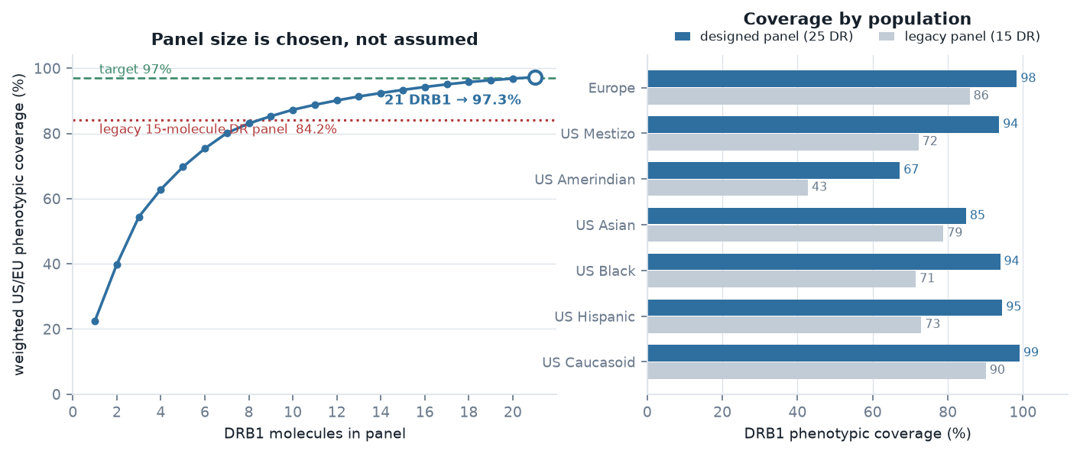
MODULE 2 · PANEL
The panel had to be designed, not inherited
84.2% → 97.3% weighted US/EU DRB1 phenotypic coverage, 15 → 25 DR molecules. The missing coverage in the legacy set sits in alleles it does not contain — DRB1*13:01, *04:04, *11:04, *16:01, *14:01 — so no amount of re-weighting fixes it.
Panel — DRB1* 07:01 · 03:01 · 15:01 · 01:01 · 11:01 · 04:01 · 13:01 · 13:02 · 04:04 · 11:04 · 16:01 · 14:01 · 04:07 · 12:01 · 09:01 · 08:02 · 01:02 · 08:01 · 15:03 · 13:03 · 04:05 + DRB3*01:01 · DRB3*02:02 · DRB4*01:01 · DRB5*01:01
Coverage is single-locus Hardy–Weinberg over the IEDB tables, reproducing the IEDB CLI to two decimals. DRB3/4/5 carry no frequencies there, so they add presentation breadth without entering this arithmetic. US Asian lands at 85% and US Amerindian at 67%: a US/EU-weighted objective does not buy those populations.

Slide 6
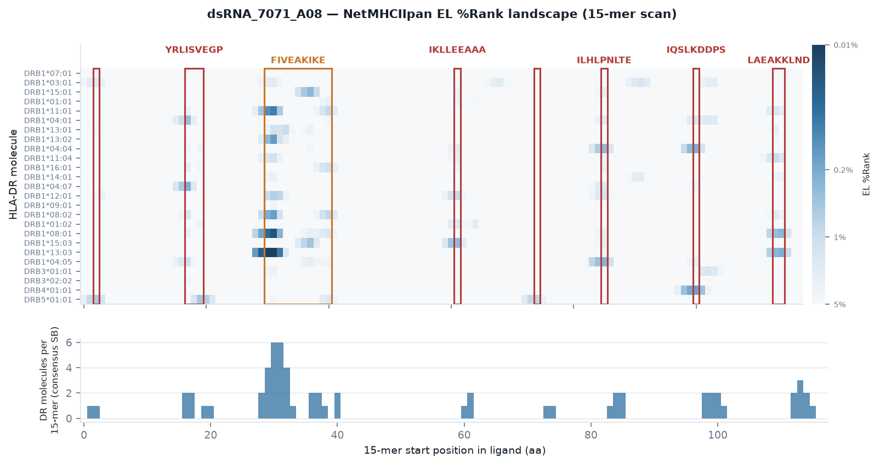
MODULE 3 · PREDICTION
Binding landscape across the full panel
329 strong-binder calls across the batch on eluted-ligand scoring at %Rank < 1. Against the labelled benchmark the affinity gate removed roughly four real epitopes for every false one, so it is off and all 329 calls are used. Affinity is still predicted and reported — it no longer vetoes a call.
15-mer scan, EL %Rank < 1 = strong, < 5 = weak. Boxes mark consolidated epitope clusters; the track below counts DR molecules with a strong call at each frame.

Slide 7
MODULE 4 · TOLERANCE FILTER
Framework hits are not risk
18.2%
4.1%
16.53×
CORES THAT ARE EXACT HUMAN 9-MERS
ONE SUBSTITUTION FROM HUMAN
ENRICHMENT OVER NULL
the peptide itself occurs in the human proteome — weight 0
8/9 identity to a human 9-mer — weight 0.35
real cores 22.3% vs shuffled-sequence null 1.4%
The threshold is validated, not asserted. Re-running the identical screen on cores drawn from shuffled versions of the same sequences — same composition, no real self-similarity — gives 1.4% at the 8/9 cut against 22.3% for real cores. A 5-of-9 "TCR-face" screen, the obvious shortcut, was tried first and discarded: with only five positions specified it matches the human proteome by chance several times per query and flags nearly everything.
The filter discriminates rather than deletes: the human self controls lose up to 100% of their unfiltered score, while the test article loses 14%. Every flagged core is written out with the human protein it matched, so each call is checkable.
Reference: UniProt Swiss-Prot Homo sapiens. This is a screen, not JanusMatrix — it does not require the human counterpart to bind the same allele, so it errs toward calling more peptides tolerised.

Slide 8
MODULE 4 · BOUNDARY CONTROLS
Where the filter is wrong, measured
The filter's rule is “self implies tolerated”. That is right often enough to be worth applying and wrong often enough to be worth measuring, so the batch carries two controls that sit on the boundary.
Control | Role | DR at %Rank<1 | at <5 | Cores tolerised | pIRS unfiltered | pIRS filtered
MBP_85_99 | self immunogenic control | 10/25 | 20/25 | 3/3 | 1.19 | 0.00
CLIP_87_101 | tolerised binder control | 1/25 | 7/25 | 1/1 | 0.00 | 0.00
The filter suppresses a real epitope, and this is the clearest example. Myelin basic protein 85–99 is a human self peptide with positive DR-restricted T-cell assays on 10 distinct DR molecules in IEDB. On this panel it is the broadest binder in the entire batch — 10/25 DR molecules at the strong-binder tier, unfiltered pIRS 1.19, higher than any ligand here. The tolerance filter takes it to 0.00.
That is the filter working as designed and being wrong. Self-derived epitopes exist — autoimmunity is what they are — and a sequence-identity filter cannot see the difference. It is safe for an affinity ligand because a foreign scaffold's framework similarity to human germline is the case it was built for; it is not safe for anything where self-reactivity is the question.
The opposite control behaves too. CLIP occupies the groove of essentially every DR molecule as the invariant chain's placeholder, yet carries no positive human DR T-cell record in IEDB. Here it reaches 7/25 at the weak tier and 1/25 at the strong tier, and ends at pIRS 0.00 — binding strength alone is not being read as risk.
Both controls' roles were checked against IEDB before assignment. They do not pass or fail the batch — they put a number on two things the filter cannot do.

Slide 9
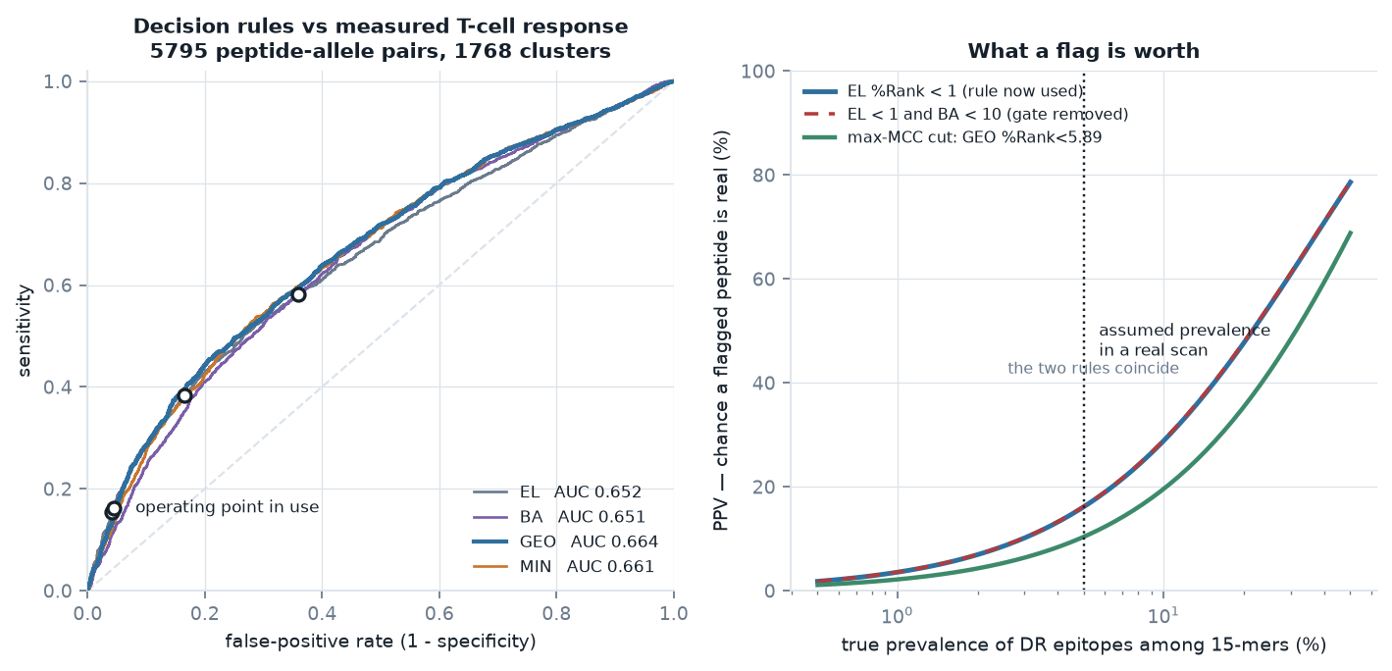
MODULES 10–11 · MEASURED ACCURACY
Does the rule actually work?
Every choice above this point was made by argument. The EL+BA consensus entered the pipeline because eluted-ligand scoring over-calls — a reasonable argument and no evidence. So the rule was scored against ground truth: every HLA-DR-restricted CD4 T-cell assay result IEDB holds for these 5,795 peptide-allele pairs, in human hosts.
9,647 labelled outcomes 5,858 positive / 3,789 negative pairs in 2,767 9-mer clusters, so overlapping peptides from one study count once
Best rule: GEO, AUC 0.664 against 0.652 for eluted-ligand scoring alone; paired cluster bootstrap puts the difference at +0.0125, 95% CI [-0.0007, 0.0246]
Calibrated cut: %Rank < 5.89 45% / 79%, MCC 0.259
Read the absolute numbers as an upper bound. NetMHCIIpan is trained on IEDB binding and mass-spec data; the labels here are T-cell assay outcomes, a different endpoint, but partial training-set overlap is certain and cannot be excluded from outside. The comparison between rules is far more robust — every rule uses the same possibly-leaky predictors on the same peptides, so leakage inflates them together and largely cancels in the difference.
IEDB's negatives carry their own bias: a peptide tested and found negative in one donor set is not a clean non-binder, which inflates apparent specificity.

Slide 10
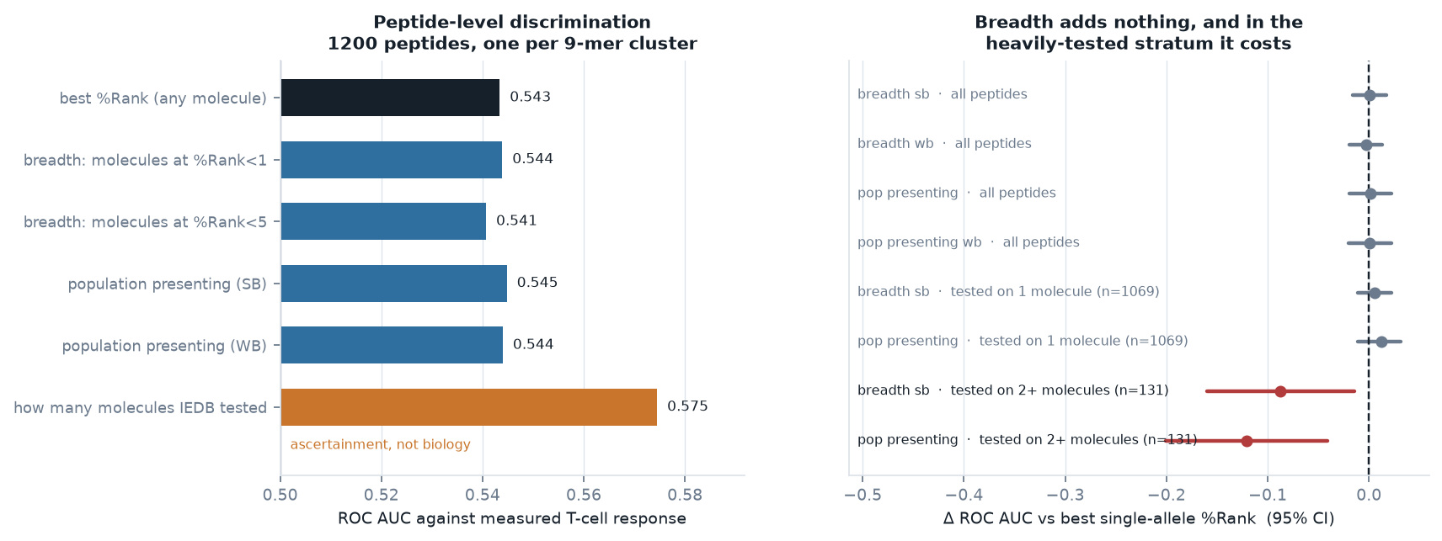
MODULE 13 · THE LAST SPECIFICITY LEVER
Does breadth beat the best single rank?
Each of the 1,200 benchmark peptides was scored against all 25 panel molecules, so “broadly presented” could be tested as a decision rule against “best single-allele %Rank” — one peptide per 9-mer cluster, paired cluster bootstrap on the AUC difference.
The lever does not exist. Breadth at %Rank < 1 is worth +0.0005 AUC against the best single rank, 95% CI [−0.0156, +0.0169]; population-weighted presentation +0.0013, [−0.0197, +0.0221]. In the 1,069 peptides tested on exactly one molecule — the only stratum where breadth cannot be inflated by how many molecules IEDB happened to test — it is still flat (+0.0054, [−0.0113, +0.0221]), and in the 131 multi-allele peptides it is significantly worse (−0.0877, [−0.1599, −0.0145]). Test count alone reaches AUC 0.575 — higher than any sequence-derived predictor here — with the positive rate climbing 46% → 80% → 96% across 1, 2 and 3 molecules tested. That is ascertainment, not biology. The pipeline keeps flagging per molecule on %Rank and keeps population weighting as an aggregation, not a criterion.
Notes:
Fourth measured negative result in this pipeline. Requiring N molecules or ranking on population coverage would trade sensitivity for nothing: breadth >= 2 at %Rank < 1 raises specificity to 0.79 but drops sensitivity to 0.28, and MCC barely moves. The multi-allele stratum is 84% positive, so its result is a small-sample signal that breadth is not adding information even where it is measurable.

Slide 11
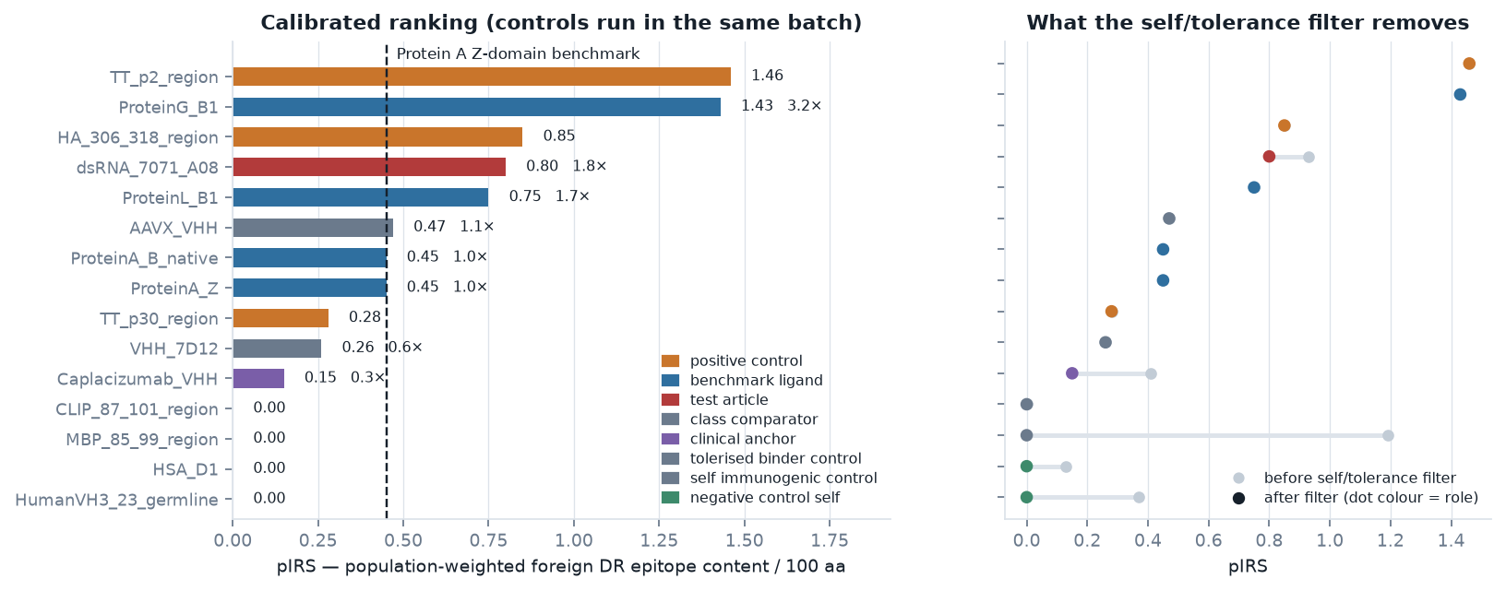
MODULES 5–6 · SCORING
Calibrated against benchmarks and controls in the same batch
System suitability check | Observed
universal epitopes detected with multi-allele breadth | HA_306_318_region 8/25 DR at %Rank<5 (2 at <1, best 0.46); TT_p2_region 15/25 DR at %Rank<5 (6 at <1, best 0.06); TT_p30_region 5/25 DR at %Rank<5 (2 at <1, best 0.64) | PASS
self controls suppressed by tolerance filter | HumanVH3_23_germline pIRS 0.00 (raw 0.37); HSA_D1 pIRS 0.00 (raw 0.13) | PASS
tolerance filter discriminates self from foreign | mean score drop: self 100.0% vs ligands 9.7% | PASS
benchmark anchor scored | ProteinA_Z pIRS 0.45 | PASS

Slide 12
MODULE 5 · EPITOPE CLUSTERS
Where the risk actually sits
From | To | Core | Peak 15-mer | EL %Rank | DR molecules | % US/EU presenting | Class
6 | 14 | ILQEITQKR | YKTILQEITQKRWKE | 0.55 | 1/25 | 0.0% | foreign
21 | 32 | YRLISVEGP | RPEYRLISVEGPHHK | 0.24 | 3/25 | 14.8% | foreign
35 | 52 | FIVEAKIKE | HKKKFIVEAKIKEYR | 0.01 | 9/25 | 54.9% | mixed
65 | 73 | IKLLEEAAA | EELIKLLEEAAAVDA | 0.31 | 2/25 | 5.5% | foreign
78 | 86 | FDKEQQAAR | DAKFDKEQQAARAEI | 0.8 | 1/25 | 0.0% | foreign
89 | 97 | ILHLPNLTE | RAEILHLPNLTEEQR | 0.27 | 2/25 | 7.5% | foreign
104 | 112 | IQSLKDDPS | NKFIQSLKDDPSQSA | 0.16 | 2/25 | 5.5% | foreign
117 | 126 | LAEAKKLND | ANLLAEAKKLNDAQA | 0.23 | 3/25 | 12.8% | foreign
Top epitopes by promiscuity
Pos | Core | 15-mer | EL %Rank | DR | % pop | Class | Presenting molecules
35 | FIVEAKIKE | HKKKFIVEAKIKEYR | 0.01 | 5 | 27% | near human 9mer | DRB1*08:01 DRB1*08:02 DRB1*11:01 DRB1*13:02 DRB1*13:03
21 | YRLISVEGP | RPEYRLISVEGPHHK | 0.24 | 2 | 15% | foreign | DRB1*04:01 DRB1*04:07
41 | IKEYRTLGE | EAKIKEYRTLGEGKS | 0.29 | 2 | 21% | foreign | DRB1*15:01 DRB1*15:03
44 | YRTLGEGKS | IKEYRTLGEGKSKKE | 0.81 | 2 | 14% | foreign | DRB1*08:02 DRB1*11:01
65 | IKLLEEAAA | EELIKLLEEAAAVDA | 0.31 | 2 | 5% | foreign | DRB1*12:01 DRB1*15:03
89 | ILHLPNLTE | RAEILHLPNLTEEQR | 0.27 | 2 | 8% | foreign | DRB1*04:04 DRB1*04:05
104 | IQSLKDDPS | NKFIQSLKDDPSQSA | 0.16 | 2 | 6% | foreign | DRB1*04:04 DRB4*01:01
118 | LAEAKKLND | ANLLAEAKKLNDAQA | 0.23 | 2 | 7% | foreign | DRB1*08:01 DRB1*13:03

Slide 13
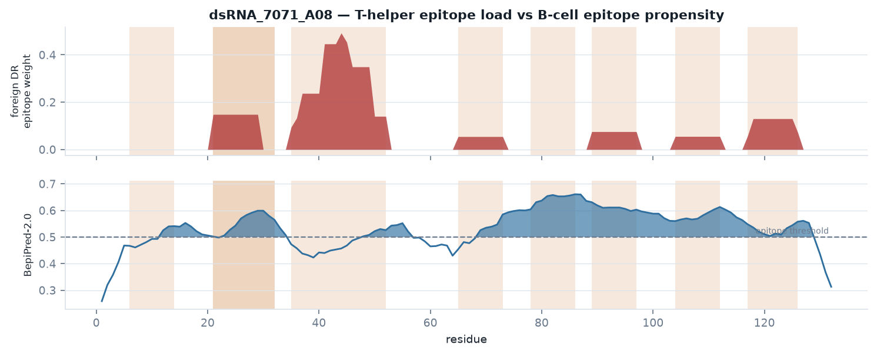
MODULE 7 · ADA LAYER
The measured endpoint is an antibody, not a T cell
A B cell only class-switches with help from a CD4 T cell recognising a peptide from the same protein. The regions worth taking into wet-lab work first are those where a non-self DR cluster and a predicted B-cell epitope coincide — shaded above.
T-cell cluster | Core | % pop presenting | B-cell region | Overlap (aa) | Region sequence
35-52 | FIVEAKIKE | 54.9% | 48-56 | 5 | GEGKSKKEA
21-32 | YRLISVEGP | 14.8% | 12-21 | 1 | QKRWKERPEY
21-32 | YRLISVEGP | 14.8% | 23-34 | 10 | LISVEGPHHKKK
117-126 | LAEAKKLND | 12.8% | 69-128 | 10 | EEAAAVDAKFDKEQQAARAEILHLPNLTEEQRNKFIQSLKDDPSQSANLLAEAKKLNDAQ
89-97 | ILHLPNLTE | 7.5% | 69-128 | 9 | EEAAAVDAKFDKEQQAARAEILHLPNLTEEQRNKFIQSLKDDPSQSANLLAEAKKLNDAQ
BepiPred-2.0 linear B-cell propensity is the weakest model in this pipeline — most real ADA epitopes are conformational. This layer prioritises regions; it is never a standalone claim.

Slide 14
MODULE 8 · EXPOSURE CONTEXT
Intrinsic risk × dose
Leachate \ dose | 1 mg | 10 mg | 100 mg | 1000 mg
1 ng/mg | 0.001 µg negligible | 0.01 µg negligible | 0.1 µg low | 1.0 µg moderate
10 ng/mg | 0.01 µg negligible | 0.1 µg low | 1.0 µg moderate | 10.0 µg elevated
100 ng/mg | 0.1 µg low | 1.0 µg moderate | 10.0 µg elevated | 100.0 µg elevated
A leached ligand is an impurity, and impurity risk is intrinsic potential multiplied by how much a patient receives. The intrinsic score places this ligand at 1.8× the Protein A Z-domain; the grid above decides whether that multiple matters for a given product.
Bands are an internal triage convention, not a regulatory threshold. No agency publishes a numeric leachate immunogenicity limit; the ICH Q6B / EMA expectation is control to a justified, consistently achieved level. Replace this grid with your product's measured leachate and dose.

Slide 15
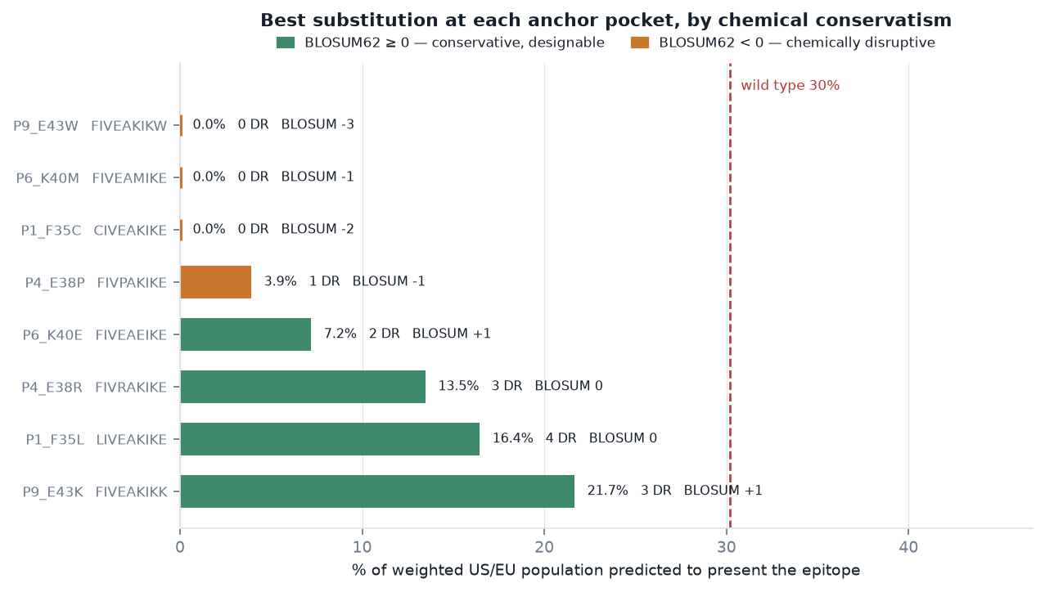
MODULE 9 · DEIMMUNISATION
If the ligand can be re-engineered
Anchor-position saturation scan Every substitution at each MHC-II anchor pocket (P1, P4, P6, P9) of the dominant core was re-scored across the full panel. Wild type is presented by 6 DR molecules reaching 30% of the weighted population; the best variants drop that to single digits.
BLOSUM62 and the human germline residue at the aligned position are reported because a substitution that abolishes DR binding and breaks the fold is not a design. Germline-matching changes are the ones least likely to create a new epitope or destabilise the framework.
Variant | Substitution | Core | DR | % pop | Δ % pop | BLOSUM62 | Germline aa
P6_K40M | K->M | FIVEAMIKE | 0 | 0.0% | -30.2 | -1 | Y
P1_F35C | F->C | CIVEAKIKE | 0 | 0.0% | -30.2 | -2 | F
P6_K40L | K->L | FIVEALIKE | 0 | 0.0% | -30.2 | -2 | Y
P6_K40Y | K->Y | FIVEAYIKE | 0 | 0.0% | -30.2 | -2 | Y
P6_K40C | K->C | FIVEACIKE | 0 | 0.0% | -30.2 | -3 | Y
P6_K40F | K->F | FIVEAFIKE | 0 | 0.0% | -30.2 | -3 | Y
P6_K40W | K->W | FIVEAWIKE | 0 | 0.0% | -30.2 | -3 | Y
DR presentation only. Effect on ligand–target affinity, resin capacity and alkaline stability is not modelled; any candidate goes back through binding and stability screens before it means anything.

Slide 16
What this is, and what it is not
In-silico DR screening ranks and localises risk. It does not measure it.
Prediction, not presentation — NetMHCIIpan scores peptide–MHC binding. It does not model antigen uptake, endosomal proteolysis, HLA-DM editing or endosomal stability.
Recommended confirmatory work — all RUO
1
HLA-DR competitive binding on the flagged peptides against the panel's dominant molecules — confirms the prediction directly. Days, lowest cost.
DR only — DP and DQ contribute to CD4 responses and are excluded by the panel specification. DQ is implicated in several biologic ADA responses.
pIRS is relative — Readable only against the benchmarks in this batch. It is not a predicted ADA incidence, and no in-silico method available today predicts one.
2
MAPPs on monocyte-derived dendritic cells from HLA-typed donors — shows what is actually processed and presented from the intact ligand.
No aggregation or adjuvant effect — Aggregated or particulate impurity is substantially more immunogenic than monomer; sequence-based methods cannot see it.
3
Ex-vivo PBMC / CD4 proliferation across ~50 HLA-typed donors matched to this panel — the closest available surrogate for clinical ADA risk.
The benchmark is an argument — “Comparable predicted epitope content to Protein A” is an inference about risk, not evidence of it.
All three are scoped by the peptide list this pipeline produces — which is the practical point of running it.
Research use only — not for regulatory submission without confirmatory wet-lab data.

