Slide 1
COMPUTATIONAL IMMUNOGENICITY ASSESSMENT — WORKFLOW v4
HLA-DR Immunogenicity Assessment
dsRNA Affinity Ligand 7071-A08 · 132 aa · Process-Related Impurity (Leached Ligand)
NetMHCIIpan-4.3 (EL + BA, %Rank) | Verified 23-Allele HLA-DR Panel | US 97.8% / EU 97.8% Panel Coverage
RUO — Research Use Only | IEDB MHC-II API + Population Coverage + CD4EpiScore | Specificity filters & 6-molecule control benchmark

Slide 2
EXECUTIVE SUMMARY
7071-A08 dsRNA Ligand — HLA-DR Immunogenicity at a Glance
132 aa
30 / 118
5 / 23
2
8.33
Sequence Length
Peptides with SB
Peak Promiscuity
HIGH Clusters
Foreign SB /100 aa
De-identified proprietary ligand; QC pass
25.4% of 15-mers (23-allele panel)
Pos 32 (FIVEAKIKE core)
of 6 total (1 MODERATE, 3 LOW)
Above TTc (7.41) — top of panel
Key Findings
• Ligand: 7071-A08, a 132-aa dsRNA affinity chromatography ligand (proprietary, de-identified); lysine/glutamate-rich sequence consistent with a nucleic-acid-binding surface. Context: leached resin ligand, low-dose process-related impurity (non-HCP).
• Two HIGH-risk promiscuous epitope clusters: pos 29–42 (core FIVEAKIKE; 5 SB alleles — DRB1*08:01/*08:02/*11:01/*12:01/*13:02) and pos 83–104 (core ILHLPNLTE; 4 SB alleles — DRB1*04:02/*04:04/*04:05/*12:01).
• Per-ligand population coverage: SB+WB binder set reaches the panel ceiling (US 97.8% / EU 97.8%); SB-only set covers US 68.1% / EU 64.2% — roughly 2 in 3 patients carry an allele predicted to strongly present a ligand peptide.
• Specificity filters: 46/55 (84%) SB calls affinity-confirmed at IC50<500 nM; 0/11 SB cores match the human proteome (fully foreign); CD4EpiScore independently flags the same regions.
• Control benchmark: foreign (non-self) SB-core density 8.33/100 aa — the highest in the 7-molecule panel, above the strongest positive control TTc (7.41) and infliximab (3.52); all tolerated negatives score 0.00.
• Overall in silico risk call: HIGH — the strongest signal observed across both ligands screened with this workflow.

Slide 3
MODULE 1
Sequence QC & Standardization
Input review · format validation · de-identification check

Slide 4
MODULE 1
Sequence QC & Standardization — All Checks Pass
Ligand Identity
QC Checklist
Field | Value
ID | 7071-A08 (de-identified, proprietary)
Type | dsRNA affinity chromatography ligand
Function | dsRNA clearance / binding (process resin ligand)
Source | User-supplied sequence (no public DB ID)
Length | 132 aa
Impurity context | Leached resin ligand, low-dose, process-related (non-HCP)
Composition note | K/E/R-rich (charged dsRNA-binding surface)
Check | Result
Standard amino acids (20 canonical) | PASS
No gaps / spaces / illegal characters | PASS
No ambiguous codes (B/Z/X/U) | PASS
Length in 50–1000 aa window | PASS (132 aa)
De-identified header (no DB accessions) | PASS
15-mers generated | 118
Input Sequence
>7071-A08_dsRNA_affinity_ligand_132aa
1 ADYKTILQEITQKRWKERPEYRLISVEGPHHKKKFIVEAKIK 42
43 EYRTLGEGKSKKEAEQRAAEELIKLLEEAAAVDAKFDKEQQA 84
85 ARAEILHLPNLTEEQRNKFIQSLKDDPSQSANLLAEAKKLND 126
127 AQAPKC 132
Proprietary sequence — analyzed as provided; no public-database cross-reference performed.

Slide 5
MODULE 2
HLA-DR Panel & Coverage
Verified 23-allele panel · US 97.79% / EU 97.83% · meets the 95–98% target

Slide 6
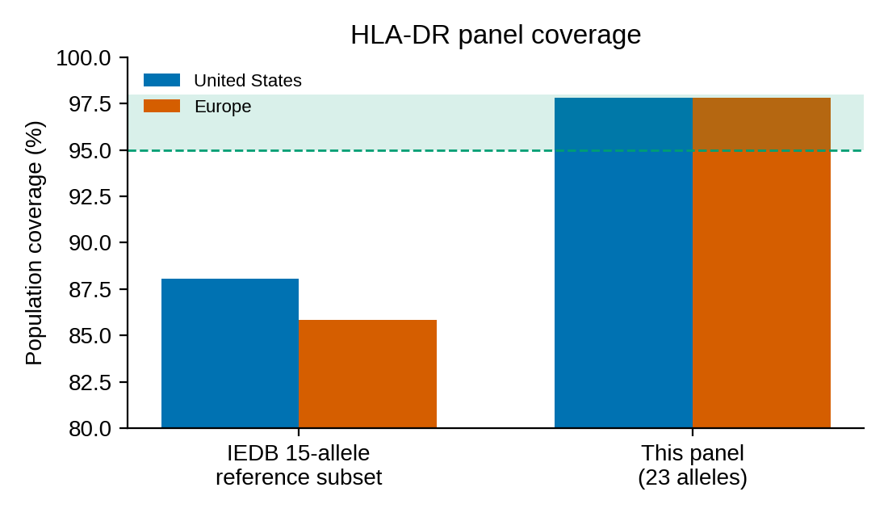
MODULE 2
Verified 23-Allele HLA-DR Panel (Reused, Session-Verified)
Panel
• 23 alleles: 19x DRB1, 2x DRB3, 1x DRB4, 1x DRB5 — the panel verified earlier this session.
• Coverage (IEDB population coverage tool): US 97.79% · EU 97.83% · World 94.15% — inside the 95–98% target band.
• The 15-allele IEDB class-II DR reference subset covers only 88.1% (US) / 85.8% (EU) and was rejected.
Method
• IEDB Population Coverage tool (Bui et al. 2006), class II, queried programmatically.
• Panel-level coverage = fraction of population carrying at least one panel allele.
Added vs IEDB reference subset
• DRB1*04:04, *13:01, *16:01, *14:01, *08:01, *04:02, *11:04, *10:01 — common US/EU specificities.
• Two of these additions (DRB1*04:02, *04:04) turn out to bind the 7071-A08 HIGH cluster C5 — panel breadth matters.
Panel coverage vs the IEDB 15-allele reference subset; green band = 95–98% target

Slide 7
MODULE 3
HLA-DR Binding / Presentation Prediction
NetMHCIIpan-4.3 EL · 15-mer scanning · %Rank classification · 2,714 predictions

Slide 8
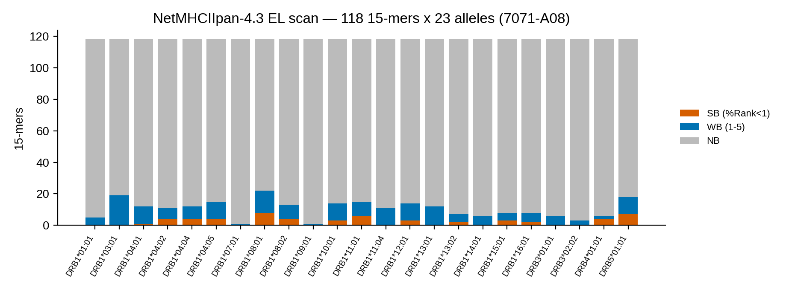
MODULE 3
Binding Prediction: Full-Sequence Scan (23-Allele Panel)
Metric | Count | % of 118
Peptides with >=1 SB allele | 30 | 25.4%
Peptides with >=1 WB allele (excl. SB) | 30 | 25.4%
Peptides with any binding | 60 | 50.8%
Non-binding peptides | 58 | 49.2%
Methodology
• NetMHCIIpan-4.3, EL %Rank
• 15-mer tiling, 118 peptides
• SB: %Rank<1 · WB: %Rank 1–5
• 23-allele DR panel
• 2,714 total predictions
55 SB / 184 WB / 2,475 NB peptide–allele pairs.
Binder load is high: half of all 15-mers (60/118) bind at least one panel allele. Median SB affinity 145 nM.

Slide 9
MODULE 4
Epitope Clusters & Per-Ligand Coverage
Core-based cluster consolidation · promiscuity tiers · predicted-epitope population coverage

Slide 10
MODULE 4
Epitope Clusters & Promiscuity (23-Allele Panel)
Cluster | Peak peptide (start) | Dominant core | SB | WB | Risk
C1 · pos 1–4 | DYKTILQEITQKRWK (2) | ILQEITQKR | 1/23 | 3/23 | LOW (DRB5)
C2 · pos 16–22 | RPEYRLISVEGPHHK (18) | YRLISVEGP | 2/23 | 9/23 | MODERATE
C3 · pos 29–42 | KKKFIVEAKIKEYRT (32) | FIVEAKIKE | 5/23 | 8/23 | HIGH
C4 · pos 60–76 | VDAKFDKEQQAARAE (74) | FDKEQQAAR | 1/23 | 7/23 | LOW (DRB5)
C5 · pos 83–104 | RAEILHLPNLTEEQR (86) | ILHLPNLTE | 4/23 | 6/23 | HIGH
C6 · pos 112–116 | QSANLLAEAKKLNDA (113) | LAEAKKLND | 1/23 | 6/23 | LOW
HIGH RISK — Cluster 3, pos 29–42
Peak KKKFIVEAKIKEYRT; core FIVEAKIKE. SB alleles: DRB1*08:01, *08:02, *11:01, *12:01, *13:02 — a DR8/DR11/DR12/DR13 family pattern.
HIGH RISK — Cluster 5, pos 83–104
Peak RAEILHLPNLTEEQR; core ILHLPNLTE. SB alleles: DRB1*04:02, *04:04, *04:05, *12:01 — DR4-supertype driven; two of these (*04:02, *04:04) are panel additions absent from the IEDB 15-allele reference subset.
MODERATE — Cluster 2, pos 16–22 (core YRLISVEGP; DRB1*04:01, *10:01).
LOW / RESTRICTED — C1, C4 (DRB5*01:01 mono-allelic) and C6 (DRB1*08:01 only): low population-level impact.
Promiscuity: peak peptide SB for >=4 alleles = HIGH, 2–3 = MODERATE, 1 = LOW. Overlapping peptides sharing a 9-mer core are consolidated (gap <=5 aa).

Slide 11
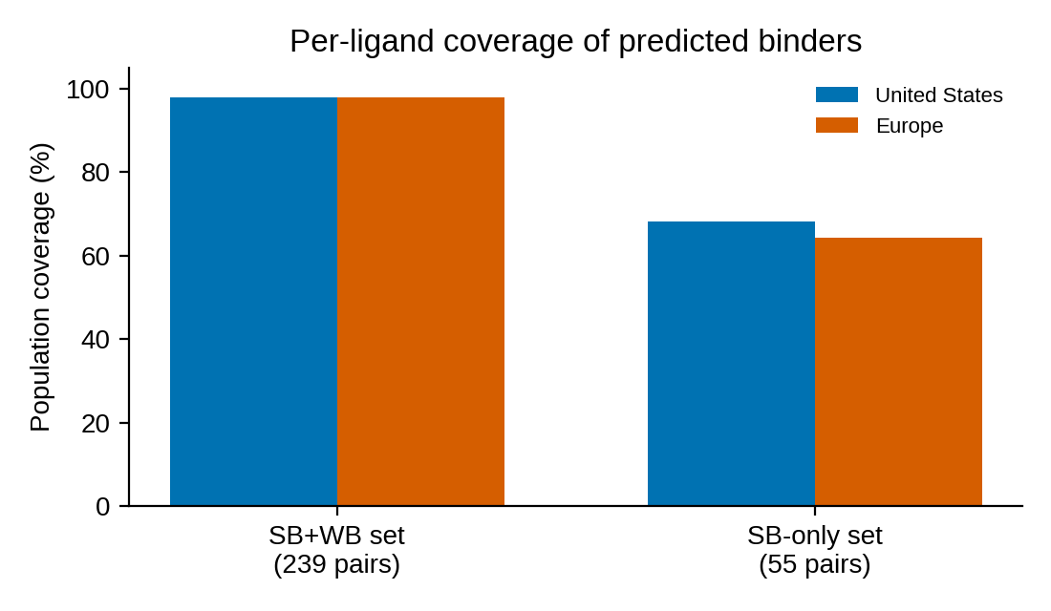
MODULE 4
Per-Ligand Epitope Population Coverage
What this metric answers
"What fraction of the US/EU patient population carries at least one HLA-DR allele predicted to present a peptide from this ligand?"
Computed with the IEDB population coverage tool using the actual predicted binder set.
Results
• SB+WB binder set (239 pairs): US 97.79% · EU 97.83% · World 94.15% — at the panel ceiling (every panel allele binds something).
• SB-only set (55 pairs): US 68.05% · EU 64.19% · World 61.79%.
Interpretation for a leached-ligand impurity
• ~2 in 3 US/EU patients carry an allele predicted to STRONGLY present a 7071-A08 peptide — a high population-level exposure potential, driven by the two HIGH clusters (DR8/11/12/13 family + DR4 supertype).
• Actual clinical risk is modulated by impurity dose (ng/mg range), exposure route, and product context; in silico presentation is not a confirmed T-cell response.
US/EU coverage of the predicted SB+WB and SB-only binder sets

Slide 12
MODULE 5
Specificity Filters, Controls & Robustness
EL+BA concordance · human self-similarity screen · CD4EpiScore · 6-molecule benchmark · threshold sensitivity

Slide 13
MODULE 5a
Specificity Filter 1: EL + BA Concordance
Question: are EL-predicted strong binders true high-affinity binders?
NetMHCIIpan-4.3 BA (IC50) run on the same 118x23 matrix; concordance tested at the classic IC50 < 500 nM affinity standard.
Note: BA %Rank<1 is too strict (ranks systematically inflated vs EL) — IC50<500 nM is the appropriate criterion.
Read-out
• 46/55 (84%) EL strong-binder calls are affinity-confirmed — high precision; 9 SB calls are presentation-driven (EL-positive but weaker affinity).
• Cluster-level: C2 6/6, C5 15/15, C1 2/2, C6 3/3 fully confirmed; C3 (HIGH) 20/27; C4 (LOW, DRB5) 0/2 — the DRB5-restricted LOW cluster is not affinity-supported.
• 269 NB pairs bind with IC50<500 nM but are NOT predicted to be presented (EL-negative) — EL adds real specificity beyond affinity alone.
Conclusion: both HIGH clusters are affinity-supported; the EL SB call set is highly specific.
EL class | Pairs | Affinity-confirmed (IC50<500 nM)
SB (EL %Rank<1) | 55 | 46/55 (84%)
WB (EL %Rank 1–5) | 184 | 128/184 (70%)
NB (EL %Rank>=5) | 2,475 | 269/2,475 (11%)

Slide 14
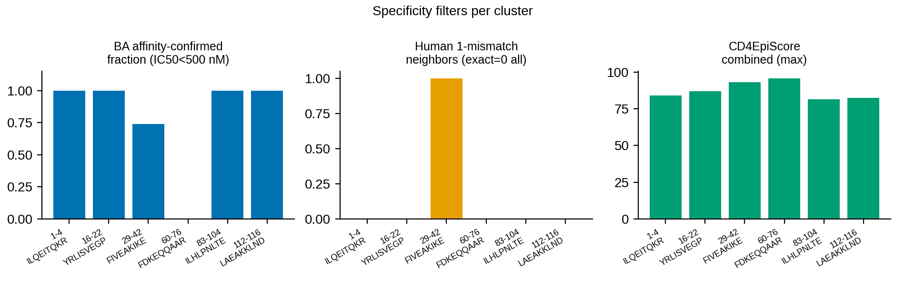
MODULE 5b/5c
Specificity Filters 2 & 3: Self-Similarity + CD4EpiScore
Self-similarity screen (tolerance flag)
All 11 unique SB cores screened against 10.4M 9-mers from the reviewed human proteome (UniProt UP000005640, 20,416 proteins):
• 0/11 exact human 9-mer matches — all cores fully non-self
• 1-mismatch near-neighbors: only FIVEAKIKE has one (FIVEADIKE); all other cores have zero
• No tolerance down-weighting applied
Cluster | Core | BA confirmed | Human self-match | CD4 combined (max)
C1 LOW | ILQEITQKR | 2/2 | No (0 near) | 84.1
C2 MOD | YRLISVEGP | 6/6 | No (0 near) | 86.9
C3 HIGH | FIVEAKIKE | 20/27 | No (1 near) | 93.3
C4 LOW | FDKEQQAAR | 0/2 | No (0 near) | 95.8
C5 HIGH | ILHLPNLTE | 15/15 | No (0 near) | 81.4
C6 LOW | LAEAKKLND | 3/3 | No (0 near) | 82.4
CD4EpiScore (independent immunogenicity model)
IEDB CD4EpiScore (combined method, 7-allele reference) on the full sequence:
• 25 scored peptides; per-cluster max combined scores 81.4–95.8
• Highest: C4 region (FDKEQQAAR, 95.75) — note CD4EpiScore uses a different 7-allele subset; our 23-allele panel calls C4 LOW (DRB5-only, not affinity-confirmed)
• Both HIGH clusters score 93.3 (C3) and 81.4 (C5) — cross-method concordance on C3
Per-cluster filter summary (full table: specificity_filters.csv)

Slide 15
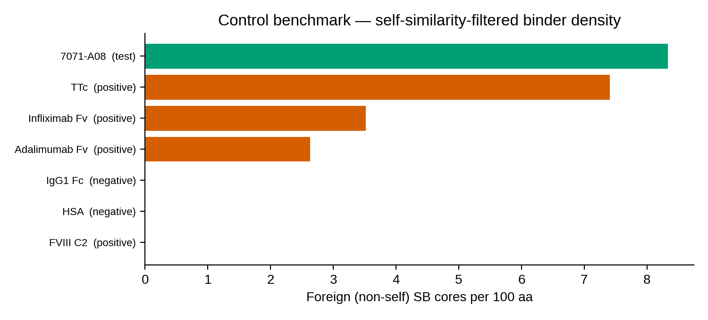
MODULE 5d
Positive / Negative Control Benchmarking (6 Molecules)
Molecule | Exp. | Foreign SB /100 aa | Peak promiscuity | Gate
TTc (tetanus toxin C-frag.) | + | 7.41 | 7 | PASS — high
FVIII C2 domain | + | 0.00 | 3 | Self-matched*
Infliximab Fv (chimeric) | + | 3.52 | 4 | PASS — high
HSA | − | 0.00 | 5 | PASS — low
IgG1 Fc | − | 0.00 | 5 | PASS — low
Adalimumab Fv (human) | − | 2.63 | 6 | Intermediate†
7071-A08 ligand | test | 8.33 | 5 | ABOVE positive range
Key insight: raw binding density does NOT separate positives from negatives — the self-similarity filter is what discriminates.
*FVIII C2 is human, 100% self-matched; its clinical immunogenicity reflects absent tolerance in hemophilia A.
†Adalimumab (40% self-matched) is intermediate — consistent with its known ~5–30% clinical ADA incidence.
7071-A08 (8.33/100 aa, 0% self) exceeds TTc (7.41) — the strongest positive control — and far exceeds infliximab (3.52).

Slide 16
MODULE 5e
Threshold Sensitivity Analysis
EL %Rank | SB pairs | Peptides w/ SB | Clusters | HIGH | Peak promiscuity
0.5 (strict) | 35 | 21 (17.8%) | 6 | 1 | 4
1.0 (default) | 54 | 29 (24.6%) | 7 | 2 | 5
2.0 | 100 | 38 (32.2%) | 8 | 4 | 8
5.0 (relaxed) | 236 | 59 (50.0%) | 6 | 6 | 13
Question: does the risk call depend on the %Rank cutoff?
• At the strict %Rank<0.5, one HIGH cluster persists (peak 4 alleles).
• Default %Rank<1: 54 SB pairs, 2 HIGH clusters, peak promiscuity 5.
• Relaxed %Rank<2: 100 pairs, 4 HIGH clusters, peak 8 — breadth grows but the same regions dominate.
Conclusion: the HIGH-risk call is robust to threshold choice; thresholds modulate breadth, not the qualitative classification.
Full data: threshold_sensitivity.csv
Note: sensitivity scan uses SB-start clustering; the primary cluster table uses core-based consolidation (6 clusters at the default threshold).

Slide 17
CONCLUSIONS
Risk Summary & Recommended Next Steps
Overall in silico risk call: HIGH — the strongest signal screened with this workflow to date
• 7071-A08 carries two promiscuous HIGH-tier HLA-DR epitope clusters (pos 29–42 FIVEAKIKE, DR8/11/12/13 family; pos 83–104 ILHLPNLTE, DR4 supertype) plus one MODERATE cluster.
• Filter 1 (EL+BA): 46/55 (84%) SB calls are true high-affinity binders; both HIGH clusters affinity-supported.
• Filter 2 (self-similarity): 0/11 SB cores match the human proteome — fully foreign, no tolerance mitigation.
• Filter 3 (CD4EpiScore): independent model scores all cluster regions 81–96 (high foreignness).
• Benchmark: foreign-epitope density 8.33/100 aa EXCEEDS the strongest positive control (TTc 7.41); tolerated negatives (HSA, IgG1 Fc) score 0.00.
• Population exposure: ~68% (US) / ~64% (EU) of patients carry an allele predicted to strongly present a ligand peptide.
• Robust: HIGH call persists at the strict %Rank<0.5 threshold.
Recommended next steps (out of scope for this RUO in silico screen)
• Priority: MAPPs (MHC-II–associated peptide proteomics) on a donor PBMC panel to confirm actual presentation of the FIVEAKIKE and ILHLPNLTE regions.
• DC–T cell proliferation / cytokine assays for the two HIGH cluster peptides.
• Optional in silico add-on: deimmunization variant design targeting the FIVEAKIKE / ILHLPNLTE cores (anchor-residue mutation scan, preserving dsRNA-binding function).
• For leached-impurity context: pair this T-cell epitope risk with impurity dose/clearance data for the overall risk assessment.
Tools: NetMHCIIpan-4.3 EL/BA (IEDB MHC-II API) · IEDB Population Coverage (Bui et al. 2006) · IEDB CD4EpiScore (Dhanda et al. 2018) · UniProt UP000005640 human proteome. RUO — Research Use Only; hypothesis-generating, not a clinical immunogenicity claim.

