Slide 1

Exploratory Data Analysis
<G2M_insight_for_Cab_Investment_firm >
<07/18/2023>

Slide 2
Executive Summary
The Client
XYZ is a private firm in US. Due to remarkable growth in the Cab Industry in last few years and multiple key players in the market, it is planning for an investment in Cab industry and as per their Go-to-Market(G2M) strategy they want to understand the market before taking final decision.
Analysis and Hypothesis Test:
Number of Transactions for each Company;
Average price charged of two companies;
Payment method Overview;
Average profit for both companies each year;
Gender Distributions;
Age Distributions;
Locations Distributions on Profit;
Users Percentage per City

Slide 3
Problem Statement
Objectives:
XYZ is interested in using our actionable insights to help them identify the right company to make their investment.

Slide 4
Approach
Explore Data Information
Find Correlations between features
Analysis on dataset and set up hypothesis
Use visualizations to investigate insights
Provide recommendations for investment

Slide 5
Data Information
Cab_Data.csv – this file includes details of transaction for 2 cab companies
Customer_ID.csv – this is a mapping table that contains a unique identifier which links the customer’s demographic details
Transaction_ID.csv – this is a mapping table that contains transaction to customer mapping and payment mode
City.csv – this file contains list of US cities, their population and number of cab users
Number of features: 18
Time period of data is from 31/01/2016 to 31/12/2018.
Number of data points: 359392
Created new feature Profit by using price charged – Cost of trip
City dataset contains other cab companies including yellow and pink
Cash and Card are only payments for both companies

Slide 6
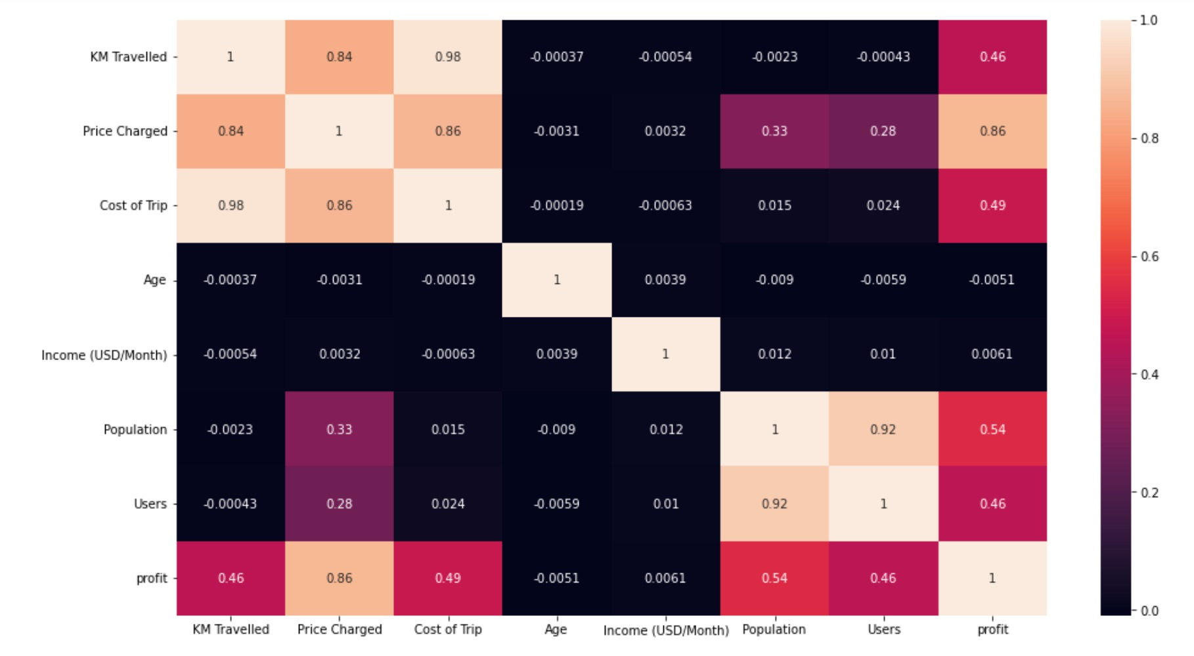
Data Correlation
There are several high correlations:
KM Travelled vs. Price Charged vs. Cost of Trip;
Populations vs. Users.
On the other hand, KM travelled/price charged/ cost of trip doesn't depend on customers' age or income.

Slide 7
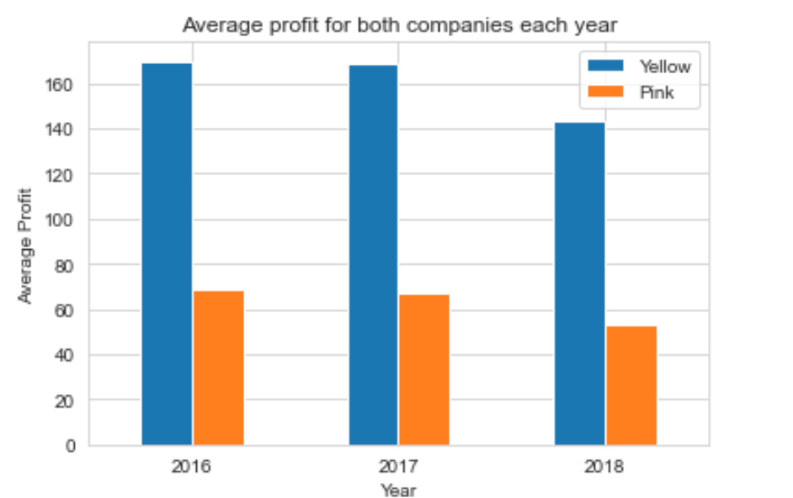
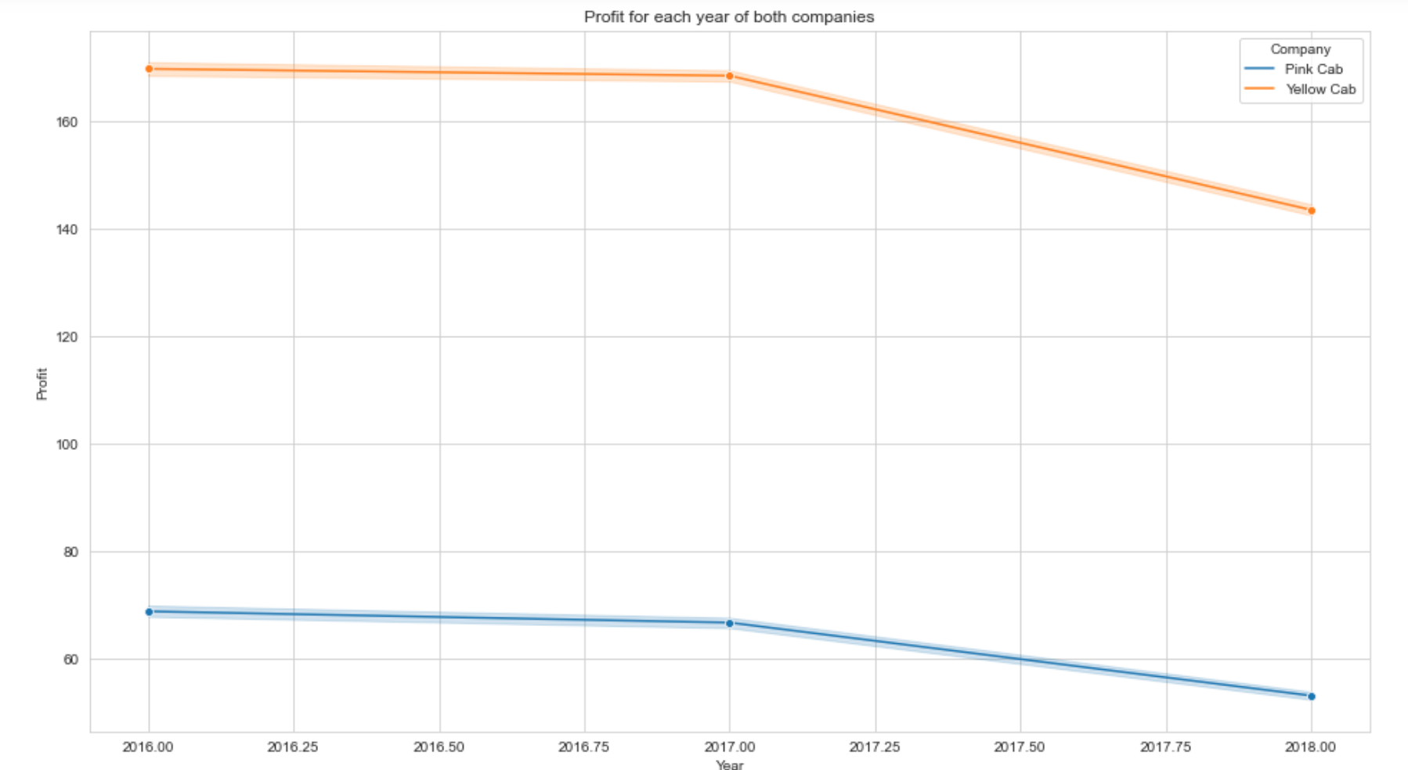
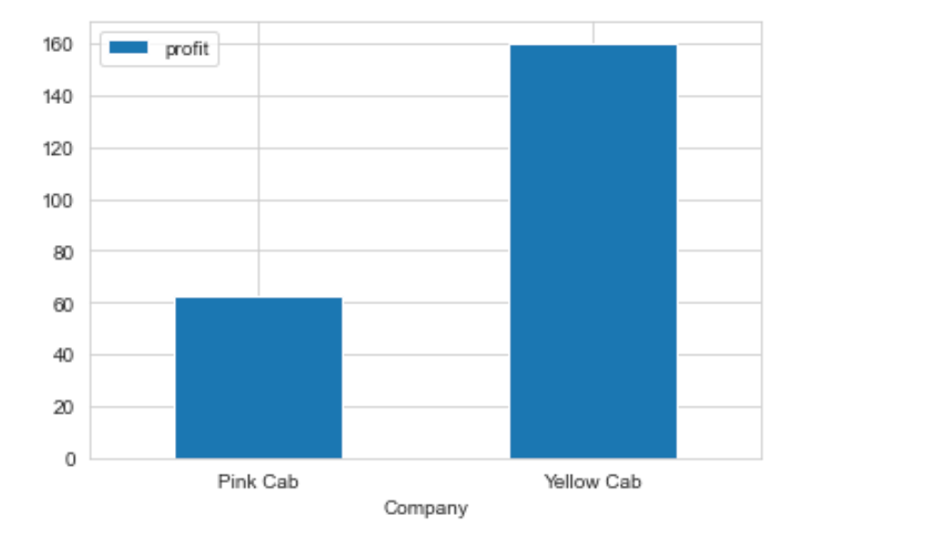
Profit Analysis
The profit decreasing each year from 2016-2018
The average profit of yellow cab is higher than pink cab each year
Overall profit of yellow cab is higher than pink cab

Slide 8
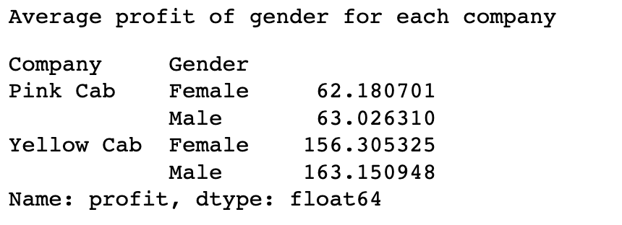
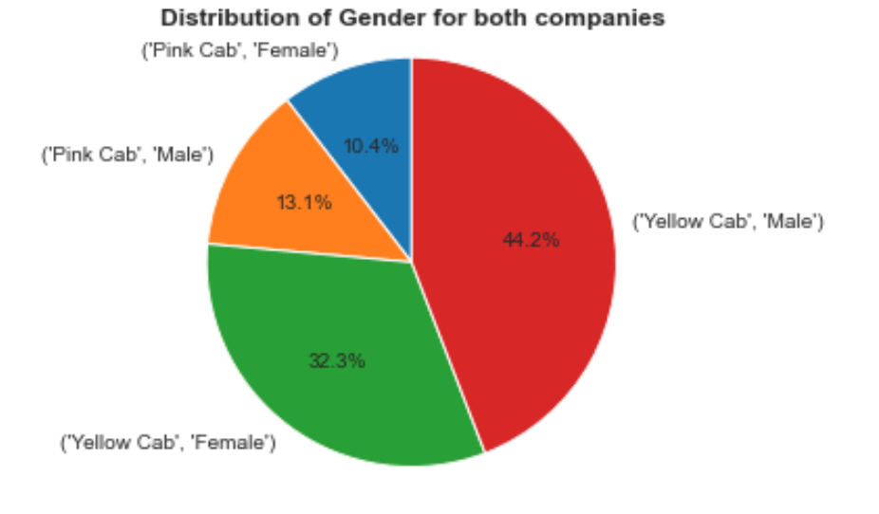
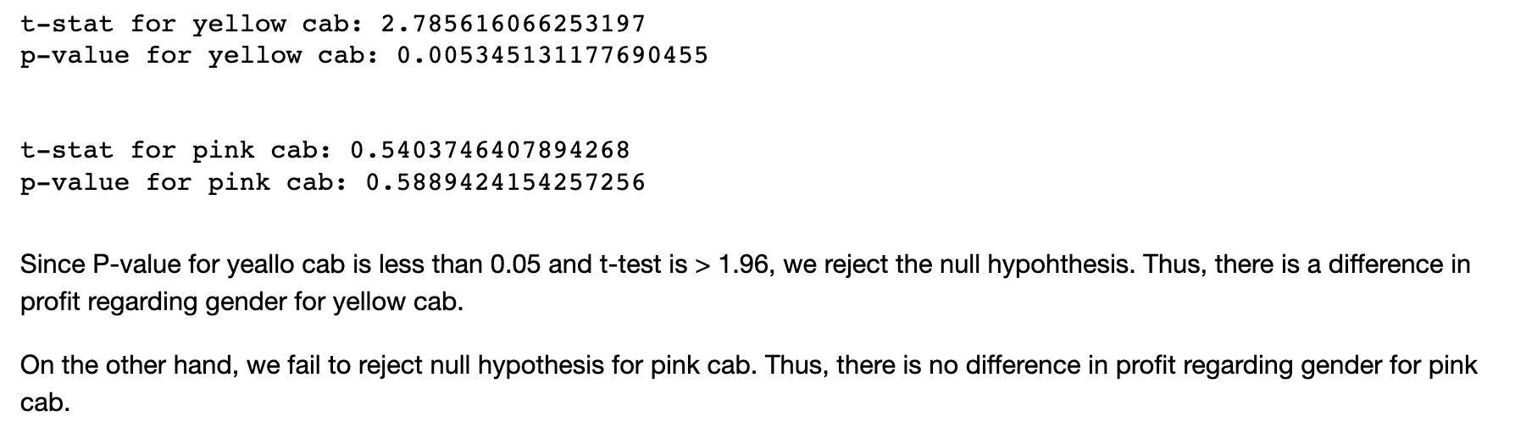
Gender Analysis
------------------------------------------------------------------------
Hypothesis: there is a difference in profit regarding gender for both companies.

Slide 9
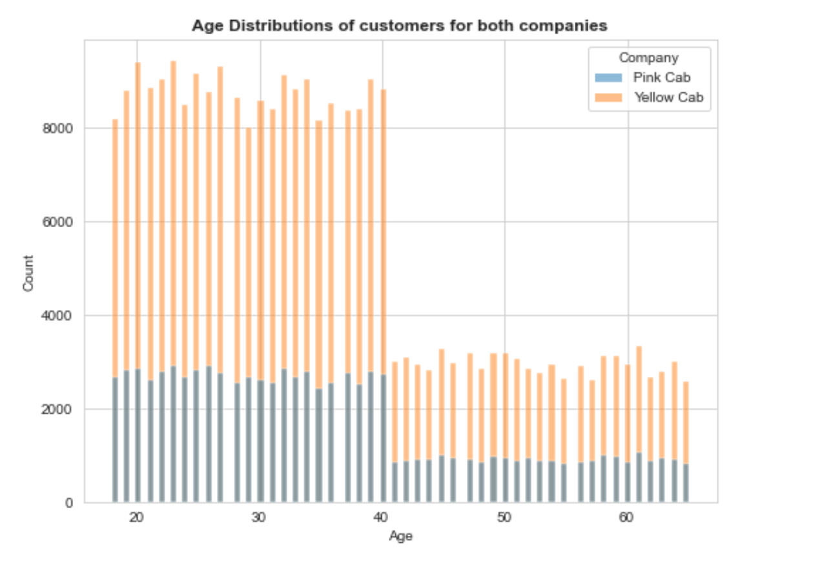
Customers’ Ages Analysis
Most of the customers are in the age group 18-40.
20- 30 age group has the most amount for yellow cab.
Total number of customers of yellow Cab is more than the one of pink cab.

Slide 10
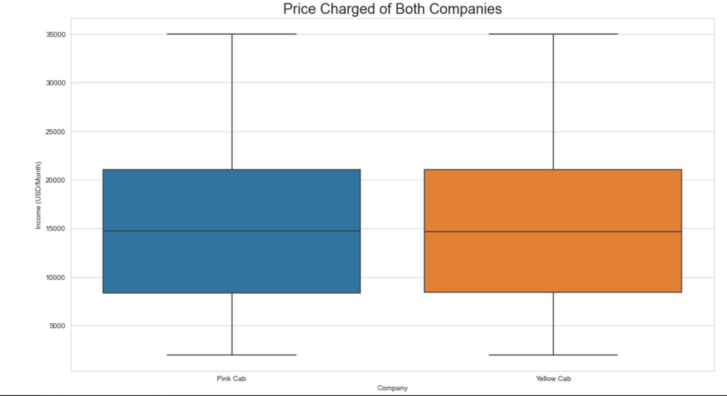
Average Income Analysis
The average income is about 15000 USD/month for both companies' customers.

Slide 11
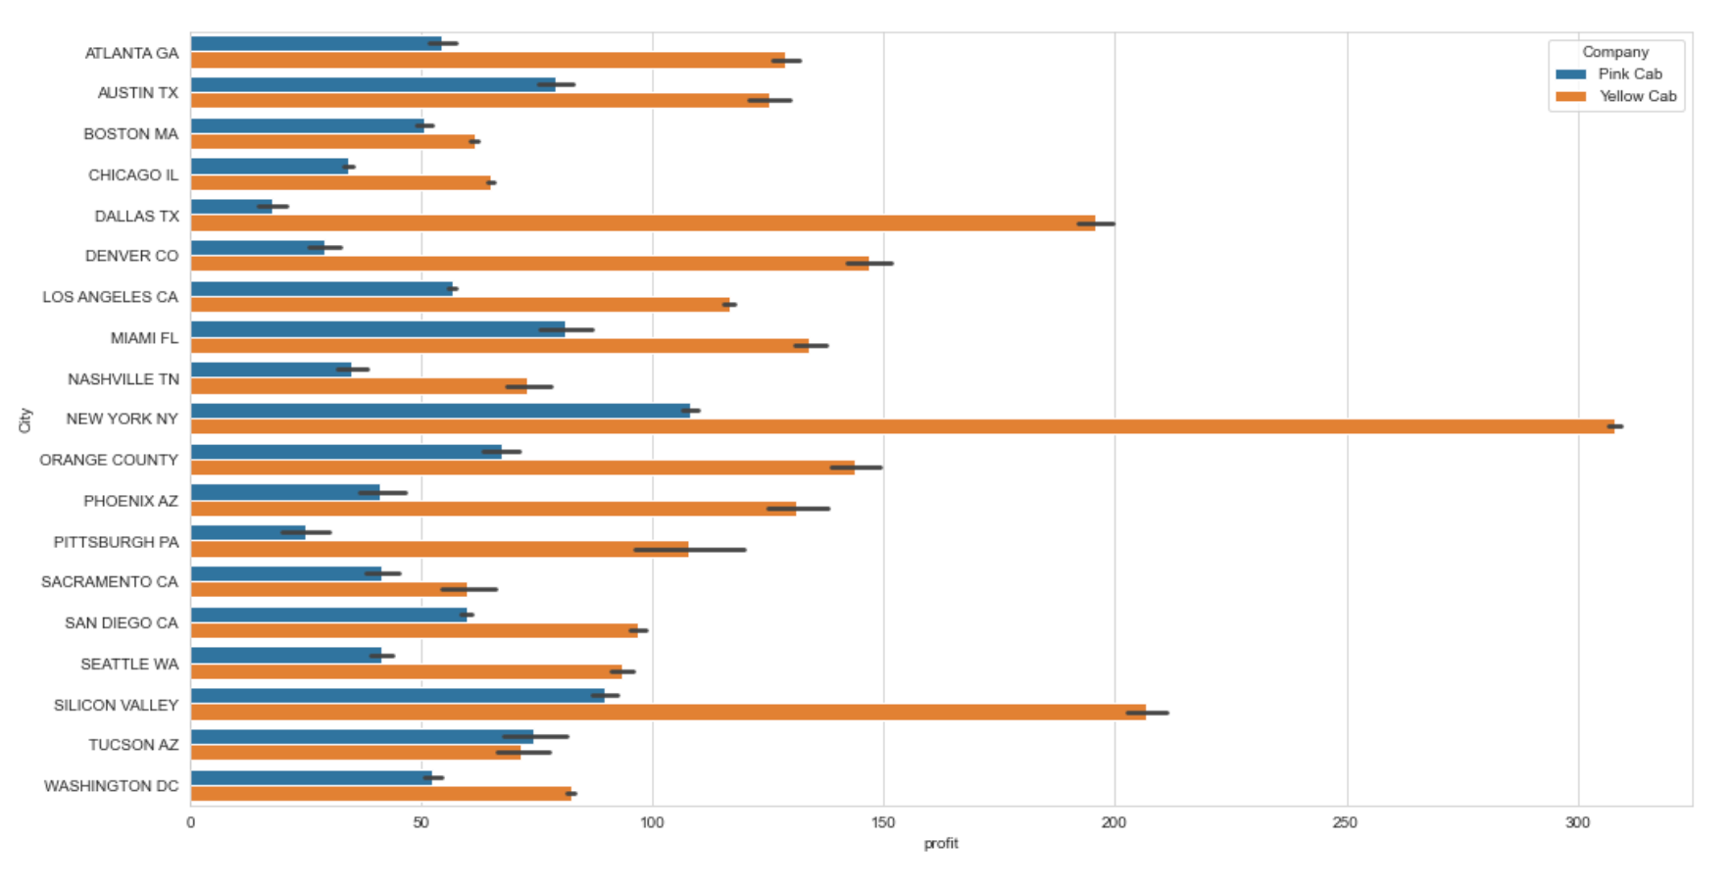
Location Analysis
New York city has the most Yellow Cab and Pink Cab customers. Dallas and Silicon Valley are the second for the yellow cab.

Slide 12
Recommendations
We recommend investing in yellow cab because:
1. Yellow cab has more users as well as transactions
2. Yellow cab has larger profit margin
3. Yellow cab has more average profit each year.

Slide 13
Thank You

