Slide 1

Chapter 7
Inferences Based on a Single Sample: Tests of Hypothesis
7.1 S.3
7.2 S.12
7.3 S.16
7.4 S.27
7.5 S.39
7.6 S.48
7.7 S.53
7.8 S.64-74

Slide 2
Content
The Elements of a Test of Hypothesis (7.1, Slide 3)
Formulating Hypotheses and Setting Up the Rejection Region (7.2, Slide 12)
Observed Significance Levels: p-Values (7.3, Slide 16)
Test of Hypothesis about a Population Mean: Normal (z) Statistic (7.4, Slide 28)
Test of Hypothesis about a Population Mean: Student’s t-Statistic (7.5, Slide 40)
Large-Sample Test of Hypothesis about a Population Proportion (7.6, Slide 49)
Test of Hypothesis about a Population Variance (7.7, Slide 57)
Calculating Type II Error Probabilities: More about β (7.8, Slide 68)

Slide 3
Hypothesis Testing
7.1 The Elements of a Test of Hypothesis
I believe the population mean age is 50 (hypothesis).
Reject hypothesis! Not close.
Population
☺
☺
☺
☺
☺
☺
☺
☺
Random sample
☺
Mean ‾X = 20
☺
☺

Slide 4
What’s a Hypothesis?
I believe the mean GPA of this class is 3.5!
A statistical hypothesis is a statement about the numerical value of a population parameter.
Determining the Target Parameter
Parameter | Key Words or Phrases | Type of Data
µ | Mean; average | Quantitative
p | Proportion; percentage; fraction; rate | Qualitative
σ² | Variance; variability; spread | Quantitative

Slide 5
Null Hypothesis
The null hypothesis, denoted H₀, represents the hypothesis that will be accepted unless the data provide convincing evidence that it is false. This usually represents the “status quo” or some claim about the population parameter that the researcher wants to test. (現狀′statəs,′kwō: the existing state of affairs, especially regarding social or political issues.)
Alternative Hypothesis
The alternative (research) hypothesis, denoted H_{a}, represents the hypothesis that will be accepted only if the data provide convincing evidence of its truth.(使人信服) This usually represents the values of a population parameter for which the researcher wants to gather evidence to support.

Slide 6
Alternative Hypothesis
Opposite of null hypothesis
The hypothesis that will be accepted only if the data provide convincing evidence of its truth
Designated H_{a}
Stated in one of the following forms: a. H_{a}: μ≠ (some value); b. H_{a}: μ < (some value); c. H_{a}: μ > (some value)
Identifying Hypotheses
Example problem: Test that the population mean is not 3.
Steps: • State the question statistically (μ ≠ 3)
• State the opposite statistically (μ = 3)
Must be mutually exclusive & exhaustive
• Select the alternative hypothesis (μ ≠ 3)
Has the ≠, <, or > sign
• State the null hypothesis (μ = 3)

Slide 7
What Are the Hypotheses?
Example
Is the population average amount of TV viewing 12 hours?
State the question statistically: μ = 12
State the opposite statistically: μ ≠ 12
Select the alternative hypothesis: H_{a}: μ ≠ 12
State the null hypothesis: H₀: μ = 12
What Are the Hypotheses?
Is the average cost per hat less than or equal to $20?
State the question statistically: μ ≤ 20
State the opposite statistically: μ > 20
Select the alternative hypothesis: H_{a}: μ > 20
State the null hypothesis: H₀: μ = 20

Slide 8
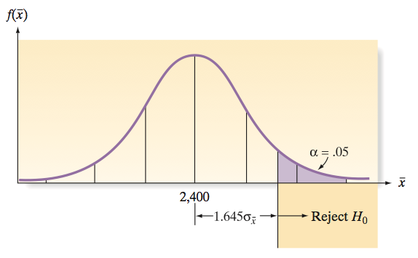
What Are the Hypotheses?
Is the average amount spent in the bookstore greater than $25?
State the question statistically: μ > 25
State the opposite statistically: μ ≤ 25
Select the alternative hypothesis: H_{a}: μ > 25
State the null hypothesis: H₀: μ = 25
Test Statistic
The test statistic is a sample statistic, computed from information provided in the sample, that the researcher uses to decide between the null and alternative hypotheses.
Example: The sampling distribution of assuming µ = 2,400, the chance of observing more than1.645 standard deviations above 2,400 is only 0.05– if in fact the true mean µ is 2,400.
f(x)

Slide 9
Type II Error
A Type II error occurs if the researcher accepts the null hypothesis when, in fact, H₀ is false. The probability of committing a Type II error is denoted by β.
Type II error =β = P(accept H₀ | H_{a} is true)
Conclusions and Consequences for a Test of Hypothesis
 | True State of Nature
Conclusion | H₀ True | H_{a} True
Accept H₀ (Assume H₀ True) | Correct decision | Type II error (probability β)
Reject H₀ (Assume H_{a} True) | Type I error (probability α) | Correct decision

Slide 10
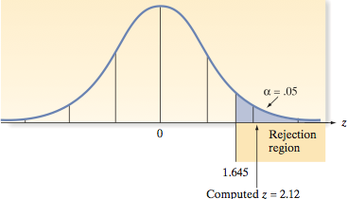
Type I Error
A Type I error occurs if the researcher rejects the null hypothesis in favor of the alternative hypothesis when, in fact, H₀ is true. The probability of committing a Type I error is denoted by α. kə′mit 提交
Type I error = α = P(reject H₀ | H₀ is true)
Rejection Region
The rejection region of a statistical test is the set of possible values of the test statistic for which the researcher will reject H₀ in favor of H_{a}.
Rejection Regions
 | Alternative Hypotheses
 | Lower-Tailed | Upper-Tailed | Two-Tailed
α = .10 | z < –1.282 | z > 1.282 | z < –1.645 or z > 1.645
α = .05 | z < –1.645 | z > 1.645 | z < –1.96 or z > 1.96
α = .01 | z < –2.326 | z > 2.326 | z < –2.575 or z > 2.575

Slide 11
Elements of a Test of Hypothesis
1. Null hypothesis (H₀): A theory about the specific values of one or more population parameters.
2. Alternative (research) hypothesis (H_{a}): A theory that contradicts the null hypothesis.
3. Test statistic: A sample statistic used to decide whether to reject the null hypothesis.
4. Rejection region: The numerical values of the test statistic for which the null hypothesis will be rejected. α is usually chosen to be small (e.g., 0.01, 0.05, or 0.10) and is referred to as the level of significance of the test. 被稱為
5. Assumptions: Clear statement(s) of any assumptions made about the population(s) being sampled.
6. Experiment and calculation of test statistic: Performance of the sampling experiment and determination of the numerical value of the test statistic.
7. Conclusion:
a. If the numerical value of the test statistic falls in the rejection region, we reject the null hypothesis and conclude that the alternative hypothesis is true.
b. If the test statistic does not fall in the rejection region, we do not reject H₀. Thus, we reserve judgment about which hypothesis is true.

Slide 12
Steps for Selecting the Null and Alternative Hypotheses
7.2 Formulating Hypotheses and Setting Up the Rejection Region
1. Select the alternative hypothesis as that which the sampling experiment is intended to establish. The alternative hypothesis will assume one of three forms:
a. One-tailed, upper-tailed (e.g., H_{a}: µ > 2,400)
b. One-tailed, lower-tailed (e.g., H_{a}: µ < 2,400)
c. Two-tailed (e.g., H_{a}: µ ≠ 2,400)
2. Select the null hypothesis as the status quo, that which will be presumed true unless the sampling experiment conclusively establishes the alternative hypothesis.
One-Tailed Test
A one-tailed test of hypothesis is one in which the alternative hypothesis is directional and includes the symbol “ < ” or “ >.” : 1. Upper-tailed (>): “greater than,” “larger,” “above”; 2. Lower-tailed (<): “less than,” “smaller,” “below”
Two-Tailed Test
A two-tailed test of hypothesis is one in which the alternative hypothesis does not specify departure from H₀ in a particular direction and is written with the symbol “ ≠.”
Some key words that help you identify this nondirectional nature are: Two-tailed (≠): “not equal to,” “differs from”.

Slide 13
Rejection Region (One-Tail Test)
Sampling Distribution
Level of Confidence
Rejection
Region
1 – α
α
Fail to Reject
Region
H_{o}
Sample Statistic
Critical
Value
Value

Slide 14
Basic Idea
Sampling Distribution
It is unlikely that we would get a sample mean of this value ...
... therefore, we reject the hypothesis that μ = 50.
... if in fact this were the population mean
20
μ
= 50
Sample Means
H₀

Slide 15
Rejection Regions (Two-Tailed Test)
Sampling Distribution
Level of Confidence
Rejection
Rejection
Region
Region
1 – α
1/2
α
1/2
α
Fail to Reject
Region
H_{o}
Sample Statistic
Critical
Value
Critical
Value
Value

Slide 16
7.3 Observed Significance Levels: p-Values
The observed significance level, or p-value, for a specific statistical test is the probability (assuming H₀ is true) of observing a value of the test statistic that is at least as contradictory to the null hypothesis, and supportive of the alternative hypothesis, as the actual one computed from the sample data.
Probability of obtaining a test statistic more extreme (≤ or ≥) than actual sample value, given H₀ is true. Called observed level of significance
Smallest value of α for which H₀ can be rejected
Used to make rejection decision
If p-value ≥ α, do not reject H₀
If p-value < α, reject H₀

Slide 17
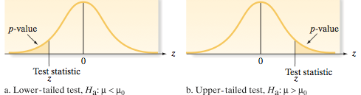
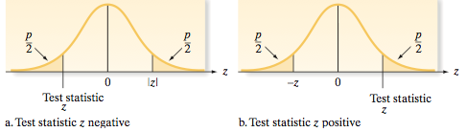
Steps for Calculating the p-Value for a Test of Hypothesis
1. Determine the value of the test statistic z corresponding to the result of the sampling experiment.
2a. If the test is one-tailed, the p-value is equal to the tail area beyond z in the same direction as the alternative hypothesis. Thus, if the alternative hypothesis is of the form > , the p-value is the area to the right of, or above, the observed z-value. Conversely, if the alternative is of the form < , the p-value is the area to the left of, or below, the observed z-value.
2b. If the test is two-tailed, the p-value is equal to twice the tail area beyond the observed z-value in the direction of the sign of z – that is, if z is positive, the p-value is twice the area to the right of, or above, the observed z-value. Conversely, if z is negative, the p-value is twice the area to the left of, or below, the observed z-value.

Slide 18
Two-Tailed z Test: p-Value Example
Example1. Does an average box of cereal contain 368 grams of cereal? A random sample of 25 boxes showed = 372.5. The company has specified σ to be 15 grams. Find the p-value. How does it compare to α = 0.05?
Solution:
H₀: μ = 368
H_{a}: μ ≠ 368
α = 0.05
R.R.: z >
368 gm.
③
1/2 p-Value
1/2 p-Value
.5000 – .4332 .0668
2. Do not reject H₀ at α = 0.05
1. p-Value is
P(z < –1.50 or z > 1.50)
= 0.1336 ≥ α = 0.05
.4332
–1.50
0
1.50
z
②
From z table: lookup 1.50
①
z value of sample statistic (observed)
Do not reject H₀ at α = 0.05

Slide 19
p-Value = 0.1336 ≥ α = 0.05 Do not reject H₀.
1/2 p-Value = 0.0668
1/2 p-Value = 0.0668
Reject H₀
Reject H₀
1/2 α = 0.025
1/2 α = 0.025
–1.50
0
1.50
z
Test statistic is in ‘Do not reject’ region

Slide 20
One-Tailed z Test: p-Value Example
Does an average box of cereal contain more than 368 grams of cereal? A random sample of 25 boxes showed = 372.5. The company has specified σ to be 15 grams. Find the p-value. How does it compare to α = 0.05?
Solution:
α = 0.05
368 gm.
H₀: μ = 368
H_{a}: μ > 368

Slide 21
One-Tailed z Test p-Value Solution
0
1.50
z
①
z value of sample statistic

Slide 22
One-Tailed z Test p-Value Solution
p-Value is P(z ≥1.50)
②
④
Use alternative hypothesis to find direction
p-Value
.5000 – .4332 .0668
.4332
0
1.50
z
③
From z table: lookup 1.50
①
z value of sample statistic

Slide 23
One-Tailed z Test p-Value Solution
p-Value is P(z ≥ 1.50) = 0.0668
②
p-Value
④
Use alternative hypothesis to find direction
0.0668
0.5000 – 0.4332 0.0668
0.4332
0
1.50
z
③
From z table: lookup 1.50
①
z value of sample statistic

Slide 24
One-Tailed z Test p-Value Solution
(p-Value = 0.0668) ≥ (α = 0.05). Do not reject H₀.
p-Value = 0.0668
Reject H₀
α = 0.05
0
1.50
z
Test statistic is in ‘Do not reject’ region

Slide 25
p-Value (Thinking Challenge)
Example2. You’re an analyst for Ford. You want to find out if the average miles per gallon of Escorts is less than 32 mpg. Similar models have a standard deviation of 3.8 mpg. You take a sample of 60 Escorts & compute a sample mean of 30.7 mpg. What is the p-value? How does it compare to α = 0.01?
H₀: μ = 32 (μ ≥ 32)
H_{a}: μ < 32
Normal Table
In some question, it may need Interpolation Method to obtain the p-value, if z value incurs larger error by using Normal Table.
Suppose 0 < z₁ < z < z₂ and z₁, z₂ are near two values on the same table row with p₁ and p₂, then approximating p-value can obtain by solving equation below: (p₂− p₁)/(z₂− z₁) ＝ (p − p₁)/(z − z₁) or
0.5 − P(0≤ z ≤ z₁) = p₁ by the definition of Normal Table in textbook.
Notes:
.

Slide 26
p-Value Solution*
p-Value is P(z ≤ -2.65) = 0.004. p-Value < (α = 0.01). Reject H₀.
②
④
p-Value
Use alternative hypothesis to find direction
0.5000 – 0.4960 0.0040
0.004
0.4960
–2.65
0
z
①
z value of sample statistic
③
From z table: lookup 2.65

Slide 27
Large-Sample Test of Hypothesis about µ
7.4 Test of Hypotheses about a Population Mean: Normal (z) Statistic
One-Tailed Test Two-Tailed Test
H₀: µ = µ₀ H₀: µ = µ₀
H_{a}: µ < µ₀ H_{a}: µ ≠ µ₀
(or H_{a}: µ > µ₀)
Test Statistic: Test Statistic:

Slide 28
Large-Sample Test of Hypothesis about µ
One-Tailed Test
Rejection region:
z < –z_{α} (or z > z_{α} when H_{a}: µ > µ₀)
where z_{α} is chosen so that
P(z > z_{α}) = α
Two-Tailed Test
Rejection region:
|z| > z_{α/2}
where z_{α/2} is chosen so that
P(|z| > z_{α/2}) = α/2
Note: µ₀ is the symbol for the numerical value assigned to µ under the null hypothesis.

Slide 29
In some question, it may need Interpolation Method to obtain the p-value, if z value incurs larger error by using Normal Table.
Suppose 0 < z₁ < z < z₂ and z₁, z₂ are near two values on the same table row with p₁ and p₂, then approximating p-value can obtain by solving equation below: (p₂− p₁)/(z₂− z₁) ＝ (p − p₁)/(z − z₁) or
0.5 − P(0≤ z ≤ z₁) = p₁ by the definition of Normal Table in textbook.

Slide 30
Conditions Required for a Valid Large-Sample Hypothesis Test for µ
1. A random sample is selected from the target population.
2. The sample size n is large (i.e., n ≥ 30). (Due to the Central Limit Theorem, this condition guarantees that the test statistic will be approximately normal regardless of the shape of the underlying probability distribution of the population.)

Slide 31
Possible Conclusions for a Test of Hypothesis
1. If the calculated test statistic falls in the rejection region, reject H₀ and conclude that the alternative hypothesis H_{a} is true. State that you are rejecting H₀ at the α level of significance. Remember that the confidence is in the testing process, not the particular result of a single test.
2. If the test statistic does not fall in the rejection region, conclude that the sampling experiment does not provide sufficient evidence to reject H₀ at the α level of significance. [Generally, we will not “accept” the null hypothesis unless the probability β of a Type II error has been calculated.]

Slide 32
Two-Tailed z Test Example
Example 3. Does an average box of cereal contain 368 grams of cereal? A random sample of 25 boxes had = 372.5. The company has specified σ to be 25 grams. Test at the 0.05 level of significance.
Solution:
Two-Tailed z Test Solution
368 gm.
H₀: μ = 368
H_{a}: μ ≠ 368
α = 0.05 
n = 25
Critical Value(s):
Test Statistic:
Decision:
Conclusion:
Reject H
Reject H
0
0
Do not reject H₀ at α = 0.05
0.025
0.025
No evidence average is not 368
–1.96
0
1.96
z

Slide 33
Two-Tailed z Test Thinking Challenge
Example 4. You’re a Q/C inspector. You want to find out if a new machine is making electrical cords to customer specification: average breaking strength of 70 lb. with σ = 3.5 lb. You take a sample of 36 cords & compute a sample mean of 69.7 lb. At the 0.05 level of significance, is there evidence that the machine is not meeting the average breaking strength?

Slide 34
Two-Tailed z Test Solution*
μ = 70
H₀:
H_{a}:
α =
n =
Critical Value(s):
Test Statistic:
Decision:
Conclusion:
μ ≠ 70
0.05
36
Reject H
Reject H
Do not reject at α = 0.05
0
0
.025
.025
No evidence average is not 70
–1.96
0
1.96
z

Slide 35
One-Tailed z Test Example
Example 5. Does an average box of cereal contain more than 368 grams of cereal? A random sample of 25 boxes showed = 372.5. The company has specified σ to be 25 grams. Test at the 0.05 level of significance.
368 gm.

Slide 36
One-Tailed z Test Solution
H₀:
H_{a}:
α =
n =
Critical Value(s):
μ = 368
Test Statistic:
Decision:
Conclusion:
μ > 368
0.05
25
Reject
Do not reject at α = .05
.05
No evidence average is more than 368
0
1.645
z

Slide 37
One-Tailed z Test Thinking Challenge
Example 6. You’re an analyst for Ford. You want to find out if the average miles per gallon of Escorts is at least 32 mpg. Similar models have a standard deviation of 3.8 mpg. You take a sample of 60 Escorts & compute a sample mean of 30.7 mpg. At the 0.01 level of significance, is there evidence that the miles per gallon is less than 32?

Slide 38
One-Tailed z Test Solution*
H₀:
H_{a}:
α =
n =
Critical Value(s):
Test Statistic:
Decision:
Conclusion:
μ = 32
μ < 32
.01
60
Reject
Reject H₀ at α = .01
.01
There is evidence average is less than 32
-2.33
0
z

Slide 39
Small-Sample Test of Hypothesis about µ
7.5 Test of Hypothesis about a Population Mean: Student’s t-Statistic
One-Tailed Test
H₀: µ = µ₀
H_{a}: µ < µ₀ (or H_{a}: µ > µ₀)
Test statistic:
Rejection region: t < –t_{α} (or t > t_{α} when H_{a}: µ > µ₀)
where t_{α} and t_{α/2} are based on (n – 1) degrees of freedom

Slide 40
Small-Sample Test of Hypothesis about µ
Two-Tailed Test
H₀: µ = µ₀
H_{a}: µ ≠ µ₀
Test statistic:
Rejection region: |t| > t_{α/2}

Slide 41
Conditions Required for a Valid Small-Sample Hypothesis Test for µ
1. A random sample is selected from the target population.
2. The population from which the sample is selected has a distribution that is approximately normal.

Slide 42
Two-Tailed t Test Example
Example 7. Does an average box of cereal contain 368 grams of cereal? A random sample of 36 boxes had a mean of 372.5 and a standard deviation of 12 grams. Test at the 0.05 level of significance.
Solution
368 gm.
Test Statistic:
Decision:
Conclusion:
H₀: μ = 368
H_{a}: μ ≠ 368
α = 0.05
df = 36 – 1 = 35
Critical Value(s):
Reject H
Reject H
Reject H₀ at α = .05
0
0
0.025
0.025
There is evidence population average is not 368
-2.030
0
2.030
t

Slide 43
One-Tailed t Test Example
Example 8. Is the average capacity of batteries less than 140 ampere-hours? A random sample of 20 batteries had a mean of 138.47 and a standard deviation of 2.66. Assume a normal distribution. Test at the 0.05 level of significance.

Slide 44
One-Tailed t Test Solution
μ = 140
H₀:
H_{a}:
α =
df =
Critical Value(s):
Test Statistic:
Decision:
Conclusion:
μ < 140
.05
20 – 1 = 19
Reject H₀
Reject at α = .05
.05
There is evidence population average is less than 140
-1.729
0
t

Slide 45
One-Tailed t Test Thinking Challenge
Example 9. You’re a marketing analyst for Wal-Mart. Wal-Mart had teddy bears on sale last week. The weekly sales ($ 00) of bears sold in 10 stores was: 8 11 0 4 7 8 10 5 8 3 At the 0.05 level of significance, is there evidence that the average bear sales per store is more than 5 ($ 00)?

Slide 46
One-Tailed t Test Solution*
H₀:
H_{a}:
α =
df =
Critical Value(s):
μ = 5
Test Statistic:
Decision:
Conclusion:
μ > 5
0.05
10 – 1 = 9
Reject H₀
Do not reject H₀ at α = 0.05
.05
There is no evidence average is more than 5
0
1.833
t

Slide 47
Summary:
Type II error =β = P(accept H₀|H_{a} is true); Power of Test = 1 ‒ β.
Rejection Region
Type I error = α =
P(reject H₀ |H₀ is true)
Conclusions and Consequences for a Test of Hypothesis
 | True State of Nature
Conclusion | H₀ True | H_{a} True
Accept H₀ (Assume H₀ True) | Correct decision | Type II error (probability β)
Reject H₀ (Assume H_{a} True) | Type I error (probability α) | Correct decision

Slide 48
7.6 Large-Sample Test of Hypothesis about a Population Proportion
Determining the Target Parameter
Parameter | Key Words or Phrases | Type of Data
µ | Mean; average | Quantitative
p | Proportion; percentage; fraction; rate | Qualitative
σ² | Variance; variability; spread | Quantitative
 | Alternative Hypotheses (Rejection Regions, R.R.)
 | Lower-Tailed | Upper-Tailed | Two-Tailed
α = .10 | z < –1.282 | z > 1.282 | z < –1.645 or z > 1.645
α = .05 | z < –1.645 | z > 1.645 | z < –1.96 or z > 1.96
α = .01 | z < –2.326 | z > 2.326 | z < –2.575 or z > 2.575

Slide 49
Large-Sample Test of Hypothesis about p
One-Tailed Test
H₀: p = p₀
H_{a}: p < p₀ (or H_{a}: p > p₀)
Test statistic:
Rejection region:
z < –z_{α} (or z > z_{α} when H_{a}: p > p₀)
Note: p₀ is the symbol for the numerical value of p assigned in the null hypothesis

Slide 50
Large-Sample Test of Hypothesis about p
Two-Tailed Test
H₀: p = p₀
H_{a}: p ≠ p₀
Test statistic:
Rejection region: z_{α /2} < |z|
Note: p₀ is the symbol for the numerical value of p assigned in the null hypothesis
Conditions Required for a Valid Large-Sample Hypothesis Test for p
1. A random sample is selected from a binomial population.
2. The sample size n is large. (This condition will be satisfied if both np₀ ≥ 15 and nq₀ ≥ 15.)

Slide 51
One-Proportion z Test Example
Example 10. The present packaging system produces 10% defective cereal boxes. Using a new system, a random sample of 200 boxes had 11 defects. Does the new system produce fewer defects? Test at the 0.05 level of significance.
Solution
Test Statistic:
Decision:
Conclusion:
p = 0.10
H₀:
H_{a}:
α =
n =
Critical Value(s):
p < 0.10
0.05
200
Reject H₀
Reject H₀ at α = 0.05
0.05
There is evidence new system < 10% defective
-1.645
0
z

Slide 52
One-Proportion z Test Thinking Challenge
Example 11. You’re an accounting manager. A year-end audit showed 4% of transactions had errors. You implement new procedures. A random sample of 500 transactions had 25 errors. Has the proportion of incorrect transactions changed at the 0.05 level of significance?
Solution
Test Statistic:
Decision:
Conclusion:
H₀: p = 0.04
H_{a}: p ≠ 0.04
α = 0.05
n = 500
Critical Value(s):
Reject H
Reject H
0
0
Do not reject H₀ at α = 0.05
0.025
0.025
There is evidence proportion is not 4%
-1.96
0
1.96
z

Slide 53
Variance
7.7
Test of Hypothesis about a Population Variance
Although many practical problems involve inferences about a population mean (or proportion), it is sometimes of interest to make an inference about a population variance, σ².

Slide 54
Test of a Hypothesis about σ ²
One-Tailed Test
H₀: σ ² = σ₀²
H_{a}: σ ² < σ₀² ⇔ σ ²/σ₀² < 1
(or H_{a}: σ ² > σ₀²)
Test statistic:
Rejection region:
(or χ ² > χ_{α}² when H_{a}: σ ² > σ₀² ⇔ σ ²/σ₀² > 1)
where σ₀² is the hypothesized variance and the distribution of χ ² is based on (n – 1) degrees of freedom.

Slide 55
Test of a Hypothesis about σ ²
Two-Tailed Test
H₀: σ ² = σ₀²
H_{a}: σ ² ≠ σ₀²
Test statistic:
Rejection region:
where σ₀² is the hypothesized variance and the distribution of χ ² is based on (n – 1) degrees of freedom.

Slide 56
Conditions Required for a Valid Hypothesis Test for s²
1. A random sample is selected from the target population.
2. The population from which the sample is selected has a distribution that is approximately normal.

Slide 57
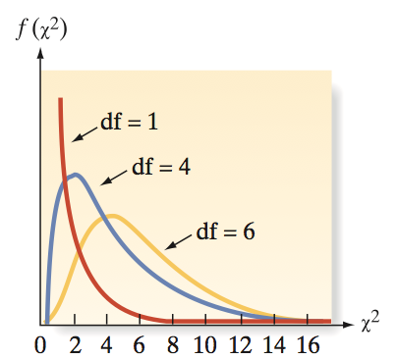
Several χ ² probability Distributions

Slide 58
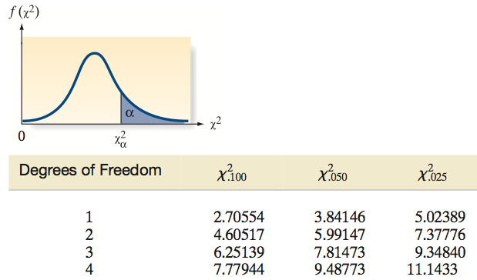
Critical Values of Chi Square

Slide 59
Finding Critical Value Example
What is the critical χ² value given: H_{a}: σ² > 0.7 n = 3 α = 0.05?
Reject
α = 0.05
df = n - 1 = 2
0
χ
2
5.991
χ² Table (Portion)
Upper Tail Area
DF
.995
…
.95
…
.05
1
...
…
0.004
…
3.841
2
0.010
…
0.103
…
5.991
Notes:
26

Slide 60
Finding Critical Value Example
What is the critical χ² value given: H_{a}: σ ² < 0.7 n = 3 α = 0.05?
What do you do if the rejection region is on the left?
Notes:
26

Slide 61
Finding Critical Value Example
What is the critical χ² value given: H_{a}: σ ² < 0.7 n = 3 α = 0.05?
Upper Tail Area for Lower Critical Value = 1–0.05 = .95
Reject H₀
α = .05
df = n - 1 = 2
0
.103
χ
2
χ² Table (Portion)
Upper Tail Area
DF
.995
…
.95
…
.05
1
...
…
0.004
…
3.841
2
0.010
…
0.103
…
5.991
Notes:
26

Slide 62
Chi-Square (χ²) Test Example
Example 12. Is the variation in boxes of cereal, measured by the σ, equal to 15 grams? (Parameters of population of the cereal packaging system was described as above.)
A random sample of 25 boxes had a standard deviation of 17.7 grams. Test at the 0.05 level of significance.

Slide 63
Solution
Test Statistic:
Decision:
Conclusion:
σ = 15
H₀:
H_{a}:
α =
df =
Critical Value(s):
σ ≠ 15
0.05
= 33.42
25 – 1 = 24
Do not reject H₀ at α = 0.05
α/2 = 0.025
There is no evidence σ is not 15
2
0
12.401
39.364
χ

Slide 64
Type II Error
7.8 Calculating Type II Error Probabilities:
More about β
The Type II error probability β is calculated assuming that the null hypothesis is false because it is defined as the probability of accepting H₀ when it is false. The situation corresponding to accepting the null hypothesis, and thereby risking a Type II error, is not generally as controllable. For that reason, we adopted a policy of nonrejection of H₀ when the test statistic does not fall in the rejection region, rather than risking an error of unknown magnitude.

Slide 65
Steps for Calculating β for a Large-Sample Test about µ
1. Calculate the value(s) of corresponding to the border(s) of the rejection region. There will be one border value for a one-tailed test and two for a two-tailed test. The formula is one of the following, corresponding to a test with level of significance α:
Upper-tailed test:
Lower-tailed test:
Two-tailed test:

Slide 66
2. Specify the value of µ_{a} in the alternative hypothesis for which the value of β is to be calculated. Then convert the border value(s) of to z-value(s) using the alternative distribution with mean µ_{a}. The general formula for the z-value is
Sketch the alternative distribution (centered at µ_{a}) and shade the area in the acceptance (nonrejection) region. Use the z-statistic(s) and Table II in Appendix D to find the shaded area, which is β.

Slide 67
Power of Test
Probability of rejecting false H₀
Correct decision
Equal to 1 – β
Used in determining test adequacy
Affected by
True value of population parameter
Significance level 
Standard deviation & sample size n

Slide 68
One-Tailed z Test Example
Example 13. Does an average box of cereal contain 368 grams of cereal? A random sample of 25 boxes had = 372.5. The company has specified σ to be 15 grams. Test at the 0.05 level of significance. Finding Power of Test.
Finding Power Step 1
Hypothesis: H₀: μ₀ ≥ 368 H_{a}: μ₀ < 368
Reject H₀
①
Do Not
Draw
Reject H₀
α = .05
368 gm.
μ
μ
= 368
x
a
0
‾
= 360

Slide 69
Finding Power Step 2 & 3
Reject H₀
①
Hypothesis: H₀: μ₀ ≥ 368 H_{a}: μ₀ < 368
Do Not
Draw
Reject H₀
α = .05
μ
= 368
‾
0
x
‘True’ Situation: μ_{a} = 360 (H_{a})
③
Draw
②
β
1–β
Specify
‾
μ
= 360
x
a

Slide 70
Finding Power Step 4
Reject H₀
①
Hypothesis: H₀: μ₀ ≥ 368 H_{a}: μ₀ < 368
Do Not
Draw
Reject H₀
α = 0.05
μ
= 368
‾
0
x
‘True’ Situation: μ_{a} = 360 (H_{a})
③
Draw
②
④
1–β
Specify
μ
= 360
363.065
x
a
‾

Slide 71
Finding Power Step 5
Reject H₀
①
Hypothesis: H₀: μ₀ ≥ 368 H_{a}: μ₀ < 368
Do Not
Draw
Reject H₀
α = 0.05
μ
= 368
x
0
‾
‘True’ Situation: μ_{a} = 360 (H_{a})
③
Draw
②
⑤
④
1–β =0.846
β = 0.154
Specify
z Table
363.065
‾
μ
= 360
x
a

Slide 72
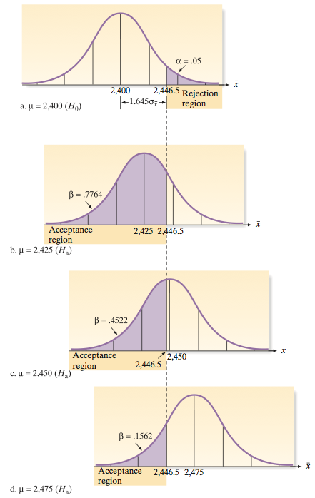
Properties of β and Power
1. For fixed n and α, the value of β decreases, and the power increases as the distance between the specified null value µ₀ and the specified alternative value µ_{a} increases.

Slide 73
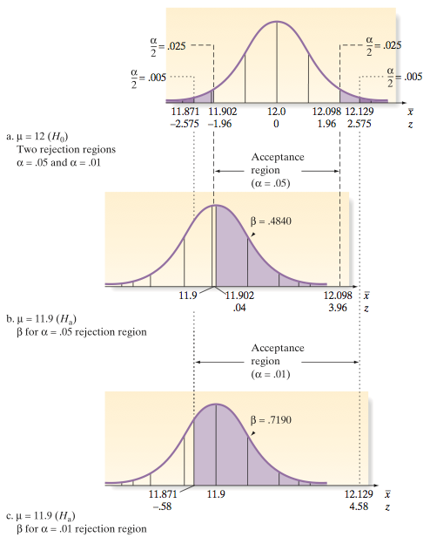
Properties of β and Power
2. For fixed n and values of µ₀ and µ_{a}, the value of β increases, and the power decreases as the value of α is decreased.

Slide 74
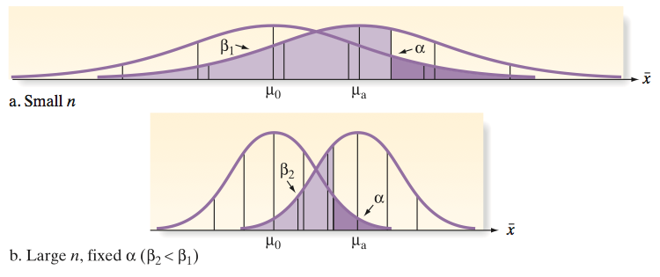
Properties of β and Power
3. For fixed α and values of µ₀ and µ_{a}, the value of β decreases, and the power increases as the sample size n is increased.

Slide 75
Key Ideas
Key Words for Identifying the Target Parameter
μ – Mean, Average
p – Proportion, Fraction, Percentage, Rate, Probability
σ ² – Variance, Variability, Spread

Slide 76
Key Ideas
Elements of a Hypothesis Test
1. Null hypothesis (H₀)
2. Alternative hypothesis (H_{a})
3. Test statistic (z, t, or χ²)
4. Significance level (α)
5. p-value
6. Conclusion

Slide 77
Key Ideas
Probabilities in Hypothesis Testing
Type I Error = Reject H₀ when H₀ is true (occurs with probability α)
Type II Error = Accept H₀ when H₀ is false (occurs with probability β )
Power of Test = P(Reject H₀ when H₀ is false) = 1 – β

Slide 78
Key Ideas
Forms of Alternative Hypothesis
Lower-tailed : H_{a} : μ < μ₀
Upper-tailed : H_{a} : μ > μ₀
Two-tailed : H_{a} : μ ≠ μ₀

Slide 79
Key Ideas
Using p-values to Decide
1. Choose significance level (α )
2. Obtain p-value of the test
3. If α > p-value, reject H₀

