Slide 1
A Deep Learning Model for
Predicting Mortality with MIMIC-III Dataset
Authors: Haohang Li, Baihao Huang, Yuhui Ren
Instructor: Emily Liu
Date: 4/16/2021

Slide 2
Introduction
Reasonable allocation of medical resources, and targeted saving of patients' lives are always big tasks for medical workers. In this project, we applied deep learning methods to create models for patients’ mortality prediction.
The dataset we used is MIMIC III, which contains plenty of electronic health records collected from patients’ hospital visits.
We combined both structured and unstructured data from MIMIC III as features, and applied embedding (both doc2vec and word2vec) to process unstructured data.
We created four deep learning models, namely ANN, fusion CNN+ANN, fusion CNN+ANN+CNN, fusion RNN+ANN.

Slide 3
Data
MIMIC-III is a large, freely-available health-related database, associated with over 40,000 ICU patients who stayed in BID Medical Center between 2001 and 2012.
MIMIC-III is widely used by many research papers, due to its rich medical information and tolerance for various researches, such as clinical decision-rule improvement, etc.
MIMIC-III contains 26 relational tables, which includes information such as demographics, vital sign measurements, laboratory test results, procedures, medications, caregiver notes and mortality.

Slide 4
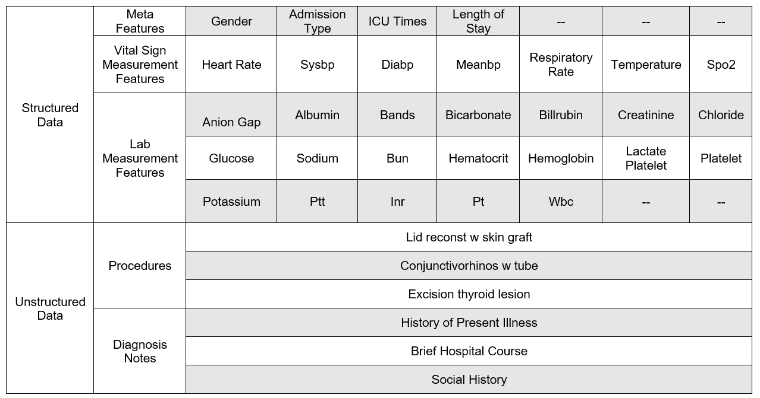
Features

Slide 5
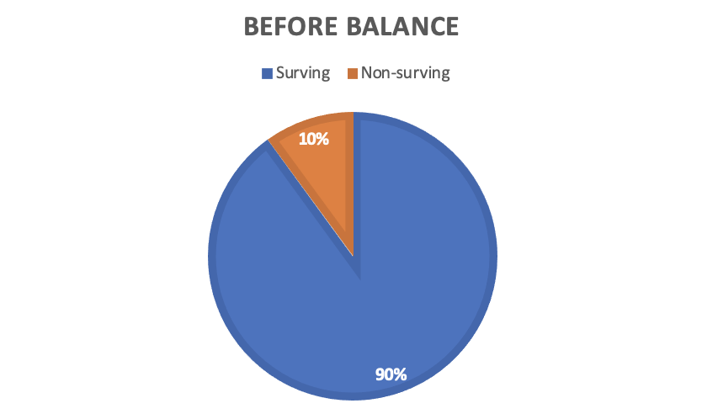
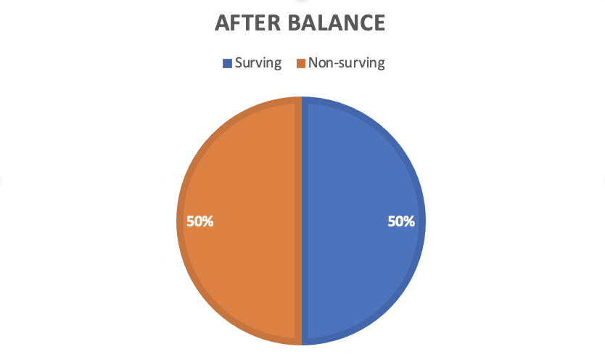
Preprocessing data
Under-sampling data

Slide 6
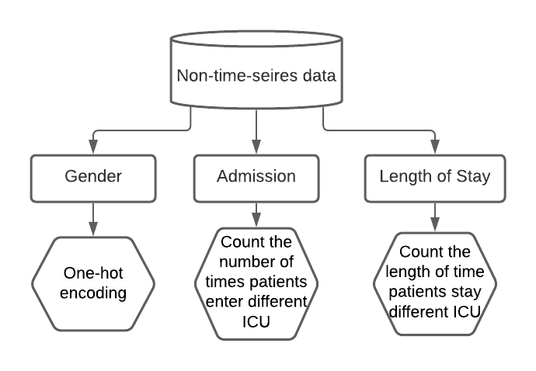
Preprocessing data
Meta feature
Processed Feature table
 | Gender | Gender | Emergency Admission | Elective Admission | Urgent Admission | Length of Stay
Patient1 | 0 | 1 | 0 | 1 | 2 | 3.8
Patient2 | 1 | 0 | 2 | 1 | 0 | 6.0
… | … | … | … | … | … | …

Slide 7
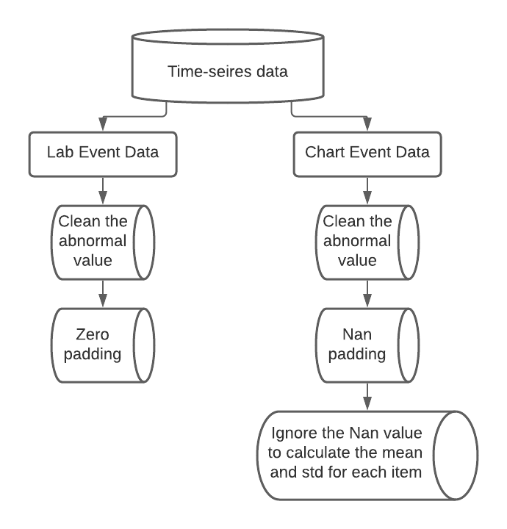
Preprocessing data
Time-series data

Slide 8
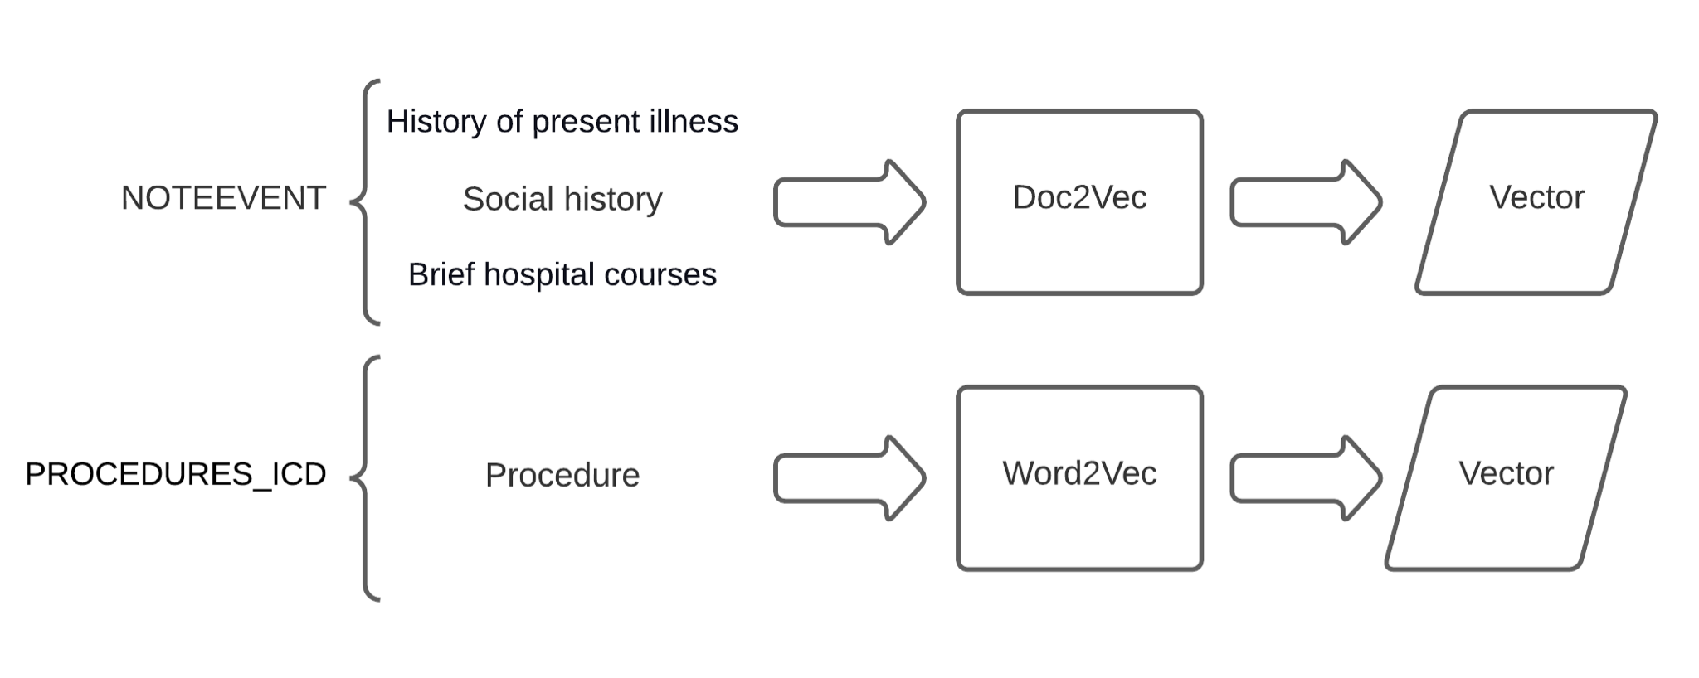
Preprocessing data
Unstructured data

Slide 9
Model
Modules
Fusion Models
Metrics
Model

Slide 10
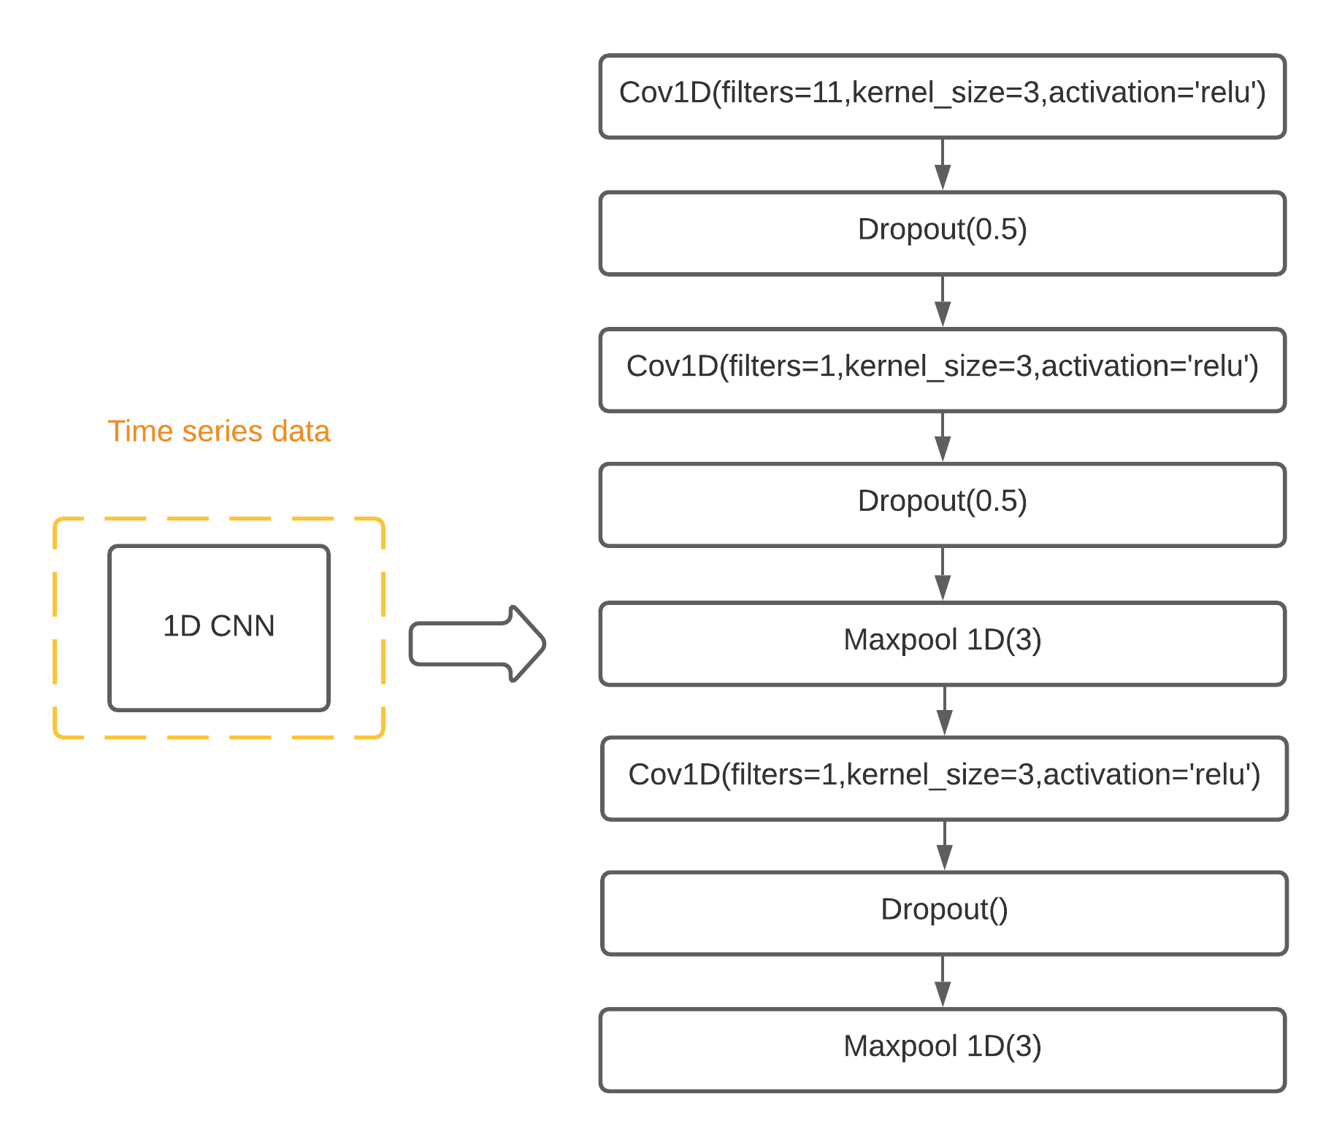
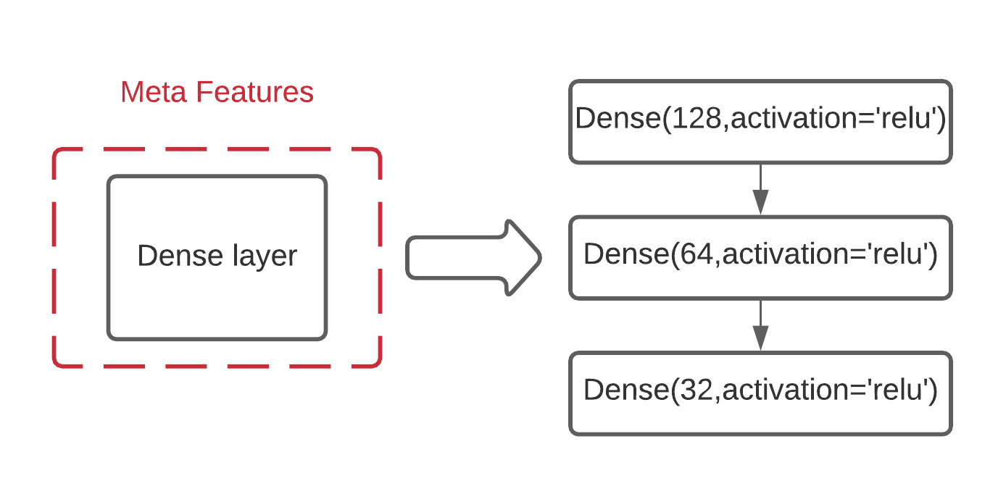
Modules

Slide 11
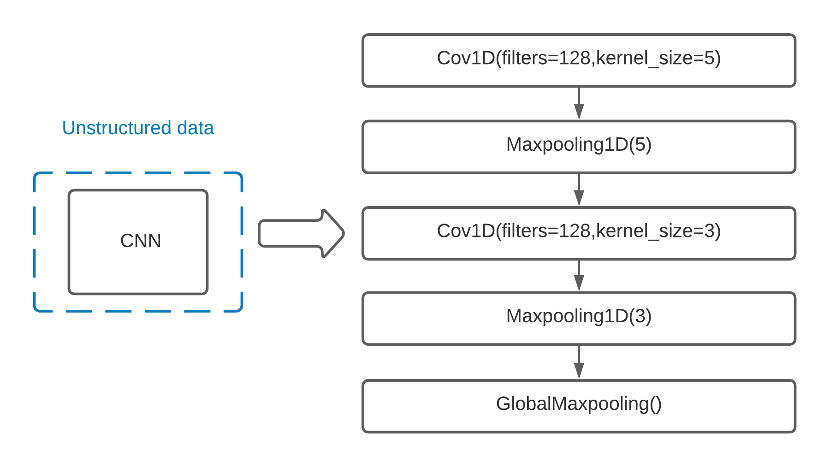
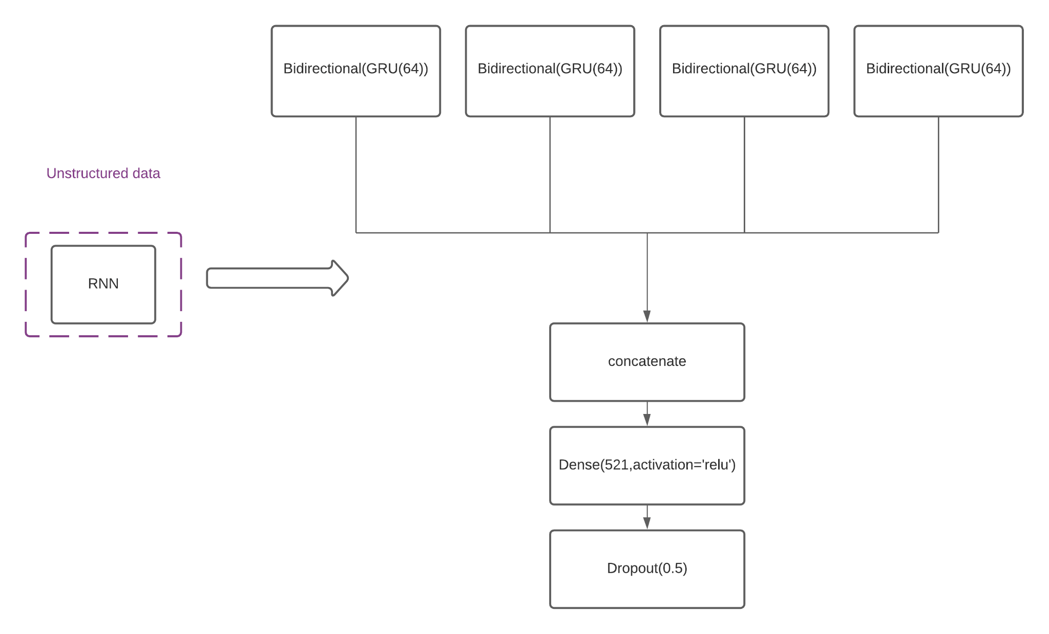
Modules

Slide 12
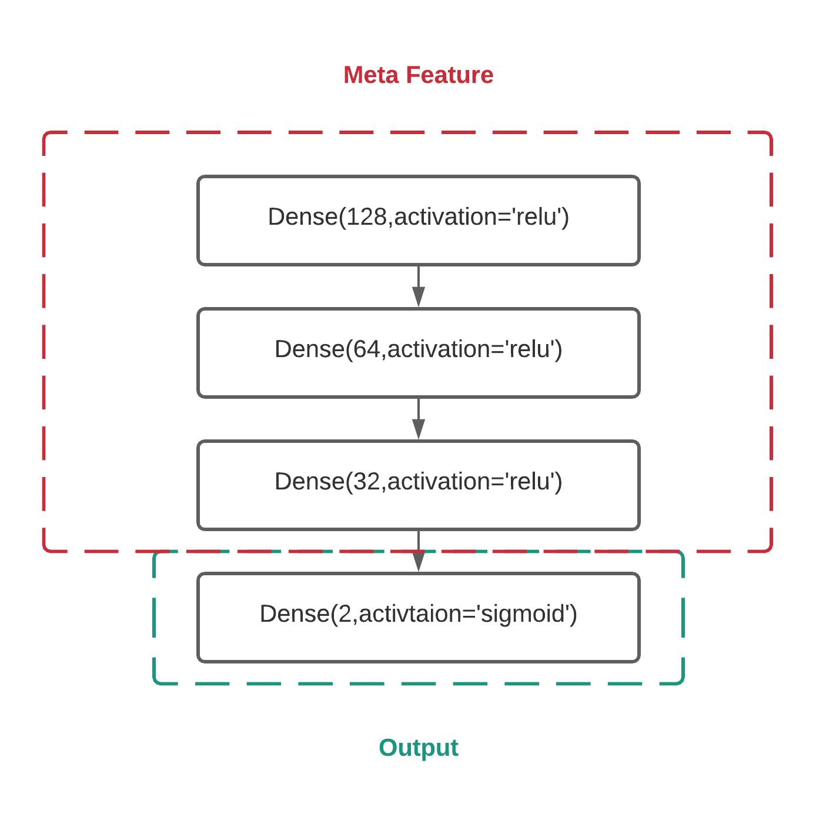
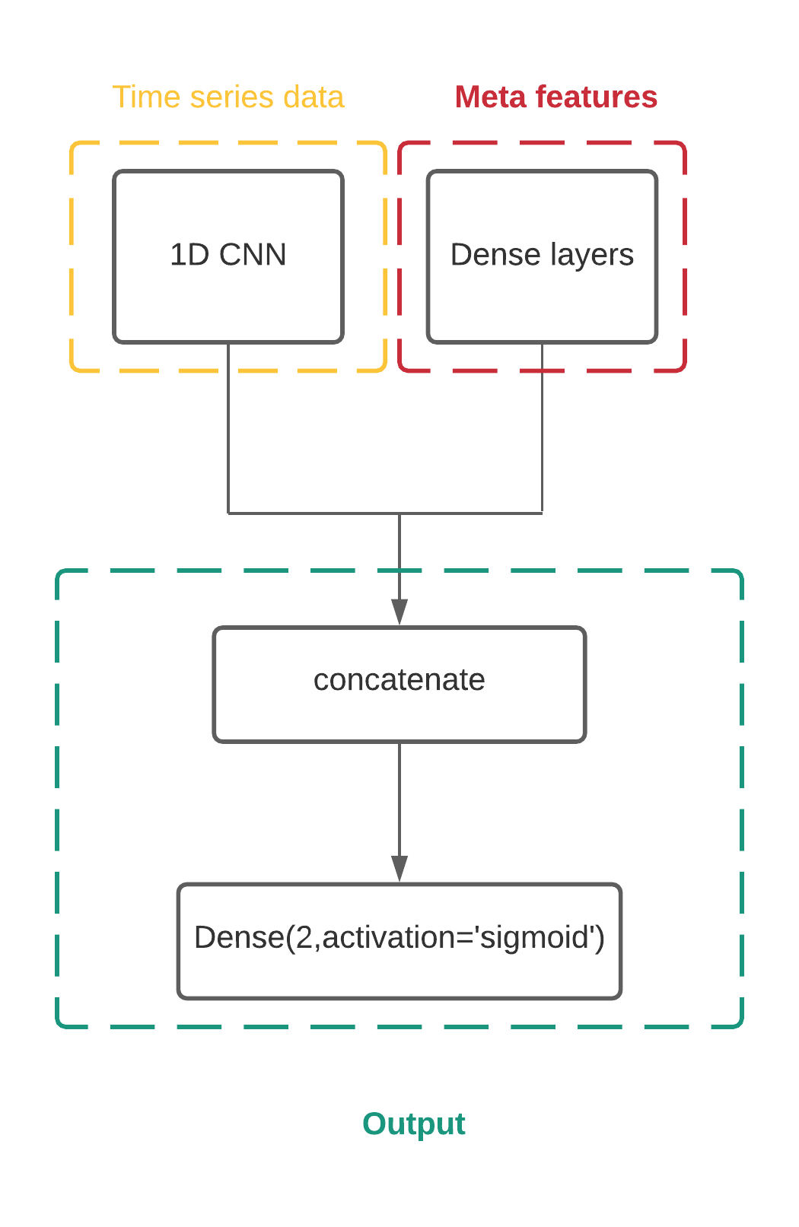
Fusion Models

Slide 13
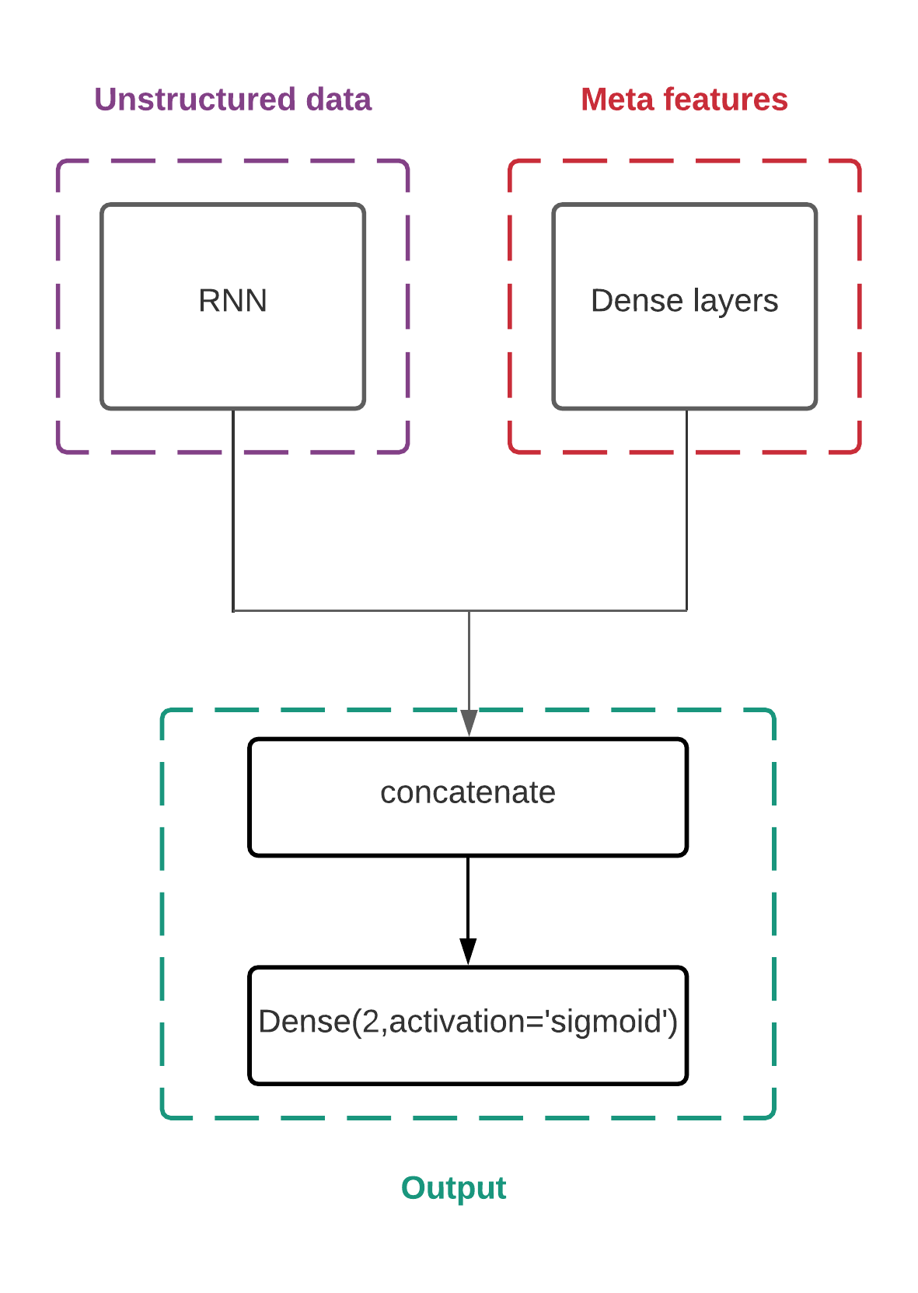
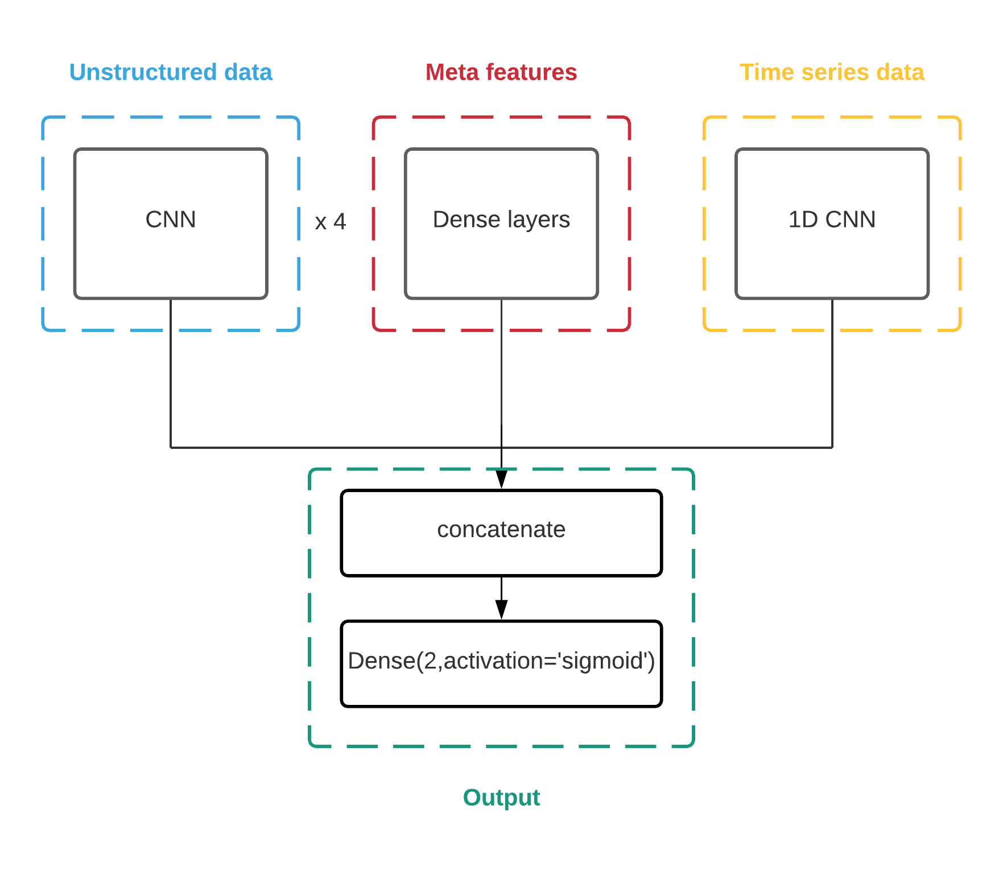
Fusion Models

Slide 14
Metrics: Classification Report
 | Precision (Deceased) | Recall (Alive) | Precision (Average) | Recall | F1-Score
ANN | 0.54 | 0.65 | 0.58 | 0.59 | 0.58
1D CNN | 0.75 | 0.69 | 0.72 | 0.72 | 0.72
RNN | 0.68 | 0.77 | 0.75 | 0.72 | 0.72
CNN | 0.75 | 0.88 | 0.81 | 0.82 | 0.81

Slide 15
Metrics: Cross Validation Result
 | Mean acc | Var acc | Mean loss | Var loss
ANN | 0.60 | 0.0014 | 15.80 | 369.664
1D CNN | 0.75 | 0.0094 | 0.54 | 0.00056
RNN | 0.73 | 0.0044 | 0.54 | 0.0043
CNN | 0.83 | 0.0125 | 0.80 | 0.00041

Slide 16
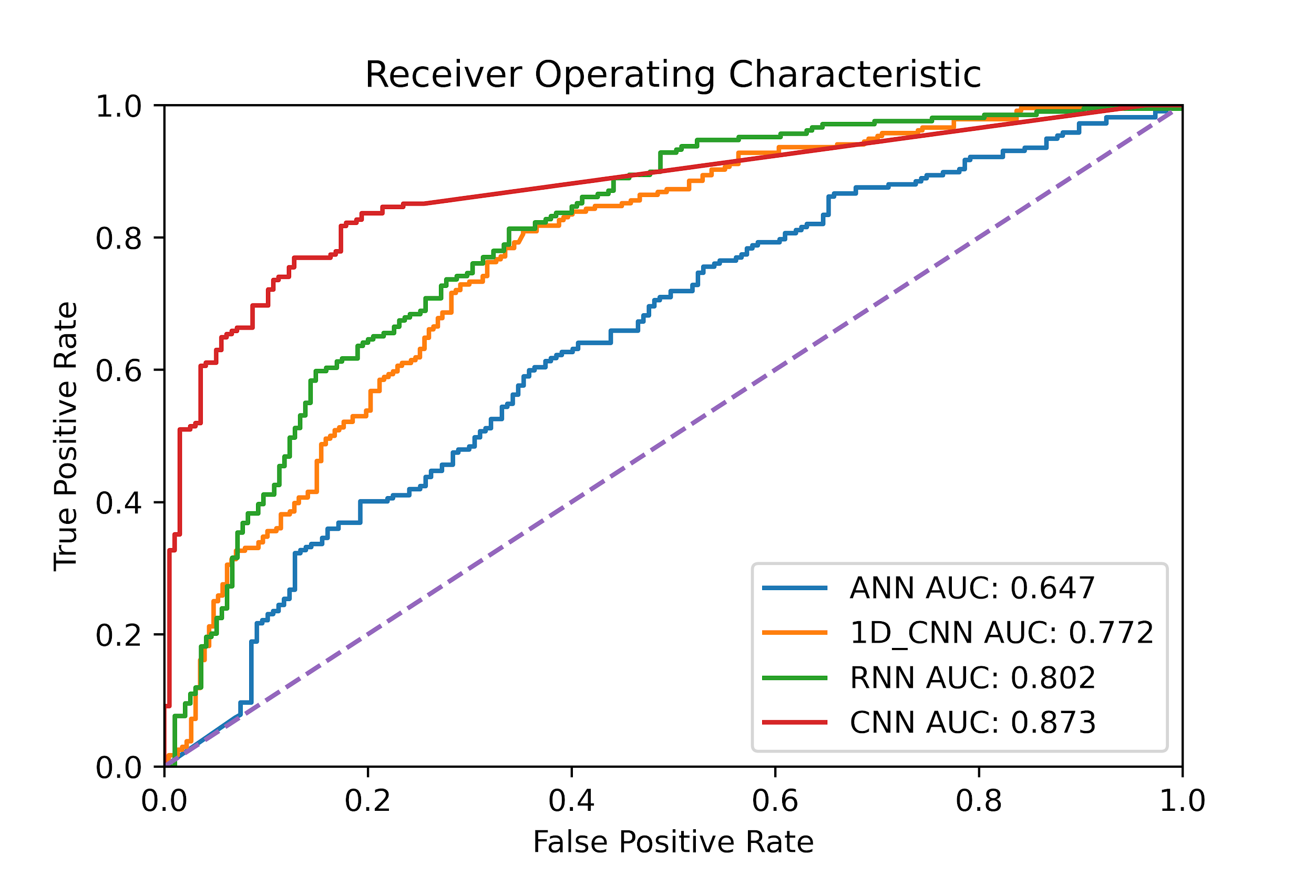
Metrics: ROC Curves

Slide 17
Future Direction
Prediction mortality on early stage
Current model rely on whole history: not practical
Early stage prediction: more beneficial to healthcare company
Entity Recognition in medical note
Diseases are correlated
Document vector will cause information loss

Slide 18
Thank You

