Slide 1

Assessment 1: Homework handbook lesson 13
Yui H
Notes:
注:
このスライド上の画像を変更するには、図を選択して削除します。次に、プレースホルダーの画像アイコンをクリックして独自の画像を挿入します。

Slide 2
Assessment 1: Homework handbook lesson 13
Learn independently (search the web) how to create a new table from query results.
Write a query that creates a new table named panel_EDA1
Write 5 business questions (only the questions, not the answers) that can be answered from the data in the panel_EDA1 table.

Slide 3
1 SELECT INTO
Learn independently (search the web) how to create a new table from query results.

Slide 4
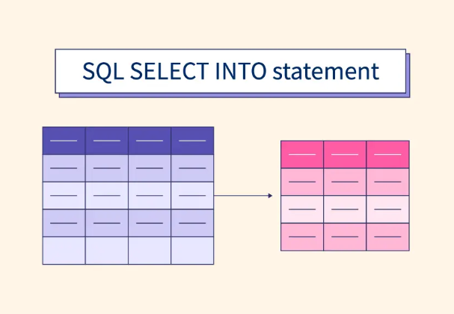
How to create a new table from query results.
SELECT INTO
The SELECT INTO syntax can insert query results into a new table in the current DB.
This results in a new table with only the information needed from multiple data sources.
Image Credit:
https://www.scaler.com/topics/sql-select-into/

Slide 5
2. creates a new table
Write a query that creates a new table named panel_EDA1

Slide 6
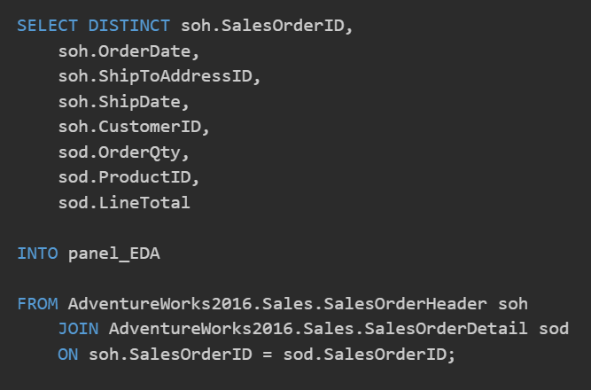
2. creates a new table named panel_EDA1
which contains the following data:
- SalesOrderID,
- OrderDate,
- ShipToAddressID,
- ShipDate,
- CustomerID,
- OrderQty,
- ProductID,
- LineTotal
Use 2 data tables :
SalesOrderHeader, SalesOrderDetails

Slide 7
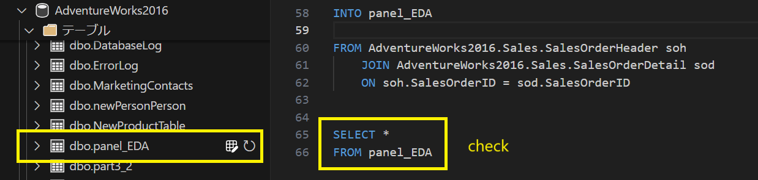
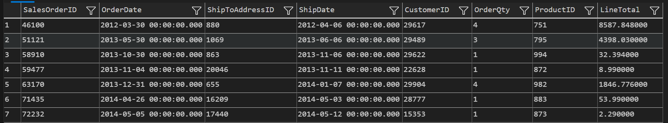
2. creates a new table named panel_EDA1

Slide 8
3. 5 business questions
Write 5 business questions that can be answered from the data in the panel_EDA1 table.

Slide 9

3. 5 business questions
Write 5 business questions that can be answered from the data in the panel_EDA1 table.
(1) Days from order to shipment
(2) Customer Purchase Cycle
(3) Purchase product combinations (basket analysis)
(4) Times and days of the week that sell well
(5) Identifying Repeat Customers

Slide 10
Lesson 13 end
Please go to next file : Lesson 14

