Slide 1

Assessment 1: Homework handbook lesson 15
Yui H
Notes:
注:
このスライド上の画像を変更するには、図を選択して削除します。次に、プレースホルダーの画像アイコンをクリックして独自の画像を挿入します。

Slide 2
Assessment 1: Homework handbook lesson 15
Check that you have a database called Test_DML
Begin to work on the new DB
Create a new table named "student”
Add a nonclustered index to the table
Add another field called "Email"
Add two records to the student table.
Change the second student's last name
Change the other student's email to his or her email address
Remove the Email column from the Student table.
Create a VIEW called ‘vSaleItemDetails’
Such a VIEW can make which calculations, reports or statistics easier?
Prepare a list of 3 Views. Describe in general terms what the purpose of the VIEW is.

Slide 3
1-2 Check a database
Check a database called Test_DML, begin to work on the new DB

Slide 4
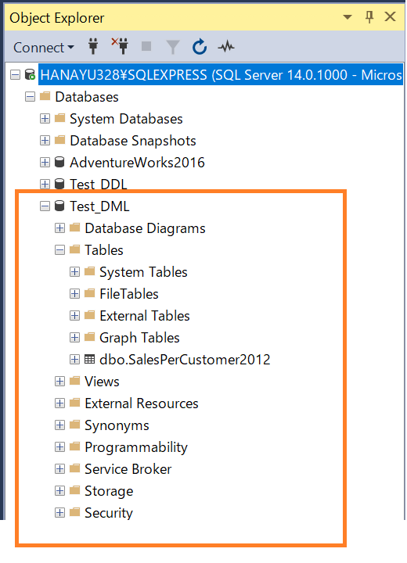
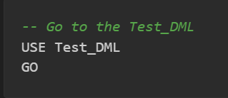
1-2. Check that you have a database called Test_DML
A1: I used the CREATE_DATABASE function to create a new database on the same level as AdventureWorks2016.
It contains one table “SalesperCustomer2012” created in class.
Q2: begin to work on the new DB
A2: The query on the left determines the database to work with.

Slide 5
3-5. Configure new table
Set up and add a column to the table.

Slide 6
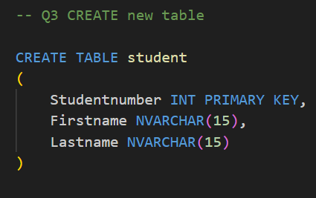
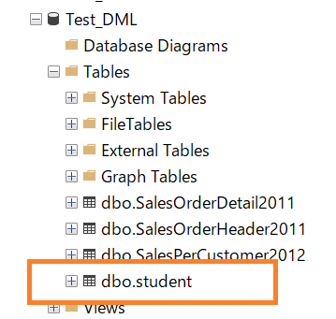
3. Create a new table named "student"
Q3: Create a new table named "student" that contains 3 fields:
a. Student number (int) - primary key
b. First name - string 15
c. Last name - string 15
A3: Create a new table using the CREATE TABLE function.

Slide 7
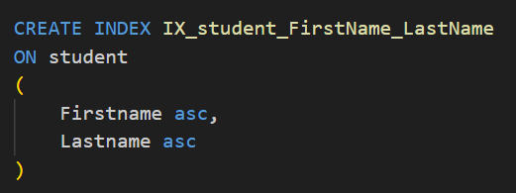
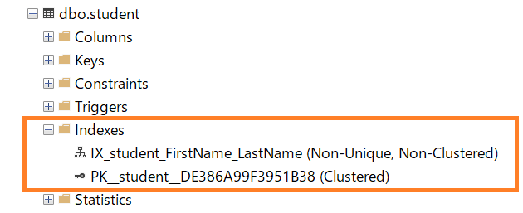
4. Add a nonclustered index
Q4: Add a nonclustered index to the student table. The index will be on the First name and then on the Last name.
A4: Two indexes were specified in the “CREATE INDEX” function.
In the Object Explorer, I can see that they have been created.

Slide 8
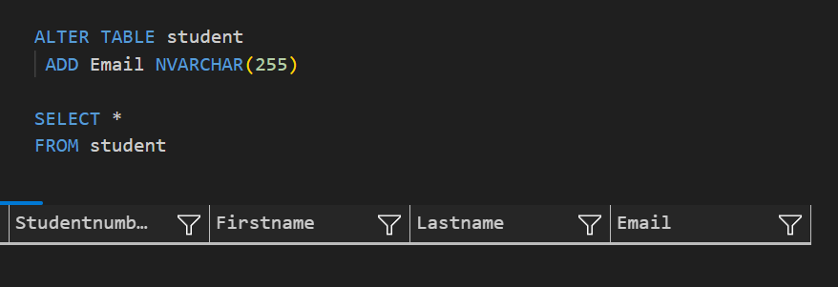
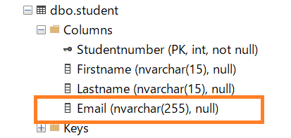
5. Add another field called "Email"
Q5: Add another field called "Email", a string 255 type, to the new Student table.
A5: Add a new column with the “ALTER TABLE” function.
The table view and object explorer will confirm that it has been created.

Slide 9
6-8. Add record, change detail
Add two records, and change the column detail.

Slide 10
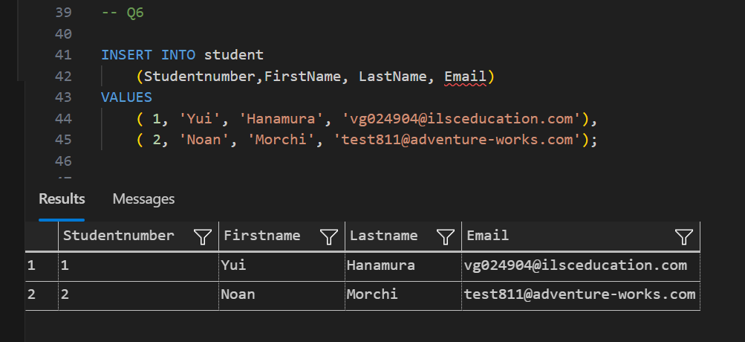
6. Add two records to the student table
Q6: Add two records to the student table: the first with your details, and the second with another student's details.
A6: Add a new row with the “INSERT INTO” function and “VALUES”. View the entire table to verify that the rows have been added.

Slide 11
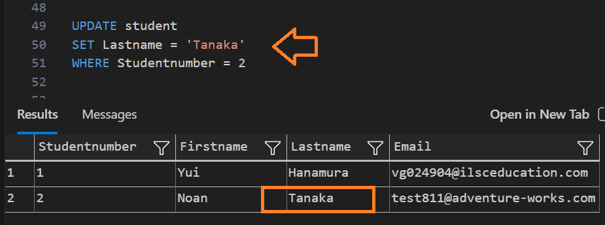
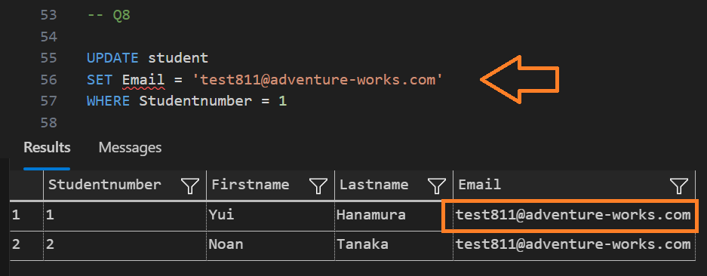
7&8. Change the column detail.
Q7: Change the second student's last name to a new last name.
Q8: Change the other student's email to his or her email address.
A7&8: Using the UPDATE and SET functions.

Slide 12
9. Remove the column
Remove the Email column from the Student table

Slide 13
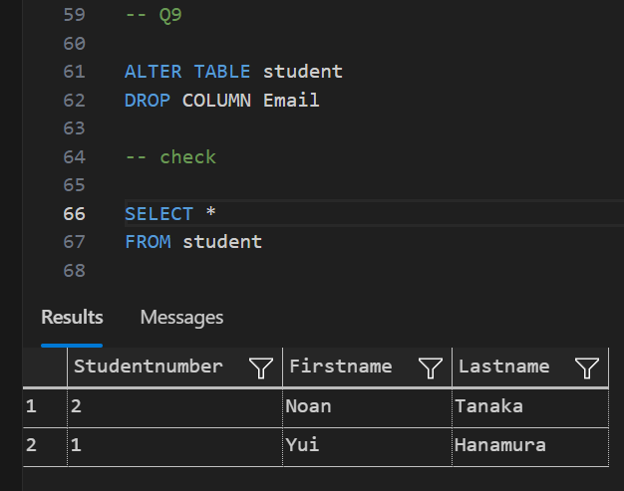
9. Remove the column from the table.
Q9: After reexamining the table structure, it was decided that there is no need for the Email column, so please remove the Email column from the Student table.
A9: The ALTER and DROP functions were used to delete columns.

Slide 14
10. create a VIEW
Create a VIEW called vSaleItemDetails that contains the detailed order data

Slide 15
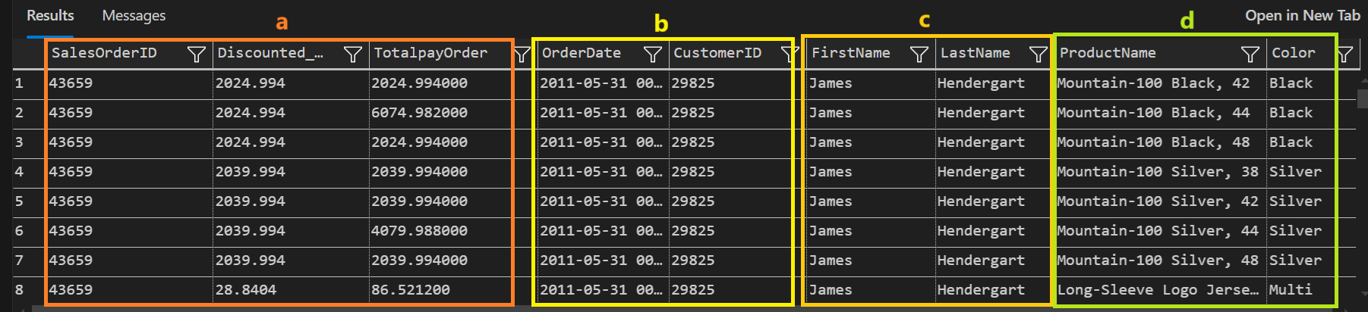
10. Create a VIEW called ‘vSaleItemDetails’
Q10: Create a VIEW that contains the detailed order data from query results.
a. Order details: Order number, Discounted item price (calculated), Total payment per order.
b. Order header: Order Date, Customer ID.
c. Persons table: First name, Last name.
d. Items table: Item name, Item color.

Slide 16
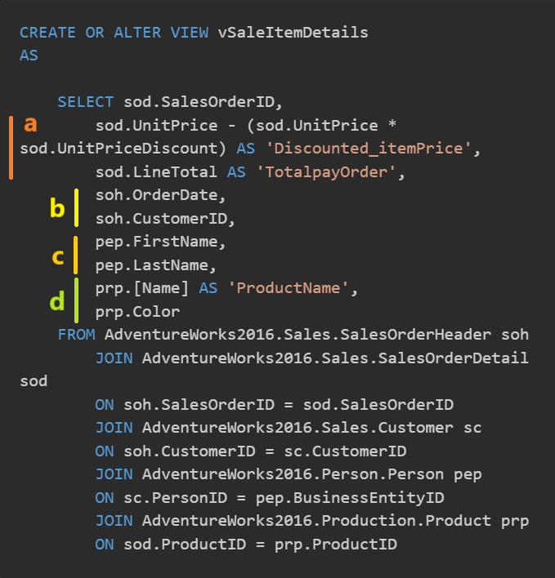
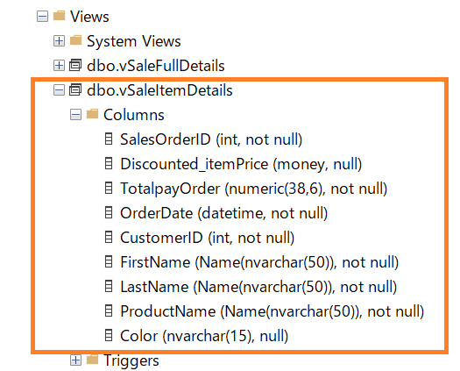
10. Create a VIEW called ‘vSaleItemDetails’
A10: This is a continuation of the answer to Q10. The figure on the left is the query.The query was composed of four tables.

Slide 17
11-12. in real situation
Imagine in real situation with using SQL

Slide 18

11-12. Imagine in real situation with using SQL
Q11. Such a VIEW can make which calculations, reports or statistics easier?
A11: Yes.
Customer preferences (color and size).
When products sell well. Sales of seasonal products.
Correlation between discount rates and sales.
Also, storing views makes it easier to share information with my team.

Slide 19
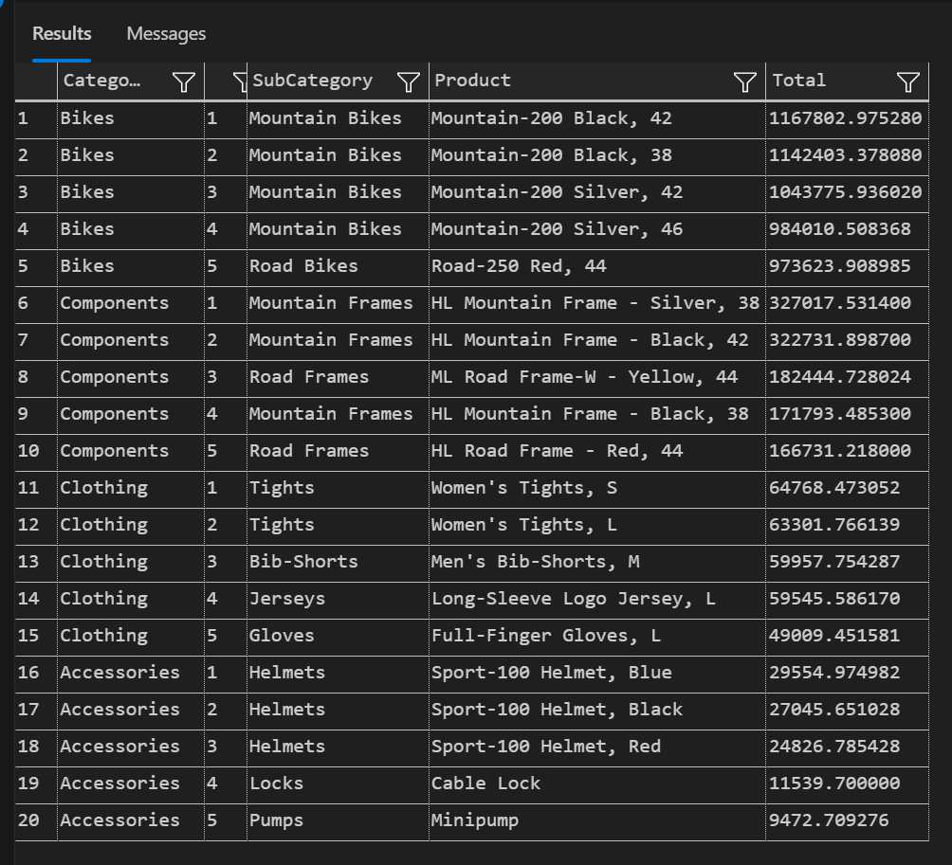
11-12. Imagine in real situation with using SQL
Q12. Prepare a list of 3 Views that you think will be useful for an analyst.
(1) Sales Ranking by Category in 2012
Knowing popular products will help you understand your company's strengths.
Purpose : To understand the company's most popular products
Description : Product name, category, date of purchase, sales
Goal : Utilize for future sales strategy

Slide 20
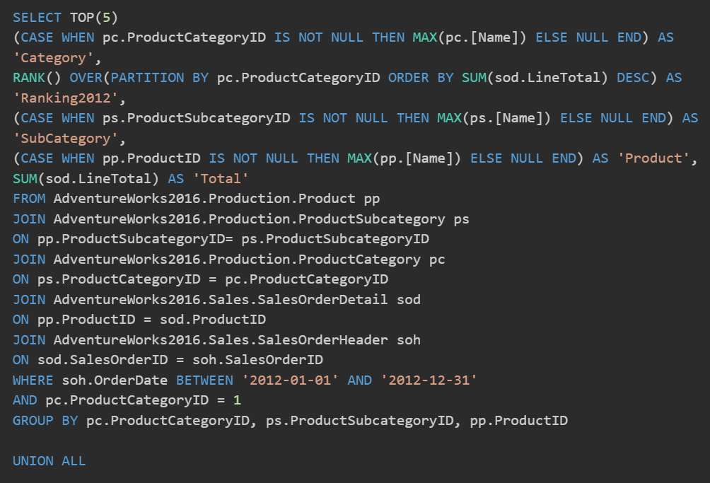
11-12. Imagine in real situation with using SQL
(1) View: Sales Ranking by Category in 2012
This is part of the query. There are four product categories.
I calculated the 2012 ranking in one category and combined the four categories with the union function.
All queries are in the attached markdown file.

Slide 21
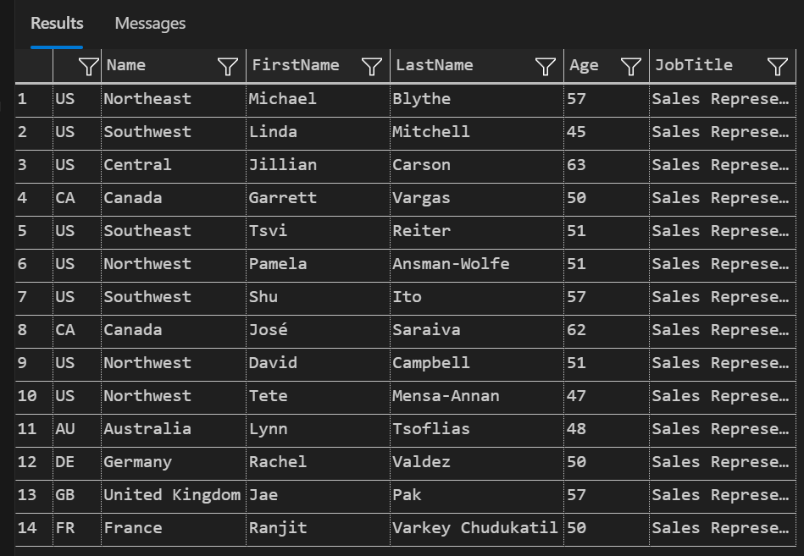
11-12. Imagine in real situation with using SQL
(2) Sales area and name of person in charge
Purpose : Information sharing
Description: Country, sales person, name, age, title
Goal : Reduce search time
For large companies, the sales region and the name of the person in charge are often not well known. This view facilitates information sharing.

Slide 22
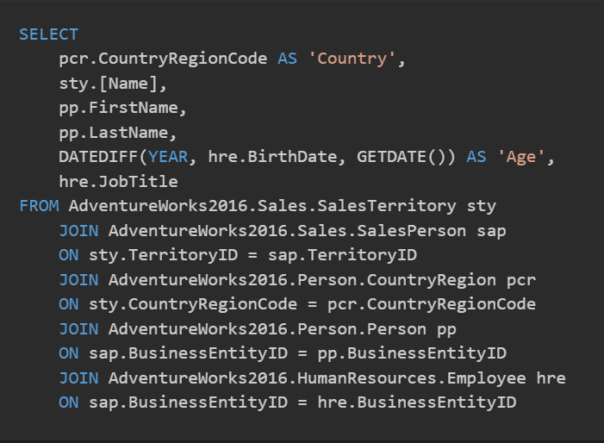
11-12. Imagine in real situation with using SQL
(2) Sales area and name of person in charge (query)
This is part of the query.
The name of the region and the name and age of the person in charge have information in separate tables.
Personally, I find it more convenient to store information that requires many JOINs in a view.

Slide 23
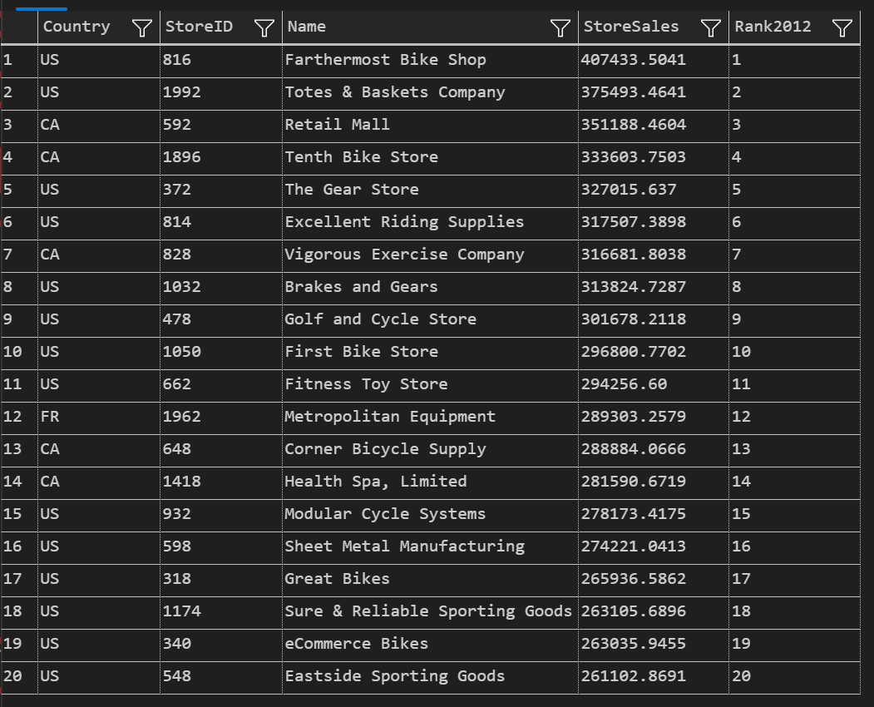
11-12. Imagine in real situation with using SQL
(3) Sales Ranking by Store in 2012
Purpose: To know which stores and countries have sales
Description: Country, store name, category, date of purchase, sales
Goal : Share information, motivate
Identifying stores with sales will provide hints for sales strategies and inspire other stores.

Slide 24
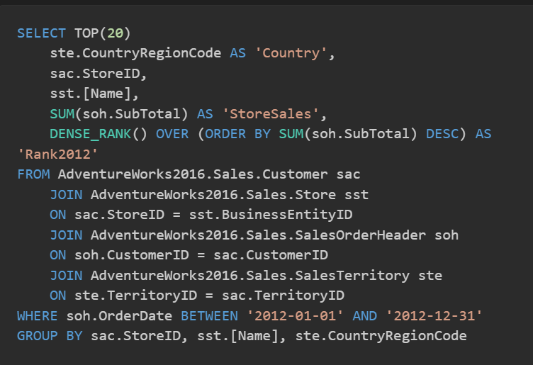
11-12. Imagine in real situation with using SQL
(3) Sales Ranking by Store in 2012
This is part of the query.
Since this company sells its products in several countries I thought I needed the name of the country as well.
I am limiting it to 2012. When creating views, I also think that too much information is difficult to share.

Slide 25
Lesson 15 end

