Slide 1

Assessment 1: Homework handbook lesson 14
Yui H
Notes:
注:
このスライド上の画像を変更するには、図を選択して削除します。次に、プレースホルダーの画像アイコンをクリックして独自の画像を挿入します。

Slide 2
Assessment 1: Homework handbook lesson 14
Check that you have a database called Test_DML.
Create a table with the same format as the Order header table, with all the data about the orders in 2011.
Create a table with the same format as the Order details table, with all the order records for 2011.
Now begin to work on the new DB: Test_DML
Change the date of all the orders from the month of May to the date 31-01-2011.
Check that section 5 worked properly. How can this be checked?

Slide 3
1 Check a database
Check that you have a database called Test_DML.

Slide 4
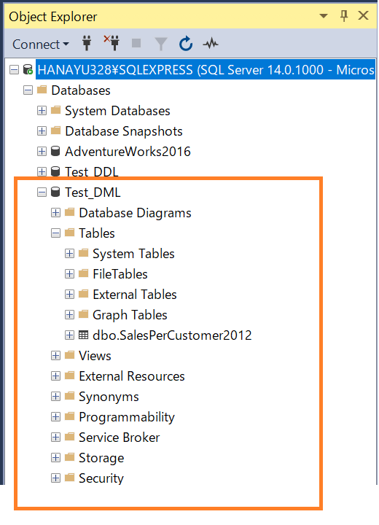
1. Check that you have a database called Test_DML
A: I used the CREATE_DATABASE function to create a new database on the same level as AdventureWorks2016.
It contains one table “SalesperCustomer2012” created in class.

Slide 5
2-3. creates a new table
In the Test_DML database, create a table with the same format as the base table.

Slide 6
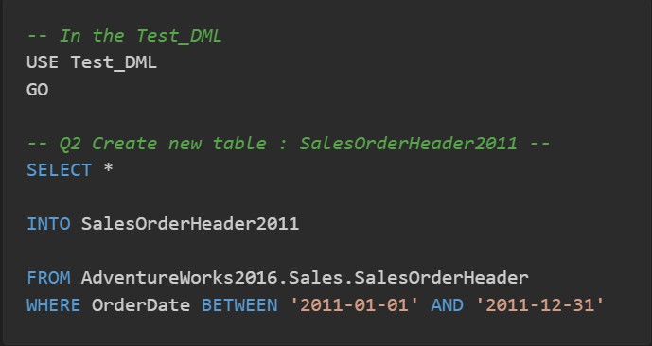
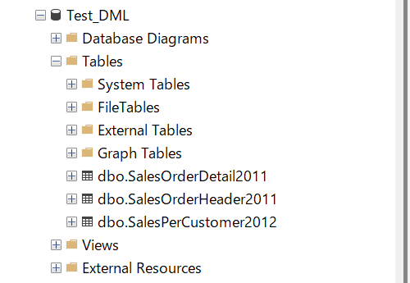
2. Create a table named 'SalesOrderHeader2011'
Q: In the Test_DML database, create a table with the same format as the Order header table, with all the data about the orders in 2011.
Name the table SalesOrderHeader2011.
A: By answering questions 2 and 3, two tables were created in Test_DML.

Slide 7
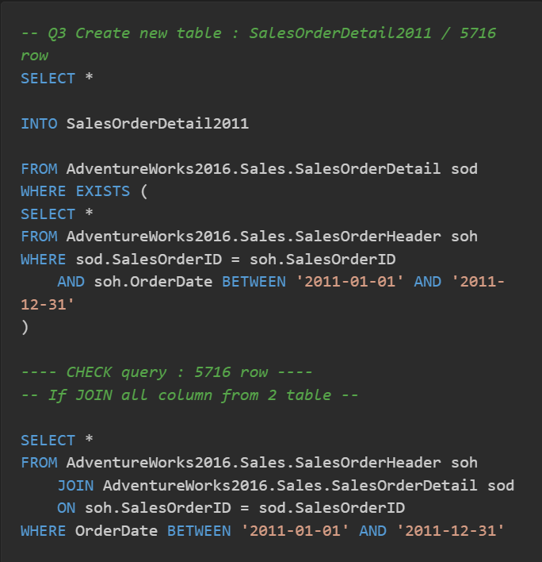
3. Create a table named 'SalesOrderDetail2011'
Q: In the Test_DML database, create a table with the same format as the Order details table, with all the order records for 2011.
Name the table SalesOrderDetail2011.
A: The OrderDetail table does not have a date. If I JOIN with the OrderHeader table, the original data structure will be broken, so I use the EXIST function to limit the data.

Slide 8
4-6. work on the new DB
Begin to work on the new DB (Tset_DML) and modify the structure

Slide 9
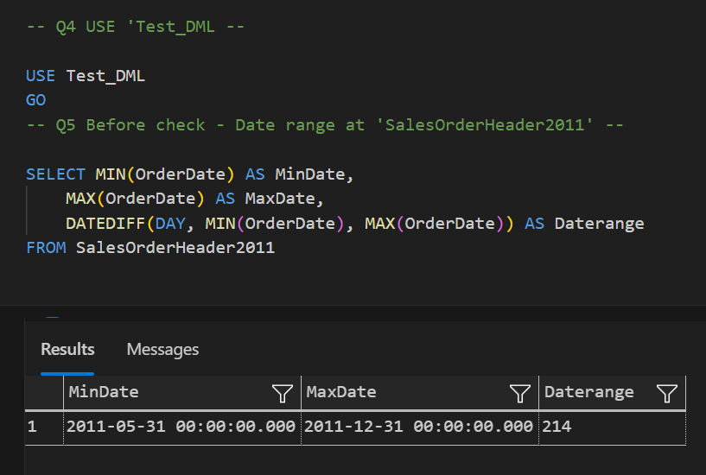
4-5. Begin to work on the new DB
Q4: Begin to work on the new DB: Test_DML
Q5: Change the date of all the orders from the month of May to the date 31-01-2011.
Before starting on the Q5 question, a preliminary check will be made. Since I’m going to change the Orderdate, I will check the current date beforehand.
I have data from May 2011 to the end of the same year.
Pre-check

Slide 10
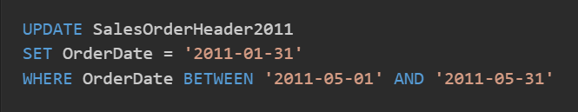
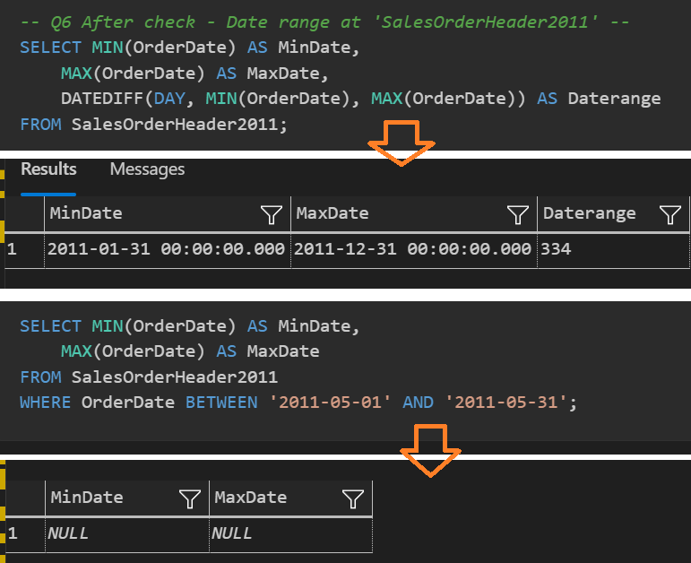
5-6. Change the data, and how to check
Q5: Change the date of all the orders from the month of May to the date 31-01-2011.
A5: Use UPDATE function
Q6: Check that section 5 worked properly. How can this be checked?
A6: Comparison with the results of the pre-check shows that dates in the table have been changed. In addition, the May order and found no values.

Slide 11
Lesson 14 end
Please go to next file : Lesson 15

