Slide 1
CS363: INTR DATABS MGT SYS
Instructor: Qi Li
Department of Computer Science
Iowa State University
qli@iastate.edu
Office: Atanasoff 102

Slide 2
Outline
Course Policies
Tools
Course overview

Slide 3
Course Resources
Instructor: Qi Li
Class hours: TT 9:30-10:45 am
Office hours: TT 10:45-11:59 am
Course website: Canvas
submission of homework, quizzes, grades, etc.
Course website: Teams
Announcements, lecture slides, and meetings
Course website: Piazza
Discussions, Q&A
Piazza are also available from Canvas and Teams

Slide 4
Course Format
Online
Lecture: Teams + studio (for short videos)
Recorded
Office hour: Teams + Webex (TA)
Not recorded
Martial: Canvas + Teams
Slides and notes: Teams
Assignments: Canvas
Exams & quizzes: Canvas
Discussion: Piazza

Slide 5
Assessments
Weekly Quizzes: 10% (highest 10 will count)
4 homeworks: 20%
3 programming projects: 25%
3 exams: 45%
You should expect 3-6 additional hours of outside work per week

Slide 6
Other Policies
Academic Honesty
Students who plagiarize other work in any part of assignment/tests will receive F as the letter grade for this course, and will be reported to the university.
Disability
If you have a documented disability and anticipate needing accommodations in this course, please make arrangements to meet with me soon.

Slide 7
How to perform well
Attend lectures
No class attending required, but you are required to know everything covered in lectures
Practice
Make friends
No friend is needed, but they will be your treasures
Ask questions, in-class or off-class
Your instructor and TAs are here to help

Slide 8
How to perform well
Think about the lectures
What concepts are covered?
Are they simple or complicate?
Why are they important?
Do they inspire something beyond the lectures?
e.g., How can I apply those techniques to solve real-world problems?
Review your weekly quizzes

Slide 9
Outline
Course Policies
Tools
Course overview

Slide 10
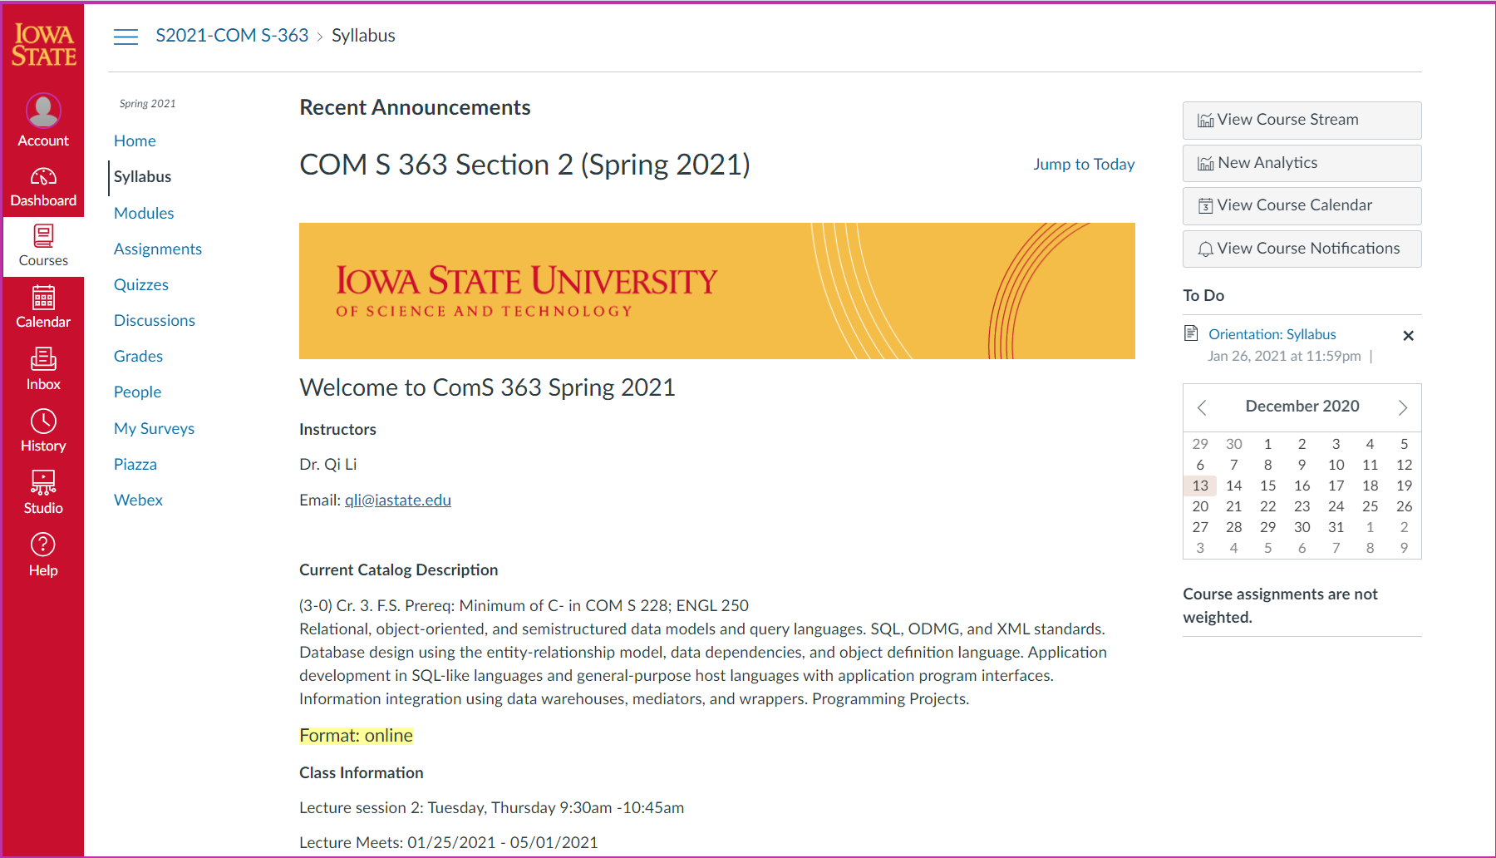
Walk Through Canvas

Slide 11
Walk Through Canvas
Check Canvas/email frequently for announcement!
All submissions through Canvas

Slide 12
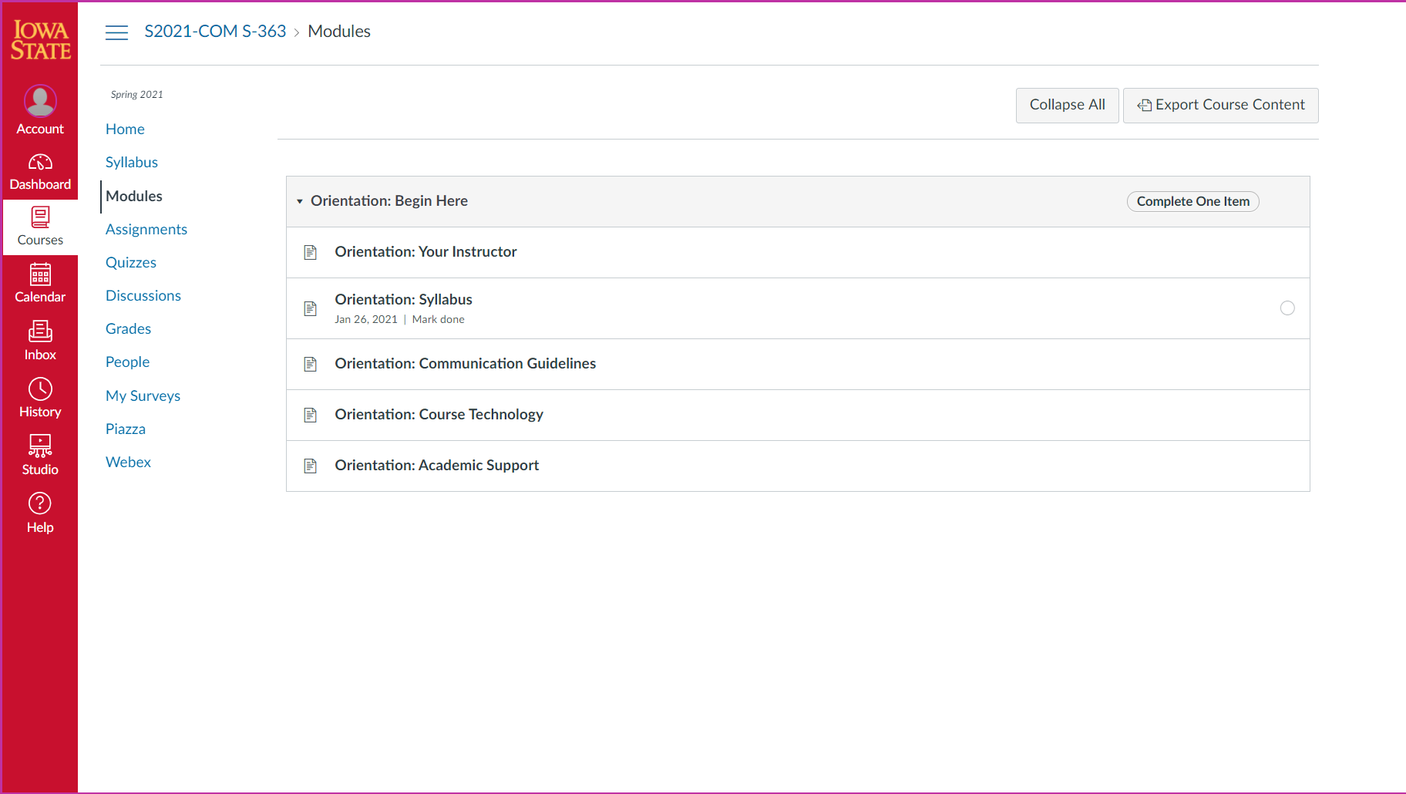
Walk Through Canvas - Module

Slide 13
Walk Through Canvas - Module
Activities organized based on week
You can also find the submission link here
There are required tasks for modules

Slide 14
Walk Through Canvas - Module

Slide 15
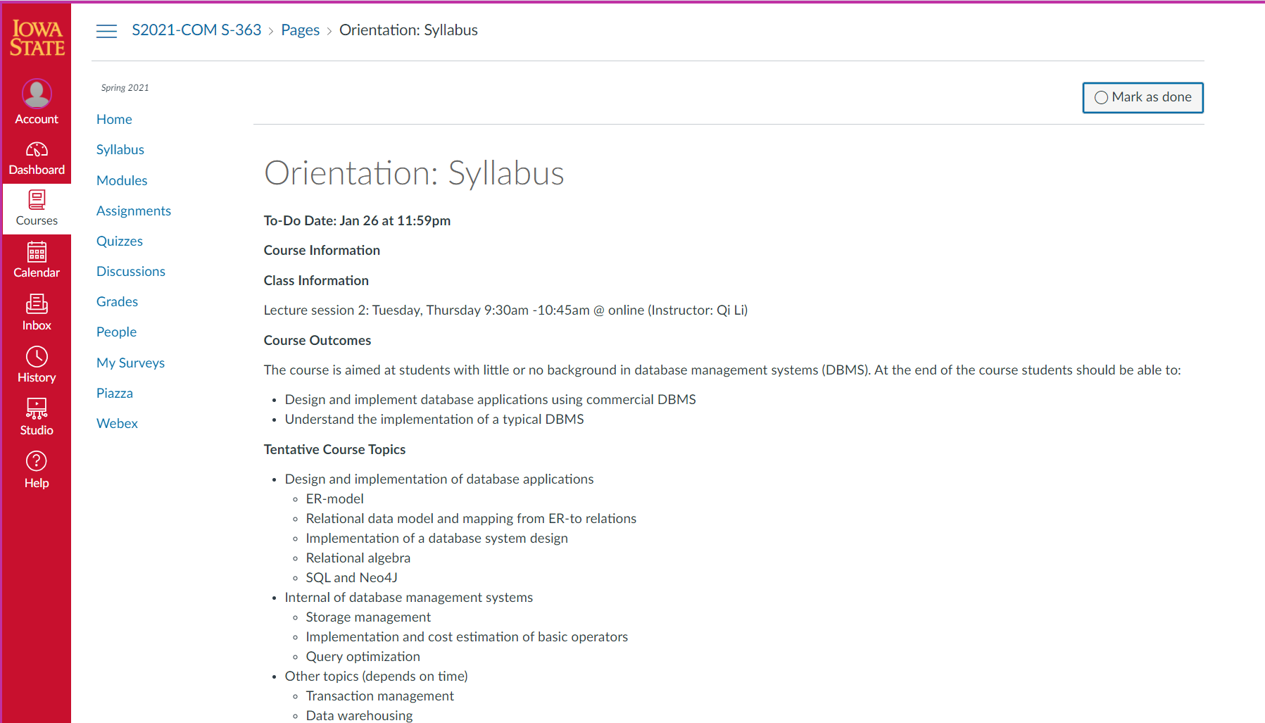
Walk Through Canvas - Module
Click here

Slide 16
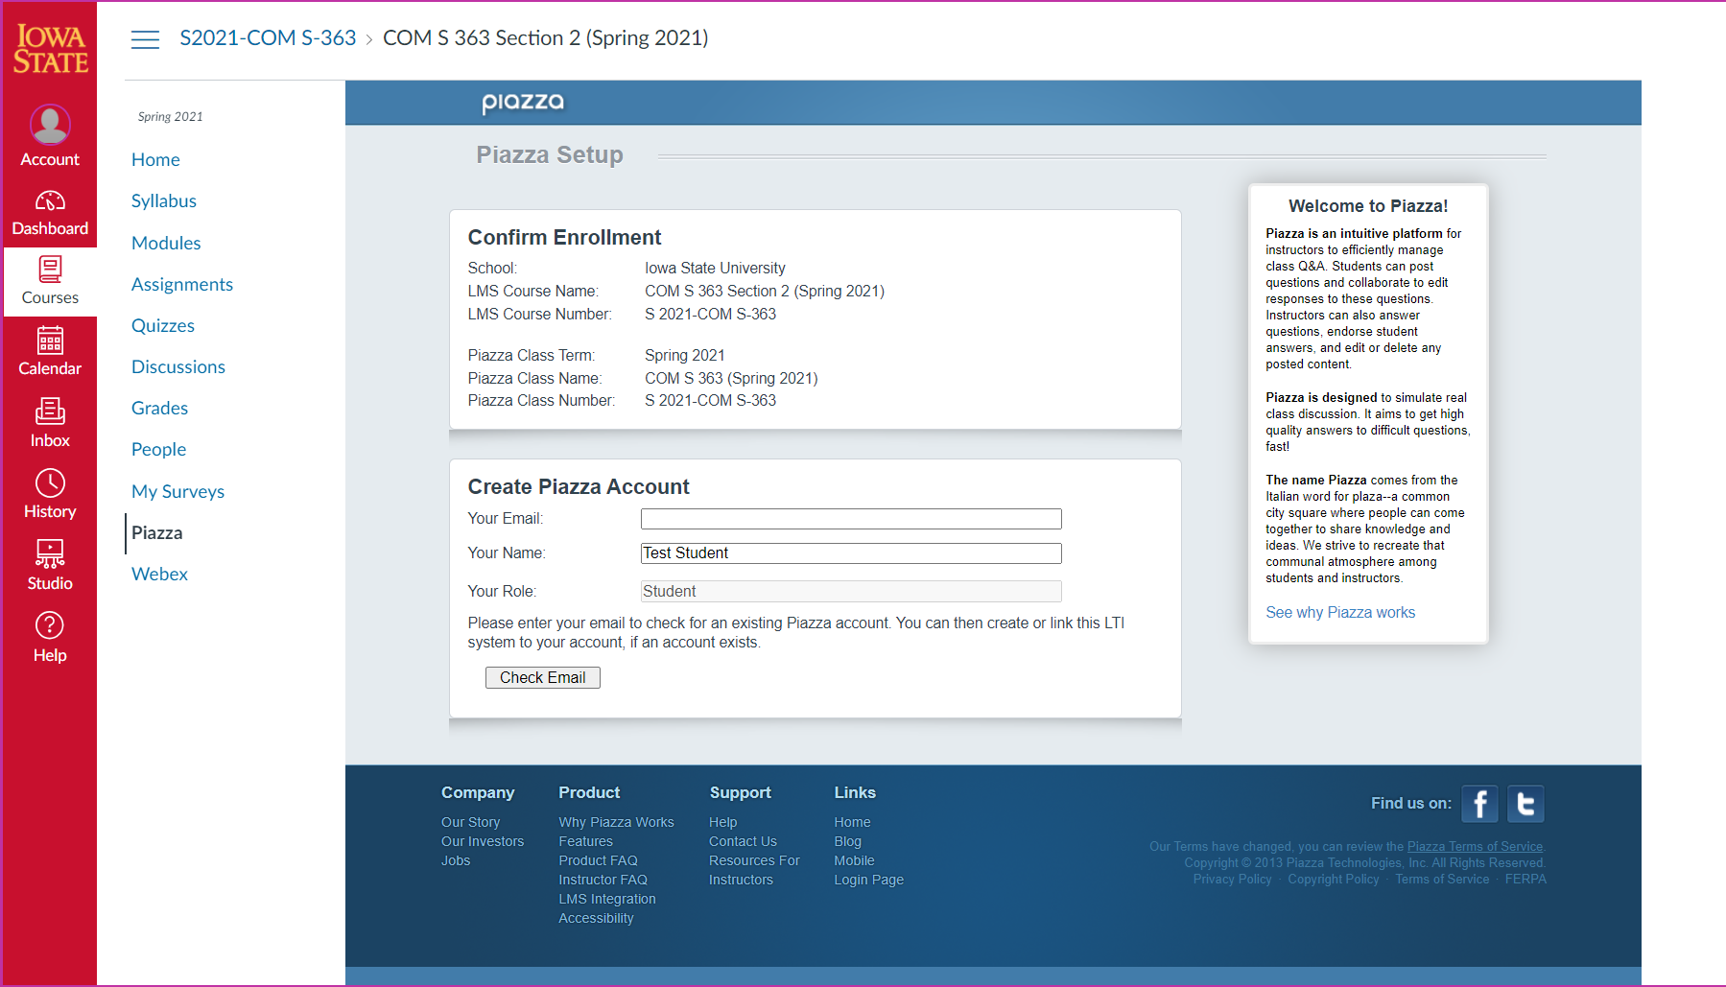
Walk Through Canvas - Piazza

Slide 17
Walk Through Canvas - Piazza
Piazza for online discussions
You can post Anonymously on Piazza
Sign-up link
Piazza.com/iastate/spring2021/s2021coms363
NOTE: this piazza is shared for both sections. Homework and Projects are the same for both sections, but EXAMS ARE NOT. If you have questions regarding EXAMS, please email me directly.

Slide 18
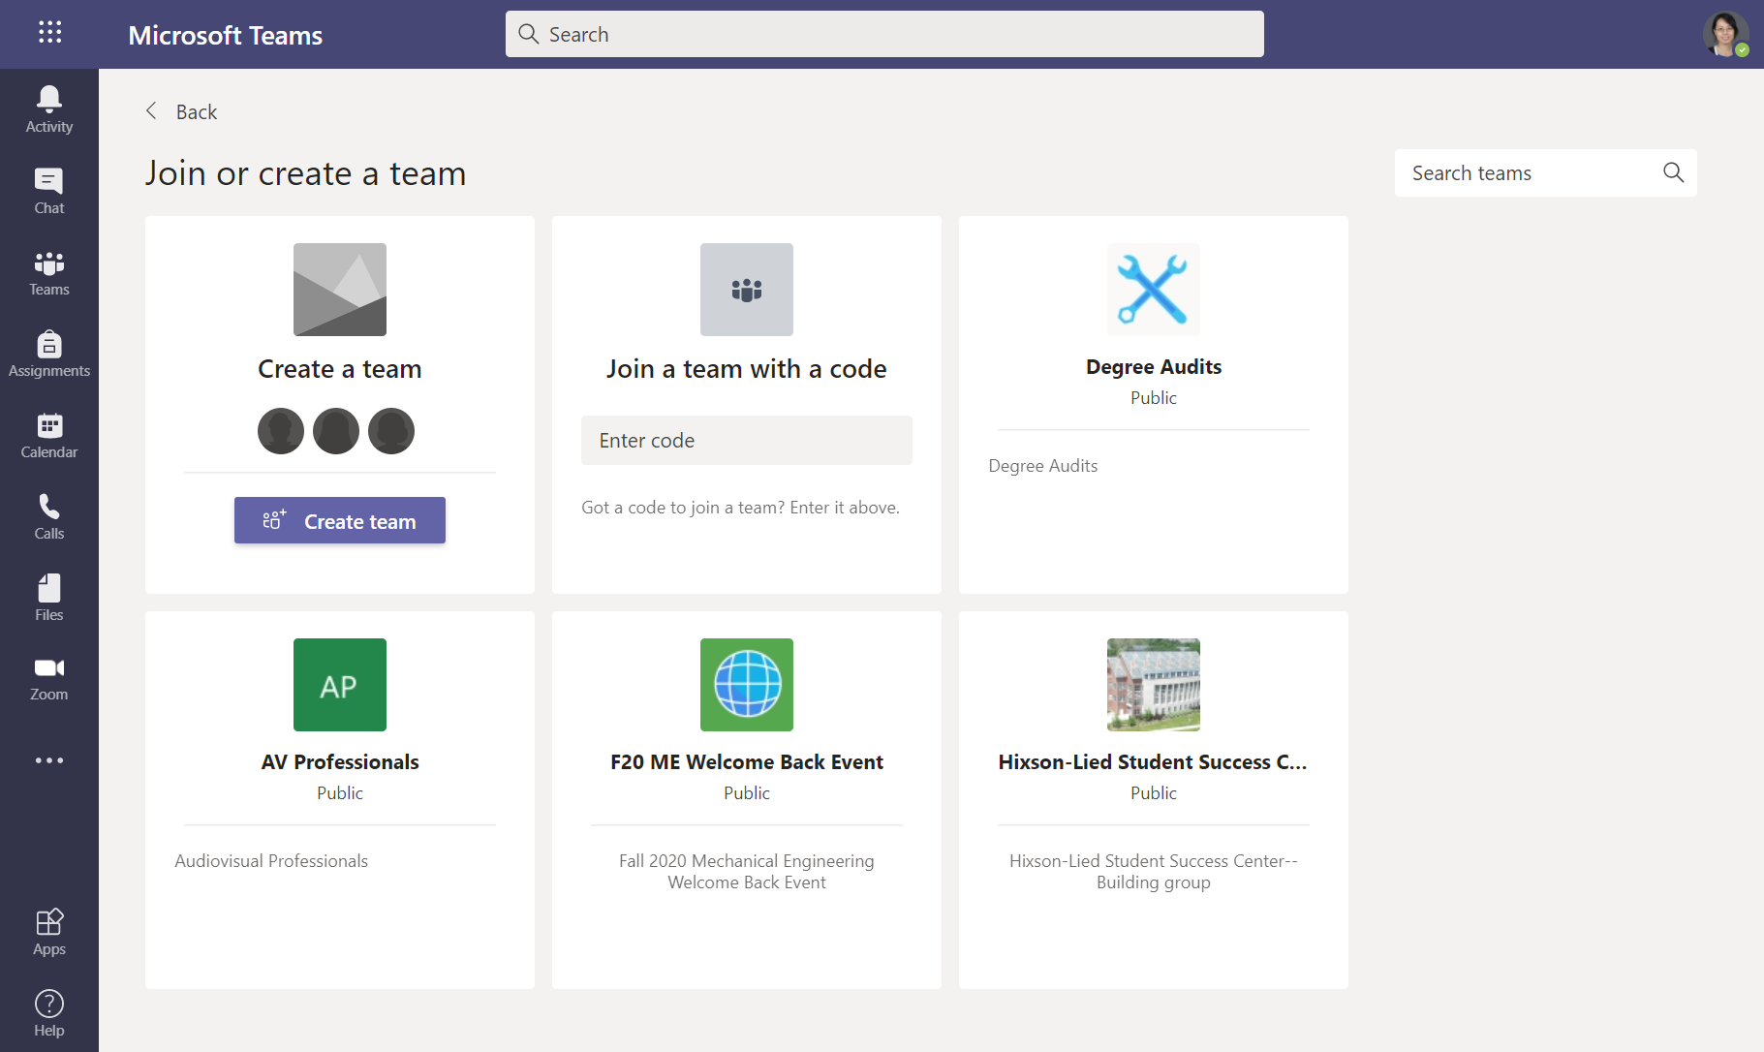
Walk through Teams

Slide 19
Walk through Teams – join by code
Enter code:
7u4vknw

Slide 20
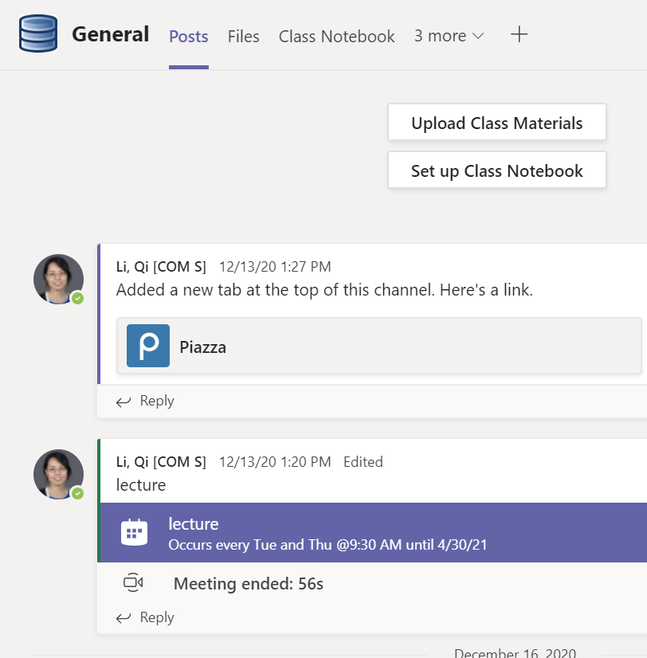
Walk through Teams – Meeting
Join lecture

Slide 21
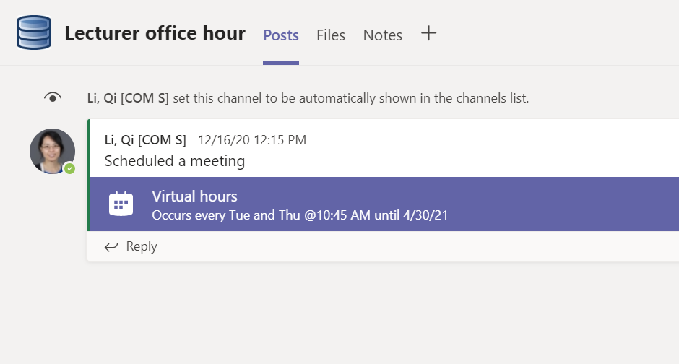
Walk through Teams – Meeting
Join office hour

Slide 22
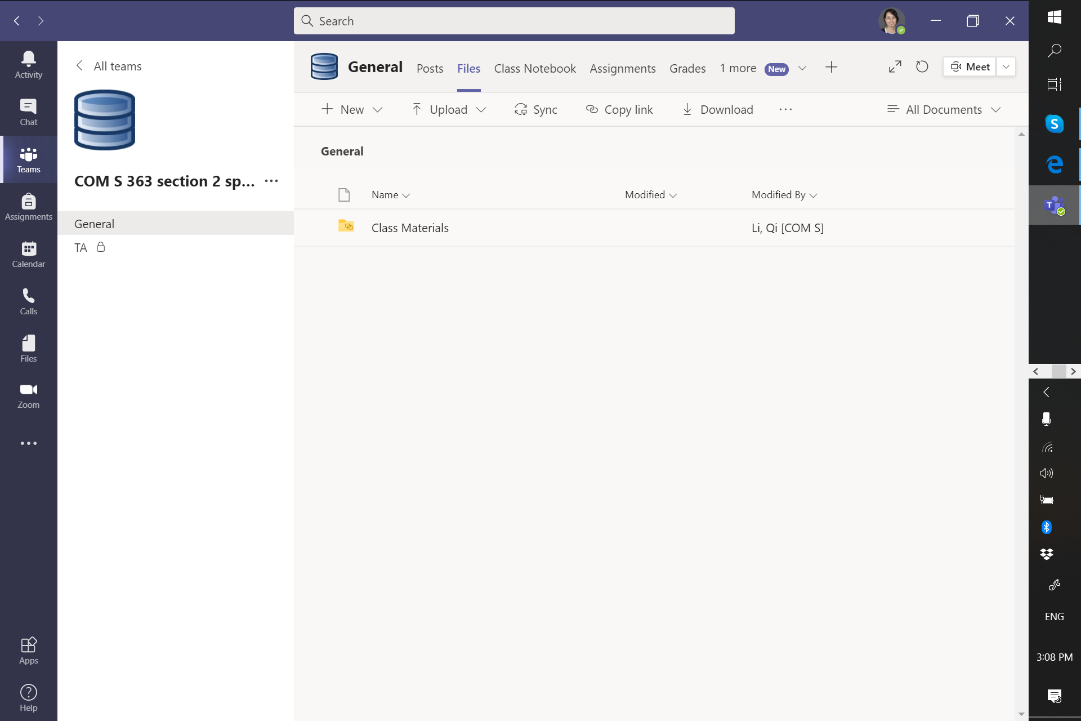
Walk through Teams
All lecture slides are available here

Slide 23
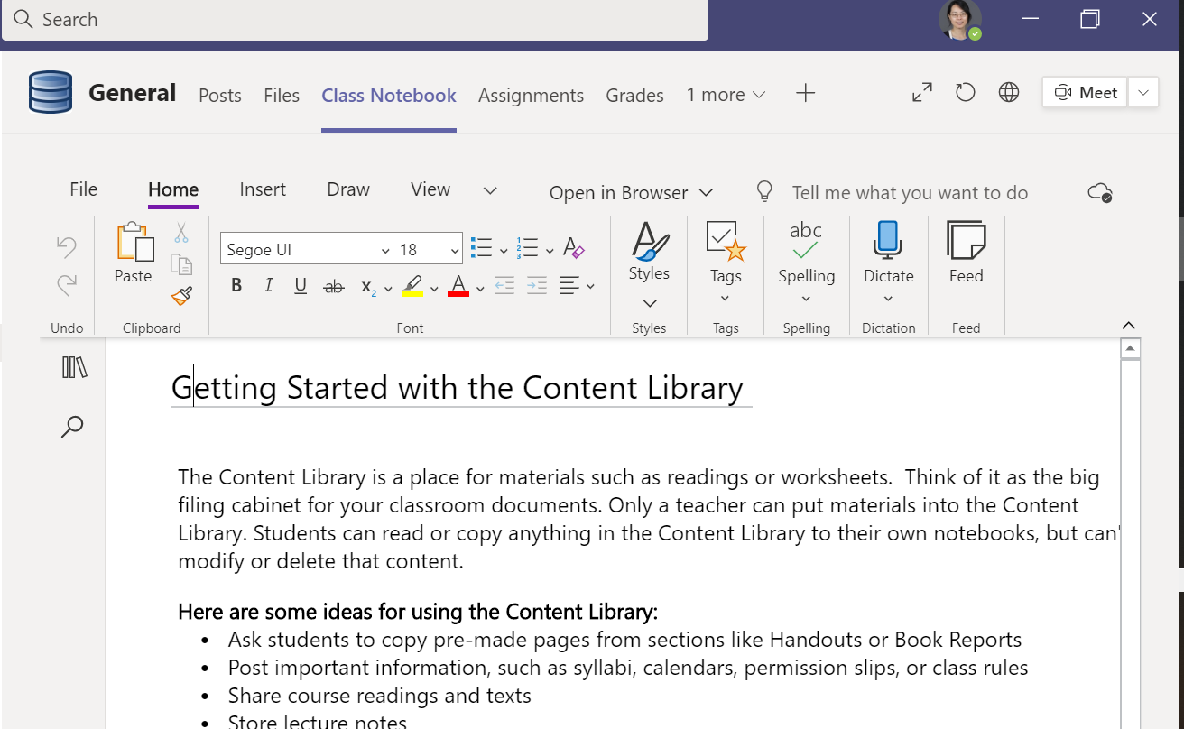
Walk through Teams
All lecture notes are available here

Slide 24
Walk through Teams
Click here for Piazza

Slide 25
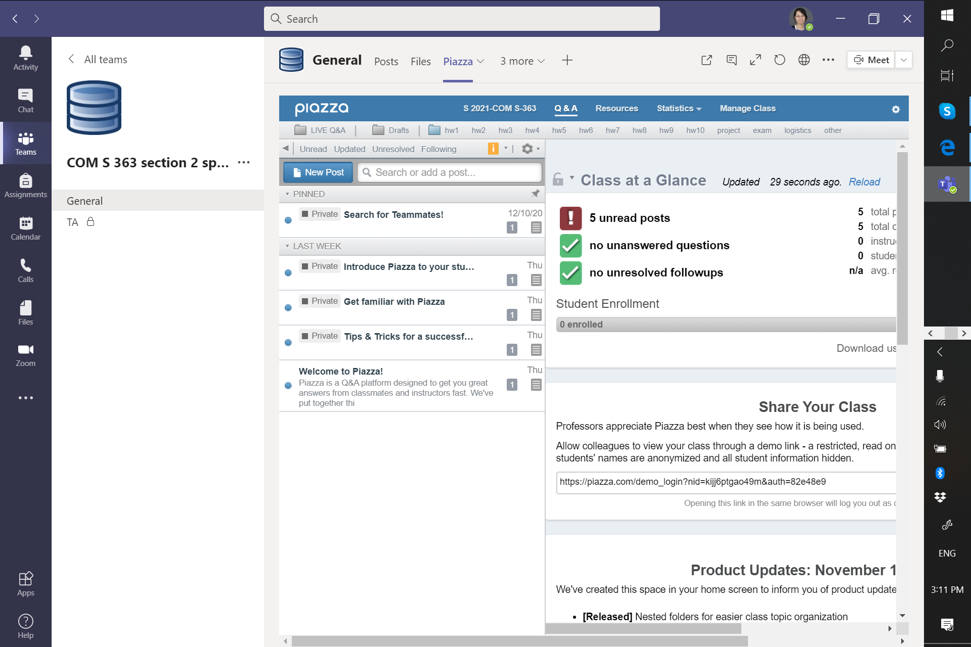
Walk through Teams

Slide 26
Walk through Teams
You can also send me direct message on Teams if it is urgent or need my immediate action.
For non-urgent requests (deadline extension, additional meeting, etc), please send me an email with title .

Slide 27
Outline
Course Policies
Tools
Course overview

Slide 28
Database
A collection of related data [Elmasri]
A database represents some aspects of real world called “miniworld” [Elmasri] or “enterprise” [Ramakrishnan]
A database can be of any size and of varying complexity
It may be generated and maintained manually or using computers

Slide 29


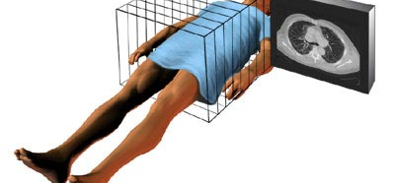
Database
To store
To organize
To retrieve
To analyze

Slide 30
Database Management System (DBMS)
A software package designed to store and manage databases
Relational DBMSs: MySQL, DB2, Informix, Oracle, Microsoft Access, Microsoft SQL Server, FoxBase, Paradox
Graph DBMSs: Neo4j

Slide 31
Why DBMS?
Data is large, extremely large, beyond the limitation of general-purpose operating systems
Allow users to manipulate the data in a convenient way
Index data for efficient data retrieval
And a lot of more
A1
P1
read/write
read/write
OS vs. DMBS
Data unit (file vs table)
Data manipulation
DBMS
OS
....
1100101010…
:
:

Slide 32
Objectives
Provide students with necessary background for
Designing and implementing database applications using some commercial DBMS
Understanding the internal implementation of a typical DBMS

Slide 33
Topic Coverage: Part 1
Design and implementation of database applications
Entity-Relationship (ER) model
Relational data model and mapping from ER-to relations
Implementation of the design of a database application
SQL

Slide 34
Topic Coverage: Part 2
Internal of database management systems
Storage management
Implementation and cost estimation of basic operators
Query optimization
Transaction management
Query Optimization
and Execution
Query Operators
Files and Access Methods
concurrency
control and
recovery
Buffer Management
Disk Space Management
DB

Slide 35
Topic Coverage: Part 3
Advanced topics
Data mining
Data warehousing

Slide 36

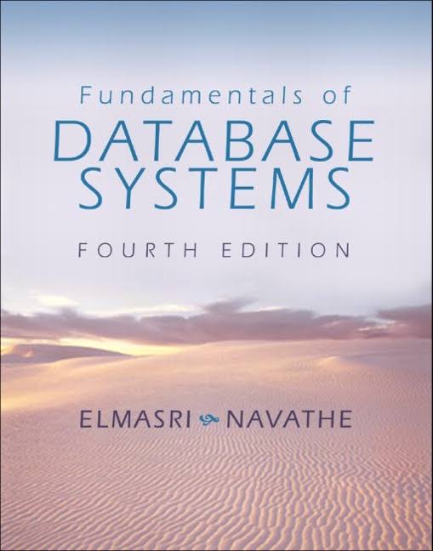
Course Materials
Required
Lecture notes available from Teams
Videos available from Canvas + Teams
Recommended

