Slide 2
Database History
What do you visualize when you hear the term “database”?
Spreadsheet like Excel table (1982), google sheet (2006)?
Spreadsheets are some simple examples of database.

Slide 3
Why not spreadsheet?
Spreadsheet targets to single user directly
Database is usually accessed by many users
Size
Retrieval can be slow (Search for a record)
Structure
Database can be structurally more complex

Slide 4
Why not spreadsheet?
Lack of security features
You can see all or nothing
Lack of concurrency control
Transactions occur at the same time

Slide 5
DBMS
Many common database functionalities are implemented
Users/developers do not need to know how the data are physically stored on disk
Users do not need to know how to retrieve the data, but just tell DBMS what data they want
Users do not need to worry about crash
DBMS can check data integrity
DBMS can manage security and user privileges
Not all DBMS are equal

Slide 6
Data Model
A data model is a collection of concepts for describing data
DBMS independent: Can be designed without knowing which DBMS to use
Entity-Relationship (ER) Model
DBMS specifics

Slide 7
Examples of Data Models that are DBMS specifics
Relational (1969 by Edgar F. Codd at IBM)
Relational DBMS: Oracle, MySQL, Postgres, Microsoft SQL, MariaDB, SQL Lite, …
Query language for relational data model:
SQL
example: select * from Students;

Slide 8
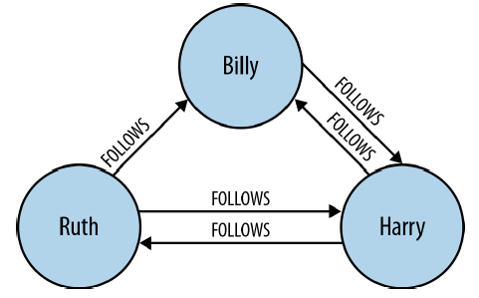
Examples of Data Models (DBMS specifics)
No-SQL: Not only SQL
Graph Data Model
Key-value store variants
Column family stores
Property Graph Data Model
Key-value store variants
- simple key and value pair → key-value store (e.g., redis)
- data stored in JSON/XML → Document stores
Neo4j, Titan, …
austin: {
currently: {
apparentTemperature: 34.82,
cloudCover: 0.99,
},
daily: {
data: {... }
},
flags: { ... }
}
Query language: Cypher
Example
MATCH (n) where n.name=‘Harry' return n
[Neo4j book]

Slide 9
Database Design
Entity-Relationship (ER) model is a high level conceptual data model
Before we can design a database to represent a mini-world, we need to understand what this mini-world is about
If we can get these two questions answered, we have a rather good understanding
What entities does this mini-world have?
What relationships exist among these entities?

Slide 10
Basic terms and notations
An entity is a uniquely identifiable object that exists on its own (e.g., an employee, a department)
Entities have attributes
An attribute is a key attribute if its values are distinct for each individual entity
There may have multiple key attributes
Similar entities (having same attributes) form an entity set
name
name
ssn
dob
did
address
Employees
Departments
Notation
an entity set : a rectangle
an attribute: a circle and a line connected to a rectangle
a key attribute: underlined
Text
there are a number of Entities E, each of which has attribute A1, A2, …, and An, where Ai is unique

Slide 11
Relationship: Association among two or more entities.
Example: Attishoo works in the Pharmacy department.
Relationship Set: Collection of similar relationships.
name
name
since
did
address
ssn
dob
Employees
works-in
Departments
Notation
a relationship set: a diamond
Every participating entity is connected to it by an edge
Every attribute is also connected to it by an edge
an attribute: a circle and a line connected to a rectangle
Text
An Ex may “have to do with” an Ey, where the relationship has attributes A1, A2, …, and An
An Ex and an Ey may participate in a relationship called Rz, which has attributes A1, A2, …, and An

Slide 12
Go to OneNote for more
Example 1 to question 3

Slide 13
So far, only two notations E and R, but they are so powerful in describing a “world”. When designing a database, think about these two questions
What entities it has
What relationships exist among these entities
Example: A database for university
E: faculty, students, courses, buildings, vehicles, research projects, departments, parking lots ...
R: A faculty teaches some students in buildings...

Slide 14
The two questions are fundamental, but we often need more information and therefore need to ask more questions
Question 3: Is there any participation constraint on relationships?
Uni-participation: An entity can participate in a relationship at most once
Total-participation: Every entity in an entity set must participate in a relationship
A combination of both: Every entity in an entity set must participate in a relationship but only once

Slide 15
Uni-participation (also called key constraint)
Each entity in an entity set can participate in at most one relationship in a relationship set
Notation: u
If there is no such constraint, then it is called multi-participation, denoted as m

Slide 16
Uni-participation (also called key constraint)
Each entity in an entity set can participate in at most one relationship in a relationship set
Notation: u
If there is no such constraint, then it is called multi-participation, denoted as m
m
u
Employees
Manages
Departments
e1
e2
e3
e4
e5
e1, d1
e1, d3
e2, d2
e1, d1
e2, d1
d1
d2
d3
allowed?
allowed?
No
Yes
What does this mean?

Slide 17
Uni-participation (also called key constraint)
Each entity in an entity set can participate in at most one relationship in a relationship set
Notation: u
If there is no such constraint, then it is called multi-participation, denoted as m
m
u
Employees
Manages
Departments
e1
e2
e3
e4
e5
e1, d1
e1, d3
e2, d2
e1, d1
e2, d1
d1
d2
d3
No
Yes
A department can participate in relationship “manages” at most one time
➔Every department can have at most one manager (but does not have to)
➔Every Employee can manage several departments (but does not have to)

Slide 18
Total participation
Every entity in an entity set must participate in a relation set
Notation: solid line
If there is no such constraint, then it is called partial-participation, denoted as dotted line
m
m
Employees
Manages
Departments
e1
e2
e3
e4
e5
e1, d1
e1, d3
e1, d1
e2, d1
e2, d3
e3, d2
d1
d2
d3
allowed?
No
allowed?
Yes
What does this mean?

Slide 19
Total participation
Every entity in an entity set must participate in a relation set
Notation: solid line
If there is no such constraint, then it is called partial-participation, denoted as dotted line
m
m
Employees
Manages
Departments
e1
e2
e3
e4
e5
e1, d1
e1, d3
e1, d1
e2, d1
e2, d3
e3, d2
d1
d2
d3
No
Yes
Every department must participate in relationship “manages”
→ Every department must have at least one manager

Slide 20
Uni-participation and total participation
Every entity in an entity set must participate in a relation set and participate only once
Notation: u and solid line
m
u
Employees
Manages
Departments
e1
e2
e3
e4
e5
e1, d1
e1, d3
e1, d1
e2, d3
e3, d2
d1
d2
d3
which one allowed?
Every department must participate in relationship “manages” and only once
→Every department must have one and only one manager

Slide 21
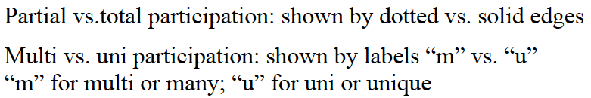
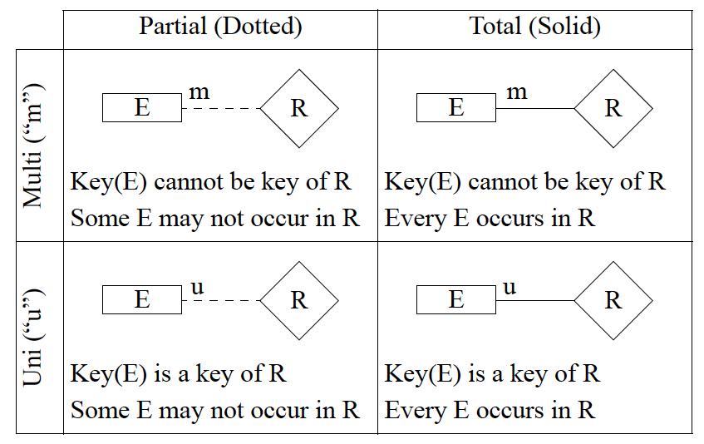

Slide 22
Corresponding notations used by Ramakrishnan’s Database Management System textbook
Partial ( thin line)
Total ( thick line)
Multi ( no arrow)
R
E
R
E
Some E may not occur in R
Every E occurs in R
Uni (arrow)
E
R
E
R
An E may occur in R only once
Every E must occur in R and occur only once

Slide 23
ISA (`is a’) Hierarchies
If we declare A ISA B, every A entity is also considered to be a B entity.
Reasons for using ISA:
To add attributes specific to a subclass.
To identify entities that participate in a relationship.
name
ssn
lot
Employees
hourly_wages
hours_worked
ISA
contractid
Hourly_Emps
Contract_Emps
Overlap constraints:
Can Joe be an Hourly_Emps as well as a Contract_Emps entity? (Allowed/disallowed)
Default value: no overlap;
Otherwise, write Hourly_Emps OVERLAPS Contract_emps
Covering constraints:
Does every Employees entity also have to be an Hourly_Emps or a Contract_Emps entity? (Yes/no)
Default value: no;
Otherwise write Hourly_Emps and Contract_Emps COVER Employees

Slide 24
ER design is subjective. There are often many ways to model a given scenario!
Analyzing alternatives can be tricky, especially for a large enterprise. Common choices include:
Entity vs. attribute, entity vs. relationship, binary or n-ary relationship, whether or not to use ISA hierarchies, and whether or not to use aggregation.
ER diagrams can use different notations, but use the same concept.
Several software tools are available for creating ER diagrams: IBM Rational Rose, Microsoft Visio

Slide 25
Key Concepts of ER Model
Entity set
Relationship set
Constraints
uni-constraint
Total participation constraint
A special kind of relationship: ISA
Question to think
Is there anything that cannot be described by ER model?

