Slide 1


Intelligent University
Course Finder
FDE2ndBatchTraining Capstone
Yuichi Yamazaki
https://github.com/YuichiYamazaki-source/Capstone

Slide 2
MARKET OPPORTUNITY
E-Learning Market is Booming
Why It's Growing
AI Integration
60% of teachers use AI; adaptive learning platforms growing 41% YoY
Remote Work Shift
Corporate e-learning demand surging as 60% of workforce needs reskilling
Mobile Access
Smartphone-first learning in Asia-Pacific driving fastest regional growth
Cost Advantage
Online courses up to 50-70% cheaper than traditional education
Source: Grand View Research, IMARC Group, Straits Research (2024-2025)

Slide 3

The Problem
Universities offer a wide range of courses, but students struggle to find courses that truly match their interests, background, and career goals.
Traditional keyword search fails to capture real intent.
🔍 Intent Mismatch
Students describe learning interests in natural language — not course names or catalog codes.
📋 Prerequisite Confusion
Understanding prerequisite relationships and identifying knowledge gaps
before advanced courses.
🗺️ Path Discovery
Discovering structured learning paths and career-aligned course sequences is nearly impossible.
📂 Fragmented Info
Course info is spread across multiple formats — catalogs, advising guides, and department docs.

Slide 4

Project Positioning — PoC Complete + PoB Partial
This project successfully demonstrates technology feasibility (PoC), but stops short of full Proof of Business — and for good reason. Three structural barriers make a complete PoB premature at this stage.
🧱 Data Quality Wall
Course descriptions are only a few sentences long — too short for precise, reliable skill-to-course matching.
Why This Framing Matters
🎯 Ground Truth Problem
Acknowledging these gaps is a sign of rigor — not weakness. Claiming full PoB prematurely would undermine credibility when the system is stress-tested against real-world data.
38 test cases are DB-query-derived, not human-validated. Even the developer cannot confidently label the "right" course.
👤 No Real User Data
Solo development means a sample size of one. Personalization cannot be validated without real users in the system.

Slide 5
Demo

Slide 6
Architecture
Explain by Architecture.pdf

Slide 7

System Requirements
REQUIREMENT 1
REQUIREMENT 2
Basic Tier
Advanced Tier
Basic RAG for course discovery
DeepEval for recommendation relevance and learning outcomes
Intent-based semantic search
Rerank using learner preference models and success rate data
Simple recommendation agent
LLM-as-judge for course quality and prerequisite validation
Skill gap identification
Token optimization for personalized learning path generation
Difficulty level filtering
Performance testing: real-time recommendations at scale
Learning objective validation guardrails
Content appropriateness and prerequisite guardrails
Basic course sequencing
Metadata filtering (org, rating, difficulty)
Simple front-end UI
for end-user demonstration
Expose via API endpoint

Slide 8
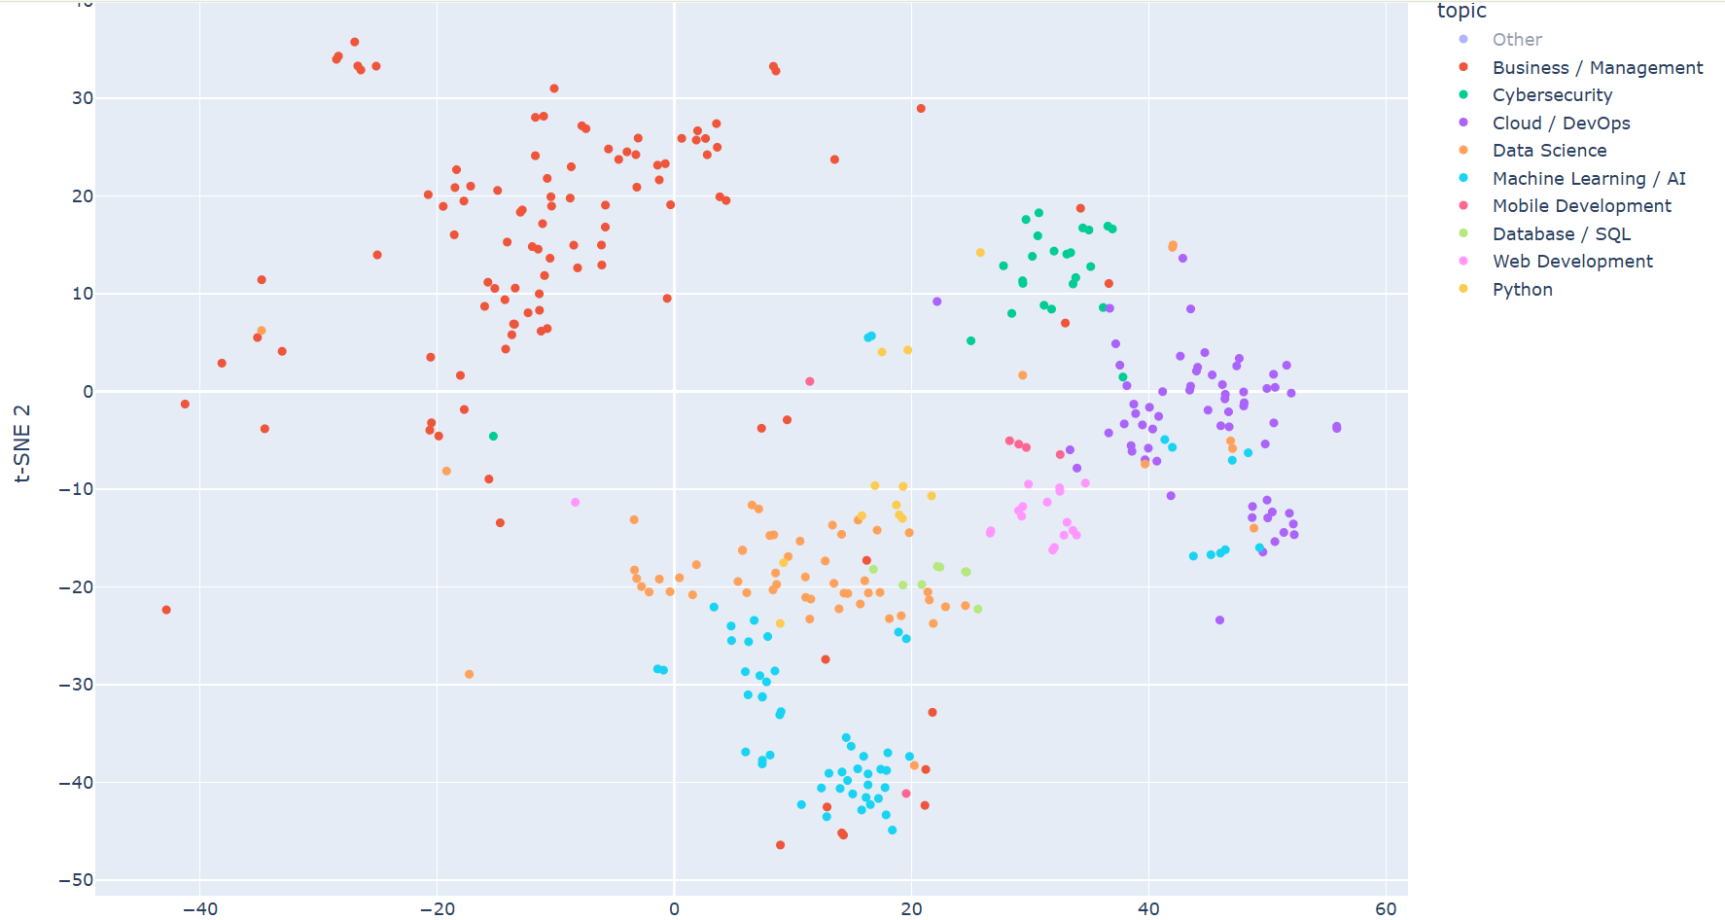
EMBEDDING ANALYSIS
Topic → Clear Clusters in Embedding Space
[Image placeholder]
Embedding input:
title + description only
Result:
Topic/subject clearly captured by semantic similarity.
Business vs. Tech domains
separate cleanly.

Slide 9
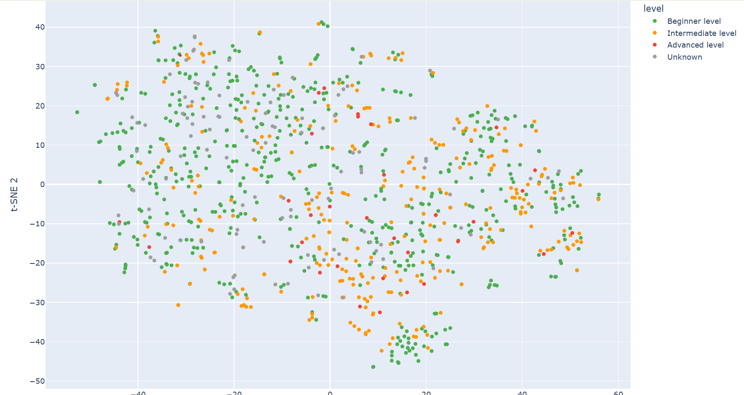
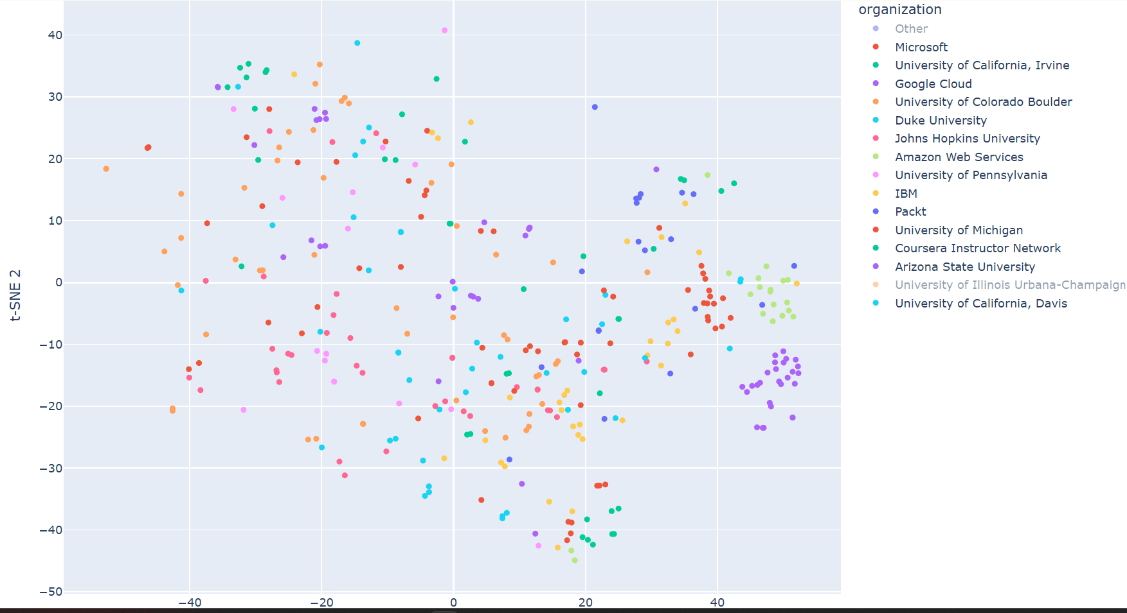
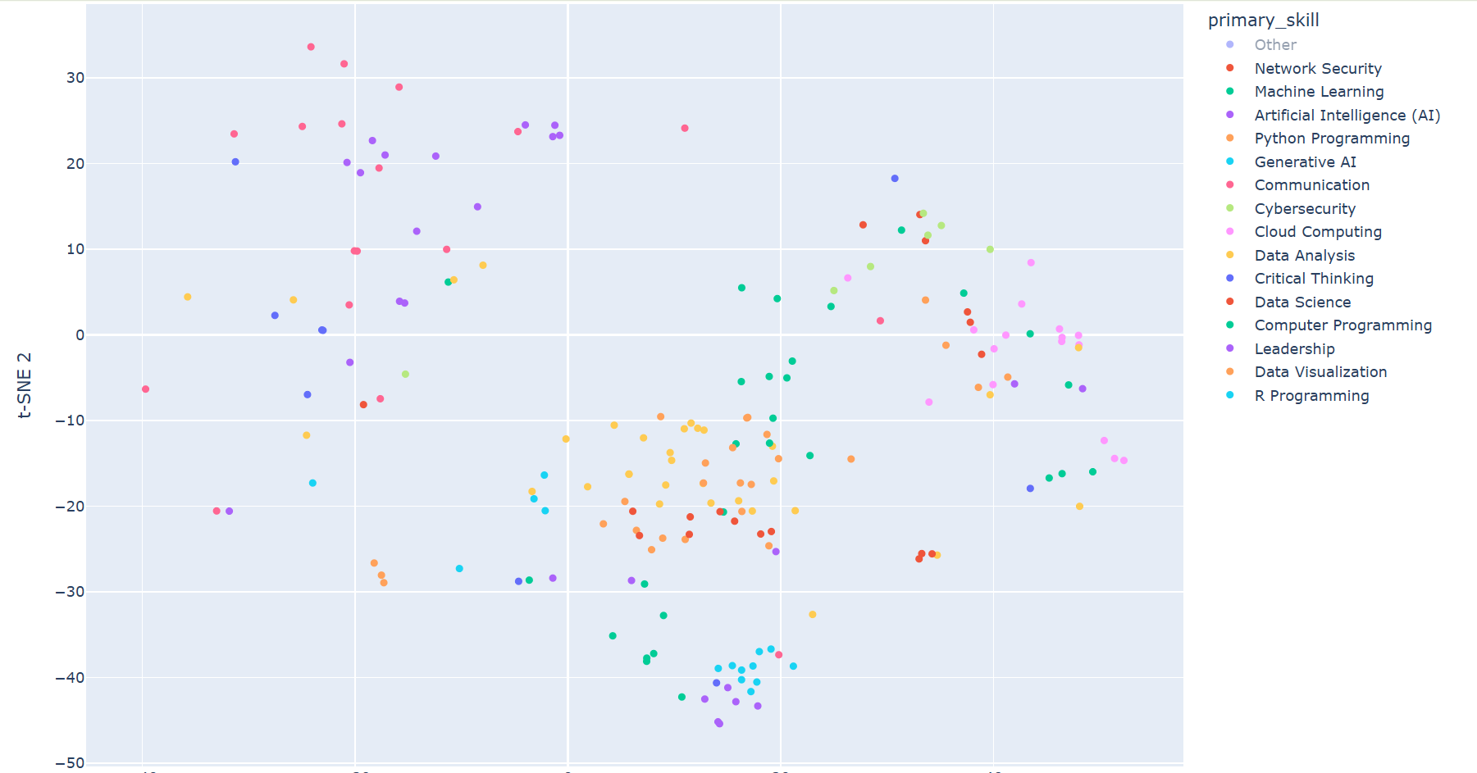
EMBEDDING ANALYSIS
No Clusters
Level
Organization
Skill
Why?
Embedding uses title + description only. Level, organization, and granular skills are not encoded in the embedding space. → These dimensions require payload filters and keyword (BM25) matching.

Slide 10
DESIGN DECISION
Data Analysis → Hybrid Search Design
Dimension
Captured?
Evidence
RAG Handling
Topic / Subject
✓ Yes
Clear t-SNE clusters
Dense vector
(semantic search)
Specific Skills
△ Partial
Sparse data (29.4% missing)
BM25 keyword
matching
Difficulty Level
✗ No
Uniform distribution
Qdrant
payload filter
Organization
✗ No
Scattered across space
Qdrant
payload filter
Qdrant
payload filter
Conclusion: Embedding captures WHAT the course is about. Metadata (level, org, rating) needs structural filtering.
Rating
✗ No
Numeric metadata

Slide 11
Strong Points of This Capstone
Three pillars that demonstrate engineering rigor, observability, and disciplined scope management throughout the project lifecycle.
1
2
3
End-to-End Working PoC
Measurement-First Design
Scope Discipline
Hybrid Search (BM25 + Dense + RRF) paired with a Multi-Agent system (4 LLMs, 5 Tools) and a React frontend — all wired into a single pipeline: user query → agent routing → hybrid retrieval → LLM response. One-command startup via Docker Compose.
LangFuse tracing instruments every LLM call (model, tokens, cost, latency). DeepEval covers Answer Relevancy, Faithfulness, and Actionability. IR metrics include Hit Rate, Precision@K, and Recall@K — all built before feature expansion.
PoC / PoB / Prd boundaries explicitly defined. "What we didn't do and why" is fully documented — 7 deferred items, each with a recommended phase and clear rationale.

Slide 12
Challenges & Lessons Learned
What we discovered building the PoC — and what it means for how we move forward.
🔴 Biggest Challenge: Ground Truth
💡 Key Lesson
38 test cases generated from DB queries — not human-validated
Course descriptions are too short to confidently label "correct" answers
This remains the most critical open problem to solve
Build observability and evaluation infrastructure before expanding features. If you can't measure it, you can't improve it.
Evaluation frameworks must be established early — not retrofitted after the fact.

Slide 13
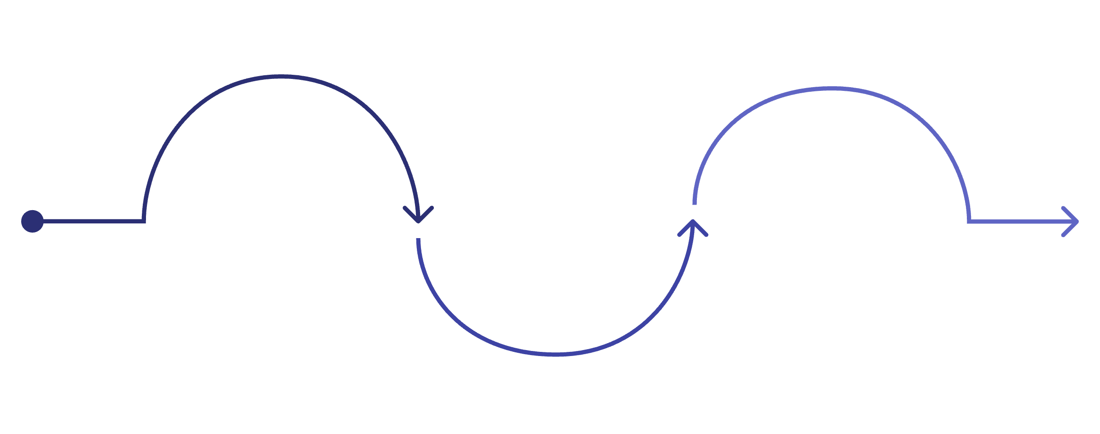
By the Numbers
A snapshot of the technical depth packed into this capstone.
4
5
3
7
LLMs Integrated
Agent Tools
Retrieval Metrics
Deferred Items
Coordinated via multi-agent routing
Specialized capabilities per tool
Hit Rate, Precision@K, Recall@K
Each with phase & justification
Measure First
Ship Disciplined
Instrument every LLM call with LangFuse + DeepEval
Build Right
Define scope boundaries and 7 documented deferrals
Hybrid Search with a Multi-Agent pipeline
The capstone follows a deliberate sequence: establish measurement infrastructure, build the full pipeline, then enforce scope boundaries — a pattern that mirrors production-grade engineering practice.

Slide 14
Next Action

Slide 15





Business Strategy & Validation
Technology alone is not enough — define how to measure and prove business value.
ROI Calculation
Market Analysis
API + infra cost model vs. value delivered
— time saved, course match quality
Competitive landscape + TAM/SAM/SOM for AI-powered course discovery
PoC vs. PoB Criteria
KPI Definition
PoC = tech feasibility. PoB = business value.
Clear go/no-go thresholds.
Engagement rate, recommendation acceptance, skill gap closure, NPS
Production-Ready
means hitting defined performance thresholds, accuracy targets, and cost ceilings — not just deploying to the cloud.

Slide 16




Agent & AI Optimization
Goal: Optimize cost, accuracy, latency, and capability through data-driven iteration.
Caching & Compression
Model Routing
Cache repeated query patterns
Prompt compression via context pruning
Reduce latency and API token cost
Cost Management
Insurance Quality
Remain Userbility
Agent Refinement
ML Integration
Optimize handoff logic
Error handling & fallback strategies
Multimodal: image/PDF input support
Recommendation engine
User behavior analysis
Personalization layer

Slide 17
Feature Roadmap & Production Infrastructure
Feature Roadmap
Secure Cloud Infrastructure
Course Analytics Dashboard
Hosting & CI/CD
Engagement metrics, popularity trends, completion rates
Azure App Service (containers) + GitHub Actions Runner
User Profile Enhancement
Networking
MCQ-based skill assessment, learning style detection
Integration Runtime — NIC inside Azure VNet, zero public endpoints
Course Registration
Secrets & IaC
Admin CRUD interface for managing course catalog
Azure Key Vault + Terraform for infrastructure as code
Data Retention & Archival
Zero-Trust Security
Structured storage policy, historical data, backups
VNet isolation, Managed Identity, self-hosted agent pool

Slide 18
Additional Considerations for Production
API & Data Quality
Governance & Operations
API Error Handling
Monitoring & Observability
Standardized error codes, retry with backoff, graceful degradation
Log aggregation, APM dashboard, alerting, token usage tracking
Input Validation & API Design
Compliance & Privacy
Schema validation, rate limiting, versioning, OpenAPI spec
GDPR / data protection, audit logs, consent management
DB Data Quality & Integrity
AI Guardrails & Safety
Missing value handling, data consistency checks, quality metrics
Hallucination detection, content filtering, output validation
Testing Strategy
Incident Response & Runbooks
Unit / integration / E2E tests + AI response quality evaluation
On-call playbooks, rollback procedures, SLA definitions

Slide 19
Appendix

Slide 20

Objective
Build an AI-powered multimodal course discovery and recommendation system that acts as an intelligent academic assistant — understanding student intent and delivering personalized, structured guidance.
Multimodal Input
Accepts text, voice, or uploaded documents as query input.
Intent Interpretation
Interprets student learning intent beyond surface-level keywords.
Semantic Retrieval
Retrieves semantically relevant courses from the full catalog.
Intelligent Advisor
Acts as a smart academic assistant guiding every step of the journey.

Slide 21





Key Capabilities
Seven core capabilities power the intelligent course discovery experience — from understanding how a student asks a question to mapping their goals to a career track.
Multimodal Query Understanding
Semantic Course Retrieval
Accepts text, voice, and uploaded document descriptions as input for maximum accessibility.
Goes beyond keyword matching to understand the true meaning behind a student's learning goal.
Relevance Assistance
Prerequisite Awareness
Explains why each course is recommended, building student trust and confidence.
Checks whether the student has the required background before recommending advanced courses.
Skill Gap Identification
Learning Path Recommendations
Suggests foundational courses to fill knowledge gaps before tackling advanced material.
Generates structured intro → advanced course sequences tailored to each learner.

Slide 22
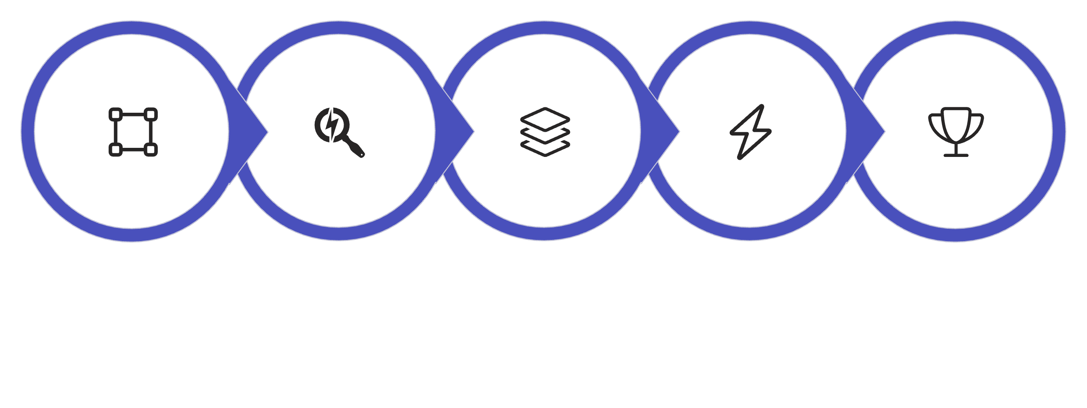





Advanced: Hybrid Course Retrieval
The retrieval layer combines the best of vector-based semantic search and traditional keyword matching, then applies cross-encoder reranking to surface the most relevant results.
Dense Embeddings
Keyword Matching
Hybrid Fusion
Cross-Encoder
Final Ranking
Vector Embeddings
Keyword Retrieval
Dense semantic representations capture meaning, context, and conceptual similarity between queries and course descriptions.
BM25 lexical matching ensures exact terminology and domain-specific terms are never missed.
Dynamic Filtering
Cross-Encoder Reranking
Filter by difficulty, rating, organization, and skill category to narrow results to what matters most.
A cross-encoder model re-scores candidate courses for improved recommendation quality and precision.

Slide 23
Multi-Agent Architecture
A collaborative multi-agent system where specialized agents handle distinct responsibilities and communicate to deliver a unified, intelligent recommendation experience.
Course Retrieval Agent
Retrieves relevant courses from the catalog using hybrid semantic search
Skill Gap Analysis Agent
Identifies missing prerequisite skills and recommends foundational courses
Learning Path Planning Agent
Generates structured, sequenced course paths from beginner to advanced
Career Alignment Agent
Maps recommended courses to specific career tracks (AI, data science, finance, SWE)
Learning Advisor Agent
Synthesizes all agent outputs into a final, coherent recommendation summary

Slide 24

Additional Intelligence
Analytics & Personalization
Agent Communication
Learning Analytics
Agent Handoff
A2A Communication
Tracks popular courses, completion trends, and engagement patterns across the learner population.
Seamless transfer of context between specialized agents as queries move across domains.
Agent-to-Agent (A2A) communication enables collaborative filtering and cross-domain reasoning.
Personalized Recommendations
Tailors suggestions based on individual learner preferences, history, and stated goals.
Adaptive Difficulty
Dynamically adjusts recommended difficulty levels based on learner progress and performance signals.

Slide 25

Dataset & Deliverables
DATASET
DELIVERABLES
Coursera Course Dataset
01
Source
Format
Architecture Diagram
Kaggle / HuggingFace / GitHub
CSV, JSON
Data flow from ingestion to recommendation (JPEG/PDF)
02
Key Fields: course_name, description, skills, difficulty_level, rating, organization
Design Document
Embedding model, chunking strategy, agent orchestration decisions and trade-offs
Supports semantic retrieval, skill mapping, and learning path generation across domains.
03
Full Executable Code
Modular microservice with README covering setup, ingestion, and example queries
04
Panel Presentation
10 min total — live demo (8 min) + Q&A (2 min)

Slide 26
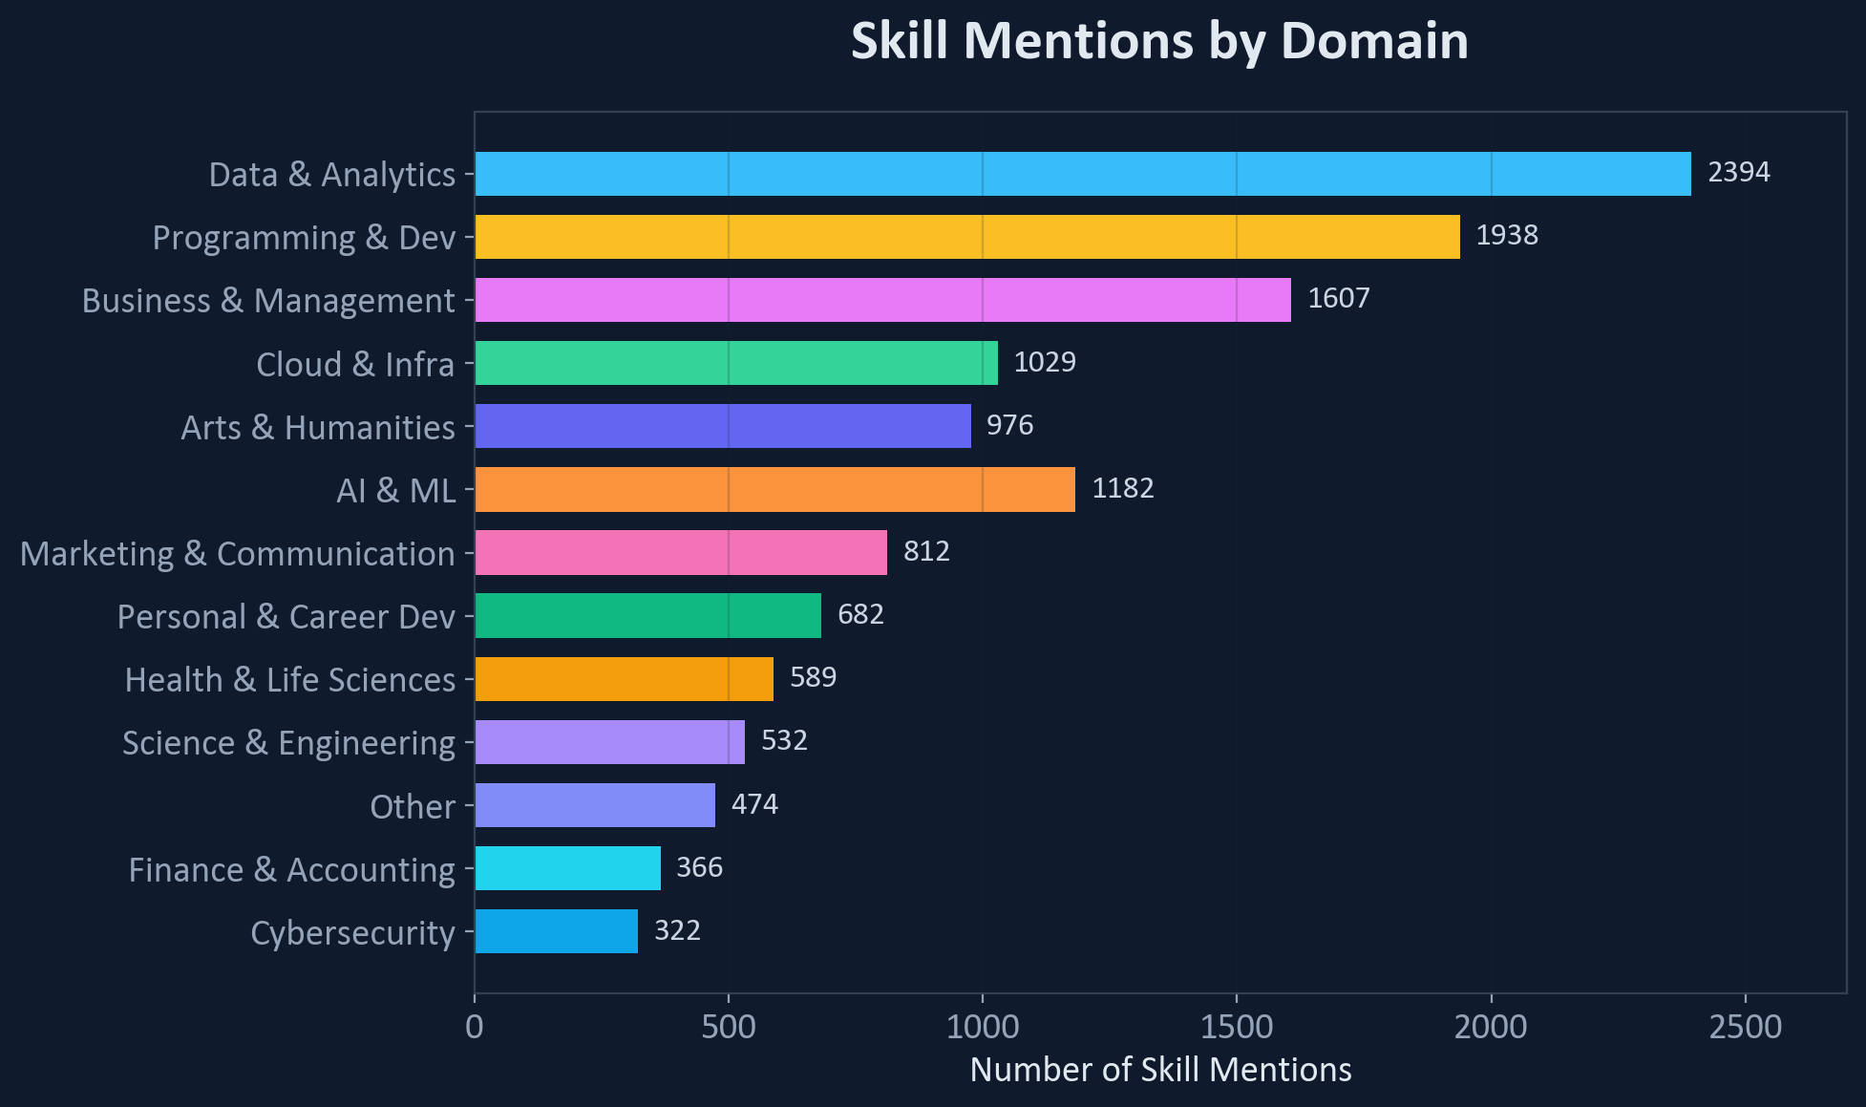
DATA ANALYSIS
6,645 Courses — Domain Distribution

Slide 27
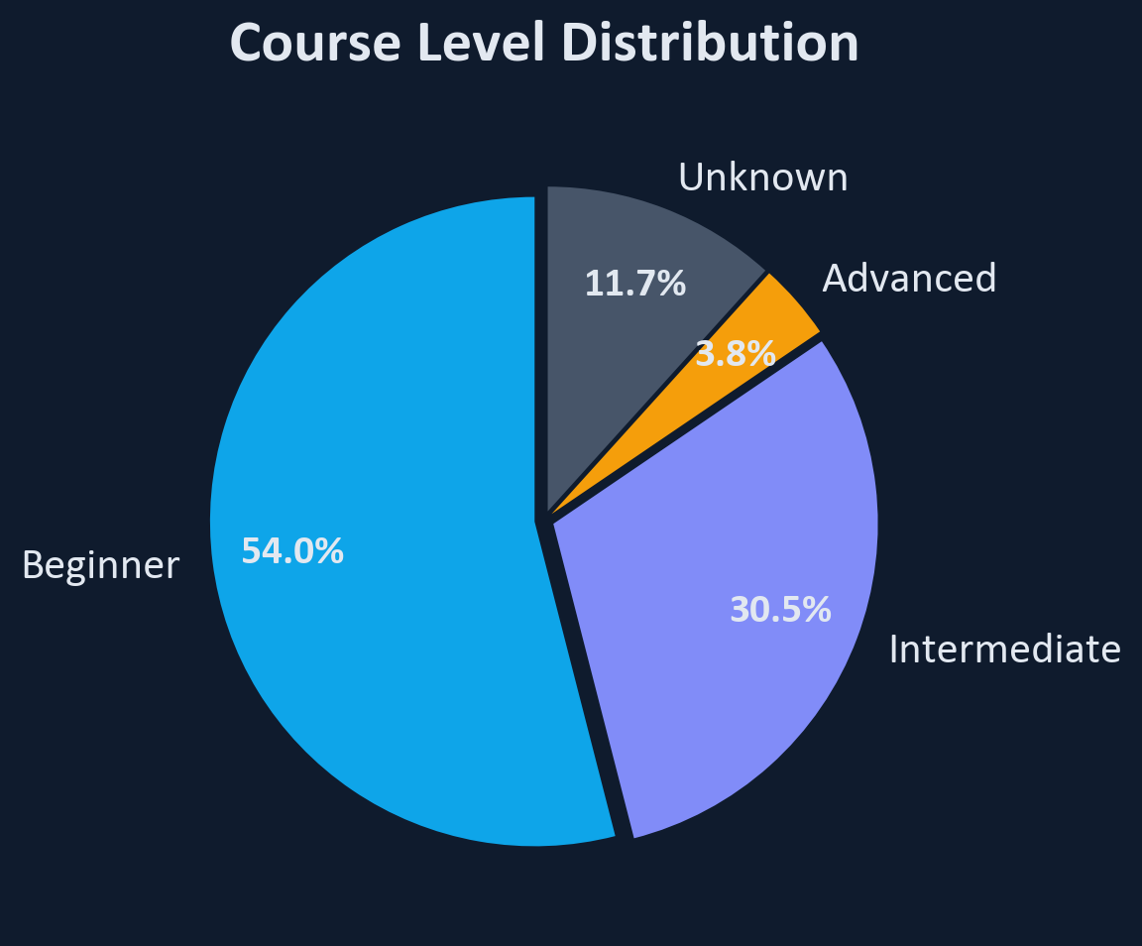
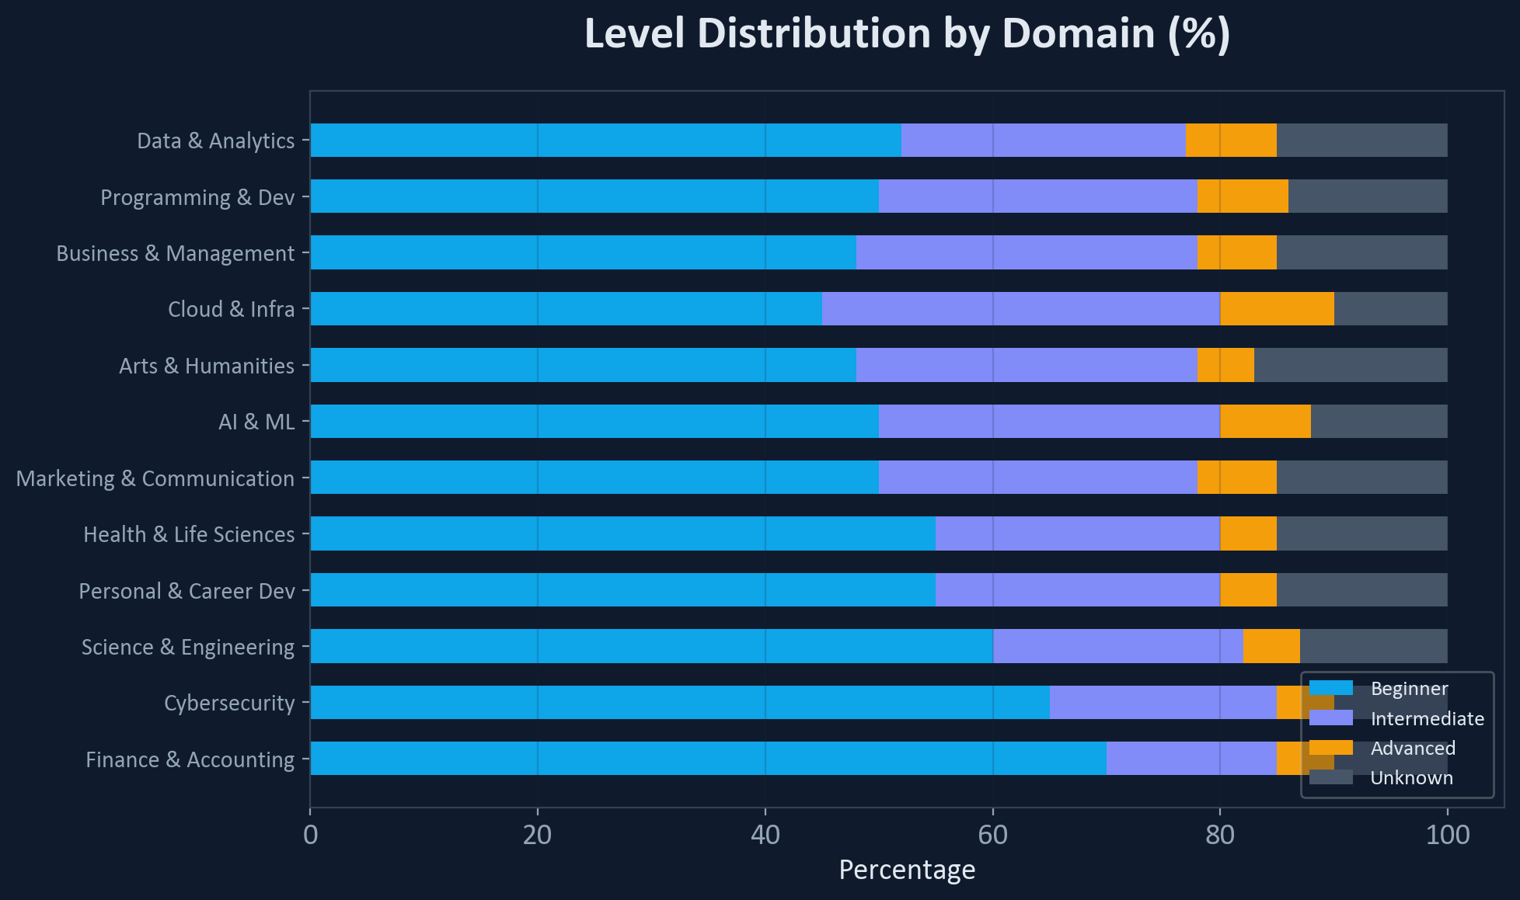
DATA ANALYSIS
54% Beginner — Consistent Across All Domains
Insight: Beginner-heavy distribution is consistent across domains.
Agents must filter by level to surface Advanced content.

Slide 28
APPENDIX
Level Distribution by Domain (Detail)

Slide 29
RAG ARCHITECTURE
Indexing Pipeline — Data Ingestion
CSV
6,645 courses
MongoDB
Document store
OpenAI
text-embedding
-3-small
Qdrant
Dense + BM25
vectors
→
→
Dense Vector (Semantic)
BM25 Sparse Vector (Keyword)
Input: title + description
Model: text-embedding-3-small
Dimensions: 1,536
Input: title + description + skills
Model: Qdrant/bm25 (built-in)
Purpose: Exact skill/tool name matching

Slide 30
RAG ARCHITECTURE
Query Pipeline — Hybrid Search + RRF
→
BM25 Search
→
RRF
Fusion
User Query
Embed (1536-dim)
weight: 1.0 | limit: 20
→
→
Dense Search
→
weight: 1.5 | limit: 20
Payload Filters (applied to both searches)
level (Beginner/Intermediate/Advanced) min_rating (≥ value) organization (text match)
Why Qdrant?
Native Hybrid Search: BM25 + Dense + RRF in single API call
Payload Filters: Structured metadata filtering on vector results
Docker Native: Lightweight, fits Docker Compose stack

Slide 31
WEB SEARCH TOOL
Real-Time Market Data via Web Search
Specialist Agent
(Skill Gap / Career)
web_search
tool
OpenAI
Responses API
+ web_search_preview
Summarized
Market Data
→
→
→
Why Web Search Matters for Agents
Skill Gap Analyst Searches for current required skills for target roles (e.g., "ML Engineer required skills 2025") Model: gpt-4o-mini
Career Advisor Searches for salary data, job market trends, career path information for informed recommendations Retry: max 2 attempts, exponential backoff

Slide 32





Demo Flow
A five-step end-to-end demonstration showcasing the full intelligence of the system — from a student's first query to a career-aligned course recommendation.
Step 1: Student Query
Student enters a natural language learning goal (e.g., "I want to learn machine learning for finance").
Step 2: Semantic Retrieval
System retrieves the most relevant courses using hybrid vector + keyword search.
Step 3: Skill Gap Analysis
Skill Gap Analysis Agent identifies missing prerequisites and recommends foundational courses.
Step 4: Learning Path Generation
Learning Path Planner generates a structured, sequenced course recommendation from intro to advanced.
Step 5: Career Alignment
Career Alignment Agent maps the final results to relevant career tracks — AI, data science, finance, or software engineering.
Live Demo: 8 minutes of live system interaction followed by 2 minutes of Q&A with the panel.

Slide 33



NEXT STEP
Build the Measurement Framework First
Before proving business value, the foundation for measuring that value must be in place. The strategy is to instrument now — so the system is ready to iterate the moment real users arrive.
LangFuse
DeepEval
Real Users
Online tracing for every LLM call — capturing cost, latency, and behavior in production.
A repeatable evaluation harness enabling consistent, automated quality benchmarking across iterations.
With infrastructure in place, each new user adds signal — turning the system into a continuously improving loop.
PoC proves the technology works. The next milestone is clear: onboard real users, collect ground truth, and prove business value.

