Slide 1
OPSFLOW
OpsFlow at a glance
Service incident
operations, made
clear and reliable
OpsFlow
CREATE INCIDENT
Incident operations
2
1
1
4
Open
Investigating
Critical
Resolved
Recent incidents
Service
Status
Owner
Checkout API
Investigating
Assigned
A simple walkthrough of the application, delivery workflow, cloud validation, GitOps, and monitoring.
Auth service
Open
Unassigned
Notifications
Resolved
Assigned
Track incidents • coordinate owners • monitor service health
RUNNING APPLICATION
Lavanya Soni | 2026

Slide 2
OVERVIEW
02
Project overview
A single place to track service problems and the engineering workflow that keeps the platform dependable.
What a user can do
The problem
Operational incidents become expensive when status, ownership, and service health are scattered across tools and conversations.
1
Create
Built beyond the UI
Log a service incident
Quality checks
36 automated API tests
2
Assign
The solution
Make ownership visible
Security gate
Serious image vulnerabilities block release
OpsFlow brings incident tracking, clear ownership, health checks, and operational visibility into one application.
3
Investigate
Cloud proof
Track progress and severity
Validated on AWS EKS, then destroyed
Operational insight
Why it matters
4
Resolve
Prometheus + Grafana show health and traffic
Faster coordination, safer releases, repeatable deployment, and clearer evidence when something goes wrong.
Close with a clear status
OpsFlow
2026

Slide 3
STACK
03
Technology stack
Each tool has one clear job in the overall system.
User experience
Application logic
Data
Containers
React + Vite
FastAPI + SQLAlchemy
PostgreSQL + Alembic
Docker + Nginx
Browser dashboard for incident work
API rules, validation, health and metrics
Incident storage and controlled schema changes
Consistent packaging from laptop to cluster
Delivery & security
Orchestration & GitOps
Cloud
Observability
GitHub Actions + Trivy + GHCR
Kubernetes + Helm + ArgoCD
Terraform + AWS EKS
Prometheus + Grafana
Tests, image builds, vulnerability gate and registry
Keep the desired deployment aligned with Git
Repeatable infrastructure and real cloud validation
See availability, traffic and application behavior
build the app → package it → check it → deploy it → keep it aligned → watch it.
OpsFlow
2026

Slide 4
ARCHITECTURE
04
Architecture overview
The application path is simple; the delivery path adds automation, cloud infrastructure and monitoring around it.
APPLICATION PATH
Browser
Frontend
Backend
Database
Incident dashboard
React + Nginx
FastAPI
PostgreSQL
DELIVERY & OPERATIONS
GitHub
Actions
GHCR
ArgoCD
Kubernetes
Source of truth
Tests + build + scan
Approved images
GitOps sync
Runs the services
Terraform created the AWS VPC + EKS environment used for cloud validation. After testing, those resources were destroyed to control cost.
Prometheus + Grafana | operational visibility
OpsFlow
2026

Slide 5
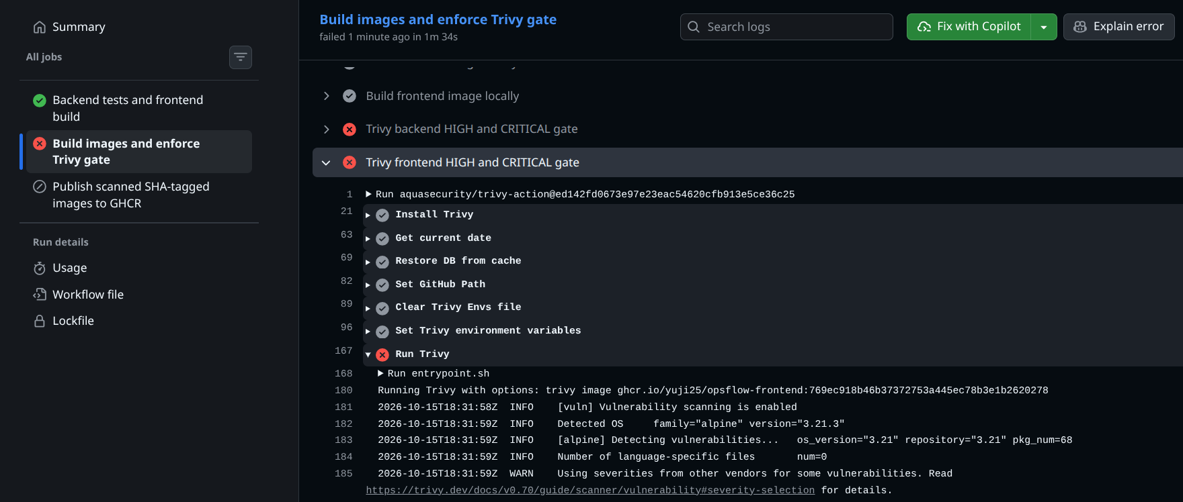
DELIVERY
05
CI/CD and security flow
Every change is checked before an image is allowed into the registry.
Test
Build
Scan
Publish
1
36 API tests + frontend build
2
Create backend + frontend images
3
Block HIGH / CRITICAL findings
4
Push SHA-tagged images to GHCR
Real security behavior: the pipeline stopped when the vulnerability gate failed.
• Fail closed — serious findings stop publication.
• Fix, then rerun — the dependency/base-image issue was remediated instead of bypassing the gate.
• Traceable releases — published images use the full Git commit SHA, not “latest”.
WHY THIS MATTERS: bad builds do not quietly move forward
OpsFlow
2026

Slide 6
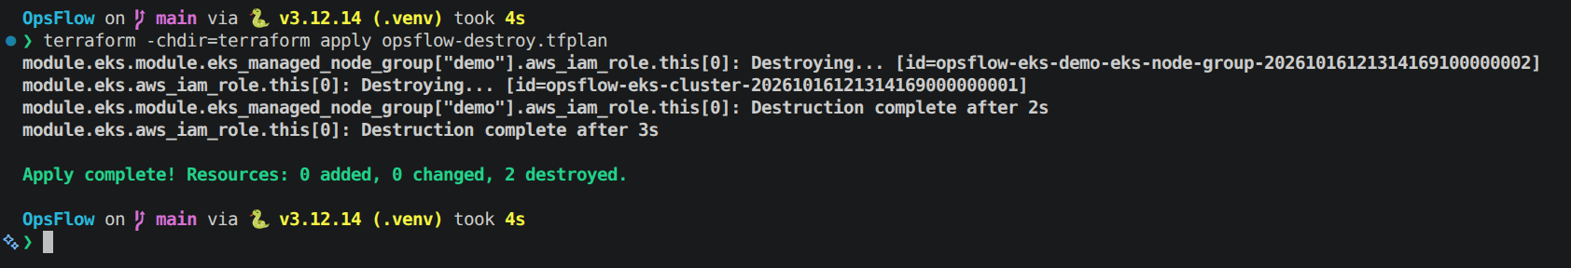
INFRASTRUCTURE
06
Infrastructure as code
Cloud infrastructure was created from code, validated on AWS, and then removed after testing.
Repeatable setup
Validation record
Terraform defines the network and EKS cluster instead of relying on manual console clicks.
2
1
1.36
public subnets
EKS worker
Kubernetes
Real AWS validation
A VPC, two public subnets, EKS and a managed worker node were provisioned in ap-south-1.
What “Infrastructure as Code” means here
• Plan first — review what will be created before applying.
• Same recipe — network and cluster configuration live in versioned Terraform files.
• Clean exit — destroy is part of the lifecycle, not an afterthought.
Cost-aware cleanup
The AWS environment was intentionally destroyed after validation to avoid ongoing charges.
OpsFlow
2026

Slide 7
ORCHESTRATION
07
Kubernetes, Helm and GitOps
Kubernetes runs the services; Helm describes the deployment; ArgoCD keeps the cluster aligned with Git.
Kubernetes
Current GitOps flow
Keeps application services running, restartable and reachable.
GitHub
main
ArgoCD
Helm chart
Minikube
Source of truth
Synced + Healthy
helm/opsflow
namespace: opsflow
Helm
Packages the deployment rules so the same application can be installed consistently.
Verified state
ArgoCD
Application
Synced / Healthy
Replicas
2 backend + 2 frontend
Watches Git and reconciles the cluster toward the version stored in the repository.
Database
PostgreSQL PVC preserved
Ingress
opsflow.local
Video-friendly GitOps demonstration: a tiny Git change can be pushed, then ArgoCD shows the new revision synchronized into the cluster.
OpsFlow
2026

Slide 8
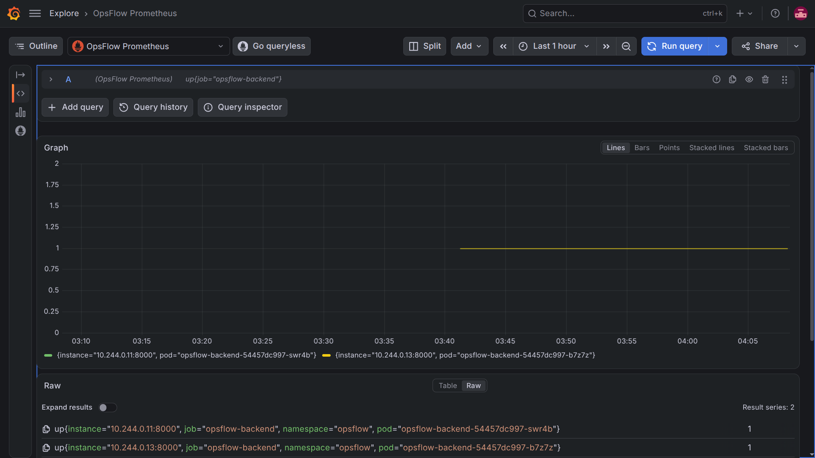
MONITORING
08
Observability
The system reports its own health so problems can be seen before users have to explain them.
Prometheus
Collects application metrics from both backend replicas every 15 seconds.
Grafana
Turns raw metrics into a dashboard for availability, traffic, latency and process behavior.
Operational endpoints
/health, /ready and /metrics provide machine-readable status checks.
2 backend targets observed as UP
Example: both backend replicas return an “up = 1” signal.
OpsFlow
2026

Slide 9
RESULTS
09
What was validated
The project was not only assembled — each layer was exercised and captured with evidence.
36
2 + 2
HIGH / CRITICAL
API tests passed
backend / frontend replicas
security gate
Synced + Healthy
AWS EKS
Destroyed
ArgoCD state
real cloud validation
cloud cleanup completed
Result: one repository now contains the application, delivery automation, infrastructure code, Kubernetes deployment, GitOps configuration, monitoring setup and grading evidence.
OpsFlow
2026

Slide 10
LEARNINGS
10
Key learnings
The strongest lessons are about making systems repeatable, observable and safe to change.
1
Automate the boring checks
Tests and security scans are more reliable when every push follows the same path.
2
Git should explain the system
Application, infrastructure, deployment and GitOps configuration are all reviewable as code.
3
Health is part of the product
Readiness checks, metrics and dashboards make operations less dependent on guesswork.
4
Cloud resources need a lifecycle
Provisioning is only half the job; cleanup and cost control are part of engineering quality.
5
Keep the story understandable
A strong system can still be explained in simple terms: build, check, deploy, synchronize, observe.
The goal is not more tools — it is a safer, clearer path from code to a running service.
OpsFlow
2026

Slide 11
DEMO ROADMAP
11
Live walkthrough
The recording will now move from the slides to the real project, in the same order requested for submission.
Codebase
Show the repository structure and key files
CI/CD
Trigger a push and follow GitHub Actions end-to-end
1
2
Terraform + AWS proof
Show the saved plan and captured VPC / EKS evidence
ArgoCD
Show Synced / Healthy and the GitOps resource tree
3
4
Kubernetes
Show pods, services and ingress healthy
Prometheus
Show OpsFlow targets UP
5
6
Grafana
Show live application metrics
7
OpsFlow
2026

