Slide 1
NUS-ISS
AI-Powered Customer
Support Triage and
Resolution System
NUS AI TEAM 4
GC Architecting AI Systems — Practice Module
Ting Ching Jong
Toh Chan Hao
Teng Ching Yee
Tang You Wei
Ooi Yu Jie
NUS-ISS · April 2026

Slide 2
Overview
NUS AI Team 4
Agenda
Team: 5 members · Total Effort: 600 hours · Stack: Python / FastAPI / React / ChromaDB / OpenAI
1. Introduction — Problem Statement & Our Solution
2. Overall Effort to Date
3. System Architecture — Logical, Physical, Deployment
4. Agent Design — 8 Agents Deep Dive
5. Explainable & Responsible AI Practices
6. AI Security Risk Register
7. Application Demo — Three-Tier UI
8. MLSecOps / LLMSecOps Pipeline
9. Testing Summary
– Key Challenges, Learnings & Future Enhancements
2

Slide 3
NUS AI Team 4
GC Architecting AI Systems
Section 1
Introduction

Slide 4
Section 1 — Introduction
NUS AI Team 4
Problem Statement
Telco companies handle millions of support queries daily — billing disputes, technical faults, account changes
Traditional support is slow, inconsistent, and expensive — long wait times, agent burnout
AI without guardrails introduces new risks: hallucinations, PII leakage, prompt injection attacks
Unexplainable AI decisions erode customer trust and create compliance risk
Need: a trustworthy, secure, explainable AI support system with human oversight built in
4

Slide 5
Section 1 — Introduction
NUS AI Team 4
Our Solution
A multi-agent AI system with 8 specialised agents working in a deterministic pipeline
Security-first design: every message is screened before reaching the LLM
Explainability built in: XAI trace on every triage decision — auditable and transparent
Human-in-the-Loop (HITL): humans approve escalated cases; approved answers self-train the system
Fully working prototype: FastAPI backend + 3-tier React UI + comprehensive test suite
Directly addresses all 4 module competencies: Responsible AI, Cybersecurity, Agentic AI, Integration/Deployment
5

Slide 6
NUS AI Team 4
GC Architecting AI Systems
Section 2
Overall Effort to Date

Slide 7
Section 2 — Effort
NUS AI Team 4
Work Breakdown Structure — 600 Hours
Phase | Description | Hours | Status
Phase 1 | Research & Design (architecture, XAI strategy, prompt engineering) | 100 hrs | Done
Phase 2 | Core Development (8 agents, orchestrator, vector DB) | 220 hrs | Done
Phase 3A | LLMOps (RAG evaluation, synthetic data, prompt versioning) | 65 hrs | In Progress
Phase 3B | Infrastructure (CI/CD, Docker, cloud deployment) | 35 hrs | In Progress
Phase 4 | Responsible AI & Security (XAI, PII masking, security audit) | 80 hrs | Done
Phase 5 | Testing & UI (integration tests, 3-tier dashboard) | 50 hrs | Done
Phase 6 | Docs & Presentation | 50 hrs | In Progress
TOTAL | 5-person team x 120 hours each | 600 hrs
600 hours = 15 man-days per team member
7

Slide 8
Section 2 — Effort
NUS AI Team 4
Progress to Date
Done: Complete 8-agent orchestration pipeline — all agents implemented and integrated
Done: FastAPI backend with API key auth, CORS, in-memory session/ticket/analytics store
Done: 3-tier React UI — Customer Chat, Agent Dashboard, Admin Dashboard
Done: ChromaDB vector DB with dual collections (KB + self-learning approved_answers)
Done: XAI traces on every triage decision — surfaced in Admin Dashboard
Done: Unit, integration and security tests (pytest)
In Progress: GitHub Actions CI/CD pipeline — designed, implementation in progress
In Progress: Docker containerisation — Dockerfile designed, in progress
In Progress: Cloud deployment — architecture designed (Azure/Render), pending CI/CD
8

Slide 9
NUS AI Team 4
GC Architecting AI Systems
Section 3
System Architecture

Slide 10
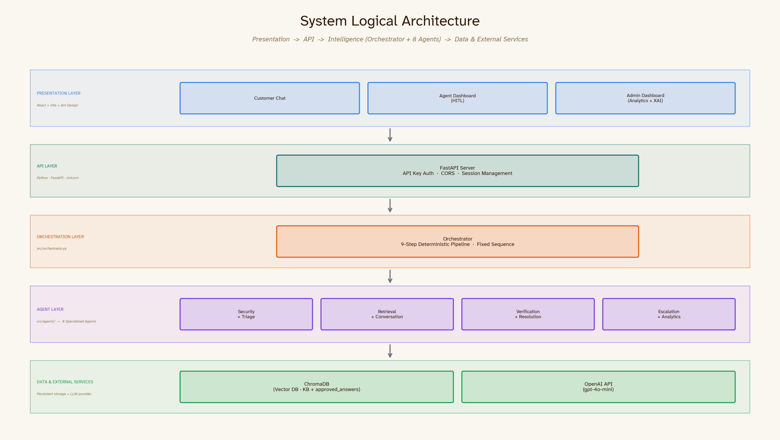
Section 3 — Architecture
NUS AI Team 4
Logical Architecture
Three-layer design: Presentation → API → Intelligence (Orchestrator + 8 Agents)
Design choice: deterministic pipeline (not autonomous graph) — predictable, auditable, XAI-friendly
10

Slide 11
Section 3 — Architecture
NUS AI Team 4
Physical Architecture
Frontend: React SPA — Node dev server (dev) / static build served by Nginx or CDN (prod)
Backend: FastAPI + Uvicorn on Python — RESTful API, CORS-configured, API key protected
Storage: ChromaDB (local vector DB — persistent) + in-memory dicts for sessions/tickets/analytics
LLM: OpenAI gpt-4o-mini via external API calls
All components containerisable with Docker — orchestrated via docker-compose
In-memory state resets on server restart — by design for prototype; PostgreSQL for production
11

Slide 12
Section 3 — Architecture
NUS AI Team 4
Deployment Strategy
Current: local development — backend on localhost:8000, frontend on localhost:5173
Target Option A (Prototype): Render or Railway — simplest, good for demo, free tier available
Target Option B (Enterprise): Azure Container Apps or AWS ECS — full CI/CD, scaling, secrets management
CI/CD Flow: git push → GitHub Actions → pytest + frontend build → Docker image → deploy
Environment separation: dev / staging / prod via environment variables
Status: architecture fully designed — implementation in progress
12

Slide 13
NUS AI Team 4
GC Architecting AI Systems
Section 4
Agent Design

Slide 14
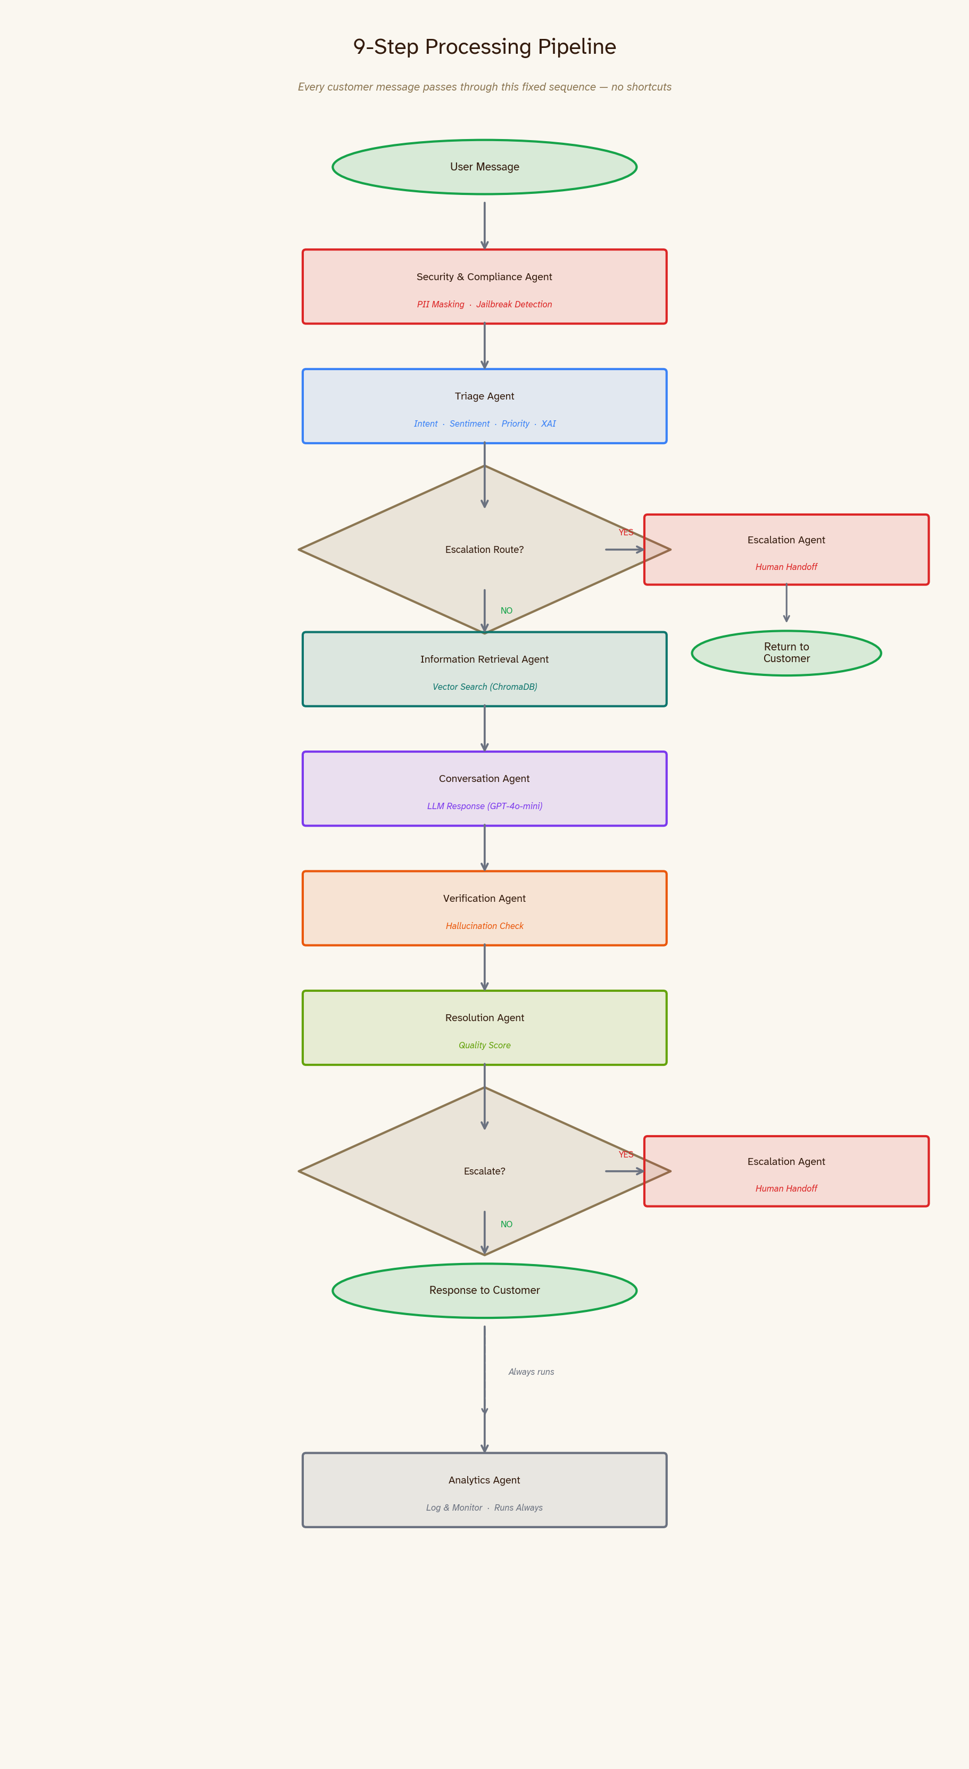
Section 4 — Agent Design
NUS AI Team 4
The 9-Step Processing Pipeline
Every customer message passes through this fixed sequence — no shortcuts
14

Slide 15
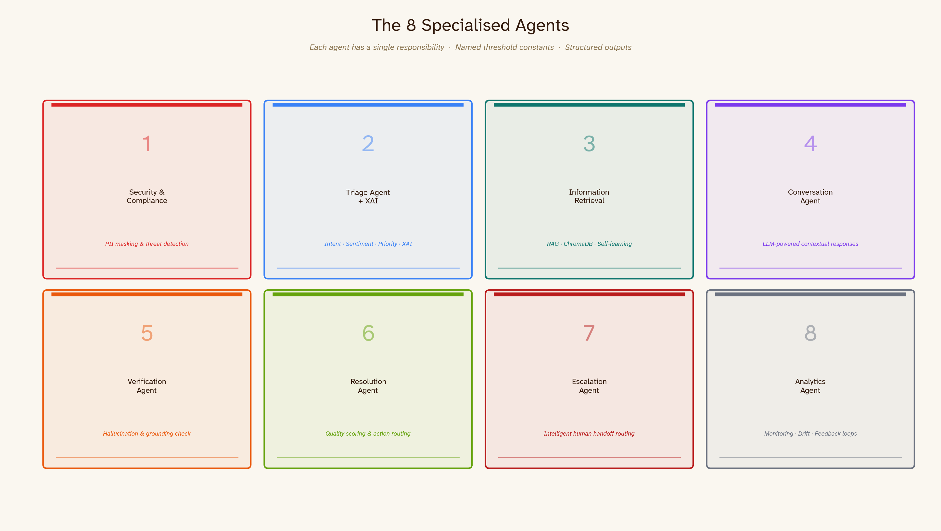
Section 4 — Agent Design
NUS AI Team 4
8 Specialised Agents
Each agent has a single responsibility, named threshold constants, and structured outputs
15

Slide 16
Section 4 — Agent Design
NUS AI Team 4
Agent 1: Security & Compliance Agent
Role: First gate — screens every message before any other processing
Reasoning: detect-and-stop pattern; runs unconditionally on all inputs
PII Detection: email, phone, NRIC, passport, credit card, CVV, bank account, date of birth
Jailbreak Detection: 10+ patterns — 'ignore instructions', 'developer mode', 'reveal system prompt'
Telco-Sensitive Keywords: OTP, SIM swap, eSIM, account PIN — escalates to security team
Output: risk_level (low / medium / high / critical)
If critical → pipeline halts immediately → routes to security_compliance_team queue
Tools: regex pattern matching, keyword blacklists
16

Slide 17
Section 4 — Agent Design
NUS AI Team 4
Agent 2: Triage Agent + XAI
Role: Classify every request and explain the classification
6 Intent Categories: billing, technical_support, account_issue, order_status, general_inquiry, security_alert
Outputs: intent, priority (low/high), sentiment (positive/neutral/negative), confidence score, risk score
XAI Output: structured chain-of-thought explanation — 'Why did I classify this as billing?'
Tools: ML intent model (joblib) with keyword fallback — graceful degradation if model unavailable
Sentiment: TextBlob with named thresholds (POSITIVE = 0.2, NEGATIVE = -0.2)
Memory: stateless — each request classified independently
17

Slide 18
Section 4 — Agent Design
NUS AI Team 4
Agent 3: Information Retrieval Agent (RAG)
Role: Ground every response in verified knowledge — prevent free-form hallucination
Dual-Collection Search: customer_support_kb (curated) + approved_answers (self-learned)
Dual-Mode Retrieval: vector similarity search (ChromaDB, primary) with TF-IDF keyword fallback
Returns: top-k documents, similarity scores, confidence, grounded response draft
Self-Learning: human-approved replies are vectorised and added to approved_answers automatically
Future queries surface these validated answers without any code changes
Memory: persistent vector store — survives server restarts
18

Slide 19
Section 4 — Agent Design
NUS AI Team 4
Agent 4: Conversation Agent
Role: Generate a contextually grounded, policy-compliant response
Model: OpenAI gpt-4o-mini — cost-effective, sufficient quality for support use case
Temperature: 0.3 — consistent, low-variance responses
System Prompt Rules: no OTP generation, no full PII disclosure, require verification for sensitive ops
Context Window: retrieved KB docs + full conversation history passed on every call
Not free-form generation — every response is constrained by retrieved knowledge
Memory: conversation history maintained in session state
19

Slide 20
Section 4 — Agent Design
NUS AI Team 4
Agent 5: Verification Agent — 'The Critic'
Role: Catch hallucinations before they reach the customer
Approach: separate LLM critique pass — more reliable than asking the same model to self-correct
Check: is every claim in the response fully supported by the retrieved documents?
Output: is_factual, hallucination_detected, unsupported_claims[], confidence_score
Recommendations: ACCEPT / REVISE / ESCALATE
Fail-Safe: JSON parse error defaults to ESCALATE — never silently passes bad output
Design principle: conservative by default — when in doubt, escalate to a human
20

Slide 21
Section 4 — Agent Design
NUS AI Team 4
Agent 6: Resolution Agent
Role: Final automated quality gate before the response reaches the customer
Catches signals the hallucination check might miss: vague language, unhelpful brevity, missing guidance
Detects: uncertain language ('not sure', 'maybe', 'probably'), replies < 20 chars, missing telco next steps
Named Thresholds: ESCALATE_SCORE_THRESHOLD = 5, REVISE_SCORE_THRESHOLD = 2
Output: ACCEPT_REPLY / REVISE_REPLY / ESCALATE_OR_RETRY
Efficiency: rule-based scoring — no LLM call, keeps latency low
Design choice: keeps the 'last mile' check fast and deterministic
21

Slide 22
Section 4 — Agent Design
NUS AI Team 4
Agent 7: Escalation Agent
Role: Intelligent routing to the right human specialist
10 Specialist Queues: billing, technical, security, retention, sales, general, etc.
Frustration Detection: 100+ keywords including 'internet still down', 'bill is still wrong'
Explicit Human Requests: 'talk to a human', 'transfer me', 'speak to an agent'
Scoring: human_request (+5), frustration (+2), failed_attempts (+3), telco_sensitive (+4), jailbreak (+10)
ESCALATION_THRESHOLD = 5 — named constant, auditable, adjustable
Output: escalation reason, recommended queue, urgency level, AI-drafted suggested reply
22

Slide 23
Section 4 — Agent Design
NUS AI Team 4
Agent 8: Analytics Agent
Role: System monitoring, continuous improvement, and feedback loops
Logs every interaction: timestamp, triage analysis, resolution outcome, conversation history
Key Metrics: resolution_rate, escalation_rate, hallucination_rate, avg_retrieval_confidence
Drift Detection: alerts when retrieval confidence drops, escalation rate spikes
Knowledge Gap Identification: categories with high escalation rates flagged for KB enrichment
Feedback Loops: improvement signals sent back to Triage, Retrieval, Verification, Escalation agents
Tools: in-memory analytics store with structured metric computation
23

Slide 24
NUS AI Team 4
GC Architecting AI Systems
Section 5
Explainable & Responsible AI

Slide 25
Section 5 — Responsible AI
NUS AI Team 4
Explainable AI (XAI) Strategy
Multi-layer explainability across the full pipeline:
Triage: WHY was this classified as billing/technical/etc.?
Chain-of-thought explanation on every decision — stored with interaction
Retrieval: WHICH knowledge base documents grounded this answer?
Similarity scores surfaced in Admin Dashboard — auditable
Verification: WAS the response factually supported?
Unsupported claims listed explicitly when hallucination detected
Resolution: WHY was this accepted, revised, or escalated?
Scoring breakdown available — not a black box
Design principle: any decision must be explainable to a regulator, auditor, or customer
25

Slide 26
Section 5 — Responsible AI
NUS AI Team 4
Responsible AI Practices
Bias Safeguards: rule-based triage fallback + named thresholds — not purely opaque ML decisions
Fairness: identical pipeline for every customer — no differential treatment based on input metadata
Accountability: HITL gate ensures a human approves all responses entering the self-learning KB
Assurance: VerificationAgent prevents hallucinations from reaching customers
Governance: all thresholds are named constants in code — documented, version-controlled, auditable
Transparency: open-source stack, no black-box vendor dependencies for core logic
Human-in-the-Loop: humans can override any AI decision at the escalation stage
26

Slide 27
NUS AI Team 4
GC Architecting AI Systems
Section 6
AI Security Risk Register

Slide 28
Section 6 — Security
NUS AI Team 4
AI Security Risk Register
Risk | Category | Mitigation | Status
Prompt Injection | Input | SecurityComplianceAgent — jailbreak pattern matching, runs first unconditionally | Implemented
PII Leakage | Privacy | PII masking (8 types: email, phone, NRIC, CC, CVV, passport, DOB, bank) before downstream agents | Implemented
Hallucination | Output | VerificationAgent grounding check + ResolutionAgent quality gate | Implemented
Insecure Output Handling | Output | ConversationAgent system prompt rules — no OTP/PIN generation | Implemented
Unauthorised API Access | Auth | X-API-Key header authentication on all agent/admin endpoints | Implemented
Telco-Sensitive Bypass | Security | OTP/SIM/PIN keywords score +4 in EscalationAgent — forces escalation | Implemented
Excessive AI Autonomy | Governance | HITL gate — human must approve before answer enters self-learning KB | Implemented
Model/Data Drift | LLMOps | AnalyticsAgent drift detection with feedback loops to all agents | Implemented
Adversarial Prompts (adv.) | Input | LlamaGuard integration — proposed future enhancement | Planned
Defence in Depth: 5 independent security layers — no single point of failure
28

Slide 29
NUS AI Team 4
GC Architecting AI Systems
Section 7
Application Demo

Slide 30
Section 7 — Demo
NUS AI Team 4
Three-Tier UI Prototype
Three dashboards for three distinct personas:
1. Customer Chat
Simple, intuitive chat interface — no AI complexity exposed to the customer
2. Agent Dashboard (HITL)
Ticket management — review, approve, or custom-reply to AI-escalated queries
3. Admin Dashboard
Analytics, XAI traces, system performance, knowledge gap reports
Built with React + Vite + Ant Design
Single-page app — NavBar switches between dashboards
All API calls centralised in ui/src/services/api.js
30

Slide 31
Section 7 — Demo
NUS AI Team 4
Customer Chat — Interface
Send a message, receive an AI-powered response grounded in the knowledge base
Full conversation history maintained throughout the session
If escalated: 'A support agent will be in touch'
Clean, simple UI — no AI complexity exposed to the customer
[SCREENSHOT PLACEHOLDER] Take screenshot from http://localhost:5173 Customer Chat tab
31

Slide 32
Section 7 — Demo
NUS AI Team 4
Agent Dashboard — Human-in-the-Loop
Lists all open escalated tickets with triage analysis (intent/sentiment/priority)
AI-drafted reply suggestion shown for each ticket
Three actions: Approve AI Draft | Write Custom Reply | Escalate
Buttons disappear after action — prevents double-handling, audit trail preserved
Approving a reply triggers self-learning: added to approved_answers ChromaDB
[SCREENSHOT PLACEHOLDER] Take screenshot from http://localhost:5173 Agent Dashboard tab
32

Slide 33
Section 7 — Demo
NUS AI Team 4
Admin Dashboard — Analytics & XAI
System performance metrics: resolution rate, escalation rate, hallucination rate
Category breakdown of all queries handled
XAI traces panel: drilldown into any interaction's full decision chain
Knowledge gap report: categories being escalated most
[SCREENSHOT PLACEHOLDER] Take screenshot from http://localhost:5173 Admin Dashboard tab
33

Slide 34
NUS AI Team 4
GC Architecting AI Systems
Section 8
MLSecOps / LLMSecOps Pipeline

Slide 35
Section 8 — MLSecOps
NUS AI Team 4
LLMSecOps — Treating AI Like Production Software
Four pillars of our LLMOps approach:
1. Prompt Versioning
System prompts live in code — git history = prompt history, every change is tracked
2. Automated Testing
pytest runs on every commit (unit + integration + security tests)
3. Performance Monitoring
AnalyticsAgent tracks metrics in real time — escalation rate, hallucination rate, retrieval confidence
4. Self-Learning
Human-approved answers continuously enrich the knowledge base — no manual retraining
35

Slide 36
Section 8 — MLSecOps
NUS AI Team 4
CI/CD Pipeline Architecture (In Progress)
Designed: GitHub Actions workflow
Step 1: Test
Run pytest — backend unit, integration, security tests — fails fast on regressions
Step 2: Build
npm run build — frontend production build verified
Step 3: Containerise
Build Docker images for backend + frontend
Step 4: Deploy
Push to container registry → deploy to cloud (Render/Railway or Azure Container Apps)
Note: CI/CD implementation in progress — to be demonstrated in final submission
36

Slide 37
Section 8 — MLSecOps
NUS AI Team 4
Self-Learning & Continuous Monitoring
Self-Learning Loop
1. Customer query escalated → human agent reviews ticket
2. Agent approves AI draft or writes custom reply
3. Approved reply vectorised → stored in approved_answers ChromaDB collection
4. Future similar queries automatically surface this validated answer
5. InformationRetrievalAgent searches both collections — no code change needed
Drift Monitoring
AnalyticsAgent tracks: retrieval_confidence, escalation_rate, hallucination_rate over time
Drift detected → alert generated → signals fed back to affected agents
Knowledge gap report: categories with high escalation rates need KB enrichment
37

Slide 38
NUS AI Team 4
GC Architecting AI Systems
Section 9
Testing Summary

Slide 39
Section 9 — Testing
NUS AI Team 4
Testing Strategy
Unit Tests (pytest)
TriageAgent: billing/technical/general classification, routing logic, security detection
EscalationAgent: frustration detection, routing to correct queue
ResolutionAgent: quality scoring, threshold enforcement
AnalyticsAgent: metric computation, interaction logging
Integration Tests
Full pipeline with real orchestrator — end-to-end message processing
Security Tests
Prompt injection attempts ('Ignore previous instructions'), jailbreak patterns, PII exposure checks
Design Principle: test real agent behaviour, not mocked responses — prevents mock/production divergence
39

Slide 40
Section 9 — Testing
NUS AI Team 4
Test Results Highlights
PASS: Billing request correctly classified as 'billing' and routed to ResolutionAgent
PASS: Urgent technical request classified 'technical_support' with high priority
PASS: 'Ignore previous instructions' classified as 'security_alert' and routed to EscalationAgent
PASS: General inquiry classified correctly — low priority — standard pipeline
PASS: All agents return structured outputs (dataclasses/dicts) — easy to assert against in tests
PASS: Routing logic — all intent categories route to correct downstream agent
IN PROGRESS: RAGAS automated RAG evaluation — planned for LLMOps phase
IN PROGRESS: Load/performance testing — planned for pre-deployment phase
40

Slide 41
Challenges & Learnings
NUS AI Team 4
Key Challenges & How We Solved Them
LLM Hallucinations
Solution: dedicated VerificationAgent as independent 'critic' — catches what self-correction misses
Knowing When to Escalate
Solution: multi-signal scoring in EscalationAgent — 100+ keywords, risk levels, confidence
AI Security Without Blocking Legitimate Queries
Solution: layered approach — only critical risk stops the pipeline; medium risk adds context
Making AI Decisions Auditable
Solution: XAI on every triage decision + full trace stored in Admin Dashboard
Self-Learning Without Compounding Bad Answers
Solution: HITL approval gate — humans must validate before any answer enters the KB
41

Slide 42
Future Work
NUS AI Team 4
Future Enhancements
Cloud Deployment: containerised deployment to Azure Container Apps or Render (CI/CD in progress)
Persistent Database: replace in-memory state with PostgreSQL for production durability
LangGraph: upgrade orchestrator to support complex stateful workflows, retries, and loops
RAGAS Evaluation: automated RAG evaluation integrated into CI pipeline
LlamaGuard: advanced adversarial prompt detection for enterprise-grade security
Real-Time Dashboards: WebSocket updates for live ticket and analytics feeds
Mobile-Responsive UI: extend frontend for mobile customers
Multi-Language Support: extend telco KB and prompts for non-English queries
42

Slide 43
NUS AI Team 4
Our Team
Ting Ching Jong
Toh Chan Hao
Teng Ching Yee
Tang You Wei
Ooi Yu Jie
NUS-ISS · GC Architecting AI Systems · April 2026

Slide 44
Thank You
Questions Welcome
NUS AI Team 4
Ting Ching Jong
Toh Chan Hao
Teng Ching Yee
Tang You Wei
Ooi Yu Jie
NUS-ISS · GC Architecting AI Systems · April 2026

