Slide 1
Academic Data Collection at RPI: Class Times
Kerui Wu

Slide 2
Goal
Statistics on class time for each subject at RPI
Help students to gain insights into departmental characteristics
Aid students in making informed decisions regarding their choice of major

Slide 3

Data Collection
Thank you Quacs!
Python
Selenium
used to control web browsers and perform browser automation
Automatically read and parse the data

Slide 4
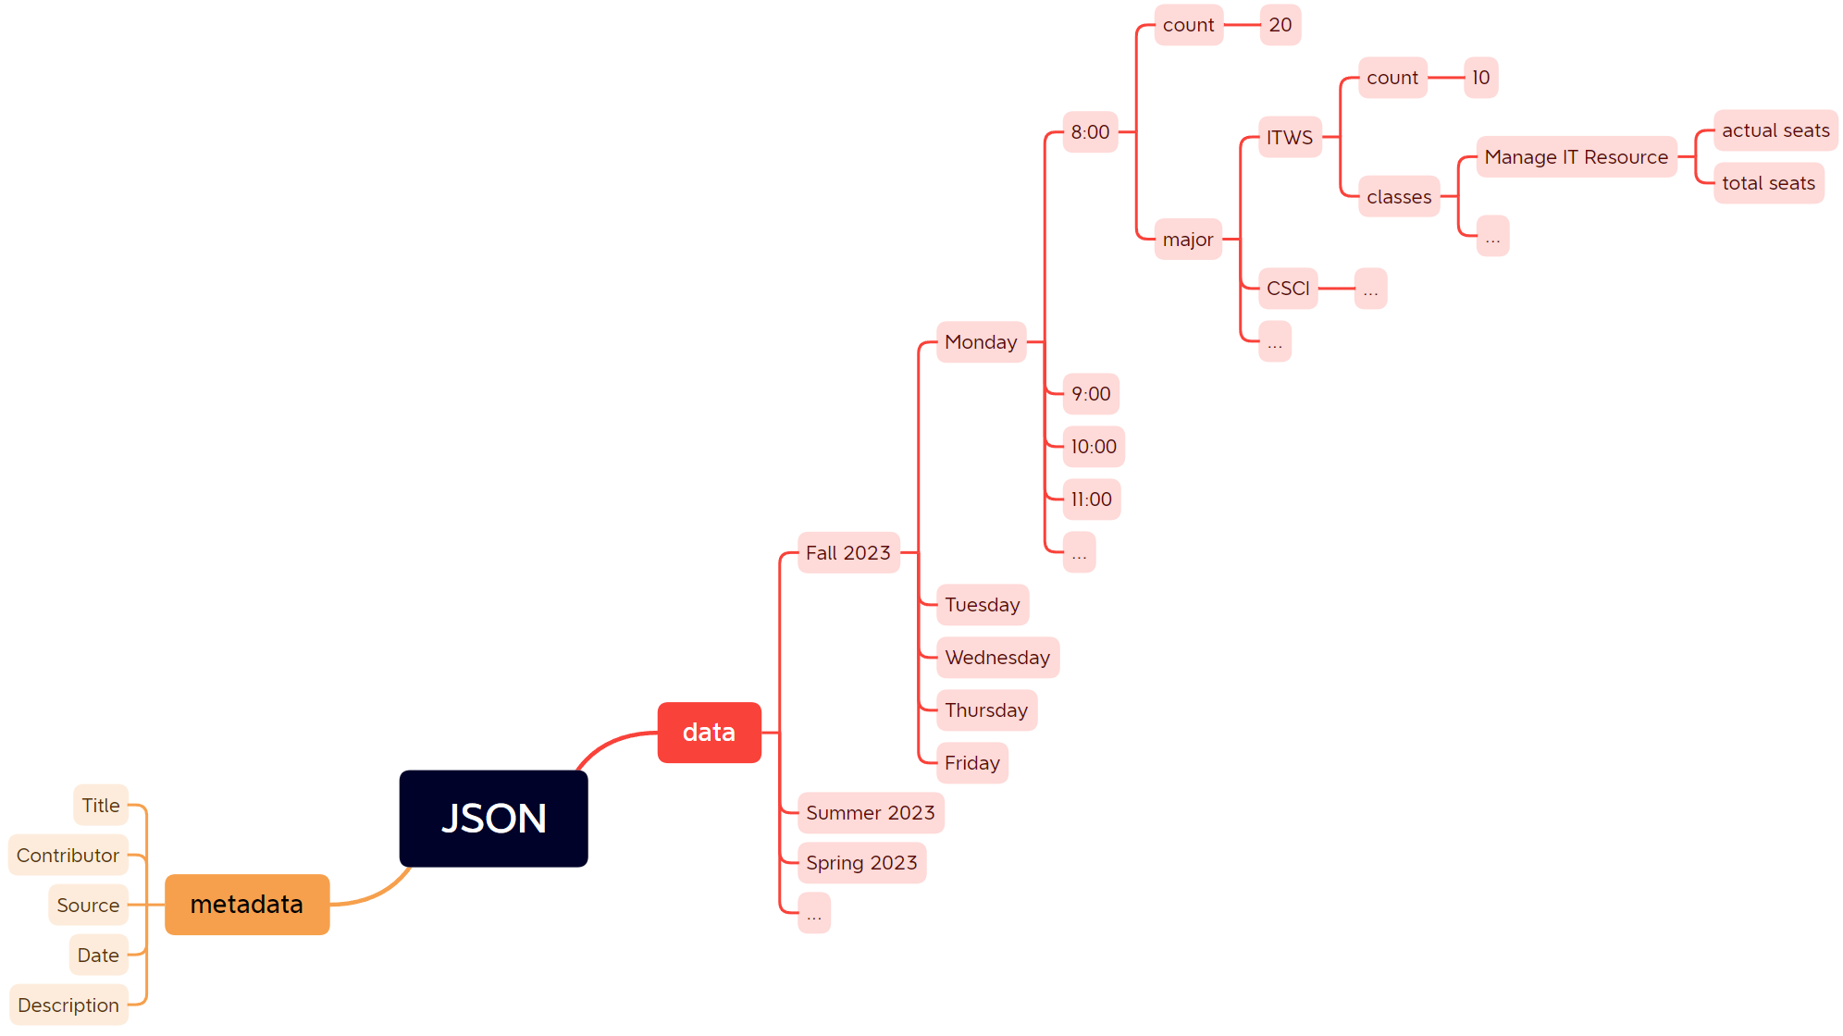
Data Format

Slide 5
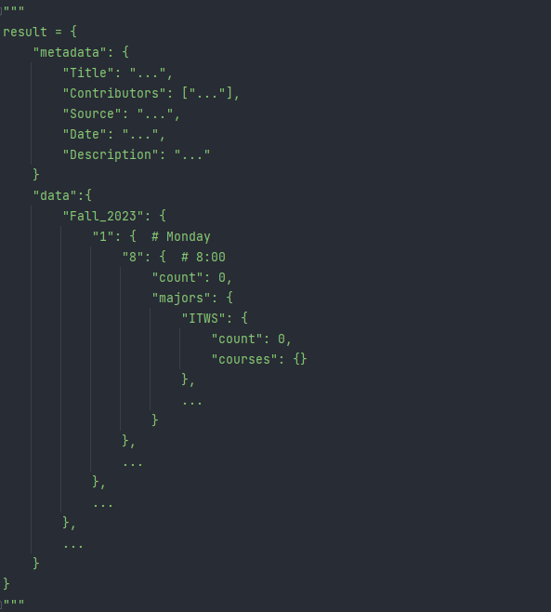
Data Format

Slide 6
Data Sample
“Monday”: {“8:00 a.m”: {“count”: 33, “majors”: {
“ENGR”: {
"count": 7,
"courses": ["ENGR4760", "ENGR1100","ENGR2050","ENGR2530", "ENGR2090",
"ENGR2300", "ENGR2600"]
}, “MATH”: {“count”: 5, …}, “MGMT”: {“count”: 3, …}, “PHYS”: {“count”: 2}, …
}}}

Slide 7
Data Sample

Slide 8

Data Storage
Github
https://github.com/Yujjio/Academic_Data_Collection_at_RPI_Class_Times
GPL License
Open Source license
Everyone is welcome to use
MongoDB

