Slide 1
Network Protocols

Slide 2

What is a Network?
A network is a way to transfer information or goods between people, places, or things.
1

Slide 3
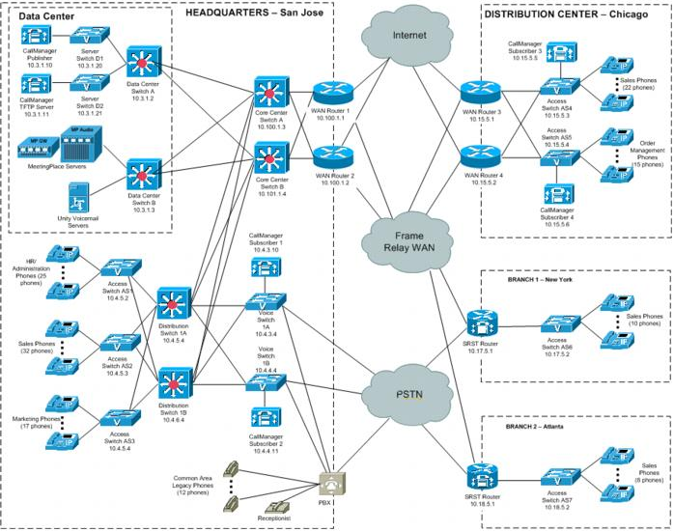
Computer Networking
Connecting devices together to share data
Switch: links devices together to form a network
Router: connects networks together and acts as a dispatcher
Some devices act as both switch and router (many of the consumer-grade routers, for example)
2
IP Telephony Network Topology Diagram Example (Cisco)

Slide 4


How does it work?
3

Slide 5
A Simple View
Application
Application
messages
HTTP
HTTP
TCP
TCP
Transport
HTTP
HTTP
Transport
Internet
IP
IP
Internet
TCP
TCP
HTTP
HTTP
Link
Link
Ethernet
Ethernet
IP
IP
TCP
TCP
HTTP
HTTP
IP?
IP
Notes:
Wrapper
HTTP, TCP, DNS

Slide 6
Messages
Application
HTTP
message, data
TCP
segment, datagram
Transport
HTTP
Internet
IP
packet
TCP
HTTP
Link
Ethernet
IP
frame
TCP
HTTP
All are “messages”.
All are frequently referred to as “packets” (and for the purposes of this class, that’s ok).

Slide 7
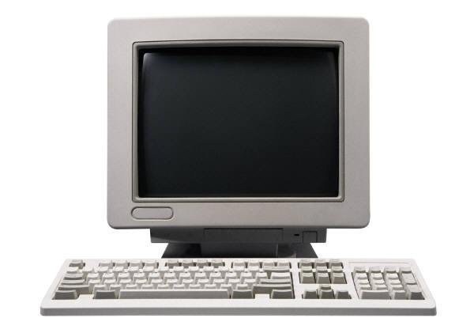
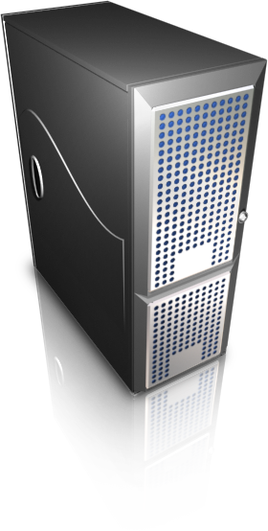
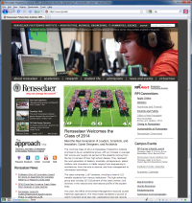

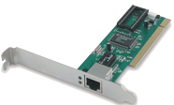
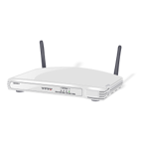

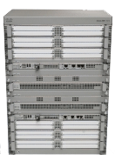

Web Browsing
1. TCP three-way-handshake: establish a connection
Application
client
server
Application
Transport
Note: There’s a DNS lookup of hostname over UDP...
Transport
TCP
1. SYN
3. ACK
2. SYN+ACK
TCP
Internet
Internet
IP
IP
Link
Link
MAC
MAC

Slide 8
Web Browsing
2. Use the HTTP protocol to get a web page (and we’ll make further requests for all its resources, too)
Application
client
server
Application
apache web server
HTTP GET Request
HTTP Response
Transport
Transport
:80
TCP
ESTABLISHED
ESTABLISHED
TCP
Internet
Internet
IP
IP
Link
Link
MAC
MAC

Slide 9
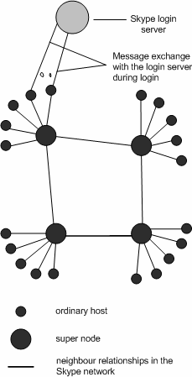


Skype
P2P VOIP
peer
1. Connects to the login
server (TCP) – (all TCP
connections require the
three-way handshake)
2. Connects to a super node (TCP) So calls can be relayed behind firewalls. See http://www.theregister.co.uk/2003/10/08/how_does_skype_get_through/
3. Can use both
TCP and UDP
during calls.
If both Skype Clients are
public, messages are passed via UDP.
peer
Application
Application
Transport
Transport
UDP
UDP
Internet
Internet
IP
IP
Link
Link
5

Slide 10
What is a Protocol?
A protocol is a set of rules
“A set of conventions governing the treatment and especially the formatting of data in an electronic communications system.” Merriam-Webster Dictionary
Already we've named:
HTTP, DNS, TCP, UDP, IP, and Ethernet protocols

Slide 11
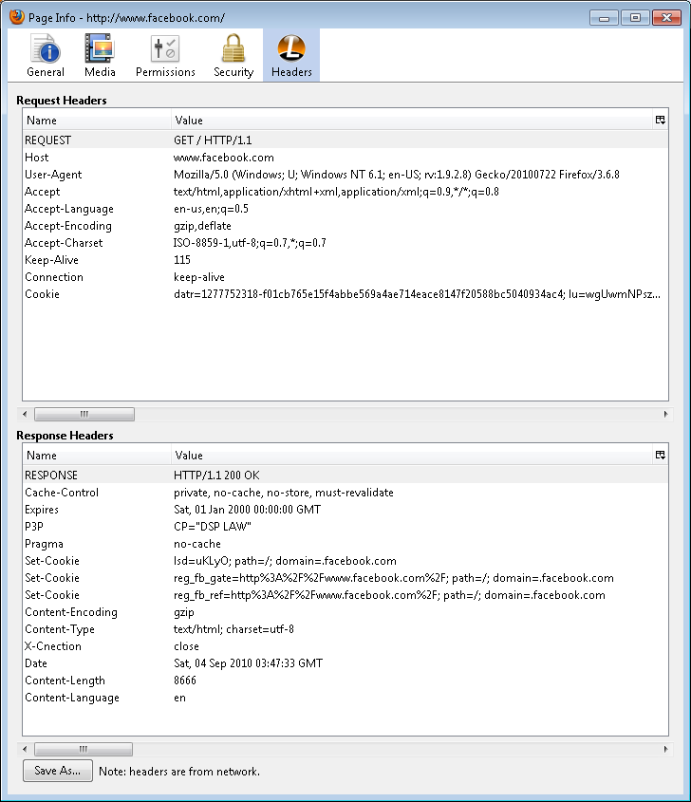
HTTP Protocol
Let’s look at an HTTP request / response cycle:
Open Firefox, and visit http://www.facebook.com (or any site of your choosing)
Select “Tools → Page Info” from the menu bar
Select “Headers” to see the Request and Response headers

Slide 12
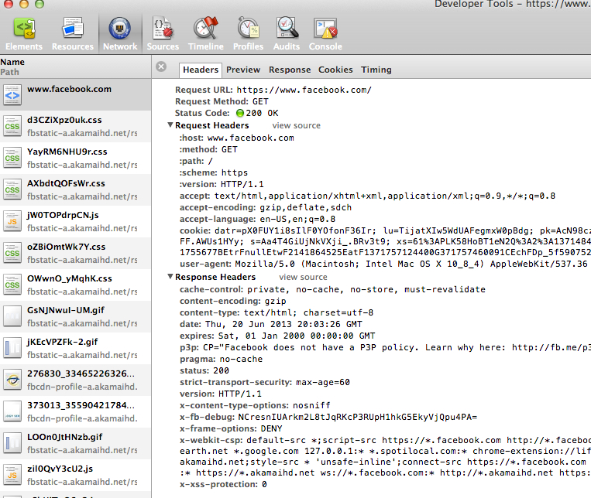
HTTP Protocol
Let’s look at an HTTP request / response cycle:
Open Chrome, and visit http://www.facebook.com (or any site of your choosing)
Select (Hotdog menu) → Tools
→ Developer Tools
Select Network and then select a
page (in this case www.facebook.com)
Select “Headers” to see the Request and Response headers

Slide 13
Network Models and the Internet Protocol Suite (TCP/IP)

Slide 14
Network Models
OSI 7-Layer reference model
Internet Protocol Suite
(also known as TCP/IP)
Protocol Examples
7
Application
Application
HTTP, FTP, IMAP, POP, SSH...
6
Presentation
5
Session
4
Transport
Transport
TCP, UDP...
3
Network
Internet
IP (v4, v6)...
2
Data Link
Link
Ethernet, IEEE 802.11, USB, DSL...
NIC, Category 5 cables, Microwave
1
Physical
RFC 1122
http://tools.ietf.org/html/rfc1122

Slide 15
Web Browsing
Revisited
Application
client
server
Application
apache web server
HTTP GET Request
HTTP Response
Transport
Transport
:80
TCP
ESTABLISHED
ESTABLISHED
TCP
Internet
Internet
IP
IP
Link
Link
MAC
MAC

Slide 16
The Link Layer
Application
Transport
Internet
Link

Slide 17
Link Layer
Physical layer
Primarily Cat 5 or 6 (wired) and Microwave (wireless)
Transmits and receives signals in the form of electrical current, light pulses, microwaves, etc.
Data link layer
The Data layer converts the signal from the Physical layer into 1s and 0s that can be used by the Network layer (and vice versa)
Ethernet is the most common data layer protocol
Data layer messages (called frames) can only send messages on the local network
Application
Transport
Internet
Data Link
Physical

Slide 18
Ethernet: Addressing
Every Ethernet adapter must have a unique address:
Media Access Control (MAC) address
aka physical address, Ethernet address, adaptor address, or hardware address (Saunders)
is unique to a specific Ethernet adapter
12-digit (48 bit) hexadecimal address
e.g. 00-13-CE-BE-8B-9F
Note: 64 bit MAC addresses will supersede 48 bit addresses due to address exhaustion
The first 6 digits are the Vendor code, (0013CE belongs to Intel), the last 6 are the individual interface’s own. (Saunders)
See http://coffer.com/mac_find/ to look up some vendor codes.

Slide 19
Ethernet Communication 1 of 2
If one machine on an Ethernet Local Area Network wants to communicate with another, it sends a “broadcast” frame
All machines on the wire see the frame
Check the destination address - is it me?
yes - hand data up the stack
no - ignore (or so we hope...)
When the recipient responds, it will include it’s MAC address in the frame headers
From this point, sender and receiver know each other by MAC address (no more broadcasts until a set period of time has passed)
Application
Transport
Internet
Link

Slide 20
Ethernet Communication 2 of 2
Sender constructs a frame
header includes source and destination address
payload (data) comes from higher layer
Sender puts the frame on “the wire”
asks physical layer to send it
Application
Transport
Internet
Link
frame
header
footer
higher layer data
payload

Slide 21
The Internet Layer
Application
Transport
Internet
Called the “Network Layer” in the OSI Reference Model
Link

Slide 22
Internet Layer
Application
When you link computers up via the Link Layer you get a network.
When you link networks up, you get an internetwork.
You need the Network layer to get data between all the little networks (often called subnets) of your internetwork. (Saunders)
Transport
Internet
Link

Slide 23
Internet Protocol (IP)
The Internet Protocol (IP) is the Network layer protocol used on the Internet! It’s so handy that most everyone uses it on all their networks big and small.
Designed for huge, ever-expanding networks of networks. Works pretty well with unreliable links, routes can be re-built when links go down. Saunders, Drew. Introduction to Networking [PDF Document]. Retrieved from http://www.stanford.edu/dept/its/support/techtraining/techbriefing-media/Intro_Net_91407.ppt Used with permission of the author.
Application
Transport
Internet
Link

Slide 24
IP Address (IPv4)
Class A | Net ID | Host ID
Class B | Network ID |  | Host ID
Class C | Network ID |  |  | Host ID
 | 8 bits | 8 bits | 8 bits | 8 bits
IP Address:
First byte(s) identify the network
Last byte(s) identify the machine
RPI is a Class B network
128.113.subnet.host
Every host must have a unique IP address
Examples:
128.113.91.241
173.194.33.104

Slide 25
Dotted Decimal Notation
IPv4 addresses are typically displayed by showing the value of each byte (in decimal).
Binary | Dotted Decimal
00000001 00000010 00000011 00000100 | 1.2.3.4
10000000 11010101 00000001 00000001 | 128.213.1.1
01111111 00000000 00000000 00000001 | 127.0.0.1 (localhost)

Slide 26
IPv6
IPv4 addresses are 4 bytes (32 bits)
Supports 2³² (approximately 4.3 billion) addresses
These are becoming exhausted
IPv6 addresses are 16 bytes (128 bits)
Supports 2¹²⁸ (approximately 340 undecillion) addresses
Notation uses hexadecimal representing pairs of bytes separated by a colon. For example: 2620:0:2820:2:3c7f:8f2:389a:b053
How big is 340 undecillion?
If you were to line up 340 undecillion soccer balls back-to-back on a string, the strand would wrap around our known universe 200 billion times.
IPv6 .340 Undecillion Soccer Balls. [Web log posting]. Retrieved August 31, 2011 from http://www.ipv6resource.com/340-undecillion-soccer-balls.html
Notes:
About 5*10^28 per each of the 7Billion on the planet

Slide 27
IP Routing 1of 3
How do we communicate between machines when all we may have is an IP address??
ARP: Address Resolution Protocol
Turns an IP address into a MAC address. You ask “Who’s 172.19.4.15” and if you get a reply, associate the MAC address with the IP address in your ARP table, and now you can keep sending your data to the intended recipient via the correct MAC address. (Saunders)
Every IP number not on your local network will “belong” to your router in your ARP table.
Application
Transport
Network
Link
ARP

Slide 28
IP Routing 2 of 3
Routers keep a table of networks attainable by the router, called a “routing table”
A routing table keeps track of
the topology of the network immediately around it,
measurements to determine best paths to destination networks it knows about,
and contains a “default route” for everything else.
Application
Transport
Network
Link

Slide 29
IP Routing 3 of 3
When an Ethernet frame arrives at a router, it looks at the destination IP address inside the Internet packet and sends a new Ethernet (or other link layer) frame out the correct interface based on the routing tables.
That frame may go to the final host if it’s on one of the routers directly connected networks, or to another router, which does the same process, until your packet gets to the router responsible for that local network, who then sends your packet to the intended host.
Application
Transport
Internet
Link

Slide 30
The Transport Layer
Application
Transport
Internet
Link

Slide 31
Transport Layer 1 of 2
Application
Responsible for delivering data to the application layer and for preparing application layer data for transport to other hosts
Breaks the data up into packets - usually called segments
Includes source and destination port numbers for application layer processes in its headers
Transport
Internet
Link

Slide 32
Transport Layer 2 of 2
Transmission Control Protocol (TCP)
Guarantees reliability and sequencing
Connection-oriented transmission
Used by HTTP, FTP, SSH, Email
User Datagram Protocol (UDP)
Does not guarantee reliability or sequencing
Connectionless, best-effort transmission
Used by VOIP, DNS, RTP where speed is more important than lost or damaged packets
Both use port numbers to identify processes
e.g. http is often on port 80, https is often on port 443, mysql is often on port 3306, etc.
Application
Transport
Internet
Link
Notes:
TCP – Mom calls you on your cell phone to come home for dinner
UDP – Mom shouts out the front door

Slide 33

Sequencing
Application
Transport
Internet
Link
Different packets may take different routes to get to their destination
TCP has to put things back in order, UDP does not (though an application may try to do so, e.g. while buffering video)

Slide 34
Ports 1 of 2
Ports are application or process-specific endpoints for data communication
Source and destination ports are included in the transport layer headers
Application
Transport
Internet
Application
Process
Process
Process
Link
Process
Process
ports
ports
ports
Transport
Notes:
Like the childs game with a board and differently-shaped holes
Like a screen fence, or sieve

Slide 35
Ports 2 of 2
Port numbers less than 1024 are typically reserved for important network services
Common well-known port numbers include 80 (HTTP), 443 (HTTP over TLS/SSL), 53 (DNS) etc.
You’ll sometimes see port numbers on URLs, e.g. “http://somesite:8080”
Application
Transport
Internet
Link

Slide 36
The Application Layer

Slide 37
Application Layer
HTTP
Hypertext Transfer Protocol for the WWW
POP, IMAP
Post Office Protocol and Internet Message Access Protocol for reading email
SMTP
Simple Mail Transfer Protocol for sending email
DNS
Protocol for the Domain Name System (both are referred to as “DNS”)
RTP
Real-time Transport Protocol for delivering audio and video (e.g. VOIP – uses RTP over UDP)
Many more...
Application
Transport
Internet
Link

Slide 38
Application Layer Example: DNS
Domain Name System

Slide 39
Domain Name System
Domain Name System (DNS)
It’s hard to remember IP addresses
Since computers require numbers, DNS provides a lookup service to convert domain names to IP addresses
Example:
If you want the number for a host name within the rpi.edu domain, you’ll ask one of our DNS servers to give it to you. If you need to go outside rpi.edu, you’ll still ask our servers, but they’ll figure out which other server(s) should get your request, send it to them (unless our server has already cached it), and will send the reply back to you.

Slide 40
Domain Name Hierarchy
managed by IANA: Internet Assigned
Numbers Authority*
other TLDs, e.g. net / gov / mil / etc...
com
org
edu
rpi
m
www
managed by Rensselaer
*IANA is part of ICANN: the Internet Corporation For Assigned Names and Numbers

Slide 41
2011: TLDs for Sale
June 2011: ICANN, the "Internet Corporation for Assigned Names and Numbers", approves a plan to allow groups to create new generic top level domains http://www.icann.org/en/announcements/announcement-20jun11-en.htm
Becoming a registrar is somewhat expensive:
$185K evaluation fee
Can take up to 20 months to go through evaluation
$25K per year if approved (plus possible other fees)

Slide 42
Suggested Reading
Designing for Cisco Internetwork Solutions, Chapter 1. Network Fundamentals Review.
http://opac.lib.rpi.edu/search/t?SEARCH=Designing%20for%20Cisco%20Internetwork%20Solutions&searchscope=1

Slide 43
Works Cited
List of Figures
Saunders, Drew. Introduction to Networking [PDF Document]. Retrieved from http://www.stanford.edu/dept/its/support/techtraining/techbriefing-media/Intro_Net_91407.ppt Used with permission of the author.
IPv6 .340 Undecillion Soccer Balls. [Web log posting]. Retrieved August 31, 2011 from http://www.ipv6resource.com/340-undecillion-soccer-balls.html
How were the messages sent along the wall? [Photograph, Great Wall of China]. Retrieved August 4, 2010 from http://www.visitourchina.com/china_great_wall/faq_02.htm
IP Telephony Network Topology Diagram Example [Bitmap]. Retrieved August 31, 2011 from http://www.cisco.com/iam/unified/ipt1/Preparing_Your_Network_for_Troubleshooting_and_Recovery.htm
Google Logo [Bitmap]. Retrieved September 3, 2010 from http://www.google.com
Slides 7 & 8: Cisco ASR 1000 Series Aggregation Services Routers [Photograph]. Retrieved September 5, 2010 from http://www.cisco.com/en/US/products/ps9343/prod_view_selector.html Cisco WS-C3750-48PS-S Catalyst 3750-48PS SMI Network Switch - 48-Port, 10/100, PoE [Photograph]. Retrieved September 5, 2010 from http://images.highspeedbackbone.net/skuimages/large/C94-2196-main.jpg
Baset, Salman A. and Henning Schulzrinne. (2004). An Analysis of the Skype Peer-to-Peer Internet Telephony Protocol [PDF Document]. Retrived from http://arxiv.org/ftp/cs/papers/0412/0412017.pdf [Untitled photo of iPhone with Skype]. Retrieved September 5, 2010 from http://static.skattertech.com/media/2010/05/skype-mobile-for-iphone-3g-600x342.jpg

