Slide 1
Forest cover classification -- stat 5003
Presented by Yujun Liu

Slide 2
Dataset Description
Classification Algorithms
PART 01
PART 02
PART 03
PART 04
PART 05
Overview of Problem
EDA & Feature Enginerring
Evaluation & Conclusion

Slide 3

1. Overview of the problem
We found the Forest Cover type dataset in the UCI Machine Learning Repository that takes forestry data from four wilderness areas in Roosevelt National Forest in northern Colorado .The observations are taken from 30m by 30m patches of forest that are classified as one of seven cover types:
The relative sizes of the train and test sets makes classification of cover type a challenging problem. We decided to use the machine learning and visualization packages available in R for this project.

Slide 4
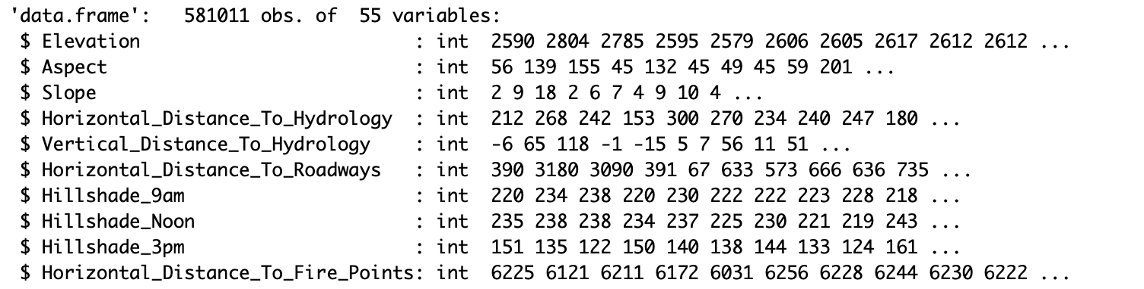
2. Dataset description
Dimension of the Dataset is 581,011 * 55
-- 10 Numeric Attributes
-- 44 Categorical Attributes: Wilderness Area Type (4) & Soil Type (40)
Multi-Class Classification Problem
-- 7 Types of Forest Cover Type
-- Goal: Predict Forest Cover Type
1 | Spruce/Fir
2 | Lodgepole Pine
3 | Ponderosa Pine
4 | Cottonwood/Willow
5 | Aspen
6 | Douglas-Fir
7 | Krummholz

Slide 5
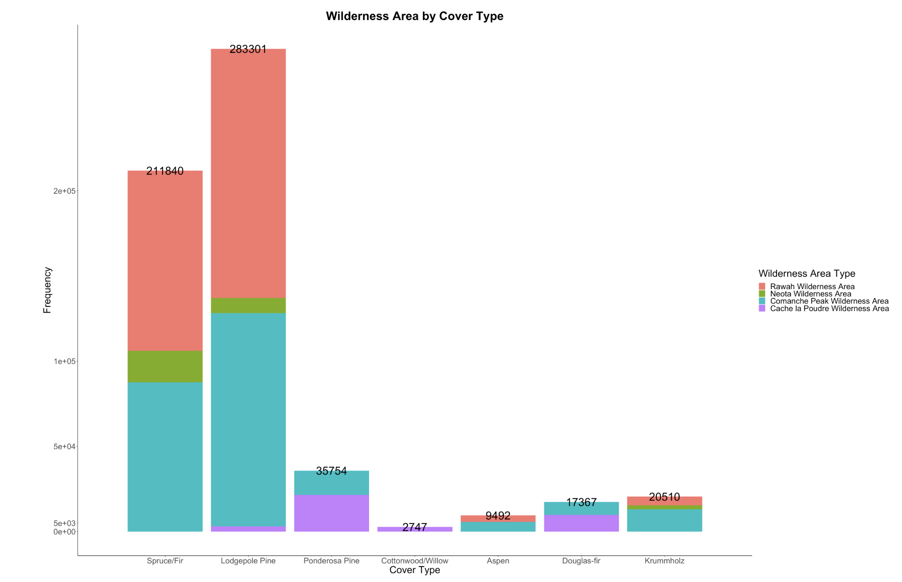
2. Dataset description
Distribution of Wilderness Area

Slide 6
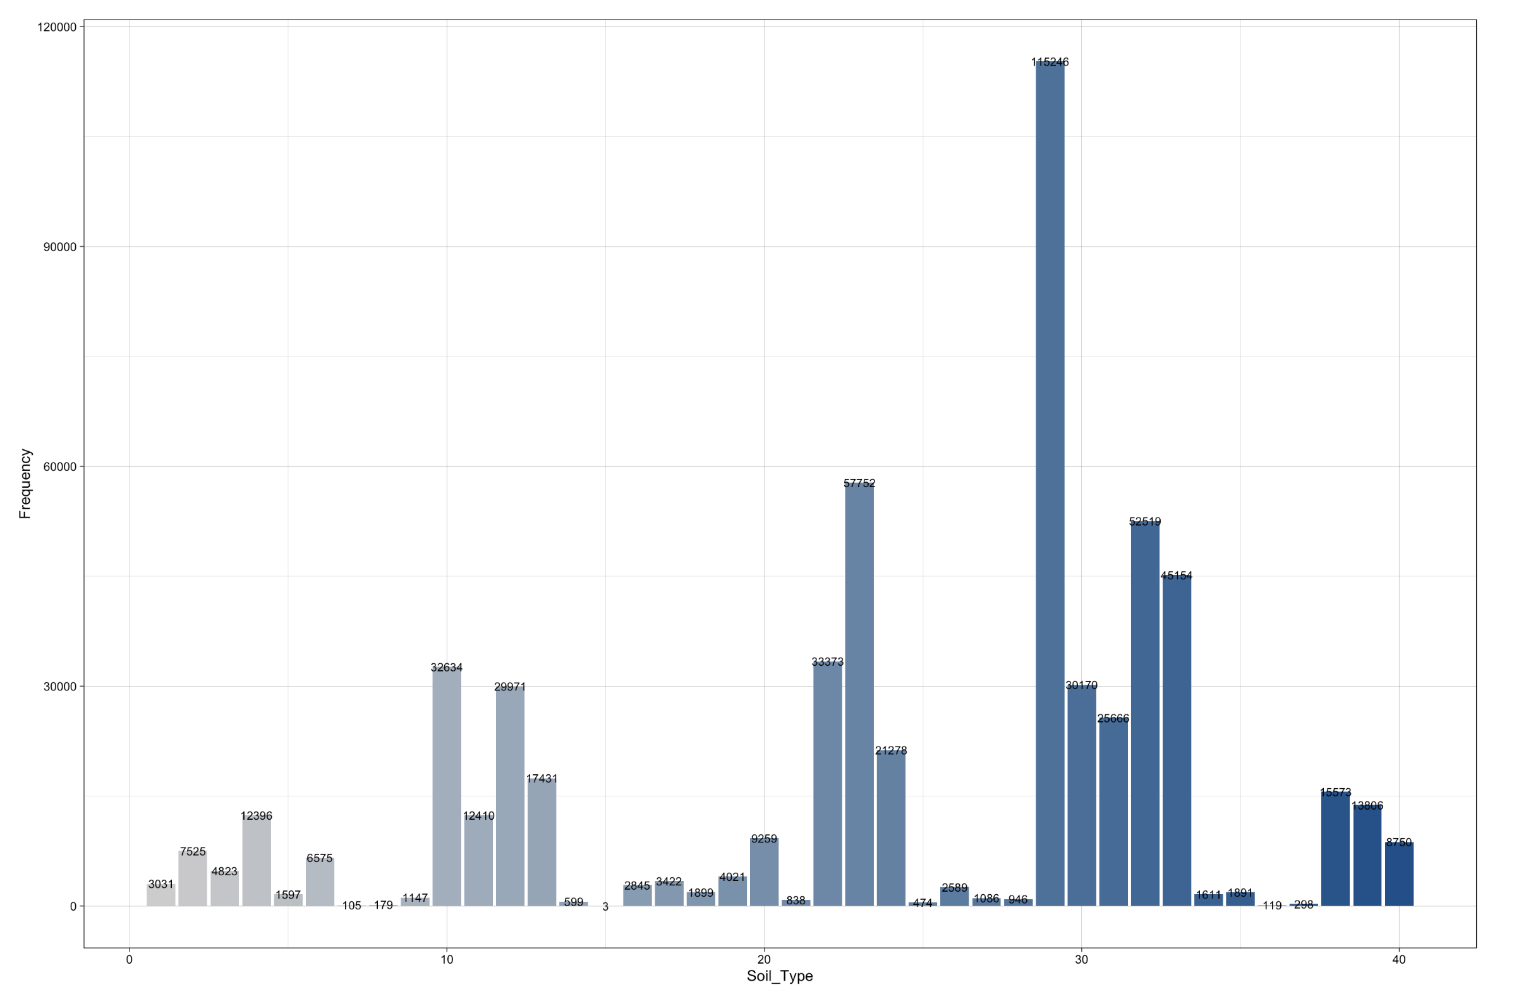
2. Dataset description
Distribution of Soil Type
Soil Type 29 Outstands Others:
Como – Legault Families Complex, extremely Stony

Slide 7
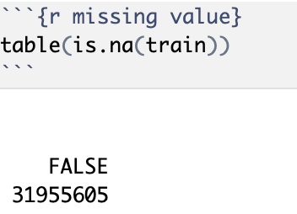
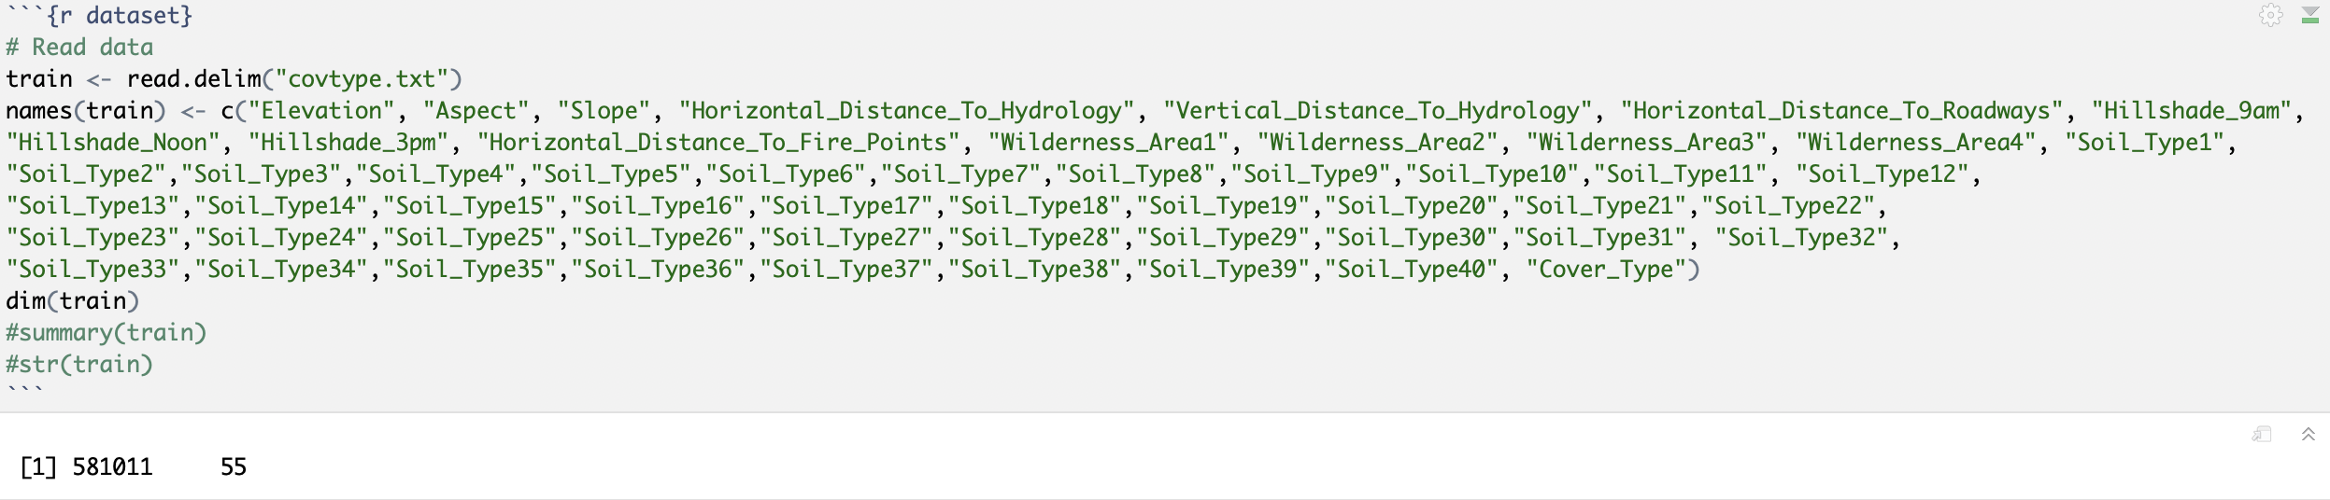
3. Data cleaning
The Dataset is Complete
The Initial Dataset does not have Column Names
-- Add Column Names to the Dataset

Slide 8
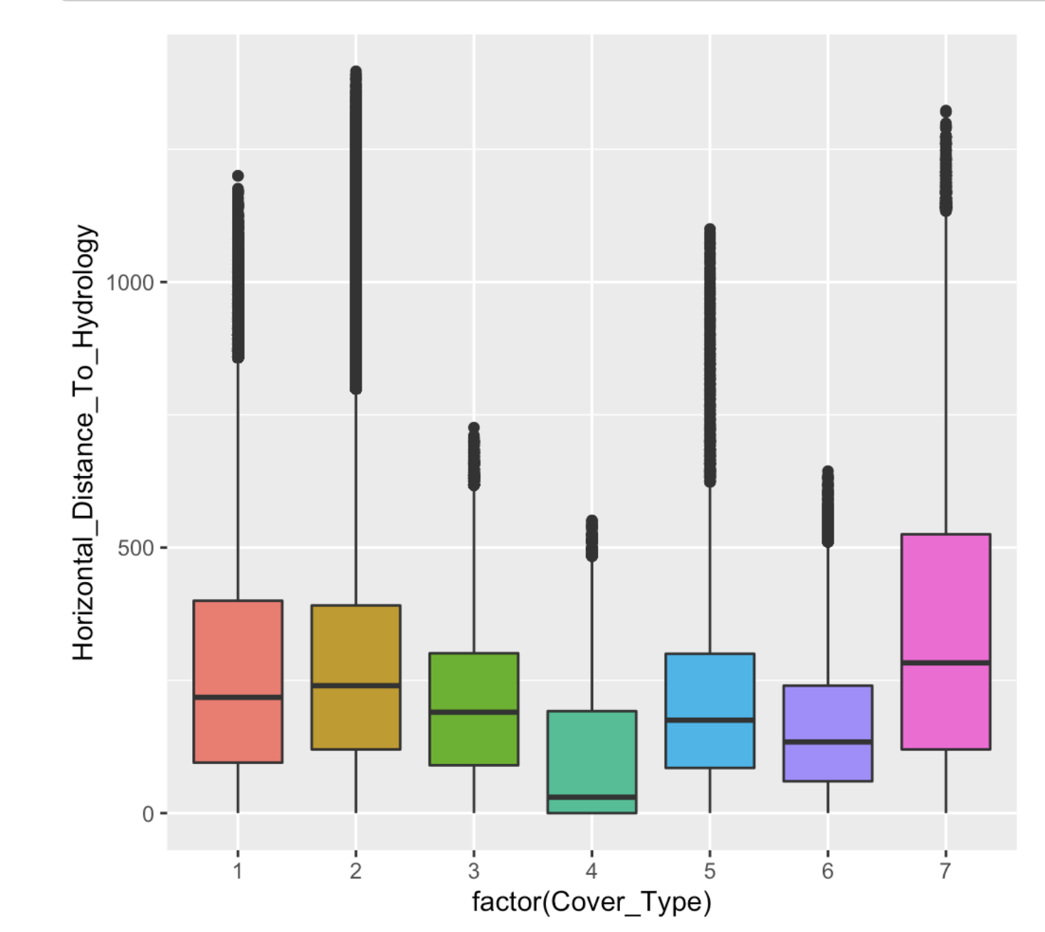
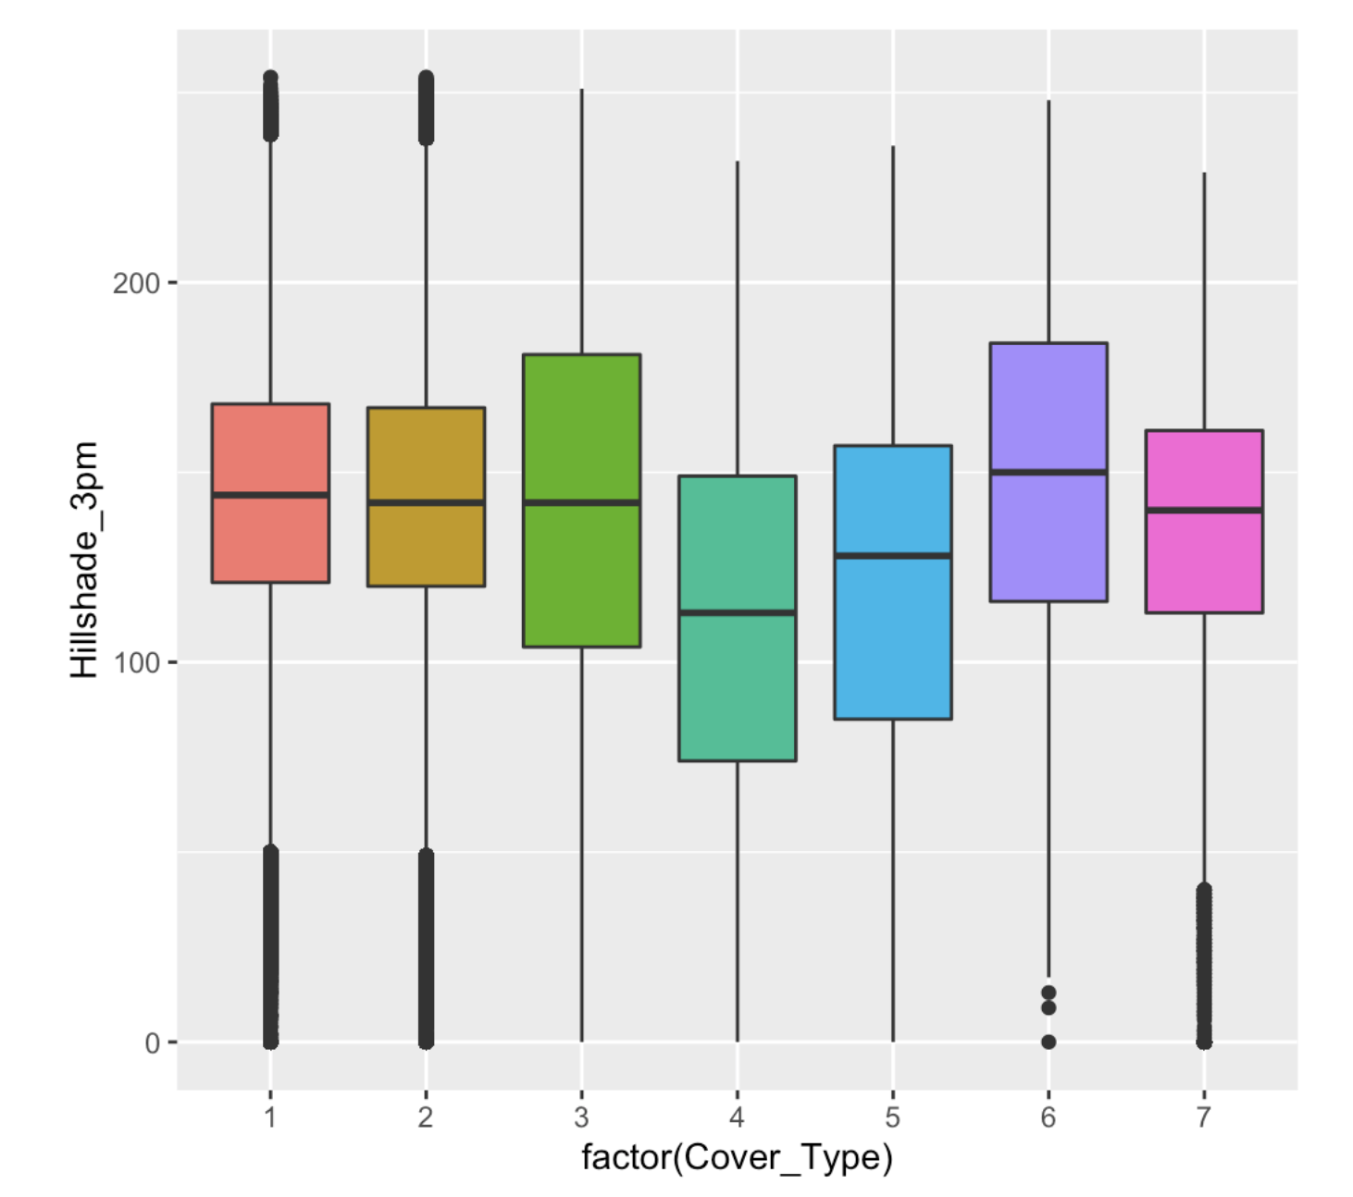
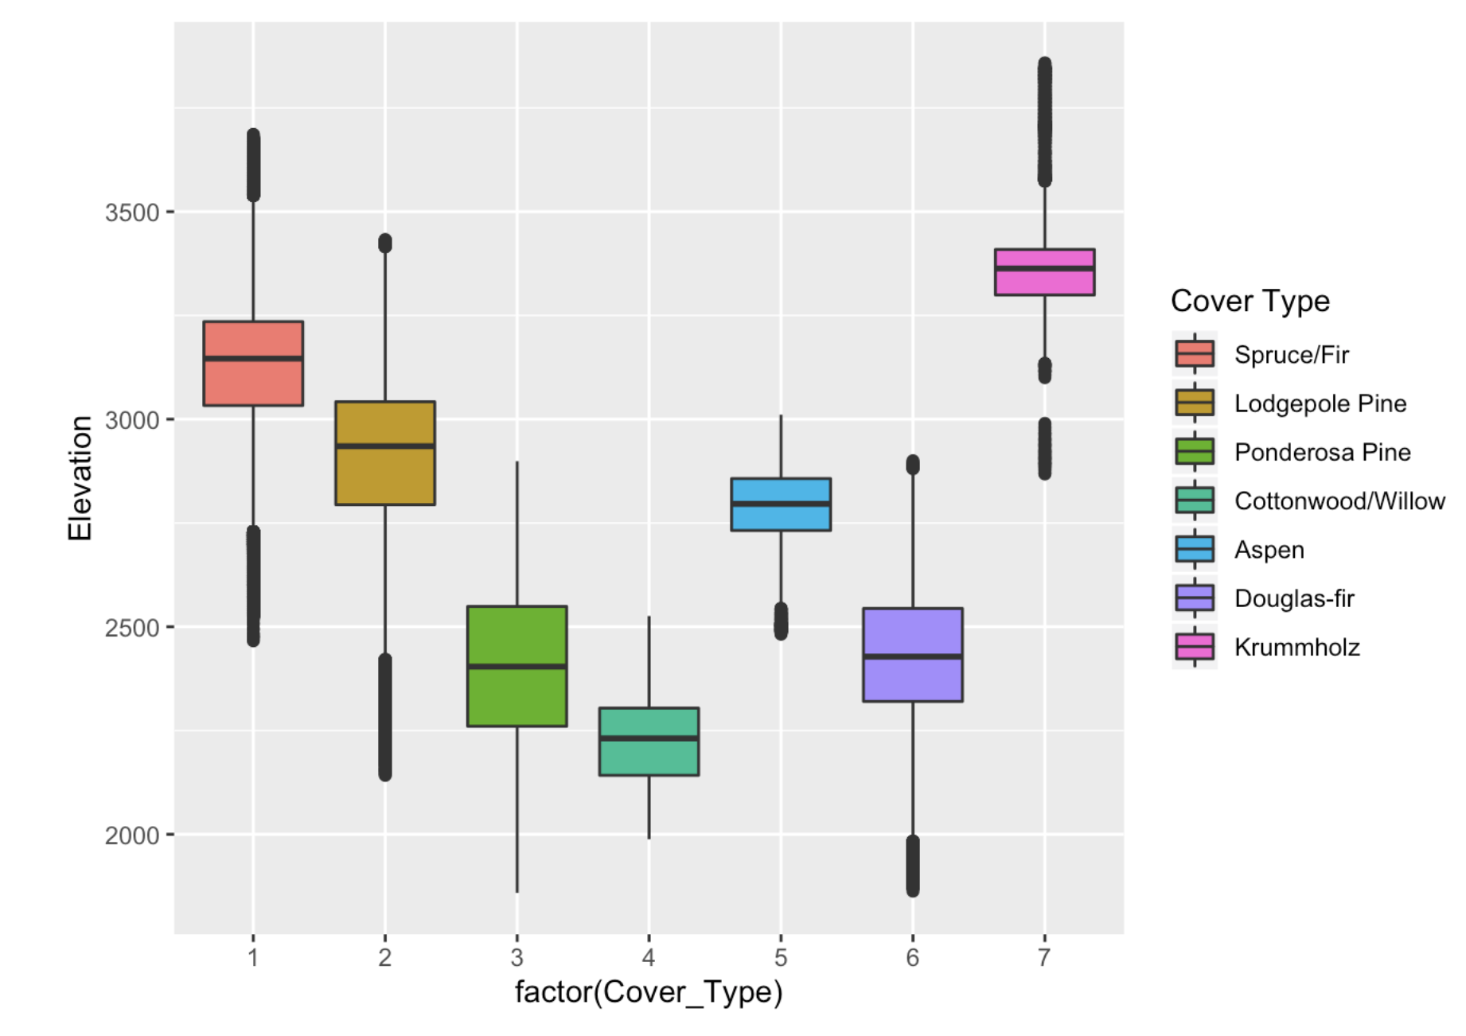
3. Exploratory data analysis
3.1 Check Outliers
Horizontal_Distance_To_Hydrology
Hillshade_3pm
Elevation

Slide 9
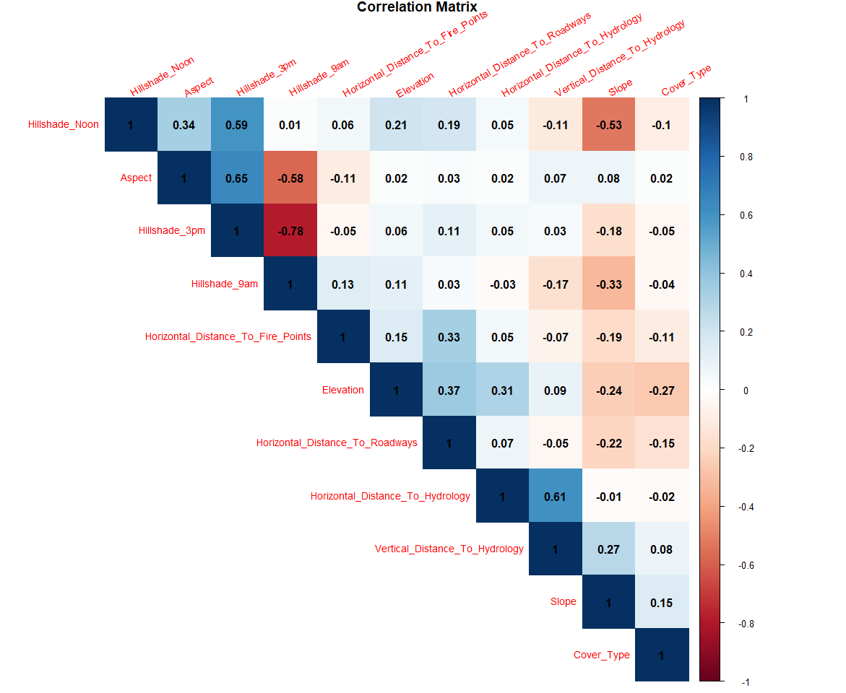
3. Exploratory data analysis
Hillshape_9am & Hillshape_3pm = -0.78
Aspect & Hillshape_3pm = 0.65
Vertical_Distance_To_Hydrology & Horizontal_Distance_To_Hydroplogy = 0.61
Hillshade_Noon & Hillshade_3pm = 0.59
Aspect & Hillshape_9am = -0.58
Hillshade_Noon & Slope = -0.53

Slide 10
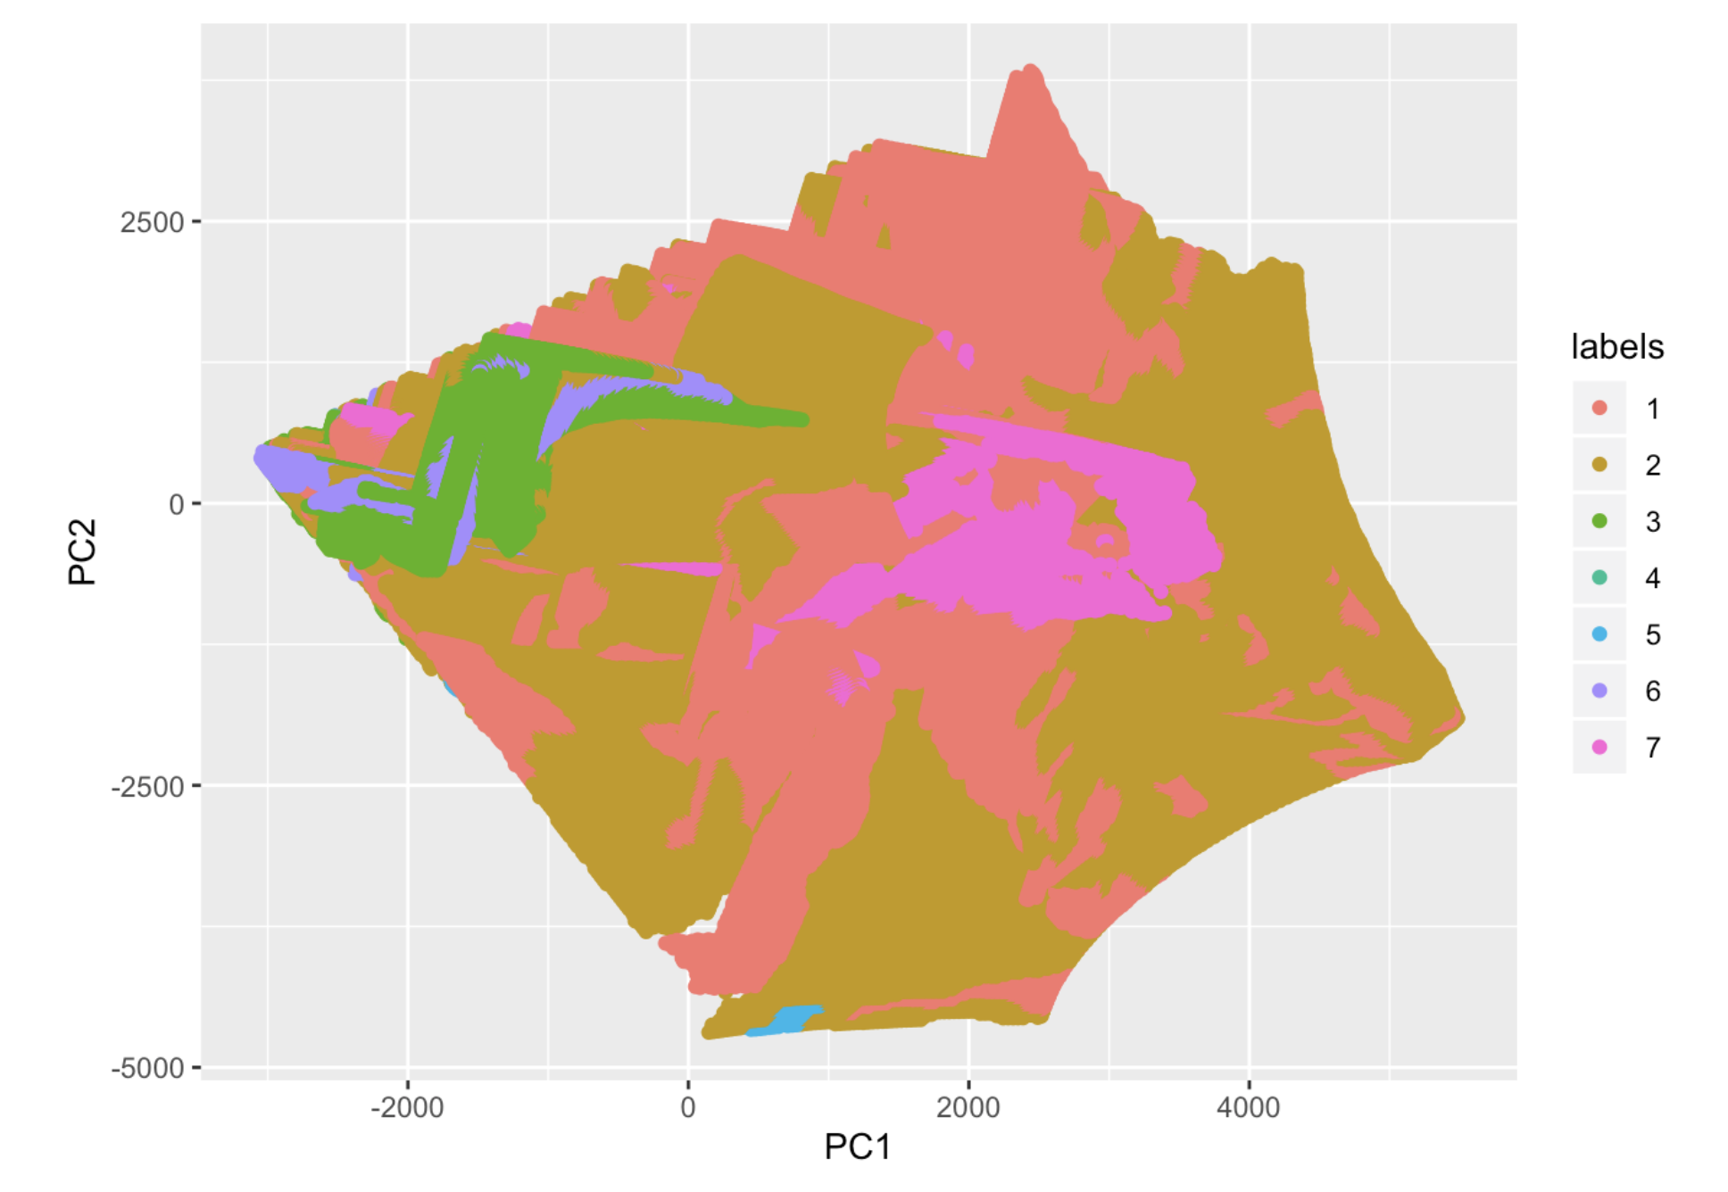
3. Exploratory data analysis
The First Two Components Explains about 80% Variance of the Original Dataset
Type 3, 4 & 7 are Clustered

Slide 11
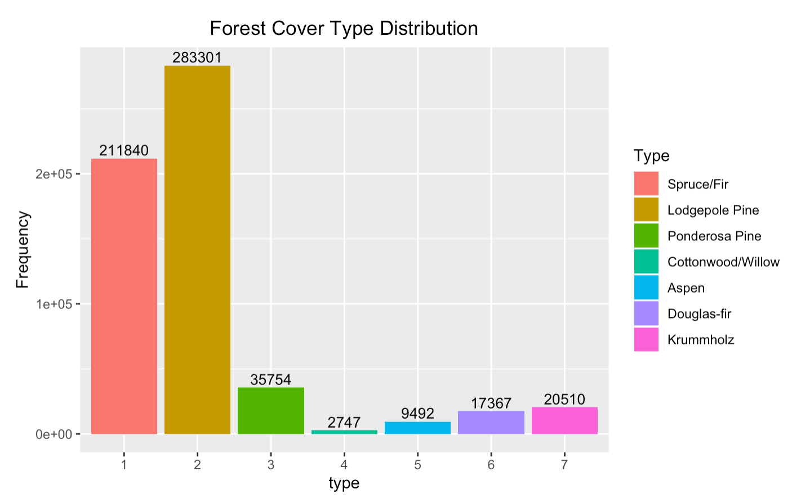
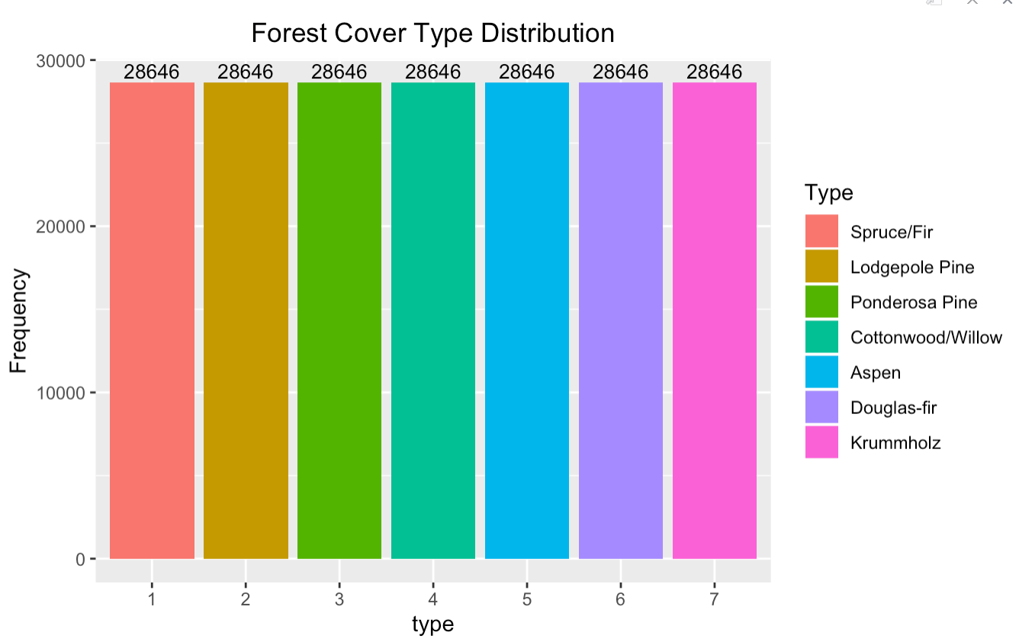
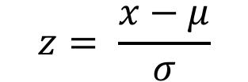
4. Feature engineering
Standardize Numeric Attributes – First 10 Columns
Down Sampling & Up Sampling on Training Dataset – Based on Type 3
$$z= \frac{x−μ}{σ}$$

Slide 12
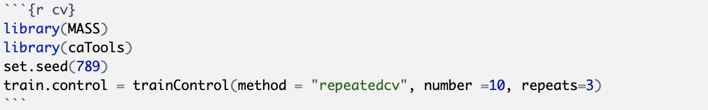
5. Classification algorithms
Train Test Split:
Algorithms:
K Nearest Neighbor
Linear Discriminative Analysis
Decision Tree
Random Forest
Support Vector Machine
 | KNN | LDA | Decision Tree | Random Forest | SVM
Training | 20% | 80% | 80% | 80% | 20%
Testing | 80% | 20% | 20% | 20% | 80%
10 – Fold Cross Validation

Slide 13
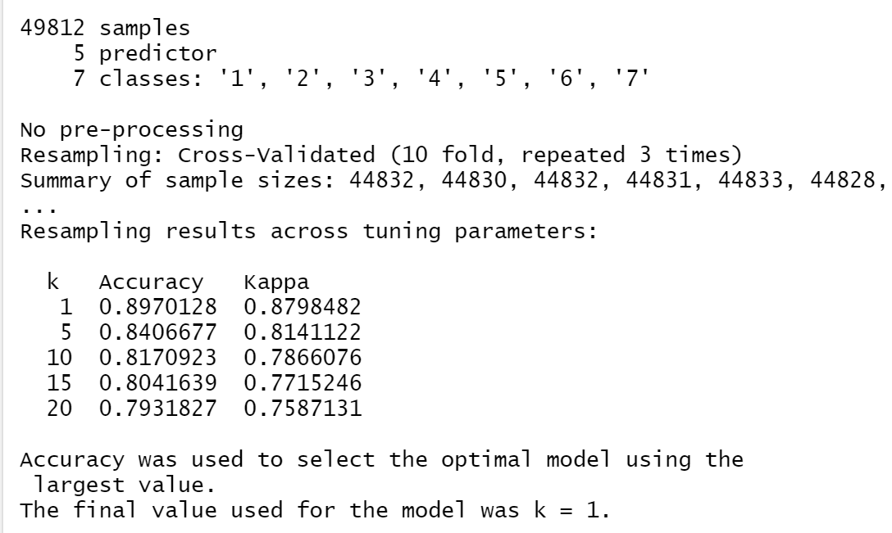
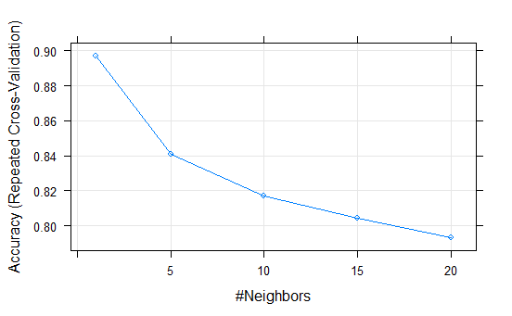
6. Classification performance -- knn
Only use Numeric Attributes for the Model
We tune k = 1, 5, 10, 15, 20 to find the Optimal k
Training Performance
Tuning Performance

Slide 14
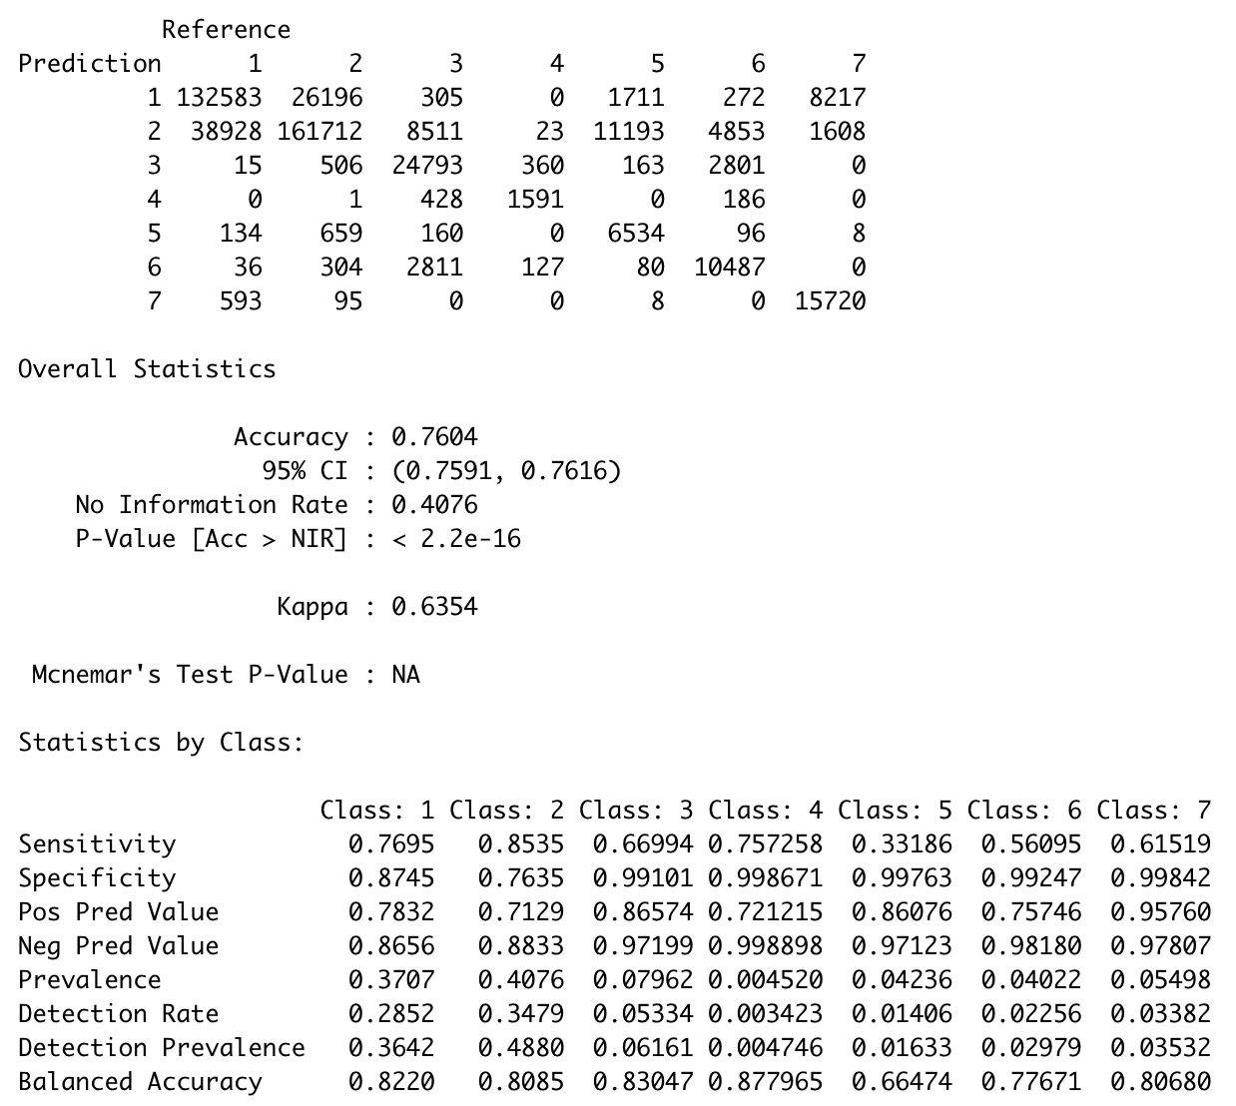
6. Classification performance -- knn
Confusion Matrix
Test Accuracy
Statistics by Class

Slide 15
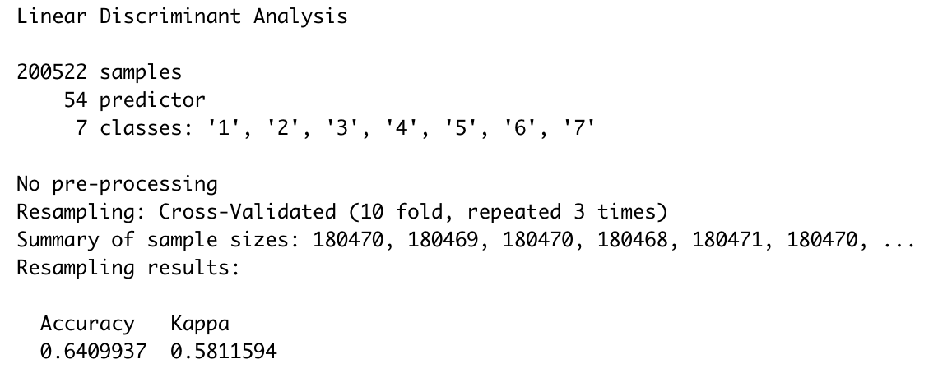
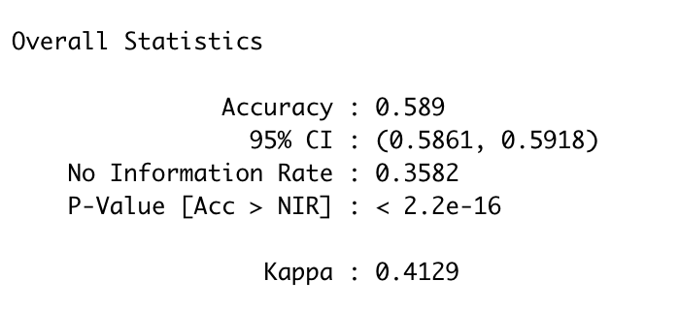
6. Classification performance -- LDA
Training Performance
Test Performance

Slide 16
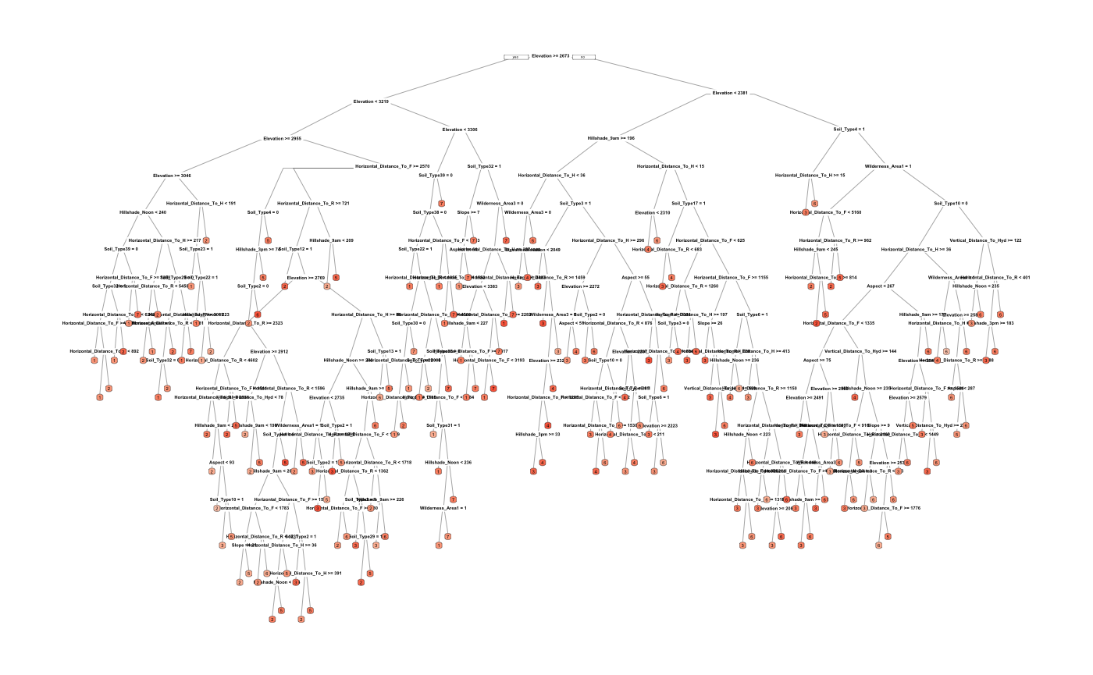
6. Classification performance
-- Decision tree
Tree Overview:
Tuning: 100 different values (tuneLength = 100)
Method: “rpart”
-- split the dataset recursively

Slide 17
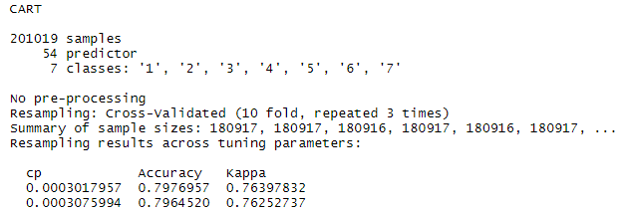
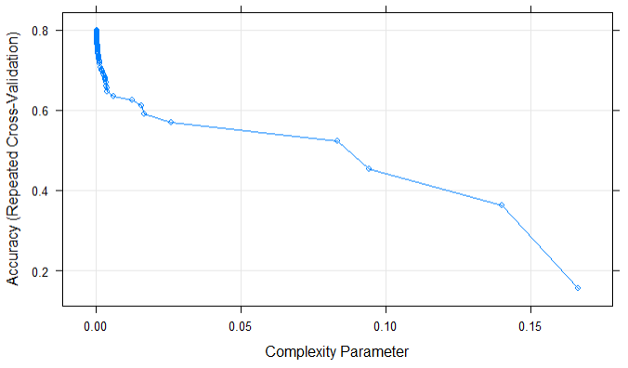
6. Classification performance
-- Decision tree
Training Performance:

Slide 18
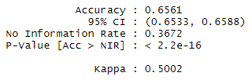
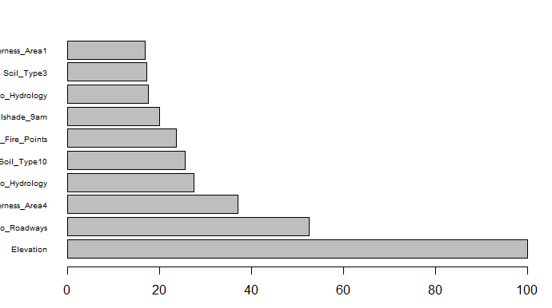
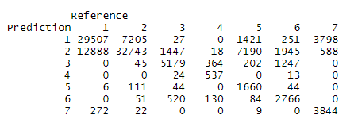
6. Classification performance
-- Decision tree
Test Accuracy:
The Contribution for Each Variable
Confusion Matrix:

Slide 19
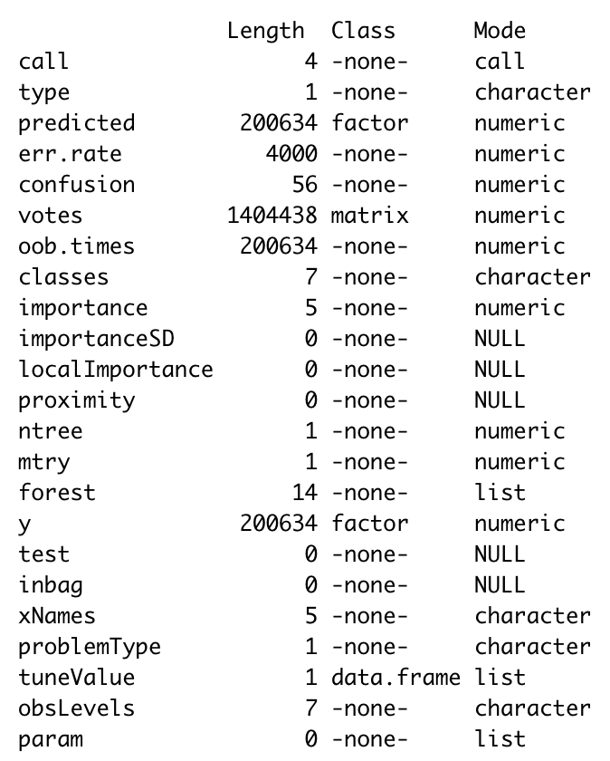
6. Classification performance
-- random forest
Choose the First 5 Important Parameters from Contribution Table
Summary of the model:
Number of Tree Features: 14
Number of Importance: 5
Tuning:
1 to 5 different number of variables available for splitting at each tree node

Slide 20
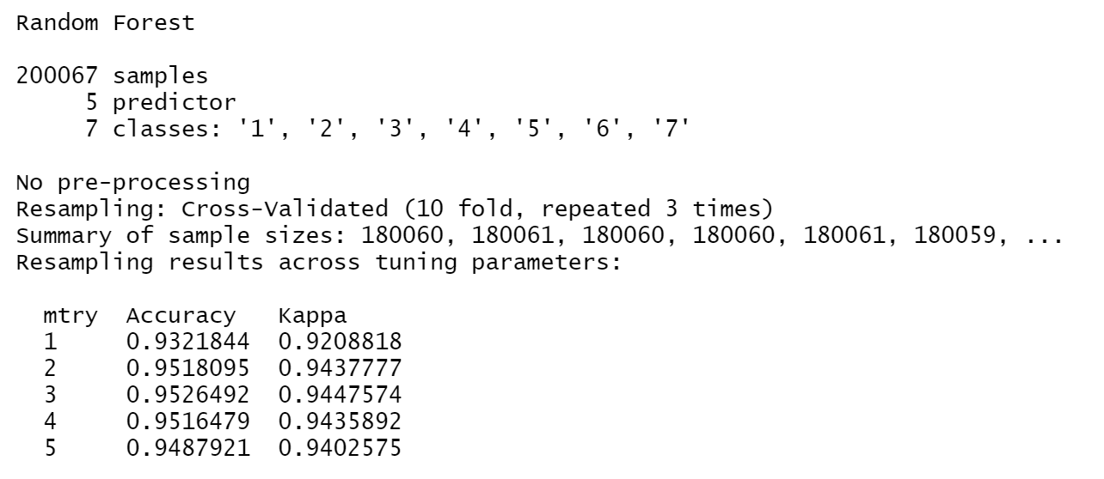
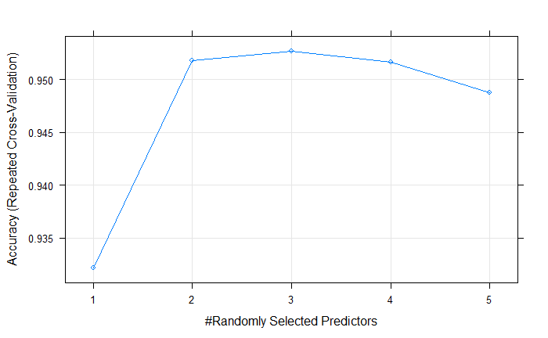
6. Classification performance
-- random forest
Training Performance
Tuning Performance
Optimal accuracy: 95% when .mtry = 3,

Slide 21
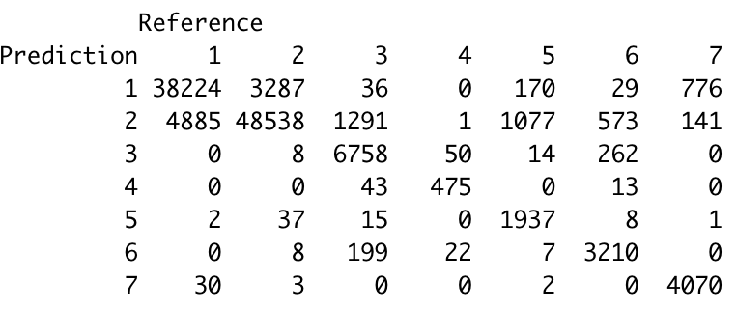
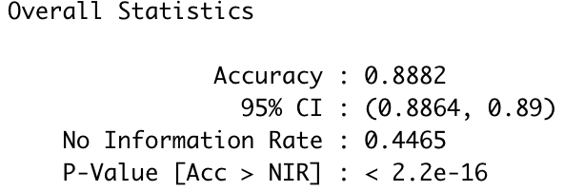
6. Classification performance
-- random forest
Confusion Matrix:
Test Accuracy

Slide 22
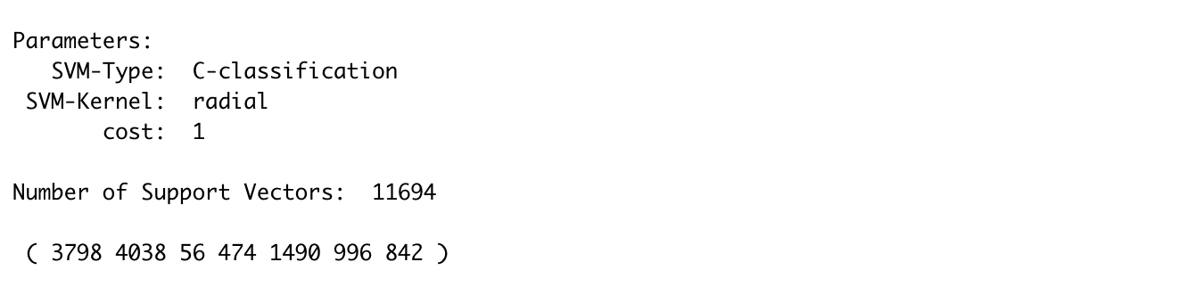
6. Classification performance
-- SVM
Kernel Tuning -- Linear & Radial & Polynomial
 | Training Accuracy | Test Accuracy | Kappa Accuracy
Linear | 76.52576% | 62.62% | 44.36%
Radial | 79.78315% | 65.19% | 47.83%
Polynomial | 78.20478% | 63.12% | 44.42%
← Best Results
Training Summary

Slide 23
7. Model comparison
 | Training Accuracy | Test Accuracy
KNN (k = 1) | 89.70% | 76.04%
LDA | 64.10% | 58.90%
Decision Tree (cp = 0.0003) | 79.77% | 65.61%
Random Forest (.mtry = 3) | 91.88% | 88.82%
SVM (Radial) | 79.78% | 65.19%

Slide 24
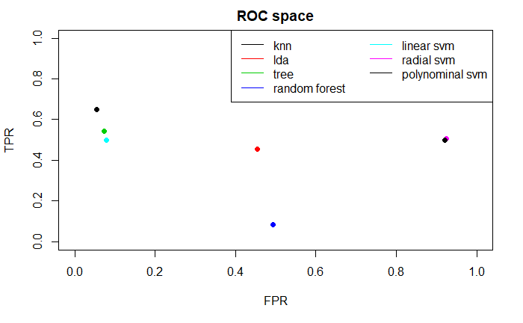
7. Model comparison
Compare Model Performance based on TPR & FPR
KNN Performs the Best
ROC evaluate the Class Performance of the Model

Slide 25
Thanks for Listening

