Slide 1

Book API: From Data to Insights

Slide 2
Building a Data-Driven Book API
Coursework Context
Core Deliverables
This project was developed for XJCO3011 as an individual coursework assignment requiring oral examination. The deliverable encompasses a secure, fully functional REST API with persistent data storage, comprehensive documentation, and verifiable test evidence demonstrating professional software engineering practices.
The final submission includes authenticated API endpoints with consistent JSON contracts, SQL database integration with migration support, technical documentation with OpenAPI specifications, and a complete test suite with coverage evidence. All artifacts are organized in a public GitHub repository with clear commit history.

Slide 3
Problem Scope and Core Objectives
01
02
03
Domain Definition
Functional Requirements
Non-Functional Goals
The system addresses book metadata management within a structured domain covering authors, publications, and user-generated reviews. This domain requires careful handling of relationships between creators, works, and audience feedback while maintaining data integrity across all entities.
Core objectives include implementing complete CRUD operations for all domain entities, providing filtered query capabilities for books and reviews, generating analytical insights from collected data, and delivering personalized recommendations based on user behavior patterns and preferences.
The system prioritizes security through JWT-based access control, consistency via standardized API response envelopes, maintainability through layered architecture, and reliability demonstrated through comprehensive integration testing with documented evidence.

Slide 4
Technology Stack Selection Rationale
FastAPI Framework
FastAPI was chosen for rapid API development, built-in interactive docs, and strong type-based validation.
Data Layer Stack
Security Implementation
Testing Framework
SQLAlchemy manages relational models, while Alembic supports reproducible database migrations.
PostgreSQL is used for production, and SQLite for local testing.
JWT authentication protects secured endpoints and supports stateless access control.
Pytest supports integration testing, reusable fixtures, and clear validation of API behaviour.

Slide 5
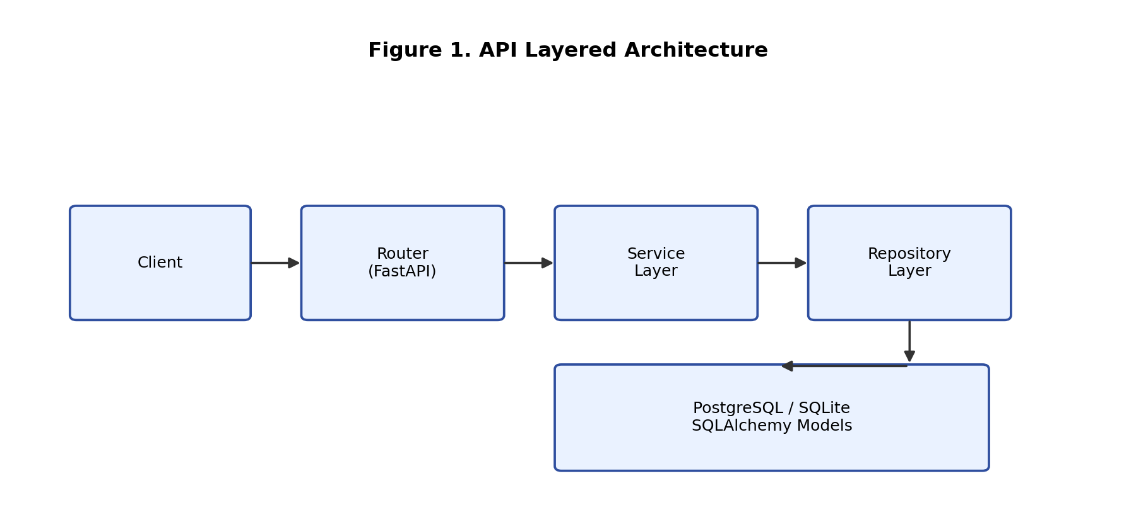
Layered System Architecture Design
Separation of Concerns
The system follows a four-layer architecture: Router for request handling, Service for business logic, Repository for data access, and Database for persistence. This separation improves testability, maintainability, and clarity of design.

Slide 6
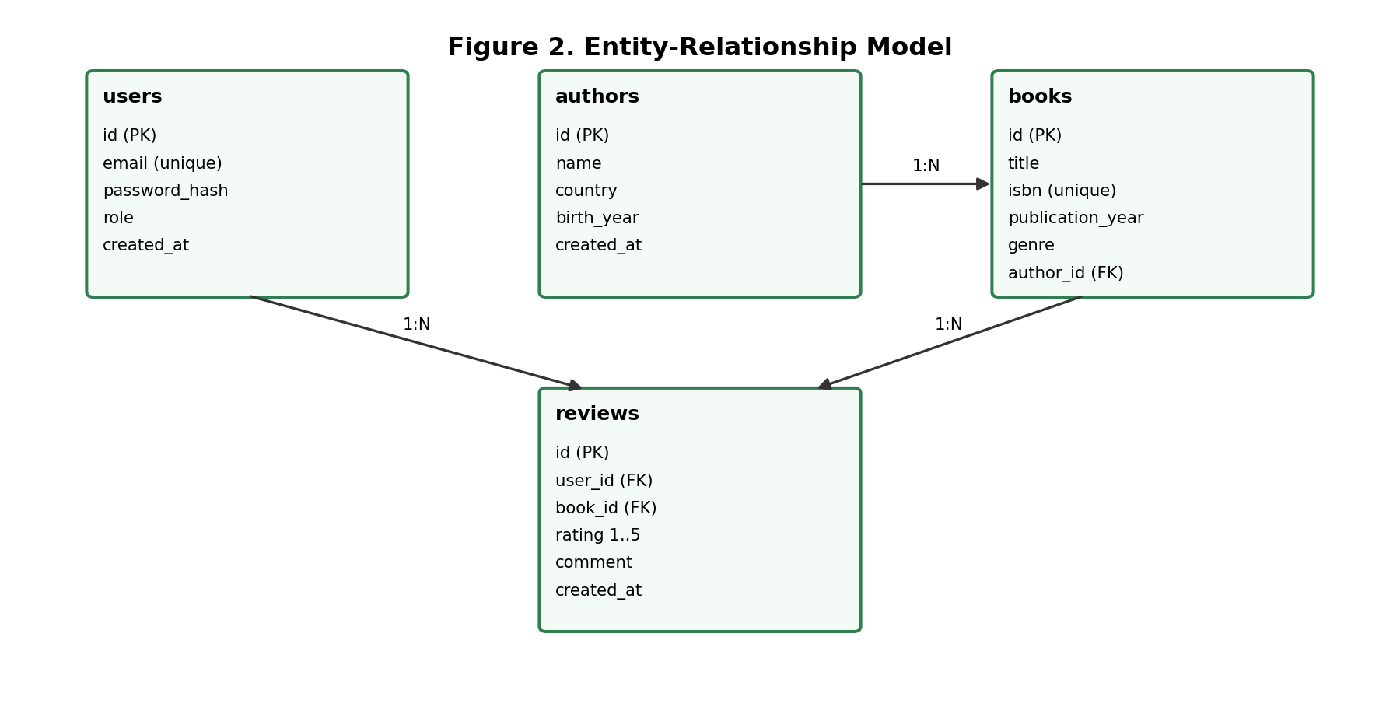
Entity Relationship Data Model
Validation Constraints
Core Entity Relationships
The database enforces a unique ISBN, rating range checks, and required foreign keys.
These constraints help prevent duplicate records and maintain data integrity.
The schema links four main entities: users, authors, books, and reviews.
Authors can have multiple books, books can have multiple reviews, and reviews connect users to books through foreign keys.

Slide 7
Comprehensive API Endpoint Groups
Authentication Endpoints
Register and login endpoints return JWT tokens for authenticated access.
Resource Management Endpoints
Authors, books, and reviews support full CRUD operations with filtering options.
Analytics Endpoints
Analytics endpoints provide genre trends, rating distribution, and personalized recommendations.

Slide 8
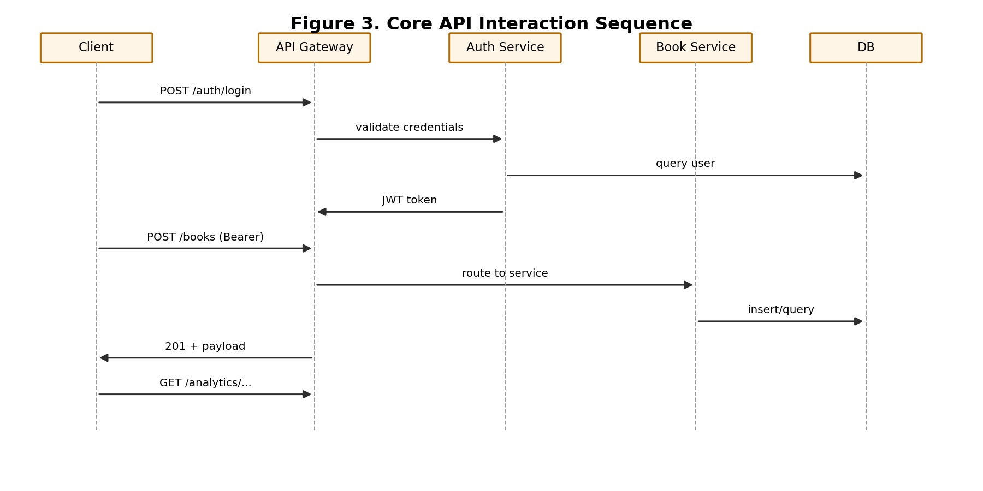
Analytics and Recommendation Engine
Genre Trend Analysis
Personalized Recommendations
The /analytics/genre-trends endpoint identifies popular genres from publication and review patterns.
The /analytics/recommendations/{user_id} endpoint suggests books based on a user’s review history.
Rating Distribution
Demo Flow Sequence
The /analytics/rating-distribution endpoint summarizes review scores across the catalog.
The demo shows registration, authentication, CRUD operations, filtering, and analytics results.

Slide 9
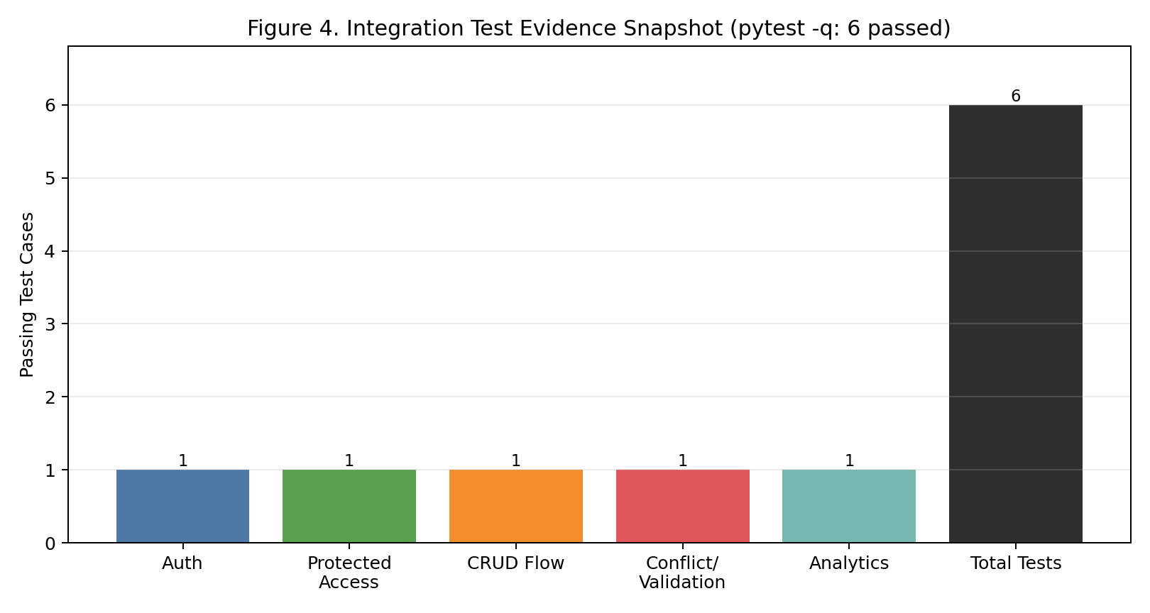
Testing Strategy and Evidence
Integration Test Coverage
The test suite encompasses six passing integration tests covering authentication flows including registration and login, protected endpoint access control verification, complete CRUD operations for all resources, validation and conflict error paths, and analytics endpoint functionality. Each test validates both successful operations and appropriate error handling.
Response Standardization
Standardized response envelopes ensure predictable client-side behavior across all endpoints. Success responses include consistent data wrapping, while error responses provide structured error codes and descriptive messages. This predictability simplifies client integration and debugging.

Slide 10
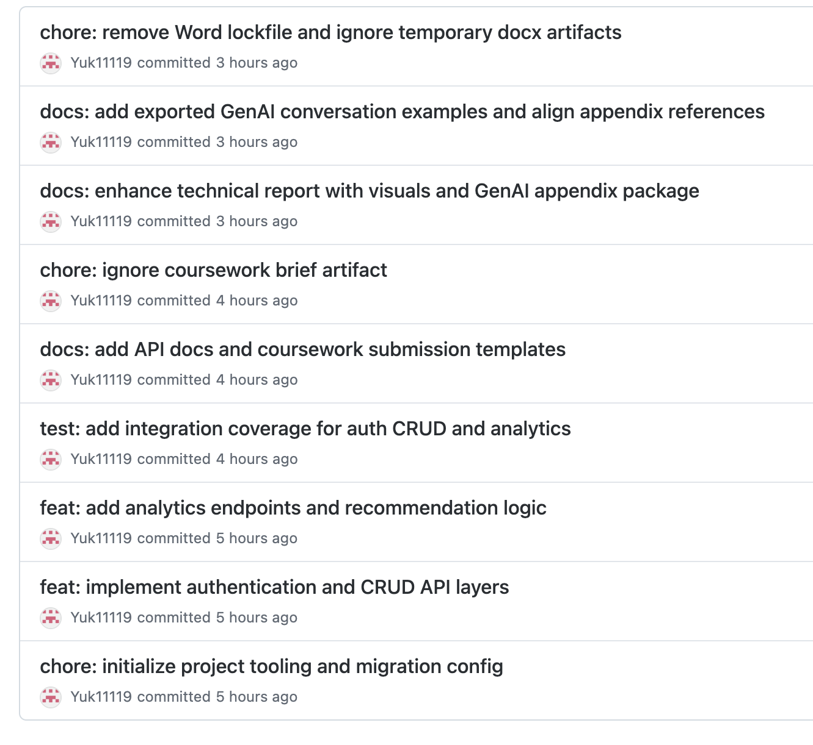
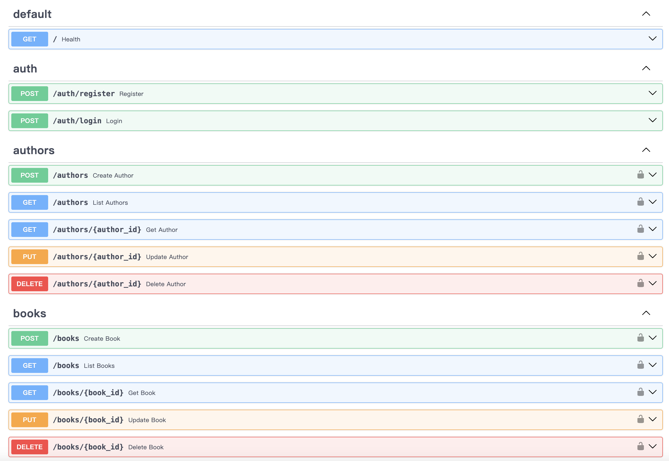
Version Control and Documentation
Git Commit Practices
Commit history shows steady development with clear commit messages.
Documentation Deliverables
Documentation includes endpoint details, authentication, parameters, and response formats.
Repository Organization
All deliverables are organized clearly in the public GitHub repository.

Slide 11
Technical Report Highlights
Architectural Choice
The layered architecture improves separation of concerns, testing, and maintainability.
Feature Scope
The API supports authentication, full CRUD operations, filtering, and analytics endpoints.
Testing Approach
Six integration tests validate core functionality, error handling, and response consistency.
Future Improvements
Possible next steps include better recommendation methods, caching, load testing, and pagination.

