Slide 1
DBMS

Slide 2
DATA
FACTS RELATED TO ANY OBJECT IN-CONSIDERATION
NAME
AGE
HEIGHT ARE DATA
WEIGHT RELATED
PICTURE (IMAGE) TO A PERSON
FILE (PROFILE)

Slide 3
DATABASE - SYSTEMATIC COLLECTION OF DATA.
First implemented in 1960s
1st DBMS by Charles Bachmen - Integrated data store (IDS)
DBMS – COLLECTION OF PROGRAMS, FOR USER (ALSO AUTHENTICATE USERS) TO ACCESS THE DATABASE, MANIPULATE DATA, REPRESENT THE DATA.

Slide 4
DAILY REALTIME USAGE OF DB
TELEPHONE CONTACT LIST
FACEBOOK STORES & PRESENT DATA RELATED TO MEMBERS
EB USING DBMS TO MANAGE BILLING AND OTHER INFO

Slide 5
DATABASE
DBMS
Relational DBMS
Object Oriented DBMS
SQL DBMS

Slide 6
ER Data Model
Data models define how the logical structure of a database is modelled.
Entity-Relationship (ER) Model is based on the notion of real-world entities and relationships among them
Best for conceptual design of a database
ER Model is based on:
Entities and their attributes.
Relationships among entities.

Slide 7
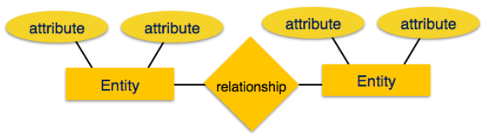
ER Data Model
Entity − is a real-world entity having properties called attributes.
Attribute is a set of values called domain.
For example, in a school database, a student is considered as an entity. Student has various attributes like name, age, class, etc.
Relationship − The logical association among entities is called relationship

Slide 8
Relational DBMS
Defines database relationships in forms of tables also known as relations.
Types of Relations or Cardinalities between Entities:
One – to – One Relationships
One – to – Many Relationships
Many – to – Many Relationships

Slide 9
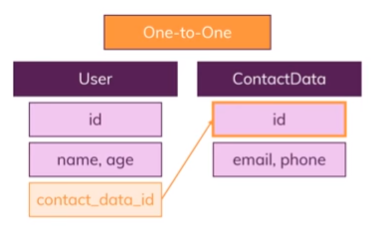
One – to – One Relationships

Slide 10
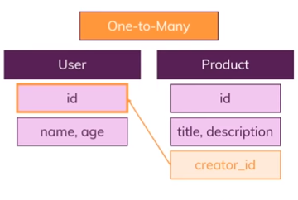
One – to – Many Relationships

Slide 11
Many – to – Many Relationships
User
Roles
id
id
Name
Role
Rights
User Roles
user_id
role_id

Slide 12
DB Schema
Database schema is the skeleton structure that represents the logical view of the database
A database schema defines its entities and the relationship among them.
A database schema can be divided broadly into two categories:
Physical Database Schema − This schema pertains to the actual storage of data and its form of storage like files, indices, etc. It defines how the data will be stored in a secondary storage. Specification all tables and columns, Foreign keys used to identify relationships between tables.
Logical Database Schema − This schema defines all the logical constraints that need to be applied on the data stored. It defines tables, views, and integrity constraints.

Slide 13
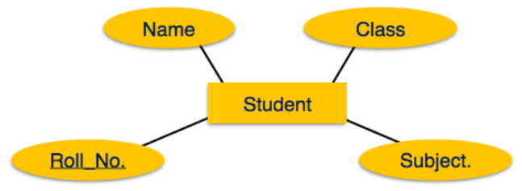
ER Model
Entity

Slide 14
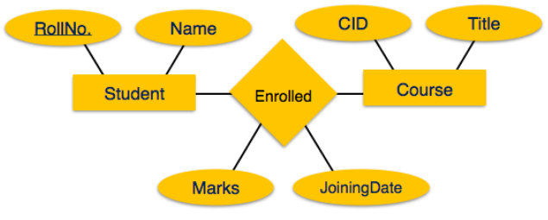
ER Model
Entity with Relationship

Slide 15
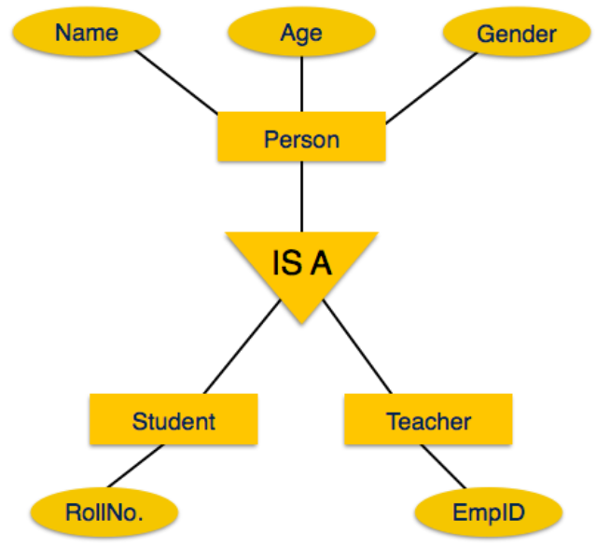
Entities with Hierarchy

Slide 16
Structured Query Language
Pronounced S-Q-L or “See-Quel”
Standard language to work in all Relational databases
Effectively used to Insert, Search, Update, Delete database records.
Beyond that … Optimizing, Maintaining databases and much more.
SQL is used in Relational Databases like Oracle, MySQL, MS SQL Server, Sybase etc.

Slide 17
SQL Command Categorization
DDL – Data Definition Language
DML – Data Manipulation Language
DCL – Data Control Language
TCL – Transaction Control Language

Slide 18
DDL - Data Definition Language
To define the database schema
DDL Commands:
CREATE : to create the database or its objects (like table, index, function, views, store procedure and triggers).
DROP : to delete objects from the database.
ALTER : to alter the structure of the database.
TRUNCATE : to remove all records from a table, including all spaces allocated for the records are removed.
RENAME : to rename an object existing in the database.

Slide 19
DML - Data Manipulation Language
Deals with the manipulation of data present in database
DML Commands:
SELECT: to retrieve data from the a database.
INSERT: to insert data into a table.
UPDATE: to update existing data within a table.
DELETE: to delete records from a database table.

Slide 20
DCL - Data Control Language
Deals with the rights, permissions and other controls of the database system.
DCL Commands:
GRANT: gives user’s access privileges to database.
REVOKE: withdraw user’s access privileges given by using the GRANT command.

Slide 21
TCL – Transaction Control Language
Deals with the transaction within the database.
TCL Commands:
COMMIT: commits a Transaction.
ROLLBACK: rollbacks a transaction in case of any error occurs.
SAVEPOINT: sets a save point within a transaction.
SET TRANSACTION: specify characteristics for the transaction.

Slide 22
DATATYPES
char(size): fixed-length character string. Size is specified in parenthesis. Max 255 bytes.
varchar(size): variable-length character string. Max size is specified in parenthesis.
dateDate value
number(size): number value with a max number of column digits specified in parenthesis.
number(size,d): number value with a maximum number of digits of "size" total, with a maximum number of "d" digits to the right of the decimal.

Slide 23
DDL - CREATE
Database:
CREATE DATABASE databasename;
Table:
Syntax 1:
CREATE TABLE employee
(
first varchar(15),
last varchar(20),
age number(3),
address varchar(30),
city varchar(20),
state varchar(20),
salary number(10),
role varchar(100)
);
Syntax 2:
CREATE TABLE TestEmp AS SELECT first, age FROM employee;

Slide 24
DDL - ALTER
To add, delete, or modify columns in an existing table.
ALTER TABLE - ADD Column
ALTER TABLE employee ADD email varchar(100);
ALTER TABLE employee ADD DateOfBirth date;
ALTER TABLE – DROP Column
ALTER TABLE employee DROP COLUMN email;
ALTER TABLE – MODIFY Column
ALTER TABLE employee MODIFY COLUMN email varchar(150);

Slide 25
DML - INSERT
Syntax 1:
Insert into employee
values
('Luke', 'Duke', 45, '2130 Boars Nest', 'Hazard Co', 'Georgia‘, 11000, ‘Programmer’);
Syntax 2:
Insert into employee (first, last, age) values
('Luke', 'Duke', 45);
Notes:
Select all columns for everyone in your employee table.
Select all columns for everyone with a salary over 30000.
Select first and last names for everyone that's under 30 years old.
Select first name, last name, and salary for anyone with "Programmer" in their title.
Select all columns for everyone whose last name contains "ebe".
Select the first name for everyone whose first name equals "Potsy".
Select all columns for everyone over 80 years old.
Select all columns for everyone whose last name ends in "ith".

Slide 26
DML - SELECT
To query the database and retrieve selected data that match the criteria.
Syntax
select "column1" [,"column2",…] from "tablename" [where "condition"];
Conditional selections used in the where clause:
= Equal
> Greater than
< Less than
>= Greater than or equal
<= Less than or equal
<> Not equal to
LIKE - pattern matching operator, percent sign "%" can be used as a wild card to match any possible character that might appear before or after the characters specified
Notes:
Select all columns for everyone in your employee table.
Select all columns for everyone with a salary over 30000.
Select first and last names for everyone that's under 30 years old.
Select first name, last name, and salary for anyone with "Programmer" in their title.
Select all columns for everyone whose last name contains "ebe".
Select the first name for everyone whose first name equals "Potsy".
Select all columns for everyone over 80 years old.
Select all columns for everyone whose last name ends in "ith".

Slide 27
DML - SELECT
select * from employee;
select first, last, city from employee;
select * from employee where first = ‘Luke';
select last, city, age from employee where age > 30;
select first, last, city, state from employee where first LIKE ‘L%';
select first, last, city, state from employee where first LIKE ‘%k%';
Notes:
Select all columns for everyone in your employee table.
Select all columns for everyone with a salary over 30000.
Select first and last names for everyone that's under 30 years old.
Select first name, last name, and salary for anyone with "Programmer" in their title.
Select all columns for everyone whose last name contains "ebe".
Select the first name for everyone whose first name equals "Potsy".
Select all columns for everyone over 80 years old.
Select all columns for everyone whose last name ends in "ith".

Slide 28
Hands-On
Select all columns for all from employee table.
Select all columns with a salary greater than 10000.
Select first and last names who are less than 30 years old.
Select first name, last name, and salary for "Programmer" as their Role.
Select all columns whose last name contains “Duke".
Select the first name whose first name equals “Luke".
Select all columns over 80 years old.
Select all columns whose last name ends in “ke".
Notes:
Select all columns for everyone in your employee table.
Select all columns for everyone with a salary over 30000.
Select first and last names for everyone that's under 30 years old.
Select first name, last name, and salary for anyone with "Programmer" in their title.
Select all columns for everyone whose last name contains "ebe".
Select the first name for everyone whose first name equals "Potsy".
Select all columns for everyone over 80 years old.
Select all columns for everyone whose last name ends in "ith".

Slide 29
DML - UPDATE
To query the database and retrieve selected data that match the criteria.
Syntax
update "tablename” set "columnname" = "newvalue" [,"nextcolumn" = "newvalue2"...] where "columnname“ OPERATOR "value" [and|or "column“ OPERATOR "value"];
Examples:
update employee set last = 'Smith', age = age+1 where last_name = 'Jones';
Notes:
Select all columns for everyone in your employee table.
Select all columns for everyone with a salary over 30000.
Select first and last names for everyone that's under 30 years old.
Select first name, last name, and salary for anyone with "Programmer" in their title.
Select all columns for everyone whose last name contains "ebe".
Select the first name for everyone whose first name equals "Potsy".
Select all columns for everyone over 80 years old.
Select all columns for everyone whose last name ends in "ith".

Slide 30
DML - DELETE
To delete records from the table.
Syntax
delete from "tablename” [where "columnname" OPERATOR "value" [and|or "column" OPERATOR "value"]];
Examples:
delete from employee;
delete from employee where last = ‘Smith';
delete from employee where first = ‘Luke' or first = 'Eric';
Notes:
Select all columns for everyone in your employee table.
Select all columns for everyone with a salary over 30000.
Select first and last names for everyone that's under 30 years old.
Select first name, last name, and salary for anyone with "Programmer" in their title.
Select all columns for everyone whose last name contains "ebe".
Select the first name for everyone whose first name equals "Potsy".
Select all columns for everyone over 80 years old.
Select all columns for everyone whose last name ends in "ith".

Slide 31
Assignments
Create an Employee table, so here the general attributes are emp_no, first_name, initial, last_name, gender, designation, dept_id, salary. Define if any attributes are possible.
Create another table Department, with attributes dept_id, dept_name.
Create an ER Diagram for both the ‘Entities’ and show the relationship between entities.
Insert 3 different rows to Employee table.
Add a column ‘chr_active_status’ to Employee table.
Update the above field for each row in Employee.
Show the first employee from the table, by using the emp_id.
Show all employees from department 1.
Show all employees from Male / Female genders.
Show the records with no salary and salary >= 1000
Drop the column ‘initial’.
Select the first & last names starting with ‘A’

