Slide 1

Analysis on Government Involvement in the Economy and its Effect on GDP growth
Yuka Langbuana
LengFan Yan
Notes:
Hello, this is Yuka Langbuana and I’m working with LengFan Yan on our analysis on government Involvement in the economy and its effect on GDP growth. The goal of this project is to compare the two competing economic theories on government involvement and see which countries perform better in terms of GDP growth. We think such study is important because this is a hotly debated topic in economic science and it has a wide range implication.

Slide 2

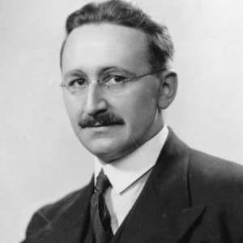
Two Competing Theories
Keynes:
“The market is inherently flawed and the state shall help stabilize them”
Hayek:
“The market shall be left alone to its natural cycle”.
Notes:
In economic science, there are two different view on government in the economy. John Keynes viewed that The market is flawed and the government need to step in, in order to stabilize the market. While Frederick Hayek, viewed that the market shall be left alone to its natural cycle.

Slide 3

Quantify Government Interference
Data we used :
Level of Government Consumption
Level of Government Subsidies and Transfer Payments
State Owned Enterprise Contribution to GDP
Government Tax Revenue
All normalized in terms of GDP
Notes:
We are currently using 4 data sets: government consumption, subsidies, tax, and state owned enterprise from world bank group to build our model

Slide 4
The Plan
Hypothesis: Government Intervention Yield Higher Growth
Separate developed & developing countries into two groups.
K-Means cluster each groups to find countries with high and low government intervention.
In each group, compare each cluster’s GDP growth with one another.
Test against the hypothesis
Notes:
Base on our background research, we build the Hypothesis that Government intervention yield higher growth,
And then we perform the clustering by grouping the countries, cluster each groups, analyze the cluster, and test the hypothesis.

Slide 5
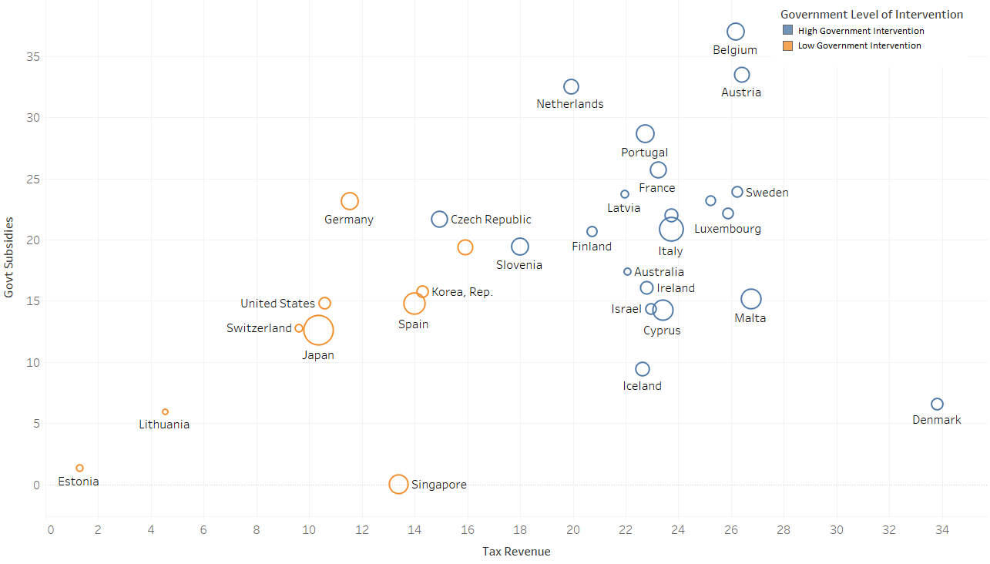
Result – Developed Countries
Notes:
After we separate the countries into two groups, we analyze the clusters that were generated. This is the clustering for developed countries. The blue circles represents countries with high government intervention, while the orange circles represents countries with low government intervention in their market. This might look confusing to you, so we created a map to better visualize things.

Slide 6
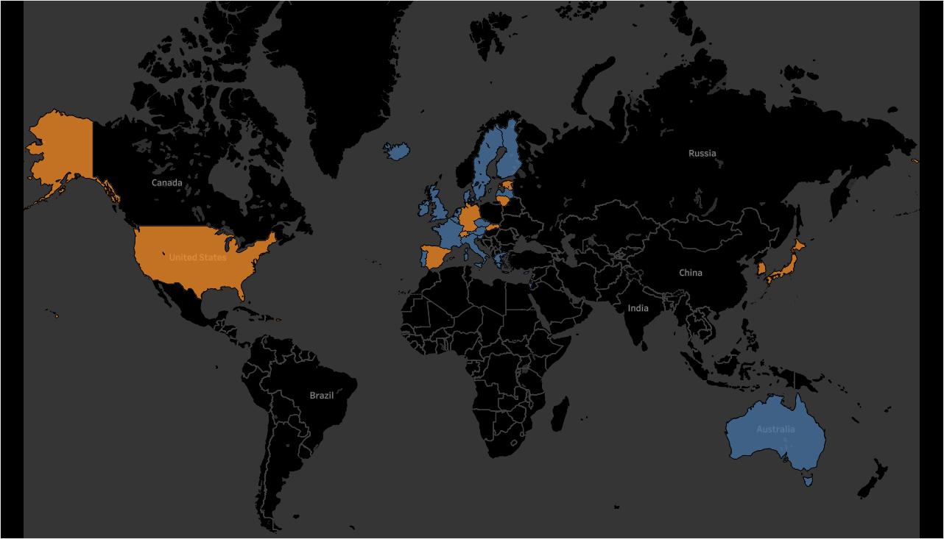

Result : Developed Countries
Notes:
As you see, countries with high government interventions are mostly European countries. This makes sense given countries in the EU have lot more social safety nets which requires government involvement to balance the forces together.

Slide 7
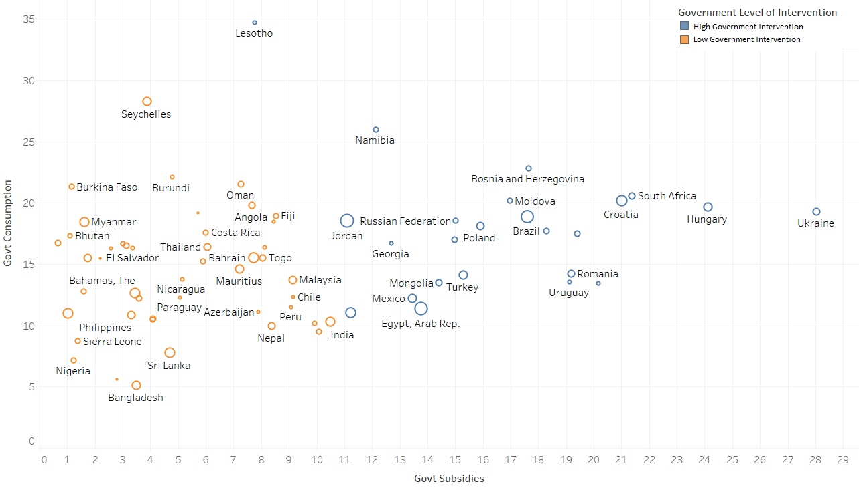
Result: Developing Countries
Notes:
This is the clustering for developing countries. The same color code applied to with this one. Let’s look at the map

Slide 8
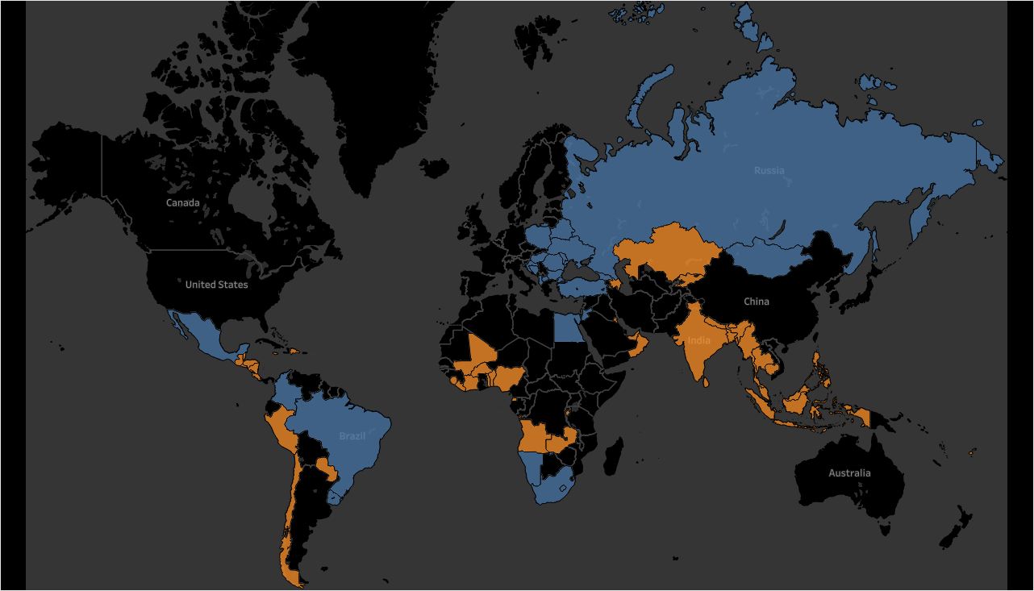
Result : Developing Countries
Notes:
In this map, we can see countries like India, and Indonesia score low on their government’s intervention, while Brazil and Russia score higher on the chart.

Slide 9
Result
Developed Countries:
Average Growth Rate : 1.5%
Countries with low government intervention: 1.92% growth/year
Countries with high government intervention: 1.29% growth/year
Developing Countries:
Average Growth Rate : 4%
Countries with low government intervention : 4.7% growth/year
Countries with high government intervention: 3.7% growth/year
Our Hypothesis is rejected: Government Intervention Yield lower growth
Notes:
After the clustering, we then analyze the cluster and see its GDP growth per year. Based on our analysis, The same conclusion can be said with both developed and developing countries. Countries with lower government intervention yields higher growth than countries with higher government intervention, out performing their peers by around ~1% difference.
Based on the result, we reject our original hypothesis. We conclude that in the end, Government Intervention would only yield lower growth.

Slide 10
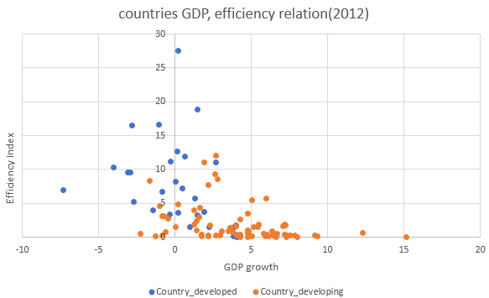
Future Work
Gather or predict missing data.
Incorporate more countries into the model.
Use additional clustering algorithm to verify our result.
Notes:
You my notice in priors slides that some large countries such as China, and Canada are not colored in both result maps, that is because we are missing some of the data for our model,
To make the model complete and accurate, we will need to fill in the data blanks, use more data sets to our model, and use additional clustering algorithm afterwards to verify our result.

