Slide 1

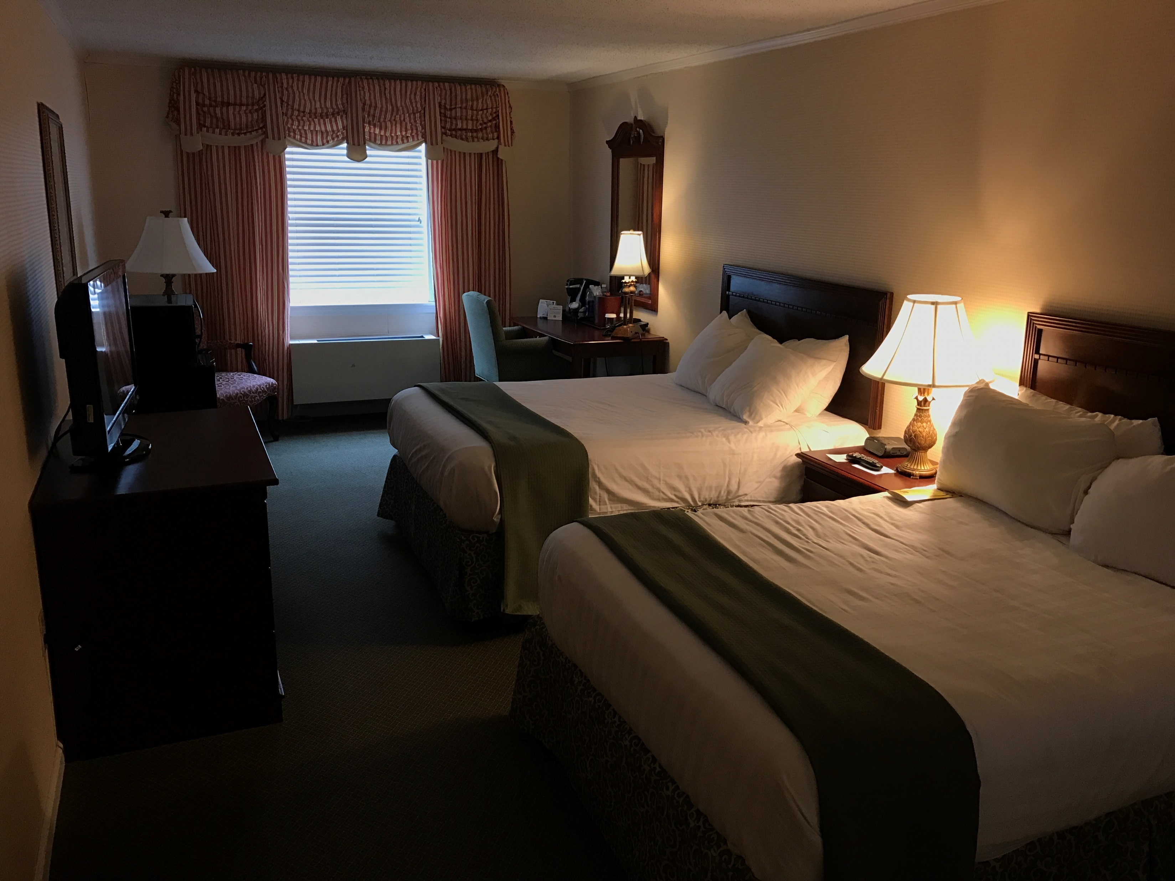
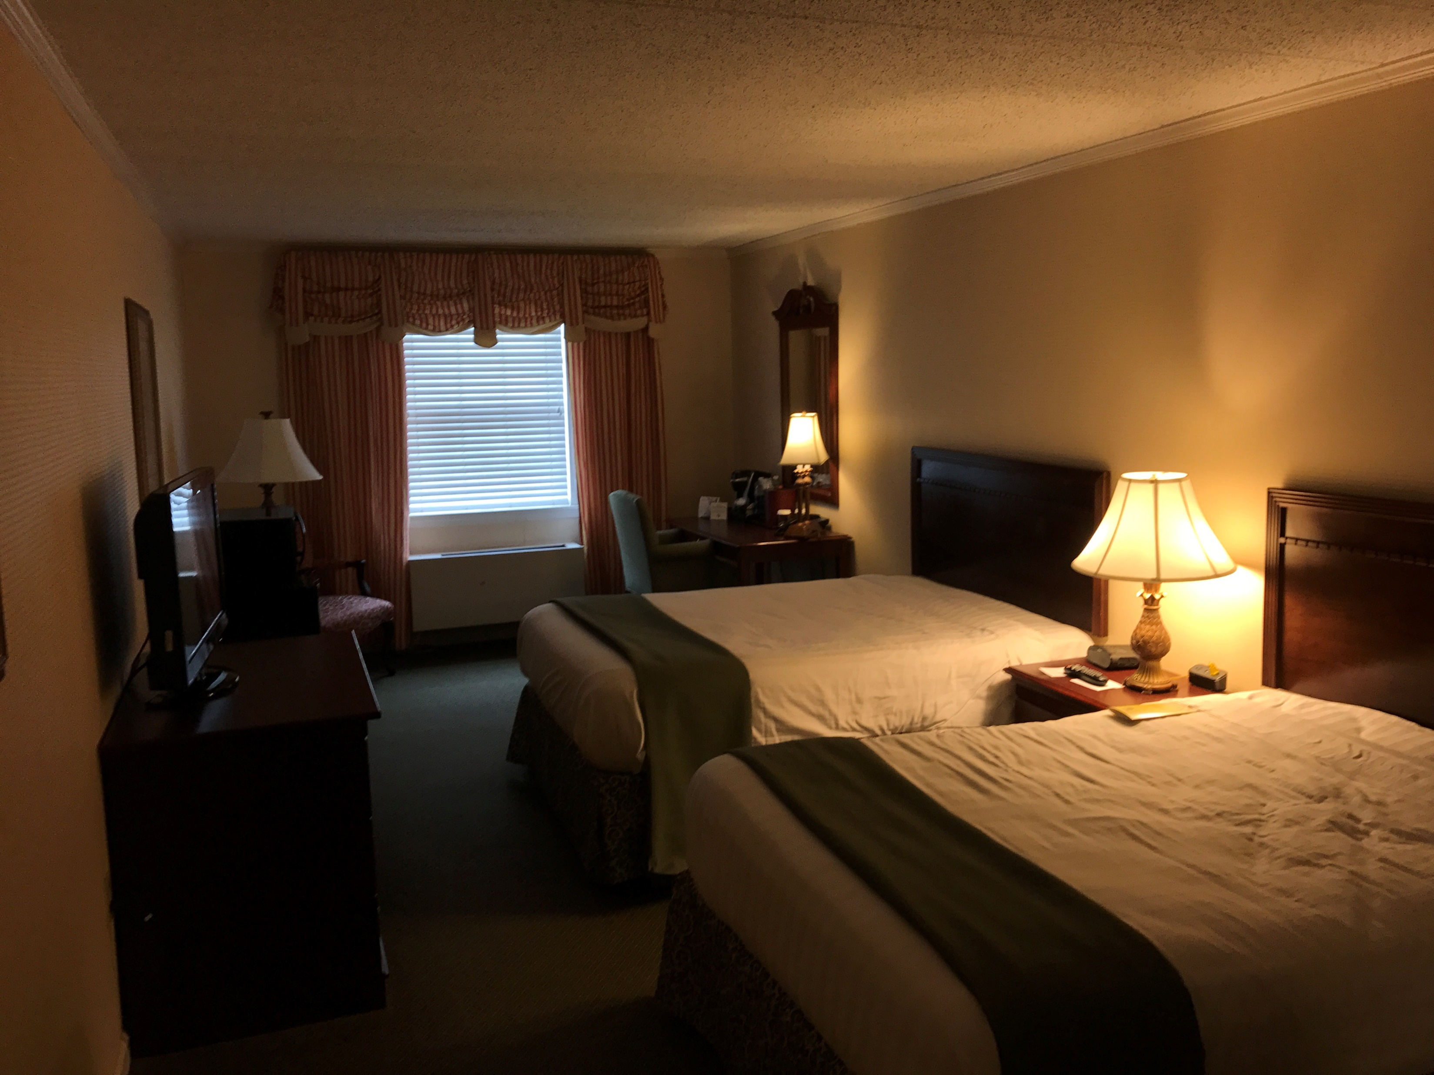
Out of place, in the mind: False memory made by schema.
Yuke Luo
Faculty Advisor: Dr. Harnish
ABSTRACT
The goal of this experiment was to search for false
memory made by schema.
Results did not support my hypothesis that
students will report there are pillows in the
hotel room no matter if the pillow is shown in the
picture or not.
Results of my study are discussed in terms of their implications for false memory.
INTRODUCTION
Prior research (Lew & Howe, 2017) suggests false memory effects for object-location bindings.
Yamada and Itsukushima (2013) states that people pay more attention to schema-unexpected objects than to schema-expected objects.
Thus, I hypothesized that students will report there are pillows in the hotel room
no matter if the pillow is shown in the picture or not.
DISCUSSION
To improve test scores, the manipulation should be stronger.
the distraction could be louder to distract participants.
Most people want to do their best in the experiment no matter the experiment is anonymous or not.
REFERENCES
Gallo, D. A. (2010). False memories and fantastic beliefs: 15 years of the DRM illusion. Memory & Cognition, 38, 833–848.
Lew, A. R., & Howe, M. L. (2017). Out of place, out of mind: Schema-driven false memory effects for object-location bindings. Journal of Experimental Psychology: Learning, Memory, and Cognition, 43(3), 404-421.
Yamada, R., & Itsukushima, Y. (2013). The effects of schema on recognition memories and subjective experiences for actions and objects. Japanese Psychological Research, 55(4), 366-377.
METHOD
Participants.
Thirty (30) Penn State New Kensington undergraduates participated in my experiment.
Each received extra credit in their introduction to cognitive psychology course.
RESULTS
To test the hypothesis, I score the mathematics test and submitted the total number correct to chi-square.
Results did not reveal support for my hypothesis.
11 participants who had the one with pillows on the bed recalled pillows. 4 participants did not recall pillows in the same situation. There were 2 participants recalled pillows where pillows were not on the bed; and 13 participants did not recall pillows where pillows were not on the bed. x² = (3, N = 30) = 11.32, p = .05
Procedure.
I randomly gave a number to the participants (1 or 2). For those who got number 1, they had the picture of hotel room with pillows on the beds; for those who got number 2, they had the picture of hotel room without pillows on the beds.
Stimulus Material.
One picture with pillows on the bed and one without pillows on the bed.
Measures.
Participants wrote their answers on a blank paper.

