Slide 1
DOCKER
Understanding Containers and Their Impact

Slide 2
What is Docker?
Definition: Docker is an open-source platform that enables developers to build, ship, and run
applications in a loosely isolated environment called containers.
Core Idea: It packages software into standardized units (containers) that include everything
the software needs to run: code, runtime, libraries, system tools, and settings.
Analogy: Think of a container as a standardized shipping container. It holds your goods
(application and its dependencies) in a consistent way, allowing them to be transported and
deployed anywhere (any server, cloud, or local machine) without issues.

Slide 3
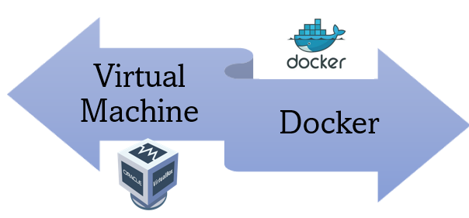
V/S

Slide 4
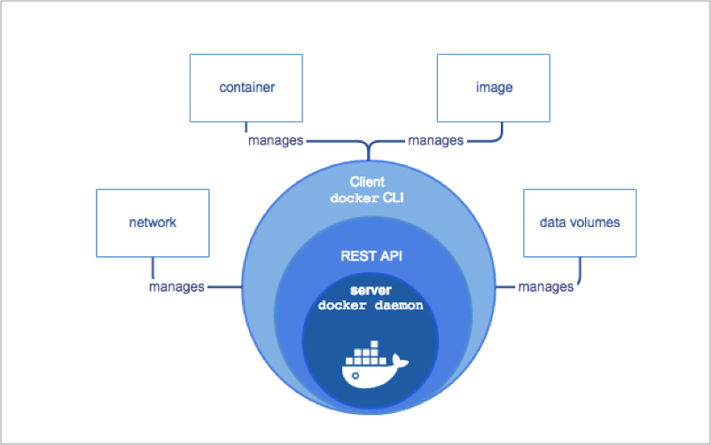
Docker Architecture

Slide 5
Key Benefits of Docker
Portability & Consistency: "Build once, run anywhere." Ensures applications behave consistently across all environments (development, staging, production).
Efficiency & Lightweight: Containers are much smaller and start faster than VMs, leading to better resource utilization.
Scalability: Easy to scale applications horizontally by spinning up new container instances quickly. Tools like Docker Compose and Kubernetes simplify orchestration.
Isolation: Each application runs in its own isolated environment, preventing conflicts and enhancing security.
Faster Development & Deployment: Streamlines CI/CD pipelines, automates builds and deployments, and reduces time to market.
Microservices Architecture: Facilitates the development and deployment of microservices by allowing each service to run in its own container.

Slide 6
Dockerfile
# Use a lightweight Python 3.9 image as the base.
FROM python:3.9-slim-buster
# Set the working directory inside the container.
WORKDIR /app
# Copy the requirements.txt file into the container's working directory.
COPY requirements.txt .
# Install the Python dependencies listed in requirements.txt.
RUN pip install --no-cache-dir -r requirements.txt
# Copy the entire current directory (where the Dockerfile resides)
COPY . .
# Expose port 5000. This informs Docker that the container will listen
EXPOSE 5000
# Define the command to run the Flask application when the container starts.
CMD ["python", "app.py"]

Slide 7
Docker commands
docker pull ubuntu:latest
docker build -t my-app:1.0 .
docker images
docker rmi my-app:1.0
docker run -d -p 8080:8080 --name my-web-server nginx
docker ps –a
docker stop my-web-server
docker start my-web-server
docker restart my-web-server
docker rm my-web-server
docker exec -it my-web-server bash
docker logs -f my-web-server
docker inspect my-web-server
docker network ls
docker volume ls

