Slide 1

Analysing the effect of different characteristics on coffee quality using generalised linear models
Jia Niu, Xiaolin Feng, Tianrui Xie, Zhilin Liu, Tianyue Wang
GROUP-14

Slide 2
Title Slides | 01
Introduction | 03
Data Cleaning | 04
Exploratory Data Analysis | 05
Generalized Linear Model (GLM) | 07
Model Evaluation | 09
Conclusion & Future Work | 11
Catalogue of research projects

Slide 3
Introduction
The aims of the analysis :
01
02
03
04
Background Coffee quality is a critical determinant of market value and consumer preference in the global coffee industry.
Research Question
How do different characteristics affect the quality of coffee?
Method By applying two Generalized
linear model.
Goals & Objectives Improve the market competitive performance of coffee farming by optimizing cultivation methods for farmers.

Slide 4
Data Cleaning
There are three steps as follows :
Handling Missing Values
Handling Outliers
Variable Transformation
Remove rows with missing values in the country_of_origin column.
Filled missing values with the median, because it is not affected by extremes.
Fill harvested year with mode, because year is a discrete variable.
By sorting the variable altitude_mean_meter, we removed outliers greater than 5000.
These figures clearly don’t make sense.
Log transformation of category_two_defects to minimise the impact of extreme values. Because most data concentrate on smaller values.
We convert Qualityclass to a binary variable by making Good to 1 and Poor to 0.

Slide 5
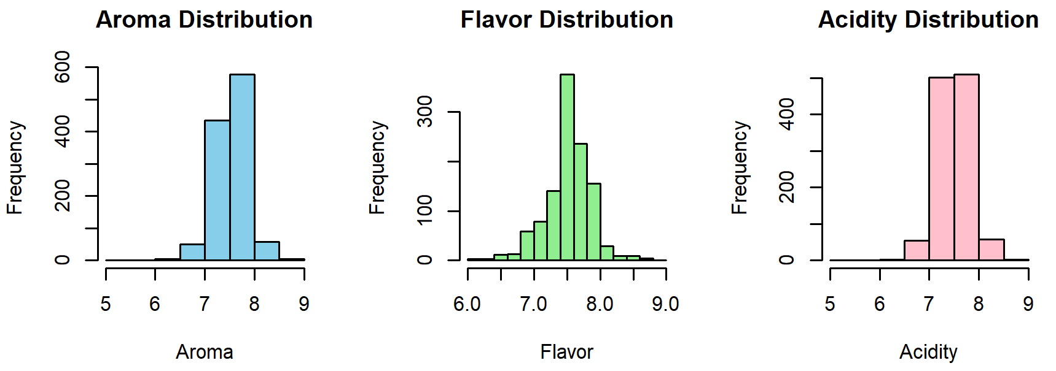
Exploratory Data Analysis
Part1: Data Distribution
Aroma is mainly concentrated between 7.0 and 8.5, with a normal distribution, the majority of the samples have high aroma scores.
Flavor distribution is similar to Aroma, with most values above 7.0.
Acidity distribution is similar to Aroma, but slightly more skewed than the flavor.

Slide 6
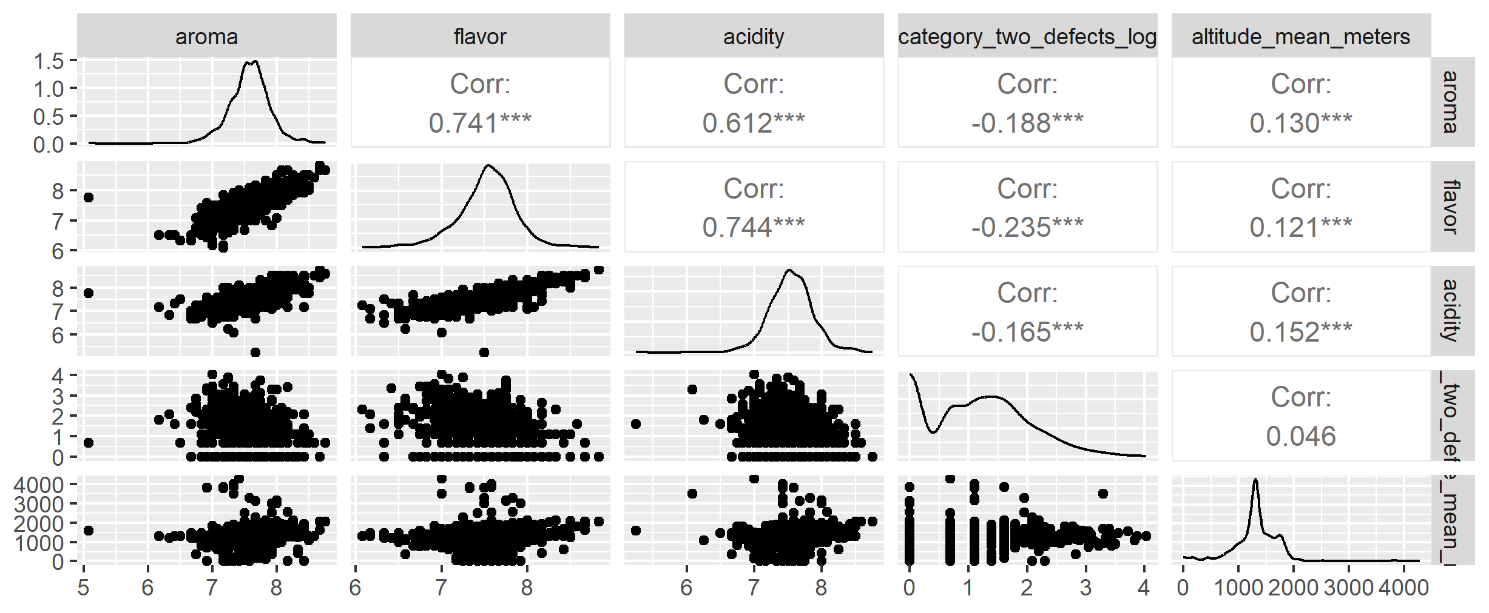
Exploratory Data Analysis
Part2 : Variable Correlation
Aroma, flavor, and acidity exhibit a strong correlation (0.6–0.8), they may have a similar impact on Qualityclass.
Category_two_defects_log might be related to Qualityclass, but there is still some negative correlation.
Altitude_mean_meters appears to have a minimal effect on Qualityclass.

Slide 7
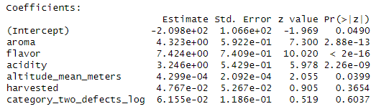

Generalized Linear Model (GLM)
Variables Response Variable：Qualityclass_binary（Good=1，Poor=0） Predictor Variables：aroma, flavor, acidity, altitude_mean_meters, harvested, category_two_defects_log
Result
The model equation

Slide 8
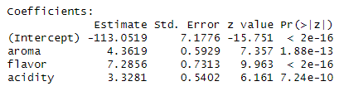

Generalized Linear Model (GLM)
Part2 : Model Refinement
Variable Interpretation The most important predictors of coffee quality are flavor (β = 7.42), aroma (β = 4.32), and acidity (β = 3.25), all highly significant (p < 0.001). Altitude (β = 0.00043, p = 0.0399) has a small but statistically significant effect. Harvest year (β = 0.0477, p = 0.3654) and defects (β = 0.0616, p = 0.6037) are not significant.
To simplify the model and improve interpretability, We ultimately discard altitude_mean_meters, harvested, and category_two_defects_log and refit the model, obtaining a new refined model.
Result
The model equation

Slide 9
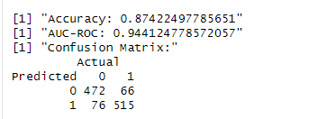
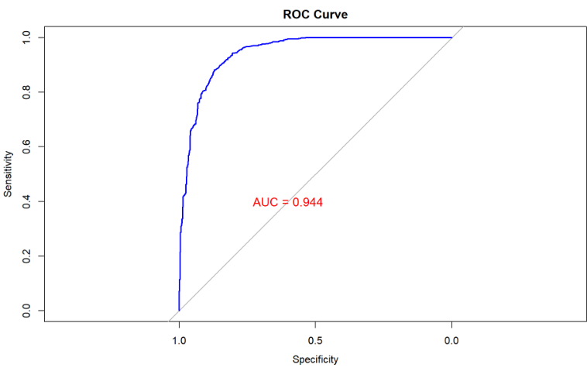
Model Evaluation
AUC and ROC
Part1: AUC-ROC and Confusion Matrix
AUC-ROC = 0.944 Indicates excellent discriminative power
The ROC curve is close to the top-left corner showing strong discriminative power
AUC > 0.9 is generally considered excellent
Confusion Matrix Analysis
Accuracy: 87.42%
True Positives (TP, Good predicted as Good): 515
True Negatives (TN, Poor predicted as Poor): 472
False Positives (FP, Poor predicted as Good): 66
False Negatives (FN, Good predicted as Poor): 76
Main sources of error:
FN and FP
The model performs well overall, but misclassification still exists. Threshold tuning may help optimize the balance between FN and FP

Slide 10
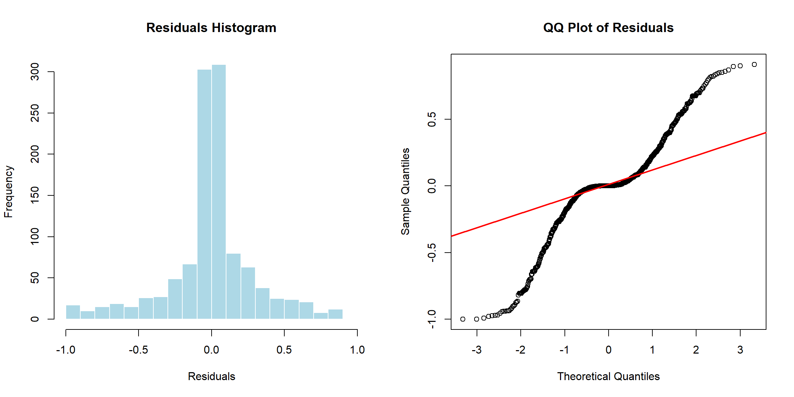
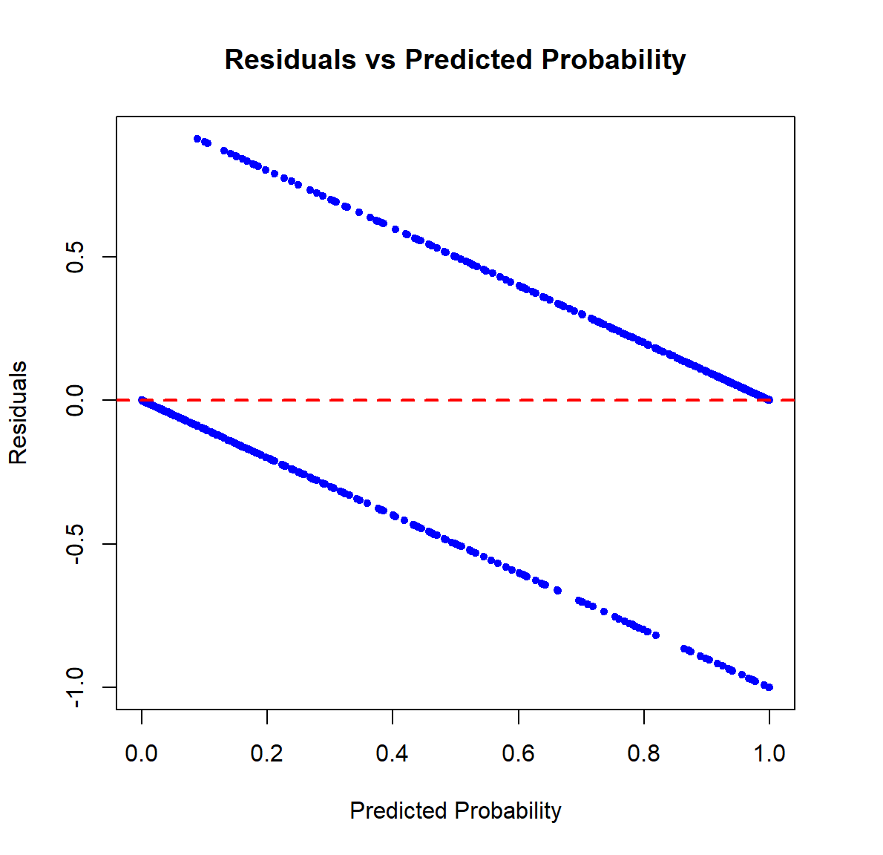
Model Evaluation
Part2: Residual Analysis
Most residuals are centered around 0, resembling a normal distribution.
However, there is slight skewness, which may indicate suboptimal variable selection.
Overall, this suggests small, randomly distributed prediction.
Central points follow the reference line, indicating approximate normality.
Heavy tails appear at both ends, suggesting possible outliers or deviations in extreme values.
The model fits well for most observations but may struggle with edge cases.
Residuals form two distinct clusters, likely due to binary classification.
This pattern suggests heteroscedasticity or nonlinearity, challenging the linear assumptions of the model.
Consider refining the model by adding interaction terms or using nonlinear methods like decision trees.

Slide 11
Conclusion & Future Work
Conclusion
Future Work & Expansion
Our analysis shows that key attributes—aroma, flavor, acidity, defect count, and altitude—significantly affect coffee quality. These features are strongly correlated with whether a coffee sample is classified as “Good” or “Poor.”
The GLM results indicate that higher aroma, flavor, and acidity scores increase the likelihood of high-quality coffee, while more defects lower it. Altitude also has a minor but consistent positive effect, suggesting environmental conditions play a supporting role.
These findings suggest that farmers should focus on improving flavor, reducing defects, and refining growing conditions.
To deepen understanding and broaden the impact of this research, future studies could explore:
More Variables: Include soil type, humidity, temperature, and processing methods.
Geographical Analysis: Assess how region and climate influence coffee characteristics.
Longitudinal Studies: Track changes across multiple harvest seasons.
Market Impact: Investigate links between quality, pricing, and consumer demand.

Slide 12
Thanks for your attention!
Jia Niu, Xiaolin Feng, Tianrui Xie, Zhilin Liu, Tianyue Wang
GROUP-14

