Slide 1

Analysing the effect of different characteristics on coffee quality using generalised linear models
Jia Niu, Xiaolin Feng ,Tianrui Xie, Zhilin Liu, Tianyue Wang
GROUP-14

Slide 2
Title Slides | 01
Introduction | 02
Purpose | 03
Methods | 04
Statistical Analysis | 05
Results | 06
Discussion | 07
Conclusion | 08
Reference Slides | 09
Catalogue of research projects

Slide 3
Introduction
The aims of the analysis :
01
02
03
04
Background Coffee quality is a critical determinant of market value and consumer preference in the global coffee industry.
Research Question
How do different characteristics affect the quality of coffee?
Method By applying two Generalized
linear model.
Goals & Objectives Improve the market competitive performance of coffee farming by optimizing cultivation methods for farmers.

Slide 4
Data Cleaning
There are three steps as follows :
Handling Missing Values
Handling Outliers
Variable Transformation
Remove rows with missing values in the country_of_origin column.
Filled missing values with the median, because it is not affected by extremes.
Fill harvested year with mode, because year is a discrete variable.
By sorting the variable altitude_mean_meter, we removed outliers greater than 5000.
These figures clearly don’t make sense.
Log transformation of category_two_defects to minimise the impact of extreme values. Because most data concentrate on smaller values.
We convert Qualityclass to a binary variable by making Good to 1 and Poor to 0.

Slide 5
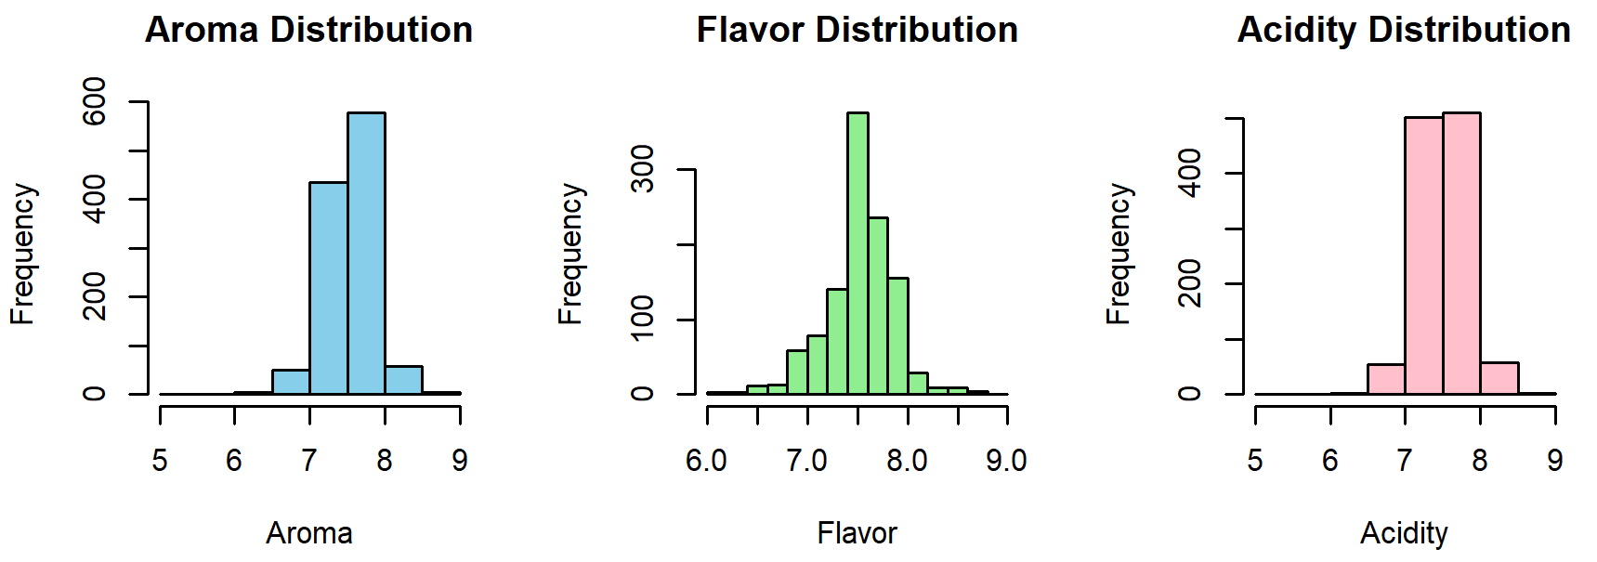
Exploratory Data Analysis
Part1: Data Distribution
Aroma is mainly concentrated between 7.0 and 8.5, with a normal distribution, the majority of the samples have high aroma scores.
Flavor distribution is similar to Aroma, with most values above 7.0.
Acidity distribution is similar to Aroma, but slightly more skewed than the flavor.

Slide 6
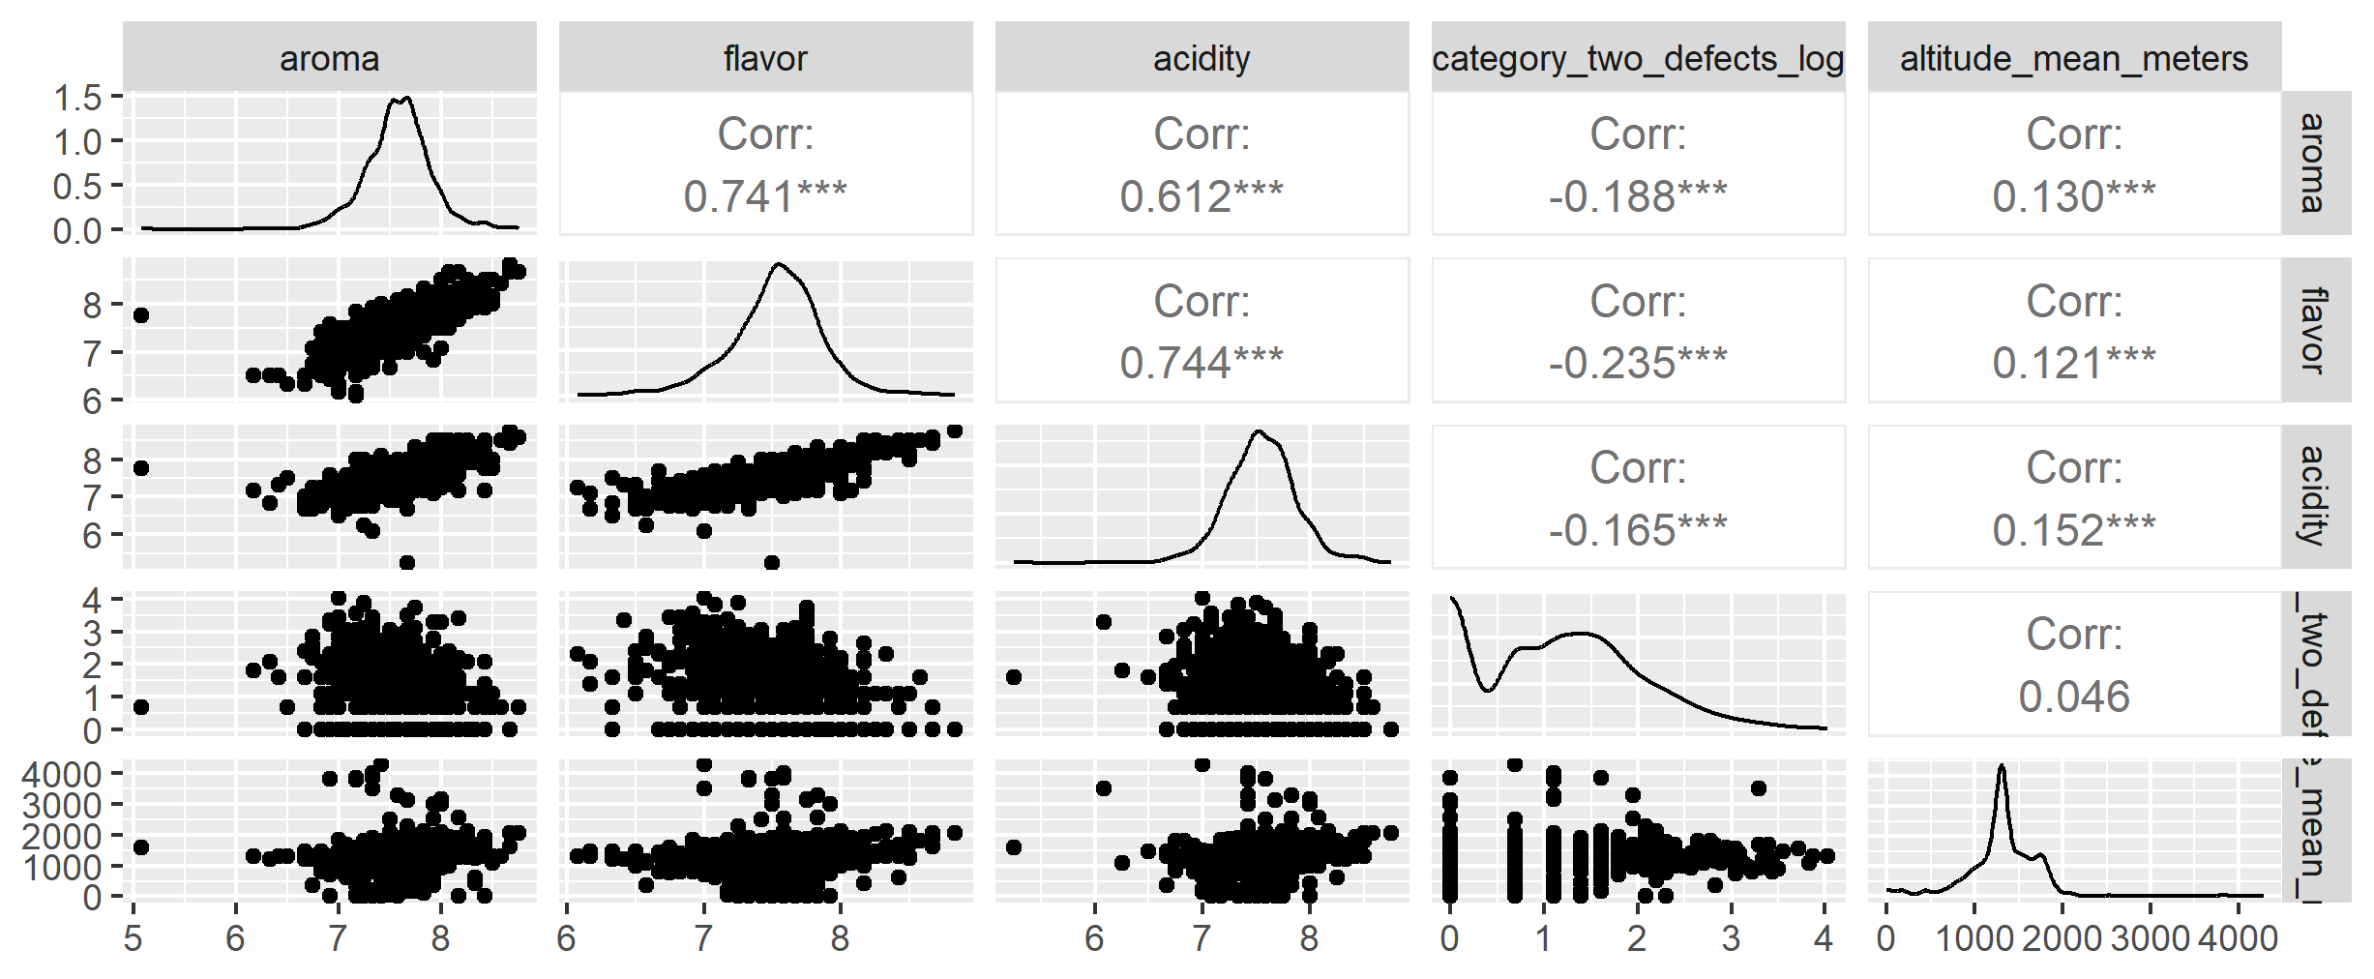
Exploratory Data Analysis
Part2 : Variable Correlation
Aroma, flavor, and acidity exhibit a strong correlation (0.6–0.8), they may have a similar impact on Qualityclass.
Category_two_defects_log might be related to Qualityclass, but there is still some negative correlation.
Altitude_mean_meters appears to have a minimal effect on Qualityclass.

