Slide 1
Chapter 3 More than one likelihood

Slide 2
3.1 Coregionalization model
3.1.1 Motivation
Coregionalizationモデルを扱う
測定点で複数の変数が観測される場合に良く使用 例、大気汚染の観測でCO2、CO、NO2が同時測定
同時測定されたこれらデータ（応答変数）の共依存関係を予測子の共有成分でモデル化
INLA-SPDEを用いれば、異なる応答変数が同じ場所で測定されていなくてもよい

Slide 3
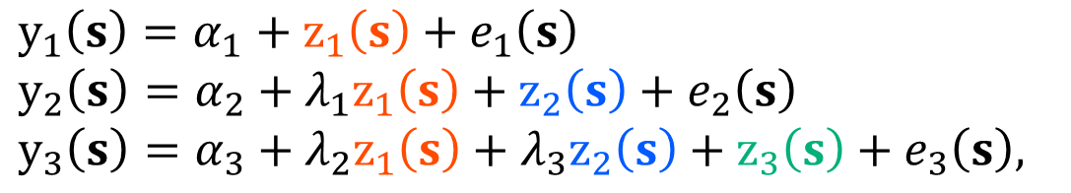
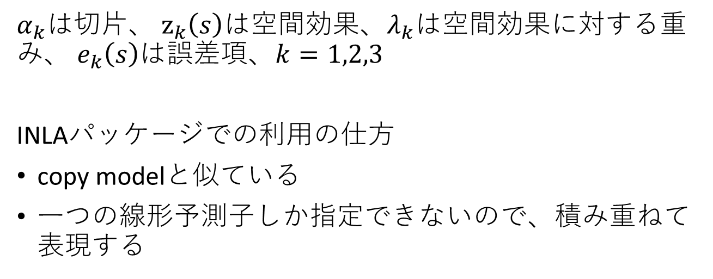
3.1.2 The model and parametrization
$$y_{1}\left(s\right)=α_{1}+z_{1}\left(s\right)+e_{1}\left(s\right)$$
$$y_{2}\left(s\right)=α_{2}+λ_{1}z_{1}\left(s\right)+z_{2}\left(s\right)+e_{2}\left(s\right)$$
$$y_{3}\left(s\right)=α_{3}+λ_{2}z_{1}\left(s\right)+{λ_{3}z}_{2}\left(s\right)+z_{3}\left(s\right)+e_{3}\left(s\right),$$
$α_{k}$は切片、 $z_{k}\left(s\right)$は空間効果、$λ_{k}$は空間効果に対する重み、 $e_{k}\left(s\right)$は誤差項、$k=1,2,3$
INLAパッケージでの利用の仕方
copy modelと似ている
一つの線形予測子しか指定できないので、積み重ねて表現する

Slide 4
3.1.3 Data simulation
alpha <- c(-5, 3, 10) # 切片
m.var <- c(0.5, 0.4, 0.3) # ランダムフィールドの分散
range <- c(4, 3, 2) # 距離スケール
beta <- c(0.7, 0.5, -0.5) # 空間効果に対する重み
e.sd <- c(0.3, 0.2, 0.15) # 応答変数の観測誤差

Slide 5
3.1.3 Data simulation
n1 <- 99; n2 <- 100; n3 <- 101 # データ数が異なる
loc1 <- cbind(runif(n1) * 10, runif(n1) * 5)
loc2 <- cbind(runif(n2) * 10, runif(n2) * 5)
loc3 <- cbind(runif(n3) * 10, runif(n3) * 5)
z1 <- book.rMatern(1, rbind(loc1, loc2, loc3), range = range[1],
sigma = sqrt(m.var[1]))
z2 <- book.rMatern(1, rbind(loc2, loc3), range = range[2],
sigma = sqrt(m.var[2]))
z3 <- book.rMatern(1, loc3, range = range[3],
sigma = sqrt(m.var[3]))

Slide 6
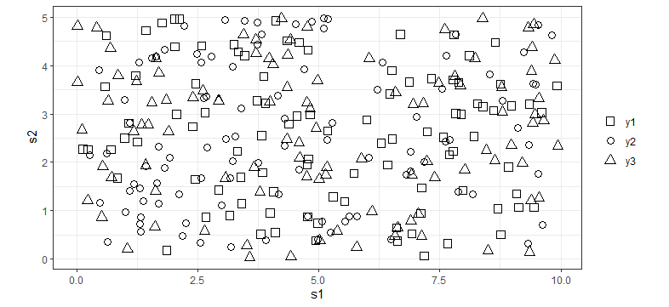
3.1.3 Data simulation
y1 <- alpha[1] + z1[1:n1] + rnorm(n1, 0, e.sd[1])
y2 <- alpha[2] + beta[1] * z1[n1 + 1:n2] + z2[1:n2] +
rnorm(n2, 0, e.sd[2])
y3 <- alpha[3] + beta[2] * z1[n1 + n2 + 1:n3] +
beta[3] * z2[n2 + 1:n3] + z3 + rnorm(n3, 0, e.sd[3])

Slide 7
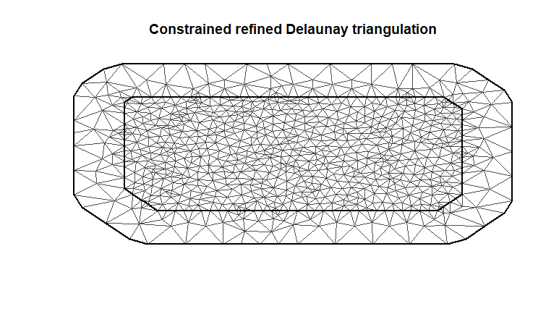
3.1.4 Model fitting
# メッシュの作成
mesh <- inla.mesh.2d(rbind(loc1, loc2, loc3),
max.edge = c(0.5, 1.25), offset = c(0.1, 1.5), cutoff = 0.1)

Slide 8
3.1.4 Model fitting
# Matern GFの設定
spde <- inla.spde2.pcmatern(
mesh = mesh,
prior.range = c(0.5, 0.01), # 距離スケールの事前分布, P(range < 0.5) = 0.01
prior.sigma = c(1, 0.01)) # GFの分散, P(sigma > 1) = 0.01
# 三角形の頂点を内点に変換するための行列
A1 <- inla.spde.make.A(mesh, loc1)
A2 <- inla.spde.make.A(mesh, loc2)
A3 <- inla.spde.make.A(mesh, loc3)

Slide 9
3.1.4 Model fitting
# コピー部分の傾きの事前分布 → 平均0、精度10の正規分布
hyper <- list(theta = list(prior = 'normal', param = c(0, 10)))
# モデル式の書き方
form <- y ~ 0 + intercept1 + intercept2 + intercept3 +
f(s1, model = spde) + f(s2, model = spde) +
f(s3, model = spde) +
f(s12, copy = "s1", fixed = FALSE, hyper = hyper) +
f(s13, copy = "s1", fixed = FALSE, hyper = hyper) +
f(s23, copy = "s2", fixed = FALSE, hyper = hyper)

Slide 10
3.1.4 Model fitting
# Inla()に渡すデータの整形
stack1 <- inla.stack(
data = list(y = cbind(as.vector(y1), NA, NA)),
A = list(A1),
effects = list(list(intercept1 = 1, s1 = 1:spde$n.spde)))
stack2 <- inla.stack(
data = list(y = cbind(NA, as.vector(y2), NA)),
A = list(A2),
effects = list(list(intercept2 = 1, s2 = 1:spde$n.spde, s12 = 1:spde$n.spde)))
stack3 <- inla.stack(
data = list(y = cbind(NA, NA, as.vector(y3))),
A = list(A3),
effects = list(list(intercept3 = 1, s3 = 1:spde$n.spde, s13 = 1:spde$n.spde, s23 = 1:spde$n.spde)))
stack <- inla.stack(stack1, stack2, stack3)
切片𝛼_1
頂点のインデックス

Slide 11
3.1.4 Model fitting
誤差項の精度の事前分布
hyper.eps <- list(hyper = list(theta = list(prior = 'pc.prec',
param = c(1, 0.01))))
計算時間節約のため初期値を設定
theta.ini <- c(log(1 / e.sd^2),
c(log(range),
log(sqrt(m.var)))[c(1, 4, 2, 5, 3, 6)], beta)
# ちょっとノイズを入れる
theta.ini = theta.ini + rnorm(length(theta.ini), 0, 0.1)

Slide 12
3.1.4 Model fitting
# inla()でパラメーター推定
result <- inla(form, rep('gaussian', 3),
data = inla.stack.data(stack),
control.family = list(hyper.eps, hyper.eps, hyper.eps),
control.predictor = list(A = inla.stack.A(stack)),
control.mode = list(theta = theta.ini, restart = TRUE),
control.inla = list(int.strategy = ‘eb’)) #経験ベイズを指定
> result$cpu
Pre Running Post Total
2.5085869 26.1219492 0.2660849 28.8966210

Slide 13
3.1.4 Model fitting
result$mode$theta

Slide 14
3.1.4 Model fitting
精度を標準偏差へ
p.sd <- lapply(result$internal.marginals.hyperpar[1:3],
function(m) {
inla.tmarginal(function(x) 1 / sqrt(exp(x)), m)
})
事後分布の要約
tabcrp1 <- cbind(true = alpha, result$summary.fixed[, c(1:3, 5)])
tabcrp2 <- cbind(
true = c(e = e.sd),
t(sapply(p.sd, function(m)
unlist(inla.zmarginal(m, silent = TRUE))[c(1:3, 7)])))
colnames(tabcrp2) <- colnames(tabcrp1)
tabcrp3 <- cbind(
true = beta, result$summary.hyperpar[10:12, c(1:3, 5)])
tabcrp <- rbind(tabcrp1, tabcrp2, tabcrp3)

Slide 15
3.1.4 Model fitting
モデルのパラメーターの事後分布

Slide 16
3.1.4 Model fitting
推定結果の検証
plot(drop(A1 %*% result$summary.random$s1$mean), z1[1:n1],
xlab = 'Posterior mean', ylab = 'Simulated', asp = 1,
main = 'z1 in y1’)
Abline(0:1)

Slide 17
3.2 Joint modeling: Measurement error model
共変量に観測誤差を含むモデル

Slide 18
3.2 Joint modeling: Measurement error model
●: xの観測点, ▲: yの観測点
観測点の生成
n.x <- 70
n.y <- 50
set.seed(1)
loc.y <- cbind(runif(n.y) * 10, runif(n.y) * 5)
loc.x <- cbind(runif(n.x) * 10, runif(n.x) * 5)

Slide 19
3.2.1 Simulation from the model
空間効果のデータ生成
range.v <- 3
sigma.v <- 0.5
range.m <- 3
sigma.m <- 1
set.seed(2)
v <- book.rMatern(n = 1, coords = loc.y, range = range.v,
sigma = sigma.v, nu = 1)
m <- book.rMatern(n = 1, coords = rbind(loc.x, loc.y),
range = range.m, sigma = sigma.m, nu = 1)

Slide 20
3.2.1 Simulation from the model
観測データの生成
alpha.y <- 2
alpha.x <- 5
beta.x <- 0.3
sigma.e <- 0.2
x.x <- alpha.x + m[1:n.x]
w.x <- x.x + rnorm(n.x, 0, sigma.e)
x.y <- alpha.x + m[n.x + 1:n.y]
w.y <- x.y + rnorm(n.y, 0, sigma.e)
eta.y <- alpha.y + beta.x * x.y + v
yy <- rpois(n.y, exp(eta.y))
xの観測点、yの観測点両方での
xの真値 vs xの観測値

Slide 21
3.2.2 Model fitting
# メッシュの作成
mesh <- inla.mesh.2d(rbind(loc.x, loc.y),
max.edge = min(range.m, range.v) * c(1 / 3, 1),
offset = min(range.m, range.v) * c(0.5, 1.5))
# vとm両方に対する変換行列を作成
Ax <- inla.spde.make.A(mesh, loc = loc.x)
Ay <- inla.spde.make.A(mesh, loc = loc.y)
# Maternモデルの作成
spde <- inla.spde2.pcmatern(mesh = mesh,
prior.range = c(0.5, 0.01), # P(practic.range < 0.5) = 0.01
prior.sigma = c(1, 0.01)) # P(sigma > 1) = 0.01

Slide 22
3.2.2 Model fitting
利用可能なデータはwとyだけなので、yにおけるxを計算できるモデルが必要
式（3.1）より、0 = α_{x} + m(s) – x(s)
fake zeros ← 0値が得られたようにする
mはGFなので、yの位置でxを予測するために使用
負のx項はβを推定するために、yの 線形予測子にコピー
inla.stack()でfake zeros、w、yに対応するデータを作成

Slide 23
3.2.2 Model fitting
ゼロデータが得られたように与える→ fake zeros
stk.0 <- inla.stack(
data = list(Y = cbind(rep(0, n.y), NA, NA)),
A = list(1, Ay),
effects = list(data.frame(alpha.x = 1, x0 = 1:n.y, x0w = -1),
m = 1:spde$n.spde),
tag = 'dat.0')
α_{x}
yの
インデックス
-x
三角形の頂点の
インデックス

Slide 24
3.2.2 Model fitting
xに対する準備
stk.x <- inla.stack(
data = list(Y = cbind(NA, w.x, NA)),
A = list(1, Ax),
effects = list(alpha.x = rep(1, n.x), m = 1:mesh$n),
tag = 'dat.x')
xの観測値
α_{x}
mの三角形の頂点の
インデックス

Slide 25
3.2.2 Model fitting
yに対する準備
stk.y <- inla.stack(
data = list(Y = cbind(NA, NA, yy)),
A = list(1, Ay),
effects = list(data.frame(alpha.y = 1, x = 1:n.y),
v = 1:mesh$n),
tag = 'dat.y')
yの値
α_{y}
yのインデックス
vの三角形の
頂点のインデックス

Slide 26
3.2.2 Model fitting
モデル式
form <- Y ~ 0 + alpha.x + alpha.y +
f(m, model = spde) + f(v, model = spde) +
f(x0, x0w, model = 'iid’, # fake zeros
hyper = list(theta = list(initial = -20, fixed = TRUE))) +
f(x, copy = ‘x0’, fixed = FALSE, # βの推定
hyper = list(theta = list(prior='normal', param = c(0, 1))))
xの観測誤差の事前分布
pprec <- list(hyper = list(theta = list(prior = 'pc.prec',
param=c(0.2, 0.5)))) # P(σ_{ε} < 0.2) = 0.5

Slide 27
3.2.2 Model fitting
モデルの実行
stk <- inla.stack(stk.0, stk.x, stk.y)
res <- inla(form, data = inla.stack.data(stk),
family = c('gaussian', 'gaussian', 'poisson'),
control.predictor = list(compute = TRUE,
A = inla.stack.A(stk)),
control.family = list(hfix, pprec, list()))
与え方を覚えるのが大変。。。

Slide 28
3.2.3 Results

Slide 29
3.2.3 Results

Slide 30
3.2.3 Results

Slide 31
3.2.3 Results
応答変数が得られた位置での共変量の予測
mesh2locs <- rbind(Ax, Ay)
m.mu <- drop(mesh2locs %*% res$summary.ran$m$mean)
m.sd <- drop(mesh2locs %*% res$summary.ran$m$sd)
作図
plot(m.mu, m, asp = 1, type = 'n',
xlab = 'Predicted', ylab = 'Simulated')
segments(m.mu - 2 * m.sd, m, m.mu + 2 * m.sd, m,
lty = 2, col = gray(0.75))
abline(c(0, 1), col = 4)
points(m.mu, m, pch = 3, cex = 0.5)

Slide 32
3.2.3 Results
m、v（GF）の作図
# Create grid for projection INLAの関数で
prj <- inla.mesh.projector(mesh, xlim = c(0, 10), ylim = c(0, 5))
par(mfrow = c(2, 1), mar = c(0.5, 0.5, 0.5, 0.5),
mgp = c(1.5, 0.5, 0))
# Posterior mean of ‘m’ 黒Inla本の関数で
book.plot.field(field = res$summary.ran$m$mean, projector = prj)
points(loc.x, cex = 0.3 + (m - min(m))/diff(range(m)))
# Posterior mean of ‘v‘ 黒Inla本の関数で
book.plot.field(field = res$summary.ran$v$mean, projector = prj)
points(loc.y, cex = 0.3 + (v - min(v))/diff(range(v)))

Slide 33
3.2.3 Results
m
v

Slide 34
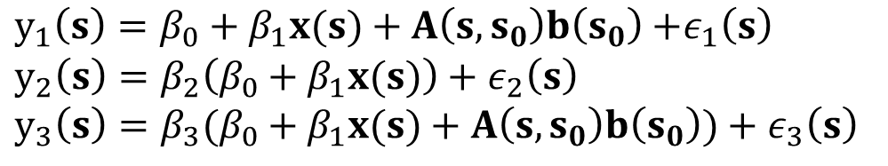
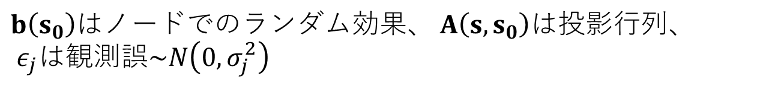
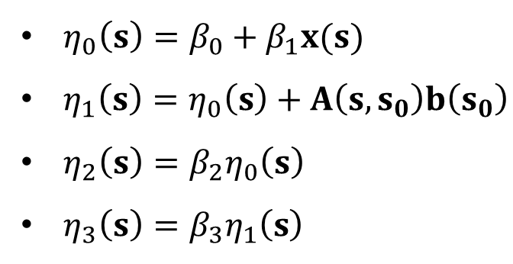
3.3 Copying part of or the entire linear predictor
線形予測子の一部をコピーして使用
$y_{1}\left(s\right)=β_{0}+β_{1}x(s)+A\left(s, s_{0}\right)b\left(s_{0}\right)$ $+ε_{1}\left(s\right)$
$$y_{2}\left(s\right)=β_{2}\left(β_{0}+β_{1}x(s)\right)+ε_{2}\left(s\right)$$
$$y_{3}\left(s\right)=β_{3}(β_{0}+β_{1}x(s)+A\left(s, s_{0}\right)b\left(s_{0}\right))+ε_{3}\left(s\right)$$
$b\left(s_{0}\right)$はノードでのランダム効果、 $A\left(s, s_{0}\right)$は投影行列、 $ε_{j}$は観測誤$\sim N\left(0, σ_{j}^{2}\right)$
以降の定義
$η_{0}\left(s\right)=β_{0}+β_{1}x(s)$
$η_{1}\left(s\right)=η_{0}\left(s\right)+A\left(s, s_{0}\right)b\left(s_{0}\right)$
$η_{2}\left(s\right)=β_{2}η_{0}\left(s\right)$
$η_{3}\left(s\right)=β_{3}η_{1}\left(s\right)$

Slide 35
3.3.1 Generating the data
beta0 = 5; beta1 = 1; beta2 = 0.5; beta3 = 2
s123 <- c(0.1, 0.05, 0.15) # 誤差項の標準偏差
Matérn covarianceのパラメーター
kappab <- 10
sigma2b <- 1
n <- 50
loc <- cbind(runif(n), runif(n))
b <- book.rMatern(n = 1, coords = loc,
range = sqrt(8) / 10, sigma = 1)

Slide 36
3.3.1 Generating the data
共変量
x <- sqrt(3) * runif(n, -1, 1)

Slide 37
3.3.1 Generating the data
線形予測子
eta1 <- beta0 + beta1 * x + b
eta2 <- beta2 * (beta0 + beta1 * x)
eta3 <- beta3 * eta1
# yの観測値
y1 <- rnorm(n, eta1, s123[1])
y2 <- rnorm(n, eta2, s123[2])
y3 <- rnorm(n, eta3, s123[3])

Slide 38
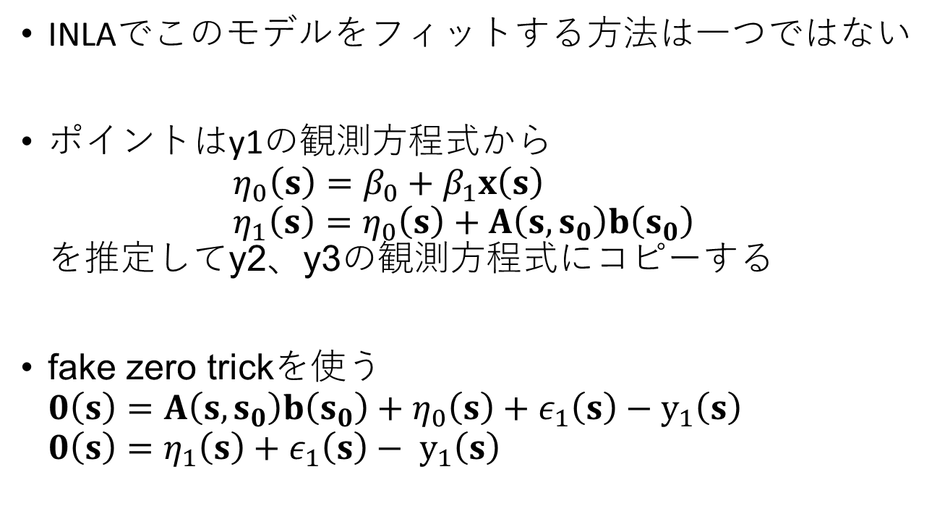
3.3.2 The fake zero trick for fitting this model
INLAでこのモデルをフィットする方法は一つではない
ポイントはy1の観測方程式から $η_{0}\left(s\right)=β_{0}+β_{1}x\left(s\right)$ $η_{1}\left(s\right)=η_{0}\left(s\right)+A\left(s, s_{0}\right)b\left(s_{0}\right)$ を推定してy2、y3の観測方程式にコピーする
fake zero trickを使う $0\left(s\right)=A\left(s, s_{0}\right)b\left(s_{0}\right)+η_{0}\left(s\right)+ε_{1}\left(s\right)−$ $y_{1}\left(s\right)$ $0\left(s\right)=η_{1}\left(s\right)+ε_{1}\left(s\right)− y_{1}\left(s\right)$

Slide 39
3.3.3 Fitting the model
mesh <- inla.mesh.2d(
loc.domain = cbind(c(0, 1, 1, 0), c(0, 0, 1, 1)),
max.edge = c(0.1, 0.3), offset = c(0.05, 0.35), cutoff = 0.05)
As <- inla.spde.make.A(mesh, loc)
spde <- inla.spde2.pcmatern(mesh, alpha = 2,
prior.range = c(0.05, 0.01),
prior.sigma = c(1, 0.01))
α = ν + d/2は2に固定

Slide 40
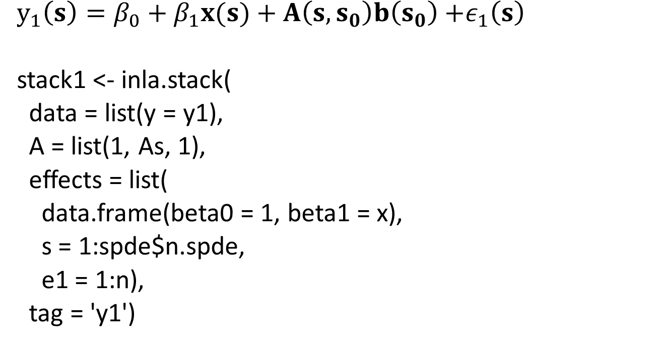
3.3.3 Fitting the model
$y_{1}\left(s\right)=β_{0}+β_{1}x(s)+A\left(s, s_{0}\right)b\left(s_{0}\right)$ $+ε_{1}\left(s\right)$
stack1 <- inla.stack(
data = list(y = y1),
A = list(1, As, 1),
effects = list(
data.frame(beta0 = 1, beta1 = x),
s = 1:spde$n.spde,
e1 = 1:n),
tag = 'y1')

Slide 41
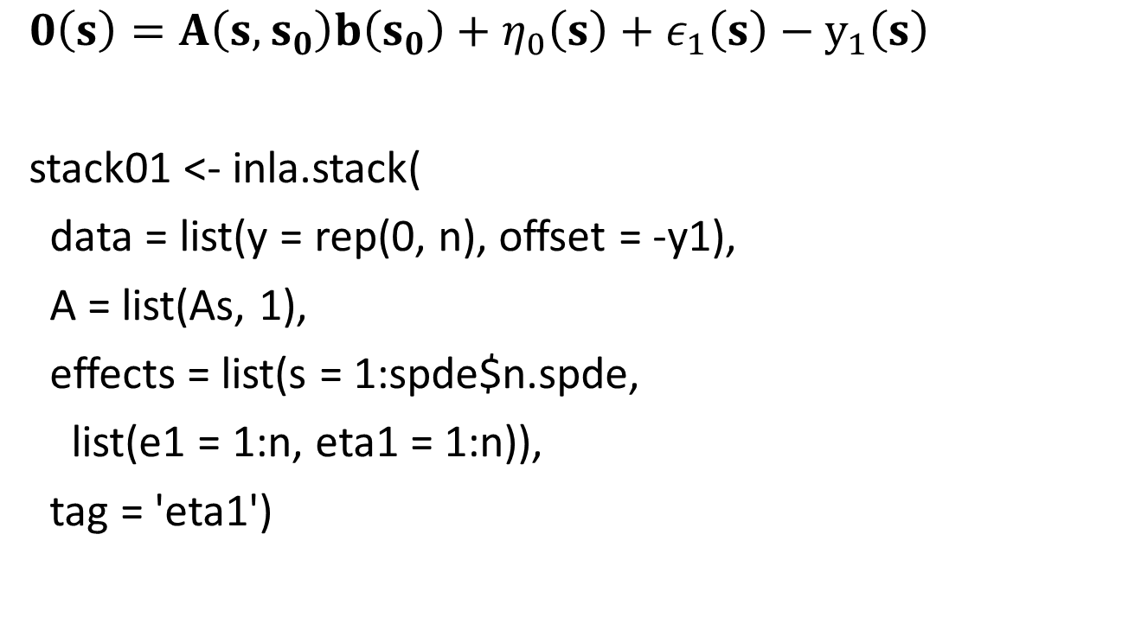
3.3.3 Fitting the model
$0\left(s\right)=A\left(s, s_{0}\right)b\left(s_{0}\right)+η_{0}\left(s\right)+ε_{1}\left(s\right)−$ $y_{1}\left(s\right)$
stack01 <- inla.stack(
data = list(y = rep(0, n), offset = -y1),
A = list(As, 1),
effects = list(s = 1:spde$n.spde,
list(e1 = 1:n, eta1 = 1:n)),
tag = 'eta1')

Slide 42
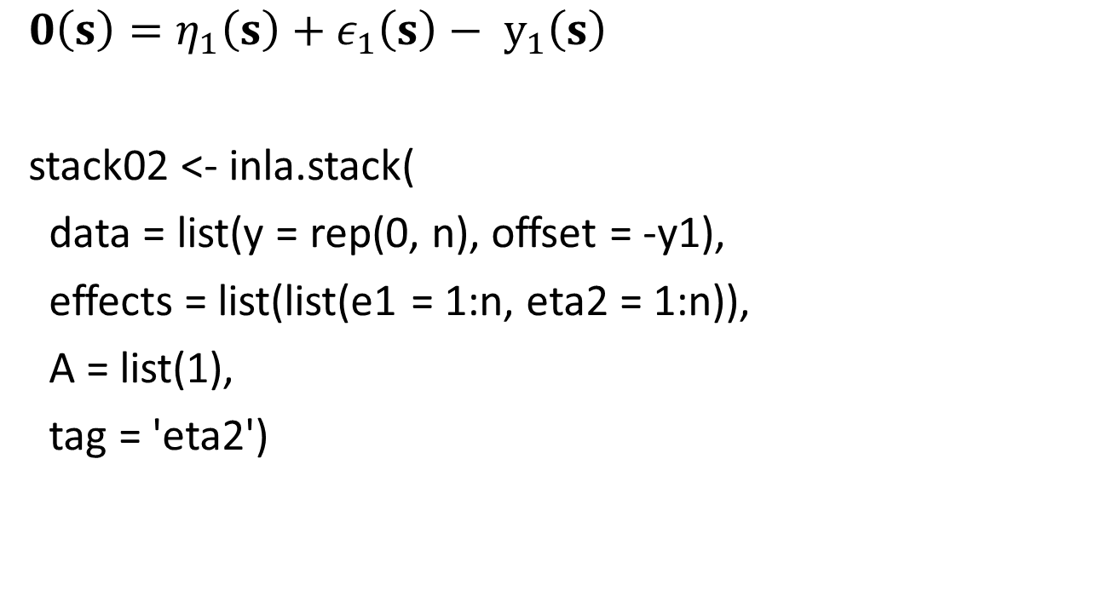
3.3.3 Fitting the model
$$0\left(s\right)=η_{1}\left(s\right)+ε_{1}\left(s\right)− y_{1}\left(s\right)$$
stack02 <- inla.stack(
data = list(y = rep(0, n), offset = -y1),
effects = list(list(e1 = 1:n, eta2 = 1:n)),
A = list(1),
tag = 'eta2')

Slide 43

3.3.3 Fitting the model
$$y_{2}\left(s\right)=β_{2}η_{0}\left(s\right)+ε_{2}\left(s\right)$$
stack2 <- inla.stack(
data = list(y = y2),
effects = list(list(eta1c = 1:n, e2 = 1:n)),
A = list(1),
tag = 'y2')

Slide 44

3.3.3 Fitting the model
$$y_{3}\left(s\right)=β_{3}η_{1}\left(s\right)+ε_{3}\left(s\right)$$
stack3 <- inla.stack(
data = list(y = y3),
effects = list(list(eta2c = 1:n, e3 = 1:n)),
A = list(1),
tag = 'y3')

Slide 45
3.3.3 Fitting the model
stack <- inla.stack(stack1, stack01, stack02, stack2, stack3)
# 観測誤差の事前分布
pcprec <- list(theta = list(prior = 'pcprec',
param = c(0.5, 0.1)))

Slide 46
3.3.3 Fitting the model
formula123 <- y ~ 0 + beta0 + beta1 +
f(s, model = spde) + f(e1, model = 'iid', hyper = pcprec) +
f(eta1, model = 'iid',
hyper = list(theta = list(initial = -10, fixed = TRUE))) +
f(eta2, model = 'iid',
hyper = list(theta = list(initial = -10, fixed = TRUE))) +
f(eta1c, copy = 'eta1', fixed = FALSE) +
f(e2, model = 'iid', hyper = pcprec) +
f(eta2c, copy = 'eta2', fixed = FALSE) +
f(e3, model = 'iid', hyper = pcprec)

Slide 47
3.3.3 Fitting the model
res123 <- inla(formula123,
data = inla.stack.data(stack),
offset = offset,
control.family = list(list(
hyper = list(theta = list(initial = 10, fixed = TRUE)))),
control.predictor = list(A = inla.stack.A(stack)))

Slide 48
3.3.4 Model results

Slide 49
3.3.4 Model results

