Slide 1
物聯網核心技術
國立中正大學資工系 黃仁竑教授

Slide 2
物聯網 學分學程

Slide 3

課程大綱
Current Landscape of the IoT/M2M
IoT/M2M Trends
IoT/M2M Business Models
Outlook of the IoT/M2M
IoT/M2M Requirements and Architecture
IoT/M2M System Structure
Introduction to oneM2M
IoT/M2M Use-Case-Driven Requirements
IoT/M2M High Level Architecture
IoT/M2M Area Networks
M2M Area Protocols
ANSI C12 Suite
Zigbee
Bluetooth
IoT Devices

Slide 4
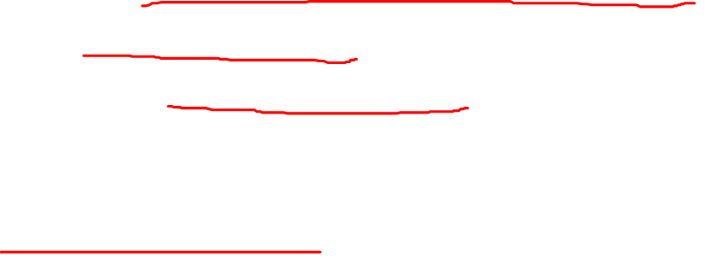
課程大綱
IoT/M2M Core Networks
M2M Impact to Core Networks
Core Network Optimization for M2M
Impact of Low Power Wide Area Network (LPWAN)
IoT/M2M Service Architecture
ETSI M2M Common Service Layer
REST Architectural Style for M2M
Resource-Based M2M Communications
The Role of IP in IoT/M2M
6LoWPAN
RPL
CoAP

Slide 5
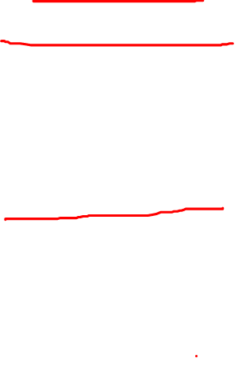
課程大綱
Key Applications of the IoT/M2M
Industrial IoT/M2M
Industrial Automation
eHealth
Smart Grid
Consumer IoT/M2M
Smart Home
Smart Cities
Connected Car

Slide 6
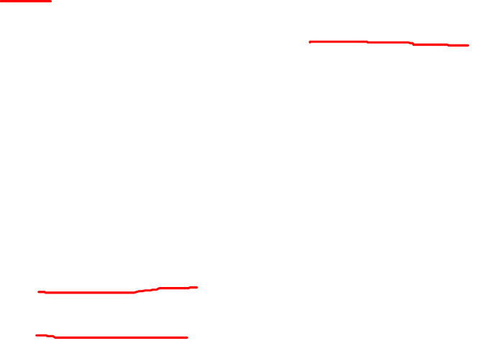
評量標準
實習報告: 4次，每次10%，共40%
Linkit one, Arduino IDE, App Inventor2 介紹
感測資料從感測器以藍芽連線傳送到手機app
ETSI service architecture: oneM2M及Node-red
Linkit one and oneM2M
期未考: 30%
期末專題報告: 30%
口頭簡報 15%
專題報告 15%

Slide 7
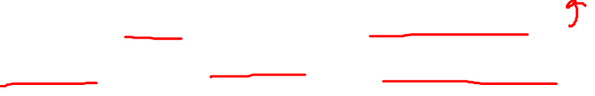
專題報告
分組: 3~4人一組
以創意實作為主
oneM2M延伸應用(感測、控制、oneM2M framework、手機app)
物聯網各種場域應用: 水族、雲端咖啡、校園空污監控…
物聯網感測器IPv6實作: port Contiki OS to TI CC2650DK
物聯網資安攻防案例探討
其他各種物聯網應用實作

