Slide 1
Performance Analysis of An RSVP-Capable Router
中正資工所－蘇弘琦

Slide 2
Introduction
Problem
  The performance cost of the guaranteed services can potentially have a negative impact on throughput and latency of the RSVP-capable routers.
Goal
  Examine the performance cost of RSVP based on measurements from an industry-strength RSVP implementation on a commercial IP router.

Slide 3
RSVP Protocol Overview
A transport layer bandwidth reservation protocol
Rely on unicast and multicast routing protocols to route the reservation message
Two types of control messages:
  PATH
  RESV

Slide 4
Traffic control module
Packet classifier
  distinguish packets that belong to different real-time sessions
Packet scheduler
  prioritize the packets on an output link’s waiting queue
Admission control
  determine if there are sufficient resources available at one node

Slide 5
Connection Establishment
Receiver-initiation style
PATH messages carry the traffic specs of the flow from the sender to the receicer
At each router, the last RSVP capable router address is recorded from the incoming PATH message
The receiver respond with the actual reservation request

Slide 6
Connection Establishment
The request is carried by the RESV messages which are unicast hop-by-hop upstream until
  the top of the multicast tree is reached
  it is merged with an existing reservation
The effective time to establish a reservation is from the time when the first PATH message is sent to the time the first RESV message is received at the source node

Slide 7
Soft State
RSVP maintains soft state in routers and hosts
  RSVP sends periodic refresh messages to maintain the state along the reserved paths
  in absence of refreshes, the state will automatically time out and be deleted

Slide 8
Soft State
L ≥ ( K + 0.5 ) * 1.5 * R
  L ⇒ the node’s local state lifetime for the corresponding connection
  K ⇒ the max. number of consecutive packet losses that could possibly occur on the link
  R ⇒ the soft state refresh period
Actual refresh period is randomly set between 0.5R to 1.5R in most implementation to avoid message synchronization

Slide 9
Soft State
The value of R may be chosen locally by a node
R may be changed dynamically to improve robustness
Most implementation simply use a fixed timer value : 30 secs

Slide 10
Reservation Merging
Reduce the amount of resources reserved and the control message overhead
If a reservation state for a real-time session is already present at a node, an incoming RESV message for the same session would not creat a new reservation state

Slide 11
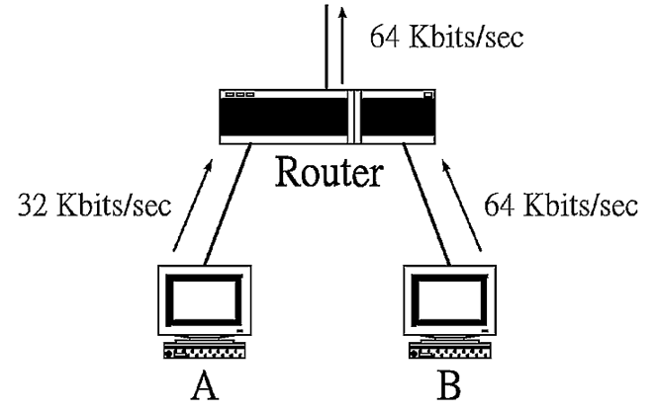
Reservation Merging

Slide 12
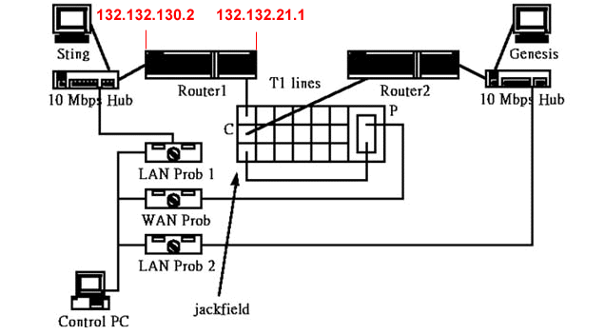
Evaluation Methodology

Slide 13
Evaluation Methodology
Problem
  the network sniffers have limited trace length due to the small buffer memory
Solution
  periodically the sniffers have to be stopped and the traces collected until that point are transferred to the control PC’s disk for off-line analysis

Slide 14
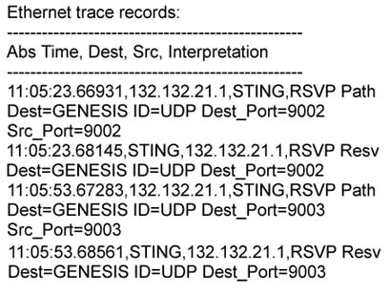
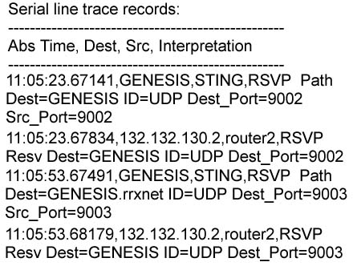
Evaluation Methodology

Slide 15
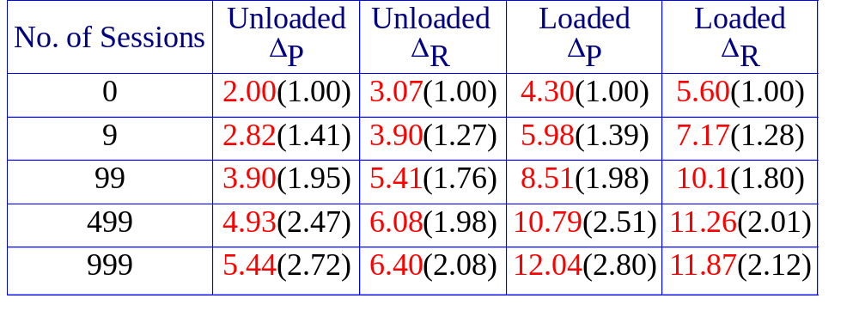
Packet Latency
Table 1. Average Control Packet Latency (in msecs) when there are a variable number of real-time sessions, which may be loaded or unloaded.
ΔP : the packet latency of a PATH message through a router
ΔR : the packet latency of a RESV message through a router

Slide 16
PATH, RESV message
<PATH message>::= <Common Header> [<INTEGRITY>] <SESSION> <RSVP_HOP> <TIME_VALUES> [<POLICY_DATA>…] [<sender descriptor>]
<RESV message>::= <Common Header> [<INTEGRITY>] <SESSION> <RSVP_HOP> <TIME_VALUES> [<RESV_CONFIRM>] [<SCOPE>] [<POLICY_DATA>…] <STYLE> <flow descriptor list> <flow descriptor>

Slide 17
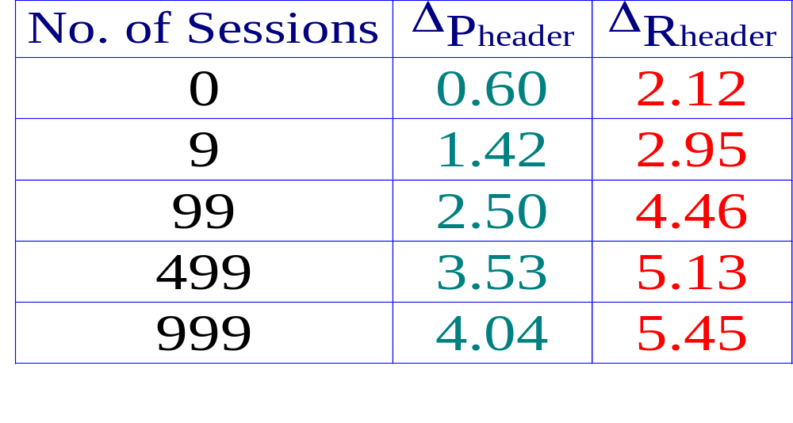
Packet Latency
ΔIPp = 1.40
ΔIPR = 0.95
Table 2. Processing overhead of RSVP header in routers (in msecs), when there are a variable number of real-time connections in the unloaded case.
ΔPheader = ΔP - ΔIPp
ΔRheader = ΔR - ΔIPR
ΔIPp : the average msg Latency of an IP packet of the same
size as a PATH msg in the unloaded case.
ΔIPR : the average msg Latency of an IP packet of the same
size as a RESV msg in the unloaded case.

Slide 18
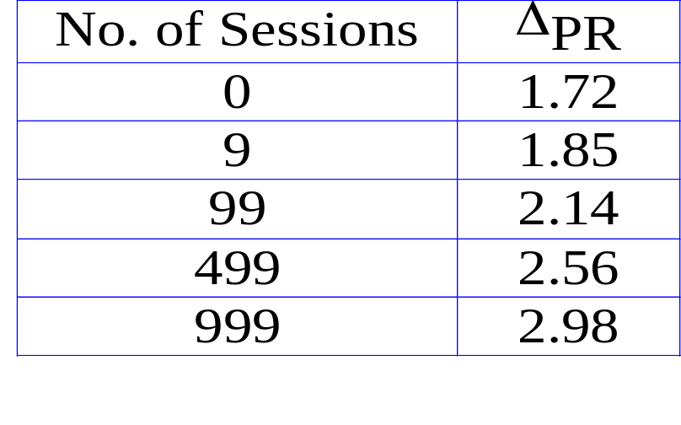
Connection Setup Time
Table 3. Latency at receiver host
(in msecs)
ΔTn = M * ΔPn + M * ΔRn + ΔPR1
+ propagation delay
ΔT : the connection setup time
ΔPR : receiver processing delay

Slide 19
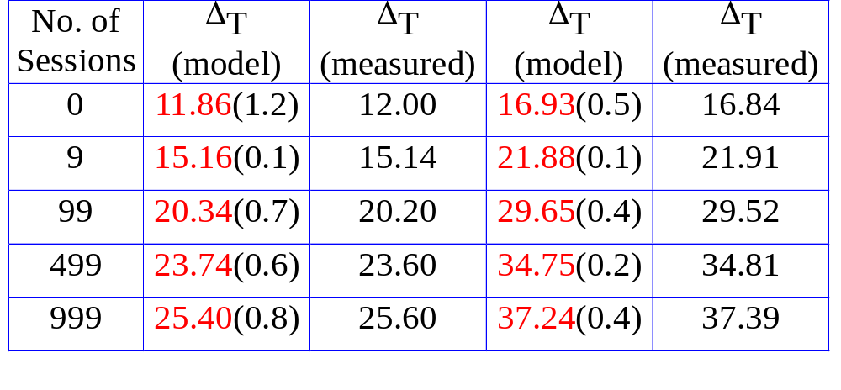
Connection Setup Time
M=2
M=3
Table 4. Connection setup time (in msecs) from the model and the actual measurements when there are a variable number of unloaded real-time connections.

Slide 20

Soft State Refresh Overheads
Case 1 : R is the fixed refresh timer value Rf
Case 2 : R is increasing by a factor of γ
  Rι : the initial refresh timer value
  Rδ : the stable state refresh timer value
  Rι , γ *Rι , γ 2*Rι , γ 3*Rι , ……… , Rδ

Slide 21



Soft State Refresh Overheads
Case 1.
Case 2-1 ( if t > td )
Case 2-2 ( if t < td )

Slide 22


Soft State Refresh Overheads
To further reduce refresh message overhead
=> use an echo-reply message
As soon as the sender receives the message,it can immediately switch to the stable state refresh interval, Rδ
The receiving node should expect a refresh interval, Rδ and tunes its state life timer accordingly.
Require a new message

Slide 23
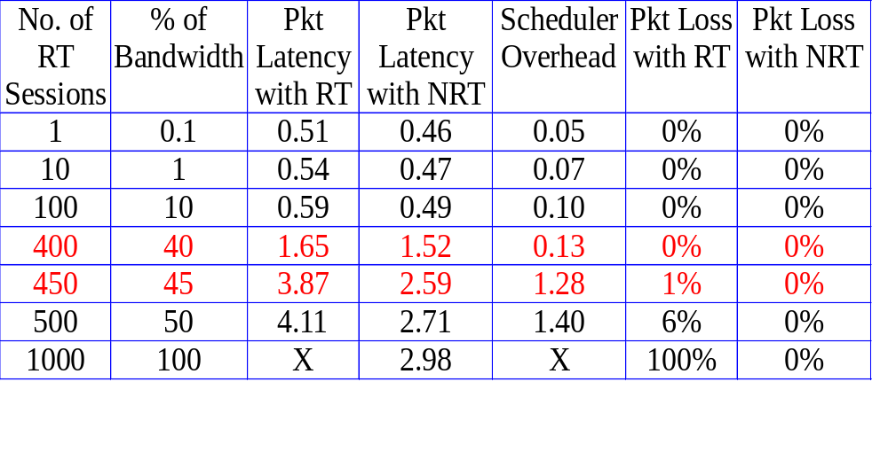
Impacts of Real-Time Packet Scheduling
Table 5. The best-effort packet latency and packet loss rates under
RT and NRT loads of the same aggregate bandwidth
requirement. All latency values are in milliseconds

Slide 24
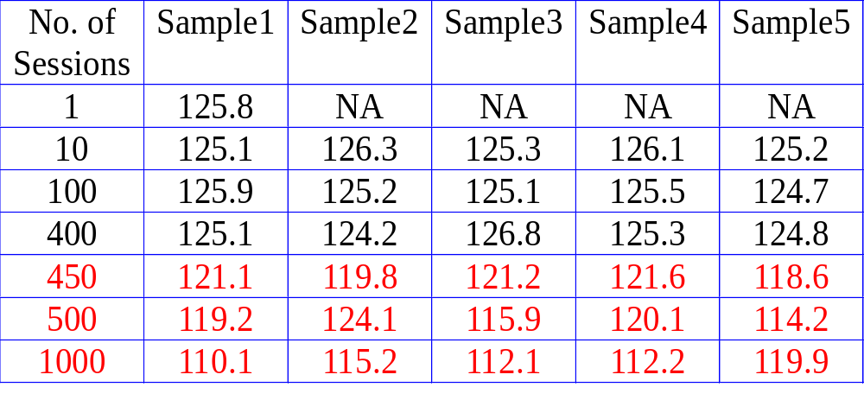
Impacts of Real-Time Packet Scheduling
Table 6. Sample measurements of the received bandwidths
in a varying number of real-time connections.
The original reservation is 125 bytes/sec

Slide 25
Conclusion
The control message bandwidth overhead can be carefully controlled without any serious negative side-effects.
Set RSVP’s control messages at higher priorities.
The performance overhead of RT packet scheduling at each output port is non-negligible.

