Slide 1
Support for RSVP-based Services over ATM network
1998 4, 14

Slide 2
Content
Introduction
Reservation setup for unicast flows
Reservation setup for multicast flows
Issue Related to Flow/Call Characteristics
Discussion

Slide 3
Introduction
RSVP-based resource reservations in a heterogeneous environment which include ATM networks
establish “shortcuts”(direct ATM connection) for the data flow through ATM network
avoid the performance penalty associated with layer 3
map RSVP flow characteristics to ATM call parameters

Slide 4
Reservation setup for unicast flows
Setup Qos VCs via ATM network
Reservation setup for unicast flows
  Classical RSVP support
  Sender-based ATM shortcut

Slide 5
Classical RSVP support
  “path” message : Tx → Rx
  “resv” message : Tx ← Rx
  QoS connections (VCs) between the routers, and between the router and the hosts
  Procedure
    “path” message from A to B
    “resv” message from B to A (setup a VC in the same LIS)
      when “resv “ from B to G : setup VC from G to B
      when “resv “ from G to F : setup VC from F to G
      when “resv “ from F to E : setup VC from E to F
      when “resv “ from E to A : setup VC from A to E

Slide 6
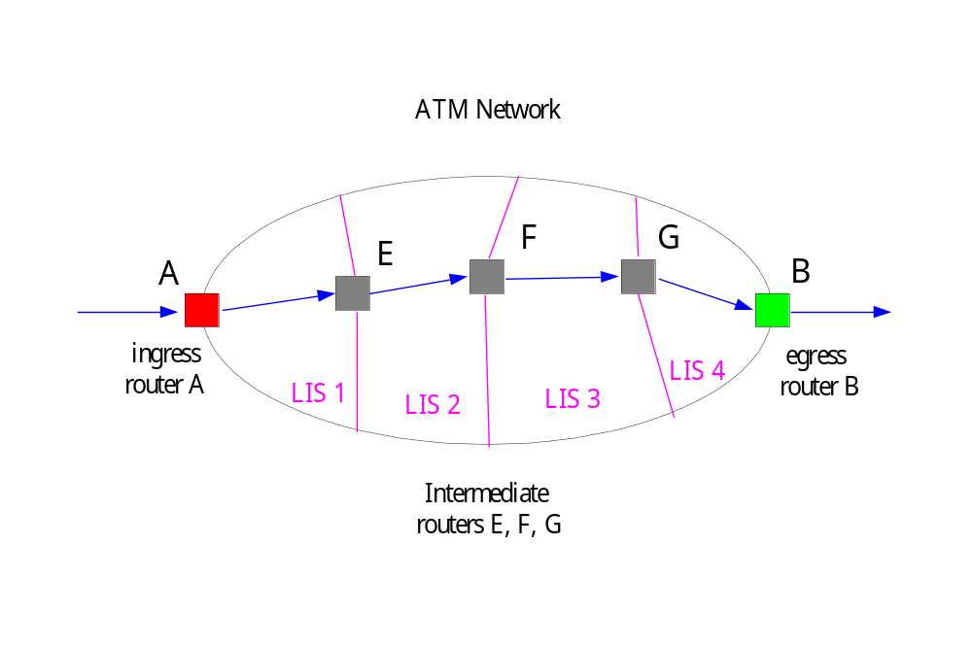
Figure 1: Reservation setup using “classical” RSVP support

Slide 7
Sender-based ATM shortcut
  establish ATM shortcuts by using the ingress router as the controller
  shortcut VC for RSVP data traffic and independent of IP routing
  Similar to NHRP (but without NH Server)
  Procedure
    “path” message
      “Path” arrives at A (Ingress R) : node A [IP_{A}, ATM_{A}] --> via IP route
      IR(Intermediate R) : forward “path” only
      “path” arrives at B (Egress R) : creates “path” state , store [IP_{A}, ATM_{A}]
    “resv” message
      new “resv” arrives at B (Egress R) : node B [IP_{B}, ATM_{B}] --> via original IP route to A
      IR(Intermediate R) : forward “resv” only
      “resv” arrives at A (Ingress R) : A obtain the ATM_{B ,} and QoS Info.
    Setup
      node A send setup a direct VC (shortcut) to node B
      Flow ID (SA, DA, Transport layer)
      B receive setup message : SETUP = Resv_ACK

Slide 8
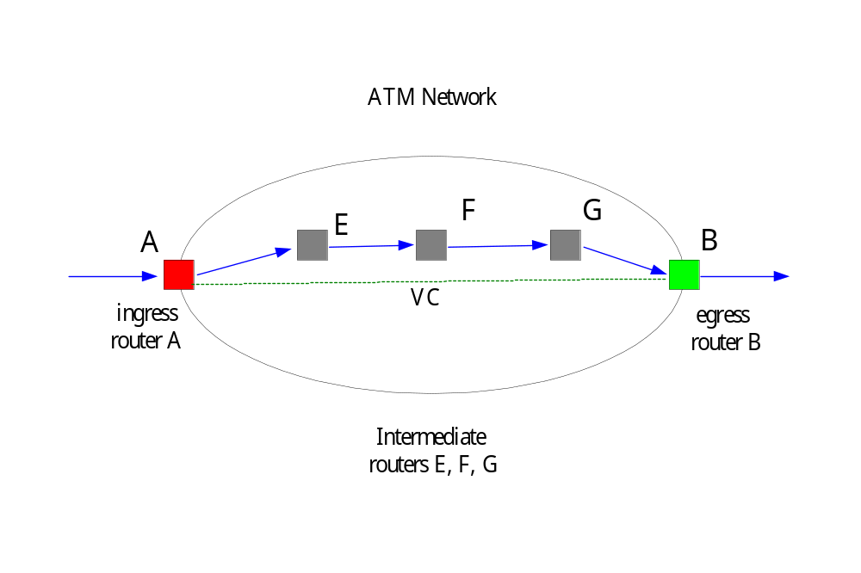
Figure 2: Reservation setup using ATM shortcuts

Slide 9
Reservation setup for multicast flows
Reservation setup for multicast flows
  Classical RSVP support
  Root-initiated ATM shortcuts
  Leaf-initiated ATM shortcuts (LIJ)
Classical RSVP support
  “path” to all receivers of the multicast group
  the first “resv” from B to F
    Router F sets up a point-to-multipoint VC from F to B
  “resv” messages arrives at E
    Router E sets up a point-to-multipoint VC from E to F and C
  another VC will be setup later from A to E

Slide 10
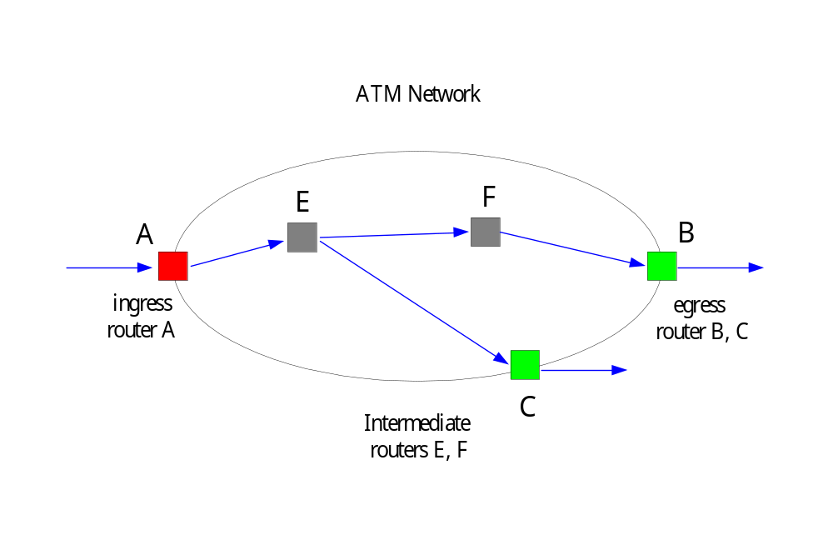
Figure 3: Reservation setup using “classical” RSVP support

Slide 11
Reservation setup for multicast flows (continue)
Root-initiated ATM shortcuts
  establish multicast VC is initiated at the ingress router A
  Procedure
    “path” message
      “Path” arrives at A (Ingress R) : node A [IP_{A}, ATM_{A}] --> via IP route
      IR(Intermediate R) : forward “path” only
      “path” arrives at B (Egress R) : creates “path” state , store [IP_{A}, ATM_{A}]
    “resv” message
      first “resv” arrives at B (Egress R) : node B [IP_{B}, ATM_{B}] --> via original IP route to A
      IR(Intermediate R) : forward “resv” only(do not merge and do not perform any reservation)
      first “resv” arrives at A (Ingress R) : A obtain the ATM_{B ,} and QoS Info.

Slide 12
  Procedure
    Setup
      node A send SETUP for a shortcut point-to-multipoint VC (shortcut) to node B
      Flow ID (SA, DA, Transport layer)
      Later, A send ADD_PARTY for adding C to the point-to-multipoint VC
  the ingress router required to perform as many ATM connection SETUPs as there are leaves in the ATM network for the multicast address
  “maximum” ATM shortcut that directly connects the ingress and egress routers
  Keep tracking route change and membership change:
    “path” refresh message keep flowing over the IP route
    “resv” refreshes from each router are suppressed as soon as the egress router receives the ATM setup message(SETUP, ADD_PARTY)

Slide 13
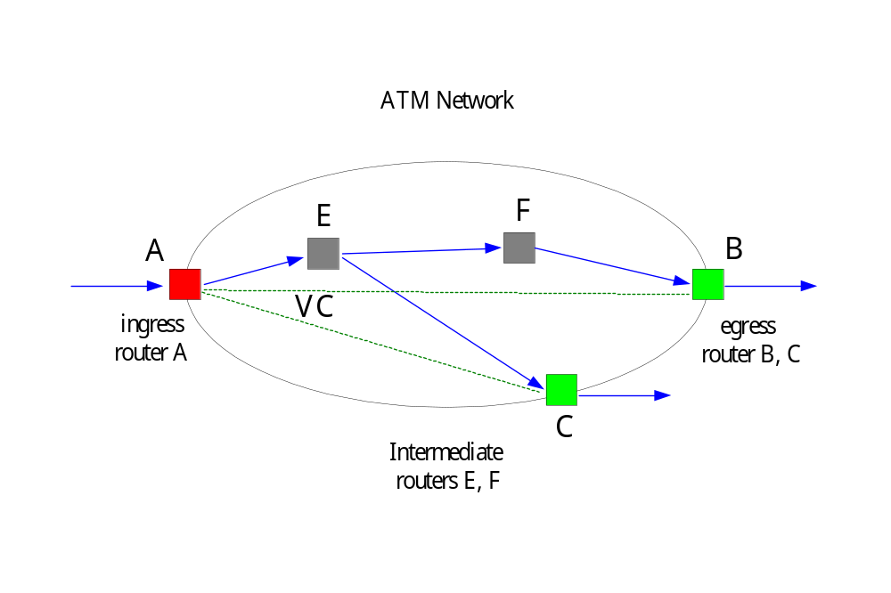
Figure 4: Reservation setup with maximum shortcut

Slide 14
Leaf-initiated ATM shortcuts (LIJ)
  Consider an ATM GCID(global connection ID) will be inserted in the “path” message
  GCID consists of a call ID uniquely chosen by the root and will used by egress routers when generating an ATM LIJ_Request to join the point-to-multipoint connection associated with the IP multicast address
  Procedure
    first “resv” reaches an egress routers B
      B sends LIJ_Request to A (because of B has the GCID of A) to create the point-to multipoint connection with root A
    egress router C do the same job
    the “resv” messages arriving at the associated egress routers is not forwarded to the ingress router during the ATM setup process

Slide 15
  Procedure (continue)
    “resv” message will continue to be propagated and merged on the IP path, but no reservation will be triggered at IRs(Intermediate Routers)

Slide 16
Issue Related to Flow/Call Characteristics
Mapping of traffic parameters and QoS guarantees
mapping types
  Traffic parameters mapping
  Mapping of Controlled Load Service Spec.
  Mapping of Guaranteed Service Spec.
    Unicast flows
    Multicast flows

Slide 17
Traffic parameters mapping
  IP traffic and ATM QoS parameters(leaky bucket models)
    IP traffic parameters (byte/sec)
      peak rate : p
      mean rate : m
      maximum burst size : b
    ATM QoS parameters (cell/sec) , ATM cell payload is 48 bytes
      peak cell rate : PCR , PCR = p/48
      maximum burst size : MBS , MBS = b/48
      sustained cell rate : SCR, SCR = r/48

Slide 18
Mapping of Controlled Load Service Spec.
  the Controlled Load Service can be mapped to the ABR service of ATM in the unicast
  mapping
    the token bucket rate r of the Controlled Load TSpec is mapped to the ABR MCR(minimum cell rate)
    the ABR service also allows transmission at a higher rate when resources are available
    allow a Controlled Load flow exceed its Tspec but without any guarantee
    not for multicast

Slide 19
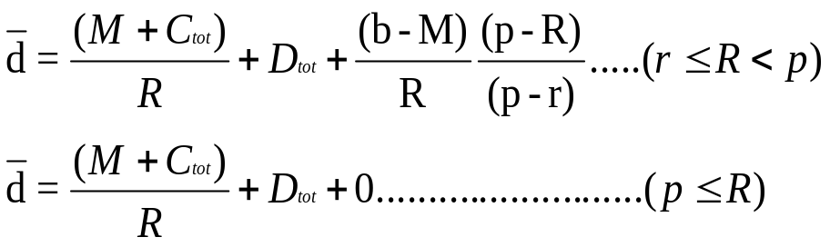
Mapping of Guaranteed Service Spec.
  maximum delay d is guaranteed to a flow
    Ctot and Dtot are values accumulated by “path” message from source S to receiver D
    R is computed at the flow’s receiver

Slide 20
  Unicast flows
    when “parh” arrives at A, the field Ctot and Dtot contain the values
    the “path” stops accumulating Ci and Di during via the ATM network
    determine end-to-end delay between A and B(D_{A,B} ) and update “path” message
      by ingress or egress router
    2 methods to determine D_{A,B}
      Local Determination of Delay Estimate
        the simplest solution
        Router B generated an estimate for the delay D_{ATM} from A to B
      Query ATM network for Delay Estimate
        actually querying
        to setup a connection between A and B with specific delay guarantees

Slide 21
  Multicast flows
    differences between multicast and unicast
      the location to determinate D_{ATM}
        unicast : determinate D_{ATM} at ingress or egress routers
        multicast : determinate D_{ATM} must at egress routers
      setup ATM connection
        Root-initiated point-to-multipoint ATM connection
        Leaf-initiated point-to-multipoint ATM connection

