Slide 1
IP Lookups using Multiway and Multicolumn Search
By chkang
9/30

Slide 2
Outline
Basic binary search scheme.
Using an array as a front end to reduce the number of keys required for binary search.
Describes how to do multicolumn and multiway binary search for IPv6.
Conclusion.

Slide 3
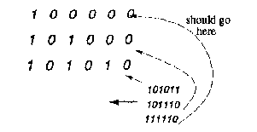
Binary search for BMP
  end up far away from the matching prefix.
  Multiple addresses that match to different prefixes, end up in the same region.

Slide 4
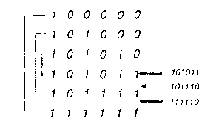
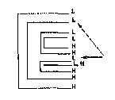
Encoding prefixes as Ranges:

Slide 5
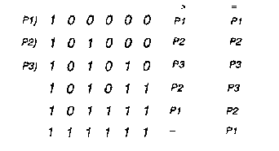
Using precomputation to avoid search

Slide 6
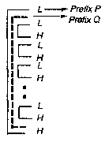
Insertion into a Modified Binary Search Table
  sort all the entries；Marking L or H.
  Using stack：from the lowest down to the highest to precompute the corresponding BMP.
  Encounter a low point ->
  stack prefix.
  See the corresponding high
  point ->unstack prefix.
  Insertions can be batched;
  or just rebuilding a table .

Slide 7
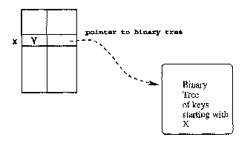
Precomputed 16 bit prefix table.
  Partition the single binary search table into multiple tables for each value of the first Y bits.(Y=16)
  Using an array as a front end reduces the maximum number of prefixes in each partitioned table to 336 from the maximum value of over 30,000

Slide 8
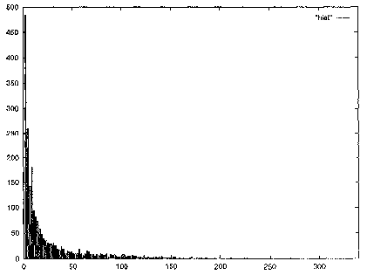

Slide 9


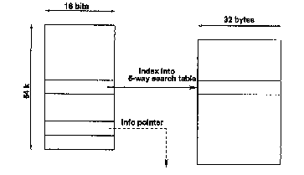
Multiway binary search
  to , where k is the number of keys in a search node.
  For the Pentium Pro ：kM+(2k+1)*p<=C. p=16bits,M=32bits,C=32bytes.

Slide 10
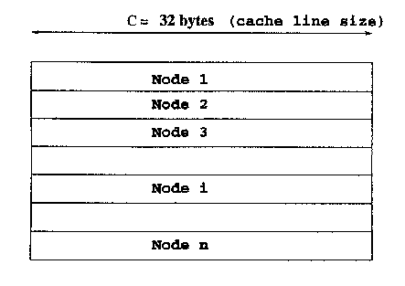
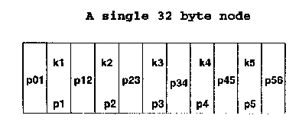

Slide 11
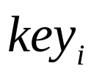
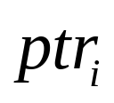
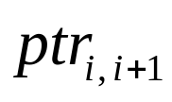
Search
  1.index into the first 16 bit array using the first 16 bits of the address.
  2.if the pointer is info. Pointer, return it.
  Otherwise enter the 6-way search with the initial node given by the pointer.
  3.if the key equals any of the keys ,using ; if the key falls in any range formed by the keys, use ;if this is an info.pointer, return it ;
  otherwise repeat this step with the new 6-way node given by the pointer.

Slide 12
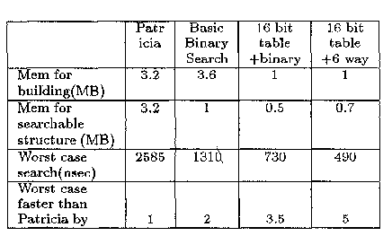
Measurements and Comparison for IPv4

Slide 13
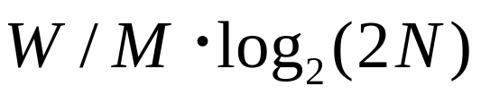
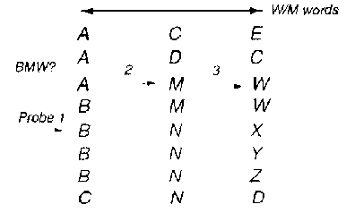
Multicolumn Binary Search of Large Identifiers
  naive binary search :
  For IPv6 : W=128 bits ;M=32 bits;
  =>32,000 entries is around 60 memory accesses.
  Work in columns :

Slide 14

Guard range
  the range for Wi points to the range of entries that have W1, W2,…., Wi in the first i words . ex : the N entry in BNY has a range of 5-7.
  To change the guard range when we move between columns .
  result : take
  cost :addition of two pointers to each word , which require more memory usage .

Slide 15


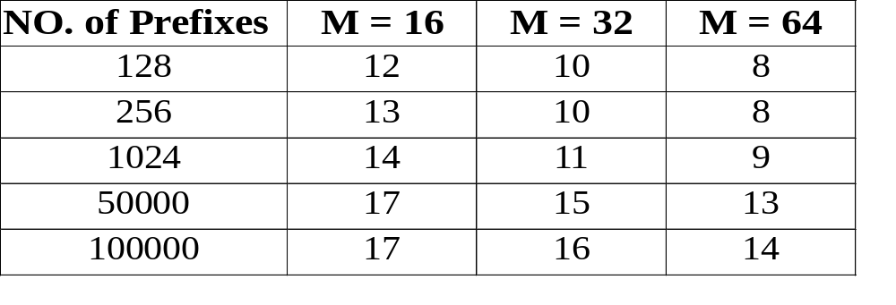
Multicolumn and Multiway search for IPv6
  the worst case time :
  kM+(2k+1)*p C ;
  C =32 bytes, p=16 bits, M=32 bits , so k=5 ;
  worst case search time : 970 nsec .

Slide 16
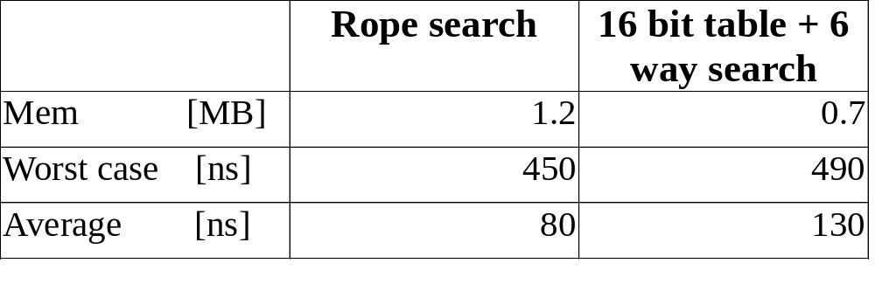
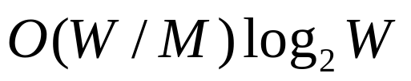
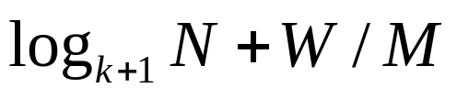
Compare
  for IPv6 :
  Rope search :
  this scheme :

Slide 17
Conclusion
Typical database :
  worst case time = 490 nsec ;
  average time = 130 nsec ;
  using storage of 0.7 Mbytes ;
future work :
  using diff. Number of bits in each column .
  The possibility of laying out the search structure to make use of the page mode load to the L2 cache by prefetching .

