Slide 1
Polynomial Algorithm for Min-Cost
Delay-Constrained Multicasting
Routing Problem in Networks
報告者:紀品顥

Slide 2
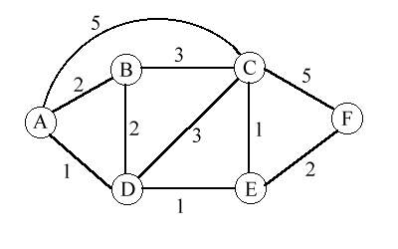
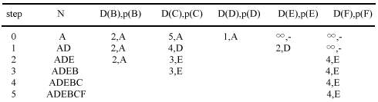
Dijkstra's algorithm

Slide 3
What is Steiner tree?
Let T be a tree and R be a subset of vertives in T.Let w(i,j) be the weight of edge (i,j) in T.If (i,j) is not a edge in T,then w(i,j) = ∞.A Steiner tree is a subtree in T that includes the vertex set R.It may include other vertices too.
Its cost is the sum of the weights of the edges in it.
(Show that finding a minmum-cost Steiner tree is NP- hard)
- computer algorithm
Horowitz/Sahni/Rajasekaran

Slide 4
1.The problem Formulation:
W(T)=∑ c => min ; (1)
∑ d ≤ d , k ∈ V’ (2)
The Goal:
to find a tree T,spanning the vetices V’,which is a solution
of the problem:
ij
(i,j)∈T
T∈F
ij
k
(i,j)∈C (T)
k

Slide 5
G=(V,E),V={0,1,…,n},where {0} is root
V’:all nodes of the multicast group,V’⊂V
F :a set of spanning trees for the set V’
C (T):a path from the vertex 0 to the vertex k in the tree T
c ∈[c,C] ,integer
d ∈[d,D] ,integer
k
ij
ij

Slide 6
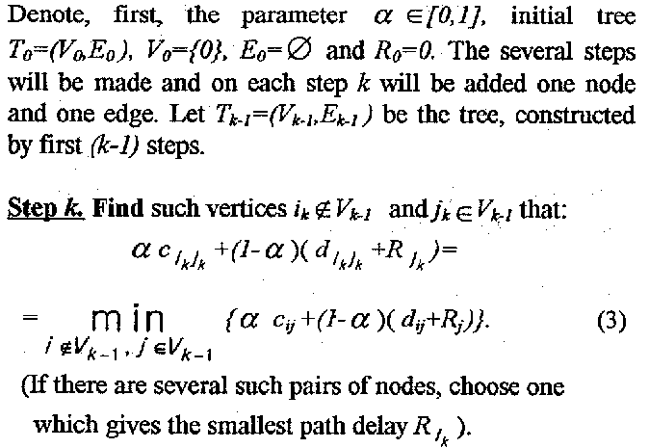
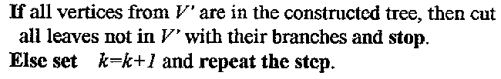
2.Algorithm Aq

Slide 7
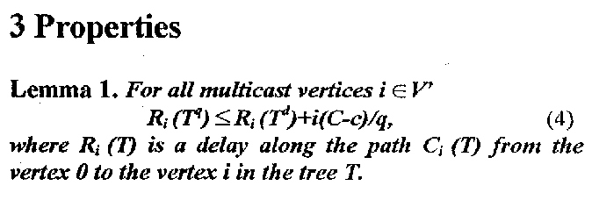
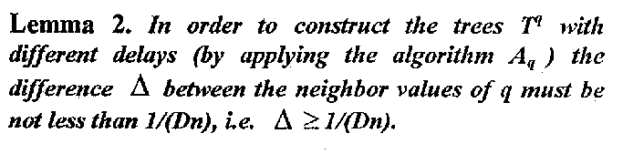

Slide 8
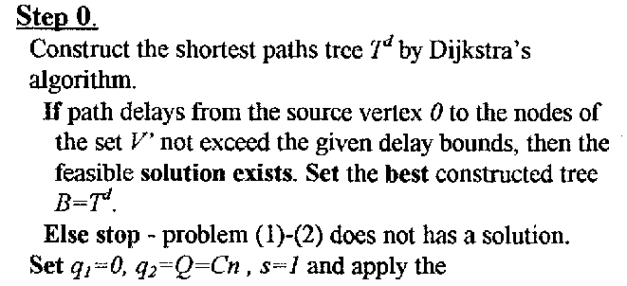
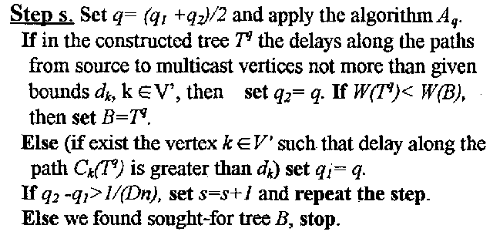
4.Algorithm A

Slide 9
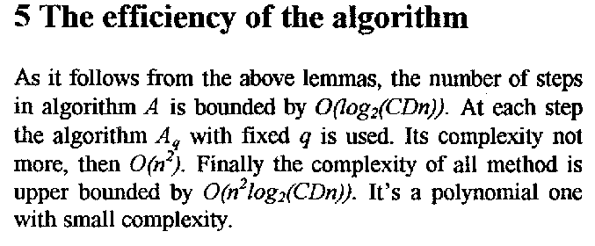
-Only what we can guarantee is that the feasible tree will be constructed(if it exist)

Slide 10
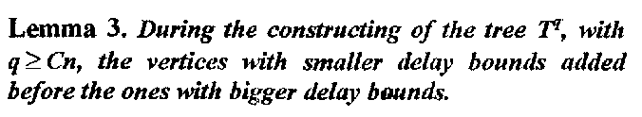
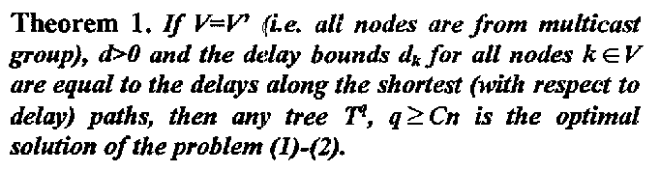
6. Optimal Solution

Slide 11
7.Dynamic case
- Solving dynamic Steiner tree problems
without limitations on delays.
(1)rearrangement of existing tree is not
allowed
(2)rearrangement is allowed
- demands to leave the multicast group
- demands to join the multicast group

Slide 12
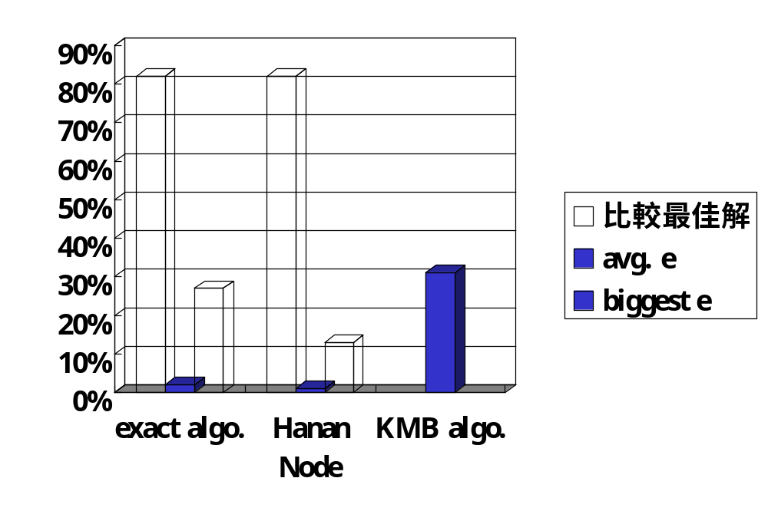
8.Simulation

Slide 13
9.Conclusion:
- Polynomial approximation algorithm
- Constructing min-cost Steiner tree for multicast nodes with different upper bounds on delays to destinations
- This algorithm with a few modifications may be applied for the dynamic version off the problem

