Slide 1
Scalable High Speed IP Routing Lookups
By chkang
8/26.

Slide 2
Outline
Existing approches to IP lookups.
Series of refinements that culminate in the basic binary search scheme.
Series of important optimizations to the basic scheme that improve average performance.
Implementation,including algorithms to build the data structure and perform insertions and deletions.
Performance evaluation.
Conclusins and future work.

Slide 3


Existing approaches to IP lookup
Trie based schemes
  the most commonly availabe IP lookup implementation is found in the BSD kernel, and is a radix trie implementation.
  Worst case time: --> ,requires up to 32 or 128 costly memory accesses,also have large storage requirements
Hardware solutions
  for exact matches, using Content Addressable Memories (CAMs) compares the input key value to the content of that memory location.
  Typical CAMs are small,large CAMs are usually slower and much more expensive .

Slide 4
Protocol based solutions
  have extra information sent along with the packet to simplify or even totally get rid of IP lookups at routers.
  IP Switching and TAG Switching. The speedup is achieved by adding information on the destination to every IP packet.
  Both scheme require large, contiguous parts of the network to adopt their protocol changes.
Caching
  for years, designers of fast routers have resorted to caching to claim high speed IP lookups.there are some problem：
    1)potentially diluting the cache with hundreds of addresses that map to the same prefix.
    2)simulations of cache behavior were done on large, fully associative caches which commonly are implemented using CAMs. CAMs are usually expensive.

Slide 5

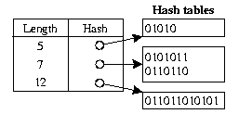
Basic binary search scheme
Linear search of Hash Tables( )
  each set of prefixes of distinct length is organized as a hash table(example:5,7,7,12)
  to search for address D,
  start with the longest length
  hash table l(i.e. 12)
  Function LinearSearch( D ) (* search for address D *)
  Initialize BMP to the empty string;
  i := Highest index in array L;
  While(BMP = nil) and (i >= 0) do
  Extrate the first L[i].length bits of D into D’;
  BMP := Search(D’, L[i].hash); (* search hash for D’)
  i := i -1;
  Endwhile

Slide 6
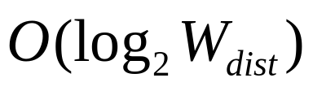
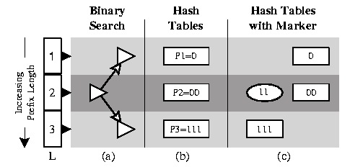
Binary search of hash tables( )
  Makers are needed to direct binary search to look for matchimg prefixes of greater length.
  Example：
    prefixes：P1=0, P2=00, P3=111
    search for 111.

Slide 7

Reducing Marker storage
  define level(P) to be the integer i for which L[i].length = length(P) (i.e.,the index of the entry in L that points to P’s hash table)
  naive view：
    placing a marker for prefix P at all levels in L higher than the level of P.
  reducing：
    it suffices to place markers at all levels in L that could be visited by binary search when looking for an entry whose BMP is P。 The number of markers at most per real prefix.

Slide 8
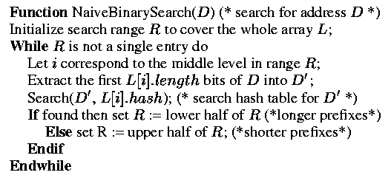
Backtracking
  markers can also cause the search to follow false leads which may fail. In case of failure ,we have to modify the binary search to backtrack and search the upper half of R again.
  example：
      prefixes：p1=1, p2=00, p3=111
      search for ：110

Slide 9
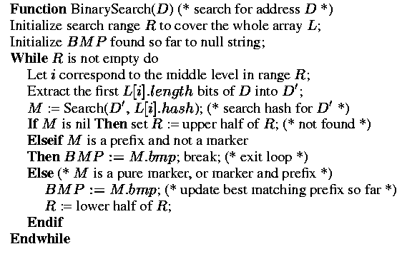
Precomputation to avoid backtracking
  node M is a record that contains a variable M.bmp which is the value of the best matching prefix of the marker M. M.bmp can be precomputed when the marker M is inserted into its hash table.

Slide 10



Refinements to basic scheme
First improvement：
  reducing the worst case number of hashes from (5 with W=32) to (4.5with =23)
  but makes the average case worse：
  prefixes with length 8, 16, 24
  in original：reach in step 2, 1, 2
  in new：step 4, 3, 5

Slide 11
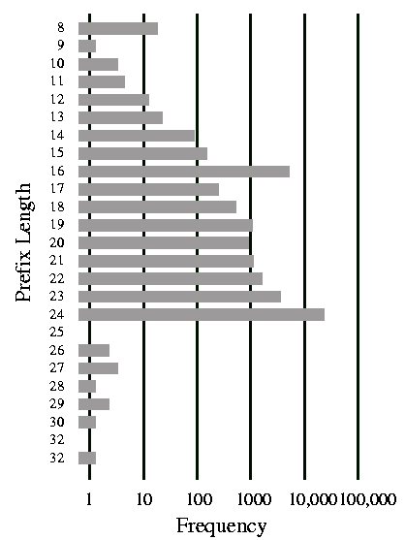
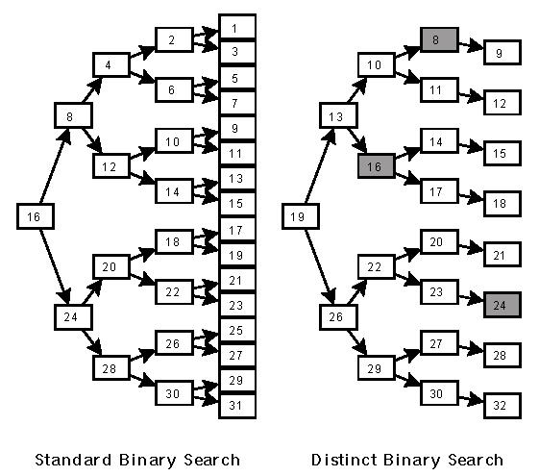

Slide 12
Asymmetric binary search
  more promissing approach is : change the tree structure to search in the most promising prefix length layers first, ,introducing asymmetry into the binary tree.
  some search will make a few more steps,which has a negative impact on the worst case.
  worst case time is not as important as the average time.(routers can temporarily buffer packets)
  two different weighting function：
  1) Strictly picking the level covering most addresses.(usage probability)
  2) Maximizing the entries while keeping the worst case bound.(keeping balance)

Slide 13
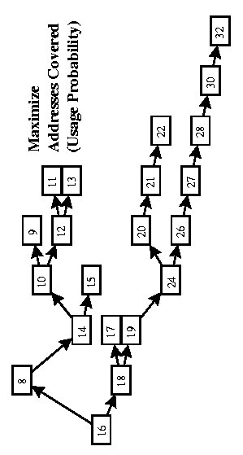
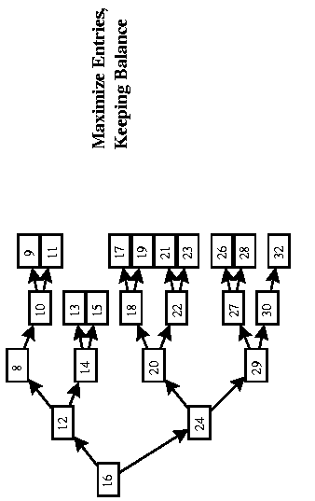
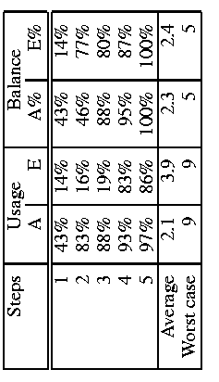

Slide 14
Mutating binary search
  in general,every match in the binary search with some marker X,means that we need only search among the set of prefixes for which X is a prefix.
  whenever we get a match and move to a new subtrie, only to do binary search on the levels of new subtrie. (the binary search mutates or changes the levels on which it searches dynamically)
  each entry E in the search table could contain a description of a search tree specialized for all prefixes that start with E.
  doing basic binary search for an IPv4 address whose BMP has length 21 requires checking the prefix lengths 16(hit), 24(miss) ,20(hit), 22(miss), and finally 21. (hit->go down,miss->go up).

Slide 15
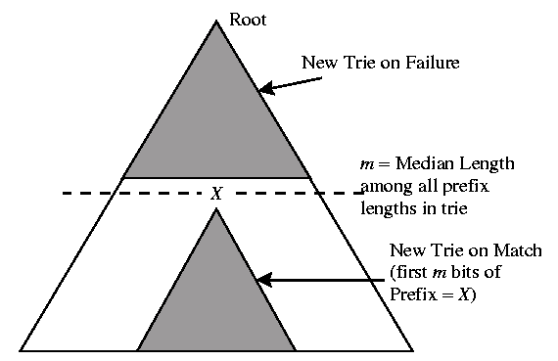
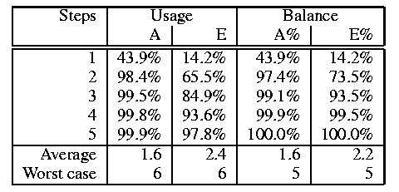

Slide 16
  using mutating binary search：the upper child of each binary tree node is the length to be searched on failure, and whenever there is a match, the search switches to the more specific tree.
  prefixes and markers labeled as : E, F, G, H, J
  search for G:
    start with a generic tree,Tree 1,finding E. Among the prefixes starting with E, there are known to be only five distinct lengths(say 17,18,19,20,21). So E contains a description of the new tree ,Tree 2, limiting the search appropriately.
    using Tree 2, find F, giving a new tree with only a single length, leading to G.
  Search for J:
    using Tree 1,find E. Switching to Tree 2,find H. after switch to Tree 4, miss at length 21.since a miss can’t update a tree,go up to length 20,find J.

Slide 17
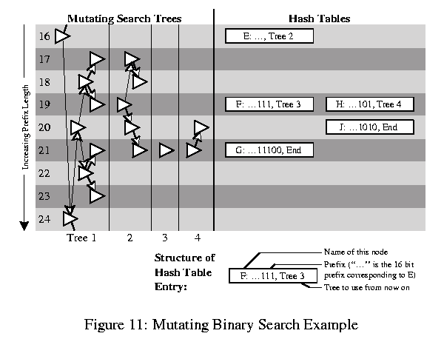

Slide 18
Note：
  The search is no longer walking through a single binary search tree,but through a whole network of interconnected trees.
  Branching decisions are not only based on the current prefix length and whether or not a match is found,but also on what the best match so far is .
  Thus at each branching point, you not only select which way to branch, but also change to the most optimal tree.
  This additional information about optimal tree branches is derived by precomputation based on the distribution of prefixes in the current dataset.

Slide 19
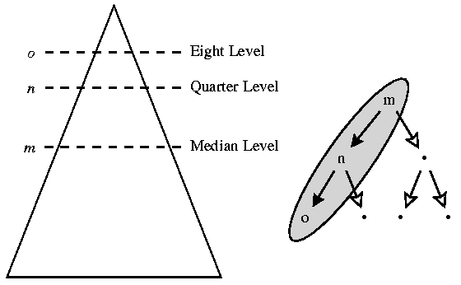
Rope：
  call it Rope,because the Rope allows us to swing from tree to tree in our network of interconnected binary trees.
  we only need to store the sequence of levels which binary search on a given subtrie will follow on repeated failures to find a match
  example：the sequence m,n,o is the Rope for the trie.

Slide 20
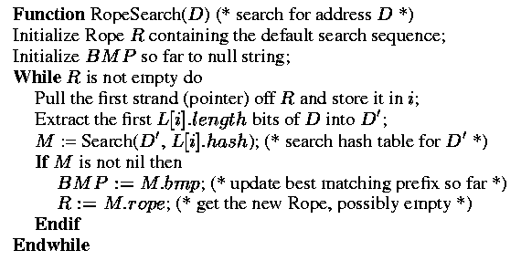
Using the Rope as the data structure is simplifils the algorithm. A Rope can easily be followed,by just picking pointer after pointer in the Rope.
The starting Rope corresponds to the default binary search tree. Example:for IPv4,starting Rope is : level 16,8,4,2,1
  *NOTE：an element that is a prefix but not a marker (i.e. the “terminal” condition) specifies an empty Rope,which leads to search termination.

Slide 21
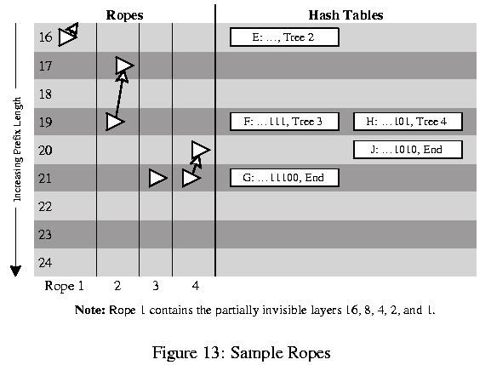

Slide 22
Using arrays
  Program complexity and memory use can be traded for speed, it might be desirable to change the first hash table lookup to a simple indexed array lookup.
  An initial array lookup is not only faster than a hash table,but also results in reducing the average number of lookups(around 0.5).
Hardware implementations
  Both binarySearch(D) and RopeSearch(D) pseudocode are very simple,so ideally suited for implementation in hardware.
  The inner component,most likely done as a hash table is software implementations,can be implemented using hashing hardware.
  The outer loop in the Rope scheme can be implemented as a shift register.Using multiple shift registers ,it is possible to pipeline the searches,resulting in one completed routing lookup per hash lookup time.

Slide 23
Implementation
Every hash table entry has an associatec bmp field and (possibly) a Rope field, both of which are precomputed.
Basic scheme built from scratch
  setting up the data structure is straightforward, as shown in the BuildBasic function.
  Note:for simplicity of implementation,the list of prefixes is assumed to be sorted by increasing prefix length in advance.
Rope search from scratch
  pass 1:builds a conventional trie .Each trie node contains a list of all prefix lengths used by its “child” nodes( subtree length set,SLS).

Slide 24
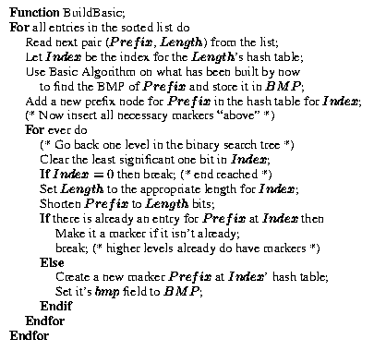

Slide 25
  Pass 2:all prefixes are inserted into the hash tables starting with the shortest prefix: for each prefix, it’s Rope and the BMP for it’s markers are calculated and then the markers and the prefix are inserted.
Insertions and deletions
  adding and removing single entries from the tree can also be done,but since no rebalancing occurs,the performance of the lookups might slowly degrade over time.
  The simplest solution is to batch a number of changes and do a complete build of the search structure.

Slide 26
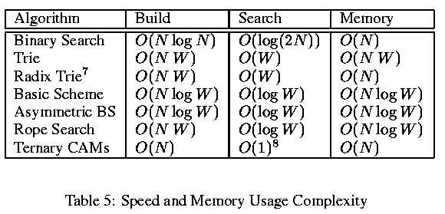
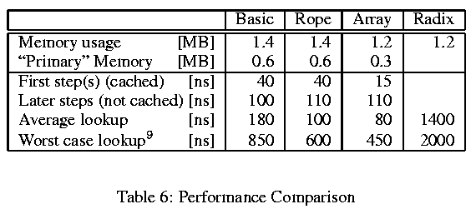
Performance evaluation

Slide 27

Projections for IP version 6
  three methods are currently being discussed in the IETF.All of them use hierarchical schemes to provide as much routing aggregation as possible：provider-based addressing, geographical addressing, and GSE(Global,Site, End-system)
  Most sites will still have to cope with a large number of routing entries ar defferent prefix lengrhs. More distinct prefix lengths, so the improvements achieved by binary search will be similar or better than those achieved on IPv4.
  Array access：less attractive,because addresses will be longer. Good starting points may require rather large prefixes(i.e. 24 bits ro longer). With necessary entries, it is no longer feasible to have a whole array stored in memory. To select a less otimal starting point to still gain improvement from the array access.

Slide 28
Conclusions
With algorithm such as Rope search,we
  believe that there is no more reason for router throughputs to be limited by the speed of their lookup engine.
  don’t believe that hardware lookup engines are required, because Rope search can be implemented in software and still perform well.
  don’t believe that there is a compelling need for protocol changes to avoid lookups as proposed in Tag and IP Switching.
Future work：
  theoretical work on a choice of balancing function；trying to optimize the building and modification processes.

