Slide 1
Routing Lookups in Hardware at Memory Access Speeds
By chkang
8/26

Slide 2
Outline
Describes the basic route lookup technique.
some variations to the technique which make more efficient use of memory.
Investigates how route entries can be quickly inserted and removed from the forwarding tables.

Slide 3
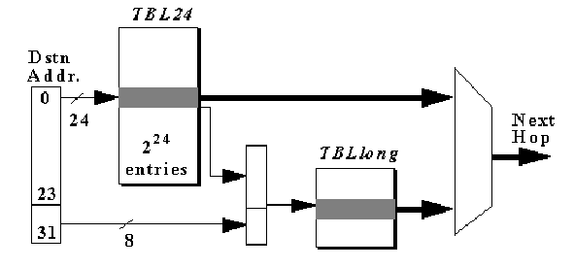
Proposed scheme
Basic scheme DIR-24-8-BASIC.
  Two tables both stored in DRAM.

Slide 4
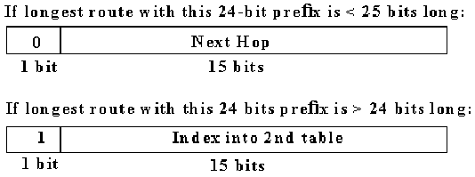
First table(TBL24):
  stores all possible route prefixes that are up to 24-bits；addressed 0.0.0 to 255.255.255
Second table(TBLlong)
  stores route prefixes that are longer than 24-bits

Slide 5
When a destination address is presented to the route lookup mechanism,then
  1)using the first 24-bits of the address as an index into the first table TBL24.
  2)if the first bit equals zero, then the remaining 15 bits describe the next hop.
  3)otherwise (if the bit equals one) ,we multiply the remaining 15 bits by 256, add the product to the last 8 bits of the original destination address ,and use this value as a direct index into TBLlong ,which caotains the next-hop.
Example:
  packet destination：10.54.22.147, 10.54.34.23, 10.54.34.194

Slide 6
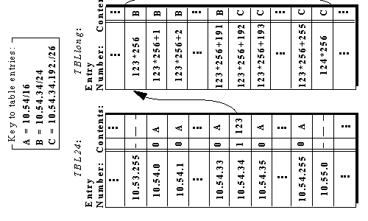

Slide 7

Variation on DIR-24-8-BASIC
DIR-24-8-INT
  in basic scheme,we insert a 26-bit prefix into the table,256 entries in TBLlong are used although only four are required.
  additional “intermediate” table--TBLint
  store an i-bit long index(i<15)value in TBL24, instead of the 15-bit used in the basic scheme.
  Extending the pipeline to three stages,but save some space.

Slide 8
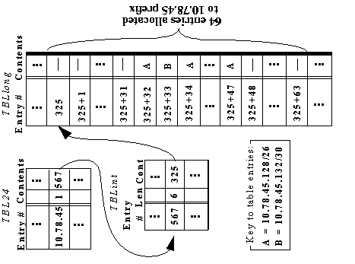

Slide 9
DIR-n-m：(DIR-21-3)
  use three smaller tables, instead of TBL24 and TBLlong. The aim is to split the 32-bit space so as to minimize memory usage.
  TBLfirst21--has entries of width 19 bits.
    The first 21 bits of the packet’s destination address are used to index into TBLfirst21.
    If the entry in TBLfirst21 is an index, concatenate this 18-bit index with the next 3 bits(22-24),and use this concatenated num. as an index into TBLsec21.
  TBLsec21--has entries of width 13 bits.
    If the entry in TBLsec21 in an index, concatenate the last 8 bits to index into TBLthird20.

Slide 10
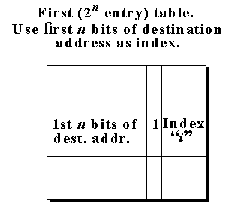
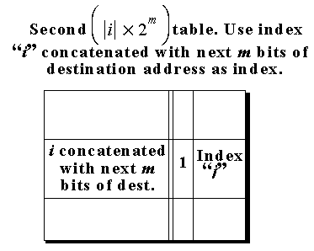
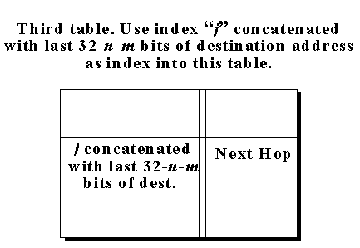
  TBLthird20--has entries of width 8 bits.
    Like TBLlong, storing the next-hop identifier

Slide 11

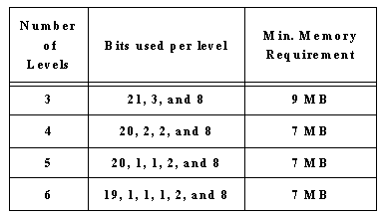
Advantage:
  9 MB of memory is required.
  Memory required of number of levels.

Slide 12
Routing table updates
Note：
  As a result of a change, one or more entries must be added, updeated, or deleted form the table.
  Measurements and anecdotal evidence suggest that routing tables change very frequently.
  DIR-24-8-BASIC scheme is that changing a single route prefix can affect a large number of entries in the table.
  Focus on DIR-24-8-BASIC scheme to update the large TBL24.
Dual memory banks
  the processor creates and downloads a new forwarding table to one bank of memory,the other bank of memory is used for forwarding. Banks are switched when the new bank is ready
  a simple but costly solution.

Slide 13
Update mechanism 1：Row-Update
  the processor sends one message for each entry that is changed in the forwarding table.
  example：
    a route of 10/8 is to be added to a table which already has a prefix of 10.45/16 installed.
    The processor will send 65536-256=65280 separate messages to the hardware.
  This scheme is simple but places a tremendous burden on the processor.

Slide 14
Update mechanism 2：Subrange-Update
  the presence of “holes” partitions the range of updated entries into a series of subrange.
  the processor can find the bounds of each subrange,and send one instruction per subrange
  “change X entries starting at Y to Z”
  example：
    a route of 10/8 is to be added to a table which already has a prefix of 10.54/16 installed.
    Update 10.0.0 ~10.44.255 and 10.46.0 ~ 10.255.255
  works well when entries have few “holes”.

Slide 15
Update mechanism3:One-Instruction-Update
  include a five bit length field in every table entry indicating the length of the prefix to which the entry belongs.
  The message would be similar to：
  “change entries starting at number X for a Y-bit long route to next-hop Z”.
  One problem is that ：a five bit length needs to be added to all 16 million entries in the table;An additional 10MB(about 30%) of memory.

Slide 16
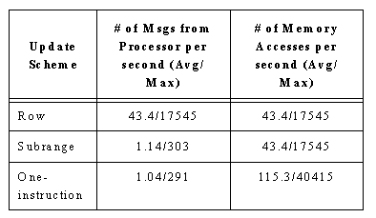
Simulation Results

Slide 17
Conclusions
The continued decreasing cost of DRAM means that it is now feasible to perform an IPv4 routing lookup in dedicated hardware in the time that it takes to execute a single memory access.
The lookup rate will improve in the future as memory speeds increase.
Updates steal less than 0.2% of the lookup capacity

