Slide 1
RSVP and Integrated Services in the Internet: A Tutorial
Guaranteed Services
IETF Integrated Services
Controlled-load Services
Resource Reservation Protocol
Path Messages
Processing & Propagation of Path Messages by Routers
Adspec
Making A Reservation Using OPWA
Reservation Styles and Merging
Slack Term
Summary

Slide 2
IETF Integrated Services
  Provide QoS along every data flow.
  No fragmented
  Reliability
Guaranteed Service
  Bandwidth, delay bound, data lossless
  R:bandwidth,B:buffer space
  r:token rate,b:depth,b/R:delay bound
  two error term: C and D.
  delay bound:b/R+C/R+D
  peak rate:p ,max. packet size: M.

Slide 3
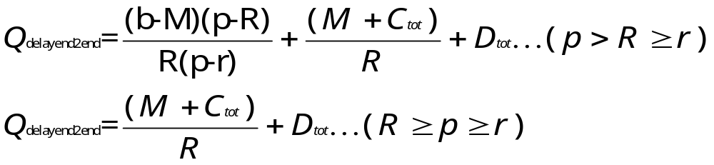
  Tspec
    p=peak rate;b=bucket depth;r=bucket rate;
    m=min. policed unit;M=max. datagram size;
  Rspec
    R= bandwidth;S=slack term;
  forward nonconforming datagrams
  traffic reshaping
    branch point:outgoing branches!=ingoing branches.
    merge point:sum Tspec(in)>sum Tspec(out)

Slide 4
Controlled-load Service
  no firm quantitative guarantees
  network load is better than best-effort
  divide the packets into two classes
Resource Reservation Protocol
  enable session to support QoS
  communication( Destination address,transport-layer protocol type, port number )
RCV1
Resv
ResvTear
PahtErr
R3
RCV2
S1
R1
R2
ResvErr
ResvConf
Path
PathTear
R4
RCV3

Slide 5
Path Messages
  Phop:Address of the last RSVP-capable node
  Sender Template:Filter specification. (IP,port)
  Tspec:Traffic Characteristic.
  Adspec:contains One Pass With Advertising (OPWA).
Processing & Propagation of Path Messages by Network Routers
  Updata the path state entry.Tspec,Adspec and previous hop address.
  Set timer.(time out clear,Path message prevented)
  Soft-state mechanism.
  Pathtear:tear down path state.

Slide 6
Adspec
  include in Path message.
  to determine QoS by receiver.
  Consists a messgae header, Default General Parameters fragement, Guaranteed Service fragement or Controlled-Load Service frage.
  Default General Parameters fragement
    Min. path latency(Sum. of link latencies)
    Path bandwidth(Min. of link bandwidth)
    Global break bit.clear when Adspec created by sender.
    Integrated services(IS) hop coupt.
    PathMTU(Min. MTU along the path)

Slide 7
  Guaranteed Service fragment
    C_{tot}: end-to-end composed value of C.
    D_{tot}:end-to-end composed value of D.
    C_{Sum}:composed value for C since last reshaping point.
    D_{Sum}:composed value for D since last reshaping point.
    Guaranteed Service Break bit:
    Guaranteed Service General Parameters Header/Values: Overrides the value given in the Default General Parameters fragment.
  Controlled-Load Service fragment
    Controlled-Load Service Break bit:
    Controlled-Load Service General Parameters Headers:
Making A Reservation Using OPWA
  Omits Adspec → One Pass → Hard to get QoS.

Slide 8
  Omits Controlled-Load → Guaranteed only
  Get data from Tspec and Adspec → Rspec
  Resv (contain Rspec)
    Reservation style: FF,SE of WF.
    Filterspec (omitted for the WF reservation style)
    Flowspec:Rspec,Tspec(set equal to the Sender’s Tspec , except M will be given by PathMTU)
    ResvConf:Receiver’s IP.
  Router gets Flowspec or Filterspec
    Router applies both admission control and policy control.
    Reject → ResvErr
    Alters the Rspec. Let (Rin,Sin) is equal to (Rout,Sout). Merged with other session.

Slide 9
Reservation Styles and Megring
  Filerspec and effective Flospec are obtained from a merging process.
  Applies style-dependent merging of stored state.
  Resv messages are created based on stored state.
  ResvTear tears down reservation state.
  Fixed Filter(FF) (Distinct Reservation and Explicit Sender Selection)
    Single sender.Effective Flowspec=Max. FF request
  Wildcard Filter(WF) (Shared Ressrvation and Wildcard Sender Selection )
    Any sender.Effective Flowspec=Max. WF request.

Slide 10
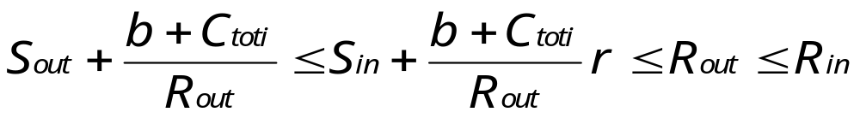
  Shared Explicit(SE) (Shared Reservation and Explicit Sender Selection)
    a set of senders. Effective Flowspec=Max SE request.
  SE,WF are useful for conferencing applications.
Slack Term
  Rspec must include a slack term, S(ms).
  S :The amount by which the end-to-end delay bound will be below the end-to-end delay requeired.
Summary
  Select appropriate class and Qos level by RSVP.
  Determine resulant in advance of making the resv.

Slide 11
FF(S1(4B),
S2(6B))
FF(S1{2B},S2{3B}S4{5B})
Reserve
S1{4B}S2{3B}S4{5B}
FF(S1{4B},S2{2B})
S1,S2
FF(S3(2B),
S4(5B))
FF(S2{6B},S4{2B},S6{2B})
S3,S4
Reserve
S2{6B}S4{4B}S6{2B}
FF(S4{4B})
FF(S5(4B),
S6(2B))
FF(S2{3B},S3{2B},
S5{4B})
S5,S6
Reserve
S2{3B}S3{2B}S5{4B}
Fixed filter

Slide 12
WF(*{5B})
WF(*{5B})
Reserve
(*{5B})
WF(*{2B})
S1,S2
WF(*{3B})
WF(*{5B})
Reserve
(*{5B})
S3,S4
WF(*{2B})
WF(*{5B})
S5,S6
Reserve
(*{5B})
WF(*{4B})
Wildcard filter

Slide 13
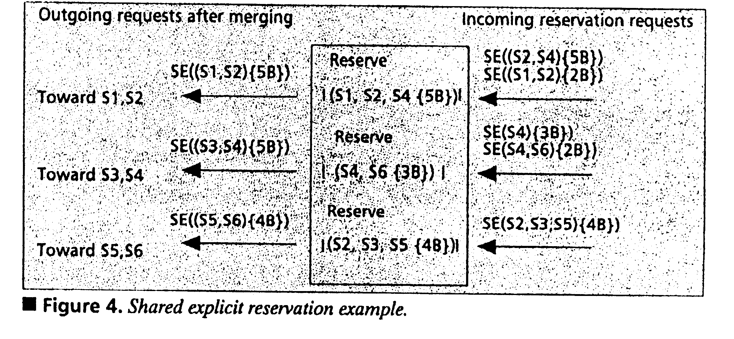

Slide 14
