Slide 1
3D Printing Workshop
By: Sahil and Liz

Slide 2
Downloading software
Cura 3.1:
https://ultimaker.com/en/products/ultimaker-cura-software
Cura specifically for Dream Maker Overlord:
http://www.dreammaker.cc/?page_id=3943

Slide 3
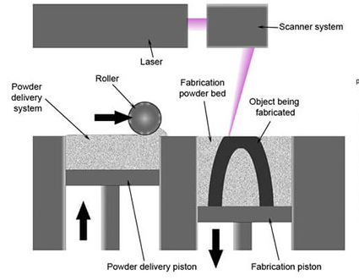
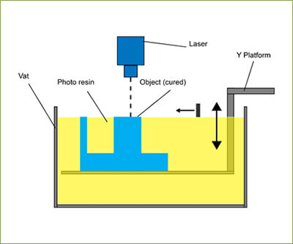
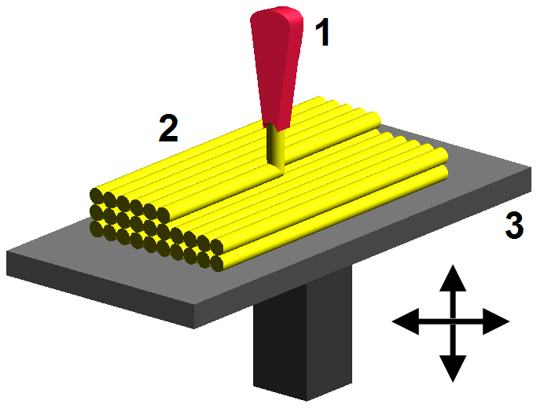
How it works
Additive Manufacturing (layer upon layer of material) aka 3D printing
Vat Photopolymerisation
UV Light cures/hardens resin layer by layer from bottom up
Selective Laser Sintering
Use laser to sinter (heat to form solid mass) metal to bind the material together
Fused Deposition Modeling
Most common, lay material layer by layer w/ filament unwound from coil from extrusion nozzle
Rapid Prototyping + Rapid Development for medical, aviation and hobbyists!

Slide 4
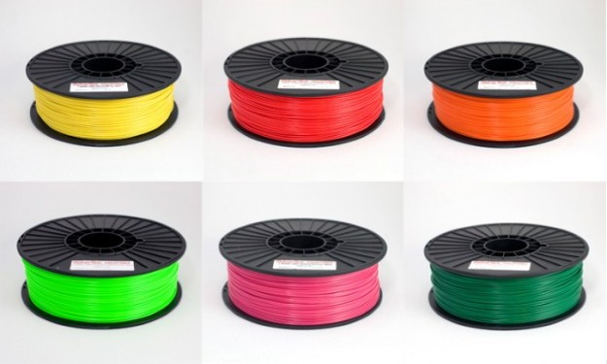
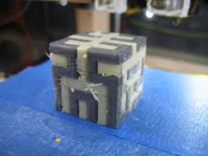
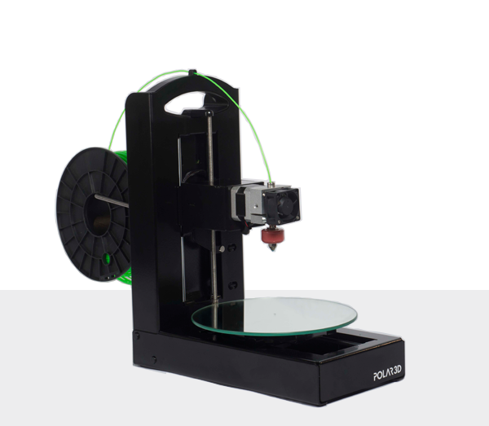
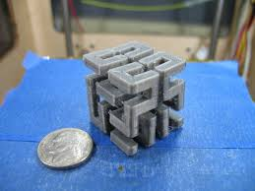
Materials
ABS (Acrylonitrile Butadiene Styrene)
Oil based plastic, stronger and more impact resistant (LEGOs)
PLA (Polylactic Acid)
More brittle plastic, and more ecological -> Packaging Materials
PVA (Polyvinyl Alcohol)
Water soluble plastic, use for support for overhanging issues
Nylon
Strong durable plastic, interlocking moving parts
Resin
Semi-transparent, rigid but delicate
Steel/metals
For industrial use, requires metal laser sintering

Slide 5
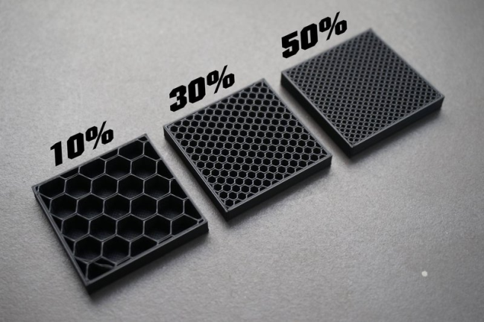
Quick Printing Considerations
Calipers for measurement
Plastic will expand ≅ 2mm (so undershoot)
Print infill, hollow or solid
Depends on your project!
Exposure to UV light, Temp, Water

Slide 6
Autodesk TinkerCAD
Online tool to create fun 3D objects
Combine different shapes together
Easy to use, no setup required!
Great tool for beginners too!
Use an external mouse please

Slide 7
Navigating TinkerCAD
Moving Frame => Middle click + drag
Rotating Frame => Left click + drag
Placing Objects => Drag and drop from right menu
Grouping Objects => Shift + select items, then Ctrl + G
Rotating Objects => Look for protractor icon
Changing Object Size => Look for “square” indicating direction of change
Making “holes” => Make object into hole, group with another object
Undoing/Redoing => Ctrl + Z for undo, Ctrl + Y for redo

Slide 8
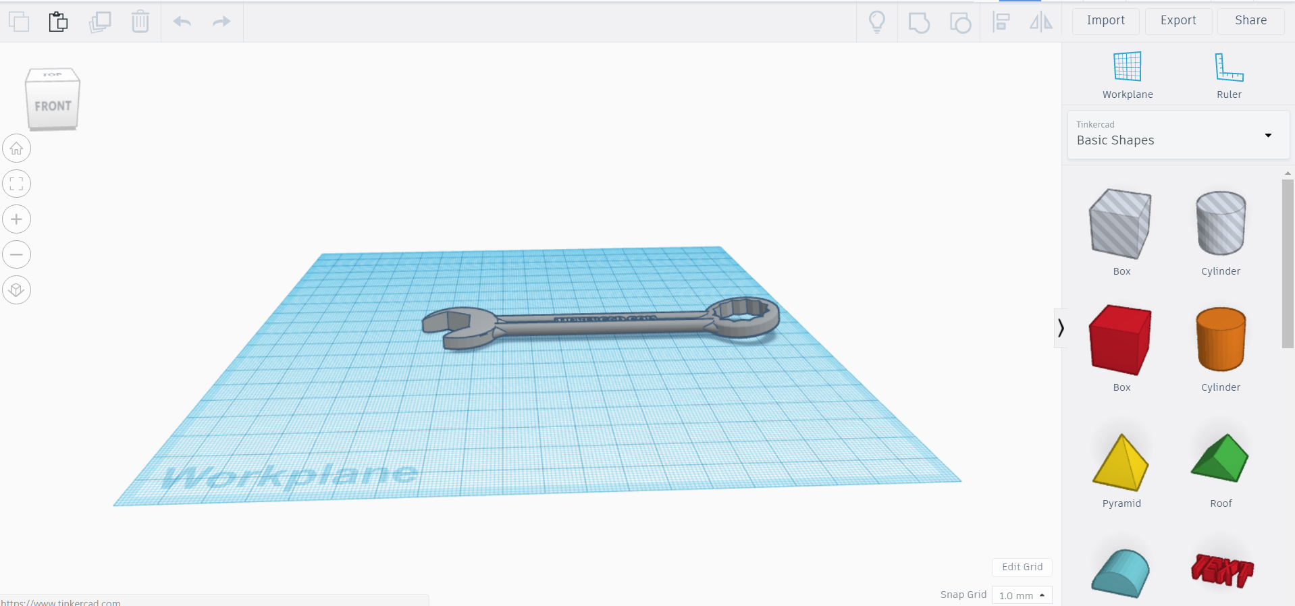

Slide 9
Cura
Slices your models ready for print
Customize your printing experience
Open source and completely free!
Documentation for Dream Maker Overlord (not the pro version!):
http://www.dreammaker.cc/?page_id=4233#1.2.2 Cura Software -- Explanation of Important Cura Parameters

Slide 10
Navigating Cura
Import STL model files into Cura
Use Adjustment Tool: move, scale, rotate and mirror
Check Printer Setting: Nozzle size, print cores and materials
Choose Profile Quality
Recommended Mode, Helper Options:
Infill density
Build Plate Adhesion
Support Structure
6) Preview, and print!

Slide 11
