Slide 1
Advanced MCU Series: MCU Peripherals
By Sahil Gandhi and Liz Xue

Slide 2
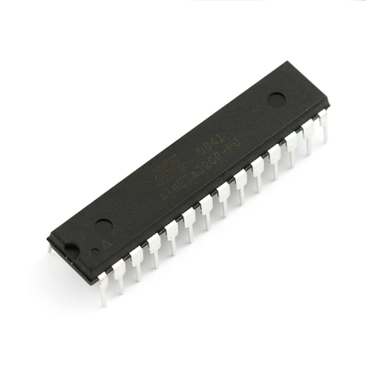
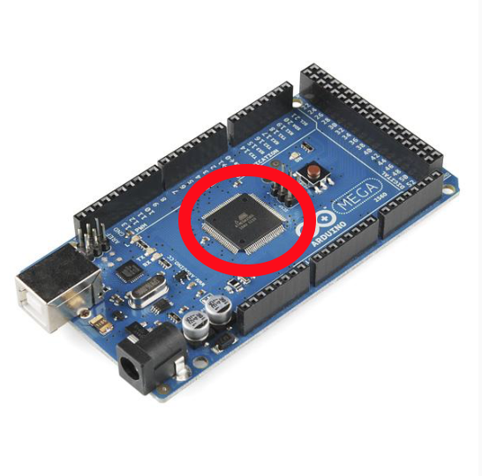
What is a Microcontroller?
A small computer used for embedded system
It contains:
An integrated processor and core
Memory
Clocks
Programmable input/output peripherals
Notes:
All MCU’s will have at least a main system clock that runs everything, but often times peripherals will have individual clocks that need to be enabled
Three types of memory: Program memory, data memory, data EEPROM

Slide 3
History of MCUs
In 1970 and 1971, Gary Boone of Texas Instruments invented the first microcontroller TMS1802NC
It had all the essential circuits to form a calculator
5,000 transistors providing 3000 bits of program memory and 128 bits of access memory
TI offered TMS1000 for sale to the electronics industry in 1974
It was made available in different configurations of RAM and ROM sizes.
Intel also created many significant microcontrollers such as 8048 and 8051.
1990s, advanced microcontrollers: can be programmed, erased and reprogrammed with the help of just electrical signals
Notes:
http://www.circuitstoday.com/microcontroller-invention-history
TM1000 combined read-only memory, read/write memory, processor and clock on one chip and was targeted at embedded systems

Slide 4
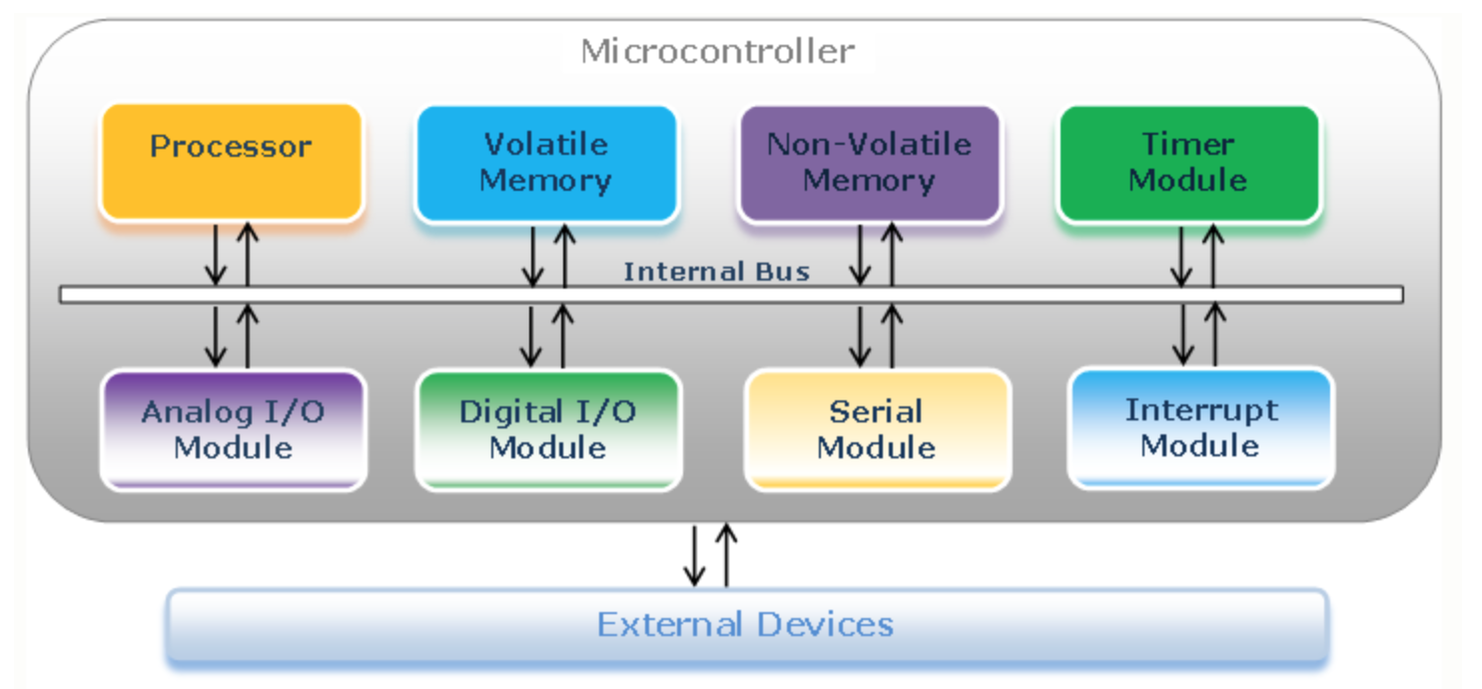
Microcontroller Components
Notes:
Details: http://www.avr-tutorials.com/general/microcontrollers-basics
A ROM chip is a non-volatile storage medium, which means it does not require a constant source of power to retain the information stored on it. By contrast, a RAM chip is volatile, which means it loses any information it is holding when the power is turned off.

Slide 5
What are peripherals?
A peripheral is a part of a microcontroller that interfaces with the outside world
Examples: GPIOs, I2C, SPI, UART, timers, USB, Screens, keyboards
Notes:
Peripherals are actual physical pieces of hardware, not just bits and bytes to be stored into memory
Much more efficient than implementing in software

Slide 6
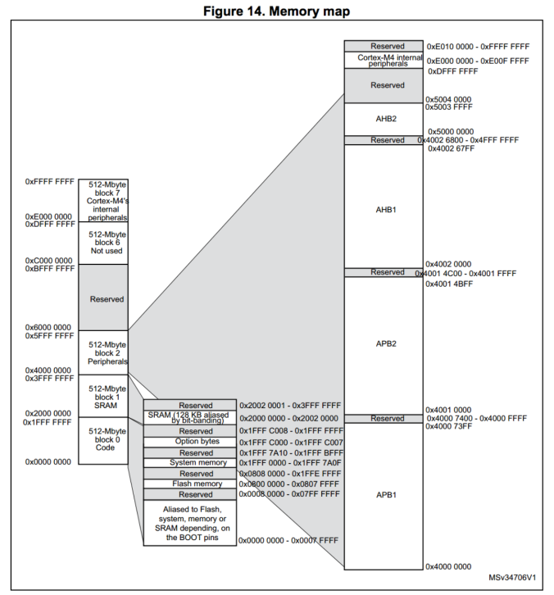
How do peripherals work?
Memory mapping
Every peripheral is given a portion of the MCU’s memory
Memory of the entire microcontroller is broken up into chunks
Each chunk reserved for a specific use
E.g. Flash, RAM, ROM, peripherals
Notes:
This includes the flash memory where code is stored, the RAM where program data and computational data is temporarily saved, and where all peripherals are mapped to.

Slide 7
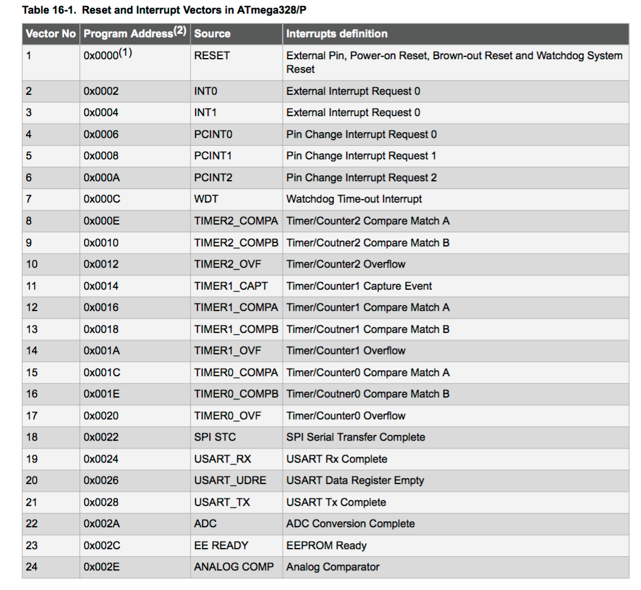
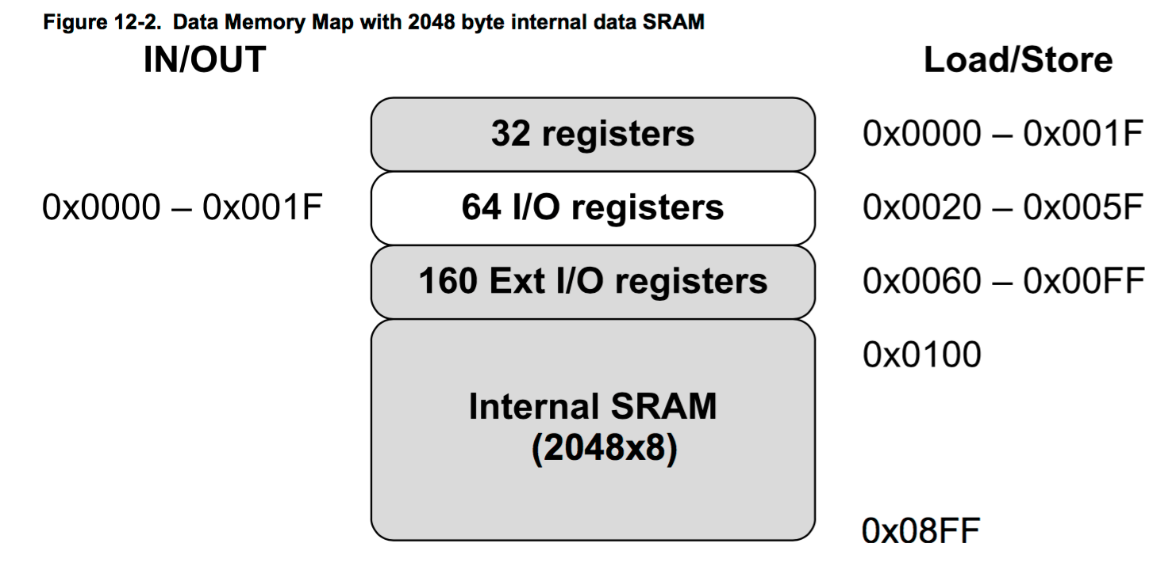
How do peripherals work? (Cont.)

Slide 8
Registers
Hardware to store bits of data (made up of flip-flops)
Devices and peripherals can use registers
Configuration Options
Store temporary values
Store input that user writes
Store output that user will read
Example: GPIO
Notes:
the user will write code to setup the configuration options in specific registers, the hardware module will take those bits as inputs and create an output, and store that output in another register, which the user can read again.
Register: http://www.instructables.com/id/Microcontroller-Register-Manipulation/

Slide 9
Why do we care about all these things?
Performance
Being able to specify the exact behavior you want helps you get best performance
Easy to use new hardware/new chips
Individual registers will be different across different hardware, but concepts are the same
High performance hardware doesn’t come with libraries
We can work with any hardware now, not just Arduino or MBed
Industry skills

Slide 10
GPIO

Slide 11
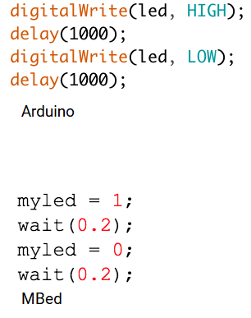
General Purpose Input/Output
Most basic functions of microcontrollers
Set voltage of a pin to a logic level HIGH or LOW
All other peripherals are built off of this!

Slide 12
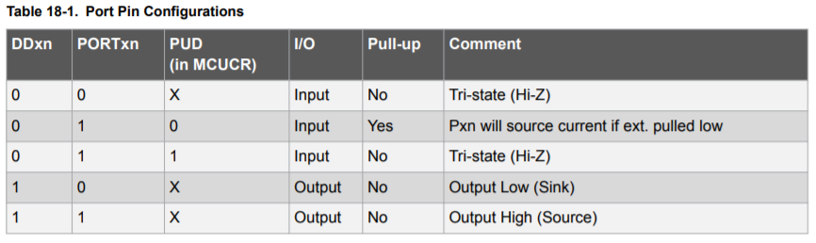
Atmega328 GPIO Port Configurations

Slide 13
Bitwise Operators
Inverse (~): ~0 = 1 ~1 = 0
OR (|): 1 | X = 1 0 | X = X
AND: 1 AND X = X 0 AND X = 0
To set bits (change bit to 1)
To clear bits (change bit to 0)
Ex from Tiva-C board:
To set a bit: DPTR(GPIO_CLOCK) = DPTR(GPIO_CLOCK) | GPIOF_CLOCK_VAL;
To clear a bit: DPTR(GPIO_CLOCK) = DPTR(GPIO_CLOCK) & ~GPIOF_CLOCK_VAL;

Slide 14
Setting a register
We want to be able to set new bits without modifying existing ones
IE: Set port b4 as an output, but port b3 is already enabled
Currently: PORTB = B00001000
Desired: PORTB = B00011000
Two ways ->
PORTB = B00011000; // if you mistype the number of 0s, it can lead to errors
PORB |= B00010000; // If you mistype, atleast port b3 is still left enabled since ORed

Slide 15
Useful Macros (for AVR (ATmegas))
Macros are just textual substitutions during compilation:
# define NAME_OF_CONSTANT VALUE_OF_CONSTANT
#define NAME_OF_MACRO(arg) (BODY_OF_MACRO((x)))
_BV(bit) -> (1 << (bit))
bit(bit) -> (1UL << (bit)) // Almost the same, except unsigned long
bitSet(x, n) -> set nth bit of register x to 1
bit_is_clear(x, n) -> checks if nth bit of register x is clear (0)

Slide 16
Programming Part!

Slide 17
Pinmode: Input or Output?
DDRx = port direction register
DDRB = port register for Port B (Pins 8-13 on the Arduino Nano)
DDRD = Port D (Pins 0-7 on the Arduino Nano)
By default, pins are set to be inputs. Set bit to 1 for output
DDRD = B11111100 // sets pins 2-7 as ouputs. Pins 0 and 1 are inputs
DDRD |= B11111100 // this is safer*
*Special attention to Port D -> 0 and 1 should be left untouched since they are TX/RX

Slide 18
DigitalOut
For DigitalOut, there are only 2 states ... 0 and 1
Therefore, DigitalOut is quite simple using the PORTx variable
PORTD = B10101000 // sets digital pins 7, 5, 3 to HIGH
PORTB = B00100101 // sets digital pins 8, 10, 13 to HIGH (PB0, PB2, PB5)
We can also use the | operator here if we do not want to change the state of other pins.
Also do not change bits 0 and 1 of PORTD (tx and rx bits)

Slide 19
DigitalInputs
Like DigitalOutput, there are only 2 input states ... 0 and 1
We can use the PINx variable:
if (PIND & B00100000)
{some logic} // Checks if pin PD5 is HIGH, does logic if it is HIGH
Compare bits using the & operator and then proceed with action

Slide 20
Timers
ATmega has 3 different timers (0, 1, 2)
Each timer has 2 output registers to control PWM outputs
When output registers reach certain value, the output is toggled
Divided by a prescale factor (2^n) -> ie divided by 1, 8, 64, etc
Arduino has 16 MHz clock frequency. Default prescaler is 64
There are also 2 different PWM modes
Fast PWM -> counts from 0 all the way to 255, and then restarts at 0 (and triggers output)
Phase-correct PWM -> counts 0 to 255, and then 255 back to 0 (and then triggers output)
CS -> Clock Select bits for prescaler
WGM -> Waveform Generation Mode Bits for timer mode
COMnA/B -> enable/disable/invert the output A/B
OCRnA/B -> set the output level of the output A/B
TCCRnA/B -> hold the main control bits for timer (not corresponding to output A/B though!)

Slide 21
AnalogOutput
Essentially we want to create a PWM signal ... consists of frequency and duty cycle
Set the proper pins to output mode (using registers or the pinMode() function)
Set the TCCRnA/B registers for the frequency
Set the OCRnA/B registers for the duty cycle
TCCR2a = _BV(COM2A1) | _BV(COM2B1) | _BV(WGM21) | _BV(WGM20); // WGM 011 = Fast PWM mode. COM2A/COM2B bits to 10 = non-inverted outputs
OCR2a = 180;
Output A frequency: 16 MHz / 64 / 256 = 976.5625Hz
Output A duty cycle: (180+1) / 256 = 70.7%

Slide 22
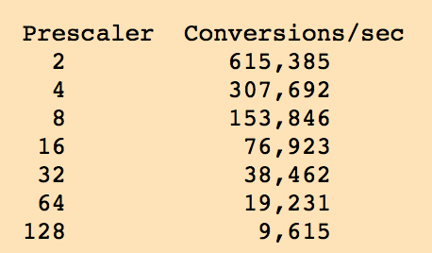
AnalogInputs
The Arduino has an ADC(Analog to Digital Converter) which is connected to various pins on the board.
1. Turn ADC on, like this:
ADCSRA = bit (ADEN);
2. Set a prescaler from 2 to 128. This divides down the processor clock speed to give an ADC clock speed. Do that by changing the ADCSRA register, like this:
ADCSRA |= bit (ADPS0) | bit (ADPS1) | bit (ADPS2); // Prescaler of 128
3. Turn on the internal voltage reference, like this:
ADMUX = bit (REFS0) | bit (REFS1); // internal 1.1V reference
Notes:
https://www.gammon.com.au/adc
https://meettechniek.info/embedded/arduino-analog.html
The ADC takes 13 ADC clock cycles to perform a conversion.

Slide 23
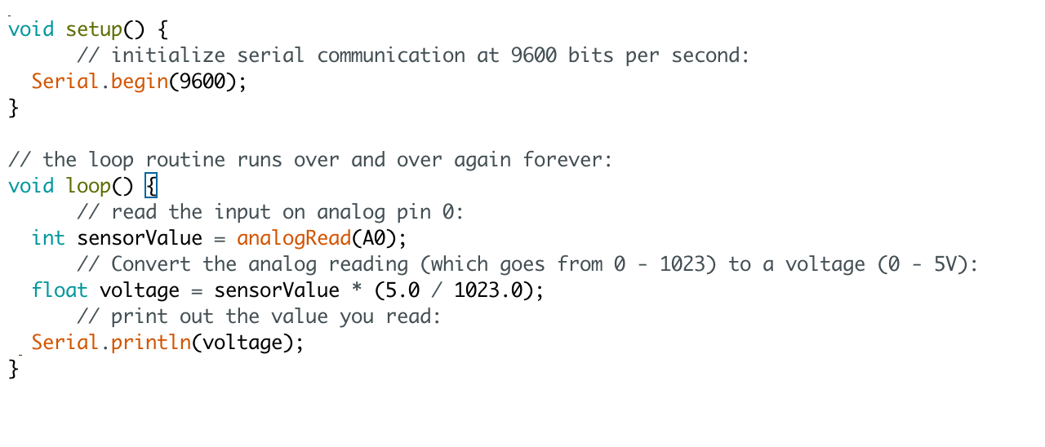
Using analogRead()

