Slide 1
I²C (I2C) Communication
By Sahil and Liz

Slide 2
Background

Slide 3
What is I2C?
Inter-integrated Circuit
Synchronous
Multi-master
Multi-slave
Serial computer bus

Slide 4
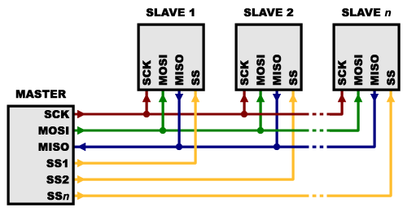
Why not SPI?
Requires more signal lines
undesirable when there are multiple slaves
Requires separate SS lines to each slave
Only allows one master

Slide 5
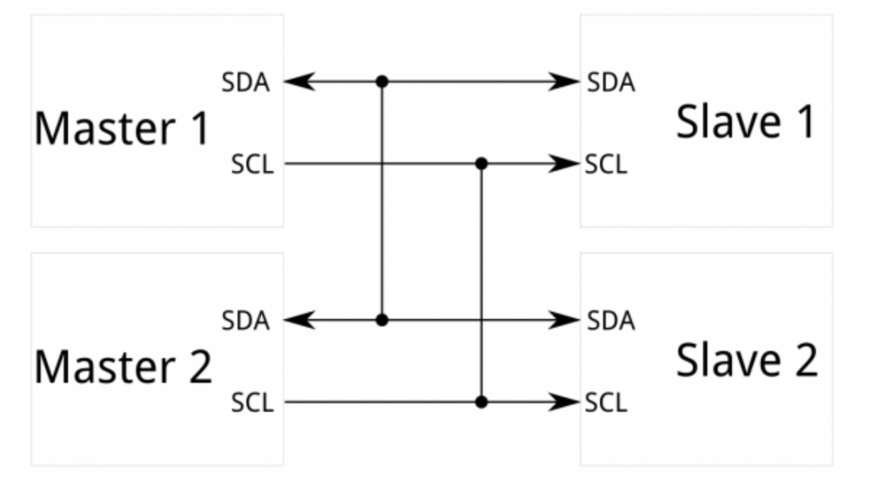
Why I2C then?
Requires only 2 wires (SDA, SCL)
Allows a multi-master system
Masters can’t talk to each other over the bus
Must take turns using the bus lines

Slide 6
Why not I2C?
More complex setup (especially if MCU doesn’t have dedicated lines for it)
Lower speed (400 KHz vs multiple MHz for SPI)
I2C uses pull-up resistors rather than push-pull ones
Due to the open-drain design, speed is limited
Requires more space for pull-up resistors on PCB
Address conflict
A conflict occurs when more than one device with the same slave address is connected to the same I2C bus
Notes:
Open-drain refers to a type of output which can either pull the bus down to a voltage (ground, in most cases), or "release" the bus and let it be pulled up by a pull-up resistor.
Each device on the I2C bus has a specific device address to differentiate between other devices that are on the same I2C bus. In the case of address conflict, I2C multiplexors split the I2C bus into several subbranches and allow the I2C master to select and address one of multiple identical devices, thus resolving address conflict. The multiplexor connects the main I2C bus to the selected slave device and removes electrically the nonselected devices.

Slide 7
More on I2C
Patented interface by Philips Semiconductors (now called NXP)
Half Duplex -> Only one side transmit/receive at given time
Master initiates communication and generates all clock signals
Most I2C devices can communicate at 100kHz or 400kHz
Slow = 100 Kbps, fast = 400 Kbps, high-speed = 3.4 Mbps
Overhead
for every 8 bits of data to be sent, one extra ACK bit must be transmitted

Slide 8
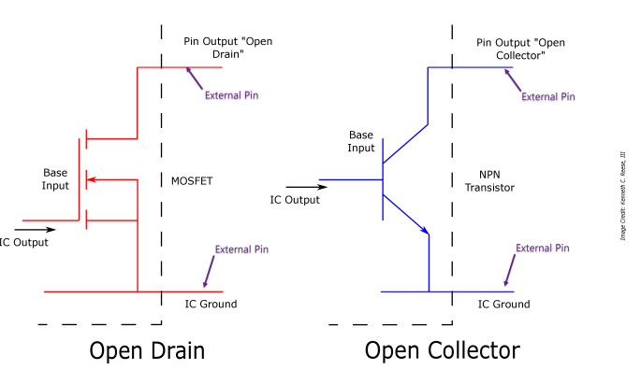
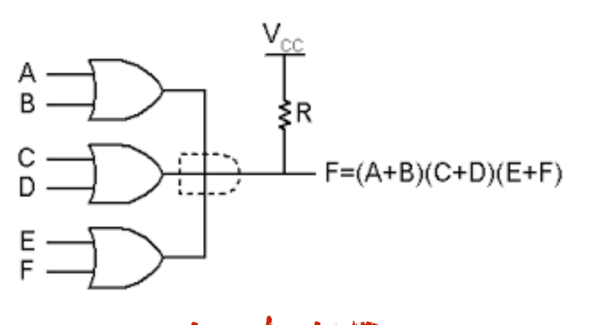
More on I2C (cont.)
Open-drain drivers act like wired-AND:

Slide 9
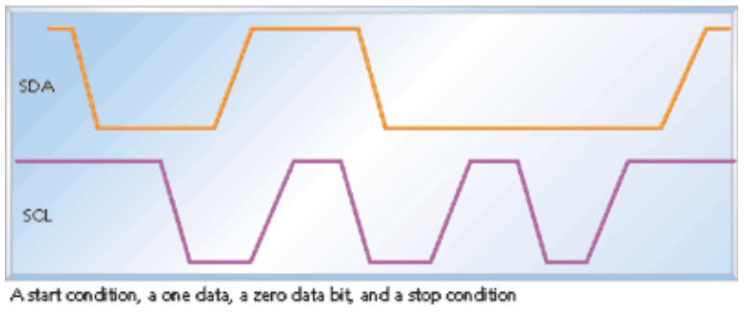
More on I2C (cont.)
Master generates start condition, 8 bit data word, ACK bit and then stop
Except start/stop, all other data bits done when SCL is low
Start = SDA goes high to low while SCL is high
Stop = SDA low to high while SCL is high
Ack = pulling SDA line low (receiver) while master releases it and allows it to float high
Clock stretching = slave pulls SCL low if it needs more time to process data bit

Slide 10
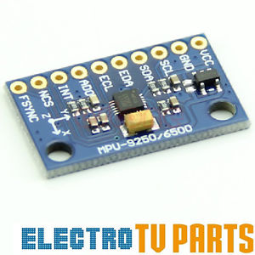
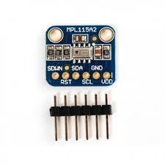
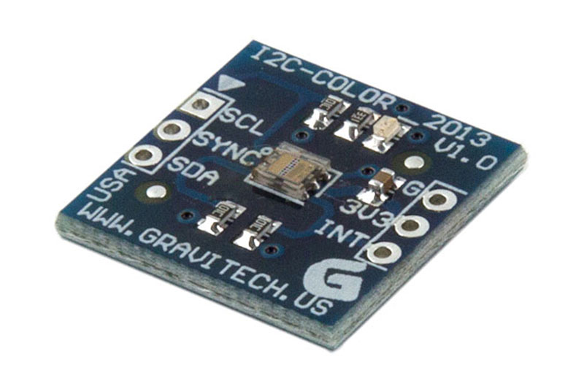
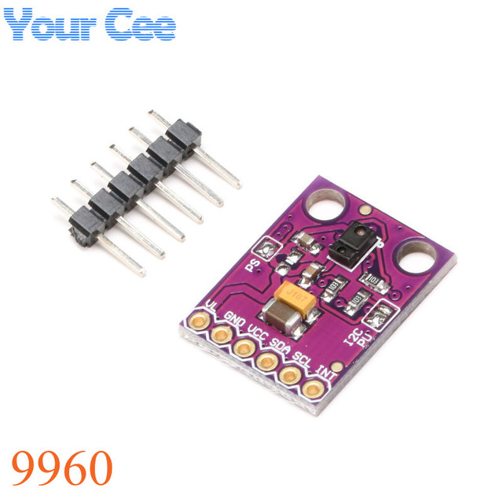
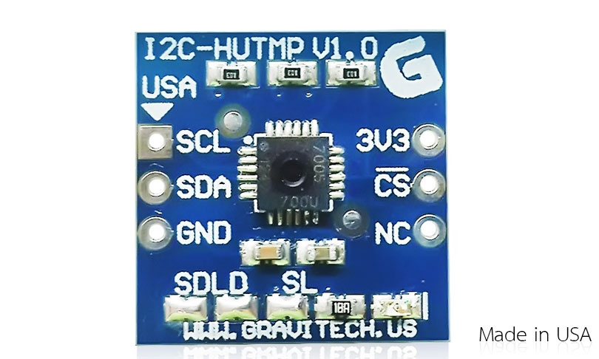
Common Applications of I2C

Slide 11
Programming I2C

Slide 12
I2C using MBED
I2C i2c(I2C_SDA, I2C_SCL); // init the interface
i2c.write(8_bit_addr, char_array, length); // send data
i2c.read(8_bit_addr, char_array, length); // read incoming data
i2c.frequency(int hz); // set frequency
i2c.read(int ack); // read the ack
i2c.start() and i2c.stop() // explicit start/stop
For individual components/sensors, Mbed may already have library
Else, check data sheets for which 8_bit_addr to use and frequency and such!

Slide 13
I2C using Arduino
Wire.begin(); //initialize I2C hardware pins
Wire.beginTransmission(address); //Begin a transmission to the I2C slave device with the given address
Wire.write(data); //sends a byte of data
Wire.endTransmission(); //Ends a transmission to a slave device that was begun by beginTransmission(address)
Notes:
SPI.transfer()s from the last example are replaced with Wire.write()s. And instead of toggling a SS pin, we use Wire.beginTransmission(address) and Wire.endTransmission()

Slide 14
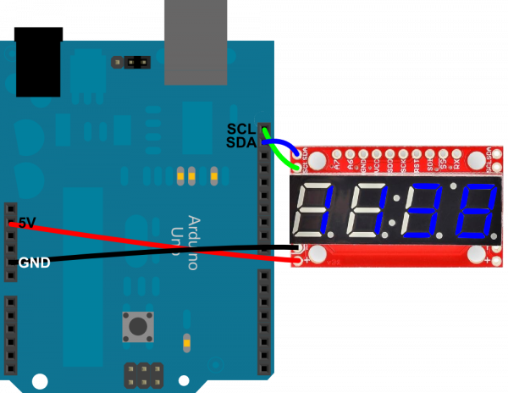
Hardware Setup
Arduino Nano Serial 7-Segment
5v ------------------------- VCC
GND --------------------- GND
SCL (A5: pin 19) - SCL
SDA (A4: pin 18) - SDA

Slide 15
Hands on Programming!

Slide 16
Fun Part
On your 7 Segment Displays -> Create a counter that counts from 0 to 1000

Slide 17
Questions?

