Slide 1
SPI Communication
By Sahil & Liz

Slide 2
What is SPI?
Serial Peripheral Interface is an interface bus commonly used to send data between microcontrollers and small peripherals such as shift registers, sensors, and SD cards

Slide 3
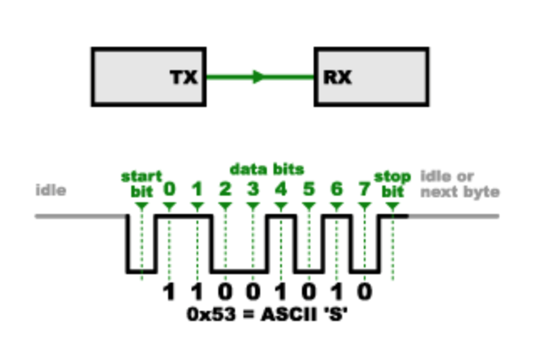
Why not serial ports?
Asynchronous:
Two systems with different clocks to communicate with each other
Adds extra start and stop bits to help receiver sync at the start of each byte→ too much overhead
Both sides must agree on the transmission speed
ie. 9600 bits/sec on both sides
Adjust Serial Monitor accordingly

Slide 4
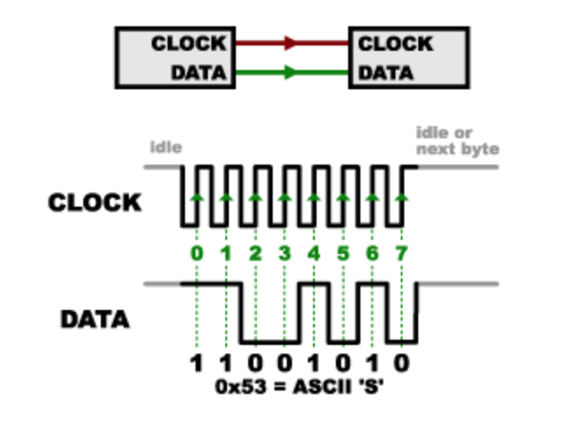
Why SPI then?
Synchronous:
A global clock that keeps both sides in sync
SCK or CLK
No need to agree on transmission speed
The receiver samples the bits on the rising or falling edge of the signal
Much simpler hardware (can be a simple shift register)
No speed limit!
Can go over 10 Mbps potentially!

Slide 5

Why not SPI?
SPI seems so good! Are there any downsides?
Requires more signal lines (wires)
The communications must be well-defined in advance
Can’t send random amounts of data whenever you want
The master must control all communications
Slaves can’t talk directly to each other
Requires separate SS lines to each slave
Keep track of # slaves, and # output pins on your MCU!
Notes:
Because the master always generates the clock signal, it must know in advance when a slave needs to return data and how much data will be returned. This is very different than asynchronous serial, where random amounts of data can be sent in either direction at any time.

Slide 6
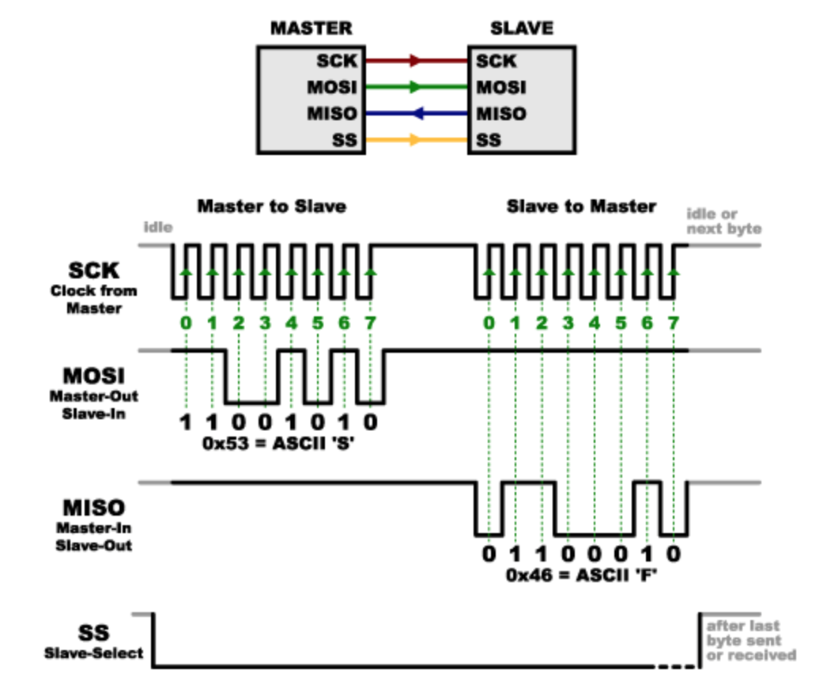
More on SPI
Full Duplex: both devices can talk simultaneously, separate send and receive lines
Master-slave architecture
SCK
Global clock
MOSI -> SDI pin on device
Master out/Slave in (data: master --> slave)
MISO -> SDO pin on device
Master in/Slave out (data: slave --> master)

Slide 7
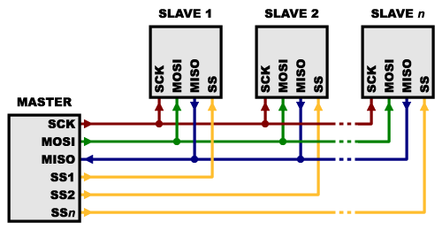
Multiple Slaves
SS_n: Controls the nth slave to be activated to send data
Can control multiple sensors/devices with 1 master MCU!
Goes to the CS (chip select) pin on sensor
Notes:
SS (slave select) is usually held high. Just before a signal is sent to the slave, it is brought low, which activates the slave

Slide 8
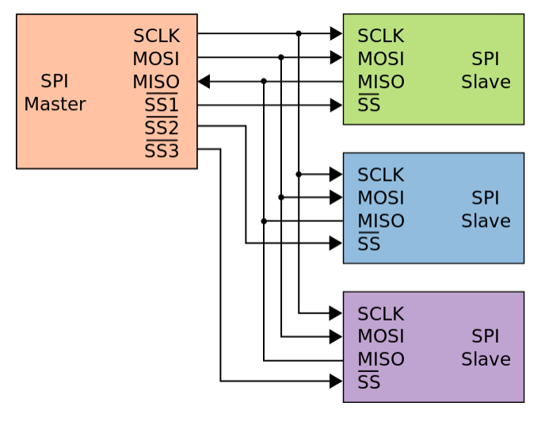
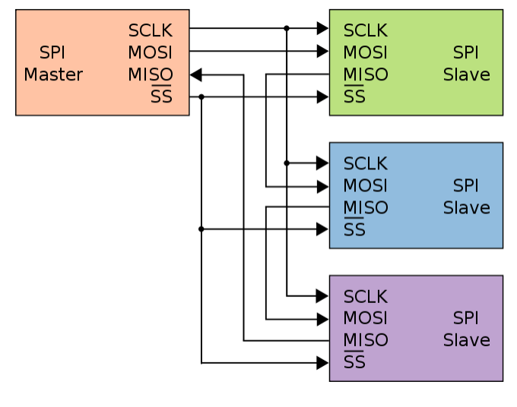
Multiple Slaves (cont.)
Typical SPI bus Daisy-chained SPI bus

Slide 9
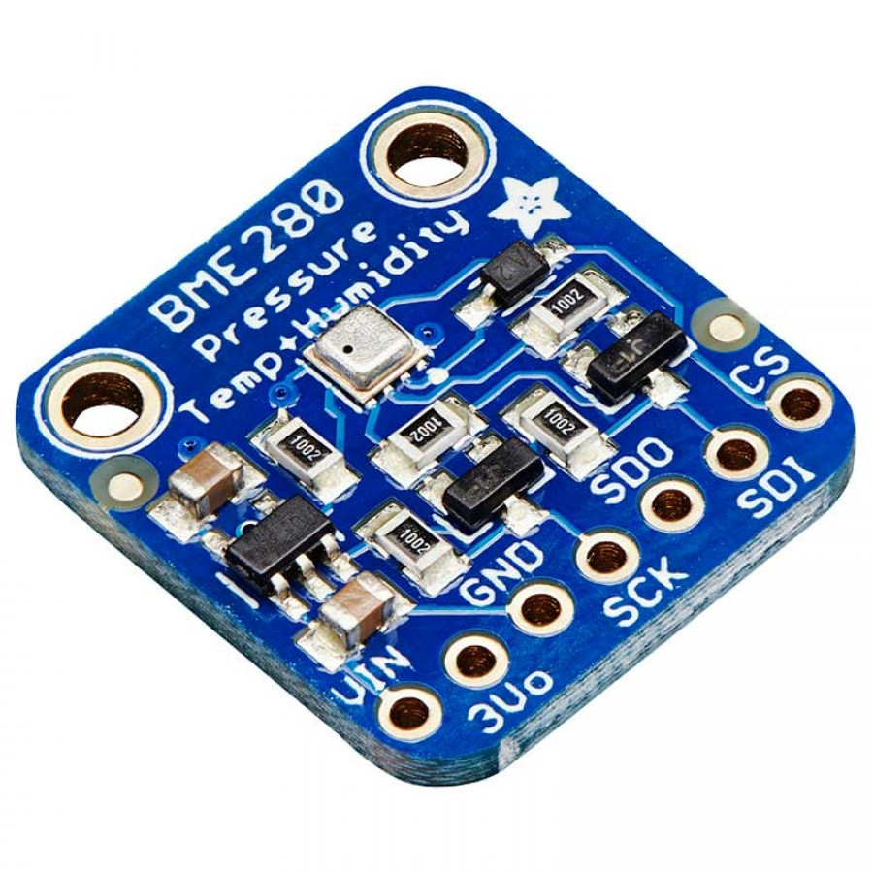
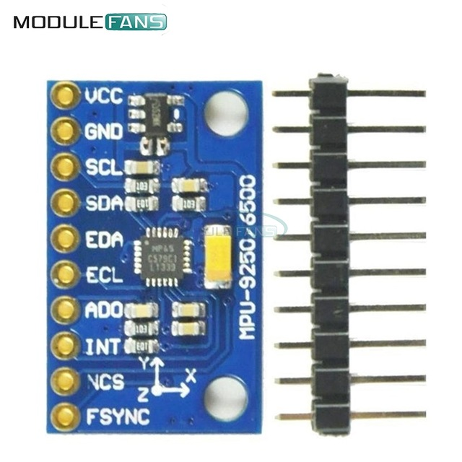
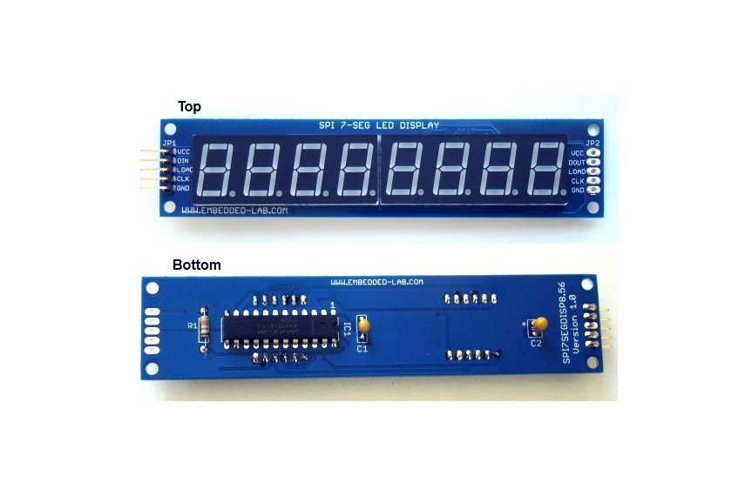
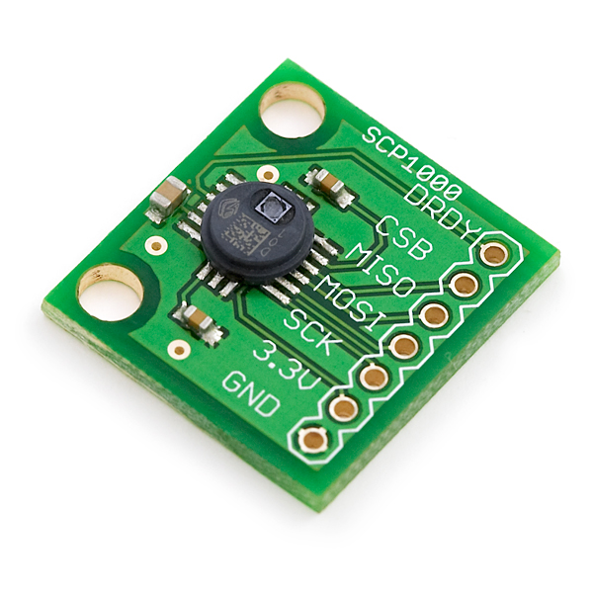
Common Applications of SPI

Slide 10
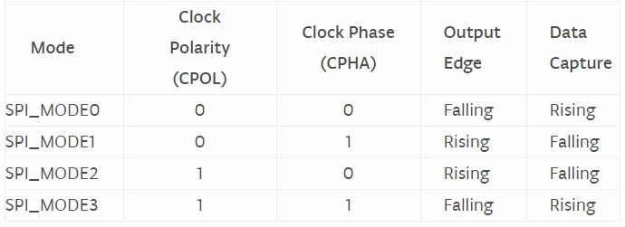
SPI using Arduino
SPI.begin() -> Start all lines and CPU in SPI mode (allows interrupts)
Will need to set the SS pin to low and high here
SPI.transfer(dataToSend)
SPI.beginTransaction() -> Start SPI, but blocks interrupts
Set the slave pin to LOW, then SPI.transfer(dataToSend) then set the slave pin to HIGH, then SPI.endTransaction()
SPI.beginTransaction(SPISettings(14000000, MSBFIRST, SPI_MODE0))
The data to send is 1 Byte at a time
Notes:
https://www.arduino.cc/en/Reference/SPI

Slide 11
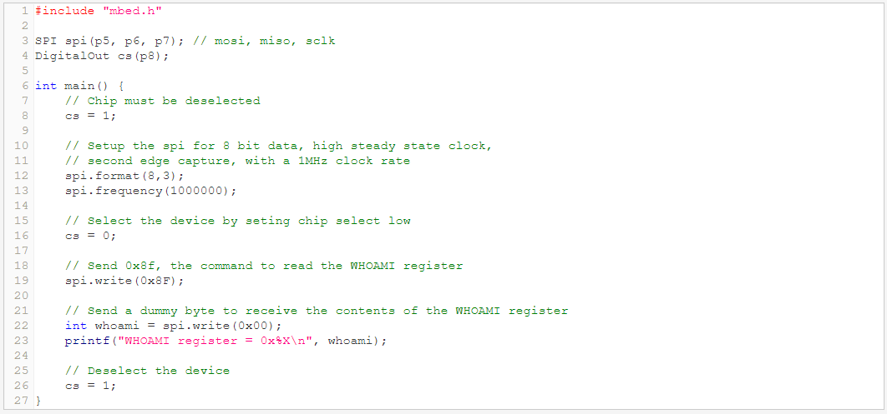
SPI using MBED

Slide 12
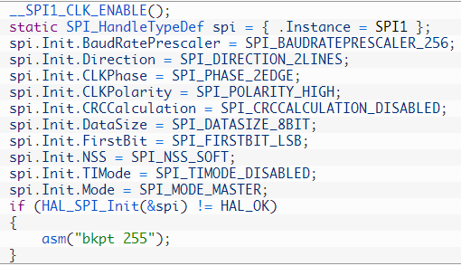
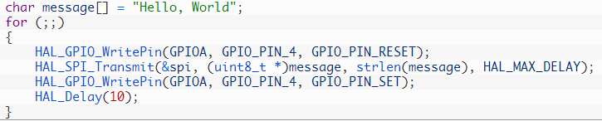
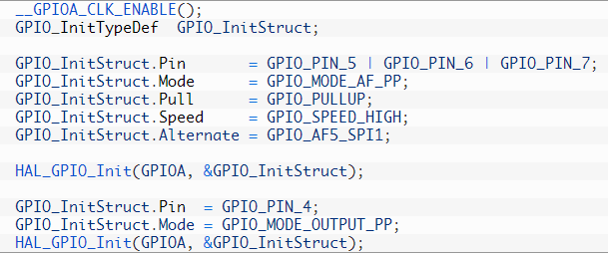
SPI STM32 Library
Notes:
https://visualgdb.com/tutorials/arm/stm32/spi/

Slide 13
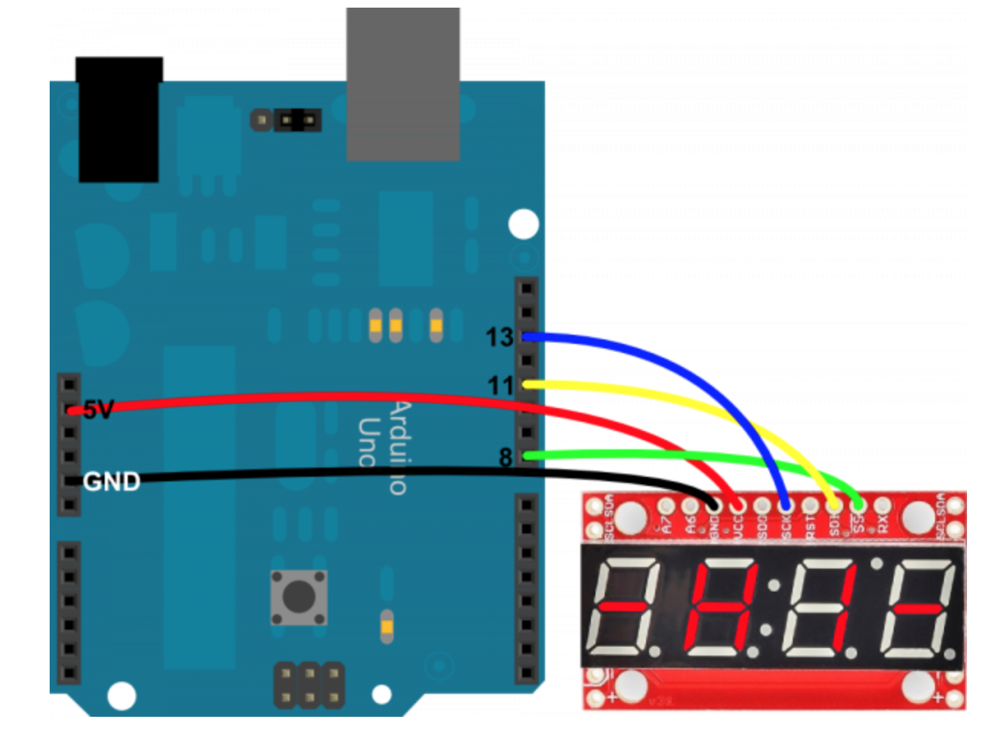
Hardware Setup
Arduino -------------- Serial 7-Segment 5V -------------------- VCC GND ------------------ GND 8 -------------------- SS 11 -------------------- SDI 13 -------------------- SCK

Slide 14
I^2C vs SPI
I^2C (hereby I2C):
Only 2 lines, vs sum(3 + #slave devices) for SPI
More complex setup (especially if MCU doesn’t have dedicated lines for it)
Lower speed (400 KHz vs multiple MHz for SPI)
Can have dynamic format of data
Requires acks for messages (like TCP)s

