Slide 1
Lab Tools Workshop Fall ‘17
By: Sahil and Liz

Slide 2
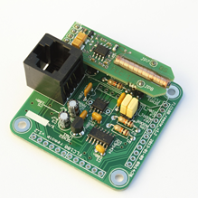
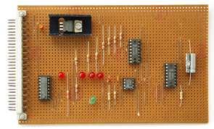
Overview and Motivations
What are lab tools?
Any of the different equipments found in the lab
Why use them?
Power up projects
Debug circuits
Gain deeper understanding of circuits
Apply those V = IR and P = IV equations

Slide 3
Today’s Concepts
Digital Multimeter (DMM)
Power Supply
Function Generator
Oscilloscope

Slide 4
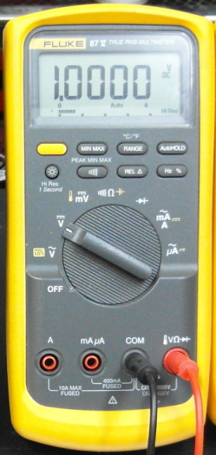
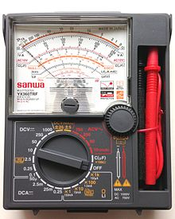
DMM
Measures voltage, current, resistance
Useful for debugging!
checks wiring, solder bridge, short circuit, etc
Sometimes you need to specify the voltage/current range!
Analog Multimeter uses a moving pointer to display readings
Notes:
In actuallity a DMM aon only measure voltages, it internally preforms calculations to convert to ohms and amps
Digital measured current by shunt resistor and meauring voltage, analog uses magnetic field and magnets
galvanometer
Uses a ADC called Successive Approximation Registers which hold the voltage information
Doesn’t affect the circuit (to an extend) 1 MegaOhm input impedance, 0.5 Ohm internal resistance

Slide 5
How to Use the DMM
Continuity Check:
Plug in black & red probes
Continuity Test Mode
Probe test leads across the components you want to test
It will beep when continuity is detected!

Slide 6
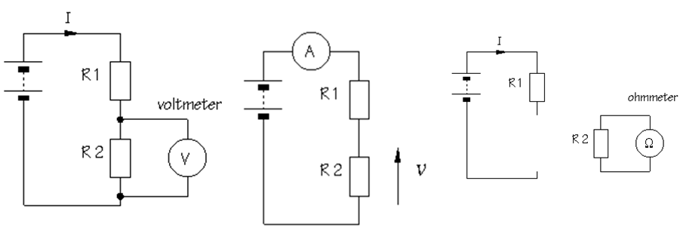
How to Use the DMM
Measure resistance, capacitance, voltage, and current:
Plug in black & red probes
Go to the symbol of the resistor, the capacitor, the capital V, or the capital A
Probe test leads across the components you want to test
For currents, remember the DMM must be in series with the component
It will show the measurement

Slide 7
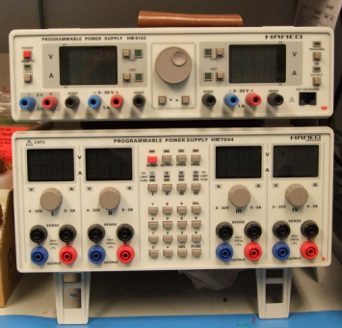
Power Supply
Powers your circuit with constant voltage/current
Useful for circuit testing
Multiple independent outputs
Will not destroy your circuit when shorts!
Sources will cap out at a voltage
Turn on OCP (over current protection) and OVP (over voltage protection)

Slide 8
How to Use Power Supply
Outputs can be set by knobs or keypads
Set the voltage/current to desired maximum
Know how much your circuit can take
Connect power and ground to appropriate pins

Slide 9
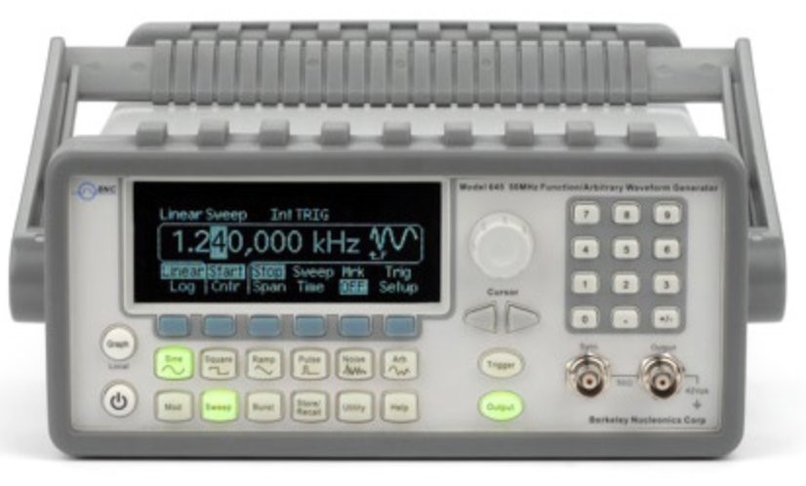
Function Generator
Generates electrical waveforms (square, sine, triangle, sawtooth)
Useful for test and repair of electrical equipment
Useful for creating/mimicking signals (AM/FM, noise)
Notes:
http://electronicdesign.com/test-amp-measurement/fundamentals-signal-generation

Slide 10
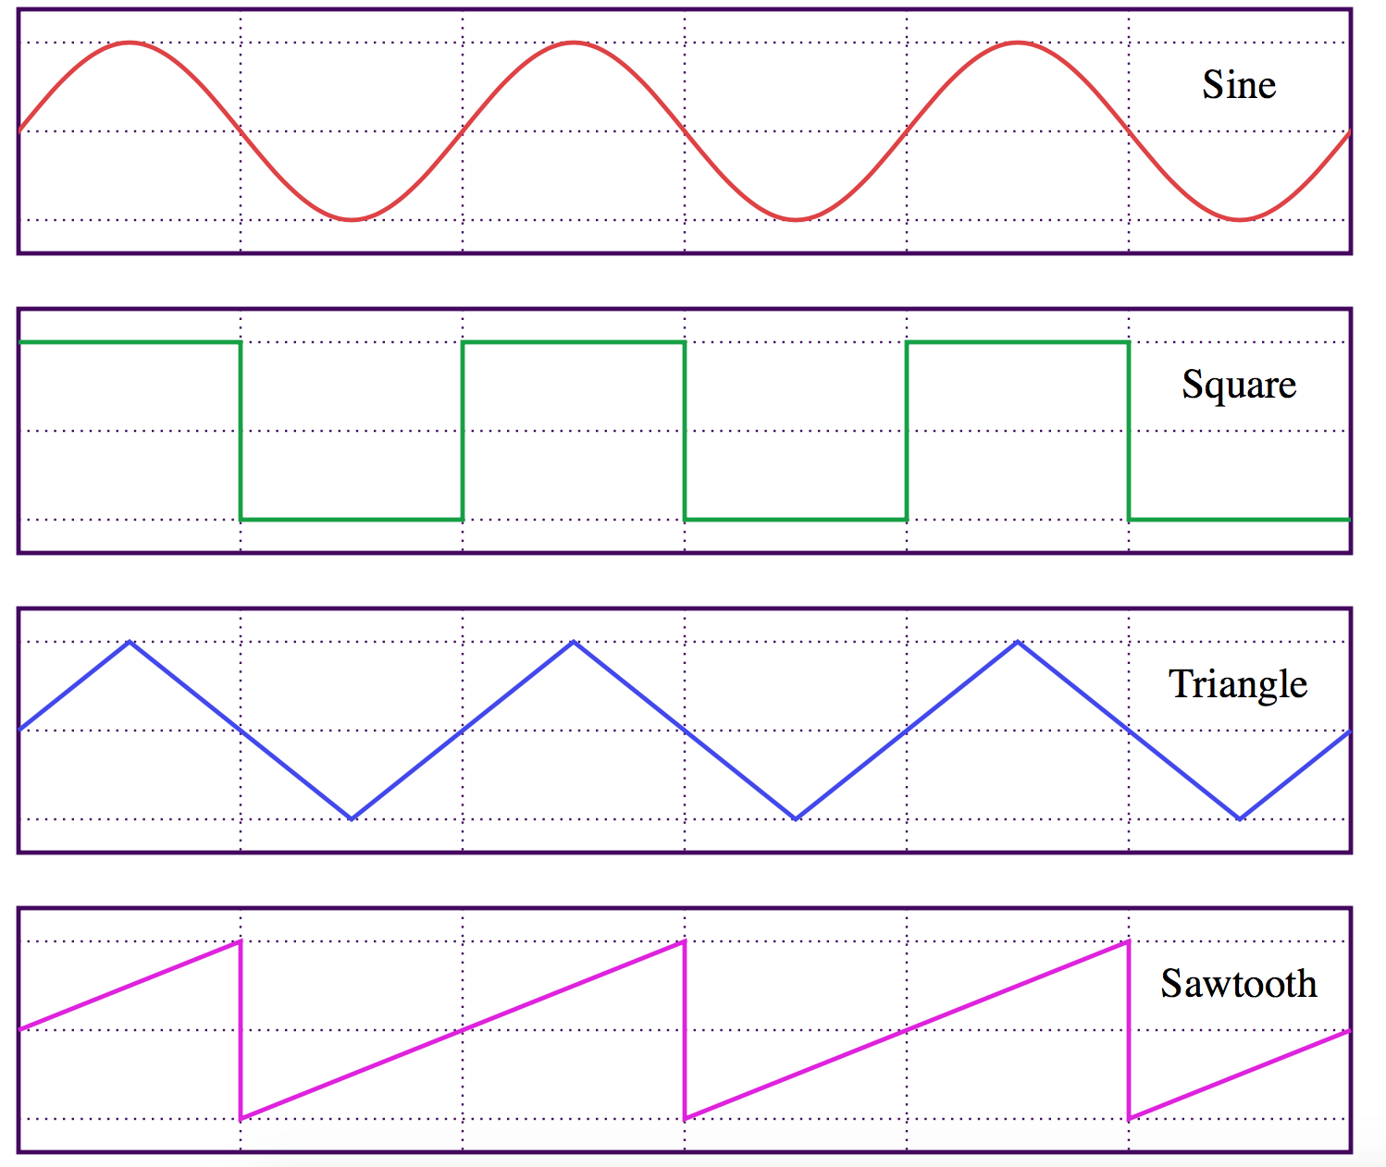
How to Use the Function Generator
Generate a specific waveform:
Connect probe to channel
Configure the output signal to the intended shape
Select waveform amplitude and frequency
Other features include frequency sweep, DC offset...

Slide 11
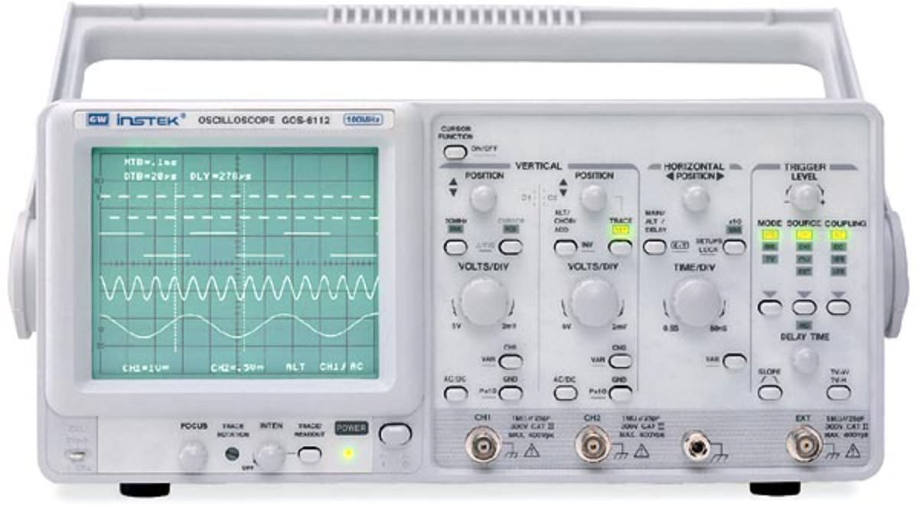
Oscilloscope
Views voltage over time
Measures time characteristics:
Frequency & period
Duty cycle
Rise and fall time
Compares two waveforms using different channels
Sweeps frequencies

Slide 12
How to Use the Oscilloscope
Attach the ground pin of scope to ground of circuit
Attach other pin to wire/signal to measure
Adjust the Volts/Div and Time/Div
Turn on whichever channel(s) you are using
Set trigger type
Notes:
http://courses.washington.edu/phys431/scope_ex/scope_ex.pdf

Slide 13
Hands on Experience Time!

Slide 14
Experience One
Connect the power supply to the power/gnd pins
Use the DMM to measure voltage across:
Power supply
Resistors
Capacitors
Measure the voltage across the LED
Use the switch to see changes!

Slide 15
Experience Two
Connect the function generator and oscilloscope to the pads on the bottom left
Set function generator to 5V sine wave
Adjust the oscilloscope to see readings
Change the frequencies on the function generator to:
Identify frequencies with largest voltage response
As well as freq. for smallest voltage response
Have a nice image of it at the end!
Notes:
You need to have HIGH frequencies like over 1 to 2 KHz to More than 40-50 KHz
0.22H, 220uF → resonance frequency= 22.8Hz

Slide 16
Experience Three
Attach the power supply to the board
Upper left of the board
Attach the oscilloscope to right hand points of the board
Adjust the scope till you see constant waveform
Find the period of the waveform
How does adjusting the potentiometer affect the period?
Notes:
Should look like a Capacitor Charging wave

