Slide 1
Android + Bluetooth Control
By Sahil Gandhi & Liz Xue

Slide 2
Links for Download
Android Studio -> https://developer.android.com/studio/index.html
Arduino IDE -> https://www.arduino.cc/en/Main/Software
Skeleton Code -> https://github.com/sahilmgandhi/IEEE_Workshops_2017_2018/tree/master/Android_Bluetooth

Slide 3
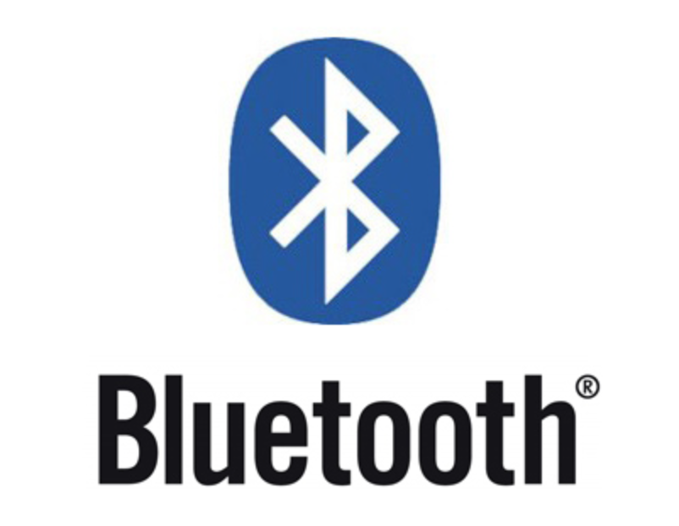
What is Bluetooth?
A standardized protocol that sends and receives data via a 2.4GHz wireless link.
Suitable for short-range, low-power, low-cost, wireless transmissions
Named after King Harald Blatonn (Bluetooth in English) who united the Danish tribes
Bluetooth unites different communication protocols!

Slide 4
How does Bluetooth Work?
Bluetooth radio and receiver work on 79 possible frequencies (channels)
Low power, several milliwatts or less per signal sent
Short distance ... < 30 ft
Connect the radio to receiver to create an ad-hoc mini computer network
Called Piconet
Up to 7 devices max in a Piconet (theoretically) + 1 master (3 bit address)
Multiple piconets can overlap (master in one can be slave in another) --> Scatternet

Slide 5
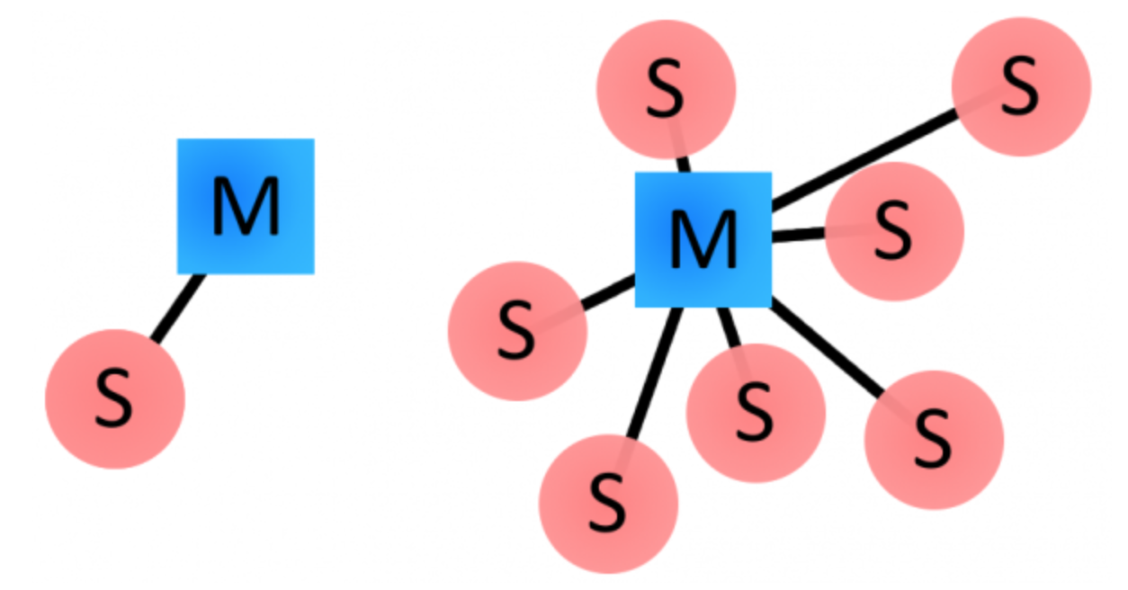
How does Bluetooth Work? (cont.)
Uses a master-slave (primary/replica) architecture
Master device (like phone) initiates communication with slave devices (module, earphones, etc)
Slave devices cannot talk to one another
Each device has 48 bit unique address (BD_ADDR)
Slave/master relationship can change after handshake performed

Slide 6
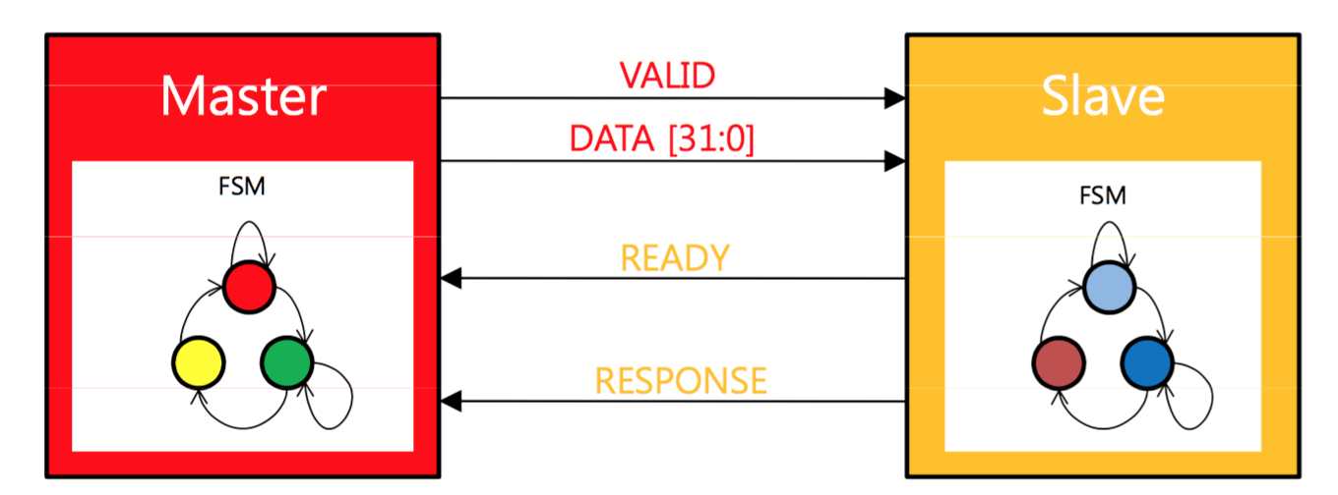
“Handshake”
A process that set parameters for communication between devices before normal communication begins

Slide 7
Advantages & Applications
Advantages of Bluetooth
Less radio interference: Transmitter changes frequency 1,600 times per second
Security: requires pairing and authentication
Allows verbal communication
Clutter-free
Applications:
Wireless networking between computers/phones in a confined space
Peripherals such as mice, keyboards, printers, speakers
Transfer of files
AND SO MUCH MORE!

Slide 8
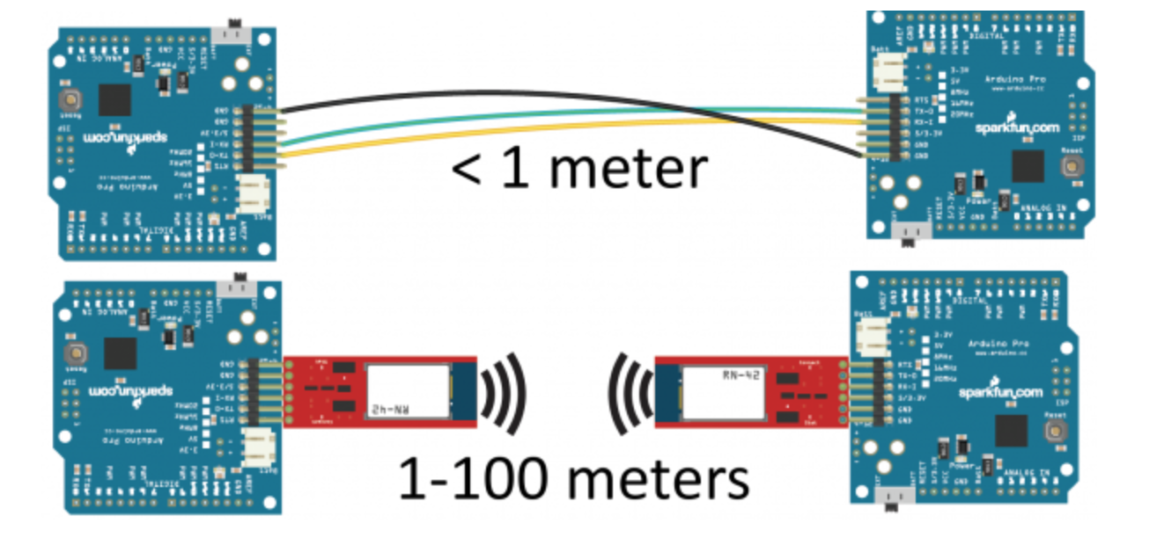
Serial Port Profile (SPP)
You can replace a serial communication interface(TX, RX) with Bluetooth
For example, two Arduinos:

Slide 9
Different Flavors of Bluetooth
1.X
First gen. 721 Kbits/s and basic security protocols
2.X
Increased to 3 Mbits/s, and low power mode
3.X
First major overhaul, expanded to 802.11 network and L2CAP channel
25 Mbit/s and 33 ft range
4.X (most common)
Longer range (100 ft), updated to 802.11n network and even lower power mode
Also data packet length extensions and support for Bluetooth Smart things connected homes
5.X (latest Gen)
Introduced in early 2017 and supported by latest Samsung and Apple phones
50 Mbits/s transfer with max 800 ft range, trade off higher speeds for low range or vice versa

Slide 10

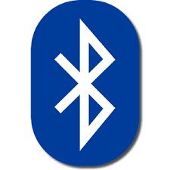

Bluetooth Vs WiFi
Both are wireless communication methods
WiFi is meant for high speed internet access
Bluetooth meant to connect devices without cables
Create separate kinds of networks
Both use 802.11 standard now
WiFi also allows overlaps of network hotspots

Slide 11
The Arduino Part

Slide 12
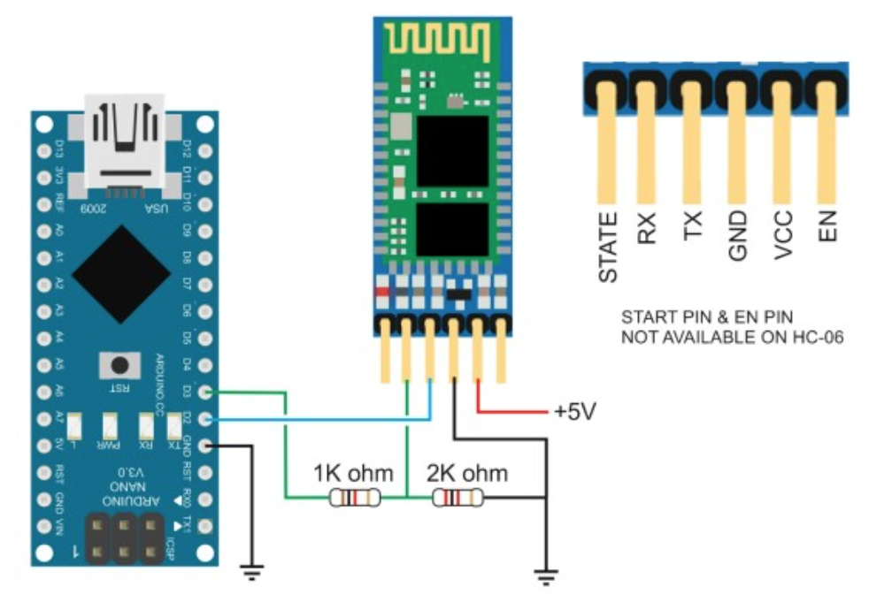
Implementing Bluetooth in Arduino
Module of choice: HC-05 Bluetooth Module
Hardware: 1) Connecting TX and RX pins a) TX = Serial Transmitter --> Connect TX module to D2 pin on Arduino b) RX = Serial Receiver --> Connect RX module to D3 pin Arduino with a voltage divider 2) Connect VCC, GND pin on module to VCC(5V) and GND on Arduino
3) Connect EN on module to 3.3V on Arduino
Software: 1) #include <SoftwareSerial.h> a) Using other pins as TX/RX pins
Notes:
Pins 2 and 3 are rx and tx in the software serial version that we will be using

Slide 13
Arduino Bluetooth (cont.)
SoftwareSerial Functions:
Initializer -> SoftwareSerial btSerial (rxPin, txPin);
Begin -> btSerial.begin(9600); //baud rate
Available -> btSerial.available()
Returns # of bytes to read that were stored in serial buffer
Read -> btSerial.read() // returns char read or -1
Print -> btSerial.print(string s) or btSerial.println(string s);
Listen -> btSerial.listen()
Sets the serial port to listen (useful if MCU has multiple serial ports)
Overflow -> btSerial.overflow()
Returns bool. False returned if more than 64 bytes in buffer (overflow)

Slide 14
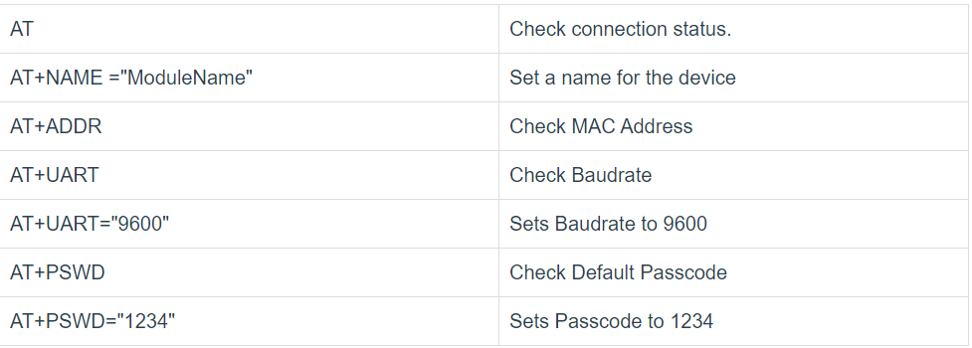
AT Commands
These are commands that can be used to program/get information from Bluetooth module
Notes:
Stands for ATtention Commands

Slide 15

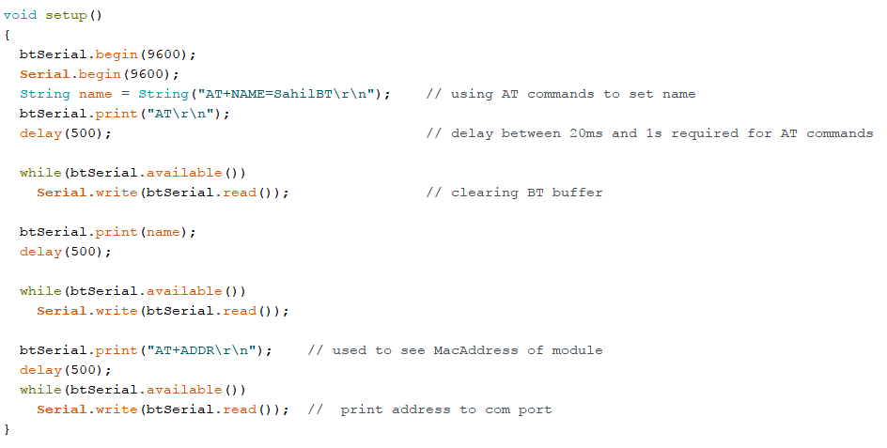
Sample Arduino Code

Slide 16
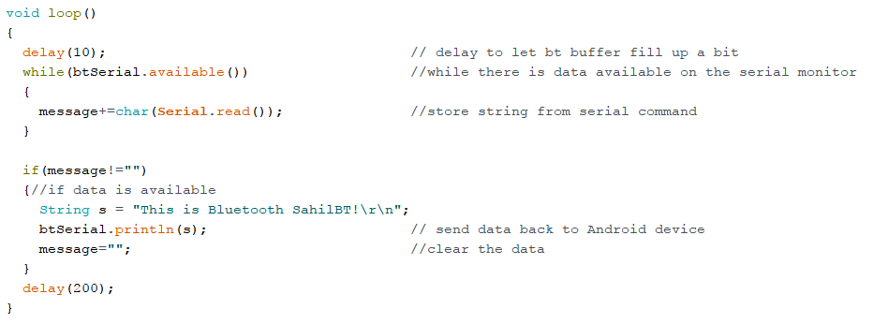
Arduino Code (cont.)

Slide 17
Code Along!

Slide 18
Moving to the Android Part!

Slide 19
Android Developer Options
If you have an Android Device:
Turn on Developer Options (Settings -> Developer Options)
Enable USB Debugging
Use Android Device to run the application!
If you do not have an Android Device:
Pair/Team up with someone who has one
Unfortunately the emulator cannot emulate a Bluetooth connection :(
See if that Android Phone can connect to your Bluetooth module!

Slide 20
Android Essentials
Activity - Window that users interact with (ie. main screen)
Intent - Runtime binding between two activities/diff parts of app
Good for launching tasks/activities based on user inputs
XML - Used for layout designing and for parsing data
Layouts - Visual structure of app ... can be preset in layout.xml or added dynamically
OnCreate, OnStart and Inflating:
OnCreate = tasks that you want to do when activity is initialized (almost like constructor)
OnStart = tasks you want to do when activity is becoming visible to user (like animation)
Inflating = Render layout by creating view object in memory (parsing xml to make the UI)
Layout Components
Edit Text = Text you want you edit (such as to send info)
Button = Button to press for action
TextView = Text to see that is not editable
Notes:
setContentView(R.layout.your_layout);
LayoutInflater inflater = LayoutInflater.from(YourActivity.this);
View theInflatedView = inflater.inflate(R.layout.your_layout, null);

Slide 21
Setting up Bluetooth Connection on Android
Check that phone supports bluetooth
Check that bluetooth is enabled
Check all bluetooth devices phone recognizes
When device found, create socket to set up two-way connection (“bridge”)
Create outputStream to send data to module
Create inputStream to look for incoming data
Create thread to continuously look for incoming data
Yay fun memories from CS 111 and 118 :)
This all looks daunting, so how does it look like in code?

Slide 22
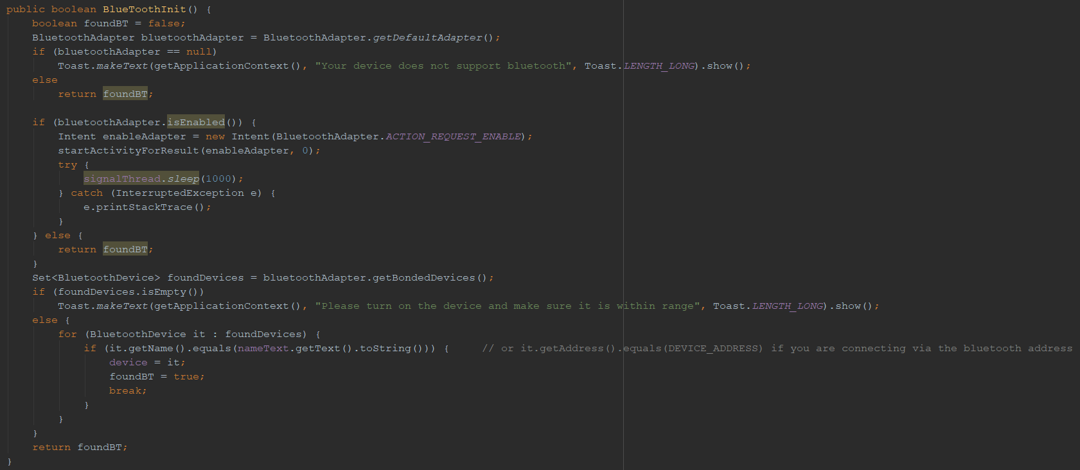
Android Bluetooth (cont.)

Slide 23
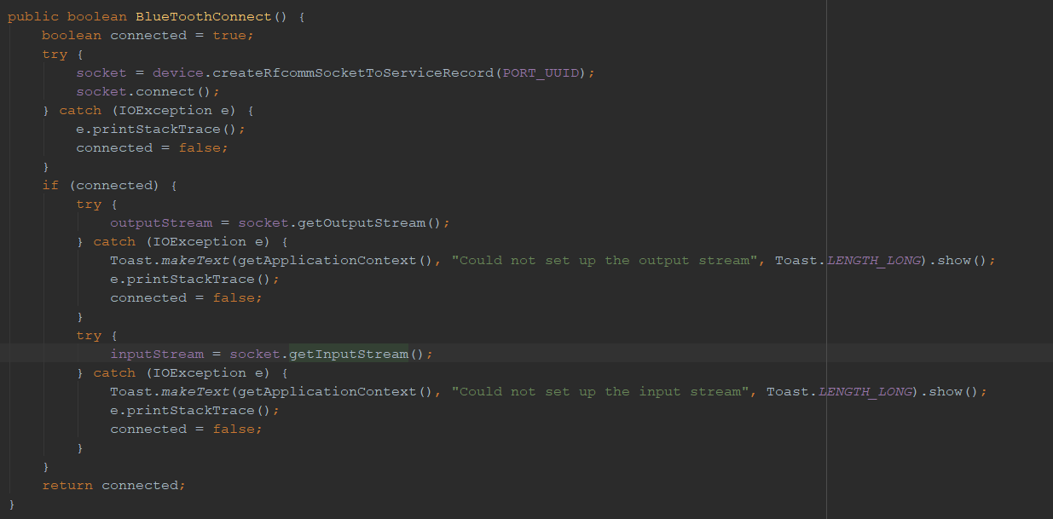
Bluetooth for Android (cont.)

Slide 24
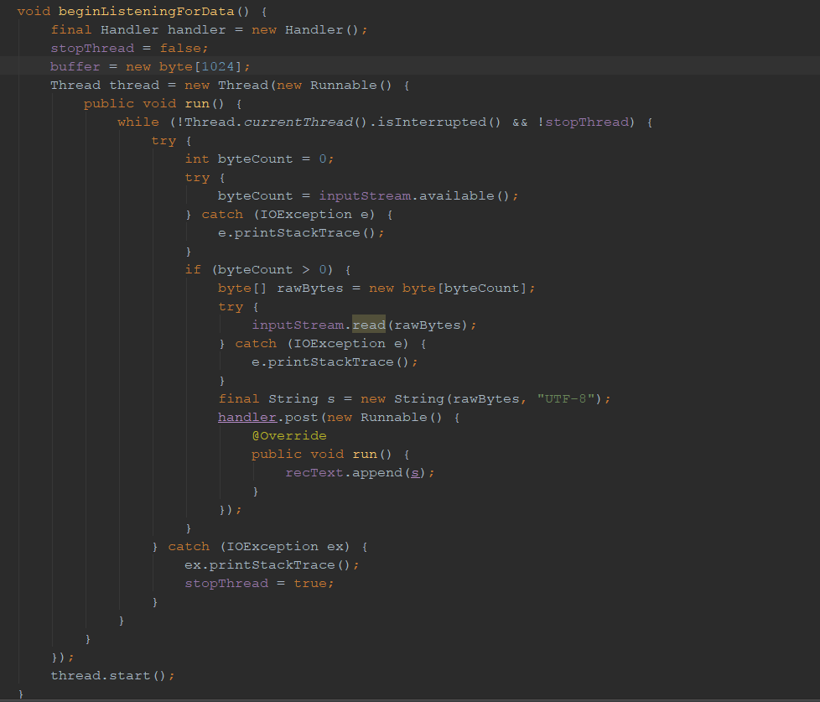
Bluetooth for Android (cont.)

Slide 25
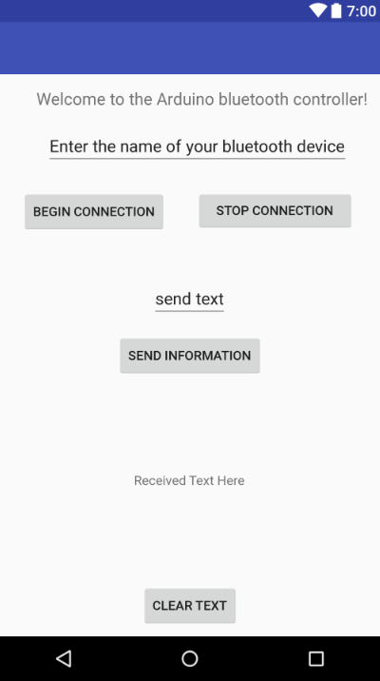
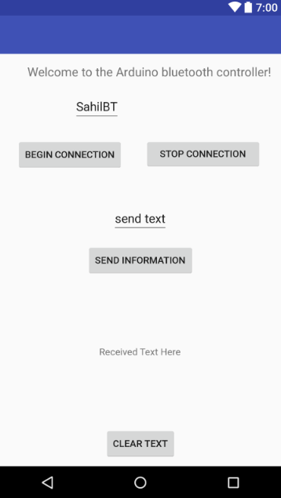
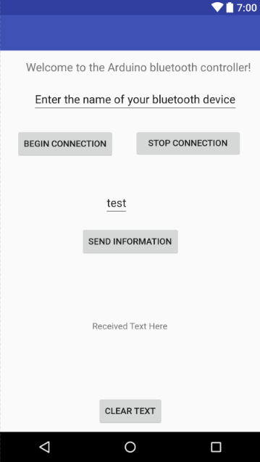
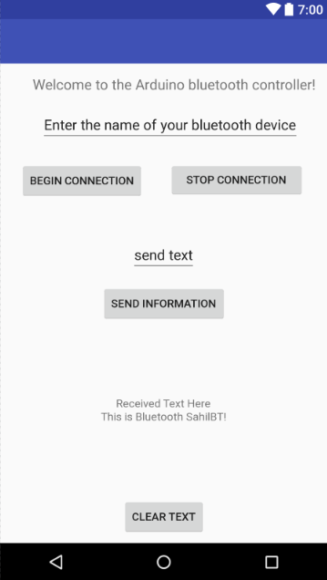
Final Result

Slide 26
Applications of Today’s Lecture
OPS: 1) Control an RC Car 2) Set PID Constants/read sensor values on the go
Micromouse: 1) Set PID constants without stopping car 2) Read sensor values on the go
AP: 1) Similar as above
Use in IDEA Hacks projects and make cool things next quarter!!!!!

Slide 27
Thoughts, Concerns, or Questions?

