Slide 1
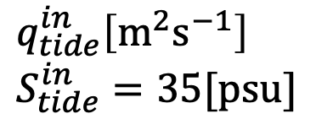












River mouth
Offshore
Higher tide
$$z$$
$$h_{tide}[m]$$
$$O$$
$$x$$
$$z_{bottom}=−1.5[m]$$
$$d[m]$$
$$q_{riv}\left[m^{2}s^{−1}\right] \\ S_{riv}=20[psu]$$
$$q_{tide}^{in}\left[m^{2}s^{−1}\right] \\ S_{tide}^{in}=35[psu]$$
$$h_{leaf}[m]$$
$$u_{bottom}=0\left[ms^{−1}\right]$$
$$h_{root}=0.1[m]$$
$$S_{sed}=S_{bottom}−0.5[psu]$$
$$L[m]$$

Slide 2

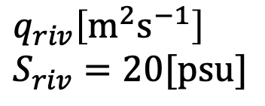



River mouth
Offshore
$$z$$
$$O$$
$$x$$
Lower tide
$$h_{tide}[m]$$
$$z_{bottom}=−1.5[m]$$
$$q_{riv}\left[m^{2}s^{−1}\right] \\ S_{riv}=20[psu]$$
$$d[m]$$
$$h_{leaf}[m]$$
$$q_{tide}^{out}\left[m^{2}s^{−1}\right]$$
$$u_{bottom}=0\left[ms^{−1}\right]$$
$$h_{root}=0.1[m]$$
$$S_{sed}=S_{bottom}−0.5[psu]$$
$$L[m]$$

Slide 3
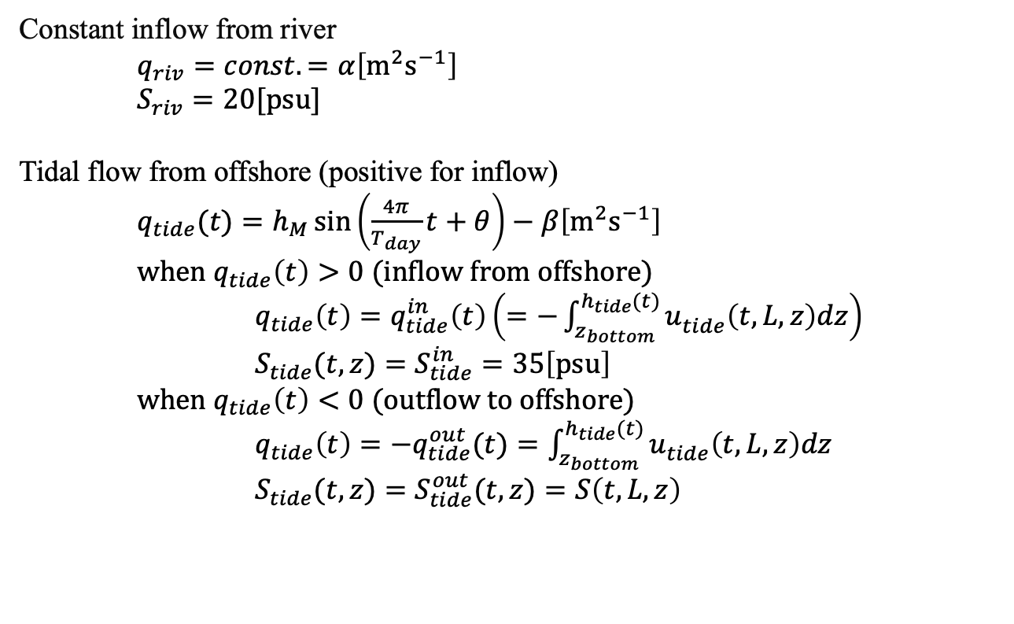
Disregard:
Water flow
Eddy & Wave of seawater
Water permeability of sediment
Temperature & Heat transfer
Evaporation
Wind
Constant inflow from river
$q_{riv}=const.=α\left[m^{2}s^{−1}\right]$ $S_{riv}=20[psu]$
Tidal flow from offshore (positive for inflow)
$q_{tide}(t)=h_{M}\sin\left(\frac{4π}{T_{day}}t+θ\right)−β\left[m^{2}s^{−1}\right]$
$when q_{tide}\left(t\right)>0$ (inflow from offshore)
$q_{tide}\left(t\right)=q_{tide}^{in}\left(t\right)\left(=−\int_{z_{bottom}}^{h_{tide}(t)}{u_{tide}^{}\left(t,L,z\right)dz}\right)$
$S_{tide}(t,z)=S_{tide}^{in}=35\left[psu\right]$
$when{ q}_{tide}\left(t\right)<0$ (outflow to offshore)
$q_{tide}\left(t\right)=−q_{tide}^{out}(t)=\int_{z_{bottom}}^{h_{tide}(t)}{u_{tide}^{}\left(t,L,z\right)dz}$ $S_{tide}(t,z)=S_{tide}^{out}(t,z)=S\left(t,L,z\right)$

Slide 4
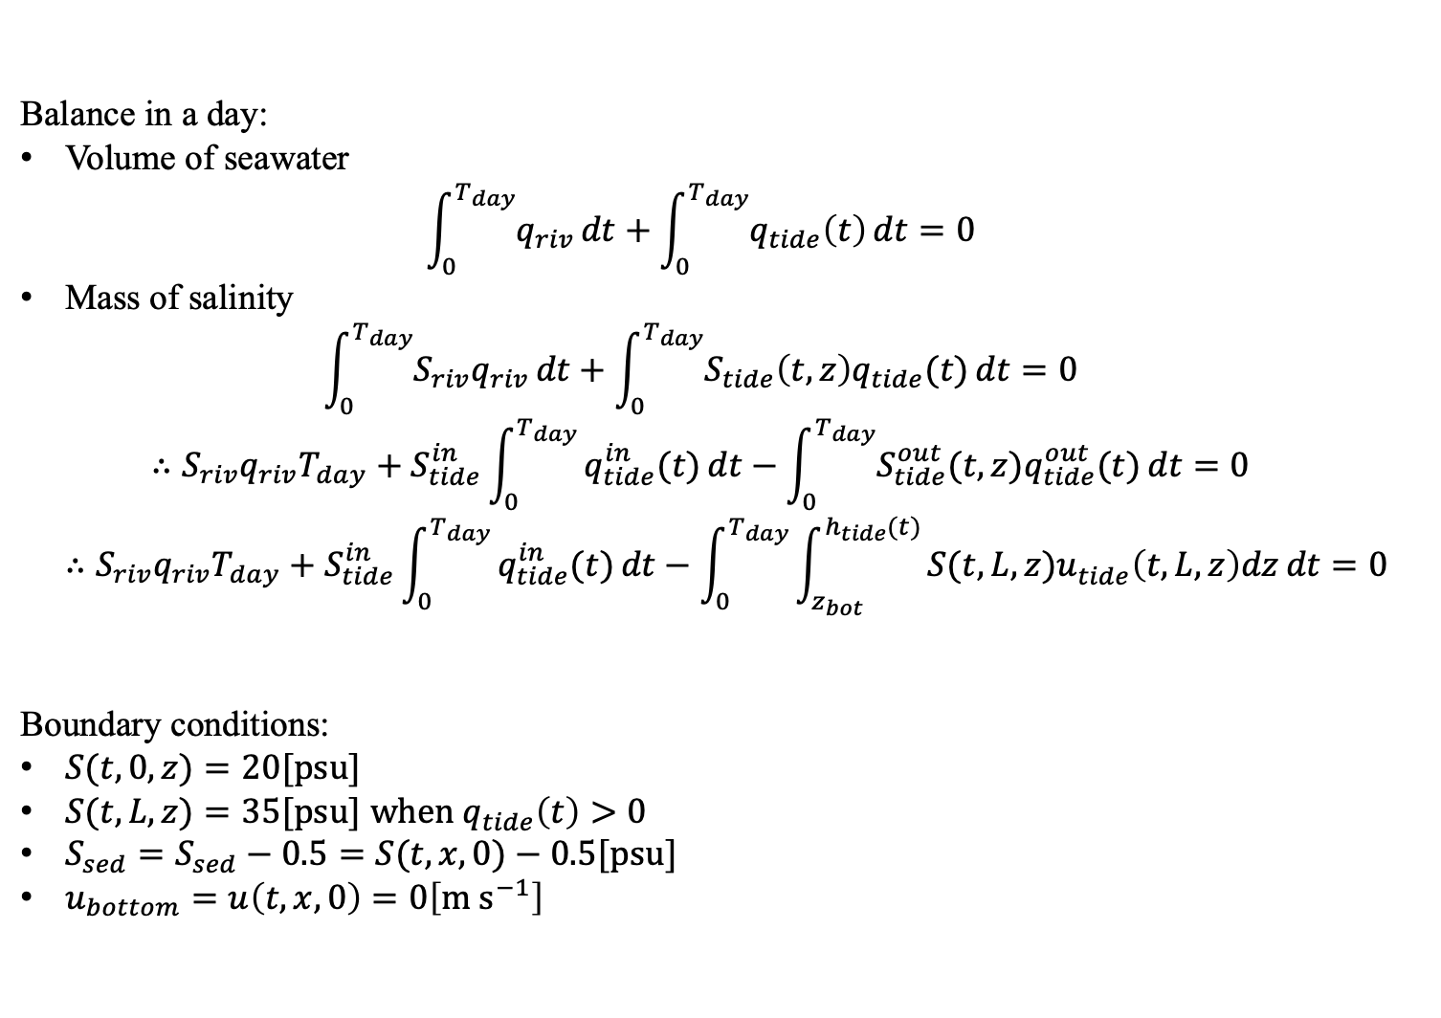
Balance in a day:
Volume of seawater $\int_{0}^{T_{day}}{q_{riv}}dt+\int_{0}^{T_{day}}{q_{tide}\left(t\right)}dt=0$
Mass of salinity $\int_{0}^{T_{day}}{{S_{riv}q}_{riv}}dt+\int_{0}^{T_{day}}{{S_{tide}\left(t,z\right)q}_{tide}(t)}dt=0$ $∴{S_{riv}q}_{riv}T_{day}+S_{tide}^{in}\int_{0}^{T_{day}}{q_{tide}^{in}(t)}dt−\int_{0}^{T_{day}}{S_{tide}^{out}(t,z)q_{tide}^{out}(t)}dt=0$ $∴{S_{riv}q}_{riv}T_{day}+S_{tide}^{in}\int_{0}^{T_{day}}{q_{tide}^{in}(t)}dt−\int_{0}^{T_{day}}{\int_{z_{bot}}^{h_{tide}(t)}{S(t,L,z)u_{tide}^{}\left(t,L,z\right)dz}dt}=0$
Boundary conditions:
$S(t,0,z)=20[psu]$
$S(t,L,z)=35[psu]$ $when q_{tide}\left(t\right)>0$
$S_{sed}=S_{sed}−0.5=S(t,x,0)−0.5[psu]$
$u_{bottom}=u\left(t,x,0\right)=0\left[m s^{−1}\right]$

