Slide 1
Использование инструментов машинного обучения для предсказания ценообразования на рынке авто
Глухов Кирилл
СТУДЕНТ 2-ГО КУРСА ФАКУЛЬТЕТА ПМ-ПУ

Slide 2
Датасет
Этот набор данных содержит информацию о ценах на автомобили в Австралии на 2023 год. Набор данных включает в себя такую информацию, как марка, год, модель, тип автомобиля, название, состояние, трансмиссия, двигатель, тип привода, тип топлива, расход топлива, километры, цвет, местоположение, цилиндры в двигателе, тип кузова, двери, сиденья и цена. Набор данных содержит более 16 000 записей объявлений об автомобилях с различных онлайн-платформ Австралии.
Float64 #Численные признаки ['Year', 'EngineL', 'FuelConsumption', 'Kilometres', 'CylindersinEngine', 'Doors', 'Seats', 'Price'] Object #Категориальные признаки ['Brand', 'Model', 'BodyType', 'UsedOrNew', 'Transmission', 'DriveType', 'FuelType', 'Color', 'State', 'City']
‹#›

Slide 3
Feature engineering
Brand | Year | Model | Car/Suv | Title | UsedOrNew | Transmission | Engine | DriveType | Fuel Type | Fuel Consumption | Kilometres | ColourExtInt | Location | Cylinder Engine | Body Type | Doors | Seats | Price
Ssangyong | 2022 | Rexton | Sutherland Isuzu Ute | 2022 Ssangyong | DEMO | Automatic | 4 cyl, 2.2 L | AWD | Diesel | 8.7 L / 100 km | 5595 | White / Black | Caringbah, NSW | 4 cyl | SUV | 4 Doors | 7 Seats | 51990
MG | 2022 | MG3 | Hatchback | 2022 MG MG3 | USED | Automatic | 4 cyl, 1.5 L | Front | Premium | 6.7 L / 100 km | 16 | Black / Black | Brookvale, NSW | 4 cyl | Hatchback | 5 Doors | 5 Seats | 19990
Brand | Year | Model | UsedOrNew | Transmission | EngineL | DriveType | Fuel Type | Fuel Consumption | Kilometres | Color | City | State | Cylinder Engine | Body Type | Doors | Seats | Price
Ssangyong | 2022 | Rexton | DEMO | Automatic | 2.2 | AWD | Diesel | 8.7 | 5595 | White Black | Caringbah | NSW | 4 | SUV | 4 | 7 | 51990
MG | 2022 | MG3 | USED | Automatic | 1.5 | Front | Premium | 6.7 | 16 | Black Black | Brookvale | NSW | 4 | Hatchback | 5 | 5 | 19990
‹#›

Slide 4
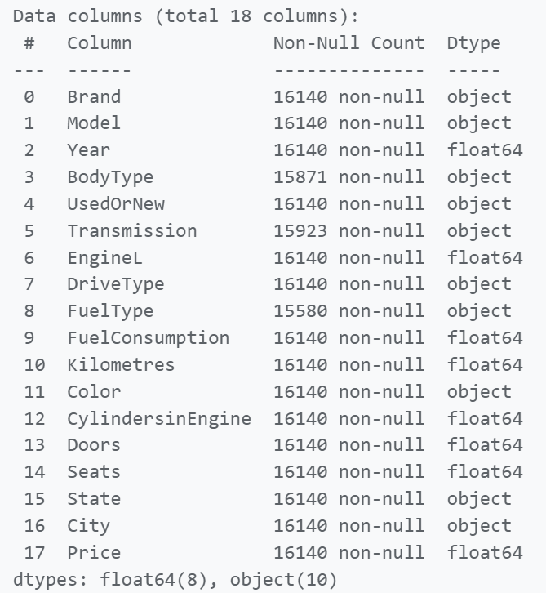

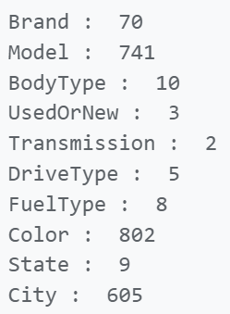
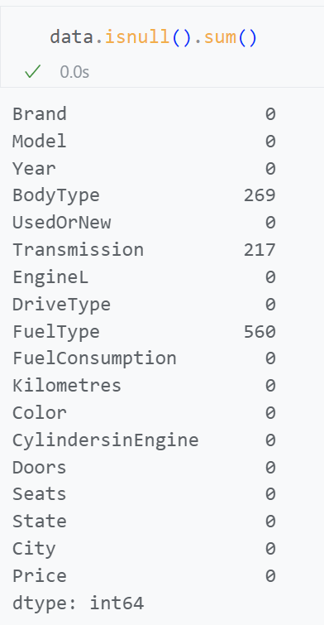
Feature engineering
‹#›

Slide 5
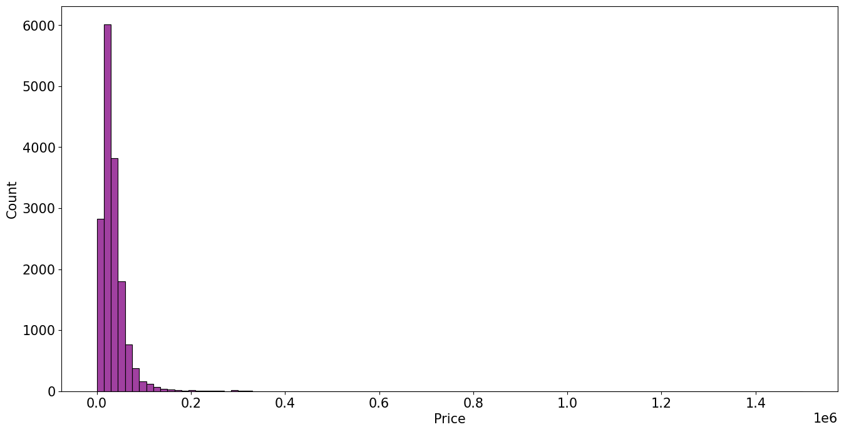
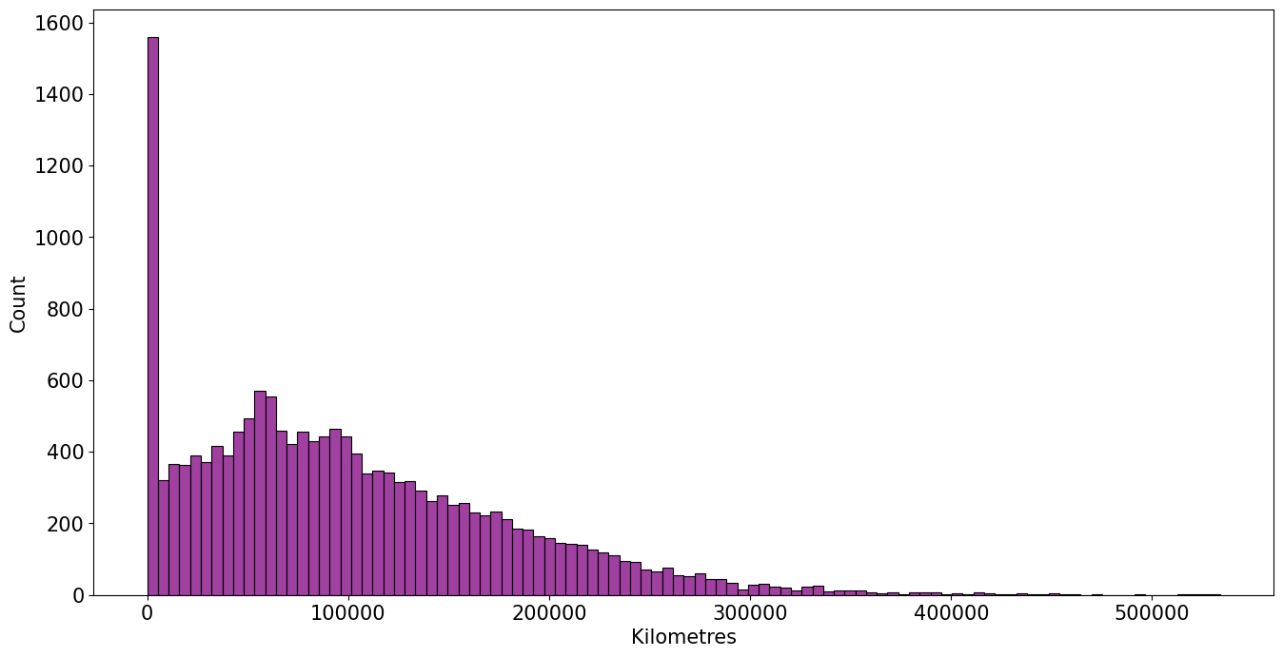
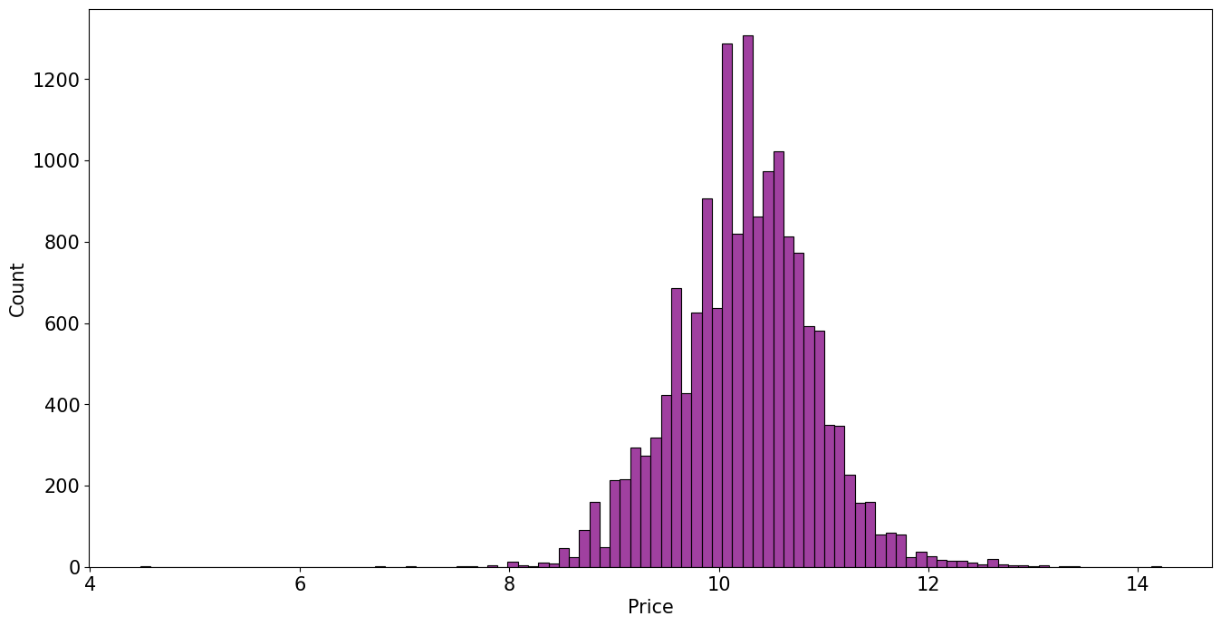
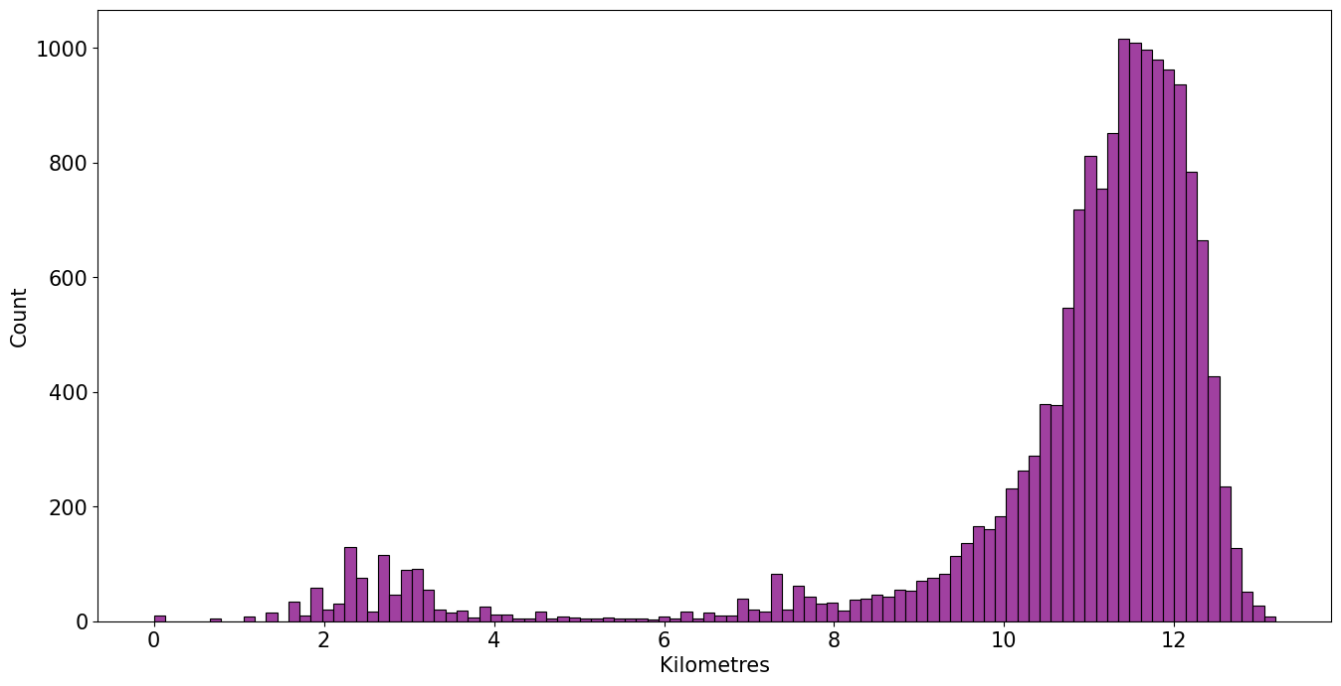
Feature engineering
Normal
Normal
Log
Log
‹#›

Slide 6
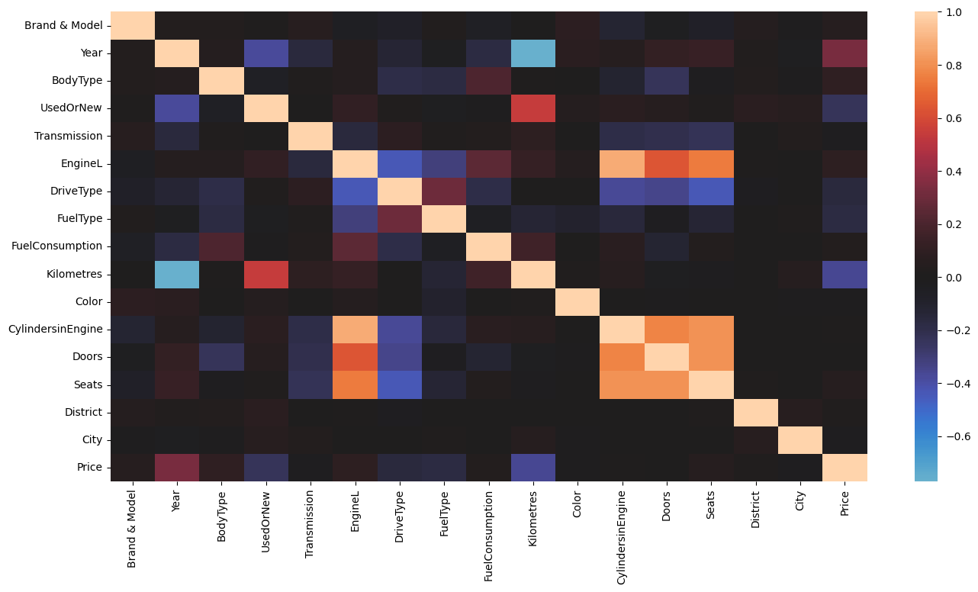
Уровень корреляции(с Label Encoder)
‹#›

Slide 7
Encoding и используемые модели
ohe_col=['UsedOrNew','Transmission','DriveType'] be_col=['FuelType','Color','BodyType','Brand', 'Model', 'State','City'] transform=ColumnTransformer(transformers=[ ('Ohe',OneHotEncoder(sparse_output=False,drop='first'),ohe_col), ('Be',ce.BinaryEncoder(),be_col) ],remainder='passthrough') models = [ ('lr',LinearRegression()), ('Lasso',Lasso()), ('Ridge',Ridge()), ('ElasticNet', ElasticNet()), ('Knn',KNeighborsRegressor()), ('DT',DecisionTreeRegressor()), ('Bagging',BaggingRegressor()), ('RT',RandomForestRegressor()), ('XGB',XGBRegressor()), ('LGBM', LGBMRegressor(verbose=-1)), ('CatBoost', CatBoostRegressor(silent=True)), ('GBR', GradientBoostingRegressor()), ('AdaBoost', AdaBoostRegressor()), ('ExtraTrees', ExtraTreesRegressor()) ]
‹#›

Slide 8
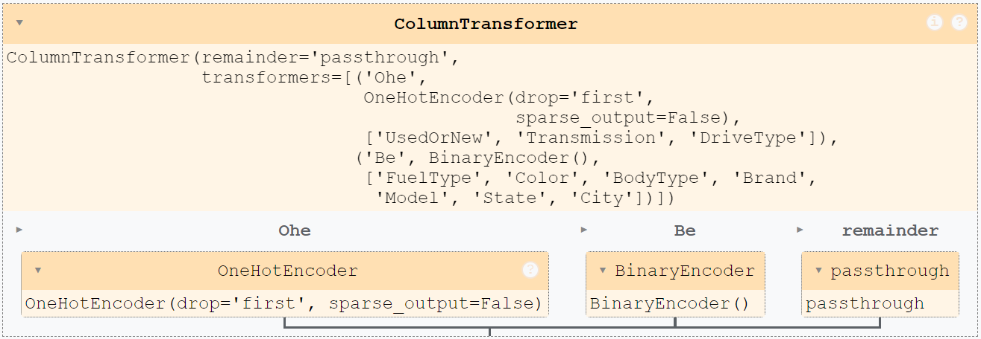
Transformer
‹#›

Slide 9
Pipeline
for model in models: print(model[0]) PL=make_pipeline(transform, StandardScaler(), model[1]) cv=cross_validate( estimator=PL, X=x, y=y, cv=7, #train 6/7 test 1/7 return_train_score=True, scoring=[ 'r2', 'neg_mean_squared_error',#Negative Mean Squared Error, which is used to measure the average of the squares of the errors. ] ) print(model[0],'train r2 score = ',cv['train_r2'].mean()) print(model[0],'test r2 score = ',cv['test_r2'].mean()) print('-'*30)
‹#›

Slide 10
Pipeline (6/7-train, 1/7-test)
lr lr train r2 score = 0.6992071178580945 lr test r2 score = 0.6704348230642506 ------------------------------ Lasso Lasso train r2 score = 0.0 Lasso test r2 score = -0.011745018764485955 ------------------------------ Ridge Ridge train r2 score = 0.6992071035731418 Ridge test r2 score = 0.6704394280607496 ------------------------------ ElasticNet ElasticNet train r2 score = 0.0 ElasticNet test r2 score = -0.011745018764485955 ------------------------------ Knn Knn train r2 score = 0.7669649271079283 Knn test r2 score = 0.6178826690886499 ------------------------------
DT DT train r2 score = 0.9999837451051717 DT test r2 score = 0.735032033110865 ------------------------------ Bagging Bagging train r2 score = 0.9743144952352255 Bagging test r2 score = 0.8539961886990058 ------------------------------ RT RT train r2 score = 0.9826093778197372 RT test r2 score = 0.8729123726164201 ------------------------------ XGB XGB train r2 score = 0.9685029451227772 XGB test r2 score = 0.8910035860683709 ------------------------------ LGBM LGBM train r2 score = 0.9231663994005939 LGBM test r2 score = 0.8831699101848247 ------------------------------
CatBoost CatBoost train r2 score = 0.9554503923374907 CatBoost test r2 score = 0.9048155151910927 ------------------------------ GBR GBR train r2 score = 0.8482544623115096 GBR test r2 score = 0.8275879148231683 ------------------------------ AdaBoost AdaBoost train r2 score = 0.6775337532859435 AdaBoost test r2 score = 0.660170755771433 ------------------------------ ExtraTrees ExtraTrees train r2 score = 0.9999837451051717 ExtraTrees test r2 score = 0.8868293321097954 ------------------------------
‹#›

Slide 11
Выбираем лучшие модели
best_models = [ ('Bagging',BaggingRegressor()), ('XGB',XGBRegressor()), ('LGBM', LGBMRegressor(verbose=-1)), ('CatBoost', CatBoostRegressor(silent=True)) ]
Bagging Bagging train r2 score = 0.9742344239231884 Bagging test r2 score = 0.8530918193528316 Bagging train mean_squared_error = 0.011052300347581567 Bagging test mean_squared_error = 0.06279232846037552 Bagging train mean_absolute_error = 0.06532351514405461 Bagging test mean_absolute_error = 0.16582467646126212 ------------------------------ XGB XGB train r2 score = 0.9706412173973472 XGB test r2 score = 0.8895784260022319 XGB train mean_squared_error = 0.012595869307095272 XGB test mean_squared_error = 0.04718941112841164 XGB train mean_absolute_error = 0.08426703958044722 XGB test mean_absolute_error = 0.14430654210786603
LGBM LGBM train r2 score = 0.923561930990839 LGBM test r2 score = 0.8804008721137331 LGBM train mean_squared_error = 0.0327885901482845 LGBM test mean_squared_error = 0.05113578193317999 LGBM train mean_absolute_error = 0.13163903364484225 LGBM test mean_absolute_error = 0.15471719158773567 ------------------------------ CatBoost CatBoost train r2 score = 0.9567355813737237 CatBoost test r2 score = 0.9045326682780107 CatBoost train mean_squared_error = 0.01855486033020013 CatBoost test mean_squared_error = 0.04089054181980117 CatBoost train mean_absolute_error = 0.10125962798735984 CatBoost test mean_absolute_error = 0.133963731346494
‹#›

Slide 12
Выбираем лучшие параметры для XGB
PL=make_pipeline(transform, StandardScaler(), XGBRegressor()) XGB_params=[ { 'xgbregressor__learning_rate':[0.05,0.1,0.15,0.20,0.25,0.30], 'xgbregressor__max_depth':[3,4,5,6,8,10,12,15], 'xgbregressor__min_child_weight':[1,3,5,7], 'xgbregressor__gamma':[0.0,0.1,0.2,0.3,0.4], 'xgbregressor__colsample_bytree':[0.3,0.4,0.5,0.7] } ] XGBRegressor_RS = RandomizedSearchCV(PL, XGB_params,n_iter=80, scoring='r2', cv=5,n_jobs=-1) XGBRegressor_RS.fit(x,y)
Также были подобраны лучшие параметры для BaggingRegressor, CatBoostRegressor.
‹#›

Slide 13
Результаты
XGB train r2 score = 0.9804495127261331 test r2 score = 0.8939557467829025 train mean_squared_error = 0.008390083282345855 test mean_squared_error = 0.045429600926812266 train mean_absolute_error = 0.06851808328792922 test mean_absolute_error = 0.1383926059013226 ------------------------------ Bagging train r2 score = 0.9827497450733013 test r2 score = 0.8697240834163431 train mean_squared_error = 0.00740010925221251 test mean_squared_error = 0.055744919096984924 train mean_absolute_error = 0.055423622438888376 test mean_absolute_error = 0.15400693725996212 ------------------------------ CatBoost train r2 score = 0.9884262344478587 test r2 score = 0.9114956933853036 train mean_squared_error = 0.0044862496417253424 test mean_squared_error = 0.04058508539001985 train mean_absolute_error = 0.05026205010090166 test mean_absolute_error = 0.13087571847169535
‹#›

Slide 14
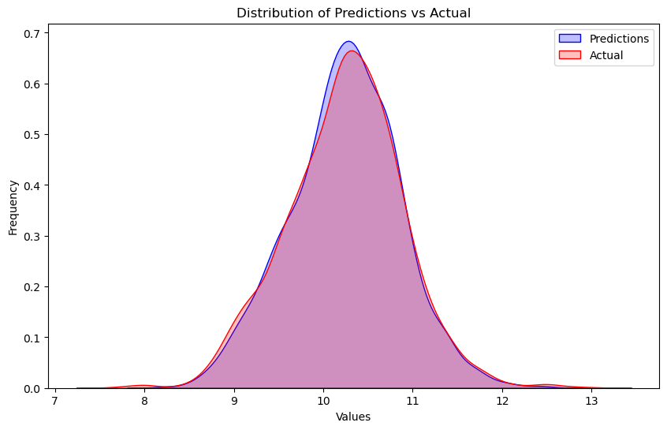
Результаты
‹#›

Slide 15
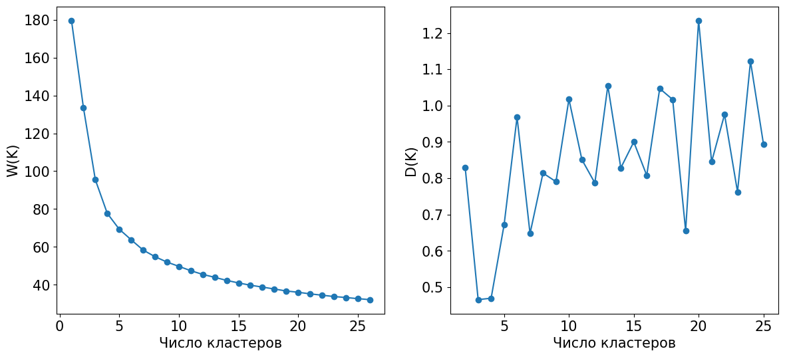
Кластеризация
‹#›

Slide 16
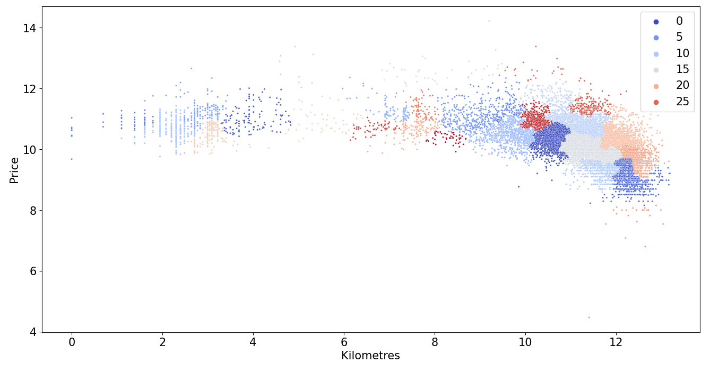
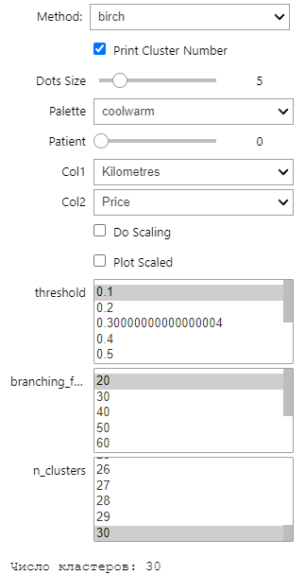
Кластеризация
‹#›

Slide 17
Ссылки
Датасет:
Github:
Kaggle - Australian Vehicle Prices
YukiTheKilla/ML
‹#›

Slide 18
Спасибо за внимание
‹#›

Slide 19



