Slide 1
INTRODUCTION TO
SYSTEMS ANALYSIS AND DESIGN:
AN AGILE, ITERATIVE APPROACH
SATZINGER | JACKSON | BURD
Chapter 2
CHAPTER 2

Slide 2
Investigating System Requirements
Chapter 2
Introduction to Systems
Analysis and Design:
An Agile, Iteractive Approach
6th Ed
Satzinger, Jackson & Burd
© 2012 Cengage Learning. All Rights Reserved. This edition is intended for use outside of the U.S. only, with content that may be different from the U.S. Edition.
May not be scanned, copied, duplicated, or posted to a publicly accessible website, in whole or in part.
Notes:
调查系统需求

Slide 3
Chapter 2 Outline
The RMO Consolidated Sales and Marketing System Project（RMO综合销售项目）
Systems Analysis Activities（系统分析活动）
What Are Requirements?（什么是需求）
Models and Modeling（模型和建模）
Stakeholders（利益相关者）
Information-Gathering Techniques（信息收集技术）
Documenting Workflows with Activity Diagrams（用活动图记录工作流）
Introduction to Systems Analysis and Design, 6th Edition
© 2012 Cengage Learning. All Rights Reserved. This edition is intended for use outside of the U.S. only, with content that may be different from the U.S. Edition.
May not be scanned, copied, duplicated, or posted to a publicly accessible website, in whole or in part.
Notes:
本章提纲
RMO综合销售和市场营销系统项目
系统分析活动
什么是需求
模型和建模
利益相关者
信息收集技术
用活动图记录工作流

Slide 4
Learning Objectives
Describe the activities of systems analysis（描述系统分析的活动）
Explain the difference between functional and nonfunctional requirements（解释功能性需求和非功能性需求之间的区别）
Describe the role of models in systems analysis（描述模型在系统分析中的作用）
© 2012 Cengage Learning. All Rights Reserved. This edition is intended for use outside of the U.S. only, with content that may be different from the U.S. Edition.
May not be scanned, copied, duplicated, or posted to a publicly accessible website, in whole or in part.
Notes:
本章目标：
描述系统分析的活动
解释功能性需求和非功能性需求之间的区别
描述模型在系统分析中的作用
识别并理解不同类型的利益相关者及其对需求定义的贡献
描述信息收集技术，并确定每种技术的最佳应用时机
开发活动图来建模工作流

Slide 5
Learning Objectives
Identify and understand different kinds of stakeholders and their contributions to requirements definition（利益相关者对需求的不同贡献）
Describe information-gathering techniques and determine when each is best applied（信息收集技术）
Develop activity diagrams to model workflows（开发活动图，建模工作流）
© 2012 Cengage Learning. All Rights Reserved. This edition is intended for use outside of the U.S. only, with content that may be different from the U.S. Edition.
May not be scanned, copied, duplicated, or posted to a publicly accessible website, in whole or in part.
Notes:
本章目标：
描述系统分析的活动
解释功能性需求和非功能性需求之间的区别
描述模型在系统分析中的作用
识别并理解不同类型的利益相关者及其对需求定义的贡献
描述信息收集技术，并确定每种技术的最佳应用时机
开发活动图来建模工作流

Slide 6
Chapter 2 Outline
The RMO Consolidated Sales and Marketing System Project（RMO综合销售和市场营销系统项目）
Systems Analysis Activities
What Are Requirements?
Models and Modeling
Stakeholders
Information-Gathering Techniques
Documenting Workflows with Activity Diagrams
Introduction to Systems Analysis and Design, 6th Edition
© 2012 Cengage Learning. All Rights Reserved. This edition is intended for use outside of the U.S. only, with content that may be different from the U.S. Edition.
May not be scanned, copied, duplicated, or posted to a publicly accessible website, in whole or in part.
Notes:
第一部分：RMO综合销售和市场营销系统项目

Slide 7
RMO Existing Application Architecture（RMO现有结构）
Supply Chain Management (SCM)
5 years old; Java/Oracle
Tradeshow system will interface with SCM
Phone/Mail Order System
12 years old; Visual Studio/SQL
Reached capacity;
Retail Store System
Older package solution;
Customer Support System (CSS)
Web based system; evolved over the years, mainly support phone/mail orders
问题：供应链的管理方式发生变化
问题：购物方式发生变化
问题：购物模式发生变化
问题：顾客需求发生变化
© 2012 Cengage Learning. All Rights Reserved. This edition is intended for use outside of the U.S. only, with content that may be different from the U.S. Edition.
May not be scanned, copied, duplicated, or posted to a publicly accessible website, in whole or in part.
Notes:
RMO现有应用程序体系结构
供应链管理(SCM)
使用5年;Java /Oracle
展会系统将与供应链交互
电话/邮购系统
使用12年;Visual Studio/SQL
达到最大产能；
零售商店
系统旧包解决方案;最小的集成
客户支援系统(CSS)
基于Web的系统;
经过多年的发展，主要支持电话/邮购

Slide 8
New Consolidated Sales and Marketing System (CSMS，新的市场推广系统)
Sales Subsystem（销售子系统）
Integrates online, phone, and retail stores
Order Fulfillment Subsystem（订单实施子系统）
Track shipments, rate products and services
Customer Account Subsystem（顾客账务子系统）
Shopping history, linkups, “mountain bucks” rewards
Marketing Subsystem（市场营销子系统）
Promotional packages, partner relationships, more complete merchandise information and reporting
© 2012 Cengage Learning. All Rights Reserved. This edition is intended for use outside of the U.S. only, with content that may be different from the U.S. Edition.
May not be scanned, copied, duplicated, or posted to a publicly accessible website, in whole or in part.
Notes:
新的综合销售及市场推广系统(CSMS)
销售子系统：集成在线，电话和零售商店
订单实施子系统：跟踪发货，评估产品和服务
顾客账务子系统：购物记录，“山鹿”积分
市场营销子系统：促销套餐，合作伙伴关系，更完整的商品信息和报告

Slide 9
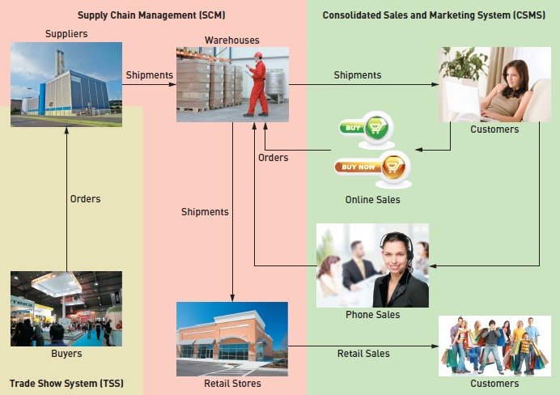
Proposed Application Architecture: Integrate SCM and New CSMS
© 2012 Cengage Learning. All Rights Reserved. This edition is intended for use outside of the U.S. only, with content that may be different from the U.S. Edition.
May not be scanned, copied, duplicated, or posted to a publicly accessible website, in whole or in part.
Notes:
TSS 贸易展系统
供应链管理 （SCM）
综合销售及市场推广系统(CSMS)

Slide 10
Chapter 2 Outline
The RMO Consolidated Sales and Marketing System Project
Systems Analysis Activities（系统分析活动）
What Are Requirements?
Models and Modeling
Stakeholders
Information-Gathering Techniques
Documenting Workflows with Activity Diagrams
Introduction to Systems Analysis and Design, 6th Edition
© 2012 Cengage Learning. All Rights Reserved. This edition is intended for use outside of the U.S. only, with content that may be different from the U.S. Edition.
May not be scanned, copied, duplicated, or posted to a publicly accessible website, in whole or in part.
Notes:
第二部分：系统分析活动

Slide 11
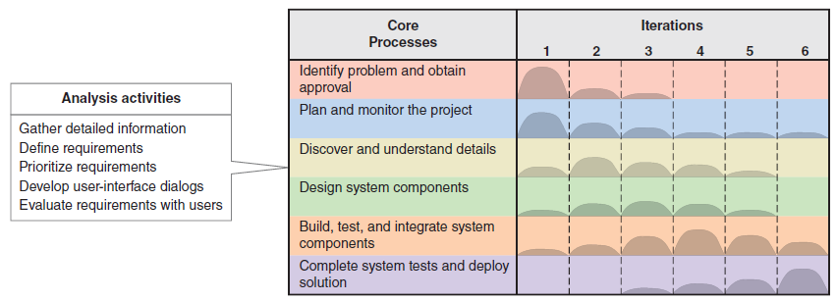
Systems Analysis Activities Involve discovery and understanding
© 2012 Cengage Learning. All Rights Reserved. This edition is intended for use outside of the U.S. only, with content that may be different from the U.S. Edition.
May not be scanned, copied, duplicated, or posted to a publicly accessible website, in whole or in part.
Notes:
系统分析活动
包括发现和理解

Slide 12
Systems Analysis Activities
Gather Detailed Information（收集信息）
Interviews, questionnaires, documents, observing business processes, researching vendors, comments and suggestions
Define Requirements（定义需求）
Modeling functional requirements and non-functional requirements
Prioritize Requirements（优先需求）
Essential, important, vs. nice to have
Develop User-Interface Dialogs（用户界面对话框）
Flow of interaction between user and system
Evaluate Requirements with Users（与用户评估需求）
User involvement, feedback, adapt to changes
© 2012 Cengage Learning. All Rights Reserved. This edition is intended for use outside of the U.S. only, with content that may be different from the U.S. Edition.
May not be scanned, copied, duplicated, or posted to a publicly accessible website, in whole or in part.
Notes:
收集详细信息 访谈，问卷调查，文件，观察业务流程，研究供应商，评论和建议
定义需求 对功能需求和非功能需求进行建模
优先考虑需求 必不可少的，重要的 vs 提升功能性（有很好，没有影响不大）
开发用户界面对话框 用户和系统之间的交互流程
与用户一起评估需求 用户参与，反馈，适应变化

Slide 13
Chapter 2 Outline
The RMO Consolidated Sales and Marketing System Project
Systems Analysis Activities
What Are Requirements?（什么是需求）
Models and Modeling
Stakeholders
Information-Gathering Techniques
Documenting Workflows with Activity Diagrams
Introduction to Systems Analysis and Design, 6th Edition
© 2012 Cengage Learning. All Rights Reserved. This edition is intended for use outside of the U.S. only, with content that may be different from the U.S. Edition.
May not be scanned, copied, duplicated, or posted to a publicly accessible website, in whole or in part.
Notes:
第三部分：什么是需求

Slide 14
What Are Requirements?
System Requirements（系统需求） =
Functional requirements（功能需求）
Non-functional requirements（非功能需求）
Functional Requirements（功能需求）– the activities the system must perform（系统必须执行的活动）
Business uses, functions the users carry out
Use cases in Chapter 1
Non-Functional Requirements– other system characteristics（非功能需求——其他系统特征）
Constraints and performance goals
Introduction to Systems Analysis and Design, 6th Edition
© 2012 Cengage Learning. All Rights Reserved. This edition is intended for use outside of the U.S. only, with content that may be different from the U.S. Edition.
May not be scanned, copied, duplicated, or posted to a publicly accessible website, in whole or in part.
Notes:
系统要求=
功能需求 非功能性需求
功能需求——系统必须执行的活动 业务用途、功能由用户执行 第1章中的用例
非功能需求-其他系统特征 约束和性能目标

Slide 15
FURPS+ Requirements Acronym 识别和分类需求的方法——FURPS+
Functional requirements（功能需求）
Usability requirements（可用性需求）
Reliability requirements（可靠性需求）
Performance requirements（性能需求）
Security requirements（安全需求）
+ even more categories…
© 2012 Cengage Learning. All Rights Reserved. This edition is intended for use outside of the U.S. only, with content that may be different from the U.S. Edition.
May not be scanned, copied, duplicated, or posted to a publicly accessible website, in whole or in part.
Notes:
用架构来识别和分类需求是一种常见方法，最常见的方法称为FURPS+
功能需求
可用性需求
可靠性要求
性能需求
安全需求
+更多类别…

Slide 16
FURPS+ Requirements Acronym
可用性
可靠性
性能
安全
设计限制
开发
接口
物理层
支持
© 2012 Cengage Learning. All Rights Reserved. This edition is intended for use outside of the U.S. only, with content that may be different from the U.S. Edition.
May not be scanned, copied, duplicated, or posted to a publicly accessible website, in whole or in part.
Notes:
功能类别 FRPS+类别 例子
功能性需求 功能性需求 业务规则和流程
非功能性需求 可用性 用户界面，易用性
可靠性 故障率，恢复方法
效能 响应时间，吞吐率
安全 访问控制，加密
+设计限制 硬件条件和软件条件
开发 开发工具，协议
接口 数据交互格式
物理层 大小，重量，能量要求
支持 安装和更新

Slide 17
Chapter 2 Outline
The RMO Consolidated Sales and Marketing System Project
Systems Analysis Activities
What Are Requirements?
Models and Modeling（模型和建模）
Stakeholders
Information-Gathering Techniques
Documenting Workflows with Activity Diagrams
Introduction to Systems Analysis and Design, 6th Edition
© 2012 Cengage Learning. All Rights Reserved. This edition is intended for use outside of the U.S. only, with content that may be different from the U.S. Edition.
May not be scanned, copied, duplicated, or posted to a publicly accessible website, in whole or in part.
Notes:
模型和建模

Slide 18
Models and Modeling
How to represent the requirements?如何表示需求
Model– a representation of some aspect of the system being built
Types of Models（模型类型）
Textual model（文本）– something written down, described
Graphical models（图形）– diagram, schematic
Mathematical models（数学公式）– formulas, statistics, algorithms
Unified Modeling Language (UML，统一建模语言)
Standard graphical modeling symbols/terminology used for information systems
© 2012 Cengage Learning. All Rights Reserved. This edition is intended for use outside of the U.S. only, with content that may be different from the U.S. Edition.
May not be scanned, copied, duplicated, or posted to a publicly accessible website, in whole or in part.
Notes:
如何表示需求?
模型——正在构建的系统的某些方面的表示
模型类型
文本模型-写下来，描述的东西
图形模型。图解、示意图
数学模型-公式，统计，算法
统一建模语言(UML) 用于信息系统的标准图形建模符号/术语

Slide 19
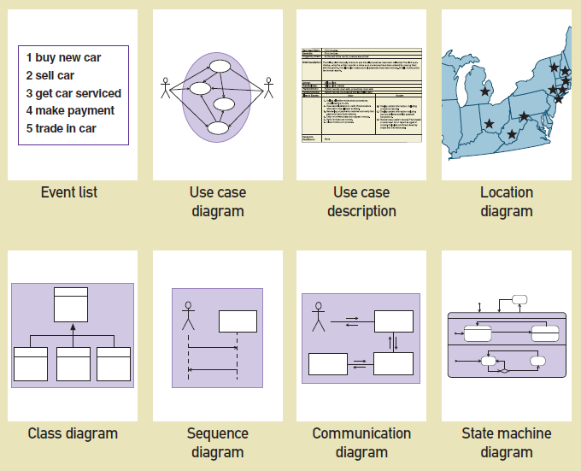
Some Analysis and Design Models
© 2012 Cengage Learning. All Rights Reserved. This edition is intended for use outside of the U.S. only, with content that may be different from the U.S. Edition.
May not be scanned, copied, duplicated, or posted to a publicly accessible website, in whole or in part.
Notes:
一些分析和设计模型
事件列表 用例图 用例描述 位置图
类图 顺序图 通信图 状态机图

Slide 20
Reasons for Modeling （建模的原因）
Learning from the modeling process（从建模过程中学习）
Reducing complexity by abstraction（通过抽象降低复杂性）
Remembering all the details（记住所有的细节）
Communicating with other development team members（与其他成员/相关人员沟通）
Documenting what was done for future maintenance/enhancement（维护、记录）
© 2012 Cengage Learning. All Rights Reserved. This edition is intended for use outside of the U.S. only, with content that may be different from the U.S. Edition.
May not be scanned, copied, duplicated, or posted to a publicly accessible website, in whole or in part.
Notes:
建模的原因：
从建模过程中学习
通过抽象降低复杂性
记住所有的细节
与其他开发团队成员沟通
与各种用户和相关人员进行沟通
为将来的维护/增强记录所做的工作

Slide 21
Chapter 2 Outline
The RMO Consolidated Sales and Marketing System Project
Systems Analysis Activities
What Are Requirements?
Models and Modeling
Stakeholders（利益相关者）
Information-Gathering Techniques
Documenting Workflows with Activity Diagrams
Introduction to Systems Analysis and Design, 6th Edition
© 2012 Cengage Learning. All Rights Reserved. This edition is intended for use outside of the U.S. only, with content that may be different from the U.S. Edition.
May not be scanned, copied, duplicated, or posted to a publicly accessible website, in whole or in part.
Notes:
利益相关者

Slide 22
Stakeholders Who do you involve and talk to?
Stakeholders（利益相关者）– persons who have an interest in the successful implementation of the system
Internal Stakeholders（内部利益相关者）– persons within the organization
External stakeholders（外部利益相关者） – persons outside the organization
Operational stakeholders （操作相关者）– persons who regularly interact with the system
Executive stakeholders（执行相关者）– persons who don’t directly interact, but use the information or have financial interest
© 2012 Cengage Learning. All Rights Reserved. This edition is intended for use outside of the U.S. only, with content that may be different from the U.S. Edition.
May not be scanned, copied, duplicated, or posted to a publicly accessible website, in whole or in part.
Notes:
利益相关者
利益相关者-对系统的成功实施有兴趣的人
内部利益相关者——组织内部的人（管理人员）
外部利益相关者——组织外部的人（客户）
操作相关者-定期与系统互动的人（管理人员）
执行相关者——不直接互动，但使用信息或有经济利益的人

Slide 23
Stakeholders of a comprehensive accounting system for public company
© 2012 Cengage Learning. All Rights Reserved. This edition is intended for use outside of the U.S. only, with content that may be different from the U.S. Edition.
May not be scanned, copied, duplicated, or posted to a publicly accessible website, in whole or in part.
Notes:
例子：上市公司会计系统的利益相关者
内部-操作相关者：出纳，会计，内部审计师
内部-执行相关者：高级经理，董事会
Both：业务经理
外部-操作相关者：合作伙伴组织；客户
外部-执行相关者：投资者，监管机构
Both：外部审计师

Slide 24
Stakeholders For RMO CSMS Project
Phone/mail sales order clerks（电话/邮件订单员）
Warehouse and shipping personnel（仓库运输人员）
Marketing personnel who maintain online catalog information（维护在线目录的营销人员）
Marketing, sales, and financial managers（市场营销）
Senior executives（高级管理人员）
Customers（客户）
External shippers (e.g., UPS and FedEx)（外部托运人）
© 2012 Cengage Learning. All Rights Reserved. This edition is intended for use outside of the U.S. only, with content that may be different from the U.S. Edition.
May not be scanned, copied, duplicated, or posted to a publicly accessible website, in whole or in part.
Notes:
RMO csmS项目的相关者
电话/邮件销售订单员
仓库和运输人员
维护在线目录信息的营销人员
市场营销、销售和财务经理
高级管理人员
客户
外部托运人(如UPS和FedEx)

Slide 25
Stakeholders For RMO CSMS Project
Operational
Executive
Order clerks
Warehouse and shipping personnel
Marketing personnel who maintain online catalog information
Marketing, sales, and financial managers
Senior executives
Customers
External shippers (e.g., UPS and FedEx)
Marketing personnel who maintain online catalog information
Senior executives
Internal
Warehouse and shipping personnel
Marketing, sales, and financial managers
Order clerks
External shippers
Customers
External
Notes:
订单订购人员
仓库和运送人员
维护在线目录信息的营销人员
营销、销售、会计和财政经理
高级管理员
消费者
外部运送人员（例如UPS和FedEx）

Slide 26
RMO Internal Stakeholders
© 2012 Cengage Learning. All Rights Reserved. This edition is intended for use outside of the U.S. only, with content that may be different from the U.S. Edition.
May not be scanned, copied, duplicated, or posted to a publicly accessible website, in whole or in part.
Notes:
首席CEO
经营和分销副总裁
市场营销和销售副总裁
财务和系统副总裁

Slide 27
Chapter 2 Outline
The RMO Consolidated Sales and Marketing System Project
Systems Analysis Activities
What Are Requirements?
Models and Modeling
Stakeholders
Information-Gathering Techniques（信息收集技术）
Documenting Workflows with Activity Diagrams
Introduction to Systems Analysis and Design, 6th Edition
© 2012 Cengage Learning. All Rights Reserved. This edition is intended for use outside of the U.S. only, with content that may be different from the U.S. Edition.
May not be scanned, copied, duplicated, or posted to a publicly accessible website, in whole or in part.
Notes:
信息收集技术

Slide 28
Information Gathering Techniques
Interviewing users and other stakeholders（采访用户和其他利益相关者）
Distributing and collecting questionnaires（发放问卷）
Reviewing inputs, outputs, and documentation（审查输入、输出和文档）
Observing and documenting business procedures（观察和记录业务流程）
Researching vendor solutions（研究供应商解决方案）
Collecting active user comments and suggestions（收集活跃用户的意见和建议）
© 2012 Cengage Learning. All Rights Reserved. This edition is intended for use outside of the U.S. only, with content that may be different from the U.S. Edition.
May not be scanned, copied, duplicated, or posted to a publicly accessible website, in whole or in part.
Notes:
采访用户和其他利益相关者
发放及收集问卷
审查输入、输出和文档
观察和记录业务流程
研究供应商解决方案
收集活跃用户的意见和建议

Slide 29
Interviewing Users and Other Stakeholders （采访用户）
Prepare detailed questions（准备详细的问题）
Obtain and discuss answers to the questions（讨论并获取答案）
Document the answers（整理答案）
Follow up as needed in future meetings or interviews（后续跟进）
© 2012 Cengage Learning. All Rights Reserved. This edition is intended for use outside of the U.S. only, with content that may be different from the U.S. Edition.
May not be scanned, copied, duplicated, or posted to a publicly accessible website, in whole or in part.
Notes:
方式1：采访用户和其他利益相关者
准备详细的问题
与用户个人或群体会面
获取并讨论问题的答案
记录答案
在以后的会议或面试中跟进

Slide 30
Themes for Information Gathering Questions
© 2012 Cengage Learning. All Rights Reserved. This edition is intended for use outside of the U.S. only, with content that may be different from the U.S. Edition.
May not be scanned, copied, duplicated, or posted to a publicly accessible website, in whole or in part.
Notes:
主题 给用户的提问
业务操作和流程是什么 你做什么？
这些操作如何完成 你如何做这个业务？遵循什么步骤？还有什么不同的操作方法？
完成这些操作哪些信息是需要的？ 你需要什么信息？你需要什么输入？你产生什么输出？

Slide 31
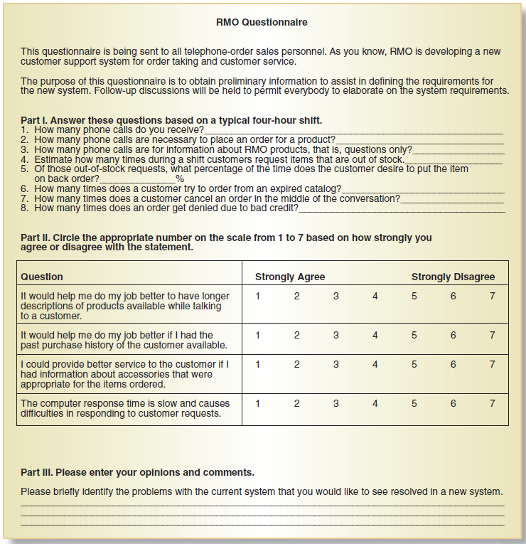
Distribute and Collect Questionnaires
© 2012 Cengage Learning. All Rights Reserved. This edition is intended for use outside of the U.S. only, with content that may be different from the U.S. Edition.
May not be scanned, copied, duplicated, or posted to a publicly accessible website, in whole or in part.
Notes:
方式2：派发及收集问卷
例子：
这个问卷被发给电话订单销售。
第一部分：根据一个典型的四小时轮班来回答这些问题
你收到多少订购电话？
订购一个产品需要打几次电话？

Slide 32
Review Inputs, Outputs, and Procedures
© 2012 Cengage Learning. All Rights Reserved. This edition is intended for use outside of the U.S. only, with content that may be different from the U.S. Edition.
May not be scanned, copied, duplicated, or posted to a publicly accessible website, in whole or in part.
Notes:
审核输入、输出和过程
姓名，地址，电话，是否是礼物，如果是礼物需不需要留message
付款的方式：信用卡，支票，礼品卡
税额计算，运输方式

Slide 33
Additional Techniques
Observe and Document Business Processes（观察和记录业务流程）
Watch and learn
Document with Activity diagram (next section)
Research Vendor Solutions（研究供应商解决方案）
See what others have done for similar situations
White papers, vendor literature, competitors
Collect Active User Comments and Suggestions（收集用户反馈）
Feedback on models and tests
Users know it when the see it
© 2012 Cengage Learning. All Rights Reserved. This edition is intended for use outside of the U.S. only, with content that may be different from the U.S. Edition.
May not be scanned, copied, duplicated, or posted to a publicly accessible website, in whole or in part.
Notes:
其他方式：
观察和记录业务流程 观察和学习 带有活动图的文档(下一节)
研究供应商解决方案 看看其他人在类似情况下是怎么做的 白皮书、供应商文献、竞争对手
收集活跃用户的意见和建议 对模型和测试的反馈 用户看到它就知道了

Slide 34
Chapter 2 Outline
The RMO Consolidated Sales and Marketing System Project
Systems Analysis Activities
What Are Requirements?
Models and Modeling
Stakeholders
Information-Gathering Techniques
Documenting Workflows with Activity Diagrams（用活动图记录工作流）
Introduction to Systems Analysis and Design, 6th Edition
© 2012 Cengage Learning. All Rights Reserved. This edition is intended for use outside of the U.S. only, with content that may be different from the U.S. Edition.
May not be scanned, copied, duplicated, or posted to a publicly accessible website, in whole or in part.
Notes:
用活动图记录工作流

Slide 35
Documenting Workflows with Activity Diagrams
Workflow（工作流）– sequence of processing steps that completely handles one business transaction or customer request（完成处理一个业务的一系列处理步骤）
Activity Diagram（活动图）– describes user (or system) activities, the person who does each activity, and the sequential flow of these activities
Useful for showing a graphical model of a workflow（用于显示工作流的图形化模型）
A UML diagram
© 2012 Cengage Learning. All Rights Reserved. This edition is intended for use outside of the U.S. only, with content that may be different from the U.S. Edition.
May not be scanned, copied, duplicated, or posted to a publicly accessible website, in whole or in part.
Notes:
工作流——完成处理一个业务事务或客户请求的一系列处理步骤
活动图——描述用户(或系统)活动、执行每个活动的人员以及这些活动的顺序流
用于显示工作流的图形化模型
UML图

Slide 36
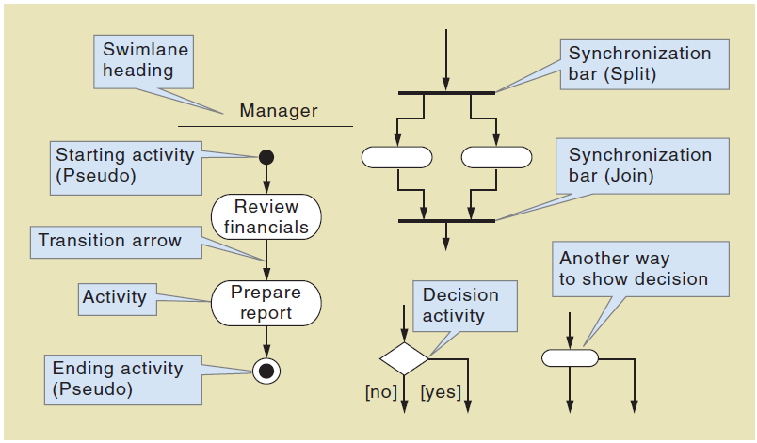
Activity Diagrams Symbols
© 2012 Cengage Learning. All Rights Reserved. This edition is intended for use outside of the U.S. only, with content that may be different from the U.S. Edition.
May not be scanned, copied, duplicated, or posted to a publicly accessible website, in whole or in part.
Notes:
泳道标题
开始活动
转移箭头
活动
结束活动
----------------------
同步条
决策活动

Slide 37
Activity Diagram with Concurrent Paths
对每个item都执行
并行操作一般成对出现，有开始有结束
© 2012 Cengage Learning. All Rights Reserved. This edition is intended for use outside of the U.S. only, with content that may be different from the U.S. Edition.
May not be scanned, copied, duplicated, or posted to a publicly accessible website, in whole or in part.
Notes:
具有并发路径的活动图
销售 （接受订单） 设计（技术参数） 采购（购买材料） 制作（控制计算机） 行程安排（安排生产）

Slide 38
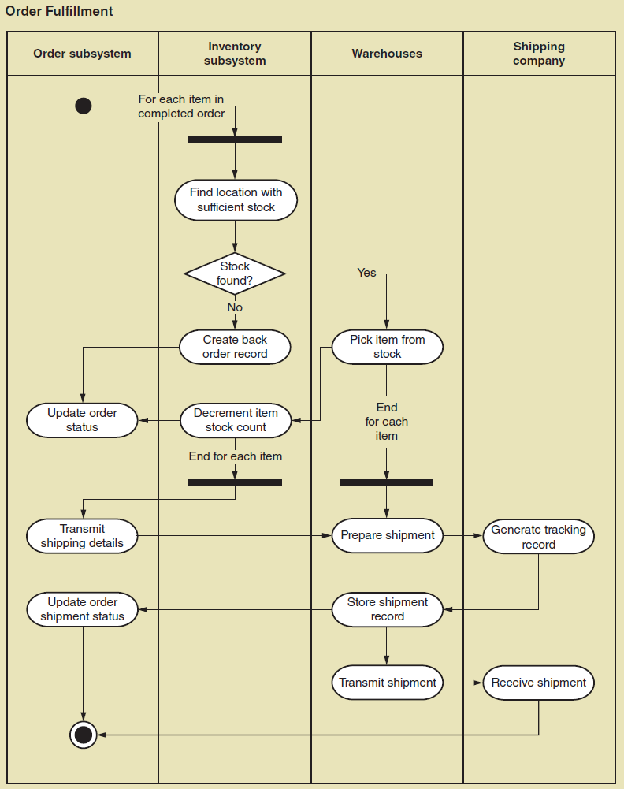
Activity Diagram for RMO Order Fulfillment
© 2012 Cengage Learning. All Rights Reserved. This edition is intended for use outside of the U.S. only, with content that may be different from the U.S. Edition.
May not be scanned, copied, duplicated, or posted to a publicly accessible website, in whole or in part.
Notes:
RMO订单履行的活动图
订单系统 库存系统 仓库 运输公司

Slide 39

主观题
10分
Please analyze the process of ordering a delivery(外卖) from a restaurant website, and then draw an Activity Diagram in UML to reasonably show this process.
正常使用主观题需2.0以上版本雨课堂
作答
Notes:
请分析从一家餐厅网站订购外卖(外卖)的过程，然后用UML绘制一个活动图来合理地展示这个过程

Slide 40
Order subsystem
Restaurant
Subsystem
Shipping
Subsystem
For each item in
Completed order
Check the order
Show the problem
Y
Any problem?
N
Give feedback
Process the order
Update order status
Prepare shipment
Update
tracking records
Update order status
Update order status
N
Receive the order?
Check the feedback
Y
Update order status
Update order status

Slide 41
Learning Objectives
Describe the activities of systems analysis（描述系统分析的活动）
Explain the difference between functional and nonfunctional requirements（解释功能性需求和非功能性需求之间的区别）
Describe the role of models in systems analysis（描述相关者对需求定义的贡献）
© 2012 Cengage Learning. All Rights Reserved. This edition is intended for use outside of the U.S. only, with content that may be different from the U.S. Edition.
May not be scanned, copied, duplicated, or posted to a publicly accessible website, in whole or in part.
Notes:
描述系统分析的活动
解释功能性需求和非功能性需求之间的区别
描述模型在系统分析中的作用
识别并理解不同类型的相关者及其对需求定义的贡献
描述信息收集技术，并确定每种技术的最佳应用时机
开发活动图来建模工作流

Slide 42
Learning Objectives
Identify and understand different kinds of stakeholders and their contributions to requirements definition（不同相关者对需求定义均有贡献）
Describe information-gathering techniques and determine when each is best applied（信息收集技术）
Develop activity diagrams to model workflows（开发活动图来建模工作流）
© 2012 Cengage Learning. All Rights Reserved. This edition is intended for use outside of the U.S. only, with content that may be different from the U.S. Edition.
May not be scanned, copied, duplicated, or posted to a publicly accessible website, in whole or in part.
Notes:
描述系统分析的活动
解释功能性需求和非功能性需求之间的区别
描述模型在系统分析中的作用
识别并理解不同类型的相关者及其对需求定义的贡献
描述信息收集技术，并确定每种技术的最佳应用时机
开发活动图来建模工作流

Slide 43
Summary
Systems analysis involves defining system requirements– functional and non-functional
Analysis activities include（分析活动包括）
Gather detailed information（收集信息）
Define requirements（定义需求）
Prioritize requirements（优先需求）
Develop user-interface dialogs（用户界面）
Evaluate requirements with users（评估需求）
FURPS+ is the acronym for functional, usability, reliability, performance, and security requirements
© 2012 Cengage Learning. All Rights Reserved. This edition is intended for use outside of the U.S. only, with content that may be different from the U.S. Edition.
May not be scanned, copied, duplicated, or posted to a publicly accessible website, in whole or in part.
Notes:
系统分析包括定义系统需求——功能性和非功能性
分析活动包括
收集详细信息 定义需求 优先考虑需求 开发用户界面对话框 与用户一起评估需求
FURPS+是功能、可用性、可靠性、性能和安全需求的缩写

Slide 44
Summary
Models and modeling are used to explore and document requirements（模型和建模用于探索和记录需求）
A model represents some aspect of a system, and can include textual, graphical, and mathematical models（模型包括文本、图形、数据模型）
Unified Modeling Language (UML) is the standard set of notations and terminology for information systems models（统一建模语言UML是标准集合）
© 2012 Cengage Learning. All Rights Reserved. This edition is intended for use outside of the U.S. only, with content that may be different from the U.S. Edition.
May not be scanned, copied, duplicated, or posted to a publicly accessible website, in whole or in part.
Notes:
模型和建模用于探索和记录需求
模型表示系统的某些方面，可以包括文本模型、图形模型和数学模型
统一建模语言(UML)是用于信息系统模型的符号和术语的标准集合

Slide 45
Summary
Stakeholders are the people who have an interest in the success of the project（利益相关人是对项目成功感兴趣的人）
There are internal vs. external stakeholders（内部vs外部相关者） and operational vs. executive stakeholders（运营vs执行相关者）
Information gathering techniques are used to collect information about the project（信息收集）
Interviews, questionnaires, reviewing documents, observing business processes, researching vendors, comments and suggestions（访谈、问卷、文件、观察业务流程等）
© 2012 Cengage Learning. All Rights Reserved. This edition is intended for use outside of the U.S. only, with content that may be different from the U.S. Edition.
May not be scanned, copied, duplicated, or posted to a publicly accessible website, in whole or in part.
Notes:
利益相关人是对项目的成功感兴趣的人
有内部利益相关者与外部利益相关者，运营利益相关者与执行利益相关者
信息收集技术用于收集有关项目的信息 访谈，问卷调查，审查文件，观察业务流程，研究供应商，提出意见和建议
UML活动图用于在收集信息后记录(建模)工作流

