Slide 1
Analyzing Food Security Indicators: Clustering & Forecasting
Classroom project using machine learning (KMeans, LSTM, CNN) to study FAO food security data.

Slide 2
Abstract
We use FAO’s Suite of Food Security Indicators to group countries and forecast trends.
Clustering: Unsupervised KMeans groups countries with similar food security profiles .
Forecasting: LSTM and CNN models predict future values of key indicators (e.g., availability, access) using time-series data .
Goal: Identify patterns and predict changes to help inform hunger relief efforts.

Slide 3
Motivation
Ending hunger is a global priority (UN SDG2: end hunger by 2030) . Yet 790+ million people still face hunger worldwide .
The FAO compiles food security metrics to track progress . Analyzing this data helps spot trends and target aid.
Data science (clustering & forecasting) can reveal hidden patterns and anticipate future challenges.
Our work aims to support these efforts by summarizing indicator data and making short-term predictions.

Slide 4
Research Questions
Clustering: Which countries have similar food security indicator profiles? How many distinct groups (clusters) emerge?
Forecasting: Can we accurately predict key indicators (like Food Consumption Score) for coming years?
Modeling: How well do LSTM and CNN models perform on this data? Which model best captures trends?
Insights: What do cluster characteristics and forecasts tell us about global food security trends?

Slide 5
Dataset
We use FAOSTAT’s Suite of Food Security Indicators, a core set of global metrics on food security . The data covers many countries and multiple indicators across four dimensions (availability, access, utilization, stability). Key features include per-country values of factors like calorie supply, dietary scores, etc.

Slide 6
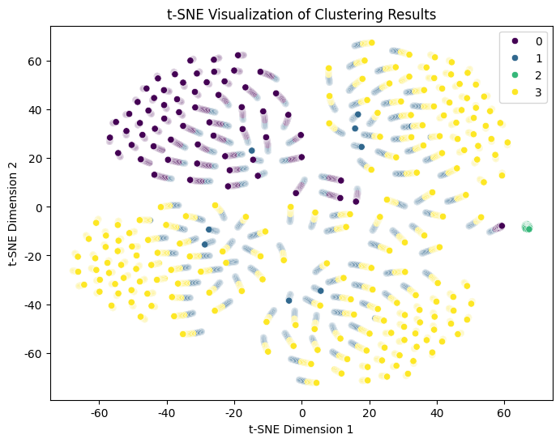
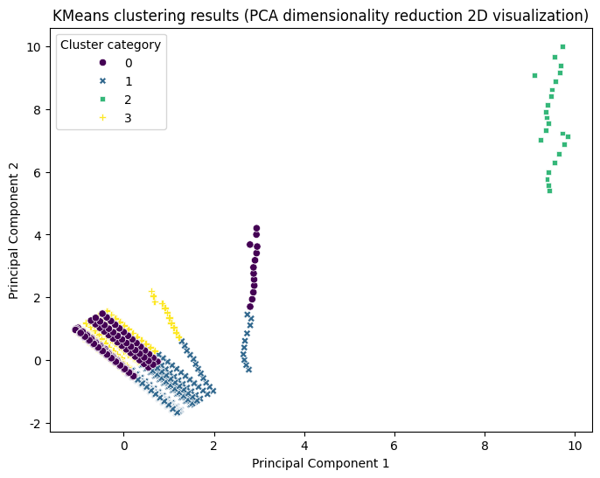
KMeans
This t-SNE visualization confirms that the 4 clusters identified by KMeans remain well-separated after dimensionality reduction. Clusters 0 and 3 exhibit clear distributions, while Cluster 1 shows "transitional" characteristics, and Cluster 2 indicates "outlier" traits. The cluster structure is reliable and interpretable.
The PCA visualization confirms the 4-cluster structure. Clusters 0 and 2 are distinctly separated, while Clusters 1 and 3 exhibit partially overlapping boundaries, indicating some feature similarity.

Slide 7
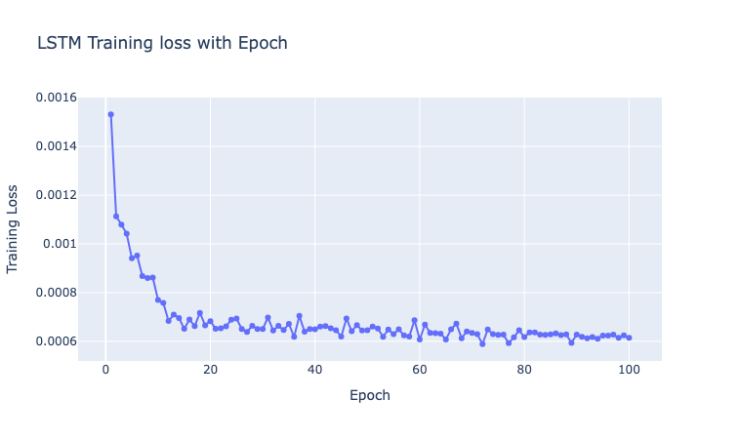
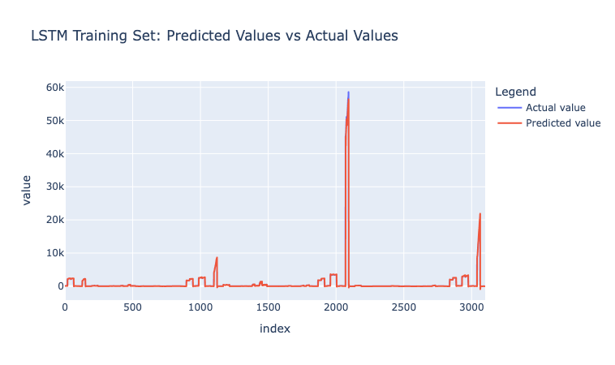
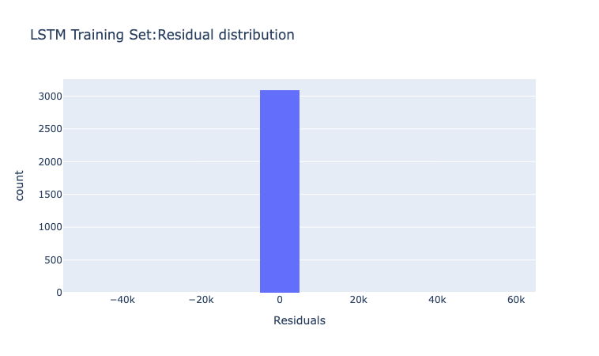
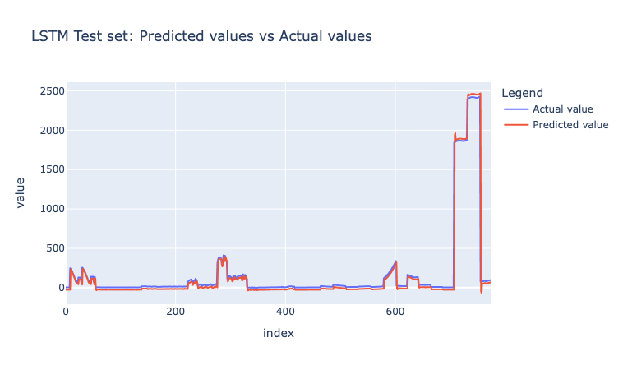
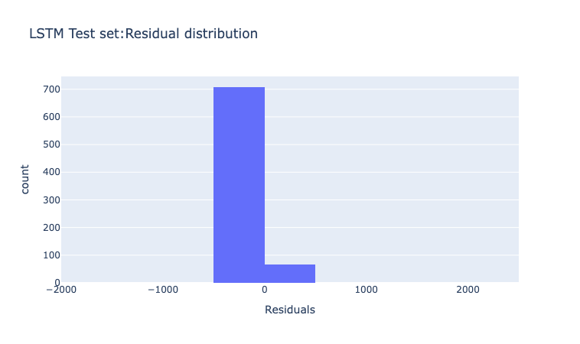
LSTM

Slide 8
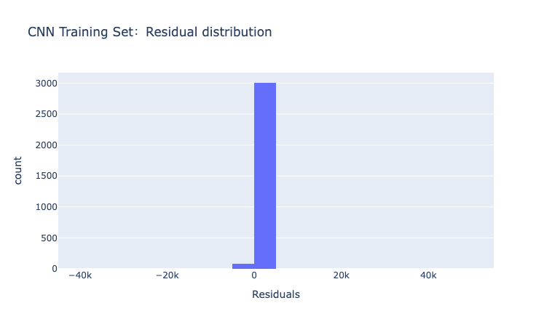
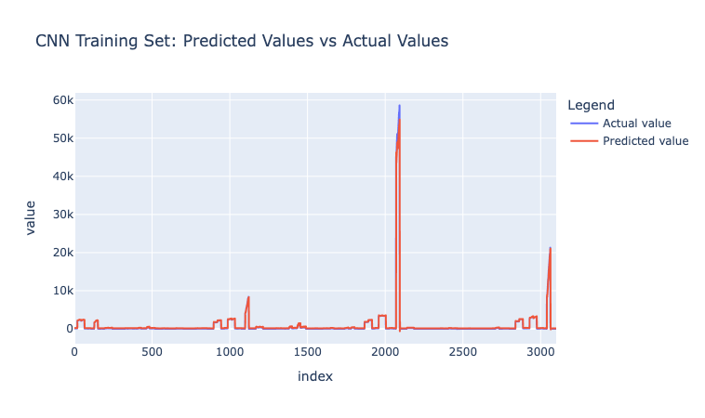
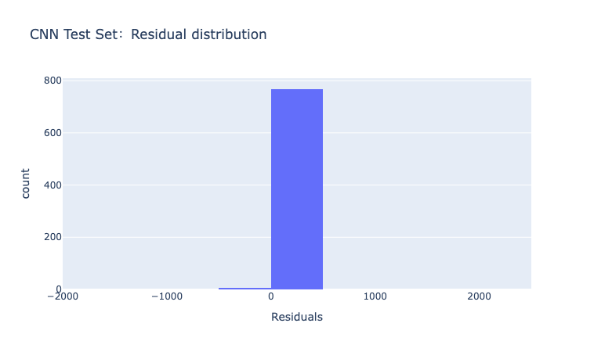
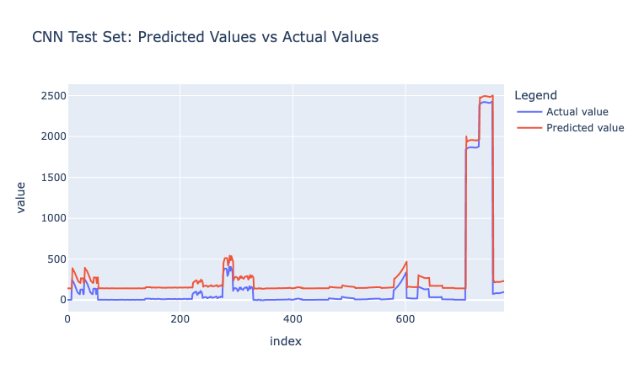
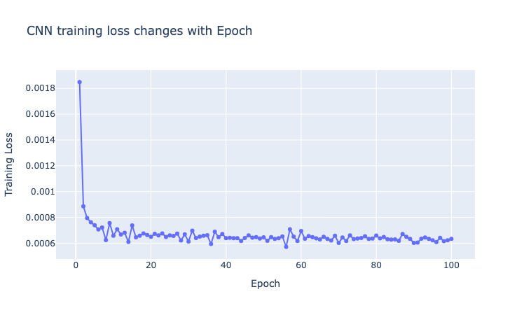
CNN

Slide 9
Conclusion
We successfully clustered countries based on food security indicators and forecasted their future indicator values using LSTM and CNN.
Clustering highlighted groups of countries with similar food security profiles, aiding comparative analysis. Forecast models captured trends in key metrics.

