Slide 1
质量保证与软件测试复习
赵晓琼

Slide 2
基本概念

Slide 3
Basic concept
 | Quality Assurance （QA） | Testing
Orientation | Process/Policy Oriented | Products/Deliverables Oriented
Defect Goals | Prevent Defects | Discover Defects
Means | Audit/ Governance | Kinds of Test Methods
Methodology | Objective | Skill and tech to meet the objective

Slide 4
分类

Slide 5
按照测试方法划分
白盒测试
语句覆盖：
条件覆盖
路径覆盖
……
黑盒测试
等价类法
边界值法
……
灰盒测试

Slide 6
按照测试的粒度或测试的范围
Unit Test
Integration Test
System Test
Acceptance Test
----------------------------------------------
Smoke Test 与 接受
----------------------------------------------
Regression Test 与 退化

Slide 7
按照被测软件的评价标准
功能性测试
性能测试
安全性测试
高可用性测试

Slide 8
α测试和β测试
α测试
开发团队内部测试
针对软件的各个方面进行测试（功能，性能，安全，可移植，可扩展，可用性）
测试方法较多（黑盒，白盒）
测试目标 [0.1，1.0)
β测试
最终用户测试
主要针对功能测试
使用黑盒测试
测试目标为有限的production candidate

Slide 9
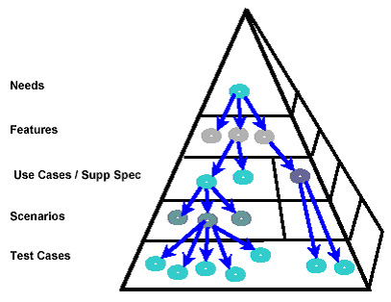
产出物的内在逻辑1：Traceability
文档化是附加产出
也可能是最重要的产出
文档化的逻辑结构呈金字塔型
其内在逻辑叫做Traceability
Notes:
Traceability is a technique that provides a relationship between different levels of requirements in the system. This technique helps you determine the origin of any requirement. The pyramid illustrates how requirements are traced from the top level down. Every need usually maps to a couple of features, and then features map to use cases and supplementary requirements. Use cases describe functional requirements, and supplementary specifications describe non-functional items. In addition, every use case maps to many scenarios. Mapping use cases to scenarios, then, is a one to many relationship. Scenarios map to test cases also in a one to many relationship. Between needs and features, on the other hand, there is many to many mapping.

Slide 10
产出物的内在逻辑2 ：Coverage
 | UC1 |  |  |  | UC2 |  | UC3
TC | MF | AF1 | AF2 | AF3 | MF | AF | MF | AF1 | AF2
TC1.1 | ● |  |  |  | ● |  | ●
TC1.2 | ● |  |  |  | ● |  | ●
TC1.3 |  | ● |  |  | ● |  | ●
TC1.4 |  | ● |  |  | ● |  |  | ●
TC1.5 |  | ● |  |  | ● |  |  |  | ●
TC1.6 |  |  | ● |  | ● |  |  |  | ●
TC1.7 |  |  | ● |  | ●
TC2.1 |  |  | ●
TC2.2 |  |  |  | ●
TC2.3 |  |  |  | ● |  | ●
TC2.4 |  |  |  | ● |  | ●
Notes:
Test coverage is defined as a technique which determines whether and how our test cases are actually covering the application original requirement, and how much requirement is exercised when we run those test cases. Frequently the coverage is measured by percentage.

Slide 11
SDP and V-model

Slide 12
Test Techniques – By Granularity
Unit Test
Integration Test
System & Acceptance Test

Slide 13
按照测试的粒度或测试的范围
RFP
V-Model
Working
System
Req
Study
Proposal
Review
Acceptance
Test Plan
Acceptance
Test
Client
Review
Proposal
Delivered
System
V-Model Documentation
the User Requirements Specification.
（URS）
the System Requirements Specification
（SS）
the System Design Specifications,
（SDS）
Detailed Design Specifications,
（DDS）
Accepted
Proposal
Deliverable
System
System
Analysis
FS
Review
System Test
Plan
System
Test
Certification
Functional
Specifications
Executable
System
Approved
FS
Executable
System
Design
Design
Review
Integration Test
Plan
Integration
Int. Test
Design
Document
Unit Tested
Code
Design
Document
Unit Test
Plan
Unit tested
code
Coding
Code
Inspection
Unit Test
Test
Audit
Inspected
Code
Inspected
Code

Slide 14
V-Model Documentation
Each document produced is associated with pairs of phases in the model.
These are the
(a) Detailed Design Specifications,
(b) the System Design Specifications,
(c) the System Requirements Specification,
(d) the User Requirements Specification.

Slide 15
V-Model Documentation
Requirements Gathering produces the User Requirements Specification (URS), which is both the input to Analysis, and the basis for Acceptance Testing.
Analysis produces the System Specification (SS) – also know as the Software Requirements Specification (SRS) – which is both the input for Software Design, and the basis for System Testing.
Design produces the System Design Specification (SDS), which is both the input for the detailed Specification phase, and the basis for Integration Testing.
The Specification activity produces the Detailed Design Specifications (DDS), which are both used to write the code, and also are the basis for Unit Testing.

Slide 16
V-model Advantages
It is simple and easy to manage due to the rigidity of the model,
It encourages Verification and Validation at all phases:
Each phase has specific deliverables and a review process.
It gives equal weight to testing alongside development rather than treating it as an afterthought.

Slide 17
V-model Disadvantages
Its disadvantages are that similarly to the Waterfall model there is no working software produced until late during the life cycle
It is unsuitable where the requirements are at a moderate to high risk of changing.
It has been suggested too that it is a poor model for long, complex and object-oriented projects

Slide 18
Test process

Slide 19
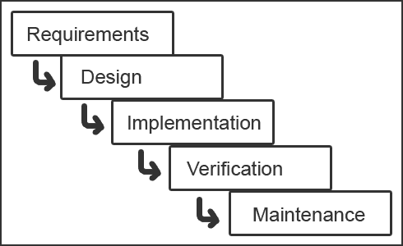
Waterfall

Slide 20
Test process
Test Requirements Analysis
Test Design
Test Delivery
Test Execution
Test Planning
Test Objective
Test Estimation
Test Strategy
Test Process
Test Schedule
Test Requirements
Testability Analysis
Requirement Traceability
Change Control
Issue Tracking
Test Case/Data Design
Automaton Design
Scripts Development
Test Coverage Analysis
Test Case Management
Environment Setup
Development
Smoke Test
Test Execution
Defect Tracking
Test Data Collection
Test Analysis
Improvement Proposal
Test Reporting
Test Package

Slide 21
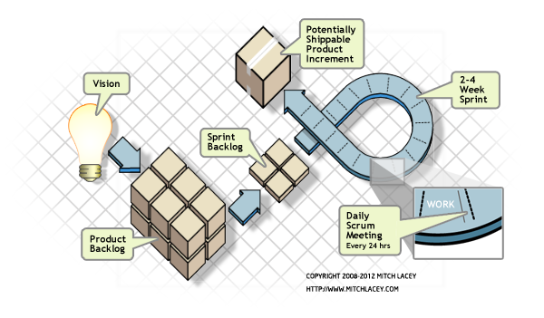
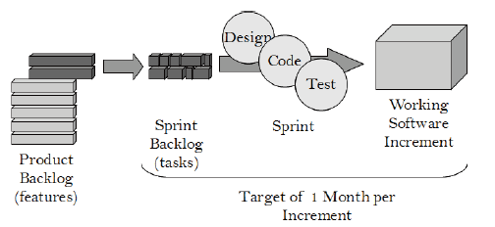
Scrum
Backlog
Sprint
Product increment
Notes:
The QA’s job on the business analysis task are: 1) help business analyst to make the requirement document and test the requirement from the logic aspect; 2) do the team working, knowledge sharing, training, and communication to keep the team’s understanding of the requirement is on the same line.
The QA’s job on the release candidate submission are do the test analysis and finish the report in order to answer the question whether or not the increment of this sprint is qualified to be released to the product environment and supply service to the end user.

Slide 22
全功能提交团队
PM
Technical leader
Developer
Developer
Technical leader
Developer
Developer
QA leader
Tester
Tester
BA
IA
Architecture

Slide 23
常态化中的一个迭代
需求分析
写文档
BA
DEV
QA
IA
PM
OP
回答问题
YY
需求分析
设计
实现
改Bug
帮运维
需求分析
写测试用例
测
写文档
需求分析
画界面
没啥事
YY 或者叫优化
写文档
需求分析
跟踪进度
协调资源
需求分析
优化（自动化，结构化）
写文档
部署
Notes:
There are 4 milestones on a SDP cycle. 1) at the end of the requirement analysis phase, the QA should do the team working, knowledge sharing, training, and communication to keep the team’s understanding of the requirement is on the same line. 2) at the end of the implementation phase that DEV team finishes the design and implementation, QA should do the test design and deliver the whole test package including the test case inventory and test cases.; 3) at the end of the testing phase, QA should do the test execution which means run all the test cases planed on the test plan, report the bug found on this phase, do the regression test, and so on; 4) at the end of the process, QA should deliver the test report after making the test analysis and finishing the report in order to answer the question whether or not the increment of this sprint is qualified to be released to the product environment and supply service to the end user.

Slide 24
Bug lifecycle

Slide 25
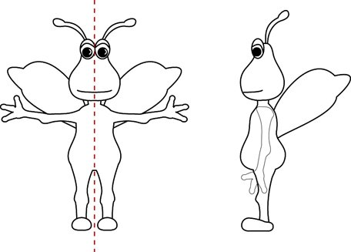
Defect Attributes
Reporting a New Bug
Summary
Reported By
Reported Date
Assigned To
Description
Severity
Component
Environment
Release/Build
Status
Priority
Type
Detection Stage
Fix Time
Comment
……

Slide 26
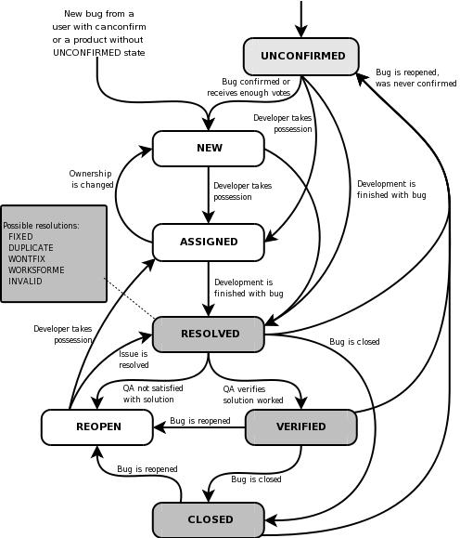
Bug Life Cycle
Defect life cycle, also known as Bug Life cycle is the journey of a defect cycle, which a defect goes through during its lifetime. It varies from organization to organization and also from project to project as it is governed by the software testing process and also depends upon the tools used.
New - Potential defect that is raised and yet to be validated.
Assigned - Assigned against a development team to address it but not yet resolved.
Active - The Defect is being addressed by the developer and investigation is under progress. At this stage there are two possible outcomes; viz - Deferred or Rejected.
Test - The Defect is fixed and ready for testing.
Verified - The Defect that is retested and the test has been verified by QA.
Closed - The final state of the defect that can be closed after the QA retesting or can be closed if the defect is duplicate or considered as NOT a defect.
Reopened - When the defect is NOT fixed, QA reopens/reactivates the defect.
Deferred - When a defect cannot be addressed in that particular cycle it is deferred to future release.
Rejected - A defect can be rejected for any of the 3 reasons; viz - duplicate defect, NOT a Defect, Non Reproducible.

Slide 27
White box testing and code coverage pattern

Slide 28
Testing and Debugging
Defect testing and debugging are distinct processes
Defect testing is concerned with confirming the presence of errors
Debugging is concerned with locating and repairing these errors
Debugging involves formulating a hypothesis about program behavior then testing these hypotheses to find the system error
Notes:
目标不同：测试的目标是发现问题，调试的目标是解决问题（发现在哪里出了问题，错误分析，缺陷定位）
优势不同：单元测试可以与jekins和git/svn这样的集成工具联动，实现自动化，更有利于团队协作和管理；debug必须手动监测变量名称，人肉执行，可以嵌入开发“中”，而不必等到事后。
对运行时的影响：无影响，必须在运行时监控代码中的变量
Value不同：单元测试可以组成不同的process，可以实现开发人员的分工，可以

Slide 29
White box testing
White-box testing (also known as clear box testing, glass box testing, transparent box testing, and structural testing) is a method of software testing that tests internal structures or workings of an application, as opposed to its functionality (i.e. black-box testing). In white-box testing an internal perspective of the system, as well as programming skills, are used to design test cases. The tester chooses inputs to exercise paths through the code and determine the expected outputs. This is analogous to testing nodes in a circuit, e.g. in-circuit testing (ICT).
White-box testing can be applied at the unit, integration and system levels of the software testing process. Although traditional testers tended to think of white-box testing as being done at the unit level, it is used for integration and system testing more frequently today. Though this method of test design can uncover many errors or problems, it has the potential to miss unimplemented parts of the specification or missing requirements.

Slide 30
White box testing coverage pattern
In computer science, test coverage is a measure used to describe the degree to which the source code of a program is executed when a particular test suite runs. A program with high test coverage, measured as a percentage, has had more of its source code executed during testing, which suggests it has a lower chance of containing undetected software bugs compared to a program with low test coverage. Many different metrics can be used to calculate test coverage; some of the most basic are the percentage of program subroutines and the percentage of program statements called during execution of the test suite.
Statement coverage – has each statement in the program been executed
Branch coverage – has each branch (also called DD-path) of each control structure (such as in if and case statements) been executed
Condition coverage (or predicate coverage) – has each Boolean sub-expression evaluated both to true and false

Slide 31
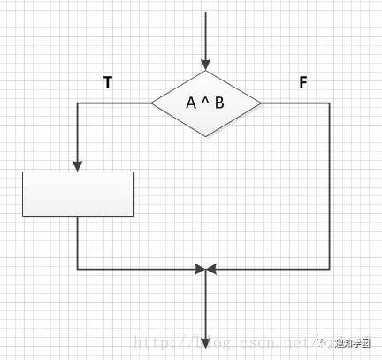
Statement coverage

Slide 32
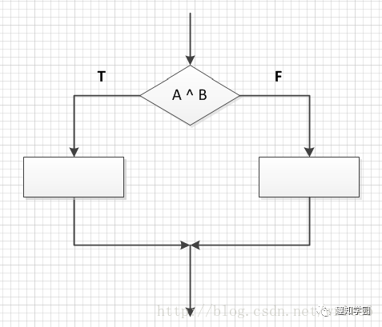
Determine coverage
Branch coverage
Notes:
测试用例条件： A ^ B = T A ^ B = F

Slide 33
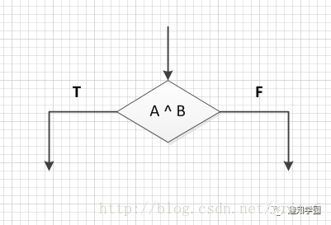
Condition coverage
Notes:
测试用例条件： A=T A=F B=T B=F

Slide 34

Branch conditional coverage
Notes:
测试用例条件： A ^ B = T A ^ B = F A=T A=F B=T B=F

Slide 35
谢谢

