Slide 1
A Method for Evaluating the Reliability of Images Captured by Mobile Observation Cameras in Natural Environment
Yukito Seo, Kosuke Takano
Kanagawa Institute of Technology ,Graduate School of Engineering ,Course of Information Technology and computer science
Notes:
発表を始めます。
I will now begin my presentation.
私は瀬尾幸斗です。
My name is Seo Yukito.
神奈川工科大学院 情報工学専攻 に所属しています。
I am a student at the Kanagawa Institute of Technology ,Graduate School of Engineering ,Course of Information Technology and computer science
宜しくお願いします。
Thank you for your time.

Slide 2
Research background
Natural environment observation is considered important for purposes such as understanding environmental problems and detecting disasters.
Unmanned aerial vehicles (helicopters, drones, etc.) are used in a wide range of fields, including natural environment observation, material transportation, and quality control.
For example, spraying pesticides in agriculture is attracting attention because it reduces the workload, shortens work time, and improves safety during spraying 1).
Notes:
自然環境観測は、地球温暖化による異常気象の発生により重要視されています。
Observation of the natural environment is becoming increasingly important due to the occurrence of abnormal weather caused by global warming.
また、自然環境観測において、移動観測が注目されています。
Mobile observation is also attracting attention as a form of natural environment observation.

Slide 3
Previous research
Archives of natural environment observations contain huge amounts of information and data.
we thought that archive management based on features in a distributed environment would be effective.
Observation data
Neural Network
DB
Features
Large-scale archives may contain observational data that is not suitable for analysis.
For proper analysis, it is important to ensure the quality and reliability of observational data.
Notes:
先行研究では、自然環境観測から得たアーカイブを効率的に検索するためのシーン分析システムを提案してきました。
In previous studies, we have proposed a scene analysis system for efficiently searching archives obtained from natural environment observations.
しかし、蓄積された大規模なアーカイブにおいて，分析に適していない観測データが含まれることがある．
However, large-scale archives may contain observation data that is not suitable for analysis.

Slide 4
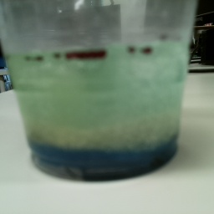

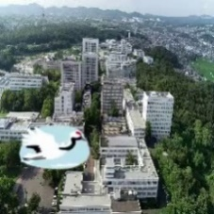
Quality and reliability of observational data
To properly analyze situations such as crop diseases and damage caused by pests, it is important to ensure the quality and reliability of observational data.
Quality: whether the quality of the image itself is good or not.
Reliability: whether what is shown in the observation data contains information that can be used for analysis.
The image is blurry
Effects of light
Irrelevant footage
When dealing with the natural environment, observational data is not always guaranteed.
Notes:
そのため、観測データを使って適切に分析するには，観測データの品質や信頼性を保証することが重要となります。
Therefore, To properly analyze observation data, it is important to guarantee the quality and reliability of the observation data.
品質とは、画像の品質が良いかどうかを指します。
Quality refers to whether the image is of good quality or not.
信頼性とは、観測データに分析で使える情報が含まれているかどうかを指します。
Reliability refers to whether the observed data contains information that can be used in analysis.
自然環境観測の場合、天候、物体の映り込みなどの変化が観測データに影響するため、常に保証されているとは限りません。
When observing natural environments, changes in weather, object reflections, etc. can affect the observation data, so this cannot always be guaranteed.

Slide 5
Problem
Image Quality
Missing pixels, differences in resolution
can be calculated using existing methods
It is not possible to judge whether the observations are appropriate, so their reliability is unclear.
Presence or absence of an observed object, visual changes
Detection can be difficult in some cases
Detecting abnormalities in observed objects (data analysis)
Plant health, pest damage
=> can be calculated using existing methods
By calculating the reliability of the observation results, reliability is ensured, which is a prerequisite for performing data analysis and processing on the observation data.
Notes:
そのため、研究では観測データに起こる問題について、次のように分類しました。
Therefore, the study classified the problems that occur with observational data as follows.
まず、画像の質についての問題です。
First, there are problems with image quality.
画像がぼやけていることや、ピクセルの欠損などが対象です。
These include blurry images and missing pixels.
次に、分析では用いることが推奨されないデータの問題です。
Next, there are problems with data that is not recommended for use in analysis.
これは、画像の色合いの変化や、何かが映り込むことで、分析に適さないデータに変化してしまうことを指します。
These refer to data that is unsuitable for analysis due to changes in the color of the image or the presence of something in the image.
この信頼性について、判断することが困難な場合があります。
It can be difficult to judge its reliability.
最後に、観測対象の分析をどのようにするかの問題です。
Finally, there is the issue of how to analyze the observed data.
これは、既存の機械学習の手法で分析することが可能です。
This can be analyzed using existing machine learning methods.
本研究では、画像の品質が良いが、分析では使うことができない画像を信頼性スコアで判断する方法を提案します。
In this study, we propose a method to determine images that are of good quality but cannot be used in the analysis by using a reliability score.

Slide 6
Proposed Method
A Method for Evaluating the Reliability of Images Captured by Mobile Observation Cameras in Natural Environment
Features of the proposed method
A reliability score can be calculated for each captured image from three perspectives: temporal continuity, spatial continuity, and object detection validity
For observational videos from mobile observations, a reliability score can be calculated for each frame image.
Notes:
ここからは、提案手法の説明をします。
Next, we will explain our proposed method.
この手法は、時間連続性、空間連続性、物体検知の妥当性の３つの観点から、動画中のフレーム画像に対して信頼性スコアを算出することができることです。
This method is capable of calculating a reliability score for frame images in a video from three perspectives: temporal continuity, spatial continuity, and validity of object detection.
また、この手法は移動観測で得られたデータに適用が可能です。
This method can also be applied to data obtained through mobile observations.

Slide 7
Our Approach
Temporal continuity ： If there are discontinuous changes over time, the calculation is made so that the reliability of the time continuity of the observed data is low.
Spatial Continuity ： When there are discontinuous changes due to spatial movement, the calculation is made so that the reliability of the spatial continuity of the observed data is reduced.
Object detection validity ： When the object to be observed is not detected, the reliability of the validity of the object detection is calculated.
Notes:
私たちのアプローチは、時間連続性、空間連続性、物体検知の妥当性の３つの観点から、信頼性を算出します。
Our approach calculates reliability from three perspectives: temporal continuity, spatial continuity, and validity of object detection.
時間連続性は、時間経過による連続性のない変化があった場合に，信頼性が低くなるように算出します。
Temporal continuity is calculated so that reliability is low when there are discontinuous changes over time.
空間連続性は、空間移動による連続性のない変化があった場合に，信頼性が低くなるように算出します。
Spatial continuity is calculated so that reliability is low when there are discontinuous changes due to spatial movement.
物体検知の妥当性は、検知した物体が観測対象かどうかで計算をします。
The validity of object detection is calculated by calculating whether there is confidence in the validity of object detection when the observed object is not detected.

Slide 8
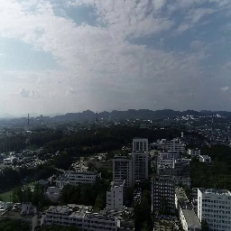
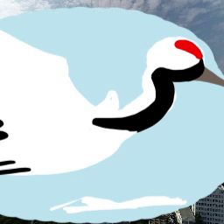
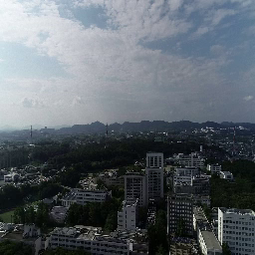
Temporal continuity
Temporal continuity: Calculate the reliability of changes in observed data over time at a certain location based on the degree of similarity.
Temporal continuity
Temporal continuity
Spatial
continuity
a
p
1
a
1
p
2
……
2
a
3
p
3
a
4
p
4
a
n-1
p
n
Observation image map
a
-
1
a
n
n
1day
2day
3day
T
T
1
T
2
T
3
T
4
T
m
-
1
T
m
Time
Area a_{x}
Notes:
では、信頼性の算出方法を説明します。
We now explain how to calculate the reliability of temporal continuity.
観測画像マップとは、一回の観測で得られたエリアごとの画像集合です。
An observation image map is a collection of images for each area obtained from a single observation.
時間連続性は１つのエリアに注目して、時間経過によるデータの連続性を信頼性として算出します。
Temporal continuity focuses on one area and calculates the reliability of the continuity of data over time.

Slide 9
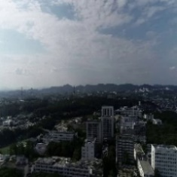
How to calculate temporal continuity
Extract feature vectors from images and calculate similarity from time continuity
Feature extraction using neural network models
Temporal continuity
…
…
Encoder
Image
Neural Network
Feature Vector
Cosine Similarity
Calculation
Notes:
時間連続性の計算方法は、図のようになっています。
The method for calculating temporal continuity is shown in the figure.
エンコーダを使って特徴ベクトルを抽出し、コサイン類似度で比較します。
We use an encoder to extract feature vectors and compare them using cosine similarity.
不確実性の定義（意味）
目的データの信頼性を算出というふうに（不確実性を扱えるかどうか）
https://qiita.com/Afo_guard_enthusiast/items/8ff4850385d1b2fa8e57

Slide 10
Spatial Continuity
Spatial continuity： Calculate the reliability of spatial changes when moving from one point to another based on the overlap rate
Temporal continuity
Spatial
continuity
a
p
a
a
1
a
1
p
2
……
p
p
+
1
2
a
3
p
3
a
4
p
4
k
k
+1
k
+2
k
+
l
Camera
position
a
n-1
p
n
Observation image map
a
-
1
a
n
n
i
k
i
k
+1
i
k
+2
…
i
k
+
l
T
1
T
2
T
3
T
4
T
m
-
1
T
m
Time
Image Sequence I
Notes:
空間連続性は、一つの観測画像マップに注目して、隣同士の画像シーケンスから信頼性を計算します。
Spatial continuity focuses on one observation image map and calculates its reliability from adjacent image sequences.
画像シーケンスはエリアをつなぐ重複のある画像のことです。
Image sequences are images with overlaps that connect an area.

Slide 11
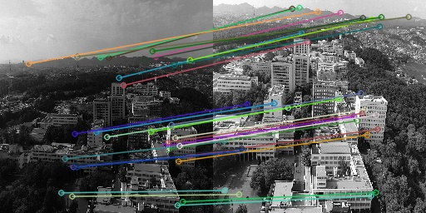
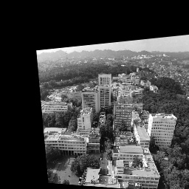
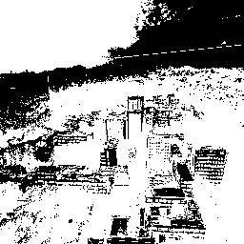
How spatial continuity is calculated
SIFT feature point extraction and matching are used to calculate overlapping parts from image sequences.
Calculating overlap using feature points of machine learning models
Feature Point Matching
Overlap Image
Binary Image
Notes:
空間連続性の計算方法は、特徴点マッチングで重複画像を作成して、変化の割合を計算します。
The spatial continuity calculation method creates overlapping images by feature point matching and calculates the percentage of change.

Slide 12
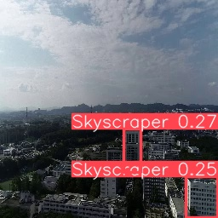
Object detection validity
Confidence score calculation based on object detection validity
The object detection algorithm calculates the type, number, and score of detected objects.
Reliability Score = Average detection score of target - Average detection score of not target
Target : Skyscraper
detect
Target : Skyscraper
Count : 2
Score : 0.27, 0.25
Image
result
Notes:
物体検知の妥当性は、次のように計算します。
The validity of object detection is calculated as follows.
まず、観測対象を設定します。
First, set the observation target.
次に物体検知を行い、観測対象の検知スコアを求めます。
Next, perform object detection and find the detection score of the observation target.
さらに、観測対象ではないものが検知された場合、その検知スコアの平均を求めます。
Furthermore, if something that is not the observation target is detected, the average detection score for those is found.
この観測対象の平均スコアから観測対象以外の平均スコアから引いたものを、信頼性スコアとします。
The reliability score is calculated by subtracting the mean score of the non-observed targets from the mean score of the observed targets.

Slide 13
Experiment
The purpose
Using an experimental system that uses the proposed method, we verify the feasibility of the proposed method by calculating a reliability score based on the validity of temporal continuity, spatial continuity, and object detection.
Setup
Temporal continuity：VQ-VAE，spatial continuity：SIFT， Object Detection ：Yolov8m-oiv7
Dataset: 100 copies of each frame image from a drone observation video, plus 100 time frame sequences with some noise added, for a total of 321 observation image sequences, for a total of 32,100 images
Notes:
ここからは、実験の説明です。
From here, we will explain the experiments.
提案手法を用いて、プロトタイプを作成しました。
A prototype was created using the proposed method.
時間連続性の特徴ベクトル抽出には、VQ-VAE、空間連続性の特徴点マッチングではSIFT、物体検知の妥当性ではYoLo8を使用しました。
VQ-VAE was used to extract time-continuous feature vectors, SIFT for spatial-continuous feature point matching, and YoLo8 for object detection validity.
データセットは、大学キャンパスをドローンで撮影した321枚のフレーム画像を使用しました。
The dataset used was 321 frame images taken by a drone of a university campus.
このデータセットのフレーム画像に対して、100枚複製して、さらにノイズを加えました。
100 copies of the frame images in this dataset were made and noise was added.

Slide 14
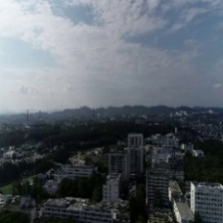
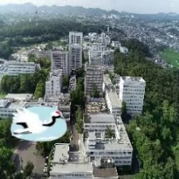
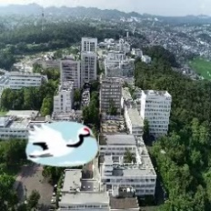
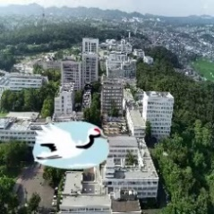
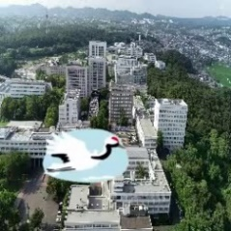
Experiment
dataset
noise１： Bird illustrations are displayed throughout the image
noise2： Bird illustrations appear in successive time frames
Notes:
ノイズには２種類あります。
There are two types of noise.
ノイズ１は、大きな鳥のイラストが映るノイズです。
Noise 1 is noise that shows a large illustration of a bird.
ノイズ２は、小さな鳥のイラストが連続して映るノイズです。
Noise 2 is noise that shows a series of small bird illustrations.

Slide 15
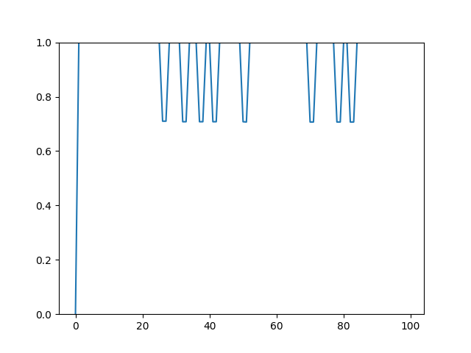
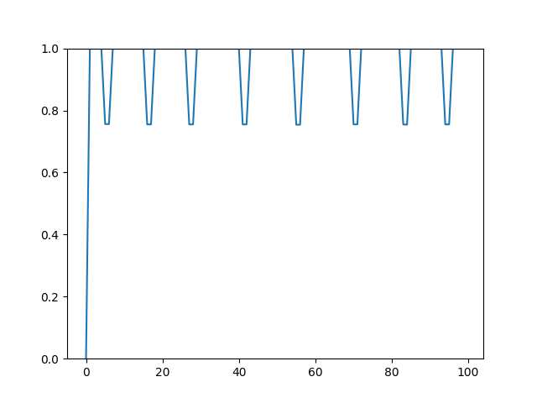
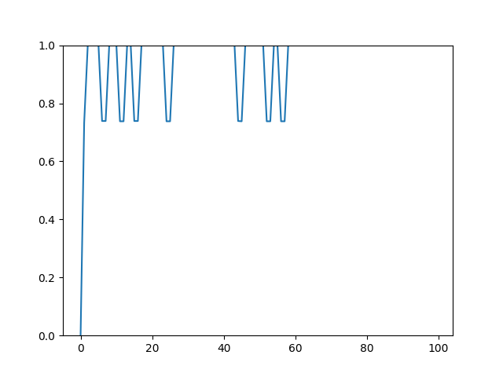
Temporal Continuity Results
Temporal continuity reliability score
i1
i151
i300
The reliability is low in the area where noise 1 is included.
This result means that images that are normal but different from the intended observed subject can be detected from time continuity.
Notes:
これは時間連続性の実験結果です。
These are the experimental results for time continuity.
ノイズ１が含まれる箇所において，信頼性が低く算出されていることから，時間連続性が途切れている部分を算出できていることが確認できる．
Since the calculations are performed with low reliability in areas containing noise 1, it can be confirmed that the parts where time continuity is interrupted have been calculated.
この結果は、画像としては正常だが、本来の観測対象と異なる画像を、時間連続性から検知できたことを意味します。
This result means that images that are normal but different from the intended observed subject can be detected from time continuity.

Slide 16
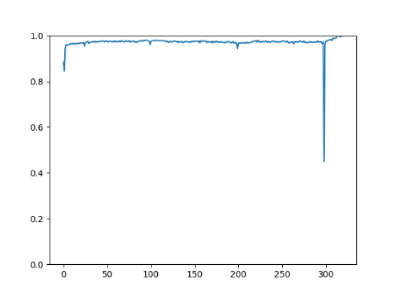
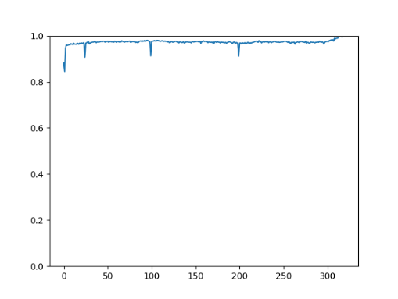
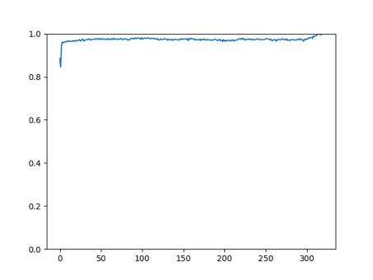
Spatial continuity Results
Spatial continuity : reliability score
T7
T32
T100
Average overlap rate ：0.971
0.972
0.973
The reliability is low in the area where noise 1 is included.
This result means that an image that appears normal but is different from the actual observed subject can be detected from spatial continuity.
Notes:
これは空間連続性の実験結果です。
These are the results of an experiment on spatial continuity.
T100にはノイズが付与されていません。
ノイズが付与されているフレームで、信頼性スコアが低くなっていることが確認できます。
The reliability score is low in areas containing noise, which confirms that areas without spatial continuity have been calculated.
この結果は、本来の観測対象と異なる画像を、空間連続性から検知できたことを意味します。
This result means that an image that appears normal but is different from the actual observed subject can be detected from spatial continuity.
この結果を現在のエリアから次のエリアまで移動したと仮定します。
この空間連続性について、Tで平均をとると、計算結果にあまり変化は見られません。
これは、エリアからエリアまで移動したときの観測データに、連続性があることを意味しています。
Suppose this result is moved from the current area to the next area.
If we take the average of this spatial continuity over T, we see little change in the calculation results.
This means that there is continuity in the observational data when moving from area to area.

Slide 17
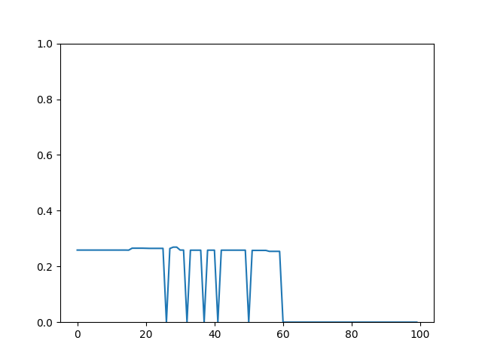
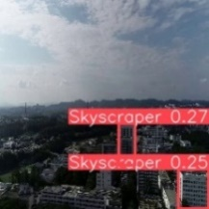
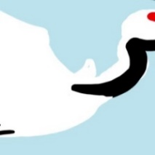
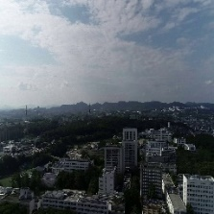
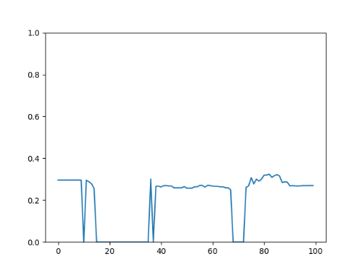
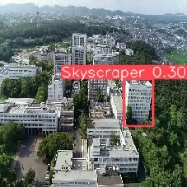
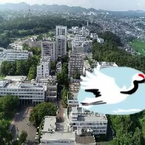
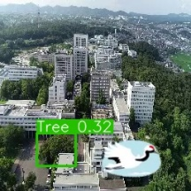
Object detection validity Results
reliability score from object detection validity
i1
T1
T26
T81
i1
i26
i26
Notes:
これは物体検知の妥当性から計算した結果です。
These are the results of calculations based on the validity of object detection.
I1から、ノイズが付与されている部分で信頼性が低くなっていることを確認できます。
From I1, we can see that reliability is low in areas where noise has been added.
しかし、途中からノイズに関係なく信頼性が全て０になってしまったことも確認できます。
However, we can also see that halfway through, the reliability score drops to 0 regardless of the noise.
これは、物体検知モデルとデータセットの互換性が問題であると考えています。
We believe this is due to a compatibility issue between the object detection model and the dataset.
そのため、モデルの追加学習の必要があると考えます。
Therefore, we believe that additional training of the model is necessary.
i26では、ノイズ２が付与されています。
In i26, noise 2 has been added.
ノイズが連続して映り込む部分で信頼性に変化が見られたことが確認できます。
We can see that there is a change in reliability in areas where noise is continuously detected.

Slide 18
Conclusion
We proposed a method to calculate the reliability of images taken during mobile observation of natural environments.
Using a prototype, we confirmed the feasibility of the system by checking the validity of time continuity, spatial continuity, and object detection.
As a future prospect, we plan to evaluate the effectiveness and practicality of the proposed method using observational data from monitoring actual natural environments.
Notes:
私たちは、時間連続性、空間連続性、物体検知の妥当性から、信頼性を算出する手法の提案を行いました。
We proposed a method to calculate reliability based on temporal continuity, spatial continuity, and the validity of object detection.
また、実験を通して、手法の実現可能性を検証しました。
We also verified the feasibility of the method through experiments.
今後の展望として，実際の自然環境をモニタリングした観測データを用いて提案手法の有効性と実用性を評価する予定である．
As a future prospect, we plan to evaluate the effectiveness and practicality of the proposed method using observational data from monitoring actual natural environments.

Slide 19
Thank you for your attention
Notes:
ご清聴ありがとうございました
That's all.
Thank you for your attention.

Slide 20
Proposed Method
Temporal continuity
Spatial
Continuity
a
p
1
1
a
p
2
……
2
a
p
3
3
a
4
p
4
a
n-1
p
n
Observation image map
a
-
1
a
n
n
T
1
T
2
T
3
T
4
T
m
-
1
T
m
Time
Notes:
このスライドでは、観測画像マップについての説明をします。
観測画像マップとは、一度の移動観測で得られるエリアごとのデータの集合です。
この観測画像マップは、何度も観測することで増えていきます。
移動観測は頻繁に行うことはできないため、数日後や１か月後といった時間をあけることを想定します。
This slide explains the observation image map.
An observation image map is a collection of data for each area obtained from a single mobile observation.
This observation image map increases as observations are conducted repeatedly.
Since mobile observations cannot be conducted frequently, it is assumed that observations will be conducted after a period of time such as several days or one month.

Slide 21
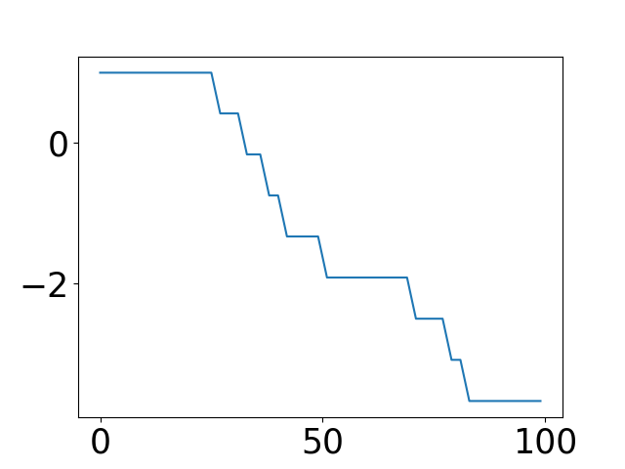
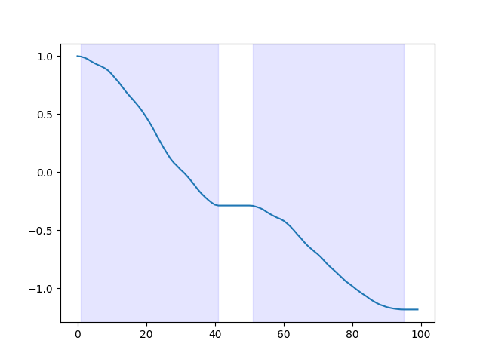

Slide 22
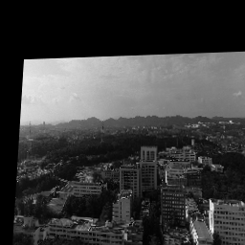
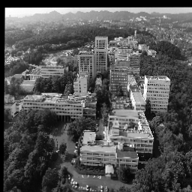
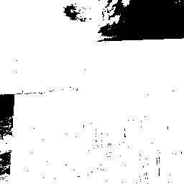
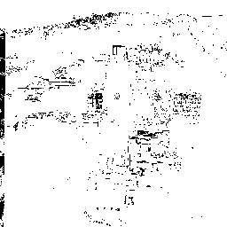

Slide 23
Proposed Method
Same Areas
Temporal continuity
Spatial
Continuity
a
1
p
1
……
a
2
p
2
a_{x}
a_{x}
．．．
a
3
a
p
3
p
4
4
T₁
T₂
a
n-1
p
n
Observation image map
a
-
1
a
n
Different time
n
T
1
T
2
T
3
T
4
T
m
-
1
T
m
Time
Notes:
時間連続性は、一つのエリアに注目して、時間経過から信頼性を計算します。
１つのエリアと時間経過の組み合わせです。
Time continuity focuses on one area and calculates reliability over time.
It is a combination of one area and time.

Slide 24
Proposed Method
Temporal continuity
a
p
a
p
Spatial
Continuity
a
p
+
1
1
a
1
p
2
……
2
a
3
p
3
a
4
p
4
k
k
+1
k
+2
k
+
l
Camera
position
a
n-1
p
n
Observation image map
a
-
1
a
n
n
i
i
i
…
i
k
k
+1
k
+2
k
+
l
Image Sequence
T
1
T
2
T
3
T
4
T
m
-
1
T
m
Time
Notes:
空間連続性は、一つの観測画像マップに注目して、隣同士の画像シーケンスから信頼性を計算します。
画像シーケンスはエリアをつなぐ重複のある画像のことです。
複数の画像シーケンスと１枚の観測画像マップの組み合わせです。
Spatial continuity focuses on one observed image map and calculates its reliability from adjacent image sequences.
Image sequences are images with overlaps that connect an area.
It is a combination of multiple image sequences and one observed image map.

Slide 25
Proposed Method
Reliability scores from temporal continuity
Extract feature vectors from images and calculate similarity from time continuity
Feature extraction using neural network models
…
…
Encoder
Images
Feature vector
Cosine similarity
Notes:
ここでは、それぞれの計算方法について説明します。
まず、時間連続性です。
画像をエンコーダに入力して、特徴ベクトルを抽出します。
エンコーダは、オートエンコーダなどのニューラルネットワークモデルを想定しています。
抽出した特徴ベクトルをコサイン類似度で、どのくらい似ているかを計算します。
このコサイン類似度の計算結果を時間連続性の信頼性スコアとします。
Here, we will explain how to calculate each.
First, time continuity.
An image is input into the encoder to extract a feature vector.
The encoder is assumed to be a neural network model such as an autoencoder.
The similarity of the extracted feature vectors is calculated using cosine similarity.
The result of this cosine similarity calculation is used as the reliability score for time continuity.

Slide 26
Proposed Method
Calculating reliability scores from spatial continuity
Calculate overlapping areas from image sequences using feature point extraction and matching
Calculate the change in the overlapping area
Calculating overlap using feature points of machine learning models
Feature Point Matching
Overlapped Image
Binary Image
Notes:
空間連続性の信頼性スコアでは、SIFTなどの機械学習モデルを使って計算を行います。
２枚の画像に対して、特徴点マッチングを行い、オーバーラップ画像を作成します。
そして、オーバーラップ画像を２値化して、どのくらい変化したかを計算します。
この重複率を信頼性のスコアとして算出します。
The spatial continuity reliability score is calculated using a machine learning model such as SIFT.
Feature points are matched between the two images to create an overlapping image.
The overlapping image is then binarized to calculate the amount of change.
This overlap rate is calculated as the reliability score.

Slide 27
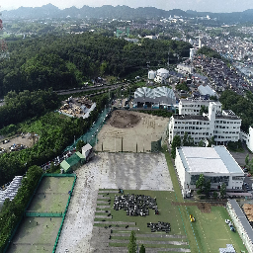
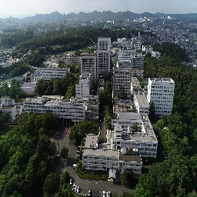
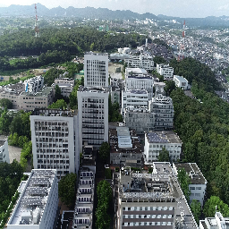
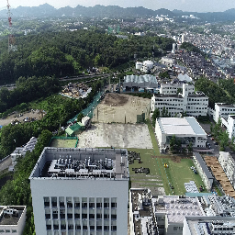
画像シーケンスの例
エリア間：重複部分なし
a
p
a
p
+
1
a_{p}
a_{p+1}
k
k
+1
k
+2
k
+
l
カメラ位置
i
k
i
k
i
k
…
i
k
+
l
+1
+2
画像シーケンス
画像シーケンスI
空間連続性
Notes:
では、信頼性の算出方法を説明します。
私たちのアプローチは、時間連続性、空間連続性、物体検知の妥当性の３つの観点から、信頼性を算出します。
時間連続性は、時間経過によるデータの類似度を計算します。
空間連続性は、移動して観測を行ったときの、エリアごとの重複率を計算します。
物体検知の妥当性は、検知した物体が観測対象かどうかで計算をします。
Now, we will explain how we calculate reliability.
Our approach calculates reliability from three perspectives: temporal continuity, spatial continuity, and validity of object detection.
Temporal continuity calculates the similarity of data over time.
Spatial continuity calculates the overlap rate for each area when observations are made while moving.
Validity of object detection is calculated based on whether the detected object is the target of observation.

Slide 28
Proposed Method
Confidence score calculation based on object detection validity
The object detection algorithm calculates the type, number, and score of detected objects.
Reliability Score = Average detection score of target - Average detection score of not target
Target : Skyscraper
detect
Target : Skyscraper
Count : 2
Score : 0.27, 0.25
Image
result
Notes:
物体検知の妥当性は、次のように計算します。
まず、観測対象を設定します。
次に物体検知を行い、観測対象の検知スコアを求めます。
観測対象がない場合、信頼性スコアは０になります。
そして、観測対象がある場合、検知スコアの平均を求めます。
さらに、観測対象ではないものが検知された場合、その検知スコアの平均を求めます。
この観測対象の平均検知スコアから観測対象以外の平均検知スコアから引いたものを、物体検知の妥当性における信頼性スコアとします。
The validity of object detection is calculated as follows.
First, set the observation target.
Next, perform object detection and find the detection score of the observation target.
If there is no observation target, the confidence score will be 0.
Then, if there is an observation target, the average detection score is found.
Furthermore, if something that is not the observation target is detected, the average detection score for those is found.
The confidence score for the validity of object detection is calculated by subtracting the average detection score of the observation targets from the average detection score of the non-observation targets.

Slide 29
Research topic
Even among observational data that passes quality assurance, there are some that are unreliable.
For proper analysis, reliability needs to be assured.
Examples of unreliability: visual changes due to weather, reflections of unrelated objects, etc.
Notes:
ここで、本研究の課題は、画像の質に問題がないデータの中で、信頼性があるかを判断する基準を作ることです。
信頼性の基準を作ることは、分析時に用いるデータが適切かどうかを判断することができます。
The challenge of this research is to create standards for determining whether data is reliable, even when the quality of the images is not an issue.
Creating standards for reliability makes it possible to determine whether the data used in analysis is appropriate.

Slide 30
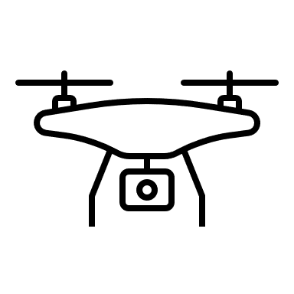
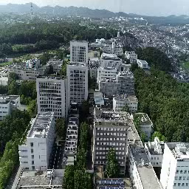
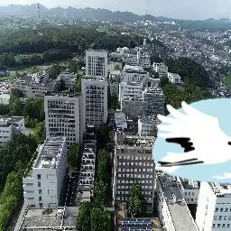
Our approach
The approach is to calculate a reliability score based on the time continuity, spatial continuity, and validity of object detection.
Temporal continuity ： Calculate the reliability of changes in observation data over time at a certain location based on the degree of similarity.
Today
1 week later
1 month later
A | B | C
 |  |  | P
Position A
Position B
Notes:
では、信頼性の算出方法を説明します。
私たちのアプローチは、時間連続性、空間連続性、物体検知の妥当性の３つの観点から、信頼性を算出します。
時間連続性は、時間経過によるデータの類似度を計算します。
空間連続性は、移動して観測を行ったときの、エリアごとの重複率を計算します。
物体検知の妥当性は、検知した物体が観測対象かどうかで計算をします。
Now, we will explain how we calculate reliability.
Our approach calculates reliability from three perspectives: temporal continuity, spatial continuity, and validity of object detection.
Temporal continuity calculates the similarity of data over time.
Spatial continuity calculates the overlap rate for each area when observations are made while moving.
Validity of object detection is calculated based on whether the detected object is the target of observation.

Slide 31
Our approach
The approach is to calculate a reliability score based on the time continuity, spatial continuity, and validity of object detection.
Spatial Continuity ： Calculate the reliability of spatial changes when moving from one point to another based on the overlap rate
A | B | C
 |  |  | P
No overlap
areas
Overlapping image connecting areas
Notes:
では、信頼性の算出方法を説明します。
私たちのアプローチは、時間連続性、空間連続性、物体検知の妥当性の３つの観点から、信頼性を算出します。
時間連続性は、時間経過によるデータの類似度を計算します。
空間連続性は、移動して観測を行ったときの、エリアごとの重複率を計算します。
物体検知の妥当性は、検知した物体が観測対象かどうかで計算をします。
Now, we will explain how we calculate reliability.
Our approach calculates reliability from three perspectives: temporal continuity, spatial continuity, and validity of object detection.
Temporal continuity calculates the similarity of data over time.
Spatial continuity calculates the overlap rate for each area when observations are made while moving.
Validity of object detection is calculated based on whether the detected object is the target of observation.

Slide 32
Our approach
The approach is to calculate a reliability score based on the time continuity, spatial continuity, and validity of object detection.
Object detection validity ： Calculate the reliability of object detection based on the type of object and detection score
Target : Skyscraper
detect
Target : Skyscraper
Count : 2
Score : 0.27, 0.25
Image
result
Notes:
では、信頼性の算出方法を説明します。
私たちのアプローチは、時間連続性、空間連続性、物体検知の妥当性の３つの観点から、信頼性を算出します。
時間連続性は、時間経過によるデータの類似度を計算します。
空間連続性は、移動して観測を行ったときの、エリアごとの重複率を計算します。
物体検知の妥当性は、検知した物体が観測対象かどうかで計算をします。
Now, we will explain how we calculate reliability.
Our approach calculates reliability from three perspectives: temporal continuity, spatial continuity, and validity of object detection.
Temporal continuity calculates the similarity of data over time.
Spatial continuity calculates the overlap rate for each area when observations are made while moving.
Validity of object detection is calculated based on whether the detected object is the target of observation.

Slide 33
参考文献
1) リプラス：「ドローンによる農薬散布のメリット・デメリット｜料金相場も紹介」, 2023.10.5, URL:https://shizenenergy.net/re-plus/column/agriculture/drones_for_pesticide_applications/#:~:text=%E5%AE%8C%E4%BA%86%E3%81%A7%E3%81%8D%E3%81%BE%E3%81%99%E3%80%82-,%E4%BD%9C%E6%A5%AD%E6%99%82%E9%96%93%E3%82%92%E7%9F%AD%E7%B8%AE%E3%81%A7%E3%81%8D%E3%82%8B,%E3%81%9F%E3%81%93%E3%81%A8%E3%81%AB%E3%81%AA%E3%82%8A%E3%81%BE%E3%81%99%E3%80%82
2) 気象庁：「ウィンドプロファイラ」，2024年4月14日参照，URL:https://www.jma.go.jp/jma/kishou/know/windpro/kaisetsu.html
3) 日本気象株式会社：「次世代エアモビリティと気象観測」，2024.2.13, URL:https://www.pref.ehime.jp/uploaded/attachment/109690.pdf
4) 気象庁:「無人航空機に係る事故等報告一覧」,2024年1月末時点,2024.4.15参照,
URL:https://www.mlit.go.jp/common/001585162.pdf

Slide 34
参考文献
5) Mottobe:「ドローンの事故件数と事例、主な原因とは? 国への事故報告が義務化」,2023.9.29, URL:https://drone-roofer.com/mottobe/topics/column/704/#%e3%83%89%e3%83%ad%e3%83%bc%e3%83%b3%e4%ba%8b%e6%95%85%e3%81%ae%e5%8e%9f%e5%9b%a0%e3%81%a8%e4%ba%8b%e4%be%8b
6) アイサンテクノロジー株式会社:「愛知県幸田町にてドローンと自動運転車連携による農産物輸送の実証実験を実施します」, 2023年9月6日, URL: https://prtimes.jp/main/html/rd/p/000000108.000050415.html
7) 国土交通省:「空飛ぶクルマの運用概念」, 2023.3.31, URL: https://www.mlit.go.jp/common/001598473.pdf
8) 「ドローンによる上空の風観測手法の検討」, https://www.dpri.kyoto-u.ac.jp/nenpo/no63/ronbunB/a63b0p25.pdf
9) NEDO:「データベース/ツール」, https://www.nedo.go.jp/library/shiryou_database.html

Slide 35
参考文献
10)地域環境計画,「ドローンを活用した自然環境調査」, 参照日2024/5/13, https://www.chiikan.co.jp/service/analysis/drone.php
11)
https://note.com/tenchijincompass/n/n1cbc425158f0
12)
https://sorabatake.jp/7777/
13)
https://www.aist.go.jp/aist_j/magazine/20231129.html
14)
https://www.softbank.jp/biz/solutions/generative-ai/ai-glossary/multimodal-ai/
15)
https://procrobo.com/blog/drone-problem/
16)
https://www.fujitaka.com/fdps/column/column07.html

Slide 36
参考文献
１７）：https://www.mlit.go.jp/plateau/
１８）： https://www.city.hokota.lg.jp/page/page006369.html
１９）：内閣府，https://www.bousai.go.jp/kazan/chousakikaku/pdf/dai4kai/siryo1-9.pdf
２０）： https://www.nipr.ac.jp/info/notice/20220124.html
２１）：https://drone.tsukuba.co.jp/drone-height.html
２２）：https://www.jstage.jst.go.jp/article/pjsai/JSAI2023/0/JSAI2023_1O5GS703/_article/-char/ja/
２３）：https://www.ntt-geospace.co.jp/products/koukuu.html#:~:text=%E5%9B%BD%E5%9C%9F%E4%BA%A4%E9%80%9A%E7%9C%81%E5%85%AC%E5%85%B1%E6%B8%AC%E9%87%8F,%E3%81%8C%E7%B5%B6%E8%B3%9B%E3%81%95%E3%82%8C%E3%81%A6%E3%81%84%E3%81%BE%E3%81%99%E3%80%82
２４）：https://www.esrij.com/gis-guide/imagery/images/#:~:text=%E8%A1%9B%E6%98%9F%E7%94%BB%E5%83%8F%E3%81%AF%E4%BA%BA%E5%B7%A5%E8%A1%9B%E6%98%9F,%E3%81%99%E3%82%8B%E3%81%93%E3%81%A8%E3%81%8C%E3%81%A7%E3%81%8D%E3%81%BE%E3%81%99%E3%80%82
２５）：https://sorabatake.jp/7777/

Slide 37
参考文献
２６）：https://www.gsi.go.jp/common/000186712.pdf
２７）：https://www.jstage.jst.go.jp/article/jsprs/56/3/56_81/_pdf/-char/ja
２８）：https://www.glavis-hd.com/social_problem/000417/
２９）：https://docs.qgis.org/3.34/ja/docs/gentle_gis_introduction/spatial_analysis_interpolation.html
３０）：https://sorabatake.jp/279/
３１）：kaggledataset: https://www.kaggle.com/datasets/raghavrpotdar/fresh-and-stale-images-of-fruits-and-vegetables/data?select=stale_apple
３２）：類似：https://www.comm.tcu.ac.jp/shi/assets/2083107.pdf
３３）https://smrmkt.hatenablog.jp/entry/2014/04/15/002238
３４） https://openreview.net/forum?id=BJJLHbb0-
３５）https://www.ibm.com/jp-ja/topics/data-reliability
３６）https://www.data.jma.go.jp/cpdinfo/ipcc/ar5/ipcc_ar5_wg1_faq1.1_jpn.pdf

