Slide 1

Group 2: LET'S BRAG
Andrii, Jonathan, Suyash, Yukitoshi

Slide 2

Elevator Pitch

Slide 3
Motivation for Development
To create a platform for high achievers to brag about their achievements
Bragging is usually considered to be rude, we want to change that perspective
Providing safe space to brag without fear of being judged as rude by others
Not many social media use bragging as the main traction of use for their application

Slide 4
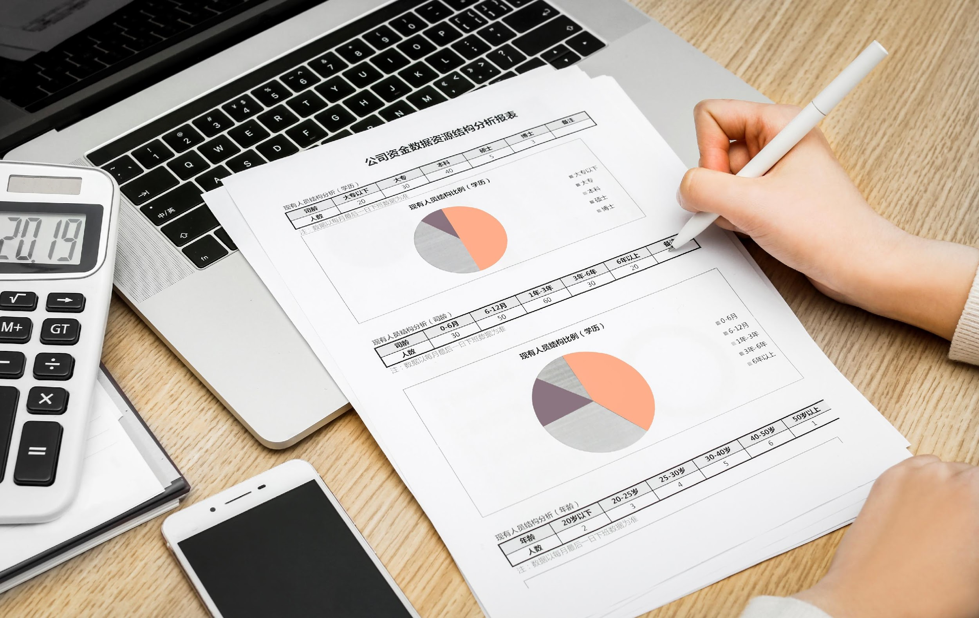
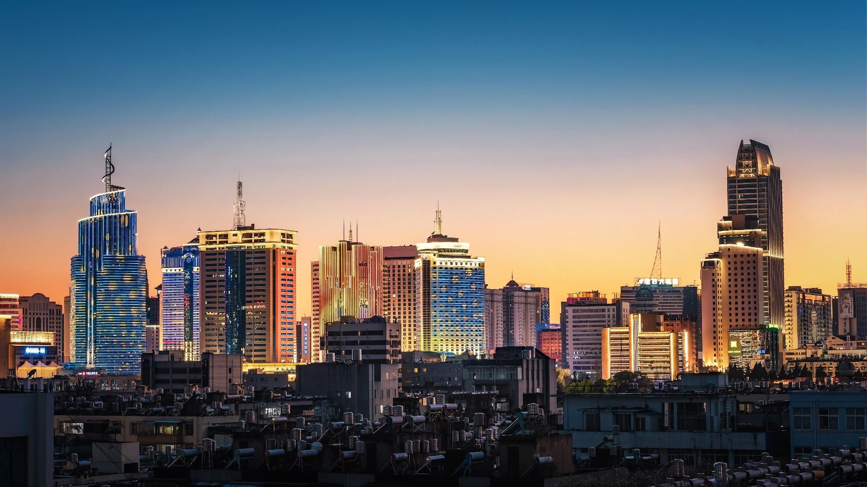
User Story
As a driven individual who thrives on recognition
I want a user-friendly social media platform dedicated to celebrating achievements, where I can share my successes and experiences with a supportive community,
So that I can receive positive feedback, inspire others, and feel a sense of belonging.

Slide 5
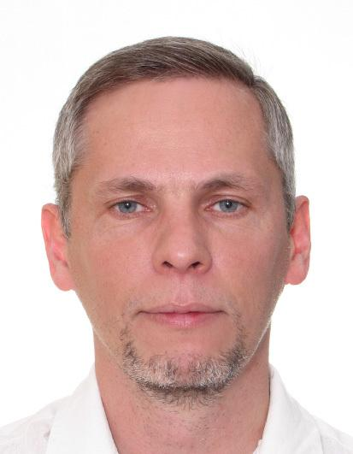

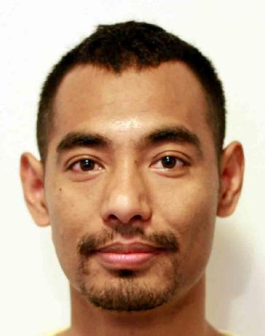
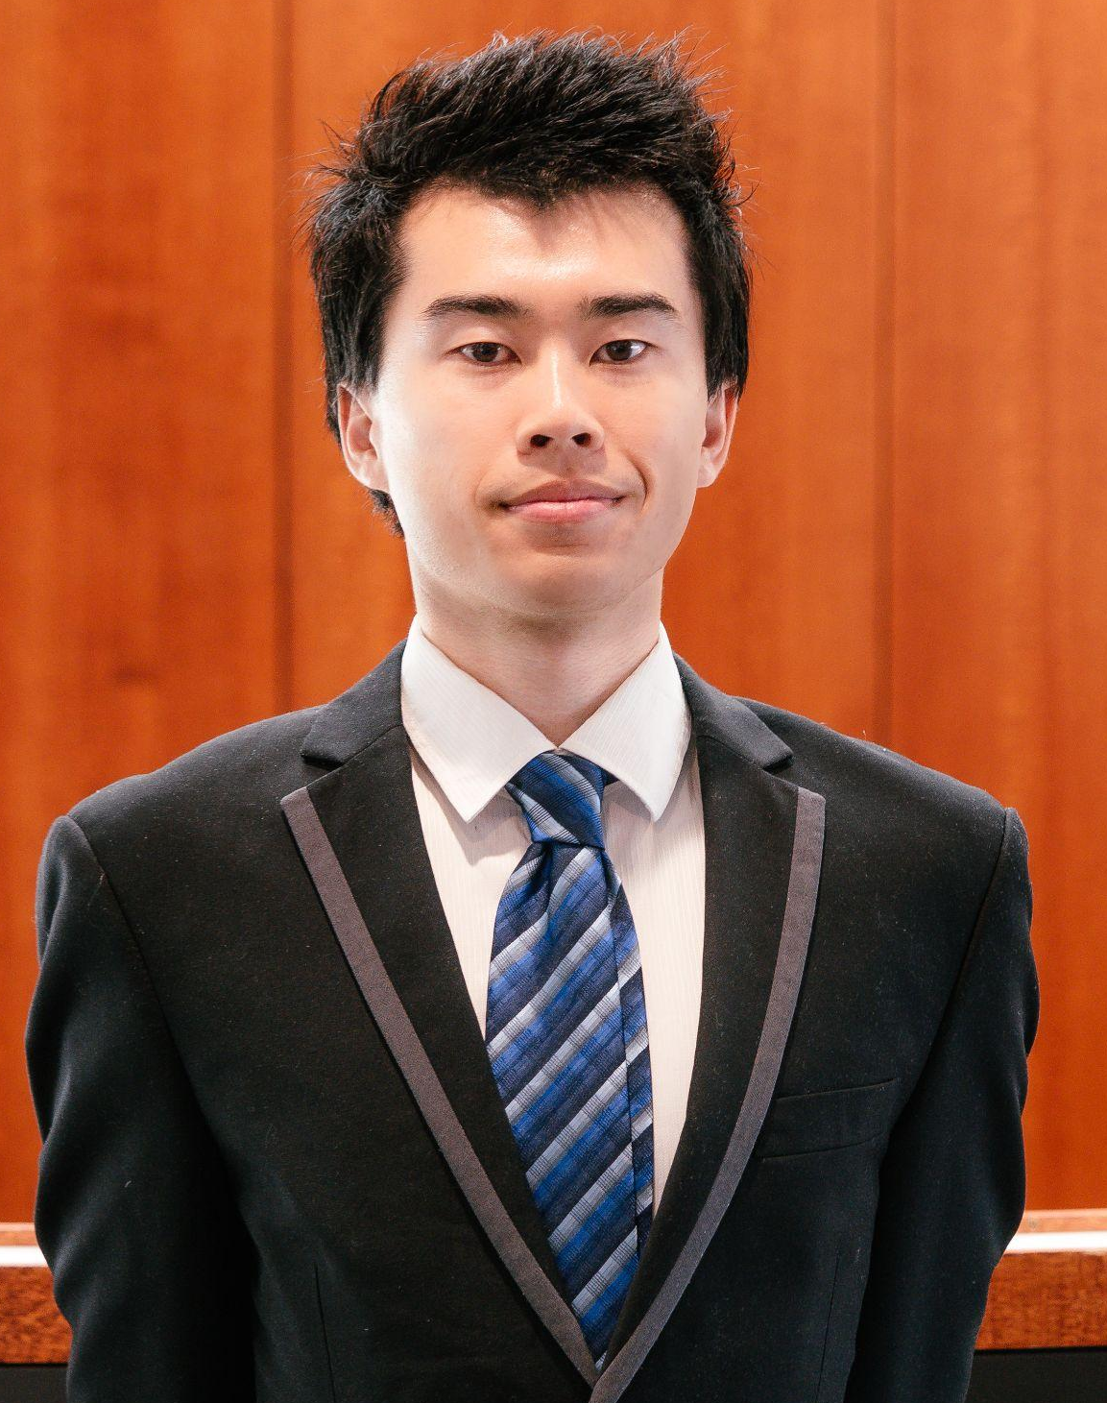
Tasks
Andrii Medvediev
Jonathan Santoso
Contributed Models and Controllers
Assisted with Seeds file
Completed Utilities Section
Completed Configuration
Contributed Models and Controllers
Multer Implementation
Assisted Completing README
Assisted Scripts
Prepared Presentation Slideshow
Suyash Maharjan
Yukitoshi Imaizumi-Zhou
Lead Coding Team
Developed User Interface
Contributed Models and Controllers
Views Completed and Functioning
Scripts Completed
Resolving Errors and Issues
Assigned tasks and Managed Progress
Contributed Models and Controllers
Completed server.js
Completed Seeds file
Developing some handlebars

Slide 6
Challenges and Successes
Challenges
Successes
Merge conflict
Time limit
Multer issue
Availability issues
Better understanding of MVC
Overcoming slow start
Gain confidence

Slide 7

Technologies Used
DayJs (to get the date and time)
Express-Session
Express-Handlebars
Connect-Session-Sequelize
Eslint-config-prettier
CSS
Tailwind
Daisy UI
Javascript
Node.js
Bcrypt
Express
MySQL2
Sequelize
DotEnv
Multer
Nodemon
Eslint
Prettier

Slide 8

DEMO

Slide 9
Direction for Future Development
Expanding categories
Introducing Let's Brag tags
Supercharged search
Live chat
Collecting more user data
More features

Slide 10
Github Repo and Heroku Link
Repo link: https://github.com/Yukitoshi12345/Lets-Brag.git
Heroku link: https://lets-brag-b258984e3793.herokuapp.com/

Slide 11
THANK YOU

